Slide 1

Lecture 19.1 -​ ​Introduction to Genomics
DLI Accelerated Data Science Teaching Kit
Notes:
This section is to introduce basic concepts of genomics.

Slide 2

The Accelerated Data Science Teaching Kit is licensed by NVIDIA, Georgia Institute of Technology, and Prairie View A&M University under the
Creative Commons Attribution-NonCommercial 4.0 International License.

Slide 3
Genomics
Genomics is an interdisciplinary field of biology focusing on the structure, function, evolution, mapping, and editing of genomes.
A genome is an organism's complete set of DNA, including all of its genes.
In contrast to genetics, which refers to the study of individual genes and their roles in inheritance, genomics aims at the collective characterization and quantification of all of an organism's genes, their interrelations and influence on the organism.
Notes:
As an interdisciplinary field of biology, genomics focuses on the structure, function, evolution, mapping, and editing of genomes, where a genome is an organism's complete set of DNA that , includes all of its genes.
It is different from genetics that is to study individual genes and their roles in inheritance.
Genomics aims at figuring out the collective characterization and accomplishing qualifications of all of an organism's genes, their interrelations and influence on the organism.

Slide 4
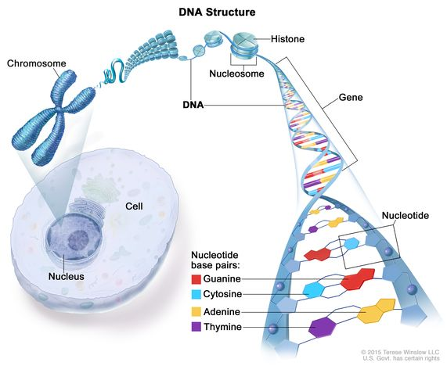
What is gene?
Based on Central Dogma of Molecular Biology, proposed by Francis Crick, a gene is a genomic sequence of nucleotides which can be transcribed to an RNA transcript of protein-coding sequences which is translated using the genetic code into an amino acid sequence.
A locatable region of genomic sequence, corresponding to a unit of inheritance, which is associated with regulatory regions, transcribed regions and/or other functional sequence regions.
Source: https://www.cancer.gov/publications/dictionaries/cancer-terms/def/gene
Notes:
Let’s check the gene in detail.
A gene is a genomic sequence of nucleotides.
It can be transcribed to an RNA transcript of protein-coding sequences, where the RNA transcript is translated using the genetic code into an amino acid sequence.
A gene is related to a locatable region of genomic sequence, corresponding to a unit of inheritance.
It is also associated with regulatory regions, transcribed regions and/or other functional sequence regions.

Slide 5
What is gene?
The gene is a union of genomic sequences encoding a coherent set of potentially overlapping functional products.
1. A gene is a genomic sequence (DNA or RNA) directly encoding functional product molecules,
either RNA or protein.
2. In the case that there are several functional products sharing overlapping regions, one takes the
union of all overlapping genomic sequences coding for them.
3. This union must be coherent—i.e., done separately for final protein and RNA products—but does not
require that all products necessarily share a common
subsequence.
Source: Gerstein et al., Genome Research, 17: 669-681 (2007). doi: 10.1101/gr.6339607
Notes:
On the other side, the gene is a union of genomic sequences encoding a coherent set of potentially overlapping functional products.
For a case with several functional products sharing overlapping regions, the gene will take a union of all overlapping genomic sequences coding for them, where the union must be coherent, for example, done separately for final protein and RNA products, but does not require that all products necessarily share a common subsequence.

Slide 6
Gene Expression Regulation
Gene expression is the process by which the information encoded in a gene is used to direct the assembly of a protein molecule.
The process of turning on a gene to produce RNA and protein.
The cell reads the sequence of the gene in groups of three bases.
Each group of three bases (codon) corresponds to one of 20 different amino acids used to build the protein.
Gene expression regulation is how a cell controls which genes, out of the many genes in its genome, are “turned on”.
Source: https://en.wikipedia.org/wiki/Artificial_neural_network
Notes:
Gene expression is the process by which the information encoded in a gene is used to direct the assembly of a protein molecule.
It is turning on a gene to produce RNA and protein.
Gene expression regulation is about how a cell controls which genes, out of the many genes in its genome, are “turned on”.
For a cell, it reads the sequence of the gene in groups of three bases, where each group of three bases (codon) corresponds to one of 20 different amino acids used to build the protein.

Slide 7
DNA Sequencing
Determining the number and order of nucleotides that make up a given molecule of DNA
1. How many base pairs (bp) are there in a human genome?
~3 billion (haploid)
2. How much did it cost to sequence the first human genome?
~$2.7 billion
3. How long did it take to sequence the first human genome?
~13 years
4.When was the first human genome sequence complete?
2000 - 2003
5. Whose genome was it?
Several people’s, but actually, mostly a person from Buffalo
Notes:
DNA sequencing is to determine the number and order of nucleotides that make up a given molecule of DNA. For example,
1. How many base pairs (bp) are there in a human genome?
~3 billion (haploid)
2. How much did it cost to sequence the first human genome?
~$2.7 billion
3. How long did it take to sequence the first human genome?
~13 years
4.When was the first human genome sequence complete?
2000 - 2003
5. Whose genome was it?
Several people’s, but actually, mostly a person from Buffalo

Slide 8
DNA Sequencing
DNA sequencing is a laboratory technique used to determine the exact sequence of bases (A, C, G, and T) in a DNA molecule.
The DNA base sequence carries the information a cell needs to assemble protein and RNA molecules.
DNA sequence information is important to scientists investigating the functions of genes.
The technology of DNA sequencing was made faster and less expensive as a part of the Human Genome Project.
Notes:
It is a laboratory technique used to determine the exact sequence of bases (A, C, G, and T) in a DNA molecule.
The DNA base sequence carries the information that a cell needs to assemble protein and RNA molecules.
DNA sequence information is important to scientists who investigat the functions of genes.
The technology of DNA sequencing was made faster and less expensive as a part of the Human Genome Project.

Slide 9
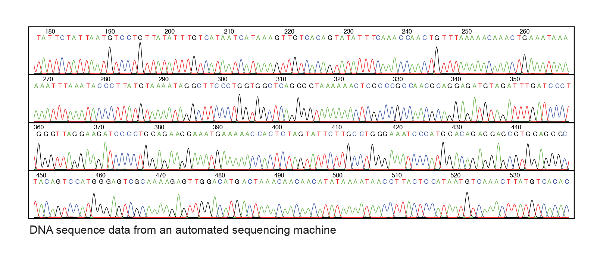
DNA Sequence Data
Source: https://www.genome.gov/genetics-glossary/DNA-Sequencing
Notes:
Here is an example of DNA sequence data from an automated sequencing machine.

Slide 10
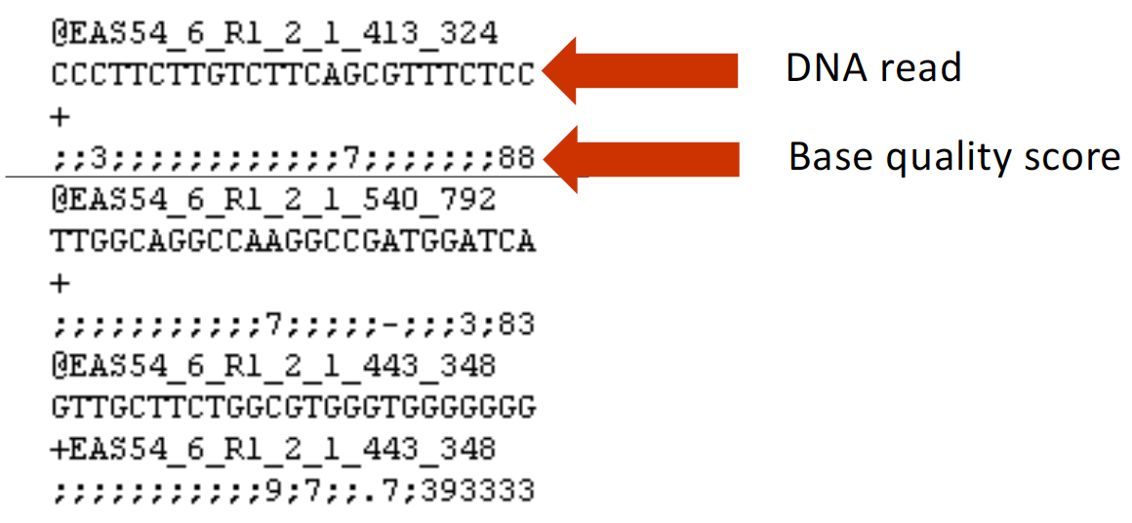
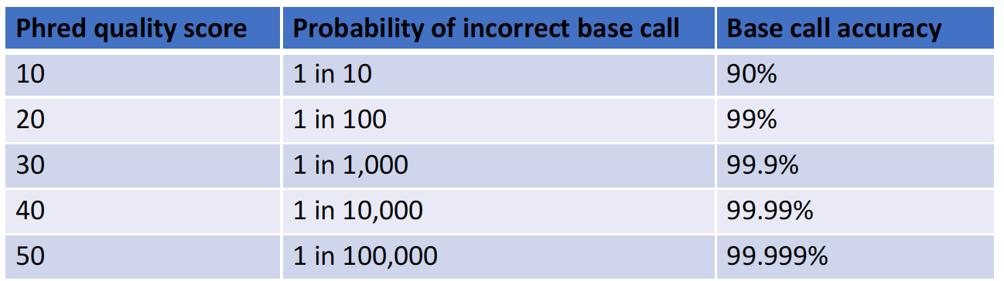
Data Format
FASTQ Format: The FASTQ format stores DNA sequence data as well as associated Phred quality scores of each base.
Phred scores define quality
Notes:
From the data format point of view, the FASTQ format stores DNA sequence data as well as associated Phred quality scores of each base, where Phred scores define the quality of DNA sequencing.

Slide 11
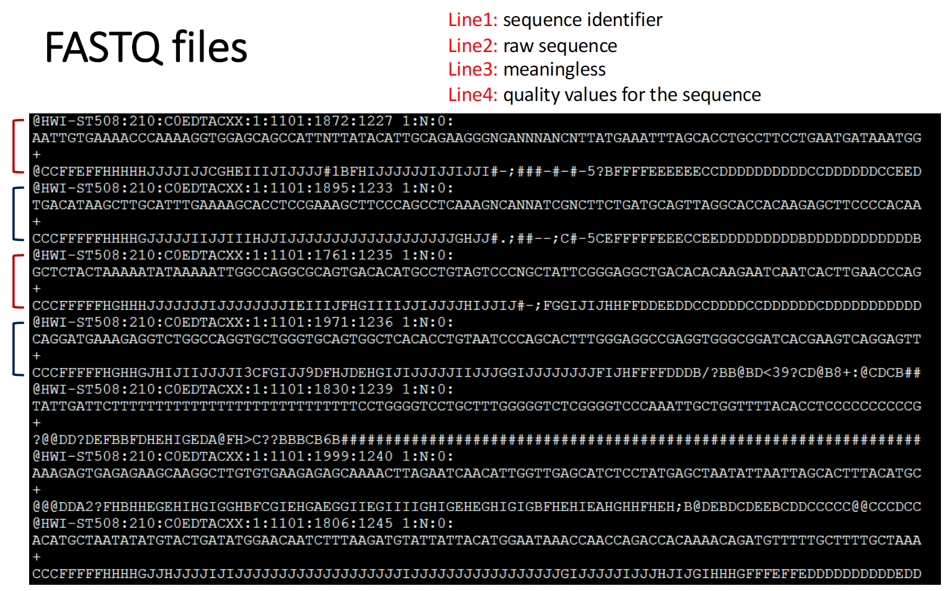
FASTQ File
Notes:
Here is an example of FASTQ file.

Slide 12
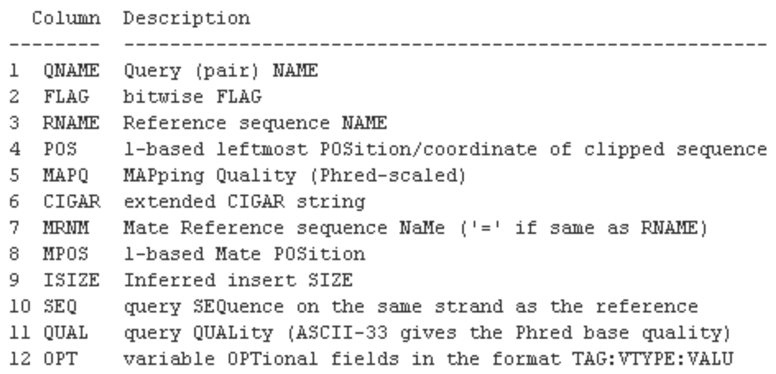
Sequence Alignment/Map Data Format (SAM)
SAM is a common format having sequence reads and their alignment to a reference genome.
BAM is the binary form of a SAM file.
Aligned BAM files are available at repositories (Sequence Read Archive at NCBI, ENA at Ensembl)
SAMTools is a software package commonly used to analyze SAM/BAM files.
Notes:
Another common format is Sequence Alignment/Map Data Format (SAM).
It is a common format having sequence reads and their alignment to a reference genome.
We will obtain the binary form of a SAM file (BAM) first at repositories (Sequence Read Archive at NCBI, ENA at Ensembl).
We can employ SAMTools to analyze SAM/BAM files.

Slide 13
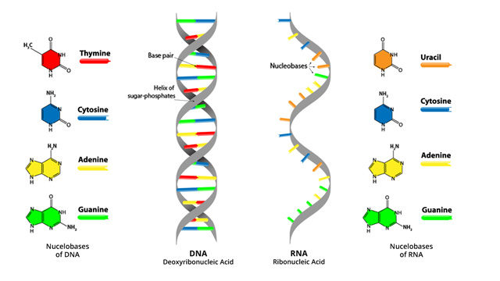
RNA-seq and Data Analysis
RNA: Ribonucleic Acid
1. RNA converts the genetic information contained within DNA to a format used to build proteins, and then moves it to ribosomal protein factories.
2. RNA only has one strand, but like DNA, is made up of nucleotides.
3. RNA strands are shorter than DNA strands.
4. RNA sometimes forms a secondary double helix structure, but only intermittently.
Source: https://www.technologynetworks.com/genomics/lists/what-are-the-key-differences-between-dna-and-rna-296719
Notes:
RNA (Ribonucleic Acid) converts the genetic information contained within DNA to a format used to build proteins, and then moves it to ribosomal protein factories.
Compared to DNA, RNA only has one strand, but like DNA, is made up of nucleotides. And they are shorter than DNA strands.
Sometimes, RNA forms a secondary double helix structure, but only intermittently.

Slide 14
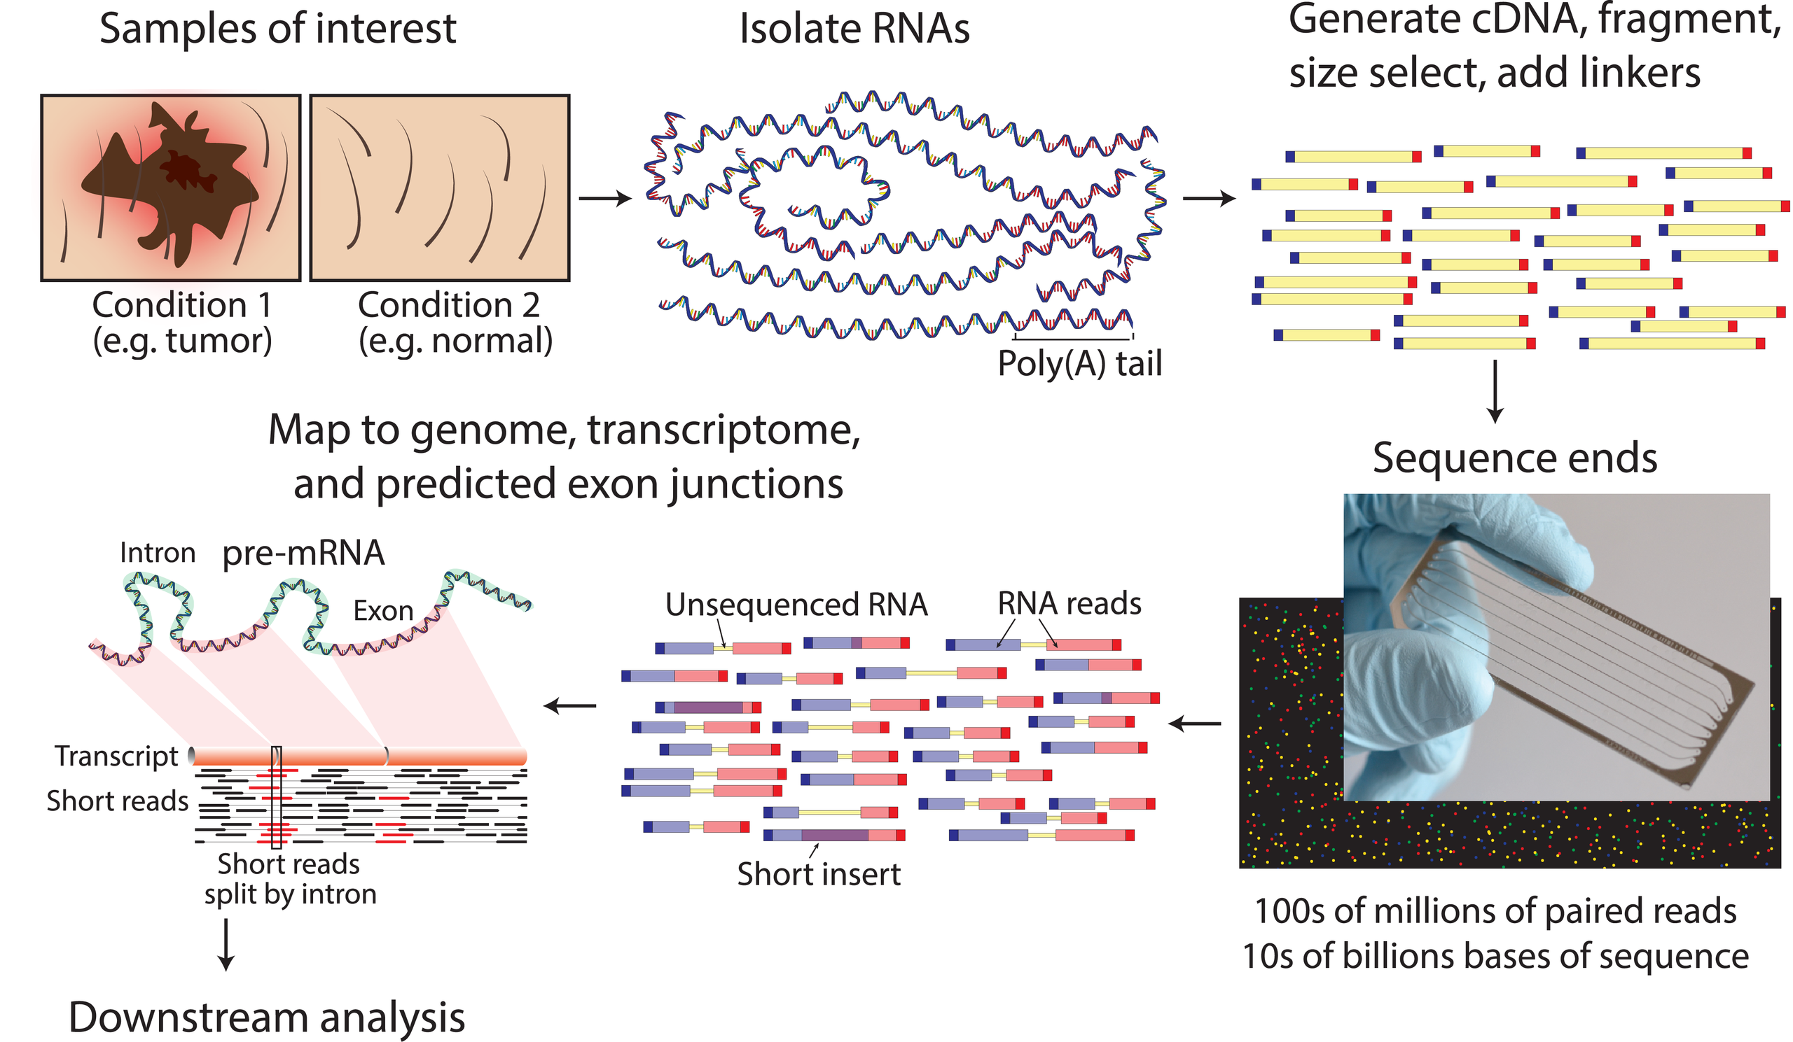
RNA-seq and Data Analysis
RNA-Seq (named as an abbreviation of "RNA sequencing") is a sequencing technique which uses next-generation sequencing (NGS) to detect the presence and quantity of RNA in a biological sample at a given moment, analyzing the continuously changing cellular transcriptome.
The quantification of the amount of RNA produced or "expressed" (i.e., RNA transcribed) at a given time in a biological sample can be done by several technologies, but RNA-seq is currently considered the most powerful, robust and adaptable technique for measuring gene expression and transcription activation at genome-wide level.
Source: https://en.wikipedia.org/wiki/RNA-Seq
Notes:
RNA-Seq (named as an abbreviation of "RNA sequencing") is a sequencing technique
It uses next-generation sequencing (NGS) to detect the presence
Meantime, it measures quantity of RNA in a biological sample at a given moment, analyzing the continuously changing cellular transcriptome.
The quantification of the amount of RNA produced or "expressed" (i.e., RNA transcribed) at a given time in a biological sample can be done by several technologies
But RNA-seq is currently considered the most powerful, robust and adaptable technique for measuring gene expression and transcription activation at genome-wide level.

Slide 15
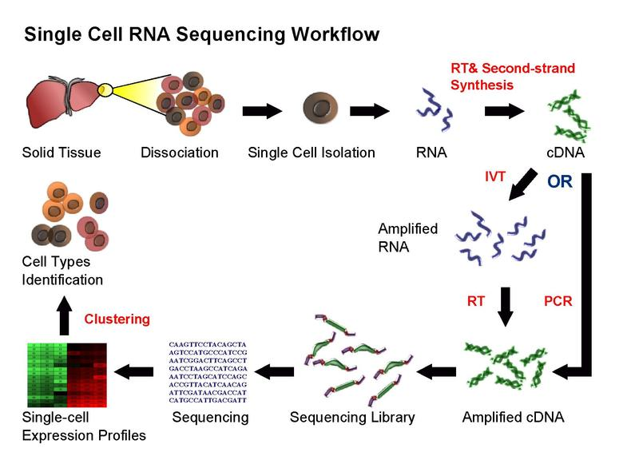
RNA-seq and Data Analysis
Single-cell RNA sequencing (scRNA-Seq) provides the expression profiles of individual cells.
Although it is not possible to obtain complete information on every RNA expressed by each cell, due to the small amount of material available, patterns of gene expression can be identified through gene clustering analyses.
This can uncover the existence of rare cell types within a cell population that may never have been seen before.
Source: https://en.wikipedia.org/wiki/RNA-Seq
Notes:
Single-cell RNA sequencing (scRNA-Seq) provides the expression profiles of individual cells.
Although it is not possible to obtain complete information on every RNA expressed by each cell, due to the small amount of material available, patterns of gene expression can be identified through gene clustering analyses.
This can uncover the existence of rare cell types within a cell population that may never have been seen before.

Slide 16
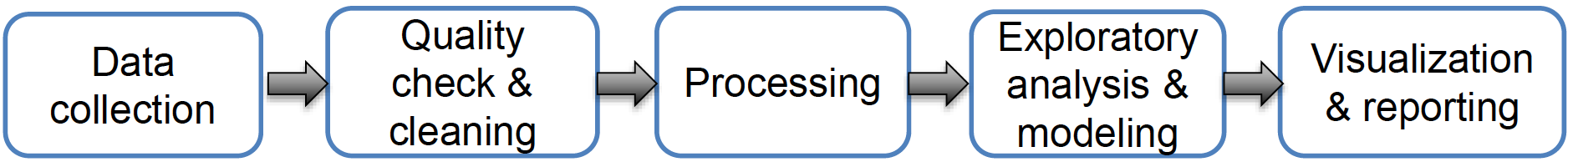
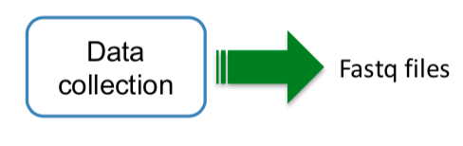
Data Analysis Workflow
Data collection
1. Which sequencing technology you are using ?
2. What kind of experiments are you doing ?
3. How many samples ?
4. How many replicates ?
5. Which public data you will include in your
analysis ?
Source: https://www.slideshare.net/altunaakalin/data-analysis-patterns-tools-and-data-types-in-genomics?from_action=save
Notes:
Here is the general flow for data analysis on sequencing data.
It involves five blocks, namely, data collection, quality check and cleaning, data processing, exploratory analysis and modeling, and visualization and reporting.
For data collection, we should answer the following questions.
1. Which sequencing technology you are using ?
2. What kind of experiments are you doing ?
3. How many samples ?
4. How many replicates ?
5. Which public data you will include in your analysis ?
After data collection, we will obtain fastq files.

Slide 17
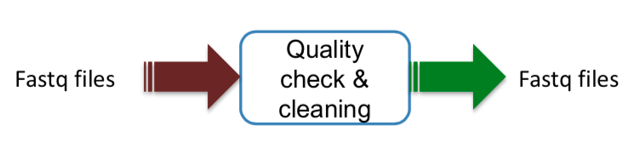
Data Analysis Workflow
Quality check and clean up
1. Quality check is mostly about checking read quality.
2. Involve removing low quality bases from reads
3. Involve removing adapter/barcode sequences from reads
Source: https://www.slideshare.net/altunaakalin/data-analysis-patterns-tools-and-data-types-in-genomics?from_action=save
Notes:
For quality check and clean up, it is checking read quality and removing low quality bases from reads like adapter/barcode sequences from reads

Slide 18
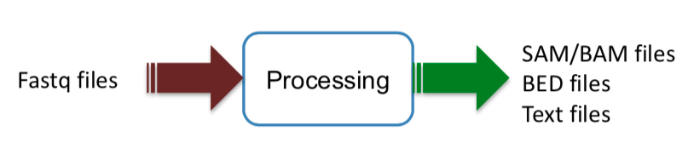
Data Analysis Workflow
Data Processing
1. Transforming raw data to a state where modeling or exploratory data analysis can start
2. Include making a tabular data structure from raw data
3. Include data transformations such as taking logs or normalization
4. Alignment + Quantification
Source: https://www.slideshare.net/altunaakalin/data-analysis-patterns-tools-and-data-types-in-genomics?from_action=save
Notes:
In the data processing, it transforms raw data to a state where modeling or exploratory data analysis can start.
It makes a tabular data structure from raw data and completes data transformations such as taking logs or normalization.
It will generate SAM/BAM files.

Slide 19
Data Analysis Workflow
Exploratory analysis and modeling
In general,
How samples or variables relate to each other
  clustering & dimension reduction (PCA, etc.)
Prediction of variable of interest: Y ~ X₁ + … + X_{n}
Statistical models including hypothesis testing
In genomics,
Annotation with gene sets/pathways
Looking at genomics data with special browsers, such as UCSC genome browser or IGV
Final visualization and reporting
Final figures, tables and text that describes the outcome of analysis
Jupyter notebook or Rmarkdown go-to tool for compiling reports these days
Source: https://www.slideshare.net/altunaakalin/data-analysis-patterns-tools-and-data-types-in-genomics?from_action=save
Notes:
The last two blocks are exploratory analysis and modeling, and final visualization and reporting.
For exploratory analysis and modeling, it is to figure out how samples or variables relate to each other, clustering & dimension reduction (PCA, etc.), predicting of variable of interest, and accomplishing statistical models including hypothesis testing.
For final visualization and reporting, final figures, tables and text will be applied to describe the outcome of analysis with some tools like Jupyter notebook or Rmarkdown go-to tool.

Slide 20
DLI Accelerated Data Science Teaching Kit
Thank You

