Slide 1

Lecture 19.3 - Clustering and Validation
DLI Accelerated Data Science Teaching Kit
Notes:
This section is to introduce Clustering and Validation for data preprocessing.

Slide 2

The Accelerated Data Science Teaching Kit is licensed by NVIDIA, Georgia Institute of Technology, and Prairie View A&M University under the
Creative Commons Attribution-NonCommercial 4.0 International License.

Slide 3
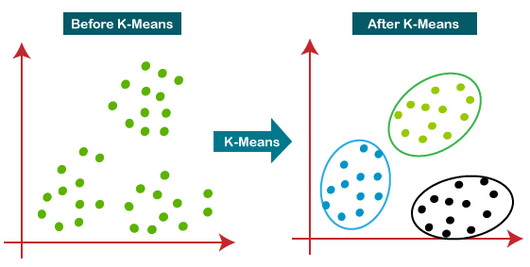
Clustering Analysis
Cluster: a collection of data objects
Similar to one another within the same cluster
Dissimilar to the objects in other clusters
High Intra-class similarity
Low Inter-class similarity
Cluster analysis
Grouping a set of data objects into clusters
Source: https://leasetruk.medium.com/k-means-algorithm-with-example-b8994b3c4ef3
Notes:
Clustering is to group data into different clusters, which is shown in the right figure.
For clustering, the result should be:
Similar to one another within the same cluster
Dissimilar to the objects in other clusters
High Intra-class similarity
Low Inter-class similarity

Slide 4
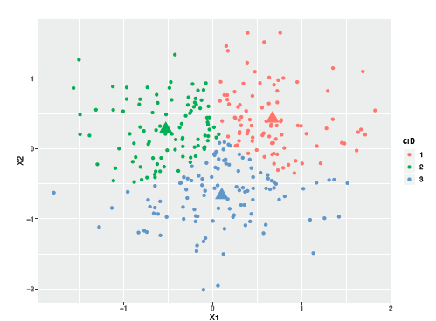
Clustering Validation
For supervised classification we have a variety of measures to evaluate how good the model is.
Accuracy, precision, recall, F1-score
For cluster analysis, the analogous question is how to evaluate the “goodness” of the resulting clusters?
To avoid finding patterns in noise
To compare clustering algorithms
To compare two sets of clusters
To compare two clusters
Notes:
Compared to supervised classification, it is more challenging to evaluate the performance since there is no prior knowledge on the data.

Slide 5
Measures of Cluster Validity
Numerical measures to judge various aspects of cluster validity
Internal Index measures the goodness of a clustering structure without respect to external information.
Sum of Squared Error (SSE)
External Index measures the extent to which cluster labels match externally supplied class labels.
Entropy
Notes:
Some measures have been designed to judge various aspects of cluster validity.
Internal Index like Sum of Squared Error (SSE) measures the goodness of a clustering structure without respect to external information.
External Index like Entropy measures the extent to which cluster labels match externally supplied class labels.

Slide 6
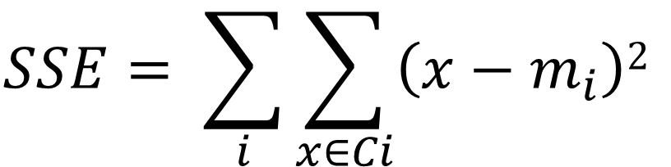
Internal Measures: SSE
Sum of Squared Error (SSE) measures how closely related objects are in a cluster.
where m_{i} is a centroid of a cluster 𝐶_{i}.
SSE is also known as the within cluster sum of squares (WSS)
$$SSE= \sum_{i}{\sum_{x∈Ci}{\left(x−m_{i}\right)2}}$$
Notes:
Sum of Squared Error (SSE) defined in this formula measures how closely related objects are in a cluster, which is also known as the within cluster sum of squares (WSS).

Slide 7
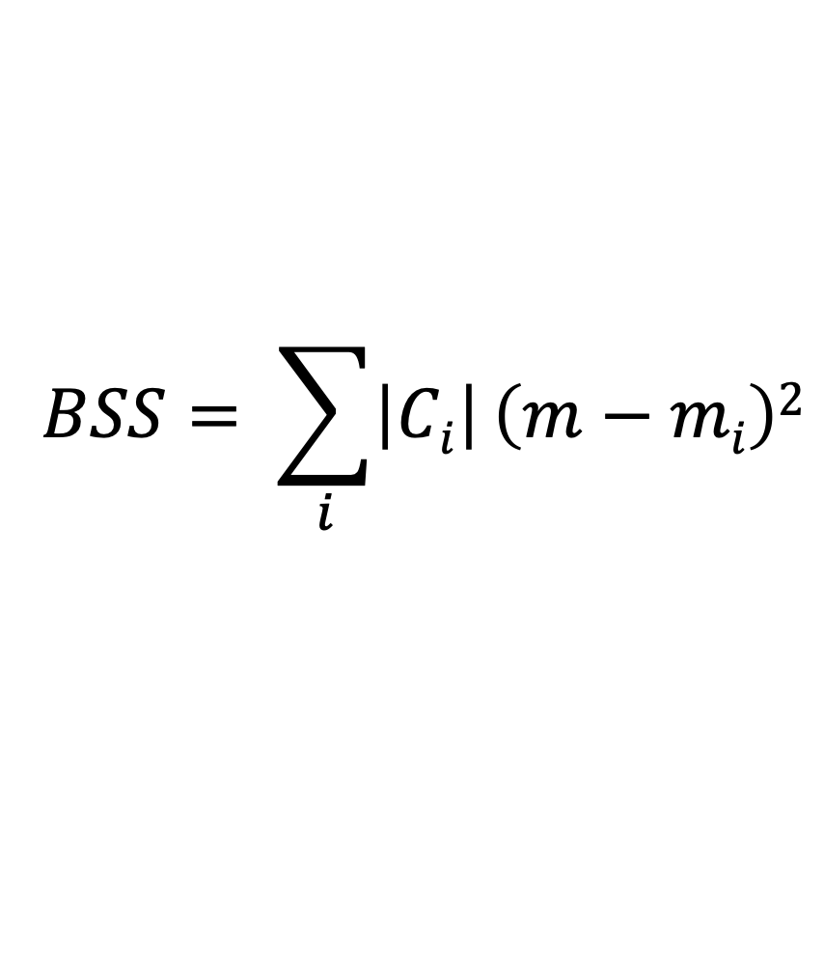
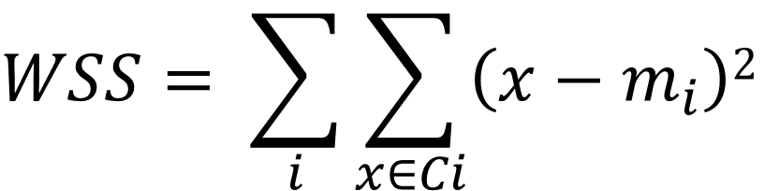
Internal Measures: Cohesion and Separation
Cluster Cohesion measures how closely related objects are in a cluster, and the within cluster sum of square (WSS) can be used to quantify it.
Cluster Separation measures how distinct or well-separated a cluster is from other clusters, and the between cluster sum of squares (BSS) can be used to quantify it.
where |𝐶_{i} | is a size of a cluster 𝐶_{i} and m is is the centroid of all the samples.
$$WSS= \sum_{i}{\sum_{x∈Ci}{\left(x−m_{i}\right)2}}$$
$$BSS= \sum_{i}{\left|Ci\right|}\left(m−mi\right)2$$
Notes:
In addition, it is also about Cluster Cohesion and Separation.
Cluster Cohesion measures how closely related objects are in a cluster, and within cluster sum of square (WSS) can be used to quantify it.
On the other side, Cluster Cohesion measures how closely related objects are in a cluster, and the within cluster sum of square (WSS) can be used to quantify it.

Slide 8
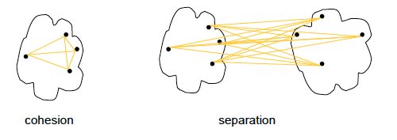
Internal Measures: Cohesion and Separation
A proximity graph-based approach can be also used to measure cohesion and separation.
Cluster cohesion is the sum of the weight of all links within a cluster.
Cluster separation is the sum of the weights between nodes in the cluster and nodes outside the cluster.
Notes:
Moreover, a proximity graph-based approach can be also used to measure cohesion and separation.
Cluster cohesion is the sum of the weight of all links within a cluster.
Cluster separation is the sum of the weights between nodes in the cluster and nodes outside the cluster.

Slide 9
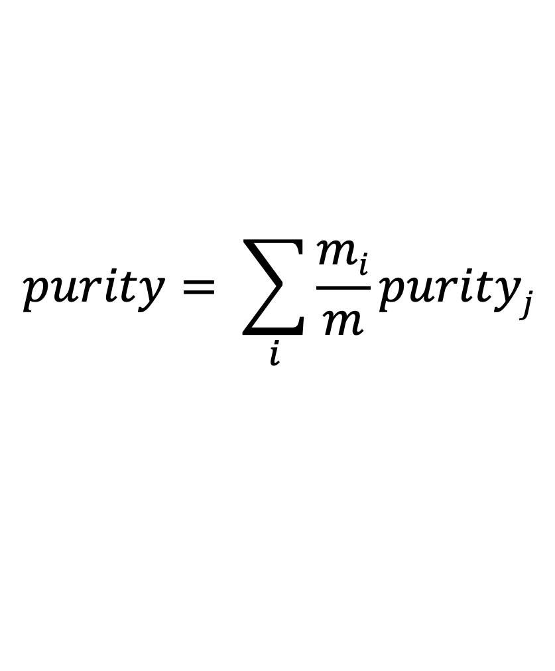
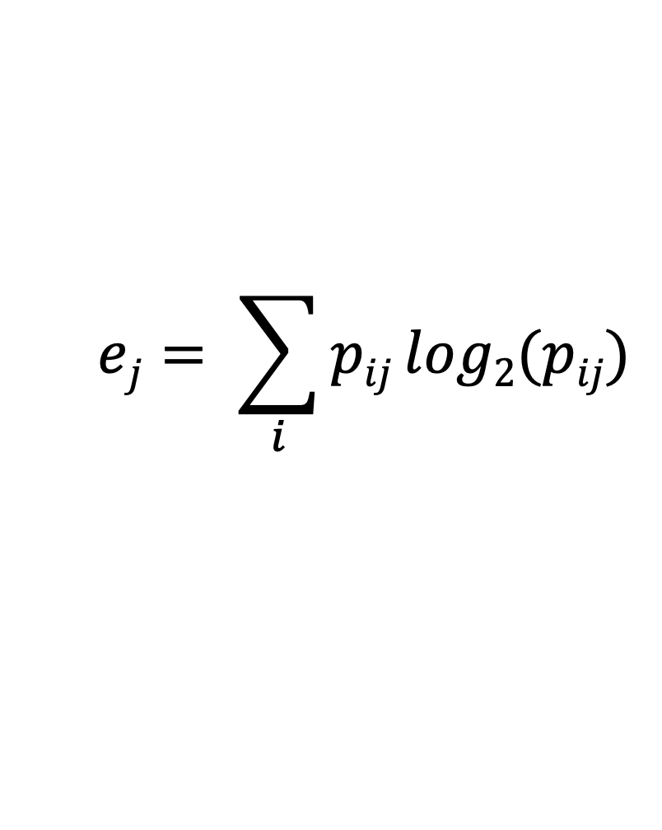
External Measures: Entropy and Purity
Entropy: For each cluster, the class i distribution of the data is calculated for cluster j, p_{ij} is the probability that a member of cluster j belongs to class i.
Then the entropy of each cluster j,
Purity: the purity of cluster j, purity_{j} = max(p_{ij}) and the overall purity of a clustering,
where 𝑚_{j} is the number of samples in cluster j and 𝑚 is the total number of samples.
$$ej= \sum_{i}{pij}log2(pij)$$
$$purity= \sum_{i}{\frac{mi}{m}purityj}$$
Notes:
For external measures, Entropy and Purity are two methods for measuring clustering quality.
For each cluster, the class i distribution of the data is calculated for cluster j, p_{ij} is the probability that a member of cluster j belongs to class i.
The purity of cluster j, purity_{j} = max(p_{ij}) and the overall purity of a clustering.

Slide 10
DLI Accelerated Data Science Teaching Kit
Thank You

