Slide 1

Lecture 19.4 - Statistical Analysis
DLI Accelerated Data Science Teaching Kit
Notes:
This section is to present basic steps for statistical analysis for data preprocessing on genomics data.

Slide 2

The Accelerated Data Science Teaching Kit is licensed by NVIDIA, Georgia Institute of Technology, and Prairie View A&M University under the
Creative Commons Attribution-NonCommercial 4.0 International License.

Slide 3
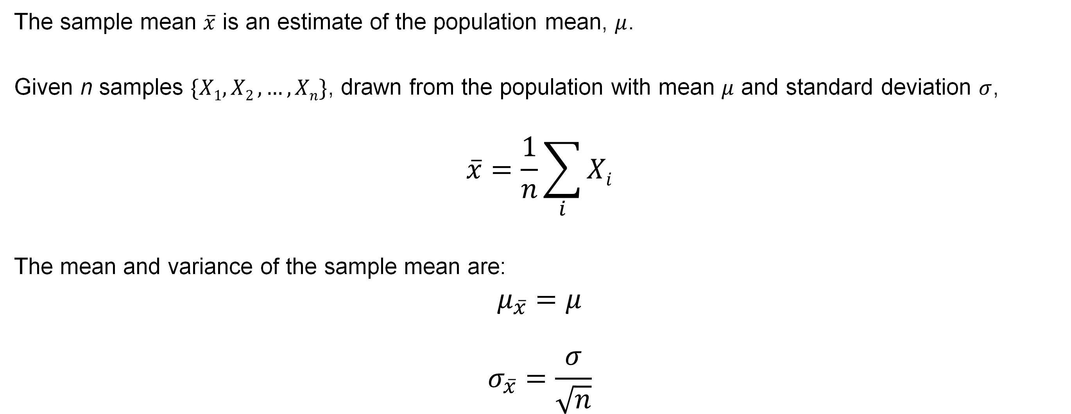
Sample Means
The sample mean $\overline{x}$ is an estimate of the population mean, $μ$.
Given n samples $\{X1,X2 ,…,Xn\}$, drawn from the population with mean $μ$ and standard deviation $σ$,
$$\overline{x}=\frac{1}{n}\sum_{i}{Xi}$$
The mean and variance of the sample mean are:
$$μ_{\overline{x}}=μ$$
$$σ_{\overline{x}}=\frac{σ}{\sqrt{n}}$$
Notes:
This first basic step is to calculate sample mean and variance values.

Slide 4

Central Limit Theorem (CLT)
For a large enough sample size 𝑛, the distribution of the sample mean $\overline{x}$ will approach a normal distribution.
$$\overline{x}\sim N\left(μ, \frac{σ}{\sqrt{n}}\right)$$
This is true for a sample of independent random variables from any population distribution, as long as the population has a finite standard deviation $σ$.
Notes:
For a large enough sample size 𝑛, the distribution of the sample mean $\overline{x}$ will approach a normal distribution in terms of Central Limit Theorem (CLT).
This is true for a sample of independent random variables from any population distribution, as long as the population has a finite standard deviation $σ$.

Slide 5

Variance
Sample variance
$s^{2}=\frac{1}{n−1}\sum_{i=1}^{n}{(x_{i}−\overline{x})}$²
Population variance
$σ^{2}=\frac{1}{N}\sum_{i=1}^{N}{(x_{i}−μ)}$²
Notes:
Just keep it in our mind.
We have to figure out the difference between sample variance and population variance.
Generally, we will calculate sample variance rather than population variance since we will not be able to obtain the whole entire data.

Slide 6
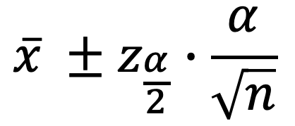
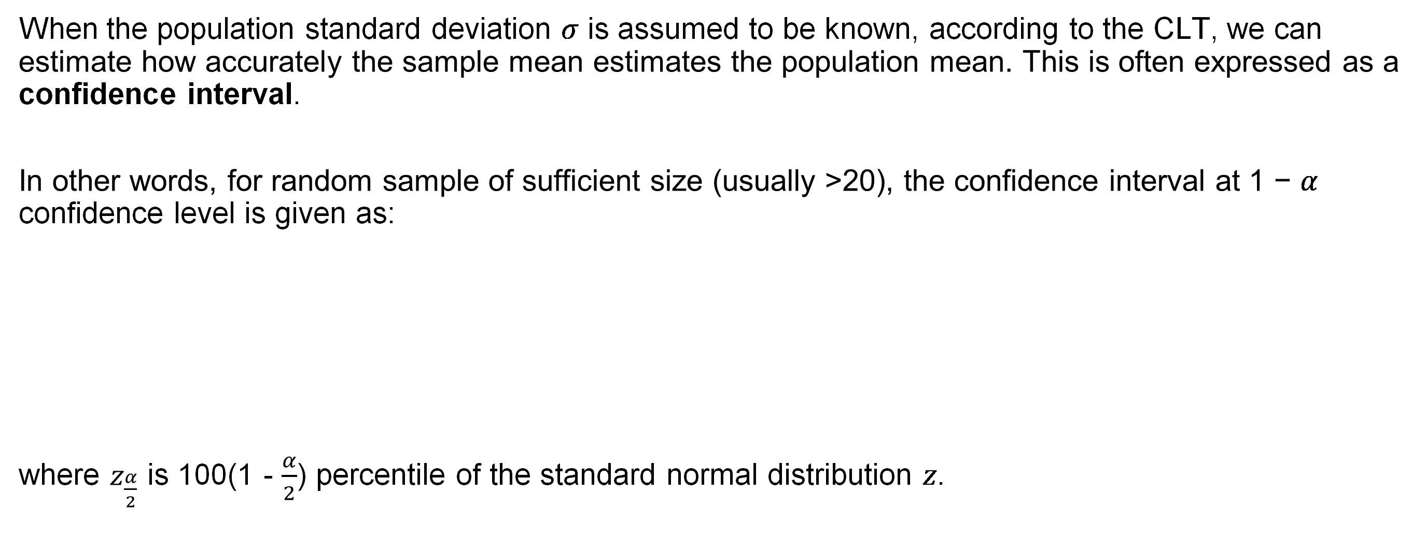
Confidence Interval
When the population standard deviation 𝜎 is assumed to be known, according to the CLT, we can estimate how accurately the sample mean estimates the population mean. This is often expressed as a confidence interval.
In other words, for random sample of sufficient size (usually >20), the confidence interval at 1 − 𝛼 confidence level is given as:
where $z_{\frac{α}{2}}$ is 100(1 - $\frac{α}{2}$) percentile of the standard normal distribution 𝑧.
$$\overline{x} ±z_{\frac{α}{2}}∙\frac{α}{\sqrt{n}}$$
Notes:
In addition, when the population standard deviation 𝜎 is assumed to be known, according to the CLT, we can estimate how accurately the sample mean estimates the population mean. This is often expressed as a confidence interval.

Slide 7
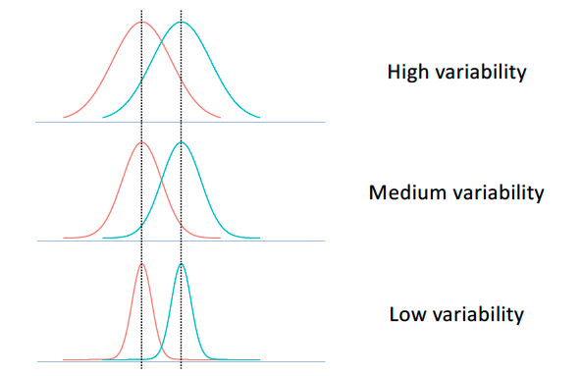
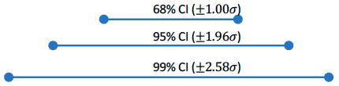
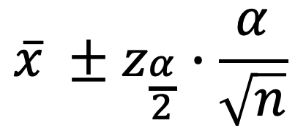
Confidence Interval
$$\overline{x} ±z_{\frac{α}{2}}∙\frac{α}{\sqrt{n}}$$
Notes:
This figure shows examples with different confidence intervals.

Slide 8
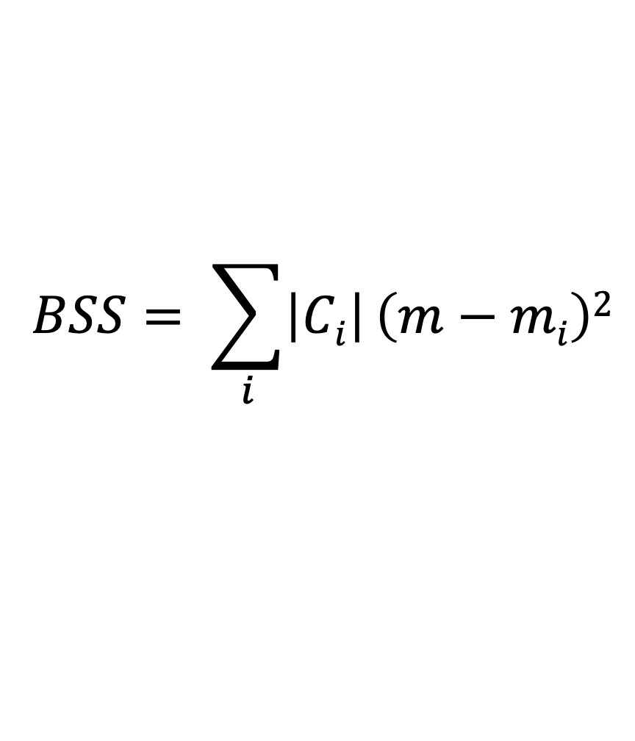
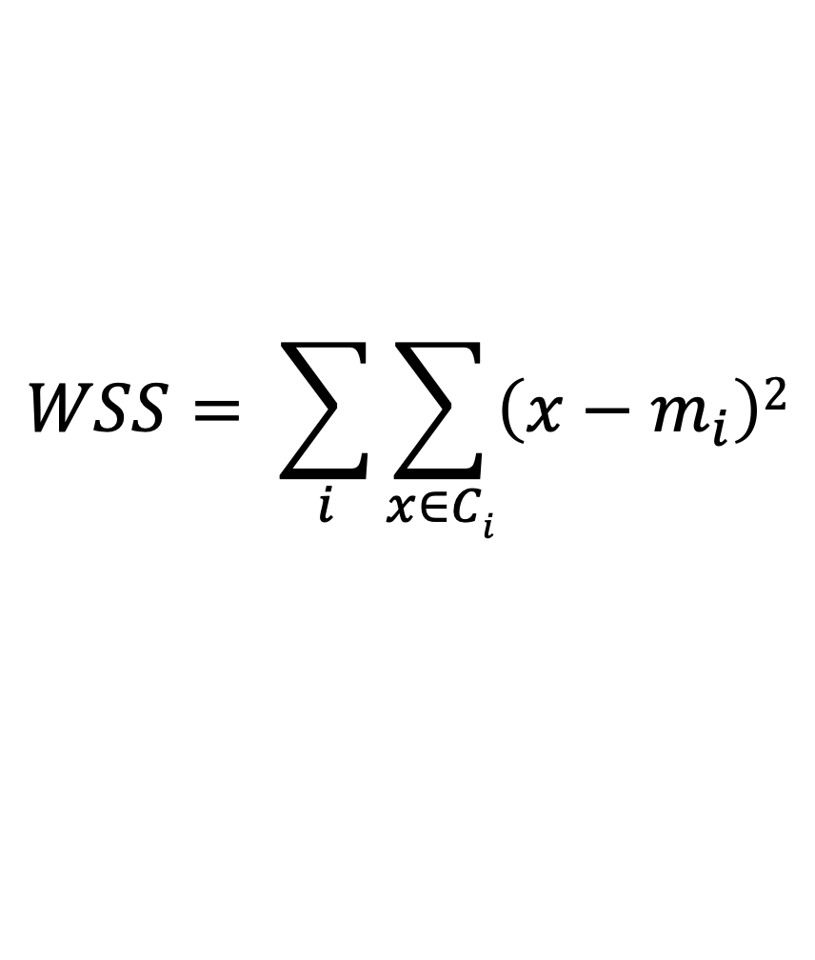
Internal Measures: Cohesion and Separation
Cluster Cohesion measures how closely related objects are in a cluster, and the within cluster sum of square (WSS) can be used to quantify it.
Cluster Separation measures how distinct or well-separated a cluster is from other clusters, and the between cluster sum of squares (BSS) can be used to quantify it.
where |𝐶_{i} | is the size of a cluster 𝐶_{i} and m is the centroid of all the samples.
$$WSS= \sum_{i}{\sum_{x∈Ci}{\left(x−m_{i}\right)2}}$$
$$BSS= \sum_{i}{\left|Ci\right|}\left(m−mi\right)2$$
Notes:
We can also measure Cohesion and Separation as mentioned in last section.

Slide 9
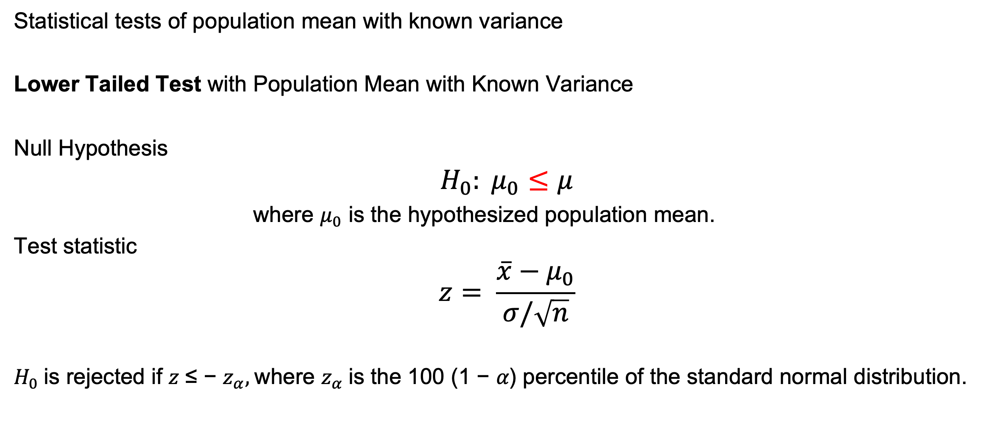
Hypothesis Testing
Statistical tests of population mean with known variance
Lower Tailed Test with Population Mean with Known Variance
Null Hypothesis
$$H_{0}: μ_{0}≤μ$$
where $μ_{0}$ is the hypothesized population mean.
Test statistic
$$z= \frac{\overline{x}−μ_{0}}{σ/\sqrt{n}}$$
$H_{0}$is rejected if 𝑧 ≤ − $z_{α},$where $z_{α}$is the 100 (1 − 𝛼) percentile of the standard normal distribution.
Notes:
We can also run statistical tests of population mean with known variance.
For example, we can run Lower Tailed Test with Population Mean with Known Variance

Slide 10

Hypothesis Testing
Statistical tests of population mean with known variance
Upper Tailed Test with Population Mean with Known Variance
Null Hypothesis
$H_{0}: μ_{0}$ $≥μ$
where $μ_{0}$ is the hypothesized population mean.
Test statistic
$$z= \frac{\overline{x}−μ_{0}}{σ/\sqrt{n}}$$
$H_{0}$is rejected if 𝑧 $≥$ − $z_{α},$where $z_{α}$is the 100 (1 − 𝛼) percentile of the standard normal distribution.
Notes:
On the other side, we can run Upper Tailed Test with Population Mean with Known Variance

Slide 11

Hypothesis Testing
Statistical tests of population mean with known variance
Two-Tailed Test with Population Mean with Known Variance
Null Hypothesis
$H_{0}: μ_{0}$ $=μ$
where $μ_{0}$ is the hypothesized population mean.
Test statistic
$$z= \frac{\overline{x}−μ_{0}}{σ/\sqrt{n}}$$
$H_{0}$is rejected if 𝑧 $≥$ $z_{\frac{α}{2}}$ or 𝑧 $≤$ ${−z}_{\frac{α}{2}},$where $z_{\frac{α}{2}}$ is the 100 (1 − $\frac{α}{2}$) percentile of the standard normal distribution.
Notes:
Certainly, we can run Two-Tailed Test with Population Mean with Known Variance.

Slide 12
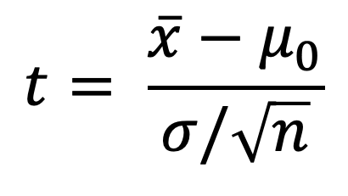
Hypothesis Testing
Statistical tests of population mean with unknown variance
Lower tailed test
Upper tailed test
Two-tailed test
Basically, the same step with only one difference.
Test statistic:
where 𝑠 is the sample variance, and 𝑡 follows Student t distribution with 𝑛 − 1 degrees of freedom.
$$t= \frac{\overline{x}−μ_{0}}{σ/\sqrt{n}}$$
Notes:
So, we can run Lower tailed test, Upper tailed test, and Two-tailed test.

Slide 13
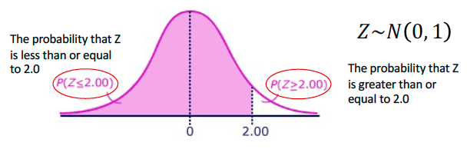
What is p-value?
a.k.a., the probability value or asymptotic significance
For a given statistical model and observations, the probability that the null hypothesis (H0) is not rejected, and hence, true.
Notes:
Finally, we can use p-value to measure statistical significance.
For a given statistical model and observations, the probability that the null hypothesis (H0) is not rejected, and hence, true.

Slide 14
Statistical Analysis for Genomics
Differentially Expressed Genes is taking the normalized read count data and performing statistical analysis to discover quantitative changes in expression levels between experimental groups.
For example, we use statistical testing to decide whether, for a given gene, an observed difference in read counts is significant, that is, whether it is greater than what would be expected just due to natural random variation.
Gene Set Enrichment Analysis (GSEA) is a method to identify classes of genes or proteins that are over-represented in a large set of genes or proteins, which may have an association with disease phenotypes.
The method uses statistical approaches to identify significantly enriched or depleted groups of genes.
Transcriptomics technologies and proteomics results often identify thousands of genes which are used for the analysis.
Notes:
After these basic steps for data preprocessing, we can perform Differentially Expressed Genes and/or Gene Set Enrichment Analysis (GSEA) on genomics data.
Differentially Expressed Genes is taking the normalized read count data and performing statistical analysis to discover quantitative changes in expression levels between experimental groups.
For example, we use statistical testing to decide whether, for a given gene, an observed difference in read counts is significant, that is, whether it is greater than what would be expected just due to natural random variation.
Gene Set Enrichment Analysis (GSEA) is a method to identify classes of genes or proteins that are over-represented in a large set of genes or proteins, which may have an association with disease phenotypes.
The method uses statistical approaches to identify significantly enriched or depleted groups of genes.
Transcriptomics technologies and proteomics results often identify thousands of genes which are used for the analysis.

Slide 15
DLI Accelerated Data Science Teaching Kit
Thank You

