Slide 1
Lecture ​2.1 - Collecting Data
DLI Accelerated Data Science Teaching Kit

Slide 2

The Accelerated Data Science Teaching Kit is licensed by NVIDIA, Georgia Institute of Technology, and Prairie View A&M University under the
Creative Commons Attribution-NonCommercial 4.0 International License.

Slide 3
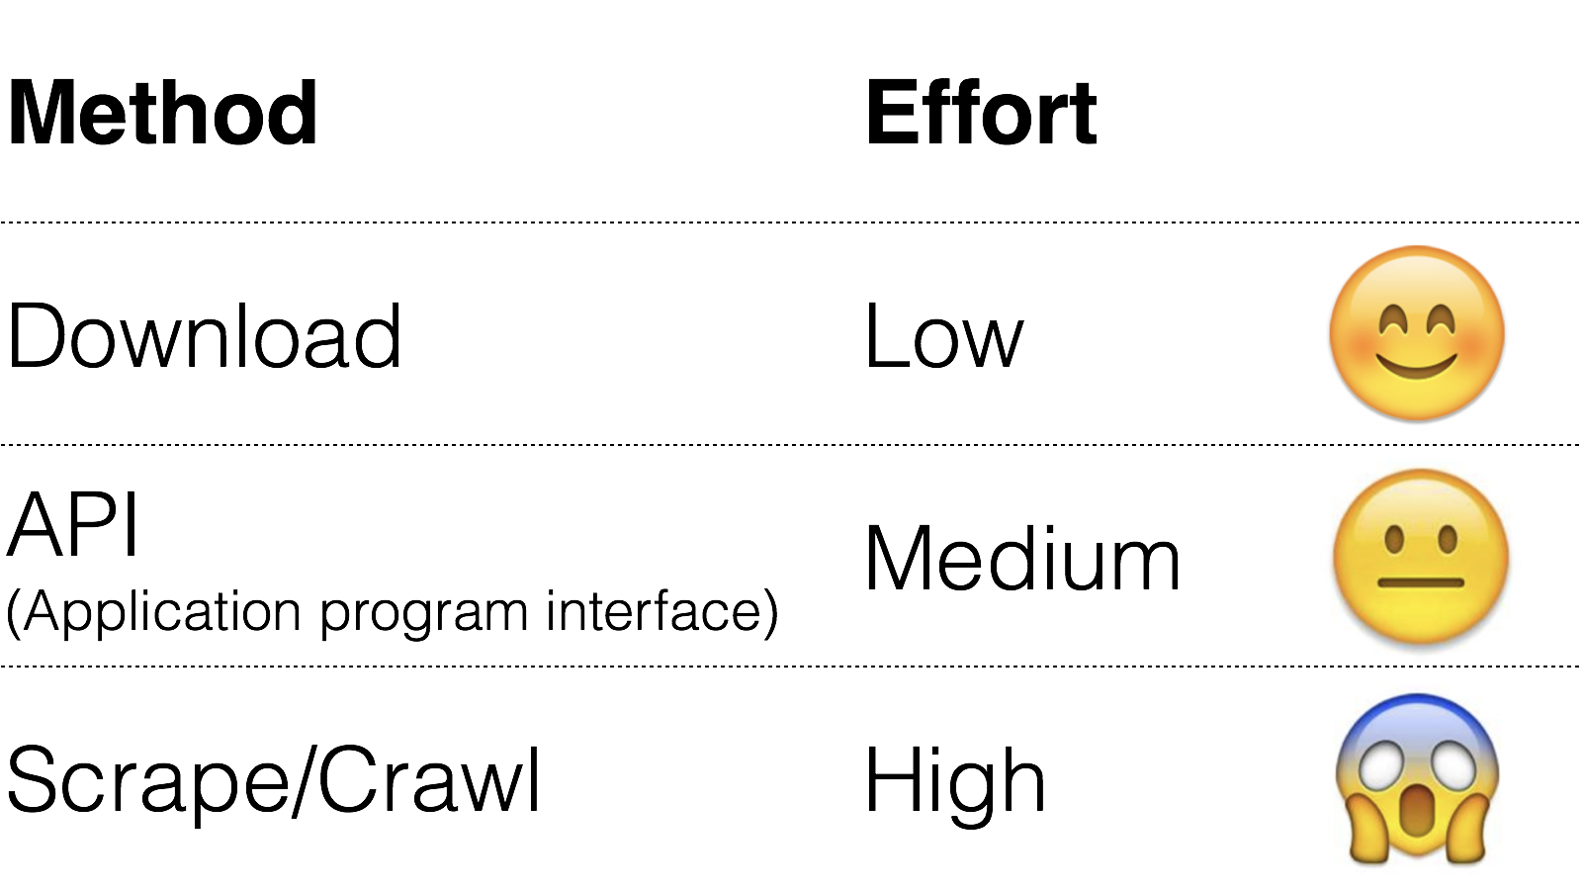
How to Collect Data?

Slide 4
Data You Can Just Download
NYC Taxi data: Trip (11GB), Fare (7.7GB)
StackOverflow (xml)
Wikipedia (data dump)
Atlanta crime data (csv)
Soccer statistics
…

Slide 5
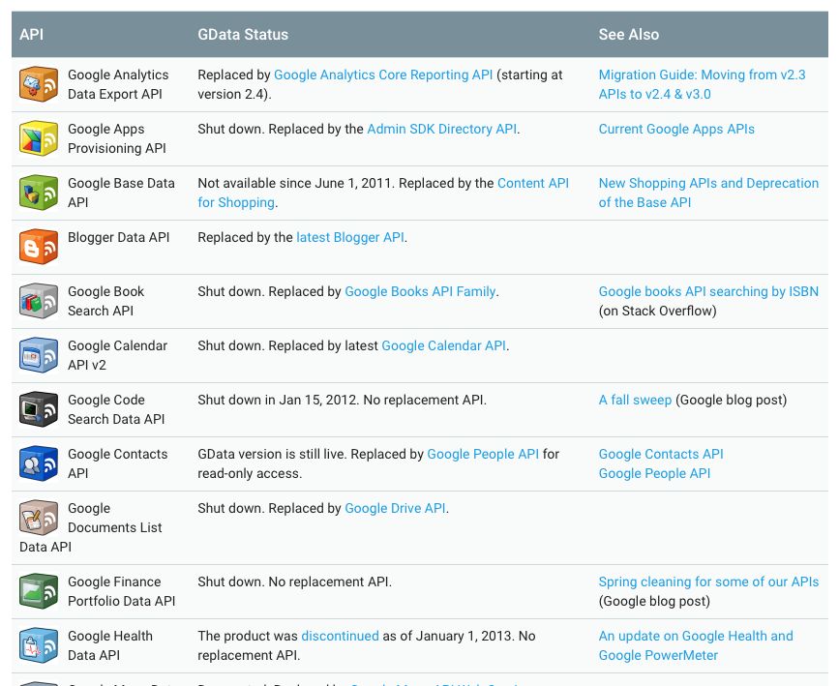
Collect Data via APIs
Google Data API (e.g., Google Maps Directions API)
https://developers.google.com/gdata/docs/directory
Twitter (small subset)
https://dev.twitter.com/streaming/overview
Last.fm (Pandora has unofficial API)
Flickr
data.nasa.gov
data.gov
Facebook (your friends only)
https://developers.google.com/gdata/docs/directory
Notes:
Application programming interface

Slide 6
Data Unavailable via APIs
Amazon (reviews, product info)
ESPN
eBay
Google Play
Google Scholar
…

Slide 7
DLI Accelerated Data Science Teaching Kit
Thank You

