Slide 1
Lecture ​2.2 - Scraping Data
DLI Accelerated Data Science Teaching Kit

Slide 2

The Accelerated Data Science Teaching Kit is licensed by NVIDIA, Georgia Institute of Technology, and Prairie View A&M University under the
Creative Commons Attribution-NonCommercial 4.0 International License.

Slide 3
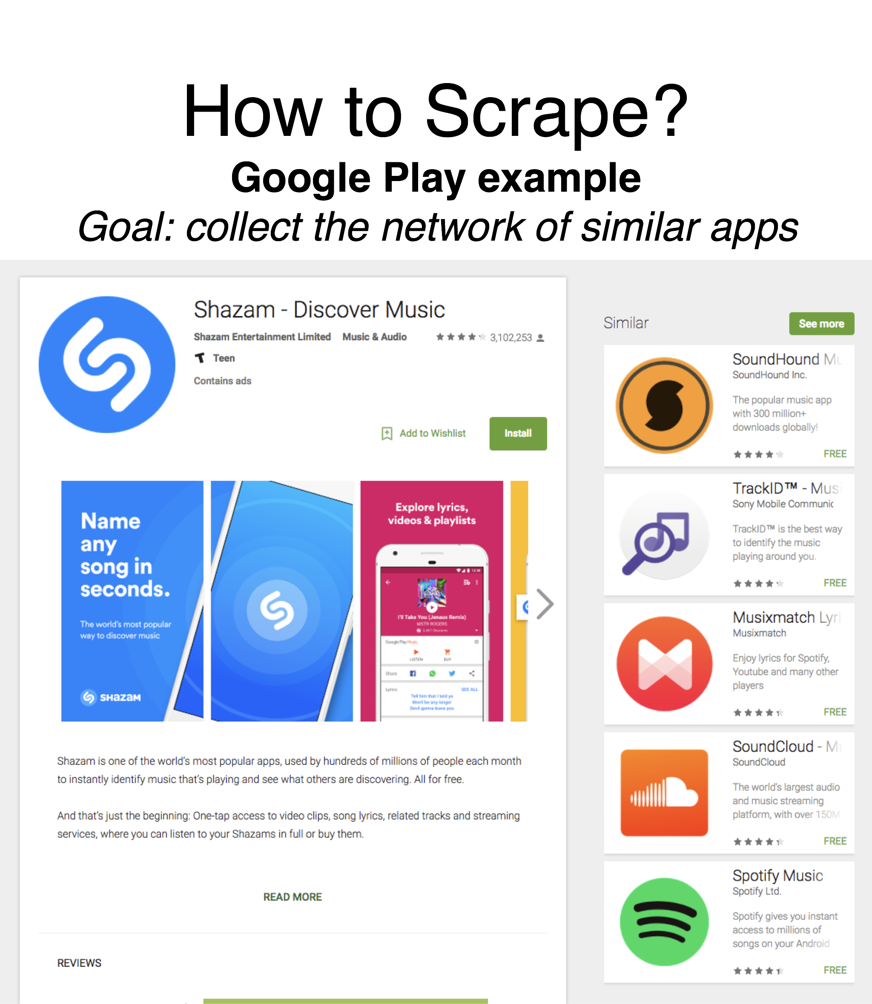
Retrieved: https://play.google.com/store/apps/details?id=com.shazam.android&hl=en

Slide 4
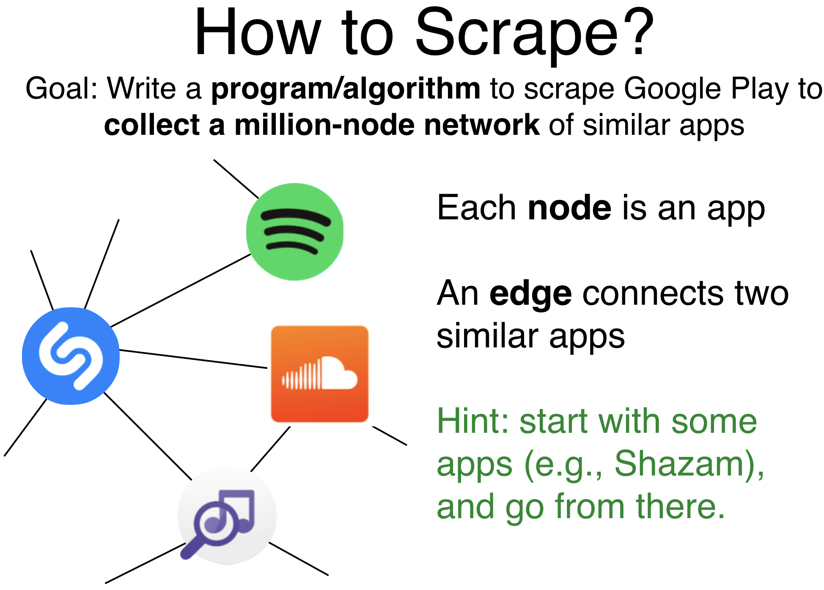
Icons from: https://play.google.com/store/apps/details?id=com.shazam.android&hl=en
https://play.google.com/store/apps/details?id=com.spotify.music
https://play.google.com/store/apps/details?id=com.soundcloud.android
https://play.google.com/store/apps/details?id=com.soundcloud.android

Slide 5
User browser’s “developer Tools” to extract data

Slide 6
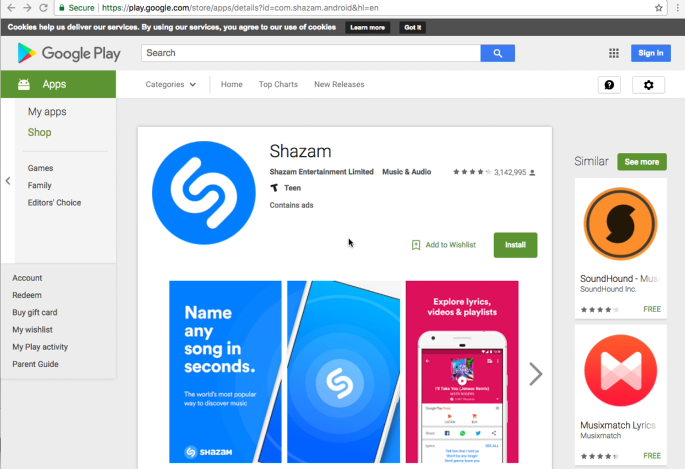

Slide 7
DLI Accelerated Data Science Teaching Kit
Thank You

