Slide 1

Lecture 2.4​ - ​Data Annotation and Data Quality
DLI Accelerated Data Science Teaching Kit
Notes:
This section will introduce basic ideas on data annotation and tools, and how to measure as well as control data quality.

Slide 2

The Accelerated Data Science Teaching Kit is licensed by NVIDIA, Georgia Institute of Technology, and Prairie View A&M University under the
Creative Commons Attribution-NonCommercial 4.0 International License.

Slide 3
Data Annotation
Data annotation is the labelling of collected data for various applications.
Image Processing
Natural Language Processing
Smart Grid
… …
Notes:
Data annotation is necessary to build machine learning models, especially for supervised learning models in different applications such as Image Processing, Natural Language Processing, and Smart Grids.
This figure shows the general flow of data annotation.
The first step is to collect raw data from different sources.
Then we have to construct a team with different expertise, especially domain experts for the applications.
Prior to data annotation, the team has to work together to complete annotation guidelines.
Finally, with these guidelines, the team will complete data annotations on the raw data and evaluate the annotation results.

Slide 4
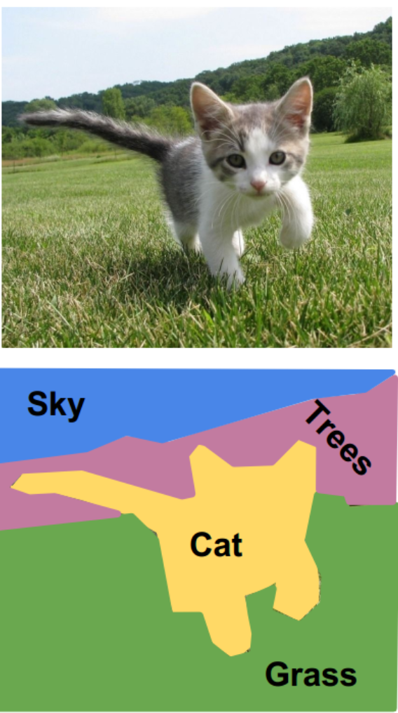
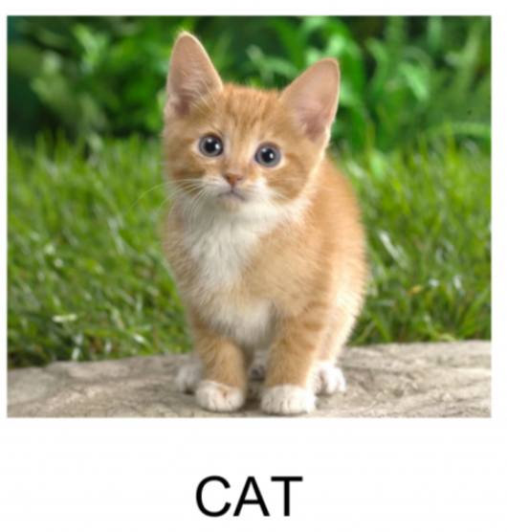
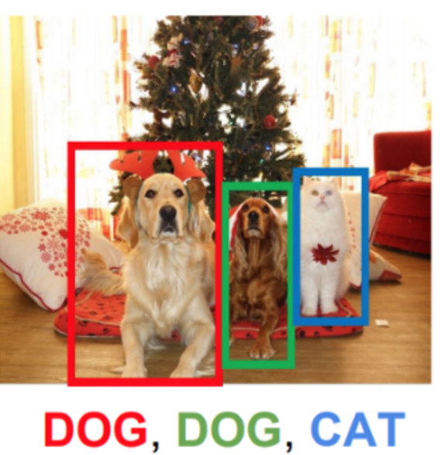
Image Processing
Examples of data annotation
Semantic Segmentation
Image Classification
Object Detection
Notes:
First example of data annotation based on image processing.
These three figures present the annotation for image classification, object detection, and semantic segmentation, respectively.
For instance, CAT is the label for the first image.

Slide 5
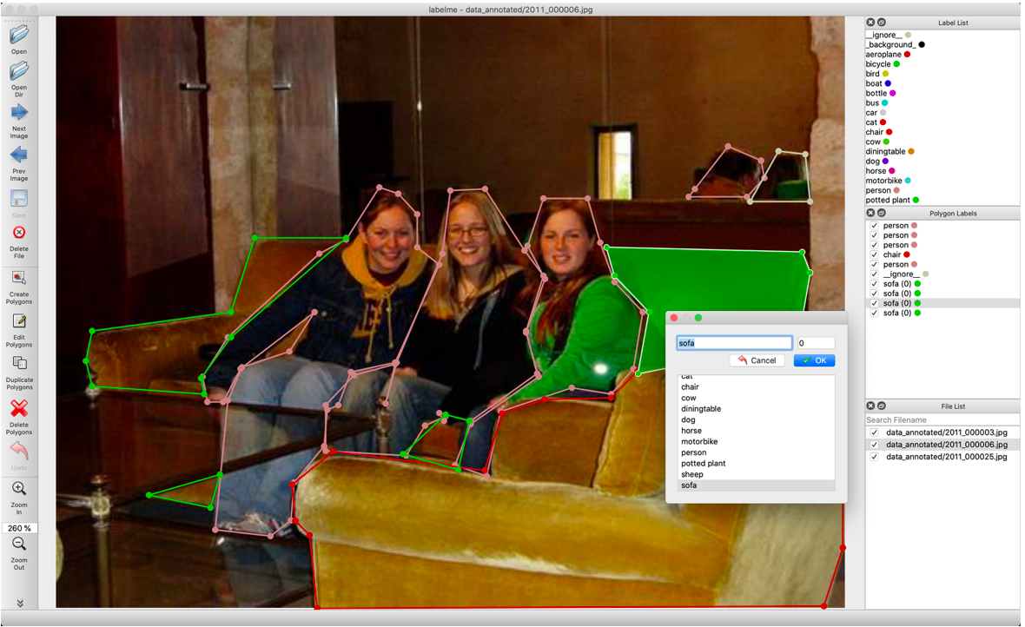
LabelMe
A graphical image annotation tool inspired by http://labelme.csail.mit.edu.
It is written in Python and uses Qt for its graphical interface.
Source: https://github.com/wkentaro/labelme
Notes:
There are many tools for image processing.
For example, LabelMe is a tool to annotate images for image segmentation.
Some features of this tool are
Image annotation for polygon, rectangle, circle, line and point.
Image flag annotation for classification and cleaning.
Video annotation.
GUI customization (predefined labels / flags, auto-saving, label validation, etc).
Exporting VOC-format dataset for semantic/instance segmentation.
Exporting COCO-format dataset for instance segmentation.

Slide 6
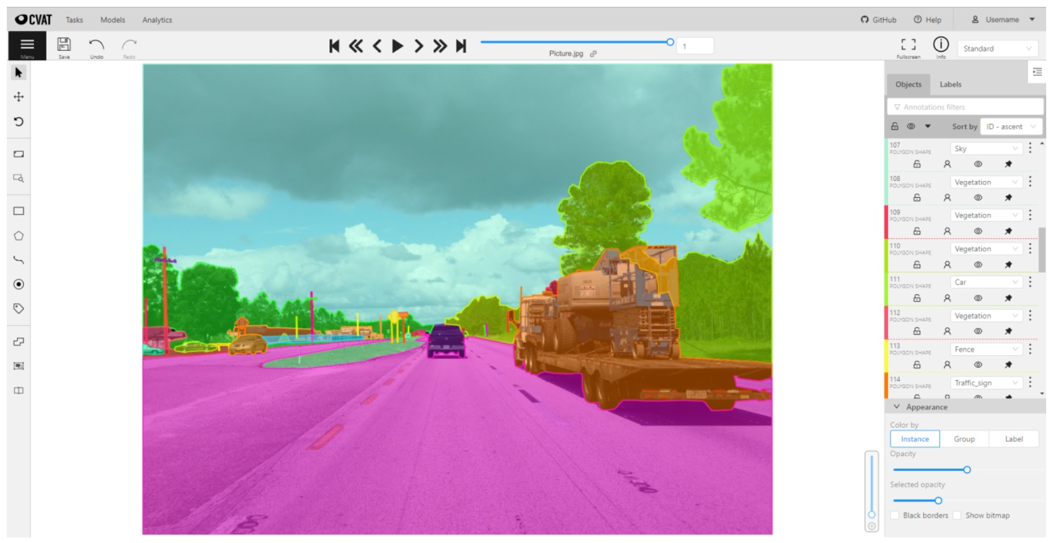
Computer Vision Annotation Tool (CVAT)
Open source
Auto annotation using trained DL models
Collaborative
Easy to deploy and maintain
Source: https://github.com/openvinotoolkit/cvat
Notes:
CVAT is a free, online, interactive video and image annotation tool for computer vision.
It is being used to annotate million of objects with different properties.
Many UI and UX decisions are based on feedbacks from professional data annotation teams.

Slide 7
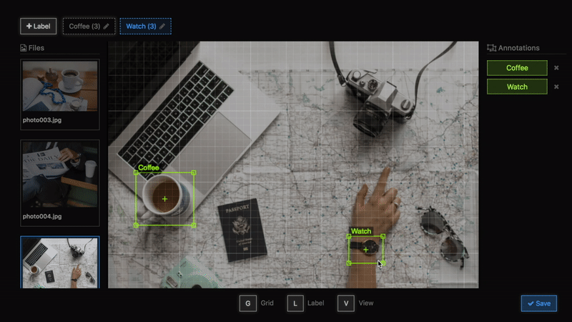
Einstein Vision Object Detection
Open Source
Image Size Change and Move
Label Change and Remove
Easy to Use
Source: https://github.com/misu007/einstein-vision-object-detection-annotation-tool-sample
Notes:
In addition, there is a sample Annotation Tool for Einstein Vision Object Detection.
It is an open-source software and easy to use.
It can be used to change Image Size and labels.

Slide 8
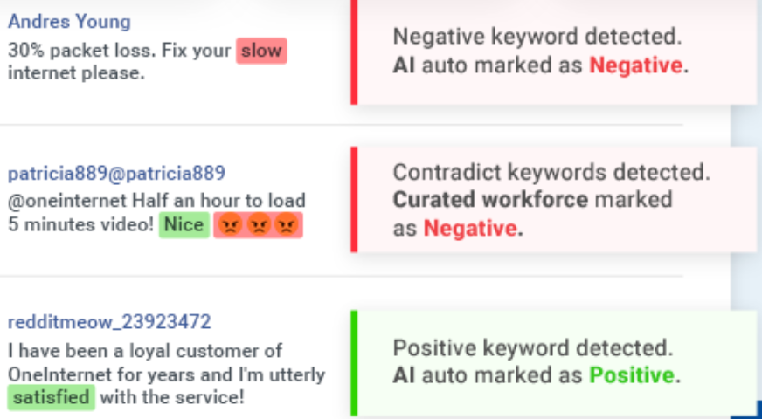

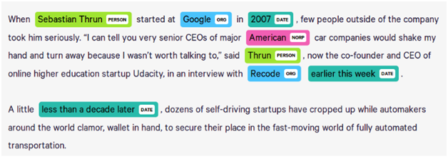
Natural Language Processing (NLP)
Sentiment Classification on Texts
Named Entity Recognition
Notes:
NLP is another application that requires substantial annotated data to build different applications.
Here are two examples of NLP tasks.
Sentiment analysis which is a natural language processing technique used to determine whether data is positive, negative or neutral.
It is often performed on textual data to help businesses monitor brand and product sentiment in customer feedback and understand customer needs.
Named entity recognition is a subtask of information extraction that seeks to locate and classify named entities mentioned in unstructured text into pre-defined categories such as person, organizations, time expressions, quantities, etc.
These two tasks needs labeled data shown with these two figures, respectively.

Slide 9
Quality Control for Data Annotation
Calculating the accuracy of an annotator compared to ground-truth data.
Calculating the overall agreement and reliability of a dataset.
Measuring inter-annotator agreement on a per-task basis to generate a confidence score for each training data label.
Designing architectures that incorporate subject matter experts into the annotation workflow.
Breaking up a task into simpler subtasks to improve accuracy, efficiency and quality control.
Source: https://livebook.manning.com/book/human-in-the-loop-machine-learning/chapter-8/v-8/1
Notes:
After completing data annotation, then the annotation quality is evaluated.
This is achieved through the following steps.
Calculating the accuracy of an annotator compared to ground-truth data.
Calculating the overall agreement and reliability of a dataset.
Measuring inter-annotator agreement on a per-task basis to generate a confidence score for each training data label.
Designing architectures that incorporate subject matter experts into the annotation workflow.
Breaking up a task into simpler subtasks to improve accuracy, efficiency and quality control.

Slide 10
Data Quality (DQ)
Data quality refers to the state of qualitative or quantitative pieces of information.
Data is of high quality if it is “Fit for Use” in their intended operational, decision-making and other roles.
Quality Properties
Relevance – does data meet basic needs?
Accuracy – are key data elements correct?
Timeliness – is data current?
Source: https://www.researchgate.net/profile/William_Winkler/publication/220695391_Data_Quality_and_Record_Linkage/links/551be3a90cf20d5fbde21e93.pdf
Notes:
Data quality refers to the state of qualitative or quantitative pieces of information.
Data is of high quality if it is “Fit for Use” in their intended operational, decision-making and other roles.
There are some quality properties which includes:
Relevance: several facets are important to the relevance of the data analysts’ use of data.
Does the data meet the basic needs for which they were collected, placed in a database, and used?
Accuracy:
Which customers will buy certain products in a grocery store? Which customers bought products (1) this week, (2) 12 months ago, and (3) 24 months ago?
Timeliness
How current do public opinion polls need to be to accurately predict election results?

Slide 11
Data Quality (DQ)
Data quality refers to the state of qualitative or quantitative pieces of information.
Data is of high quality if it is “Fit for Use” in their intended operational, decision-making and other roles.
Quality Properties
Comparability
  Can several databases be combined into a data warehouse?
Completeness
  No missing records, no missing data elements
Source: https://www.researchgate.net/profile/William_Winkler/publication/220695391_Data_Quality_and_Record_Linkage/links/551be3a90cf20d5fbde21e93.pdf
Notes:
Comparability
Can several databases be combined into a data warehouse?
Is it appropriate to combine several databases into a data warehouse to facilitate the data’s use in (1) exploratory analyses, (2) modeling, or (3) statistical estimation?
Completeness
No missing records, no missing data elements
In the survey sampling literature, entire missing records are known as unit non-response and missing items are referred to as item non-response. Both unit non-response and item non-response can indicate lack of quality. In many databases such as financial databases, missing entire records can have disastrous consequences. When such problems arise, the processes that create the database must be examined to determine whether (1) certain individuals need additional training in use of the software, (2) the software is not sufficiently user-friendly and responsive, or (3) certain procedures for updating the database are insufficient or in error.

Slide 12
Why Care About Data Quality?
High-quality data can be a major business asset, a unique source of competitive advantage.
Poor data quality can lower customer satisfaction.
Poor data quality can lower employee job satisfaction too, leading to excessive turnover and the resulting loss of key process knowledge.
Poor data quality can also breed organizational mistrust and make it hard to mount efforts that lead to needed improvements.
Source: https://www.researchgate.net/profile/William_Winkler/publication/220695391_Data_Quality_and_Record_Linkage/links/551be3a90cf20d5fbde21e93.pdf
Notes:
Reasons to control data quality are presented on this slide.
High-quality data can be a major business asset, a unique source of competitive advantage.
Poor data quality can lower customer satisfaction.
Poor data quality can lower employee job satisfaction too, leading to excessive turnover and the resulting loss of key process knowledge.
Poor data quality can also breed organizational mistrust and make it hard to mount efforts that lead to needed improvements.

Slide 13
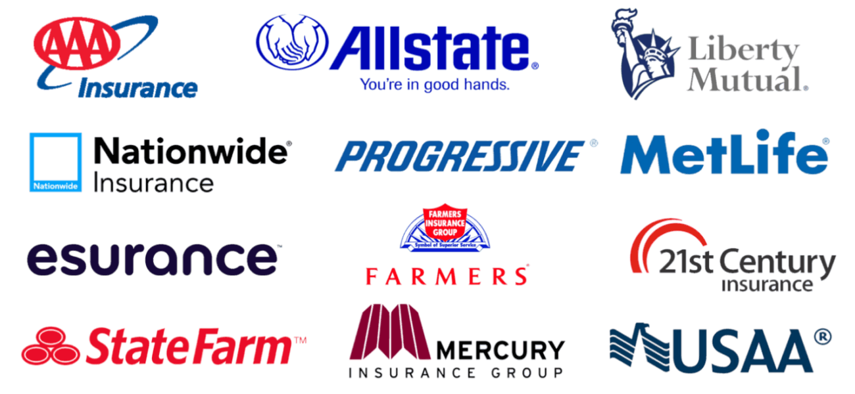
An Example
Insurance companies need accurate and complete databases in order to:
Accomplish Mandated Accounting Tasks
Compute Insurance-in-force
Compute Claim Rates
Calculate Premiums
Construct Models to Predict Future Results
Source: https://redrockslocksmith.com/do-insurance-companies-cover-car-lockouts/
Notes:
An example of what the data quality should be for an application.
Insurance companies need accurate and complete databases in order to:
Accomplish Mandated Accounting Tasks
Compute Insurance-in-force
Compute Claim Rates
Calculate Premiums
Construct Models to Predict Future Results

Slide 14
How Do You Obtain High-Quality Data?
Prevention: Keep Bad Data Out of the Database/List
Detection: Proactively Look for Bad Data Already Entered
Repair: Let the Bad Data Find You and Then Fix Things
Allocating Resources: How Much for Prevention, Detection, and Repair
Source: http://content.schweitzer-online.de/static/catalog_manager/live/media_files/representation/zd_std_orig__zd_schw_orig/001/813/790/9780387695020_content_pdf_1.pdf
Notes:
The following processes is used to ensure that high-quality data is obtained:
Prevention: Ensure that all data entering the database/list are of high quality.
Detection: the data analyst needs to proactively look for data quality problems and then correct the problems.
Repair: the worst approach is to wait for data quality problems to surface on their own.
Allocating Resources: the question arises as to how best to allocate the limited resources available for a sample survey and an analytical study.
The typical mix of resources devoted to these three activities in the United States tends to be on the order of: Prevent: 10% Detect: 30% Repair: 60%.
Strongly suggests that a more cost-effective strategy is to devote a larger proportion of the available resources to preventing bad data from getting into the system and less to detecting and repairing (i.e., correcting) erroneous data. It is usually less expensive to find and correct errors early in the process than it is in the later stages. A much better mix of resources would be Prevent: 45% Detect: 30% Repair: 25%.

Slide 15
DLI Accelerated Data Science Teaching Kit
Thank You

