Slide 1
Lecture 2.5 - SQLite as Simple, Effective Storage
DLI Accelerated Data Science Teaching Kit

Slide 2

The Accelerated Data Science Teaching Kit is licensed by NVIDIA, Georgia Institute of Technology, and Prairie View A&M University under the
Creative Commons Attribution-NonCommercial 4.0 International License.

Slide 3
Data Storage
How to store the data?
What’s the easiest way?

Slide 4
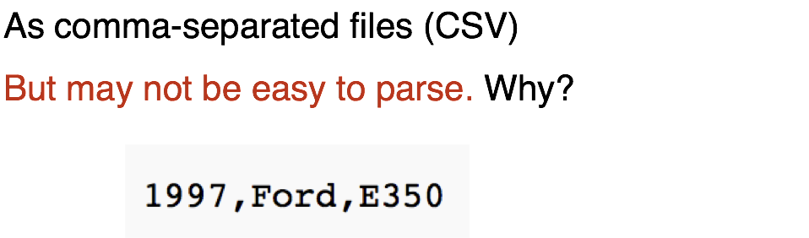
Easiest Way to Store Data

Slide 5
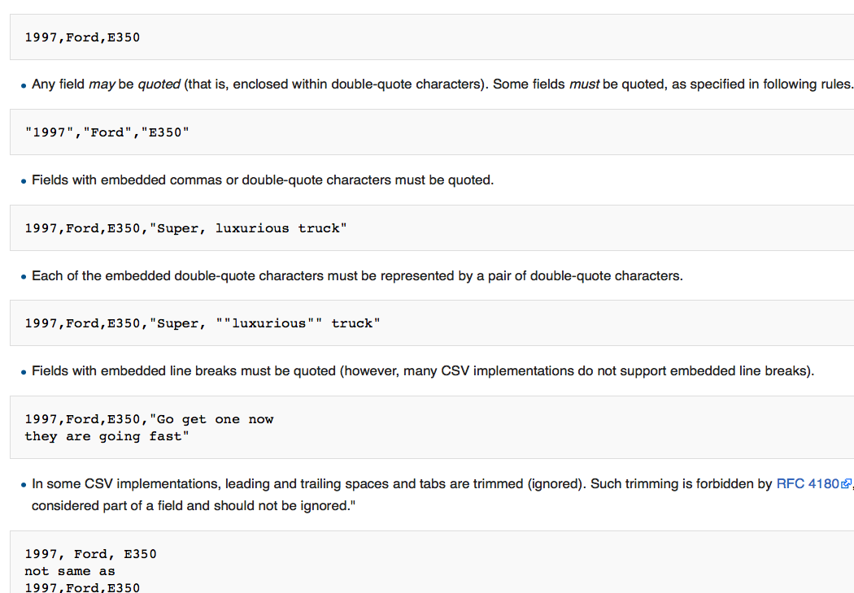
Easiest Way to Store Data
Retrieved: https://en.wikipedia.org/wiki/Comma-separated_values

Slide 6
Retrieved: www.sqlite.org

Slide 7
DLI Accelerated Data Science Teaching Kit
Thank You

