Slide 1
Lecture 2.6 - SQL Refresher
DLI Accelerated Data Science Teaching Kit

Slide 2

The Accelerated Data Science Teaching Kit is licensed by NVIDIA, Georgia Institute of Technology, and Prairie View A&M University under the
Creative Commons Attribution-NonCommercial 4.0 International License.

Slide 3
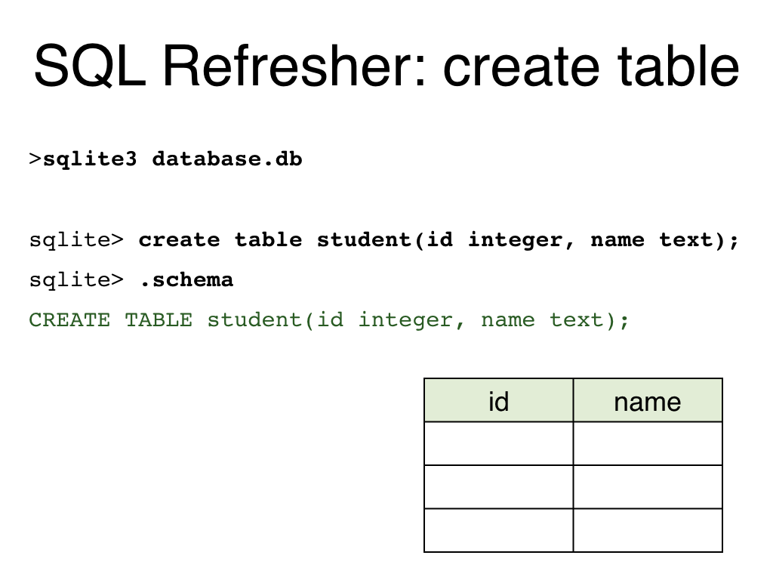

Slide 4
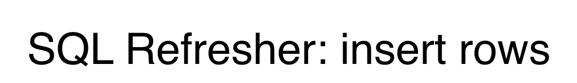
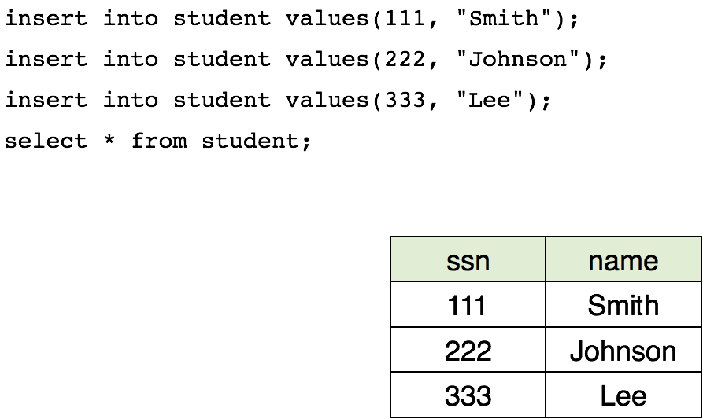

Slide 5
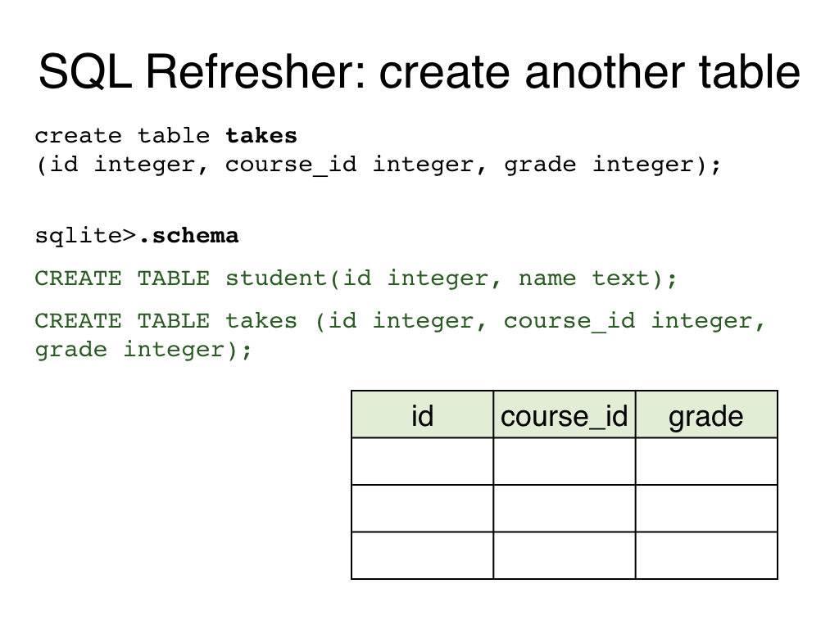

Slide 6
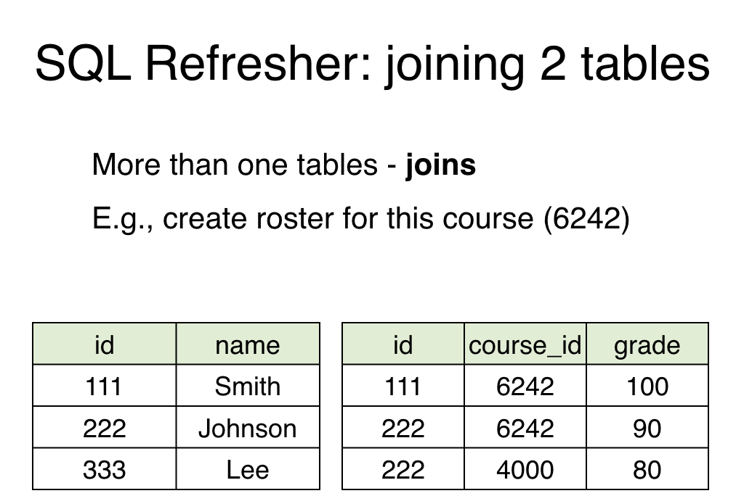

Slide 7
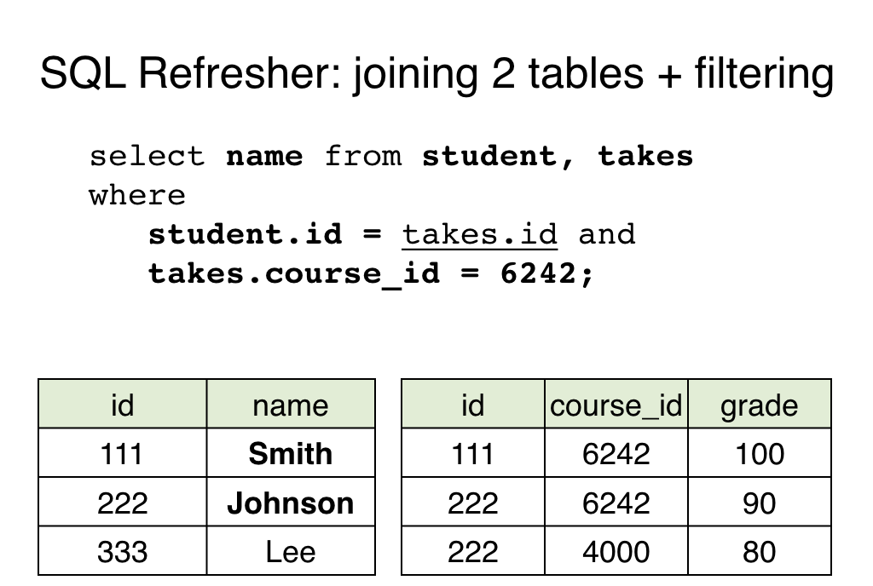

Slide 8
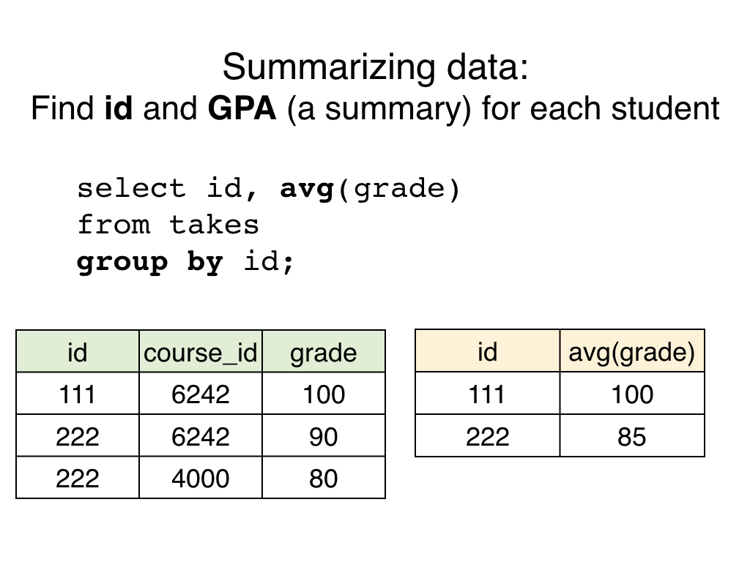

Slide 9
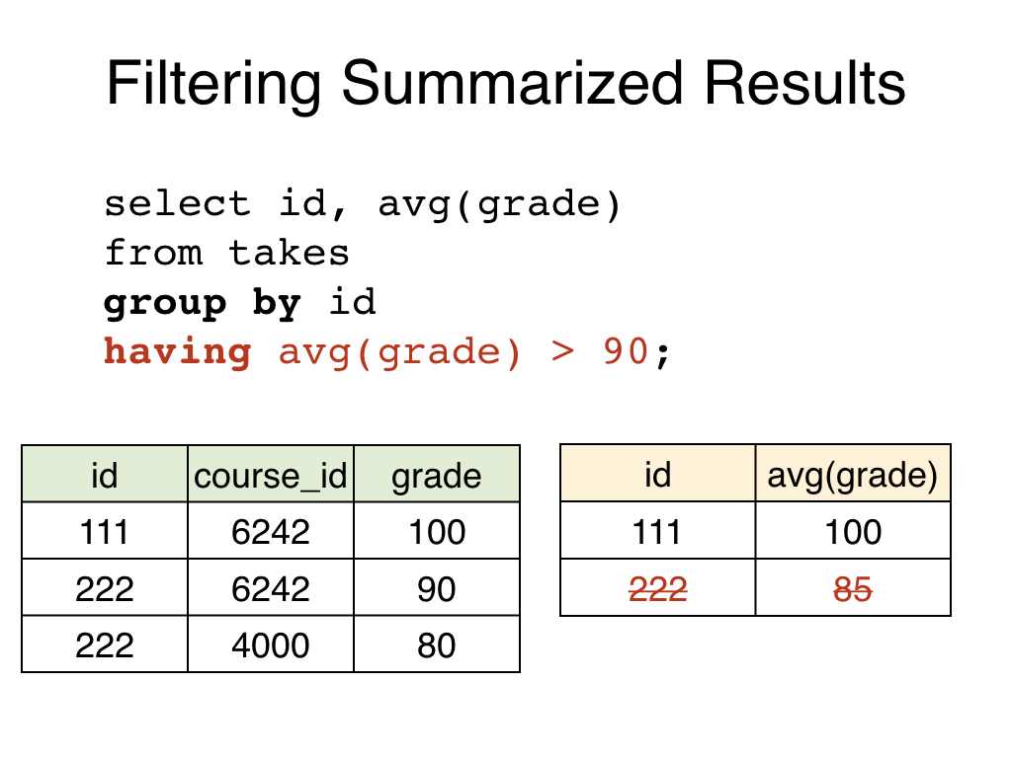

Slide 10
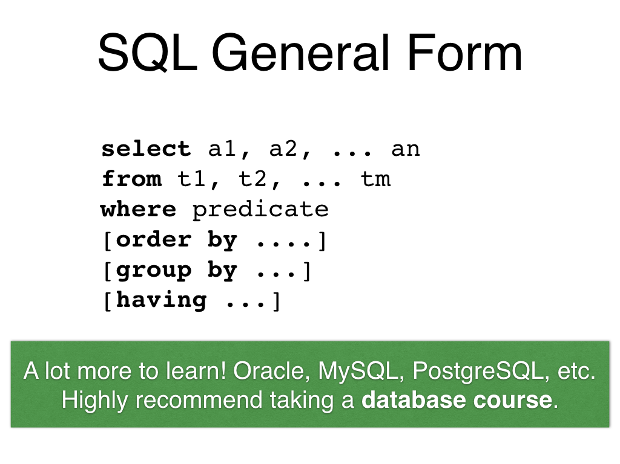

Slide 11
DLI Accelerated Data Science Teaching Kit
Thank You

