Slide 1
Lecture 21.1 – GPU Accelerating Your Workflows
DLI Accelerated Data Science Teaching Kit

Slide 2

The Accelerated Data Science Teaching Kit is licensed by NVIDIA, Georgia Institute of Technology, and Prairie View A&M University under the
Creative Commons Attribution-NonCommercial 4.0 International License.

Slide 3
Challenges with Applying Data Science in Industry Today
Performance bottlenecks limit user productivity
Data continues to explode
Add missing feature
12
Configure Data Prep Workflow
Restart Data Prep Workflow
9
😖
3
Data Volume in Zetabytes
Fix Unexpected Null Values Stored as String…
Dataset Downloads Overnight
6
Restart Data Prep Workflow Again
Finally Start Developing First Model…
Stay Late
TYPICAL DATA SCIENCE WORKFLOW
Source: IDC, Revelations in the Global DataSphere, US49346123, July 2023
Waiting
Building
Notes:
1. Performance bottlenecks limit user productivity
- Traditional CPU-powered workflows present numerous bottlenecks in data science operations.
- This forced data scientists to spend a lot of their days waiting…
2. Data continues to explode
Enterprise applications have become increasingly demanding. As the world digitizes, the amount of data processed by these applications has skyrocketed. From personalized recommendations that see over 1 billion visits to e-commerce sites daily, to large-scale language models like GPT-4 that required 13 trillion tokens for training. From forecasting hundreds of millions to 1 billion product-store combinations weekly at Walmart, to detecting fraud in the 1.9 billion credit card transactions per day nationwide. Looking ahead, this upwards trajectory is slated to continue across use cases – genomics as a field is estimated to generate between 2-40 exabytes of data within the next decade, while the domain of cybersecurity witnessed a 50% increase in cyberattacks in 2021 alone. The demand is insatiable
Source: IDC, Revelations in the Global DataSphere, US49346123, July 2023”
IDC is expecting to see 9x growth in datasize between 2017 to 2027 – from 31.6 ZB to 291.1 ZB
Factoids to support data growth for above use cases:
Recommenders: 1B visits/day to e-commerce sites
LLMs: 13T tokens to train GPT 4 per Semianalysis | 570 GB of data trained GPT 3 (https://arxiv.org/pdf/2005.14165.pdf)
Forecasting: Walmart forecasts hundreds of millions to 1 billion product-store combinations weekly https://www.datanami.com/2019/03/22/how-walmart-uses-gpus-for-better-demand-forecasting/
Fraud Detection: 1.9B/day credit card transactions natiowide (CapitalOne)
Genomic Analysis: genomics research will generate between 2 and 40 exabytes of data within the next decade (NIH, 2021/3)
Cybersecurity: Cyber attacks increased by 50% in 2021, IDC

Slide 4
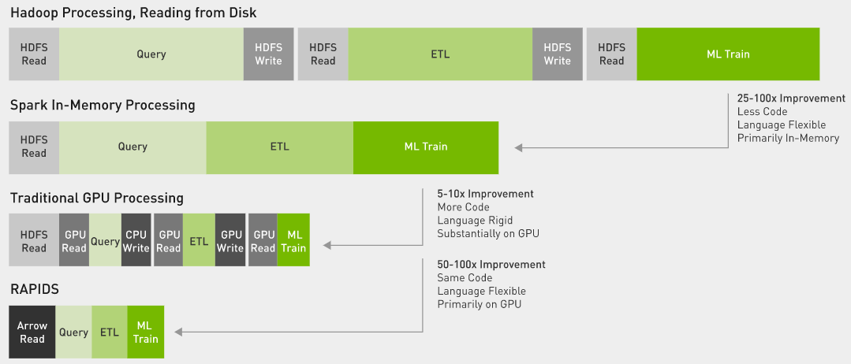
Brief History on Data Processing Tools
Data processing evolution
Overview of data processing with different frameworks
Image credit: NVIDIA

Slide 5
Accelerated Data Science
Less waiting, more building
Add missing feature
Train Model
Validate
12
Start
12
Test Model
Restart Data Prep Workflow
Experiment with Optimizations and
Repeat
Configure Data Prep Workflow
9
😖
3
9
😌
3
Fix Unexpected Null Values Stored as String…
Finally Start Developing First Model…
Dataset Downloads Overnight
6
Restart Data Prep Workflow Again
Dataset Downloads Overnight
6
Stay Late
Go Home on Time
CPU WORKFLOW
ACCELERATED COMPUTING
WORKFLOW
Waiting
Building
Notes:
Traditional CPU-powered workflows present numerous bottlenecks in data science operations.
In contrast, GPU-powered workflows streamline the process, from dataset collection to inference, enabling data scientists to efficiently train, validate, and iterate their models.

Slide 6


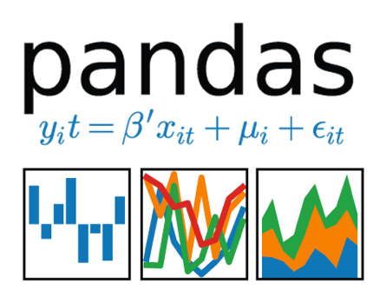




RAPIDS Libraries Accelerate Data Science Pipelines End-to-End
The Platform
Data Preparation
Model Training
Visualization
Dask
cuDF cuIO
Analytics
cuML
Machine Learning
cuGraph
Graph Analytics
cuVS
Vector Search
cuSpatial
Spatial Analytics
PyTorch, TensorFlow, MxNet
Deep Learning
cuxfilter, pyViz, plotly
Visualization
API Familiarity with CPU based PyData tools
GPU Memory
Notes:
Light Intro to RAPIDS
Let’s first start out on what is RAPIDS

Slide 7
NVIDIA Accelerated Data Science Stack
DEPLOYMENT KUBERNETES | DOCKER | NGC | SLURM | TRITON
DATA ENGINEERING DATA ANALYTICS | MACHINE LEARNING | STREAMING | VISUALIZATION
DEEP LEARNING FRAMEWORKS | STREAMING | TRANSFER LEARNING | TENSORRT
DATA PROCESSING
DASK
SQL | DATAFRAMES | STREAMING
SPARK
SQL | DATAFRAMES
MEDIA PROCESSING
LOADING | AUGMENTATION
RAPIDS
LINEAR ALGEBRA | DATAFRAMES | GRAPH | SPATIAL | VECTOR SEARCH | EVENT STREAMS | SIGNAL PROCESSING | VISUALIZATION | NEURAL NETWORKS
NVIDIA MAGNUM IO TRANSPORT PROTOCOL | SYSTEM INTERCONNECT | NETWORK TOPOLOGY | STORAGE | FILE SYSTEMS
HARDWARE
WORKSTATION | DATA CENTER | EDGE | IOT | CLOUD | VIRTUAL
Notes:
The NVIDIA Data Science Platform runs on any NVIDIA GPUs, within any of these hardware footprints. It is incredibly important because it provides flexibility to move data science projects between different environments, at any point the user requires.
Magnum IO is the collective name for all of the foundational IO capabilities. This includes networking protocols and things like GPU Direct Storage.​
CUDA-X then provides the primary implementations of algorithms to drive the data science use cases above.​
We then place the data processing layer on top of that. This is where we provide distributed processing frameworks like DASK and Spark as well as our data loading and augmentation libraries for media such as audio, video (DALI) and radio.​
Importantly, In the next layer we have both Data Engineering and Deep Learning. ​
Data Engineering is driven by the RAPIDS project. Here we support tasks like (cuDF, cuPy, Numba) ETL, Data Preparation, Cleansing, Normalization, Machine Learning libraries (cuML, cuGraph, cuSpatial) like XGBoost, Stream Processing for real-time and near real-time workflows and visualization.​
On the Deep Learning side video streaming and optimization tools provide flexible and efficient capabilities, and a variety of deep learning framework like PyTorch and Tensorflow are available and supported.​
Also of note in this layer is that pipelines can certainly be created moving from the data engineering workloads directly to the deep learning workload without having to take the data out of the GPU memory.​
​
Next is the deployment layer. This covers orchestration and container technologies as well as deployment repositories and inferencing in production.​

Slide 8
Benefits of RAPIDS
Easy integration and familiarity
Easy end-to-end accelerated analytics using GPUs
Connecting data practitioners to High Performance Computing
Familiar syntax for most data scientists
Integrated with several data science frameworks like Apache Spark, Numba, etc. along with Deep Learning frameworks like Pytorch, Tensorflow, etc.
Overcomes communication bottlenecks with the use of frameworks like UCX-py

Slide 9
Benefits of RAPIDS
Run anywhere at scale
Great scalability: a single workstation to multi-GPU servers to multi-node clusters
Provides a platform to scale up and out with the help of other libraries like Dask
Run anywhere: Cloud or on-premise environment
Faster data access with less data movement
Bridging the gap between compute resources and existing frameworks

Slide 10
Speed Comparison
Introduction
Data exploration is a vital part of Data Science Workflows:
Understanding, cleaning, manipulating data
Consistent data types, formats and filling in gaps
Reiterating to add features
Pandas: Functions developed with vectorized operations for top-speed computations
But they are CPU-constrained, therefore, tasks are very time consuming
RAPIDS: Much faster Extract, Transform and Load (ETL) tasks

Slide 11
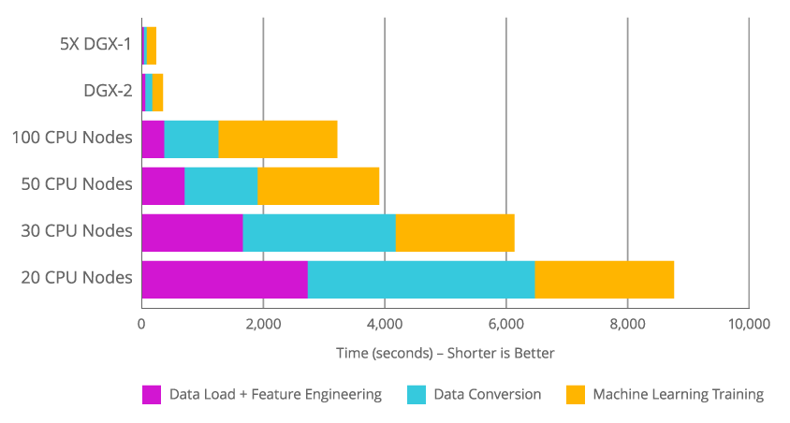
Speed Comparison
Example: Fannie Mae loan performance Dataset: 400 GB data in memory
Results for a complete ETL (manipulating DataFrames and training a gradient boosted decision tree model on the GPU using XGBoost)​
Image credit: NVIDIA

Slide 12
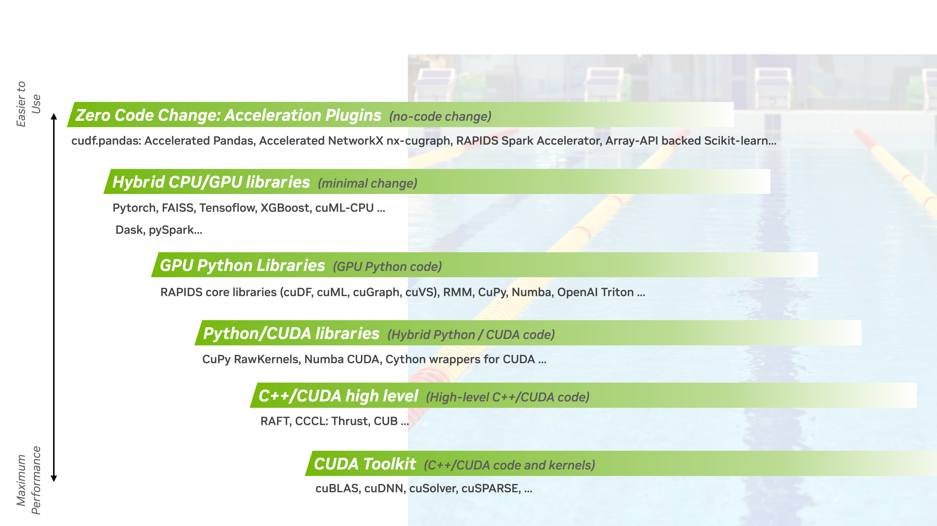
There are 3 levels to access this acceleration
1.
pandas and Polars accelerated with cuDF, NetworkX accelerated by cuGraph, RAPIDS Accelerator for Apache Spark...
2.
RAPIDS core libraries (cuDF, cuML, cuGraph, cuVS), RMM, CuPy, Numba, OpenAI Triton
3.

Slide 13
The GPU Accelerated Data Science Stack
Data Science and AI Applications
Apache Spark Stack
Python Data Stack
1.
RAPIDS Accelerator for Apache Spark
Zero Code Change Accelerators
Distributed Computing with Dask
DataFrames
SQL
ML
Pandas
Polars
XGBoost
NetworkX
DataFrames
ML
Graph
RAPIDS GPU Python and C++ Libraries
2.
DataFrames
cuDF
ML
cuML
Graph
cuGraph
Spatial
cuSpatial
Vector Search
cuVS
3.
CUDA
Hardware
Workstation | Data Center | Cloud
Notes:
Ditch the outlines

Slide 14
1. Intro to Zero-Code-Change

Slide 15
Zero Code Change Acceleration....But Why?
Popular libraries are hard to switch-
Familiarity
Availability of tooling
Alternatives requiring changes to preexisting code
Same code for both CPU and GPU env -
Developing on local machines with CPU
Deploying on cloud (Spot Instances / EC2) with GPU access
Not the whole code needs to run on GPU-
Memory Hungry tasks like I/O on CPU
Compute Hungry tasks like feature engineering, model training on GPU

Slide 16

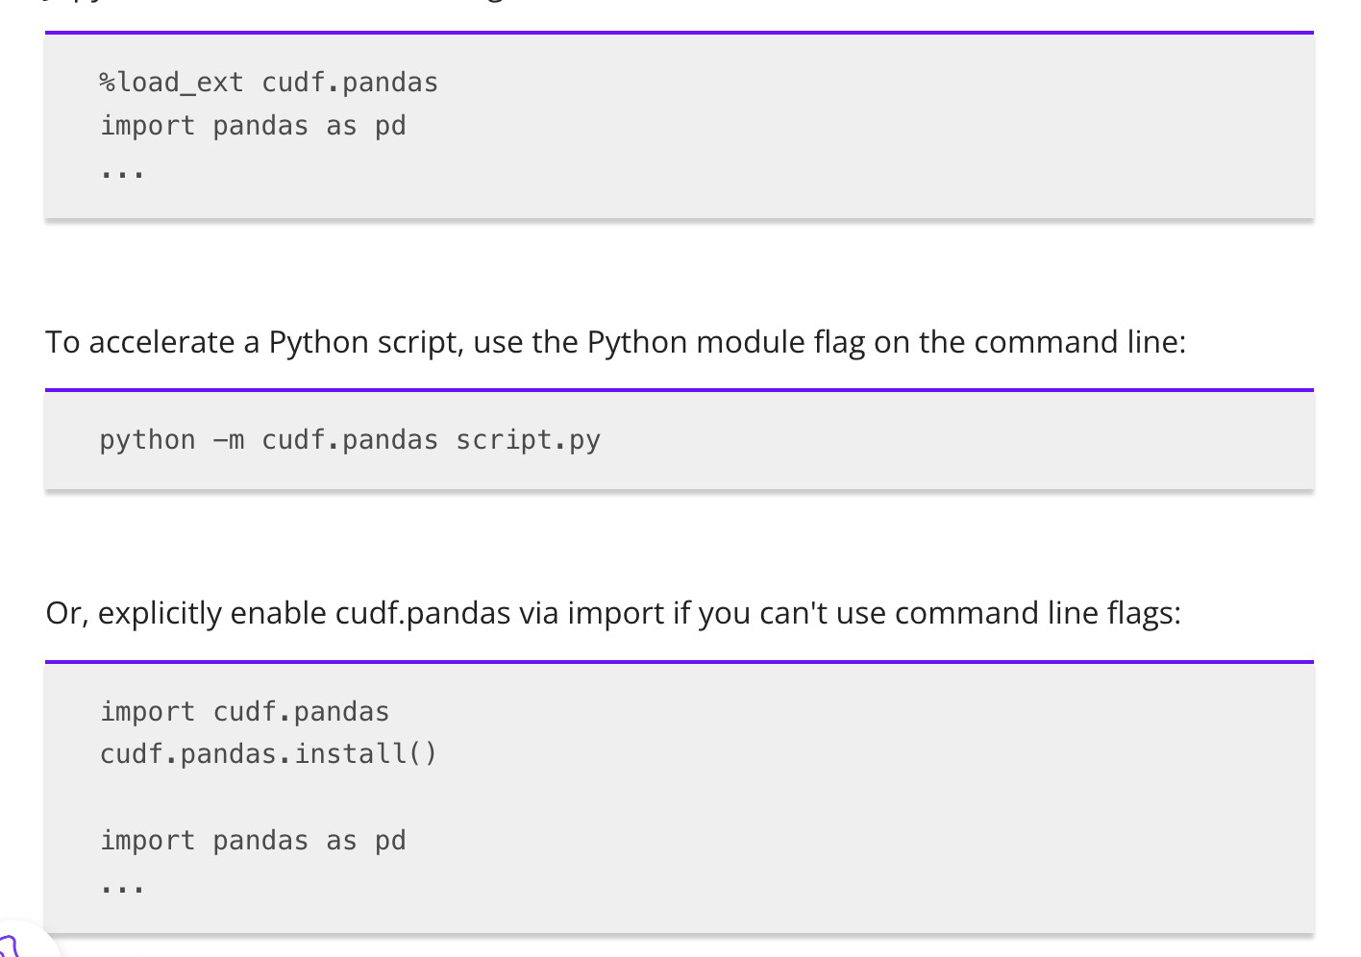

GPU accelerator for pandas powered by RAPIDS cuDF
Up to 50x speedup with zero code change
The cuDF.pandas software stack
Requires no changes to existing pandas code. Just:
cuDF.pandas
CPU-only
pandas
Accelerated DataFrames
RAPIDS cuDF
CUDA
Accelerates workflows up to 50x using the GPU
Compatible with code that uses third-party libraries
Integration tested with SciPy, scikit-learn, XGBoost, Matplotlib, seaborn, HoloViews, PyTorch, TensorFlow, …

Slide 17
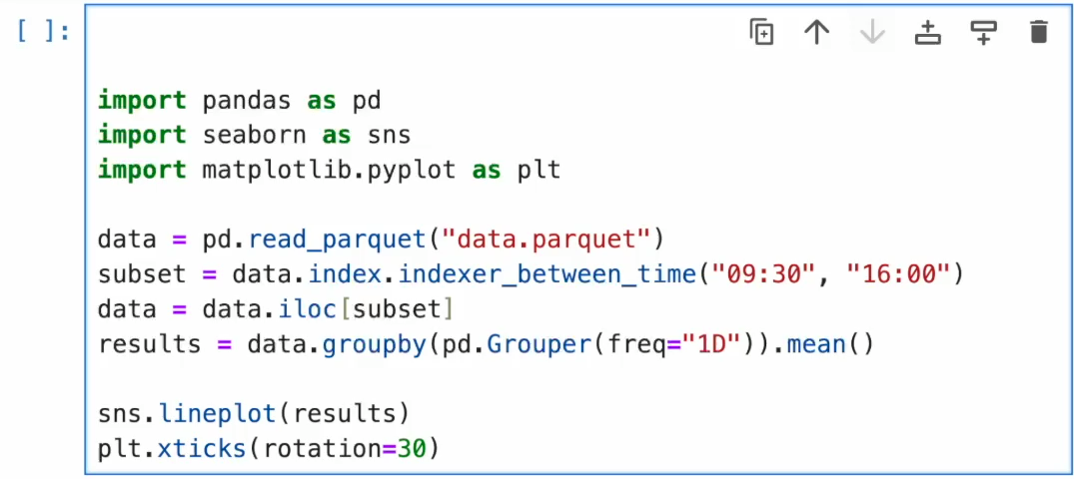
GPU accelerator for pandas powered by RAPIDS cuDF
How it works
Requires no changes to existing pandas code. Just
%load_ext cudf.pandas
$ python –m cudf.pandas <script.py>
Load cudf.pandas
Your Code
Third-Party Libraries Using Pandas
You call function
If data on CPU
Copy to GPU
Try cuDF Function
If GPU execution fails
If copy fails
Copy to CPU
Call pandas Function
Result
Demonstration video

Slide 18
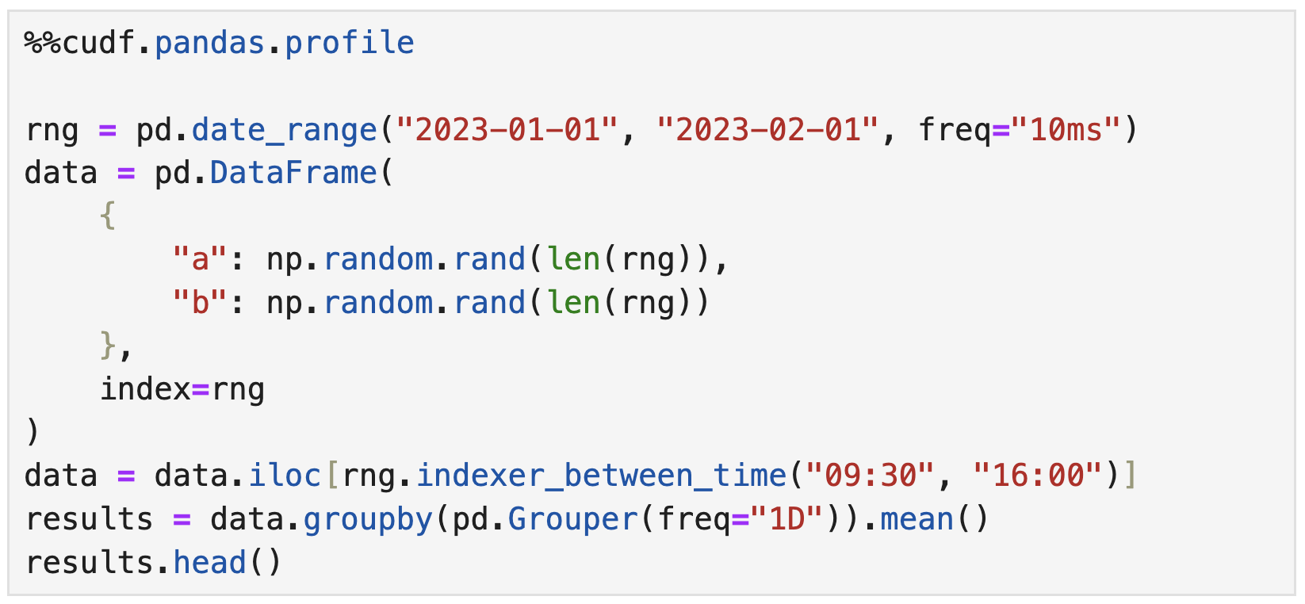
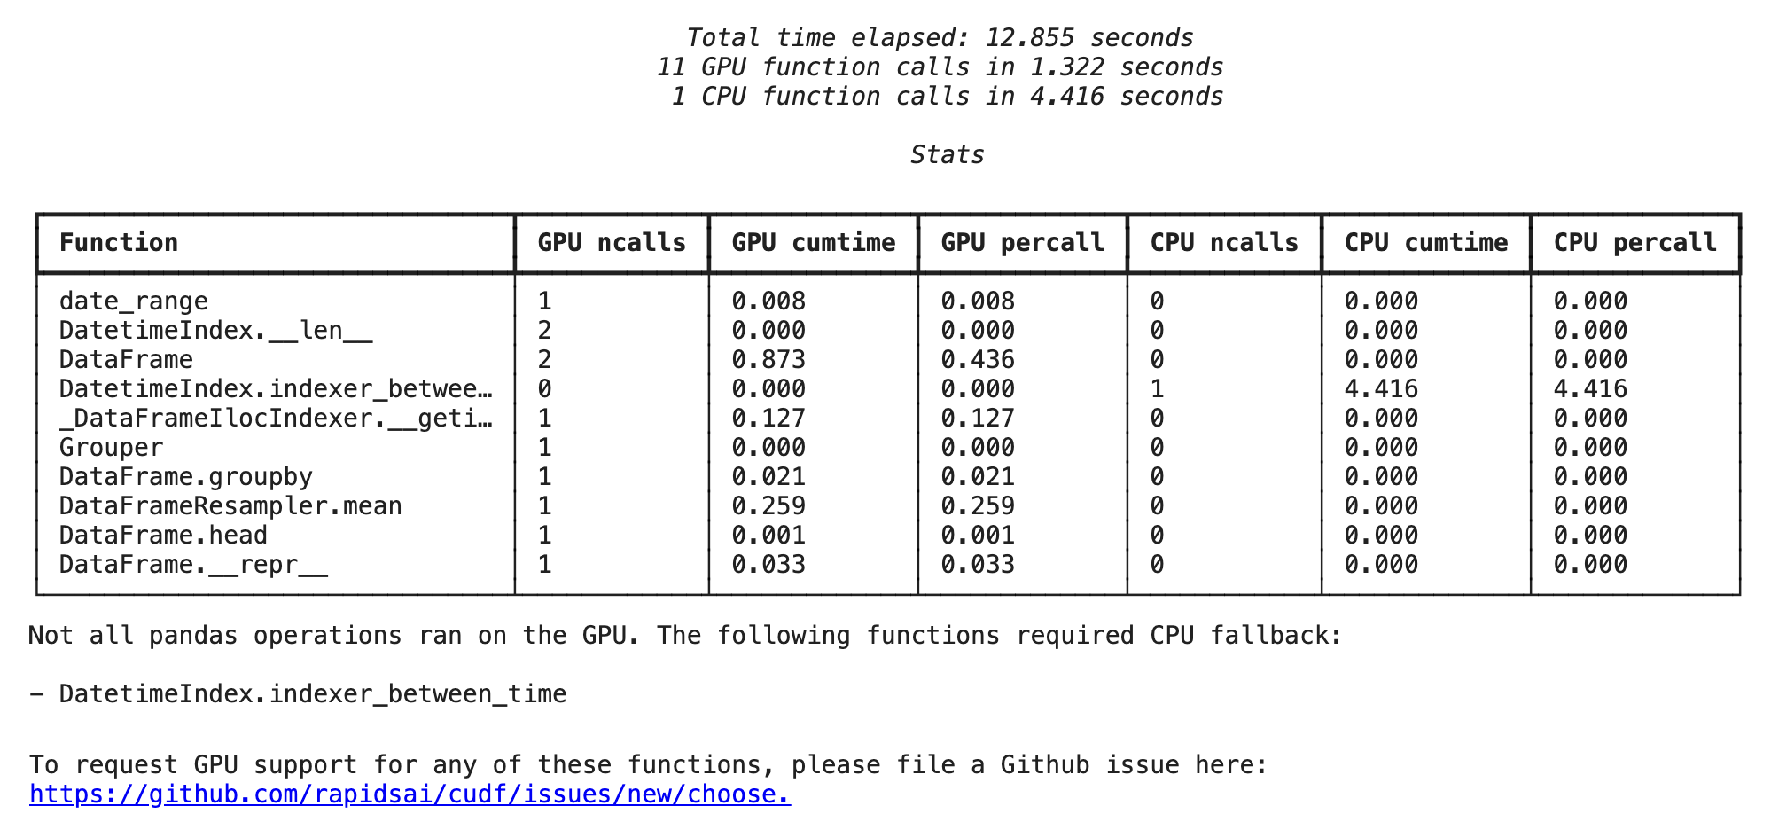
cuDF.Pandas can profile your code to optimize how it runs on both CPU and GPU
Use the %%cudf.pandas.profile cell magic in Jupyter, or import it directly:
Shows which functions ran on the CPU and which ran on the GPU
from cudf.pandas import Profiler
with Profiler() as p:
# code goes here
p.print_per_function_stats()

Slide 19
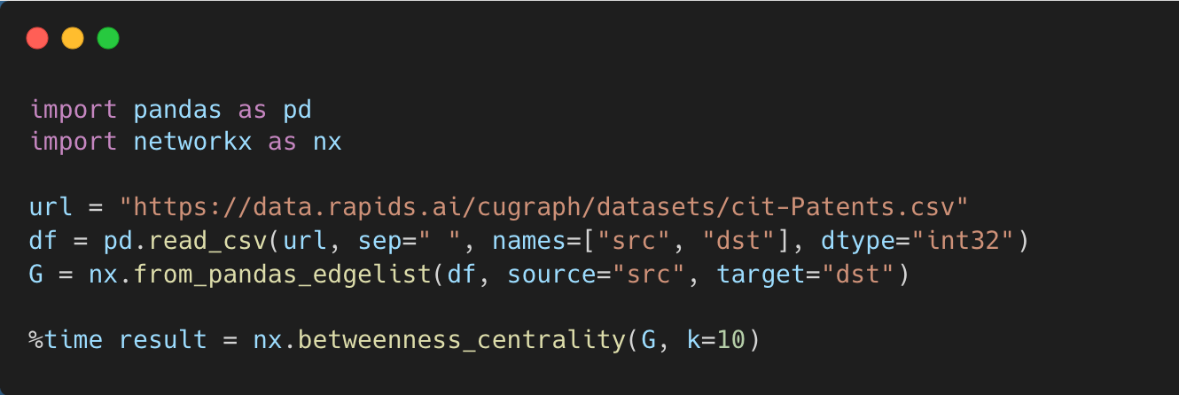
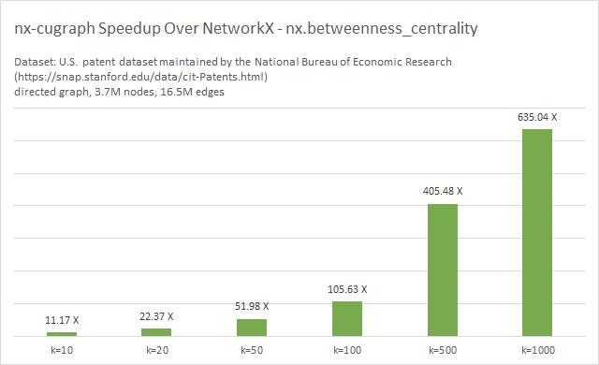
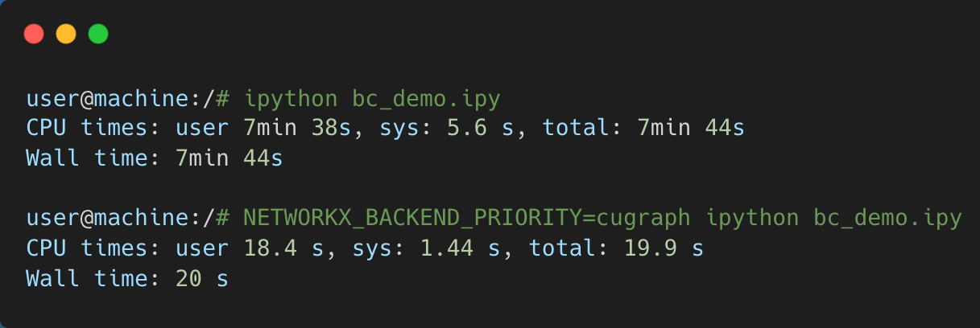
NetworkX accelerated by RAPIDS cuGraph
Zero-code-change GPU-acceleration for NetworkX code
Accelerates up to 600x depending on algorithm and graph size
Support for 60 popular graph algorithms and growing
Fallback to CPU for any unsupported algorithms
NetworkX 3.2, CPU: Intel(R) Xeon(R) Platinum 8480CL 2TB, GPU: NVIDIA H100 80GB

Slide 20
NeworkX accelerated by RAPIDS cuGraph
How it works
Import networkx
nx-cugraph is a GPU backend for NetworkX
What’s a NetworkX backend?
NetworkX added the ability to dispatch various function calls to third-party backends, starting in NetworkX 3.0
Backends provide an alternate implementation for NetworkX to call
Allows users to run implementations optimized for their environment without changing their code – the NetworkX “frontend” remains the same
Multiple backends can be used together:
Ex. Access a graph in a remote graph database using a database backend, run algorithms on GPU using the nx-cugraph backend
NETWORKX_BACKEND_PRIORITY=cugraph, some_other_backend
NetworkX loads enabled backends
You call a NetworkX function
NetworkX: can any enabled backend run this function?
Yes
User-defined priority order
NO
Run default NetworkX implementation
nx-cugraph
Some other backend
Lookup cached graph or convert to GPU
Run function on GPU
Result

Slide 21
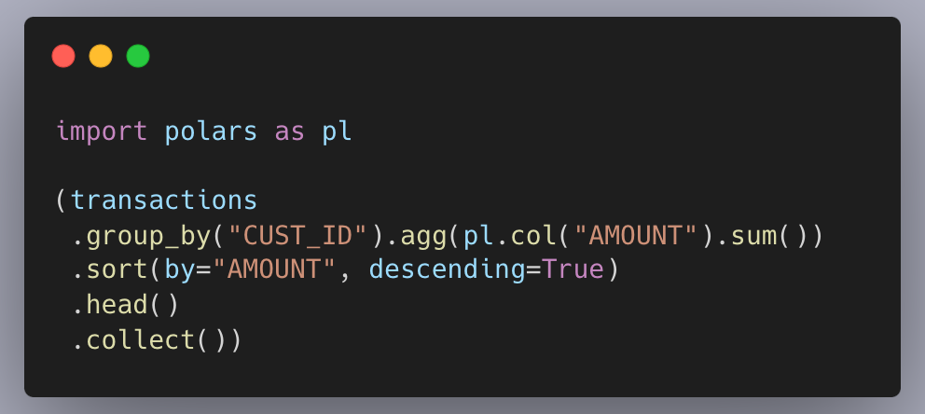
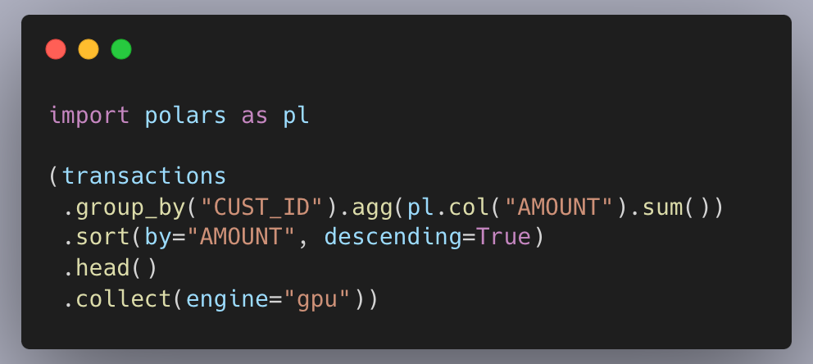
Polars GPU engine powered by RAPIDS cuDF
Process 100s of millions of rows in seconds
Delivers fastest performance for Polars applications, 13x on NVIDIA GPUs​ vs CPUs ​
Zero code change – simply set engine=“gpu” in the collect operation​ ​​
Compatible with the ecosystem of tools built for Polars​ ​
Graceful CPU fallback for unsupported queries
PDS-H benchmark | GPU: NVIDIA H100 PCIe | CPU: Intel Xeon W9-3495X (Sapphire Rapids) | Storage: Local NVMe​

Slide 22
Polars GPU engine powered by RAPIDS cuDF
How it works
.collect()
.collect(engine=“gpu”)
Domain Specific Language (DSL)
Domain Specific Language (DSL)
Tree of operation names
Tree of operation names
Intermediate Representation (IR)
Intermediate Representation (IR)
- Directed Acyclic Graph of operations
- Metadata
- Schema’s
- Resolved names
- Directed Acyclic Graph of operations
- Metadata
- Schema’s
- Resolved names
Optimizer
Optimizer
Optimized IR
Optimized IR
cuDF callback
(Partial) accelerated IR
Polars in-memory engine
Polars in-memory engine
CPU
GPU
CPU

Slide 23
DLI Accelerated Data Science Teaching Kit
Thank You

