Slide 1
Lecture 21.2 - Refactoring Workloads
DLI Accelerated Data Science Teaching Kit

Slide 2

The Accelerated Data Science Teaching Kit is licensed by NVIDIA, Georgia Institute of Technology, and Prairie View A&M University under the
Creative Commons Attribution-NonCommercial 4.0 International License.

Slide 3
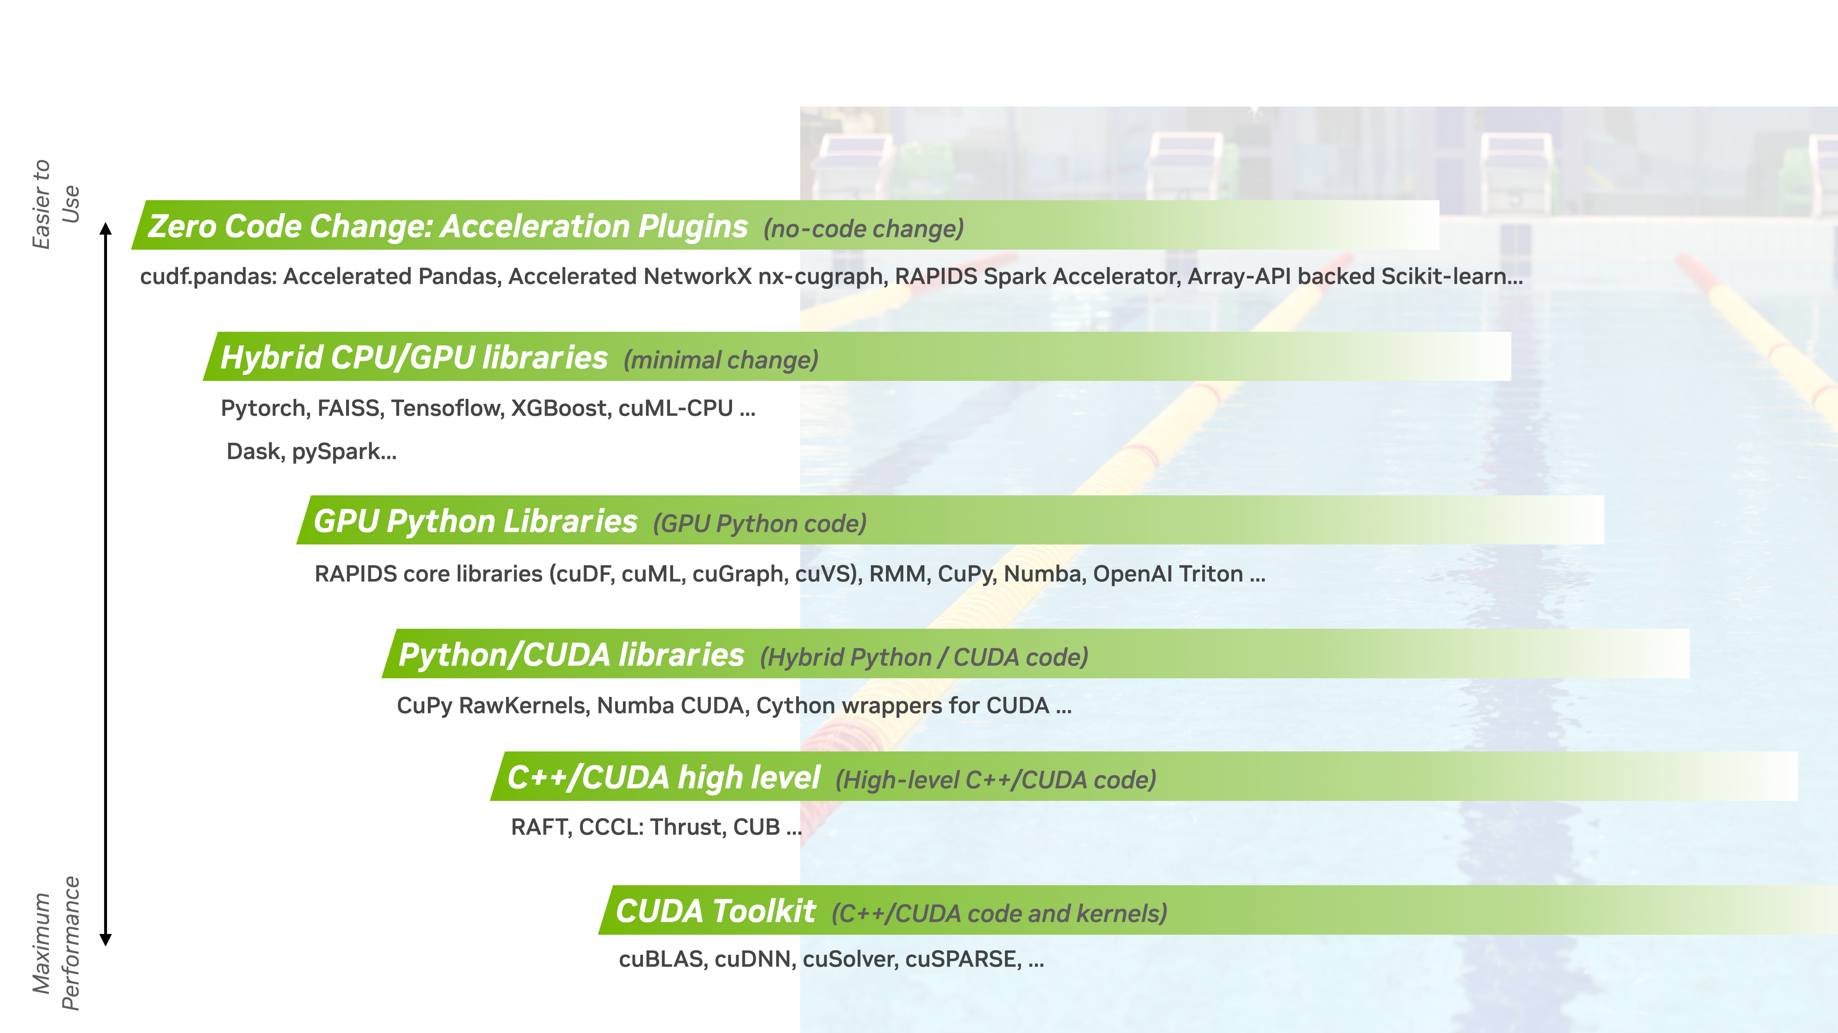
As we covered before… There are 3 levels to access this acceleration
1.
pandas and Polars accelerated with cuDF, NetworkX accelerated by cuGraph, RAPIDS Accelerator for Apache Spark...
2.
RAPIDS core libraries (cuDF, cuML, cuGraph, cuVS), RMM, CuPy, Numba, OpenAI Triton
3.

Slide 4
The GPU Accelerated Data Science Stack
Data Science and AI Applications
Apache Spark Stack
Python Data Stack
1.
RAPIDS Accelerator for Apache Spark
Zero Code Change Accelerators
Distributed Computing with Dask
DataFrames
SQL
ML
Pandas
Polars
XGBoost
NetworkX
DataFrames
ML
Graph
RAPIDS GPU Python and C++ Libraries
2.
DataFrames
cuDF
ML
cuML
Graph
cuGraph
Spatial
cuSpatial
Vector Search
cuVS
3.
CUDA
Hardware
Workstation | Data Center | Cloud
Notes:
Ditch the outlines

Slide 5
The RAPIDS Library Generalized Technology Stack
Python
Cython
Algorithms
Prims
CUDA Libraries
CUDA

Slide 6
2. GPU Python Libraries

Slide 7
Overview of the RAPIDS GPU Library Python Stack
Python
cuDF
cuML
cuGraph Dask cuDF
Cython
Algorithms
Prims
CUDA Libraries
CUDA

Slide 8
Refactoring
CPU to GPU Data Science
Large amounts of existing code in PyData (Numpy, pandas, scikit-learn, etc.)
RAPIDS uses Pandas-like API
Very easy and straightforward
Simple changes in a few lines of code
Replace import statements
import pandas as pd import cudf
import numpy as np import cupy as cp
Use the new imports in place of previous libraries

Slide 9
Example 1
Pandas to cuDF
Use the cudf df like pandas df
Examples: sort_values, concat, merge, unique, std, iloc, groupby
import pandas as pd
df = pd.read_csv('df.csv’)
df1 = pd.read_csv(‘df1.csv’)
pd.concat([df, df1])
df.fillna(0)
df.head(10)
import cudf
df = cudf.read_csv('df.csv’)
df1 = cudf.read_csv(‘df1.csv’)
cudf.concat([df, df1])
df.fillna(0)
df.head(10)
Same output, but faster!

Slide 10
Example 2
Numpy to cuPY
Use the cupy array like numpy array
Examples: randint, arrange, zeros, shape, max, flatten, sort
import numpy as np
choices = range(6)
probs = np.random.rand(6)
s = sum(probs)
probs = [e / s for e in probs]
selected = np.random.choice(choices, 10000, p=probs)
print(selected.shape)
import cupy as cp
choices = range(6)
probs = cp.random.rand(6)
s = sum(probs)
probs = [e / s for e in probs]
selected = cp.random.choice(choices, 10000, p=probs)
print(selected.shape)
Same output, but faster!

Slide 11
Example 3
Scikit learn to cuML
cuML has similar capabilities as sklearn
Examples: train_test_split, SVC, KMeans, LinearRegression, LabelBinarizer, NearestNeighbors
from sklearn.linear_model import LinearRegression
from sklearn.model_selection import train_test_split
X_train, X-test, y_train, y_test = train_test_split(X, y, random_state =0)
model = LinearRegression()
model.fit(X_train, y)
y_pred = model.predict(X_test)
import cuml.LinearRegression
from cuml.preprocessing.model_selection import train_test_split
X_train, X-test, y_train, y_test = train_test_split(X, y, random_state =0)
model = cuml.LinearRegression()
model.fit(X_train, y)
y_pred = model.predict(X_test)
Same output, but faster!

Slide 12
3. C++/CUDA High Level

Slide 13
Overview of C++/CUDA High Level
Building Data Science Applications and Expanding the RAPIDS Python Libraries
Python
Target Users:
Application Developer
C++ Analytics Library
Cython
Algorithms
Prims
CUDA Libraries
CUDA

Slide 14
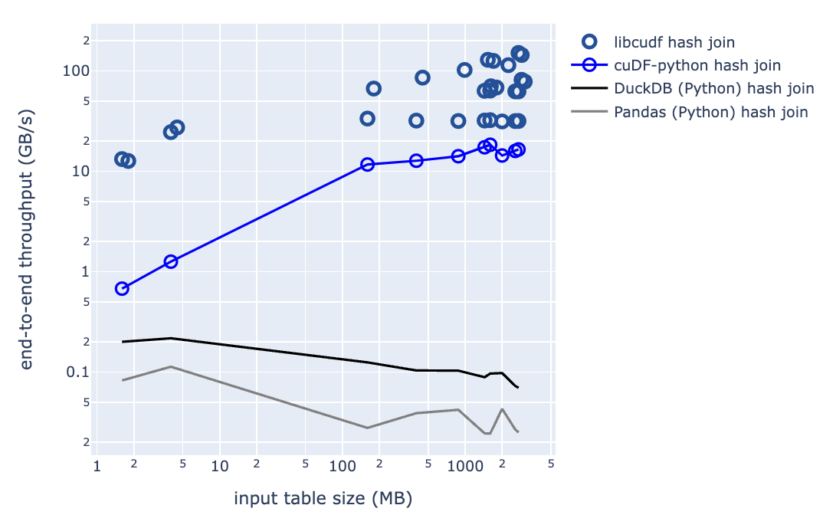
libcuDF Overview
The engine powering GPU-accelerated Apache Spark, Dask, and high-performance data analytics
libcudf is the CUDA/C++ framework for tabular data analysis
Data ingestion and parsing, joins, aggregations, filters, window functions, regular expressions, nested types, and more
Built on the Apache Arrow memory specification
Consistent C++17 RAII-based APIs
Fastest library for joins, aggregations, sorting, and more
Up to 10x faster than cuDF
Traditional and conditional joins
Nested-type sorting and aggregations
Explore: https://github.com/rapidsai/cudf/tree/branch-24.12/cpp/examples

Slide 15
cuML Technology Stack
https://github.com/rapidsai/cuml/tree/branch-24.12/cpp
Python
Dask cuDF
cuDF
NumPy
cuPy
Cython
cuML Algorithms
Thrust
Cub
cuSolver
nvGraph
CUTLASS
cuSparse
cuRand
cuBlas
cuML Prims
CUDA Libraries
CUDA
Explore: https://github.com/rapidsai/cuml/tree/branch-24.12/cpp/examples

Slide 16
cuGraph Technology Stack
https://github.com/rapidsai/cugraph/tree/branch-24.12/cpp
Python
Dask cuGraph Dask cuDF
cuDF
Numpy
Cython
cuGraph Algorithms
Prims
cuGraphBLAS
cuHornet
Thrust
Cub
cuSolver
cuSparse
cuRand
Gunrock*
CUDA Libraries
CUDA
Explore: https://github.com/rapidsai/cugraph/tree/branch-24.12/cpp/examples

Slide 17
DLI Accelerated Data Science Teaching Kit
Thank You

