Slide 1
Lecture 22.2 - Project Idea Checklist: Heilmeier Questions
DLI Accelerated Data Science Teaching Kit

Slide 2

The Accelerated Data Science Teaching Kit is licensed by NVIDIA, Georgia Institute of Technology, and Prairie View A&M University under the
Creative Commons Attribution-NonCommercial 4.0 International License.

Slide 3
How to Develop Great Project Ideas?
Recommendations
Work on something that you are excited about
(e.g., NetProbe for eBay fraud detection)
  Is it interesting? e.g., computationally? visualization-wise?
  Is it impactful? (e.g., save lives? fight crime? shorten commute? save resources?)
Work on something interestingly challenging, so you will learn more
Browse the list of datasets on course homepage

Slide 4
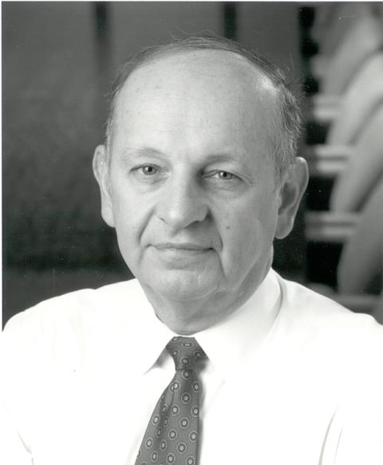
George Heilmeier
Former Director of DARPA
Retreived: https://en.wikipedia.org/wiki/George_H._Heilmeier

Slide 5
Heilmeier Questions
  Preflight checklist for successful projects
What are you trying to do? Articulate your objectives using absolutely no jargon.
How is it done today; what are the limits of current practice?
What's new in your approach; why it will be successful?
Who cares?
If you're successful, what difference and impact will it make? How do you measure them (e.g., via user studies, groundtruth data)?
What are the risks and payoffs?
How much will it cost?
How long will it take?
What are the midterm and final "exams" to check for success?
Retreived: http://en.Wikipedia.org/wiki/George H. Heilmer
Retreived: http://smlv.cc.gatech.edu/2010/10/17/heilmeiers-questions

Slide 6
DLI Accelerated Data Science Teaching Kit
Thank You

