Slide 1
Lecture 23.2 - Warning! Keep Your Repository Private Initially
DLI Accelerated Data Science Teaching Kit

Slide 2

The Accelerated Data Science Teaching Kit is licensed by NVIDIA, Georgia Institute of Technology, and Prairie View A&M University under the
Creative Commons Attribution-NonCommercial 4.0 International License.

Slide 4
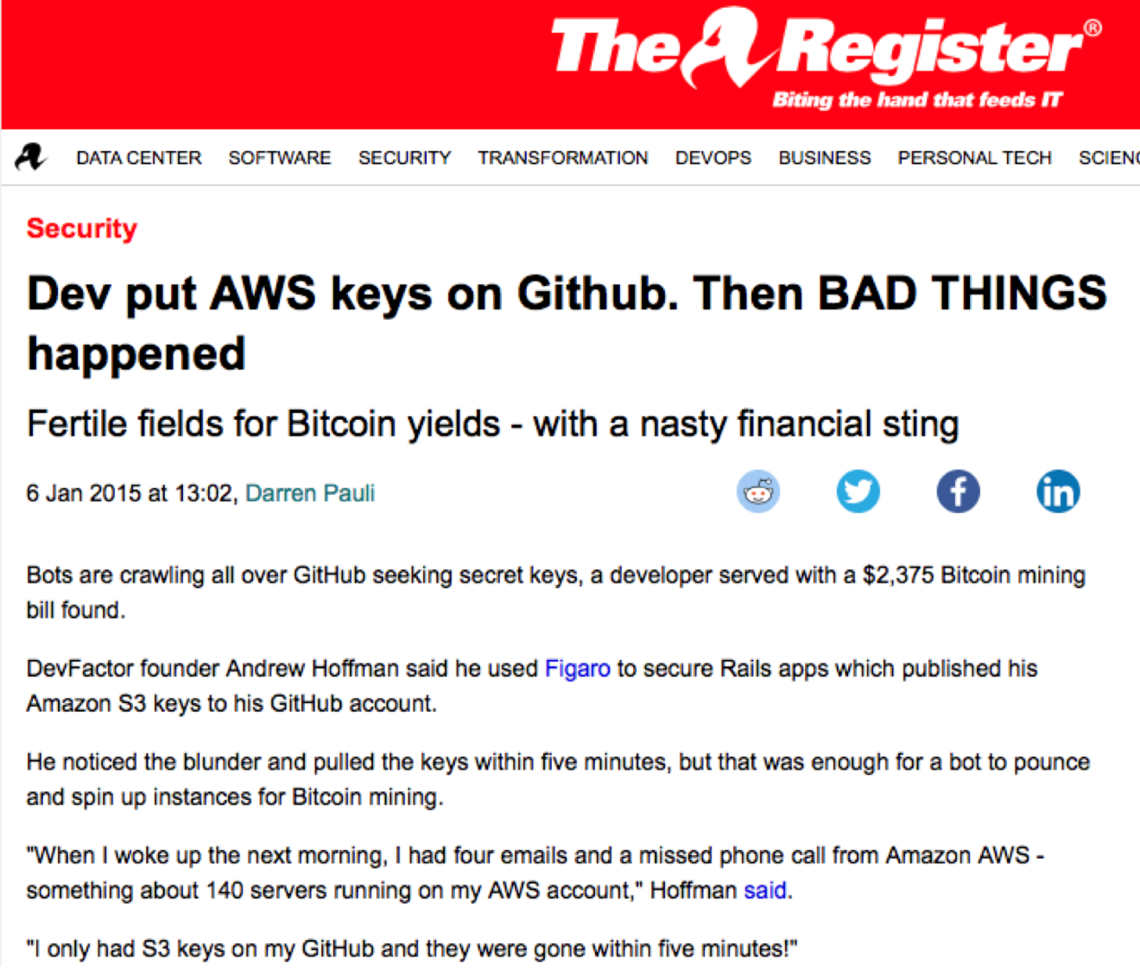
Retreived: Screenshot of http://www.theregister.co.uk/2015/01/06/dev_blunder_shows_github_crawling_with_keyslurping_bots/

Slide 5
DLI Accelerated Data Science Teaching Kit
Thank You

