Slide 1
Lecture 23.3 - GitHub and Bitbucket
DLI Accelerated Data Science Teaching Kit

Slide 2

The Accelerated Data Science Teaching Kit is licensed by NVIDIA, Georgia Institute of Technology, and Prairie View A&M University under the
Creative Commons Attribution-NonCommercial 4.0 International License.

Slide 3
GitHub | Bitbucket
Large community supports | Smaller community
Popular for hosting open-source projects | Fewer open-source projects
Unlimited public & private repos | Unlimited public & private repos
Unlimited collaborators for private repos | Up to 5 collaborators for private repos
Web interface + native apps for Mac, Windows | Web Interface

Slide 4
GitHub Desktop Client
Retrieved: https://desktop.github.com

Slide 5
Retrieved: Screenshot of https://github.com/showcases/github-pages-examples

Slide 6
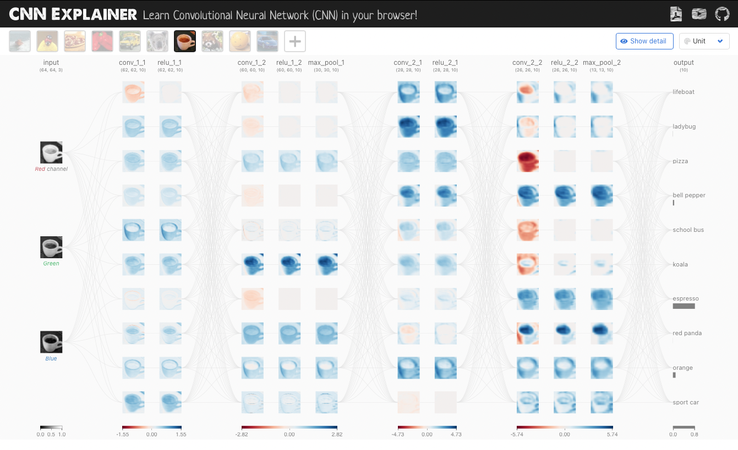
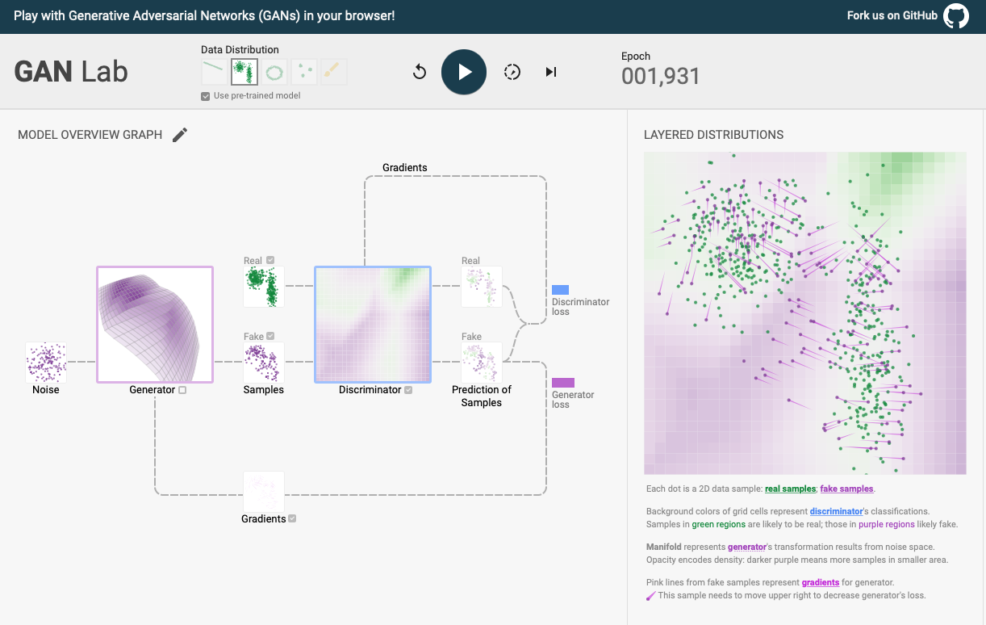
Full-fledged Interactive Apps as GitHub Pages
GAN Lab
CNN Explainer
https://poloclub.github.io/cnn-explainer/
https://poloclub.github.io/ganlab/

Slide 7
DLI Accelerated Data Science Teaching Kit
Thank You

