Slide 1

Lecture 24.1 - Introduction to Team Project
DLI Accelerated Data Science Teaching Kit
Notes:
This section will show you the details on team project.

Slide 2

The Accelerated Data Science Teaching Kit is licensed by NVIDIA, Georgia Institute of Technology, and Prairie View A&M University under the
Creative Commons Attribution-NonCommercial 4.0 International License.

Slide 3

Fake News Detection on Social Media
Social media (e.g., Twitter and Facebook) has become a new ecosystem for spreading news.
Nowadays, people are relying more on social media services rather than traditional media because of its advantages such as social awareness, global connectivity, and real-time sharing of digital information.
Unfortunately, social media is full of fake news. Fake news consists of information that is intentionally and verifiably false to mislead readers, which is motivated by chasing personal or organizational profits.
Fake news detection is to determine the truthfulness of the news by analyzing the news contents and related information such as propagation patterns.
Source: https://abcnews.go.com/US/ways-spot-disinformation-social-media-feeds/story?id=67784438
Notes:
Social media (e.g., Twitter and Facebook) has become a new ecosystem for spreading news, and more and more people are relying on social media to obtain updates of news because of its advantages such as social awareness, global connectivity, and real-time sharing of digital information.
Unfortunately, social media is full of fake news that is intentionally and verifiably false to mislead readers because of chasing personal or organizational profits.
Fake news detection can help us to determine the truthfulness of the news automatically through analyzing the news contents and related information such as propagation patterns.

Slide 4

Fake News Detection via Machine Learning
Treat fake news detection as text classification
Two classes: Fake and True
Short texts from social media
Dataset (https://www.kaggle.com/c/fake-news/data?select=train.csv)
Source: https://www.kaggle.com/c/fake-news/data?select=train.csv
Notes:
With machine learning techniques, fake news detection can be accomplished automatically if we treat fake news detection as text classification.
Specially, it will be related to short text classification since the news from social media is very short compared to normal news.
First, you have to download the dataset from the link (Source: https://www.kaggle.com/c/fake-news/data?select=train.csv)
It is from fake news competition on Kaggle, which is to identify unreliable news articles.

Slide 5
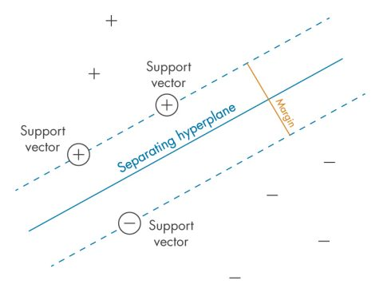
Machine Learning Models for Classification
Support Vector Machine
Random Forest
Logistic Regression
Source: https://www.mathworks.com/discovery/support-vector-machine.html
Notes:
This project will require students to complete fake news detection with three models including support vector machine, random forest, and logistic regression.

Slide 6
Data Preprocessing
Five Steps:
Remove rows with missing values
Stemming (https://en.wikipedia.org/wiki/Stemming)
Remove stop words (https://en.wikipedia.org/wiki/Stop_word)
Extract features with Term Frequency — Inverse Document Frequency (TFIDF) (https://en.wikipedia.org/wiki/Tf–idf) to build samples
Split the samples into training and testing data with the ratio 0.2
Notes:
The first key component for the team project is data preprocessing including:
Removing rows with missing values
Word stemming (https://en.wikipedia.org/wiki/Stemming)
Removing stop words (https://en.wikipedia.org/wiki/Stop_word)
Extracting features with Term Frequency — Inverse Document Frequency (TFIDF) (https://en.wikipedia.org/wiki/Tf–idf) to build samples
Spliting the samples into training and testing data with the ratio 0.2.
Some reference have come with the steps.

Slide 7
Building Fake News Detection Models
Nine Steps:
Load training data and testing data
Train a classifier 1 with traditional random forest from sklearn on the training data and record the training time
Train a classifier 2 with traditional Logistic Regression from sklearn on the training data and record the training time
Train a classifier 3 with traditional SVM from sklearn on the training data and record the training time
Train a classifier 4 with random forest from cuML on the training data and record the training time
Notes:
There are 9 steps to complete this fake news detection.
Load training data and testing data
Train a classifier 1 with traditional random forest from sklearn on the training data and record the training time
Train a classifier 2 with traditional Logistic Regression from sklearn on the training data and record the training time
Train a classifier 3 with traditional SVM from sklearn on the training data and record the training time
Train a classifier 4 with random forest from cuML on the training data and record the training time

Slide 8
Building Fake News Detection Models
Nine Steps:
Train a classifier 5 with Logistic Regression from cuML on the training data and record the training time
Train a classifier 6 with SVM from cuML on the training data and record the training time
Complete the inference on testing data with these six models and record the classification performance such as accuracy
Compare the training time and the classification performance
Notes:
Train a classifier 5 with Logistic Regression from cuML on the training data and record the training time
Train a classifier 6 with SVM from cuML on the training data and record the training time
After training these 6 classifiers, you have to complete the inference on testing data with these six models and record the classification performance such as accuracy, and finally compare the training time and the classification performance.

Slide 9
DLI Accelerated Data Science Teaching Kit
Thank You

