Slide 1

Lecture 24.2 - Evaluation of Team Project
DLI Accelerated Data Science Teaching Kit
Notes:
This section will introduce how to evaluate performance of team project.

Slide 2

The Accelerated Data Science Teaching Kit is licensed by NVIDIA, Georgia Institute of Technology, and Prairie View A&M University under the
Creative Commons Attribution-NonCommercial 4.0 International License.

Slide 3
Score Distribution
Evaluation Metrics | Score
Source code (Jupyter Notebook) | 30
Project Report (Word Document) | 40
Project Presentation | 30
Total | 100
Notes:
This table presents the score distribution of different components.
In other words, you have to complete all three components, namely, source codes, project report, and project presentation.

Slide 4
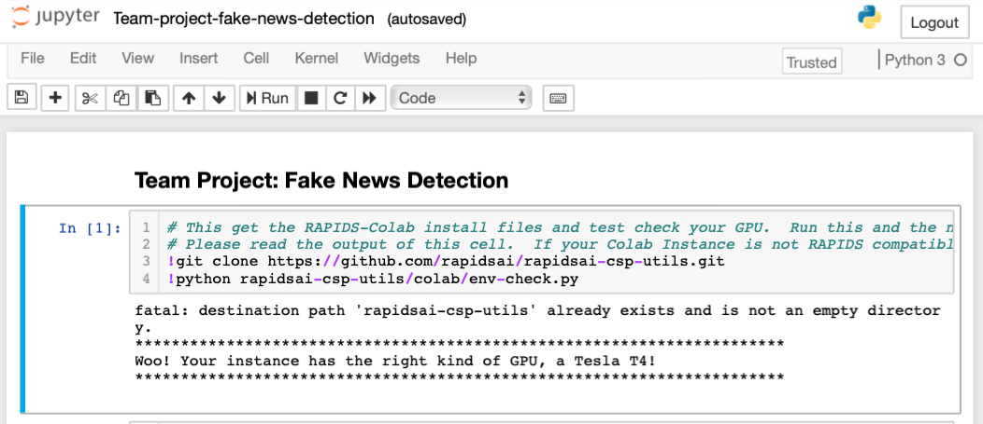
Source Code
Submit the source code (jupyter notebook files) and the data you use for the project, where the codes have no bugs.
Notes:
For the source code, you have to submit jupyter notebook without any bugs.
Here is an example of jupyter notebook.

Slide 5
Project Report
Write and submit the project report with the following components:
  Project description
  Model description
  Result analysis
    Make a table to show the comparison of Accuracy and training time (seconds)
    Analyze the observations on the comparison results
Notes:
For the project report, it will contain three parts: project description, model description, and result analysis.\
Specifically, for the result analysis, you have to make a table to show the comparison of Accuracy and training time (seconds) for different models and analyze the observations on the comparison results.

Slide 6
Project Presentation
Presentation
  20 ~ 30 minutes’ presentation with slides (around 25 pages)
  Slide Outline
    Project description
    Model description
    Result analysis
Notes:
For the presentation, it will be 20 ~ 30 minutes by presenting slides (around 25 pages).
The slide outline is identical to that of project report.
In other words, you should use this presentation to introduce your project clearly.

Slide 7
DLI Accelerated Data Science Teaching Kit
Thank You

