Slide 1

Lecture 3.2 - Data Cleaning and Statistical Preprocessing
DLI Accelerated Data Science Teaching Kit
Notes:
This section will present details on data cleaning and how to use statistical methods for data pre-processing.

Slide 2

The Accelerated Data Science Teaching Kit is licensed by NVIDIA, Georgia Institute of Technology, and Prairie View A&M University under the
Creative Commons Attribution-NonCommercial 4.0 International License.

Slide 3
Data Cleaning
Data cleaning is the preprocessing of missing values and removal data noise.
Pre-processing missing values
Removing noise
Notes:
Data cleaning is a key step to preprocess the data.
Missing value is a common feature of data collected in almost all research and can have a significant effect on the conclusions that can be drawn from the data. It refers to the data value that is not stored for a variable in the observation of interest.
In addition, data noise cannot be avoided in most of cases of data analytics. This refers to a large amount of additional meaningless information. Random noise is often a large component of the noise in data.

Slide 4
Why the Need to Handle Missing Values?
Missing values are generated by collection errors or missing observations.
Missing values are the most common problem in data analytics.
When missing values come out, certain model performance is decreased.
Even for models that can handle missing values, they might be sensitive to it.
Notes:
Obviously, it is imperative to deal with missing values for the following reasons.
Missing values are generated by collection errors or missing observations, which is difficult to avoid.
Missing values are the most common problem in data analytics.
When missing values come out, certain model performance is decreased since missing values will lead to model bias.
Even for models that can handle missing values, they might be sensitive to it. Moreover, the model performance will be reduced with the increment of missing values such as data analytics on streaming data.

Slide 5
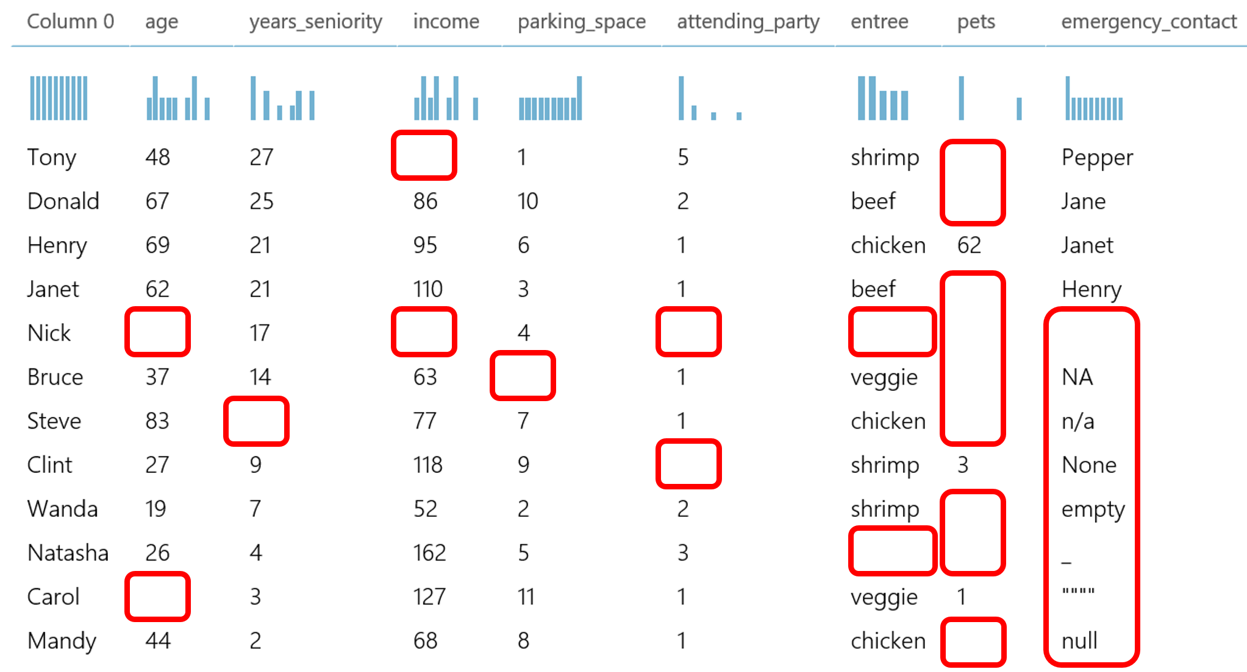
How to deal with missing values?
Typical methods to process missing values:
Deletion
Dummy substitution
Mean substitution
Frequent substitution
Regression substitution
Source: https://gallery.azure.ai/Experiment/Methods-for-handling-missing-values-1
Notes:
Typically, we can process missing values with methods including Deletion, Dummy substitution, Mean substitution, Frequent substitution, and Regression substitution.
We will introduce these methods.
Before that, you can observe various cases of missing values from these figures.

Slide 6
How to deal with missing values?
Typical methods to process missing values:
Deletion: removing records with missing values
Source: https://gallery.azure.ai/Experiment/Methods-for-handling-missing-values-1
Notes:
As shown in this figure, we can delete the rows with most missing elements.
Generally, we can set a threshold for the ratio between number of missing elements and number of elements for a certain row to implement deletion.

Slide 7
How to deal with missing values?
Typical methods to process missing values:
Dummy substitution: Replace missing values with a dummy value e.g. UNKNOWN for category values or 0 for numerical values
0
0
0
0
0
UNKNOW
0
Source: https://gallery.azure.ai/Experiment/Methods-for-handling-missing-values-1
Notes:
For the categorical attributes/features, we could use “UNKNOWN” to replace missing values.
In other words, we introduce additional attribute values, which will not significantly affect model performance if missing values don’t dominate these attributes.

Slide 8
How to deal with missing values?
Typical methods to process missing values:
Frequent substitution: If the missing values are categorical, replace the missing values with the most frequent item.
0
0
0
0
0
chicken
0
48
Source: https://gallery.azure.ai/Experiment/Methods-for-handling-missing-values-1
Notes:
In addition, we could use the most frequent attribute value to replace the missing values for the categorical attributes.
For example, missing values of the attribute “entree” can be filled out with most frequent item “chicken”.

Slide 9

How to deal with missing values?
Typical methods to process missing values:
Mean substitution:
$x_{mean}=\sum_{i = 1}^{n}{x_{i}/n}$
n: number of values
0
0
0
0
0
UNKNOW
0
48
Source: https://gallery.azure.ai/Experiment/Methods-for-handling-missing-values-1
Notes:
For continuous attributes, we could use mean of attribute values to replace the missing values.
Take the attribute “Age” as an example, we use the mean value 48 to replace the missing values for this attribute.

Slide 10
How to deal with missing values?
Typical methods to process missing values:
Regression substitution: Use a regression method to replace the missing values with regressed values.
  Time-series data
  ARIMA [1] (autoregressive integrated moving average)
0
0
0
0
0
UNKNOW
0
48
[1] Contreras, J., Espinola, R., Nogales, F. J., & Conejo, A. J. (2003). ARIMA models to predict next-day electricity prices. IEEE transactions on power systems, 18(3), 1014-1020.c
Source: https://gallery.azure.ai/Experiment/Methods-for-handling-missing-values-1
Notes:
Moreover, we can employ regression methods such as ARIMA to estimate the missing values if we have attributes with time-series features.

Slide 11
Outliers
An outlier is a data point that differs significantly from other observations.
Outliers can be very common in multidimensional data.
Outliers can be results of bad data collection.
Outliers would distort the models.
Some models are sensitive to outliers.
Sometimes outliers are the interesting data points.
Notes:
In addition to missing values, outliers are another challenge to data processing.
Outliers is very common in multidimensional data such as high-dimensional data.
Outliers would distort the models, which will decrease model performance significantly. For example, outliers will reduce the clustering performance with KMEANS clustering methods.
Some models such as KMEANS clustering methods are sensitive to outliers.
However, sometimes outliers are the interesting data points. For example, streaming data will introduce challenge on judging outliers since some “outliers” will be a clue for detecting concept drift.

Slide 12
How to deal with outliers?
It depends on how to generate the outliers.
Keep outliers
  We should pay more attention to the outliers since they may be genuine observations in the collected data.
  In many applications, outliers provide crucial information for data analytics.
Notes:
For example, credit card fraud detection alerts purchases that fall outside a customer’s usual purchase patterns.

Slide 13
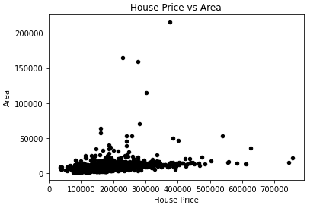
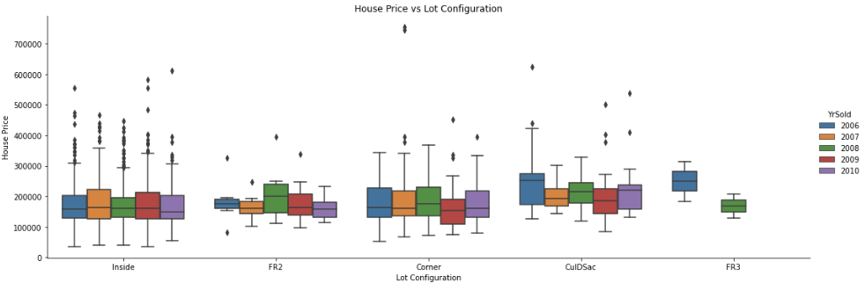

How to detect outliers?
Two popular methods:
Scatter Plot
Box Plot
Notes:
Some tools will help detect outliers such as scatter plot and box plot.

Slide 14
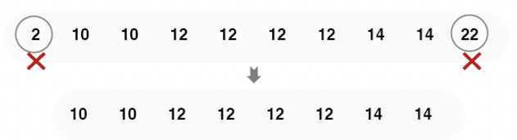
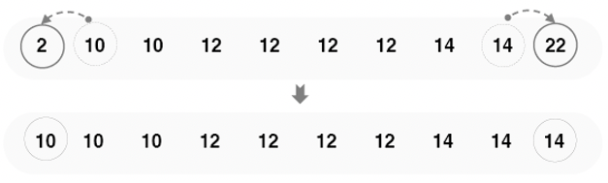
How to deal with outliers?
It depends on how to generate the outliers.
Exclude outliers
  Trimming: discarding the outliers.
  Replacement: replacing the outliers with the nearest “normal” data point
Notes:
Additionally, we can process outliers with methods such as trimming and replacement if the outliers can be recognized accurately.

Slide 15

Data Normalization
Data normalization is the rescaling of numerical values to a specific range.
Two popular methods:
Min-Max Normalization:
$$X_{norm}=\frac{X−X_{min}}{X_{max}−X_{min}}$$
Z-score Normalization (or Standardization)
$$X_{Z−score}=\frac{X−μ}{δ}$$
$μ:mean of X$
$δ:standard deviation of X$
Notes:
Data normalization is a process in which data attributes within a data model are organized to increase the cohesion of entity types.
In other words, the goal of data normalization is to reduce and even eliminate data redundancy.
There are two primary advantages of having a highly normalized data schema:
Increased consistency. Information is stored in one place and one place only, reducing the possibility of inconsistent data.
Easier object-to-data mapping. Highly-normalized data schemas in general are conceptually closer to object-oriented schemas because the object-oriented goals of promoting high cohesion and loose coupling between classes results in similar solutions (at least from a data point of view).

Slide 16
Data Down-Sampling
Data down-sampling is reducing large data to a smaller and more manageable size.
Record down-sampling (clustering): select the records and only choose the representative subset from the data.
Attribute down-sampling (Feature selection): select only a subset of the most important attributes from the data.
Notes:
Downsampling is the process of reducing the sampling rate of a signal, which is an effective way to handle imbalanced data.

Slide 17
DLI Accelerated Data Science Teaching Kit
Thank You

