Slide 1
Lecture ​3.3 - Data Cleaners: OpenRefine and Wrangler
DLI Accelerated Data Science Teaching Kit

Slide 2

The Accelerated Data Science Teaching Kit is licensed by NVIDIA, Georgia Institute of Technology, and Prairie View A&M University under the
Creative Commons Attribution-NonCommercial 4.0 International License.

Slide 3


Slide 5
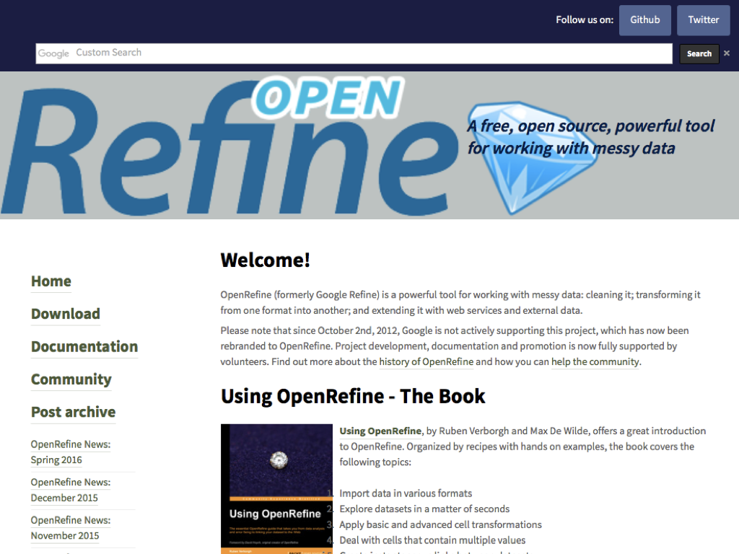

Slide 6
Students watch
1st OpenRefine “Explore Data” video at http://openrefine.org
Wrangler video ar http://vis.stanford.edu/wrangler

Slide 7
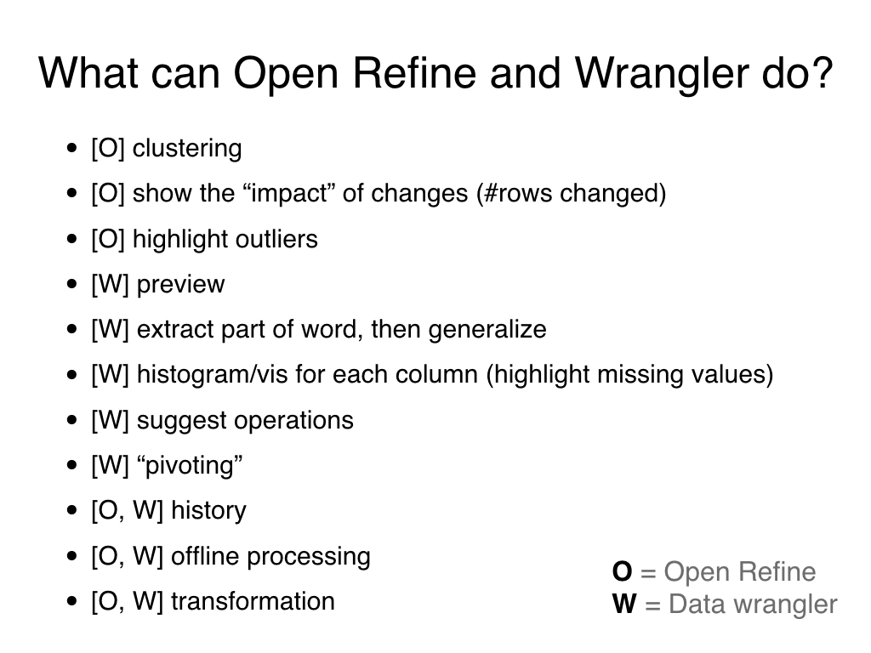

Slide 8
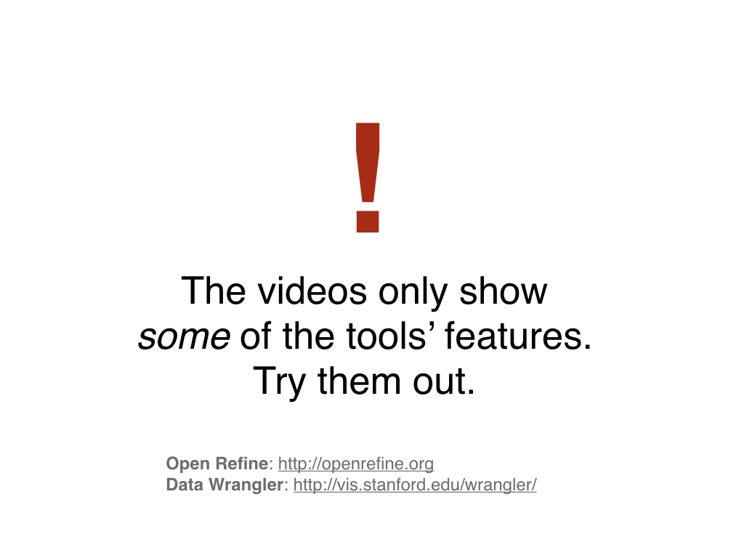

Slide 9
DLI Accelerated Data Science Teaching Kit
Thank You

