Slide 1

Lecture 3.4 - Feature Selection: Introduction to Filter Methods
DLI Accelerated Data Science Teaching Kit
Notes:
This section will introduce how to reduce dimensionalities by feature selections.
We will focus on filter methods in this submodule.

Slide 2

The Accelerated Data Science Teaching Kit is licensed by NVIDIA, Georgia Institute of Technology, and Prairie View A&M University under the
Creative Commons Attribution-NonCommercial 4.0 International License.

Slide 3
Feature
Feature is a distinctive attribute or aspect of something.
In machine learning based data analytics, a feature is an individual measurable property or characteristic of a phenomenon being observed.
a distinctive attribute or aspect of something
Face Recognition
Nose
Mouth
Eye
Ear
… …
Source: https://www.nyclu.org/en/news/facial-recognition-cameras-do-not-belong-schools
Notes:
Data ontain many attributes/features.
For face recognition, various features such as shape of nose and distance between the eyes are useful for building models.

Slide 4
Feature Extraction
Feature extraction is to extract features from raw data or even create new features on the raw data.
Creating new features is a process to generate new variables/features based on existing variables/features.
a distinctive attribute or aspect of something
Notes:
Feature extraction is to extract features from raw data or even create new features on the raw data.
Specially, creating new features is a process to generate new variables/features based on existing variables/features.
For example, “New Day” and “New Month” are new features created based on feature “Date”

Slide 5
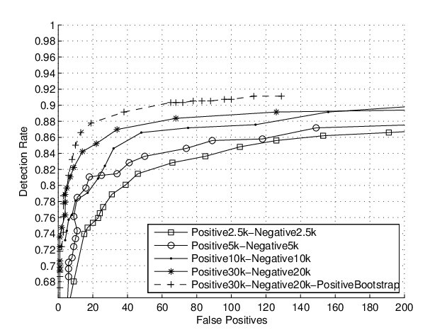
Feature Extraction
Different sets of features will lead to different performance of data analytics.
Face Detection
Performance comparison of detectors using multiple feature sets on the CMU+MIT frontal face data set.
a distinctive attribute or aspect of something
Source: Xiao, R., Zhu, H., Sun, H., & Tang, X. (2007, October). Dynamic cascades for face detection. In 2007 IEEE 11th International Conference on Computer Vision (pp. 1-8).
Notes:
However, different sets of features will lead to different performance of data analytics.
As shown in this figure, more features will enhance model performance.

Slide 6
Feature Engineering
Feature engineering is a process that is to represent the features by feature selection or feature reduction for data analytics.
Requiring collaborations between domain experts and data scientists
A trade-off between including more informative features and avoiding too many unrelated features
Informative features improve model performance.
Unrelated features reduce model performance.
Notes:
Not all features will be useful regarding feature redundancy and irrelated features.
Feature engineering is a process that is to represent the data by feature selection or feature reduction for data analytics.
Therefore, before the data is input to the model, the data needs to be represented with the flow shown in this figure.
Actually we need to achieve a trade-off between including more informative features and avoiding too many unrelated features
Informative features improve model performance.
Unrelated features reduce model performance.

Slide 7
Feature Selection
Feature selection is able to remove features that are either redundant or irrelevant without loss of information of data.
Simplifying the models
Shortening time for model construction
Avoiding curse of dimensionality
Enhancing model generalization
Notes:
Feature selection is able to remove features that are either redundant or irrelevant without loss of information of data.
It can
Simplifying the models
Shortening time for model construction
Avoiding curse of dimensionality
Enhancing model generalization

Slide 8
Curse of Dimensionality
It refers to phenomena that arise when analyzing and organizing data in high-dimensional spaces.
Certain models might perform poorly in high-dimensional space.
More features might need more samples to fill out the high-dimensional space.
Samples are difficult to be obtained.
Notes:
Feature selection can help overcome Curse of Dimensionality for data analytics in high-dimensional space.

Slide 9
Approached for Feature Selection
There are three categories of feature selection methods.
Filter methods select features regardless of the model.
Wrapper methods select features based on performance of a specific model with a greedy search in a forward/backward manner.
Model-based methods select features during the procedure of model construction.
Notes:
There are three categories of feature selection methods.
Filter methods select features regardless of the model.
Wrapper methods select features based on performance of a specific model with a greedy search in a forward/backward manner.
Model-based methods select features during the procedure of model construction.

Slide 10
Filter Methods
Generally, filter methods are to calculate the correlations between the features and target attributes.
Statistical measurements
Chi squared test
Mutual information
Pearson correlation
… …
Notes:
We will focus on Chi squared test and Mutual information in this section.

Slide 11
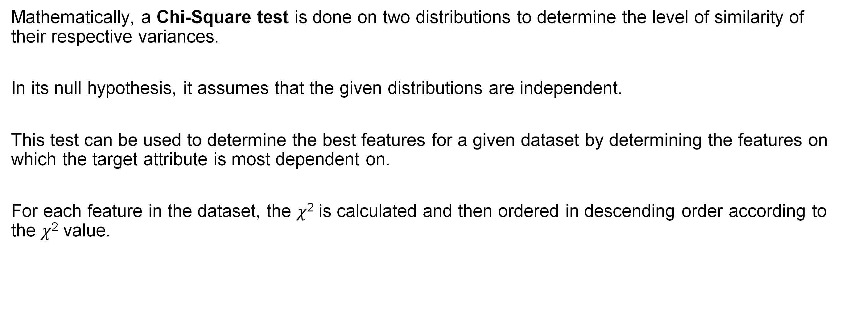
Chi Squared Test
Mathematically, a Chi-Square test is done on two distributions to determine the level of similarity of their respective variances.
In its null hypothesis, it assumes that the given distributions are independent.
This test can be used to determine the best features for a given dataset by determining the features on which the target attribute is most dependent on.
For each feature in the dataset, the $χ$² is calculated and then ordered in descending order according to the $χ$² value.
Notes:
Mathematically, a Chi-Square test is done on two distributions to determine the level of similarity of their respective variances.
In its null hypothesis, it assumes that the given distributions are independent.
This test can be used to determine the best features for a given dataset by determining the features on which the target attribute is most dependent on.
For each feature in the dataset, the 𝜒2 is calculated and then ordered in descending order according to the 𝜒2 value.

Slide 12

Chi Squared Test
The higher the value of $χ$², the more dependent the output label is on the feature and higher the importance the feature has on determining the output.
$$χ^{2}=\sum_{i=1}^{m}{\sum_{j=1}^{k}{\frac{{(O}_{ij}−E_{ij})2}{E_{ij}}}}$$
$O_{ij}$: Observed frequency
$E_{ij}$: Expected frequency
Notes:
The higher the value of $χ$², the more dependent the output label is on the feature and higher the importance the feature has on determining the output.

Slide 13
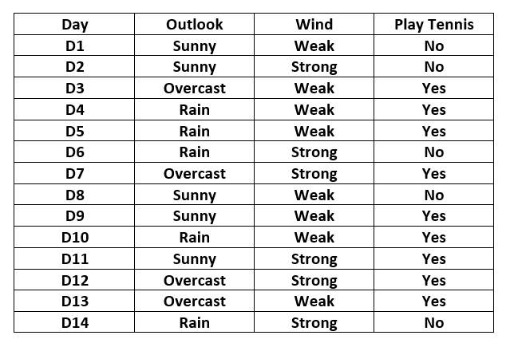
Chi Squared Test
Predicting Play Tennis
Two features
Outlook
Wind
Target Attribute
Play Tennis
Notes:
Take Play Tennis data as an example.
We have two features including Outlook and Wind, and one target attribute Play Tennis.

Slide 14
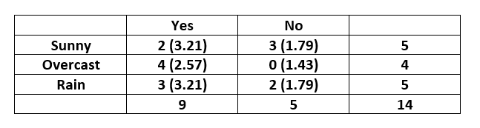
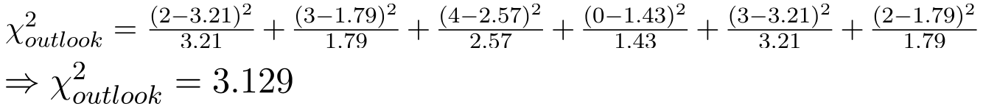
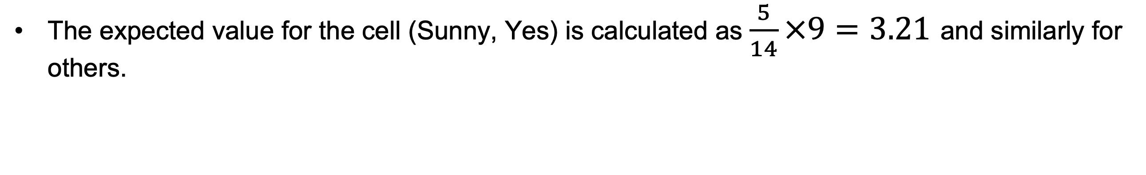
Chi Squared Test
The contingency table for the feature “Outlook” is constructed as below.
The expected value for the cell (Sunny, Yes) is calculated as $\frac{5}{14}×9=3.21$ and similarly for others.
Notes:
For each feature, a contingency table is created with i rows and j columns. Each cell (i,j) denotes the number of rows having attribute feature as i and class label as j. Thus, each cell in this table denotes the observed frequency. To calculate the expected frequency for each cell, first the proportion of the feature value in the total dataset is calculated and then it is multiplied by the total number of the current class label.
Here the output variable is the column named “PlayTennis” which determines whether tennis was played on the given day given the weather conditions.

Slide 15
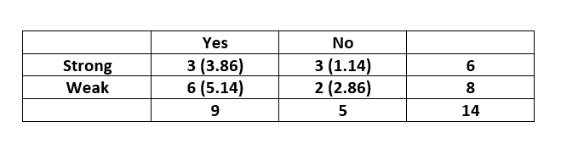
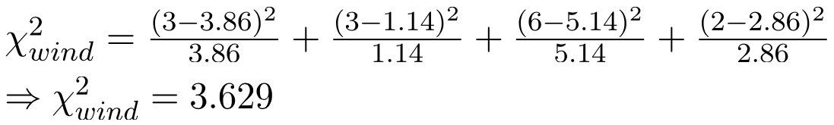
Chi Squared Test
The contingency table for the feature “Wind” is constructed as below.
On comparing the two scores, we can conclude that the feature “Wind” is more important to determine the output than the feature “Outlook”.
Notes:
On comparing the two scores, we can conclude that the feature “Wind” is more important to determine the output than the feature “Outlook” since its value of wind is larger than that of outlook.

Slide 16
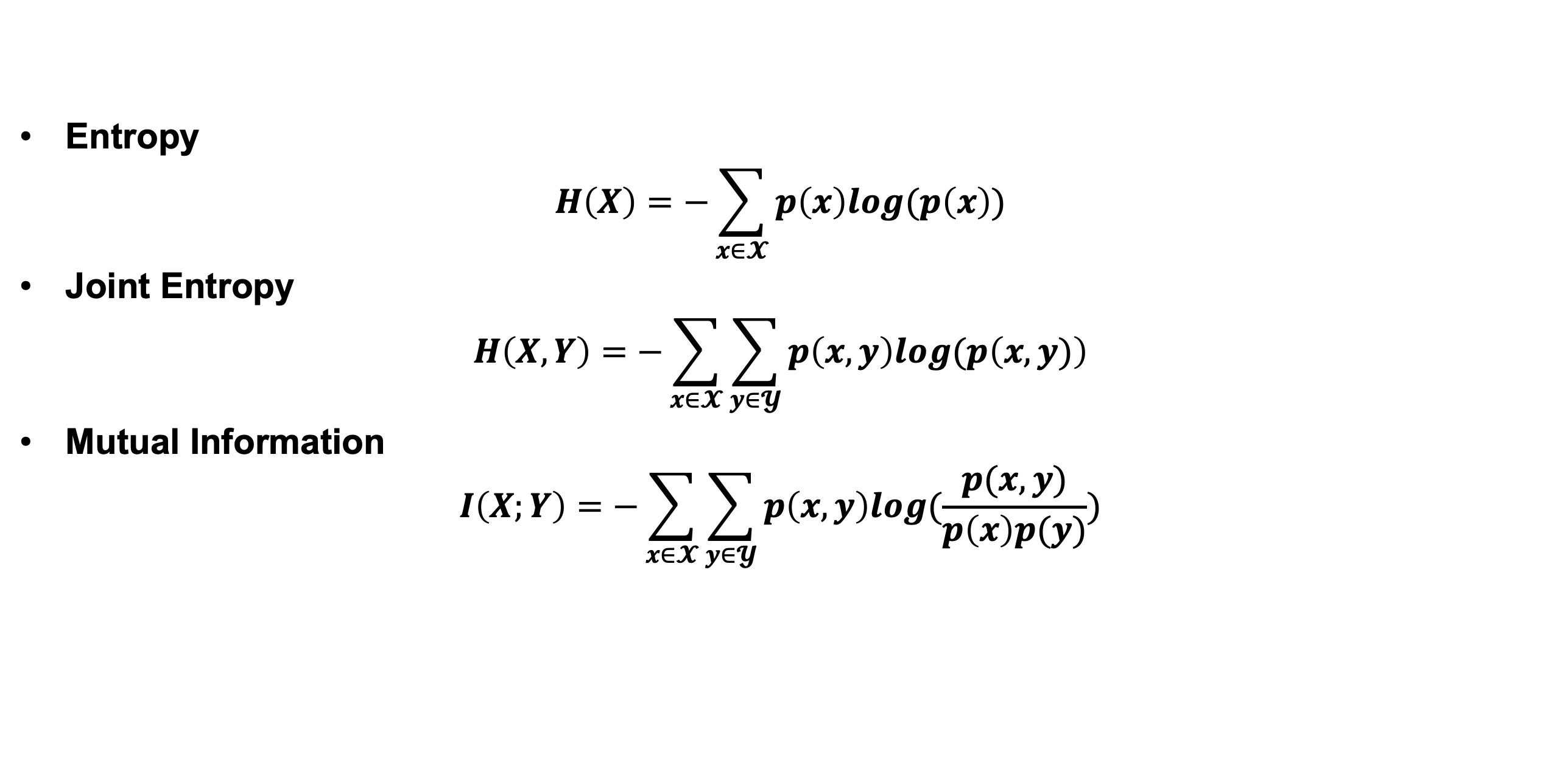
Mutual Information
In information theory, the mutual information (MI) of two random variables is a measure of the mutual dependence between the two variables.
Entropy
$$H\left(X\right)=−\sum_{x∈𝓧}{p\left(x\right)log(p\left(x\right))}$$
Joint Entropy
$$H\left(X, Y\right)=−\sum_{x∈𝓧}{\sum_{y∈𝓨}{p\left(x,y\right)log(p\left(x,y)\right)}}$$
Mutual Information
$$I\left(X;Y\right)=−\sum_{x∈𝓧}{\sum_{y∈𝓨}{p\left(x,y\right)log(\frac{p(x,y)}{p\left(x\right)p(y)})}}$$
Notes:
Mutual information is intimately linked to that of entropy of a random variable.
Mutual information has been successfully adopted in filter feature-selection methods to assess both the relevancy of a subset of features in predicting the target variable and the redundancy with respect to other variables.
Y could be target values while X will be features.
The straightforward idea to implement feature selection is to calculate MI values between all features and target values and select features with a predefined threshold.

Slide 17
DLI Accelerated Data Science Teaching Kit
Thank You

