Slide 1

Lecture 3.5 - Feature Selection: Introduction to Model-based Methods
DLI Accelerated Data Science Teaching Kit
Notes:
In this section, we will introduce model-based feature selection methods.
The main idea is to select the features during learning the machine learning models.

Slide 2

The Accelerated Data Science Teaching Kit is licensed by NVIDIA, Georgia Institute of Technology, and Prairie View A&M University under the
Creative Commons Attribution-NonCommercial 4.0 International License.

Slide 3
Model-based Methods for Feature Selection
Model-based methods learn the best features that contribute to the model performance when constructing these models.
The most common methods are regularization methods.
It is to penalize the model, which introduce additional constraints into the optimization of learning the models with lower complexity.
Notes:
This figure demonstrates the flow of model-based feature selection.
All features are the initial input to the feature selection procedure.
Basically, the feature subset is iteratively built with respect to the model performance when constructing models.

Slide 4
LASSO (Least Absolute Shrinkage and Selection Operator)
It is a powerful method that perform two main tasks: regularization and feature selection.
First formulated by Robert Tibshirani in 1996.
The LASSO method puts a constraint on the sum of the absolute values of the model parameters, the sum has to be less than a predefined value (upper bound).
In order to do so the method apply a shrinking (regularization) process where it penalizes the coefficients of the regression variables shrinking some of them to zero.
During features selection process the variables that still have a non-zero coefficient after the shrinking process are selected to be part of the model. The goal of this process is to minimize the prediction error.
Notes:
The first method introduced is LASSO.
The basic idea is to complete regularization and feature selection. It puts a constraint on the sum of the absolute values of the model parameters, the sum has to be less than a predefined value (upper bound). In order to do so the method apply a shrinking (regularization) process where it penalizes the coefficients of the regression variables shrinking some of them to zero.
From another perspective, the goal of this process is to improve the model accuracy, where the coefficient for features can be treated as feature weights.

Slide 5
LASSO (Least Absolute Shrinkage and Selection Operator)
There are many advantages in using LASSO method.
It can provide a promising prediction accuracy, because shrinking and removing the coefficients can reduce variance without a substantial increase of the bias.
This is especially useful when the data has a small number of samples and a large number of features.
LASSO helps increase the model interpretability by eliminating irrelevant variables that are not related to the target variable, which would reduce overfitting as well.
Notes:
This is especially useful when the data has a small number of samples and many features. In other words, it would be effective to analyze high-dimensional, low-sample size data.
For example, cell classification with micro-array data in biomedical domain will involve around hundreds of samples with 20 ~ 50 thousands of genes. LASSO would be an effective method to select less than 50 genes for this classification problem.
LASSO helps increase the model interpretability by eliminating irrelevant variables that are not related to the target variable, which would reduce overfitting as well.
Overfitting refers to a model that models the training data too well. It happens when a model learns the detail and noise in the training data, which negatively impacts the performance of the model on testing data. This means that the noise or random fluctuations in the training data is picked up and learned as concepts by the model. The concepts however do not apply to new data and negatively impact the model ability to generalize.

Slide 6


LASSO in the Linear Model
Linear model, often called Linear Regression Model, describes the relationship between response Y and explanatory variables $X$.
The case of one explanatory variable is called Simple Linear Regression while the case with two or more explanatory variables is called Multiple Linear Regression.
An assumption is the linearity of the model, that is a linear relationship between the response variable and the explanatory variables.
$$Y=w_{0}+w_{1}×x_{1}+⋯+w_{n}×x_{n}=W×X$$
where the parameters $w_{0}$, $w_{1}$, …, $w_{n}$ are the weights for the model and $n$ is the number of the explanatory variables (features). $Y$ is the response variable (target variable).
Notes:
Let me show you an example with linear regression model.
Linear model, often called Linear Regression Model, describes the relationship between response Y and explanatory variables $X$.
The case of one explanatory variable is called Simple Linear Regression while the case with two or more explanatory variables is called Multiple Linear Regression.
An assumption is the linearity of the model, that is a linear relationship between the response variable and the explanatory variables.
The instructor will show you the details on the explanation of these formulas.

Slide 7
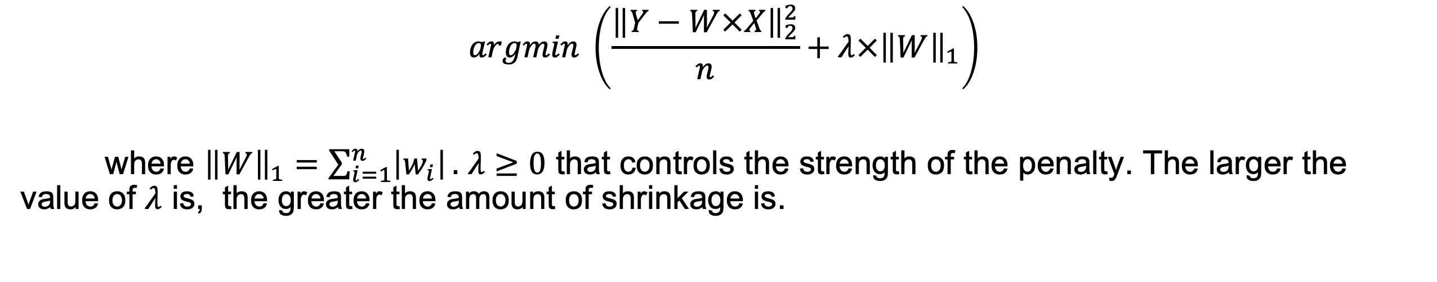

LASSO Based Object Function for Linear Models
The objective of optimizing the model is to minimize the mean square errors.
$$minimize \left(\frac{{\left\|Y−W×X\right\|}_{2}^{2}}{n}\right) subject to {\left\|W\right\|}_{1}<t$$
where t is the upper bound for the sum of the weights, $n$ is the number of samples.
This optimization problem is equivalent to the parameter estimation that follows.
$$argmin \left(\frac{{\left\|Y−W×X\right\|}_{2}^{2}}{n}+λ×{\left\|W\right\|}_{1}\right)$$
where ${\left\|W\right\|}_{1}=\sum_{i=1}^{n}{\left|w_{i}\right|}.$ $λ≥0$ that controls the strength of the penalty. The larger the value of $λ$ is, the greater the amount of shrinkage is.
Notes:
An assumption is the linearity of the model, that is a linear relationship between the response variable and the explanatory variables.
It can be implemented with maximum likelihood estimation (MLE).
The instructor will show you the details on the explanation of these formulas.

Slide 8
Feature Selection via Tree Model
Tree-based methods will estimate the feature importance during the procedure of constructing models to select important features.
The most common method could be decision tree and random forest.
Notes:
Another model-based method is Tree-based model.
Generally, we can rank the feature importance when constructing the tree of featrures for different tasks such as classification.
The most common method could be decision tree and random forest.

Slide 9
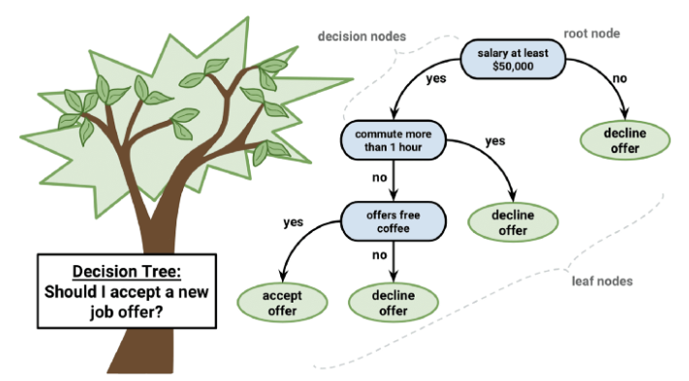
Decision Tree
Decision tree builds classification or regression models in the form of a tree structure.
A decision tree predicts the value of a target variable by following the decisions in the tree from the root (beginning) down to a leaf node.
A tree consists of branching conditions where the value of a predictor is compared to a trained weight.
The number of branches and the values of weights are determined in the training process.
Source: https://medium.com/analytics-vidhya/machine-learning-decision-tree-regression-ff8563ffaf52
Notes:
Let me give you a basic example of decision tree.
This figure is used to show a decision tree to complete a task that is to decide if a job offer should be accepted.
The leaf node presents the decisions on if the job offer should be accepted.
The other nodes show the attributes (features) related to this task.
Each node will be assigned a weight during training with methods such as information gain, where the weight can be treated as the importance of the feature.
The challenge to build a decision tree is to choose appropriate depth and width for this tree that will affect the performance significantly.
We will introduce the details in the module 14 that is Introduction to Machine Learning: Classification.

Slide 10
DLI Accelerated Data Science Teaching Kit
Thank You

