Slide 1

Lecture 3.6 - Feature Reduction: PCA
DLI Accelerated Data Science Teaching Kit
Notes:
Another popular method to overcoming overfitting by reducing dimensionality is feature reduction.

Slide 2

The Accelerated Data Science Teaching Kit is licensed by NVIDIA, Georgia Institute of Technology, and Prairie View A&M University under the
Creative Commons Attribution-NonCommercial 4.0 International License.

Slide 3
Feature Reduction
Feature Reduction is the transformation of data from a high-dimensional space into a low-dimensional space so that the low-dimensional representation retains meaningful properties of the original data.
It is to reduce large numbers of observations and/or large numbers of variables for tasks such as signal processing, speech recognition, natural language processing, and bioinformatics.
The difference between feature selection and feature reduction is that feature selection is directly to eliminate original features while feature reduction is to map the original high-dimensional feature space to a low-dimensional space.
The data transformation may be linear or nonlinear.
Notes:
These principal components would be orthogonal. In other words, they would be independent.
The difference between feature selection and feature reduction is that feature selection is directly to eliminate original features while feature reduction is to map the original high-dimensional feature space to a low-dimensional space, where the dimensions of the low-dimensional space is predefined.

Slide 4
Feature Reduction
A linear or non-linear transform on the original feature space
Unsupervised methods
Principal Component Analysis (PCA)
Independent Component Analysis (ICA)
Autoencoder
Supervised methods
Linear Discriminant Analysis (LDA)
Notes:
Generally, methods of feature selection can be classified into two categories: linear and non-linear.
The data transformation may be linear, as in principal component analysis (PCA), but many nonlinear dimensionality reduction techniques such as autoencoder also exist.
On the other side, it can be classified into supervised and unsupervised regarding ground truth.

Slide 5
Feature Reduction
A linear or non-linear transform on the original feature space.
Unsupervised methods
Principal Component Analysis (PCA)
Independent Component Analysis (ICA)
Autoencoder
Supervised methods
Linear Discriminant Analysis (LDA)
Notes:
This section will focus on PCA.

Slide 6

PCA (Principal component analysis)
PCA is to calculate the principal components for data analytics, where only the a few of principal components are selected in terms of a predefined number $K$of features.
It is commonly used for dimensionality reduction by projecting each data point onto only the first few principal components to obtain lower-dimensional data while preserving as much of the data's variation as possible.
The first principal component can equivalently be defined as a direction that maximizes the variance of the projected data.
The i^{th} principal component can be taken as a direction orthogonal to the i – 1 principal components, which maximizes the variance of the projected data.
Notes:
These principal components would be orthogonal. In other words, they would be independent.
It performs a linear mapping of the data to a lower-dimensional space in such a way that projection distances in the low-dimensional representation are maximized.

Slide 7
PCA (Principal component analysis)
The goal of PCA is to reduce the dimensionality of the data while preserving the variation present in the dataset as much as possible.
The axes have been rotated to new principal components such that:
Principal component 1 has the highest variance.
Principal component 2 has the next highest variance, and so on.
Notes:
The circles in this figure are samples in the data.
If we project these samples along with v1, we can observe that the sum of projection distances are larger than that projected along with v2.

Slide 8
PCA (Principal component analysis)
Principal Components (PCs): orthogonal vectors that are ordered by the fraction of the total information (variation) in the corresponding directions.
PCs can be found as the “best” eigenvectors of the covariance matrix of the data points.
PCs are linear least squares fits to samples, each orthogonal to the previous PCs:
First PC is a minimum distance fit to a vector in the original feature space
Second PC is a minimum distance fit to a vector in the plane perpendicular to the first PC

Slide 9
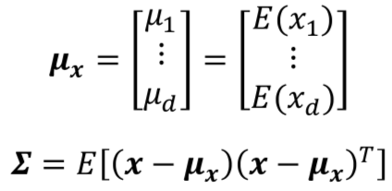
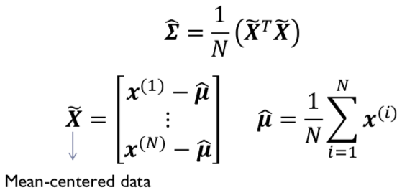
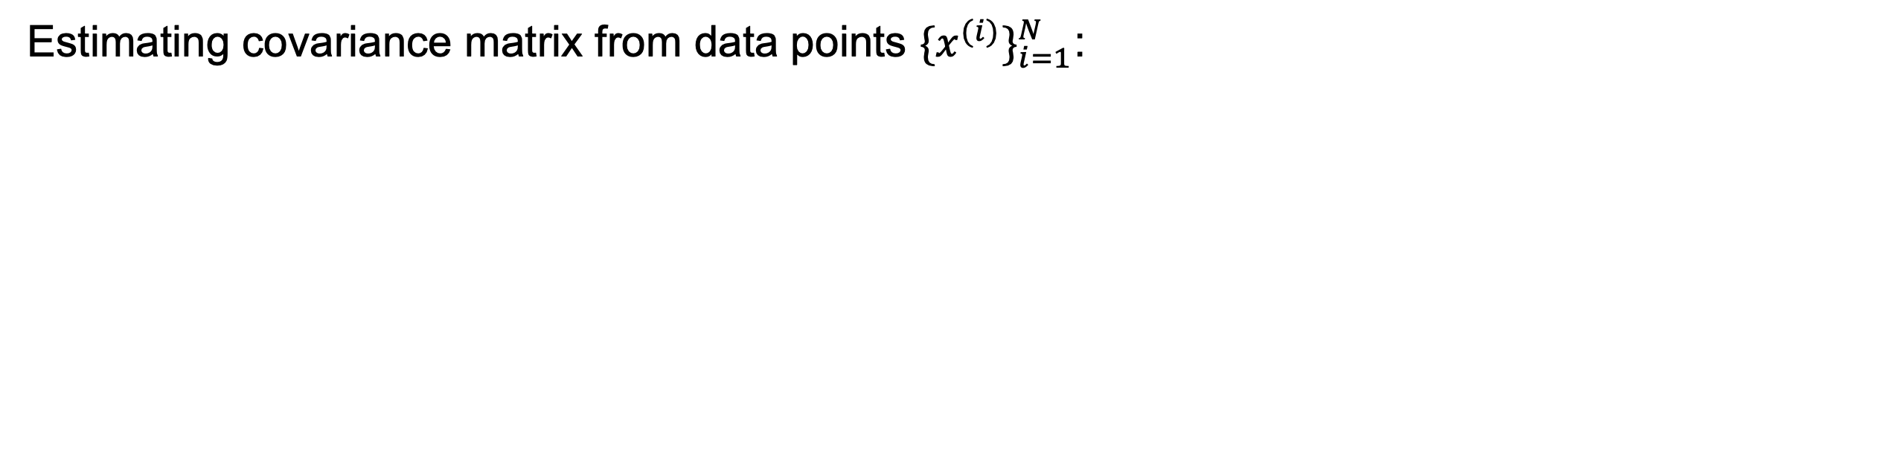
Mathematics for PCA
Covariance Matrix
Estimating covariance matrix from data points ${\{x^{(i)}\}}_{i=1}^{N}$:
Notes:
Here are some points of mathematics for PCA.

Slide 10
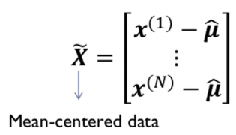

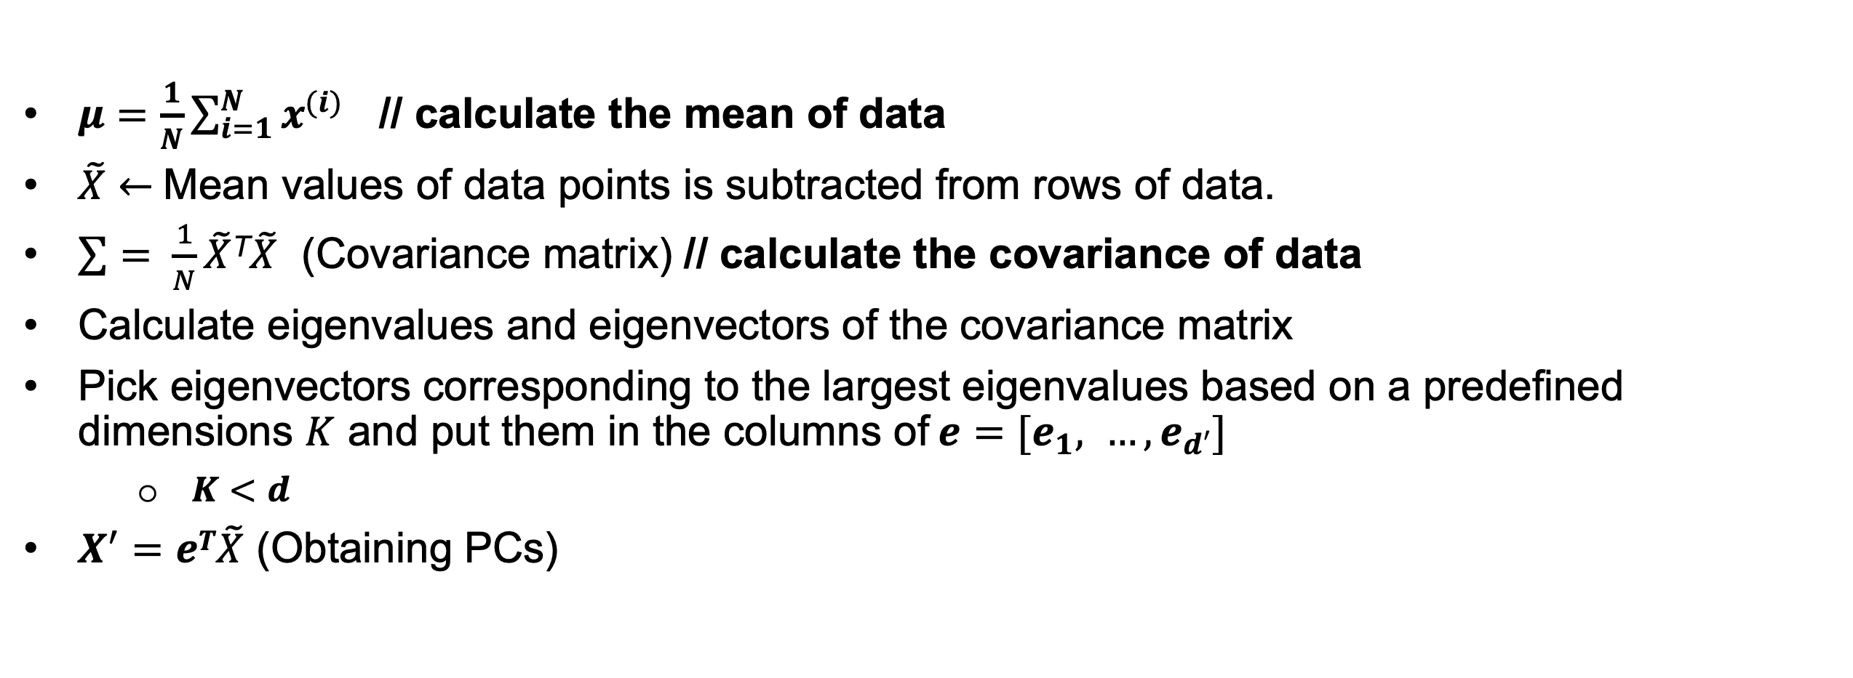

Calculating PCA
Input: $N×d$ data matrix $X$ (each row contains a $d$dimensional data points)
$μ=\frac{1}{N}\sum_{i=1}^{N}{x^{(i)}}$ // calculate the mean of data
$\tilde{X}←$Mean values of data points is subtracted from rows of data.
$\sum{= \frac{1}{N}}\tilde{X}$^{T}$\tilde{X}$ (Covariance matrix) // calculate the covariance of data
Calculate eigenvalues and eigenvectors of the covariance matrix
Pick eigenvectors corresponding to the largest eigenvalues based on a predefined dimensions $K$ and put them in the columns of$e=[e_{1}, …,e_{d′}]$
$K<d$
$X^{′}=eT\tilde{X}$ (Obtaining PCs)
Output: $X^{′}$ (PCs)
Notes:
Here are the detailed steps to obtain PCs.

Slide 11
An Example of PCA application
House Information
# | House Price | Area
1 | 10 | 9
2 | 2 | 3
3 | 1 | 2
4 | 7 | 6.5
5 | 3 | 2.5
Two features of house data
House Price (Million of dollars)
House Area
Notes:
Let us use one example to check how to use PCA to implement feature reduction.
Two features for this data.

Slide 12

An Example of PCA application
# | House Price | Area
1 | 10 | 9
2 | 2 | 3
3 | 1 | 2
4 | 7 | 6.5
5 | 3 | 2.5
Calculate $μ=\frac{1}{N}\sum_{i=1}^{N}{x^{(i)}}$
$$μHouse Price=\frac{10+2+1+7+3}{5}=4.6$$
$$μArea=\frac{9+3+2+6.5+2.5}{5}=4.6$$
Notes:
We calculate the mean of each features.

Slide 13

An Example of PCA application
# | House Price | Area
1 | 10 – 4.6 | 9 – 4.6
2 | 2 – 4.6 | 3 – 4.6
3 | 1 – 4.6 | 2 – 4.6
4 | 7 – 4.6 | 6.5 – 4.6
5 | 3 – 4.6 | 2.5 – 4.6
Calculate $\tilde{X}←$Mean values of data points is subtracted from rows of data.
# | House Price | Area
1 | 5.4 | 4.4
2 | -2.6 | -1.6
3 | -3.6 | -2.6
4 | 2.4 | 1.9
5 | -1.6 | -2.1
Notes:
We centralize the features by subtracting the mean.
The instructor will show you the details on the explanation of calculations.

Slide 14
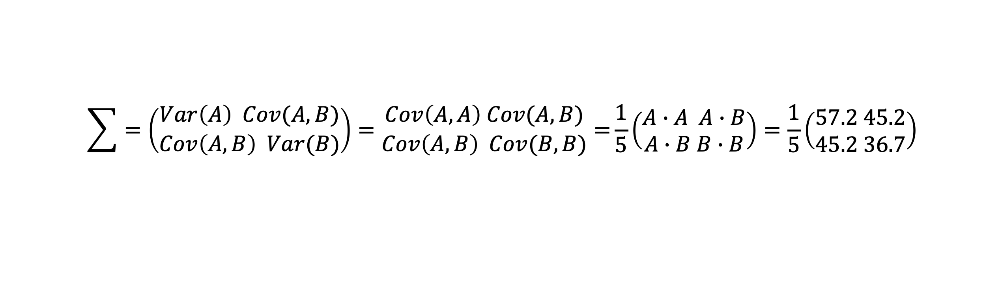
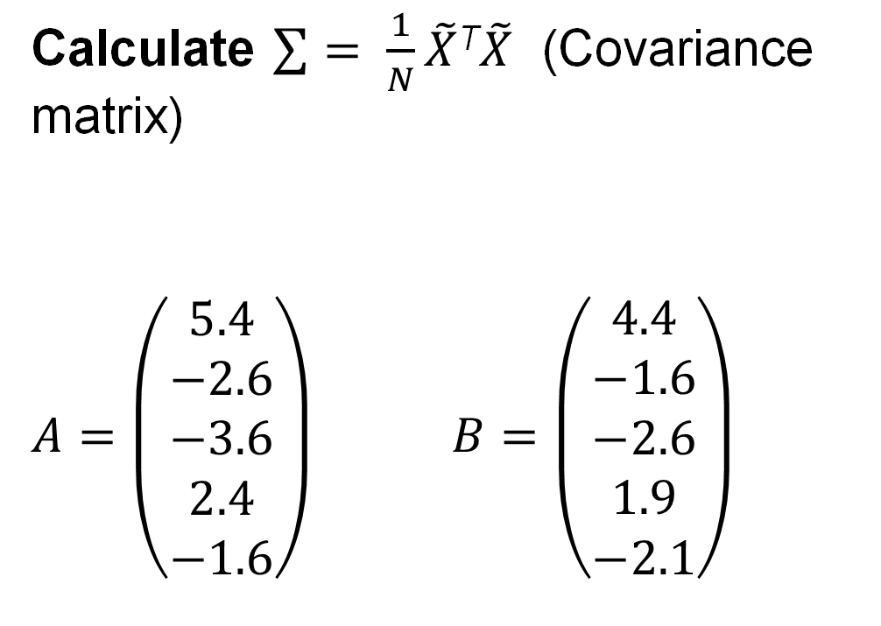
An Example of PCA application
Calculate $\sum{= \frac{1}{N}}\tilde{X}$^{T}$\tilde{X}$ (Covariance matrix)
$A=\left(\begin{aligned}5.4 \\ −2.6 \\ −3.6 \\ 2.4 \\ −1.6\end{aligned}\right)$ $B=\left(\begin{aligned}4.4 \\ −1.6 \\ −2.6 \\ 1.9 \\ −2.1\end{aligned}\right)$
# | House Price | Area
1 | 5.4 | 4.4
2 | -2.6 | -1.6
3 | -3.6 | -2.6
4 | 2.4 | 1.9
5 | -1.6 | -2.1
$$\sum{=\left(\begin{aligned}Var\left(A\right) Cov(A,B) \\ Cov\left(A,B\right) Var(B)\end{aligned}\right)=\begin{aligned}Cov\left(A,A\right) Cov(A,B) \\ Cov\left(A,B\right) Cov(B, B)\end{aligned}=}\frac{1}{5}\left(\begin{aligned}A∙A A∙B \\ A∙B B∙B\end{aligned}\right)=\frac{1}{5}\left(\begin{aligned}57.2 45.2 \\ 45.2 36.7\end{aligned}\right)$$
Notes:
Calculate the covariance.
The instructor will show you the details on the explanation of calculations.

Slide 15

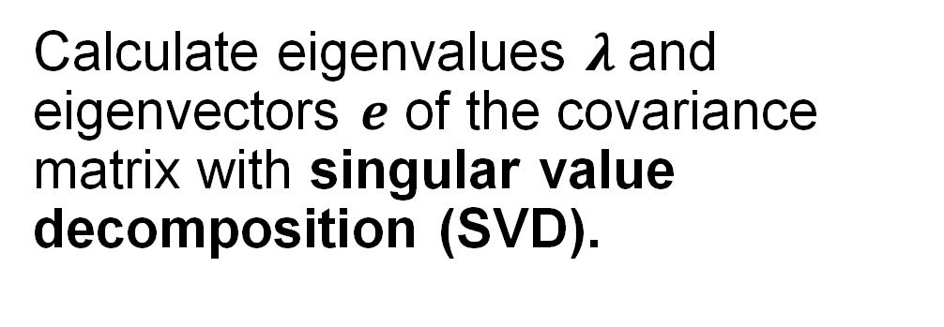
An Example of PCA application
Calculate eigenvalues $λ$and eigenvectors $e$ of the covariance matrix with singular value decomposition (SVD).
# | House Price | Area
1 | 5.4 | 4.4
2 | -2.6 | -1.6
3 | -3.6 | -2.6
4 | 2.4 | 1.9
5 | -1.6 | -2.1
$\sum{=\left(\begin{aligned}−0.78 −0.62 \\ −0.62 0.78\end{aligned}\right)}\left(\begin{aligned}18.66 0 \\ 0 0.12\end{aligned}\right)$ $\left(\begin{aligned}−0.78 −0.62 \\ −0.62 0.78\end{aligned}\right)$
$e1=\left(\begin{aligned}−0.78 \\ −0.62\end{aligned}\right). e2=\left(\begin{aligned}−0.62 \\ 0.78\end{aligned}\right)$. $λ=\left(\begin{aligned}18.66 \\ 0.12\end{aligned}\right)$
Notes:
Calculate eigenvalues $λ$and eigenvectors $e$ of the covariance matrix with SVD on the Covariance matrix.
The instructor will show you the details on the explanation of calculations.

Slide 16

An Example of PCA application
Pick eigenvectors corresponding to the largest eigenvalues and put them in the columns of$e=[e_{1}, …,e_{d′}]$
# | House Price | Area
1 | 5.4 | 4.4
2 | -2.6 | -1.6
3 | -3.6 | -2.6
4 | 2.4 | 1.9
5 | -1.6 | -2.1
$$e1=\left(\begin{aligned}−0.78 \\ −0.62\end{aligned}\right). e2=\left(\begin{aligned}−0.62 \\ 0.78\end{aligned}\right)\text{.}$$
$$e=(e1, e2)=\left(\begin{aligned}−0.78 −0.62 \\ −0.62 0.78\end{aligned}\right).$$
Notes:
We then pick eigenvectors.
The instructor will show you the details on the explanation of calculations.

Slide 17
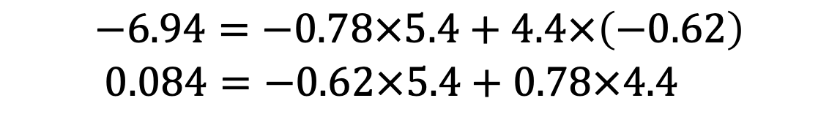



An Example of PCA application
Obtain PCs $X^{′}=eT\tilde{X}$
$$\tilde{X}=\left(\begin{aligned}5.4 4.4 \\ −2.6 −1.6 \\ −3.6 −2.6 \\ 2.4 1.9 \\ −1.6 −2.1\end{aligned}\right)$$
$$e=(e1, e2)=\left(\begin{aligned}−0.78 −0.62 \\ −0.62 0.78\end{aligned}\right).$$
# | PC1 | PC2
1 | -6.94 | 0.084
2 | 3.02 | 0.364
3 | 4.42 | 0.204
4 | -3.05 | -0.006
5 | 2.55 | -0.646
$$−6.94=−0.78×5.4+4.4×\left(−0.62\right)$$
$$0.084=−0.62×5.4+0.78×4.4$$
Notes:
We can obtain PCs.
The instructor will show you the details on the explanation of calculations.

Slide 18
PCA for clustering
Point | House Price | Area
S₁ | 10 | 9
S₂ | 2 | 3
S₃ | 1 | 2
S₄ | 7 | 6.5
S₅ | 3 | 2.5
PCA
Map 2D to 1D
Point | PC1
P₁ | -6.94
P₂ | 3.02
P₃ | 4.42
P₄ | -3.05
P₅ | 2.55
Notes:
If we do clustering on the original space, it is not obvious to group S4 and S1 into one cluster.
If we do clustering with PC1, it is easier to group P1 and P4 into the same cluster if the clustering rules are below.
if Pi < 0, Pi belongs to C1
if Pi > 0, Pi belongs to C2

Slide 19
DLI Accelerated Data Science Teaching Kit
Thank You

