Slide 1
Lecture 4.1 - Sources of Bias and Fairness Measures
DLI Accelerated Data Science Teaching Kit

Slide 2

The Accelerated Data Science Teaching Kit is licensed by NVIDIA, Georgia Institute of Technology, and Prairie View A&M University under the
Creative Commons Attribution-NonCommercial 4.0 International License.

Slide 3
Bias Sources and Fairness Measures
Outline
Bias Source
Types of Bias
Bias from the training data
Bias from unequal model performance
Fairness Measures
False/true positive/negative rate
Demographic parity
Equalized odds
Disaggregated values

Slide 4
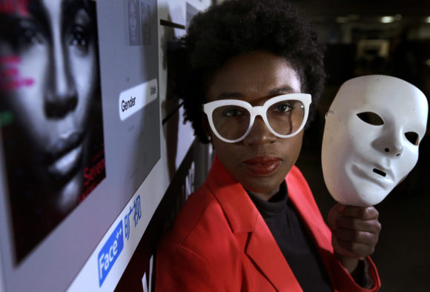
Why do we care about bias and fairness?
Example 1: Skin Color Bias in Facial Recognition
Some software could not detect dark-skinned faces
Facial attribute classifiers have lower accuracy on black women than white men
Image credit: https://www.nytimes.com/2020/11/11/movies/coded-bias-review.html

Slide 5
Why do we care about bias and fairness?
Example 2: Gender Bias in Word Embeddings
Word embedding transforms words into vectors
The distance in the word embedding vector space has semantic meaning
Word embedding’s arithmetic properties reveal gender bias
“Woman” + “King” – “Man” = “Queen”
“Woman” + “Doctor” – “Man” = “Nurse”
Example: Bolukbasi, T., Chang, K. W., Zou, J., Saligrama, V., & Kalai, A. (2016). Man is to computer programmer as woman is to homemaker? debiasing word embeddings. arXiv preprint arXiv:1607.06520.

Slide 6

Where are the bias from?
Key source: training data
Data is a social mirror
Bias exist in real life and data collection
ML models learn from data patterns, including bias

Slide 7
Types of Bias
Reporting bias: what people share does not align with real-world frequencies
Selection bias: data selection does not reflect random sample
Temporal bias: difference in populations and behaviors over time
In-group bias: preference of an individual for characteristics you share
Out-group homogeneity bias: tendency to stereotype individuals from other group
Confirmation bias: processing data in a way that affirm pre-existing hypothesis and beliefs
And 100+ other bias types listed on Wikipedia
Bias types: https://en.wikipedia.org/wiki/List_of_cognitive_biases

Slide 8



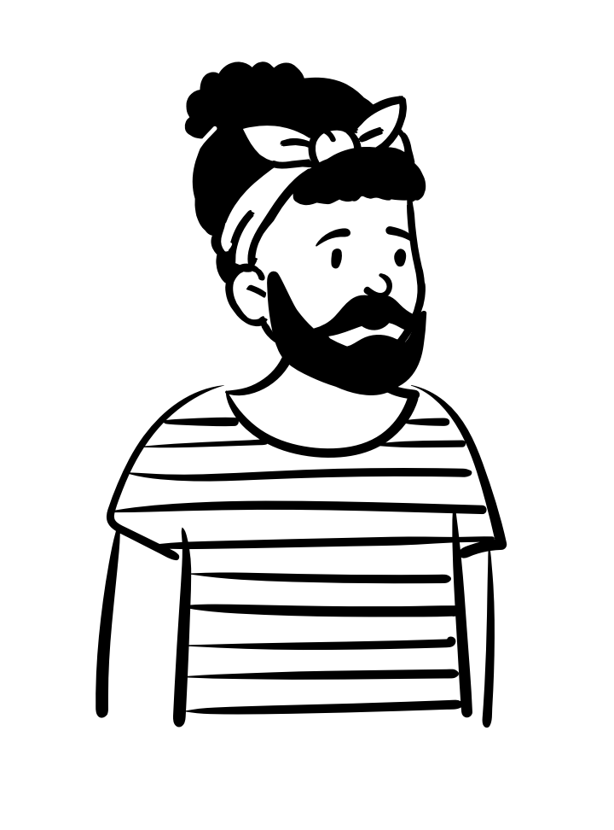




Bias in Data
Biased data representation
Even when the data include an appropriate amount of samples for each group, some group can be represented less positively than others.

Slide 9
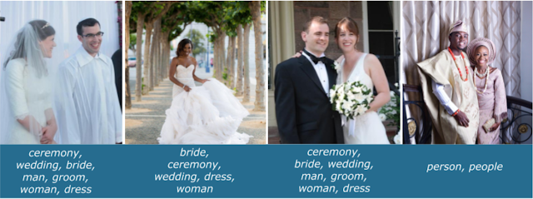
Bias in Data
Biased labels
Data label reflects annotation’s pre-existing beliefs.
Image credit: https://ai.googleblog.com/2018/09/introducing-inclusive-images-competition.html

Slide 10



Bias in Interpretation
Bias from unequal model performance
College Admission Model
91% accuracy
Bias from overgeneralization
Majority group enjoys higher accuracy in decision making
95% accuracy
32% accuracy

Slide 11
How do we measure fairness?
Confusion matrix
Actual: Positive
Actual: Negative
True Positive
False Positive
Analyze confusion matrix in addition to test accuracy
Choose evaluation metrics based on the goal of your model
False positive might be better than false negative (COVID testing)
Predicted:
Positive
False Negative
True Negative
Predicted:
Negative

Slide 12
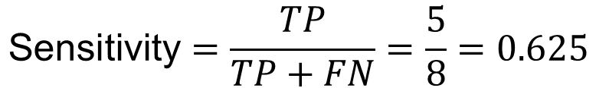
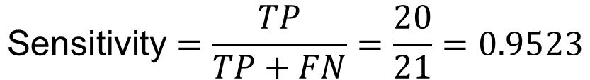
How do we measure fairness?
Equality of opportunity
Male applicant
Female applicant
Equality of opportunity: sensitivity (true positive rate) is equal across subgroups
It measures whether the people with positive labels are equally likely to be classified as positive regardless of their group membership
True Positive (TP) = 20
False Positive
(FP) = 5
True Positive (TP) = 5
False Positive
(FP) = 4
False Negative
(FN) = 1
True Negative
(TN) = 100
False Negative
(FN) = 3
True Negative
(TN) = 30
$$\text{Sensitivity}=\frac{TP}{TP+FN}=\frac{20}{21}=0.9523$$
$$\text{Sensitivity}=\frac{TP}{TP+FN}=\frac{5}{8}=0.625$$
Fairness metrics: https://developers.google.com/machine-learning/glossary/fairness

Slide 13
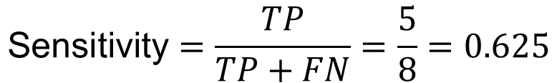
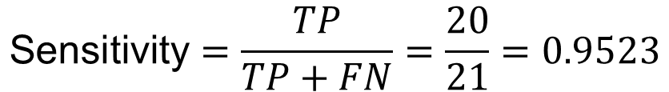
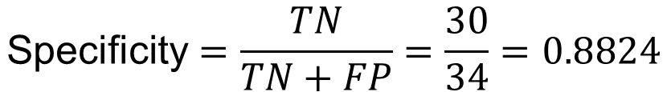
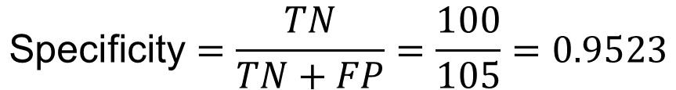
How do we measure fairness?
Equalized odds
Male applicant
Female applicant
Equalized odds: sensitivity (true positive rate) and specificity (true negative rate) are both equal across subgroups
It measures for any given label and attribute, whether a model predicts that label equally well for all values of that attribute
True Positive (TP) = 20
False Positive
(FP) = 5
True Positive (TP) = 5
False Positive
(FP) = 4
False Negative
(FN) = 1
True Negative
(TN) = 100
False Negative
(FN) = 3
True Negative
(TN) = 30
$$\text{Sensitivity}=\frac{TP}{TP+FN}=\frac{20}{21}=0.9523$$
$$\text{Sensitivity}=\frac{TP}{TP+FN}=\frac{5}{8}=0.625$$
$$\text{Specificity}=\frac{TN}{TN+FP}=\frac{100}{105}=0.9523$$
$$\text{Specificity}=\frac{TN}{TN+FP}=\frac{30}{34}=0.8824$$
Fairness metrics: https://developers.google.com/machine-learning/glossary/fairness

Slide 14
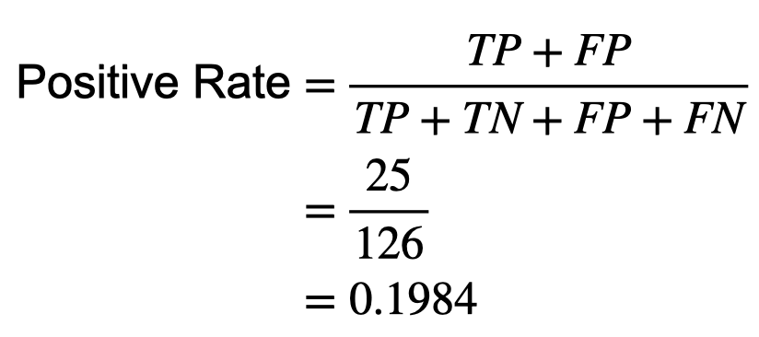
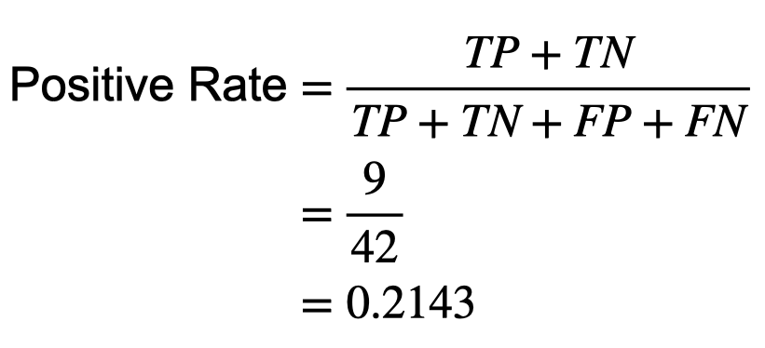
How do we measure fairness?
Demographic parity
Male applicant
Female applicant
True Positive (TP) = 20
False Positive
(FP) = 5
True Positive (TP) = 5
False Positive
(FP) = 4
Demographic parity: model positive rate is equal across subgroups
It measures whether a model’s positive prediction rate is not dependent on a given attribute
False Negative
(FN) = 1
True Negative
(TN) = 100
False Negative
(FN) = 3
True Negative
(TN) = 30
Fairness metrics: https://developers.google.com/machine-learning/glossary/fairness

Slide 15
DLI Accelerated Data Science Teaching Kit
Thank You

