Slide 1
Lecture 4.2 - Tools for Discovering and Interpreting Bias in Models
DLI Accelerated Data Science Teaching Kit

Slide 2

The Accelerated Data Science Teaching Kit is licensed by NVIDIA, Georgia Institute of Technology, and Prairie View A&M University under the
Creative Commons Attribution-NonCommercial 4.0 International License.

Slide 3
Discovering and mitigating bias
Outline
Avoiding Bias
Diversity in team composition
Understand task, stakeholders, and potential for errors
Verify data representation
Understand model decision
Discovering Bias
Targeted test
Quick test
Comprehensive test
Ecologically valid test
Adversarial test
Mitigating Bias
Adversarial training
Correlation loss
Constrained optimization
Tools

Slide 4

Bias Avoidance
Best practice
Diversity in team composition
Understand task, stakeholders, and potential for errors
Verify data representation
Understand model decision

Slide 5

Bias Avoidance
Best practice
Diversity in team composition
Understand task, stakeholders, and potential for errors
Verify data representation
Understand model decision

Slide 6

Bias Avoidance
Best practice
Diversity in team composition
Understand task, stakeholders, and potential for errors
Verify data representation
Understand model decision
Through experiments, surveys and other methods

Slide 7

Bias Avoidance
Best practice
Diversity in team composition
Understand task, stakeholders, and potential for errors
Verify data representation
Understand model decision
Use ML explainability methods to understand the model decision making process

Slide 8
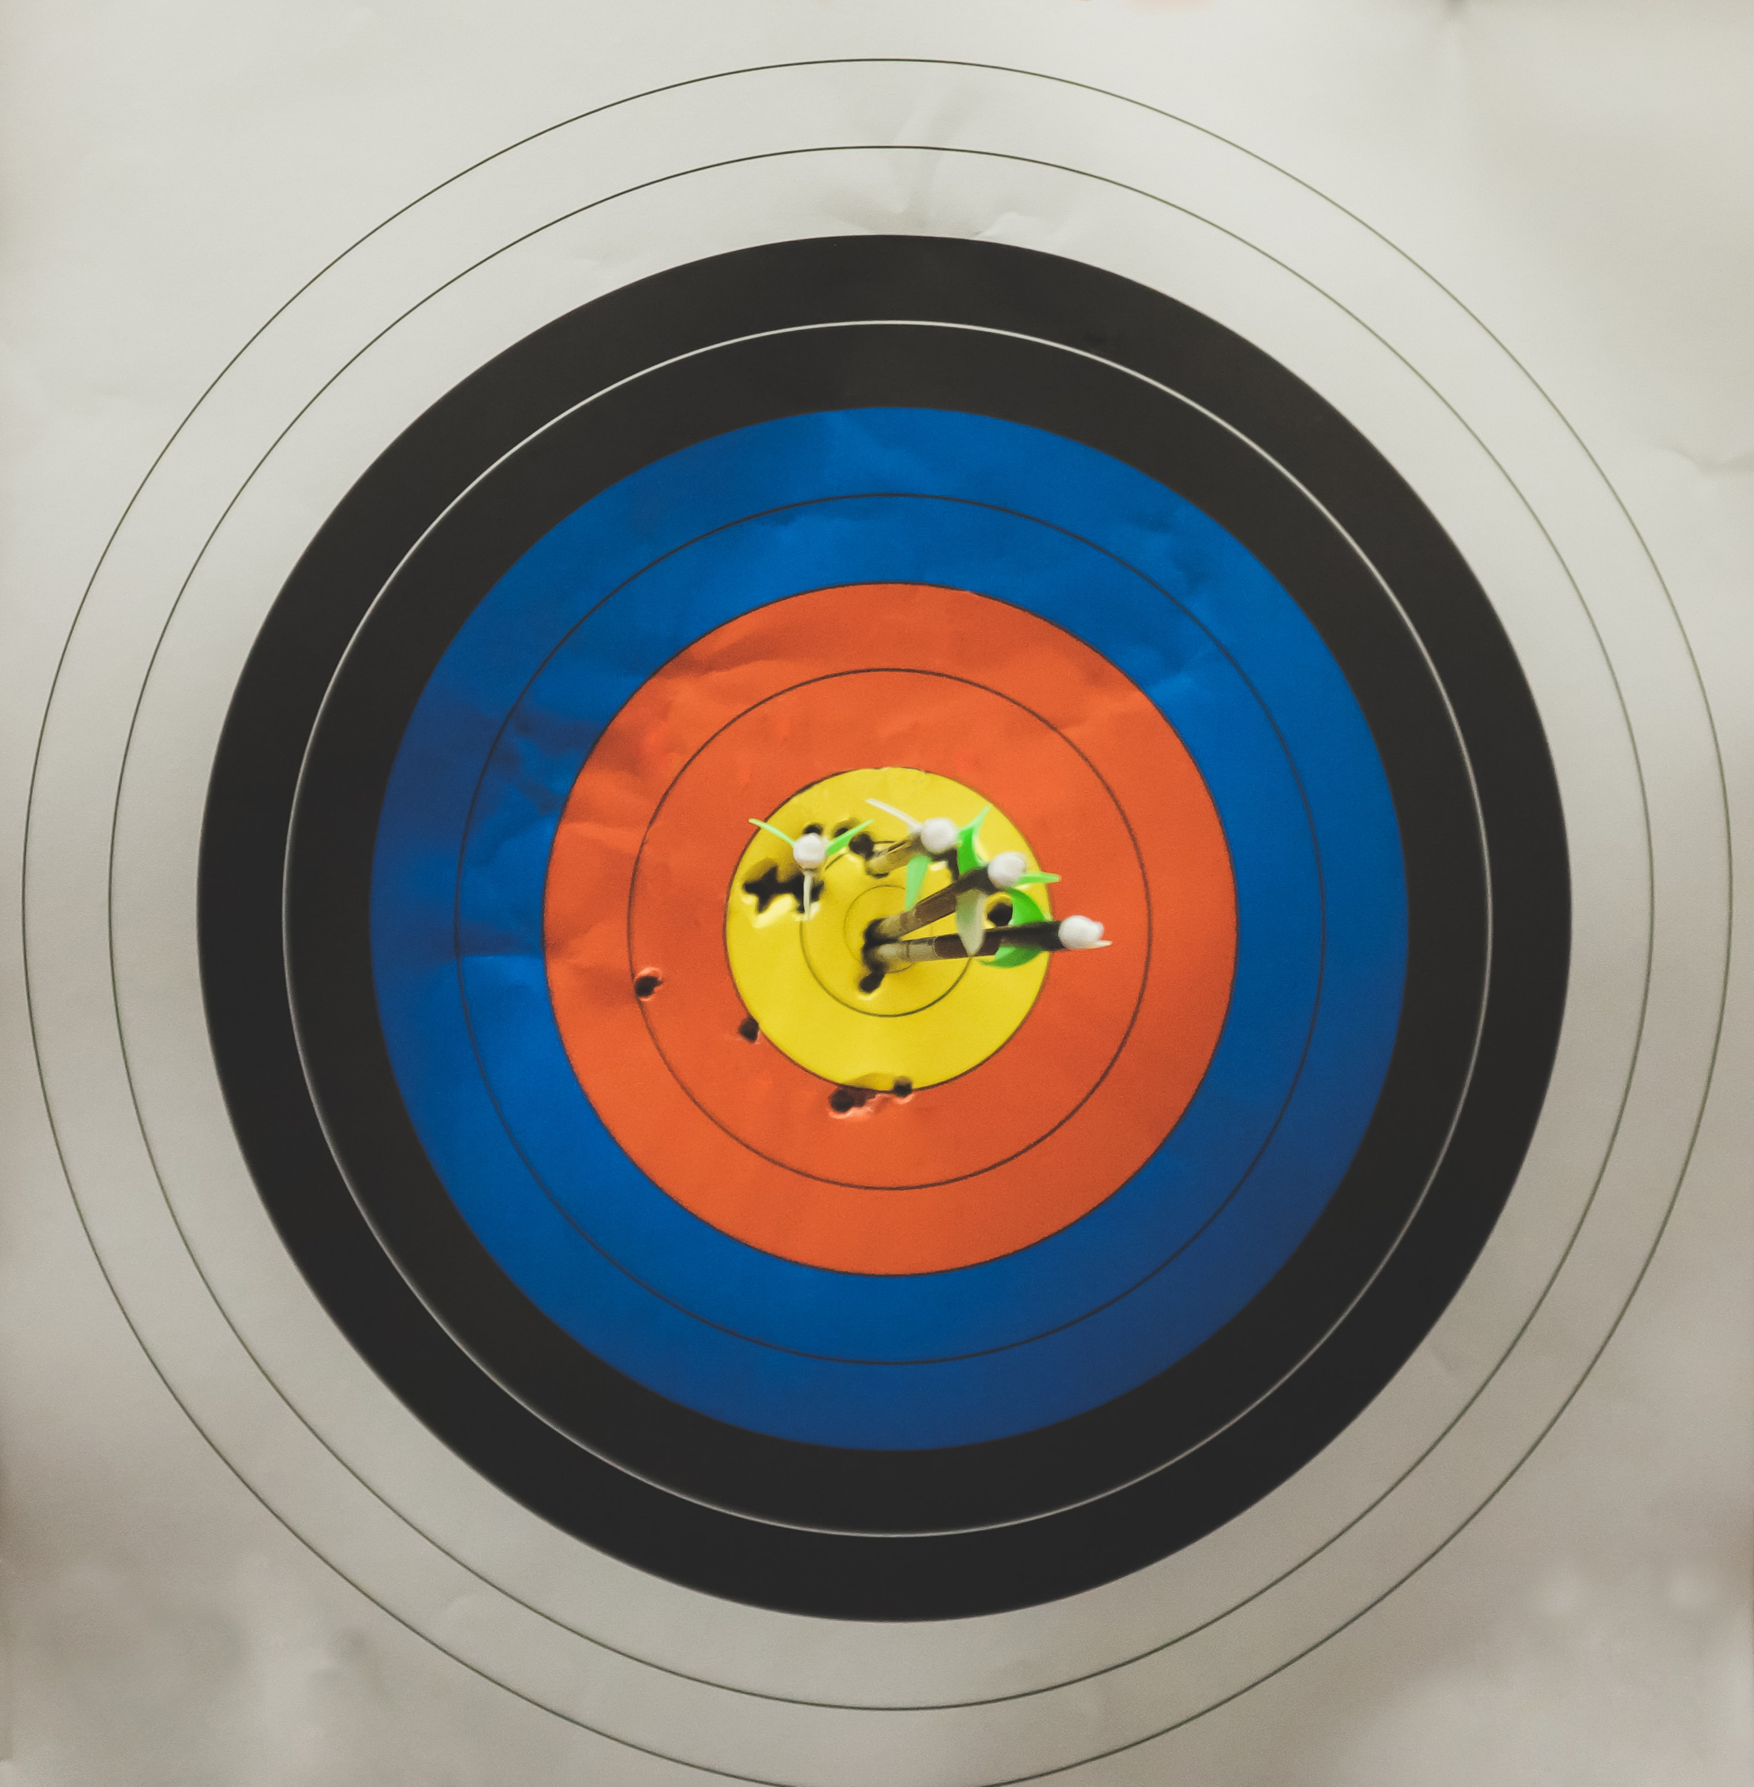
Discovering Bias
Targeted test
Test models on instances that are likely to be affected by bias based on prior experience/knowledge
Test images with different skin colors on facial recognition models
Test gender stereotypes on natural language processing models

Slide 9
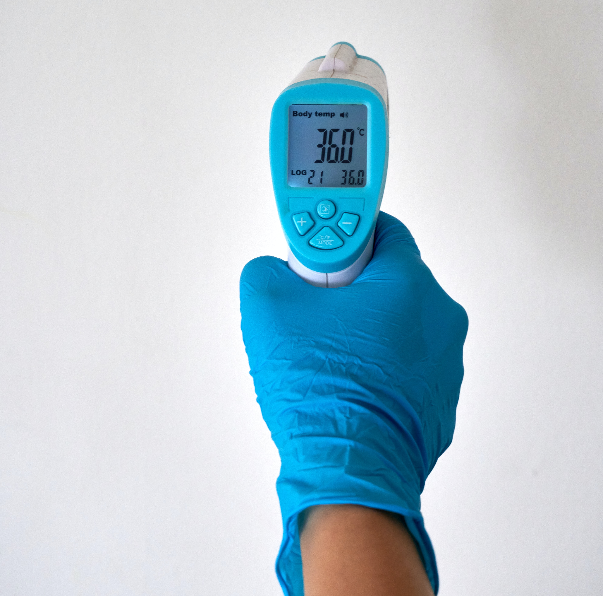
Discovering Bias
Quick test
Check extreme cases
Low coverage but quick to spot major issues
Consider marginalized groups

Slide 10
Discovering Bias
Comprehensive test
Include enough test data for each subgroup
Include all relevant combinations of attributes
Critical if the model will be used in system that has high social impacts

Slide 11

Discovering Bias
Ecologically valid test
Test models on real-world settings
Test how model generalize to newer data
Useful when historical data is available or there are ways to estimate real data distribution

Slide 12

Discovering Bias
Adversarial test
Test for rare but extreme harm
For example, test high-risk options in a medical treatment recommender system
Requires domain knowledge

Slide 13
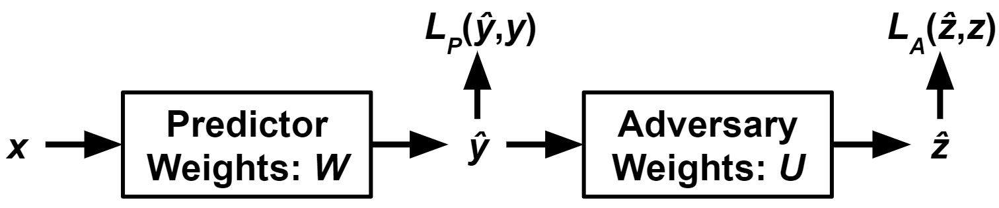
Mitigating Bias
Adversarial learning
Train a predictor (predict label Y) and an adversary (predict attribute Z) simultaneously
Maximize predictor’s power to predict Y and minimize adversary’s ability to predict Z
Figure credit: Zhang, B. H., Lemoine, B., & Mitchell, M. (2018, December). Mitigating unwanted biases with adversarial learning. In Proceedings of the 2018 AAAI/ACM Conference on AI, Ethics, and Society (pp. 335-340).

Slide 14
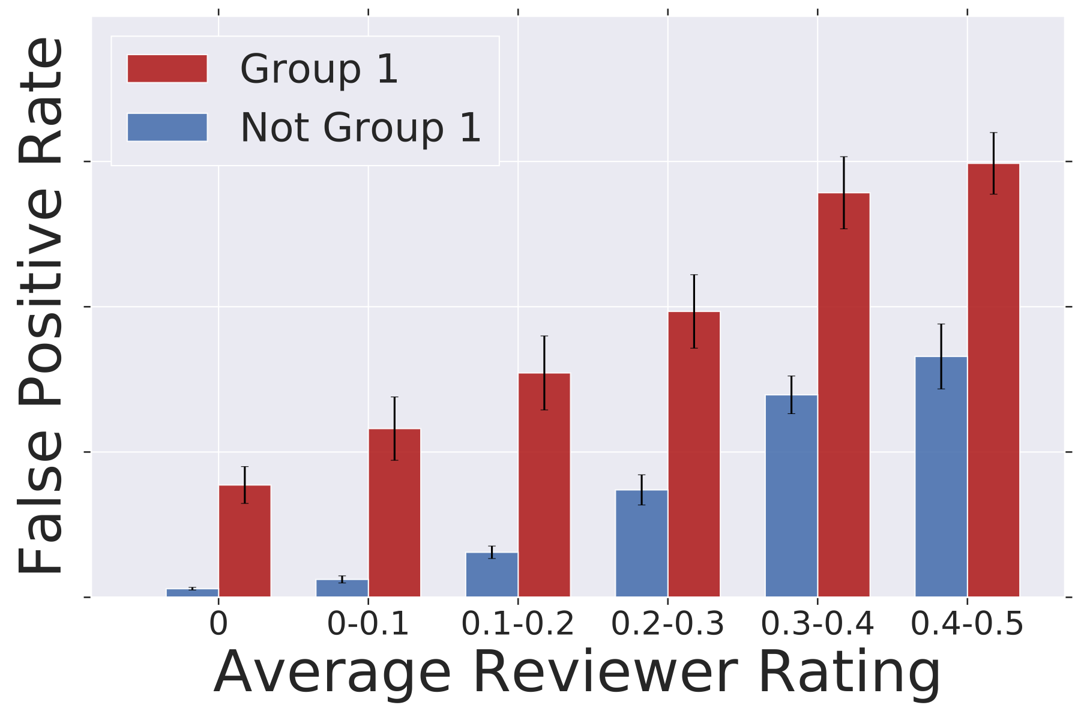
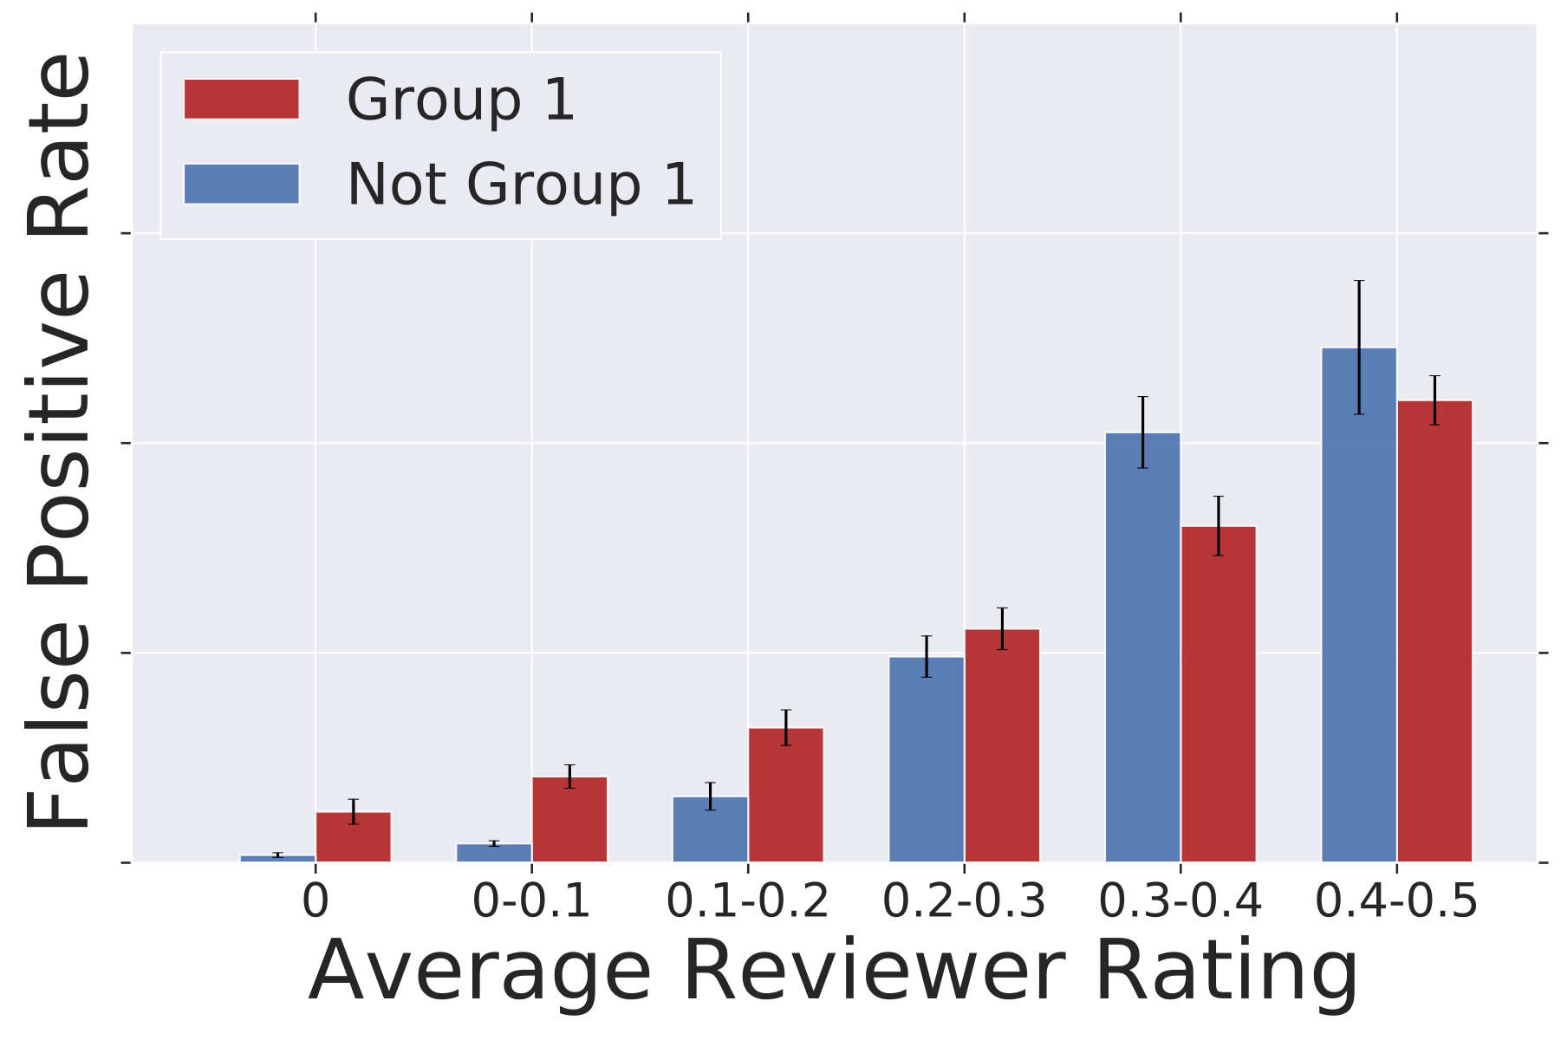
Mitigating Bias
Correlation loss
Include fairness metrics in the loss function (of machine learning algorithms)
Maximizing model’s prediction power while minimizing the predicted label distribution across different protected groups
Before
After
Figure credit: Beutel, A., Chen, J., Doshi, T., Qian, H., Woodruff, A., Luu, C., ... & Chi, E. H. (2019, January). Putting fairness principles into practice: Challenges, metrics, and improvements. In Proceedings of the 2019 AAAI/ACM Conference on AI, Ethics, and Society (pp. 453-459).

Slide 15
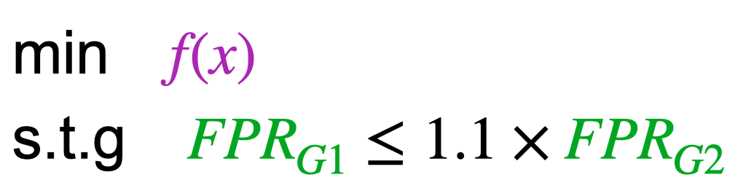
Mitigating Bias
Constrained optimization
Explicitly encode fairness goals as optimization constraints
Trained model minimizes the loss function subject to the fairness constraints
Figure credit: Cotter, A., Gupta, M., Jiang, H., Srebro, N., Sridharan, K., Wang, S., ... & You, S. (2019, May). Training well-generalizing classifiers for fairness metrics and other data-dependent constraints. In International Conference on Machine Learning (pp. 1397-1405). PMLR.

Slide 16
Practical Tools and Libraries
Discovering, understanding, and mitigating bias
Facets — Visualizations for ML datasets
FairVis — Discovering Bias in Machine Learning Using Visual Analytics
Microsoft InterpretML —A toolkit to help understand ML models and enable responsible AI
Microsoft Azure Interpretability Toolkit — SDK packages for ML explainability
IBM Open Scale — A system to monitor model fairness
IBM Fairness 360 — A toolkit for examine, report, and mitigate bias
Microsoft Fairlearn — A toolkit for assessing and improving fairness in AI
Datasheets for Datasets — Fairness information for shared datasets
Model cards — Fairness information for shared models
Fact sheets — Fairness information for AI service
Open source libraries: Aequitas, Audit-AI, FairML, Fairness Comparison, Fairness Measures, FairTest, Themis™, Themis-ML.

Slide 17
DLI Accelerated Data Science Teaching Kit
Thank You

