Slide 1
Lecture ​5.1 - Knowledge Graph
DLI Accelerated Data Science Teaching Kit

Slide 2

The Accelerated Data Science Teaching Kit is licensed by NVIDIA, Georgia Institute of Technology, and Prairie View A&M University under the
Creative Commons Attribution-NonCommercial 4.0 International License.

Slide 3
What is Data Integration?
Combining data from multiple sources to provide the user with a unified view.
Why is it Important?
Think about the apps, websites, and
services that you use every day.

Slide 4
Businesses derive value through data integration.

Slide 5
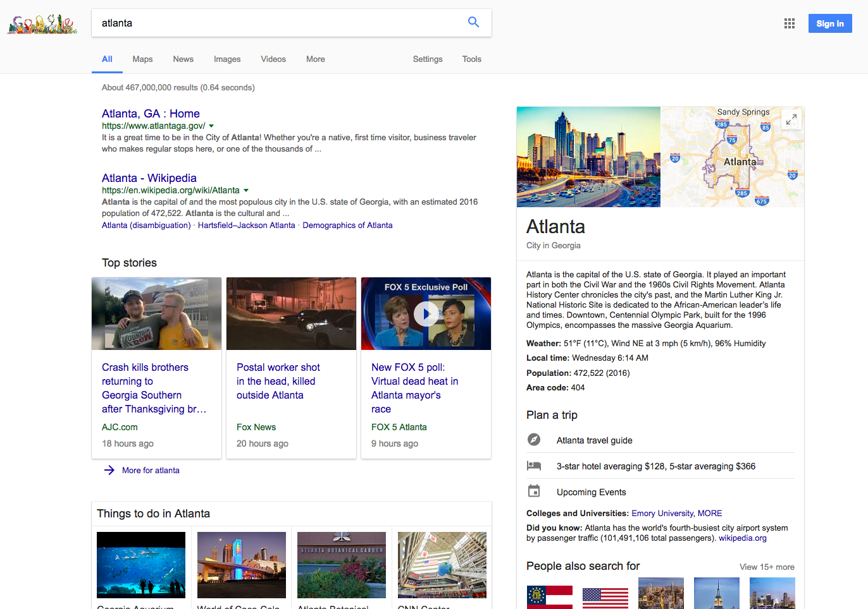
Retrieved: https://www.google.com/search?q=atlanta

Slide 6
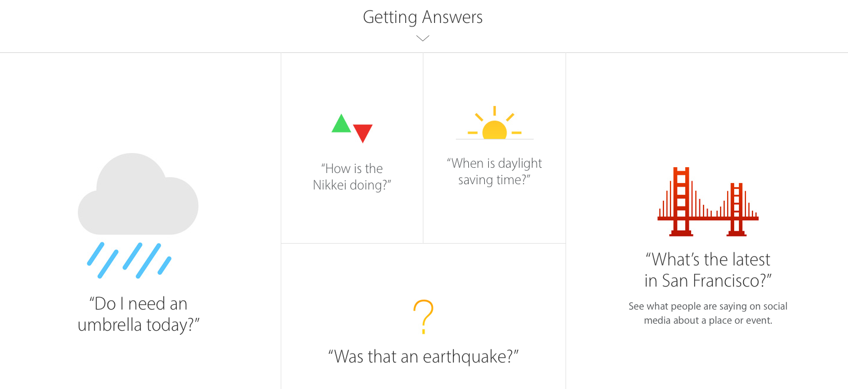
Apple Siri
Retrieved: https://www.apple.com/ios/siri/

Slide 7
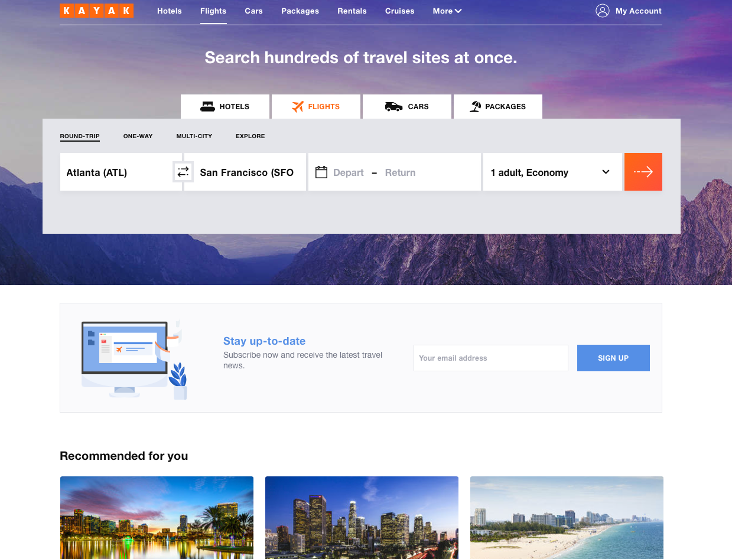
Retrieved: https://www.kayak.com

Slide 8
More Examples?
Social media (data from users, businesses)
  Facebook: your posts, advertisements, review
Search engine: Google, Bing, Yahoo, etc.
Smart assistants: Siri, Cortana, Alexa
Price comparison: Kayak
Uber, Lyft: drivers, traffic data, customers
Google maps: users, restaurants, traffic….
8

Slide 9
How to do data integration?

Slide 10
“Low” Effort Approaches
1. Use database’s “Join”! (e.g., SQLite)
When does this approach work? (Or, when does it NOT work?)
id | name
111 | Smith
222 | Johnson
333 | Lee
id | salary
111 | $40k
222 | $60k
333 | $50k
id | name | salary
111 | Smith | $40k
222 | Johnson | $60k
333 | Lee | $50k
2. Open Refine
http://openrefine.org (Video #3 “Reconcile and Match Data“)
10

Slide 11
IDs are really important, and can simplify data integration!
But who creates the IDs?

Slide 12
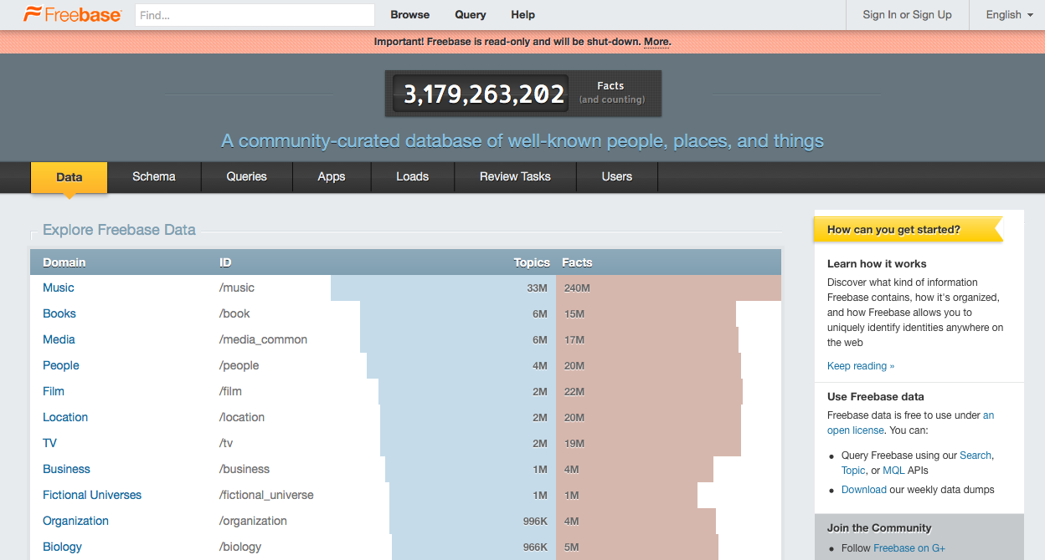
Crowd-sourcing Approaches: Freebase
Freebase intro video: https://youtu.be/TJfrNo3Z-DU
Learn more about Freebase at https://en.wikipedia.org/wiki/Freebase
12

Slide 13
Freebase
(a graph of entities)
“…a large collaborative knowledge base consisting of metadata composed mainly by its community members…”
  Wikipedia.
Retrieved on November 27, 2017https://en.wikipedia.org/wiki/Freebase
13

Slide 14
So what?
What can you do with the Freebase knowledge graph?
Hint: Google acquired it in 2010.
14

Slide 15
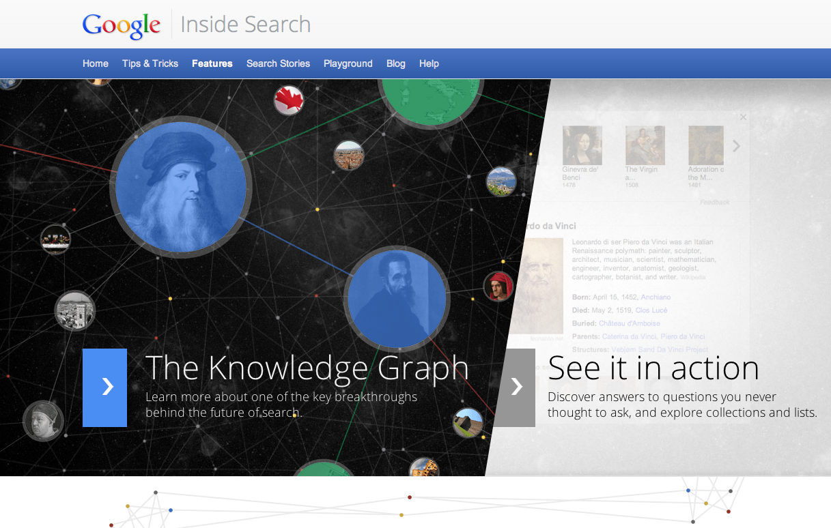
Retrieved: https://www.google.com/intl/bn/insidesearch/features/search/knowledge.html
https://www.google.com/intl/bn/insidesearch/features/search/knowledge.html
http://www.google.com/insidesearch/features/search/knowledge.html

Slide 16

Freebase replaced by
Google Knowledge Graph API
Example:
What does Google know about Taylor Swift?
https://developers.google.com/knowledge-graph/
16

Slide 17
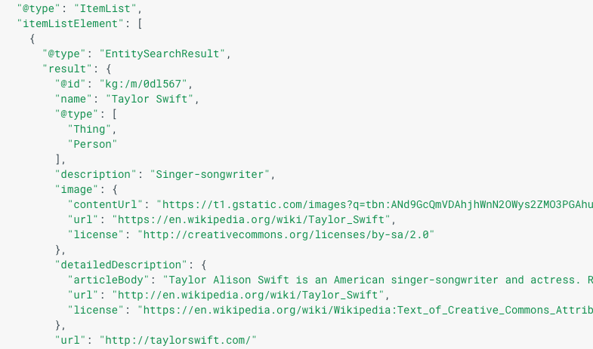
What does Google know about Taylor Swift?
https://developers.google.com/knowledge-graph/
Retrieved: https://developers.google.com/knowledge-graph/
17

Slide 18
Google has the Knowledge Graph.
Facebook has…

Slide 19
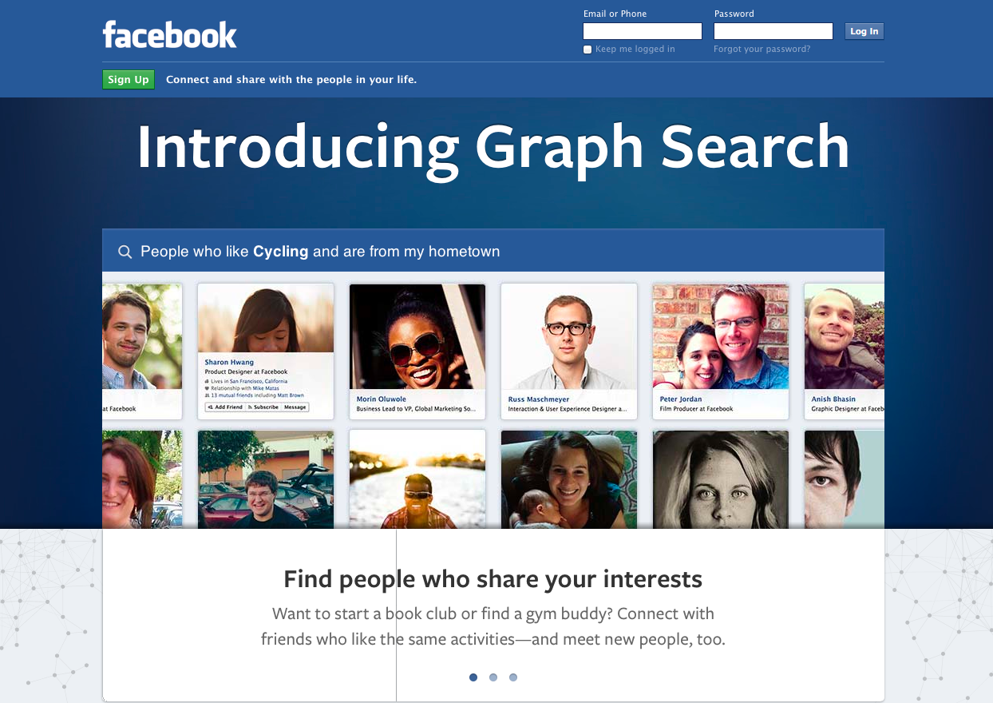
Graph Search intro video: https://youtu.be/W3k1USQbq80
Retrieved: https://search.fb.com

Slide 20
DLI Accelerated Data Science Teaching Kit
Thank You

