Slide 1
Lecture 5.2 - Data De-duplication
DLI Accelerated Data Science Teaching Kit

Slide 2

The Accelerated Data Science Teaching Kit is licensed by NVIDIA, Georgia Institute of Technology, and Prairie View A&M University under the
Creative Commons Attribution-NonCommercial 4.0 International License.

Slide 3
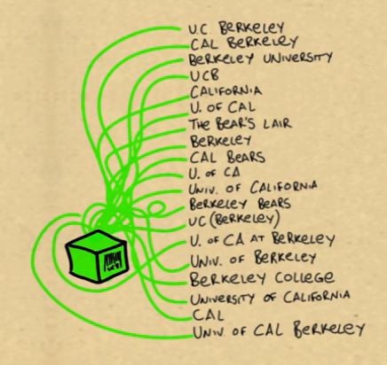
What if we don’t have the luxury of having IDs ?
A common problem in academia:
Polo Chau
Duen Horng Chau
D.H. Chau
D. Chau
(Screenshot from FreeBase video)
3

Slide 4
Then you need to do…
Entity Resolution
(A hard problem in data integration)
4

Slide 5
Why is entity resolution so difficult?
Let’s understand it through shopping for an iPhone on
Apple, Amazon and eBay

Slide 6
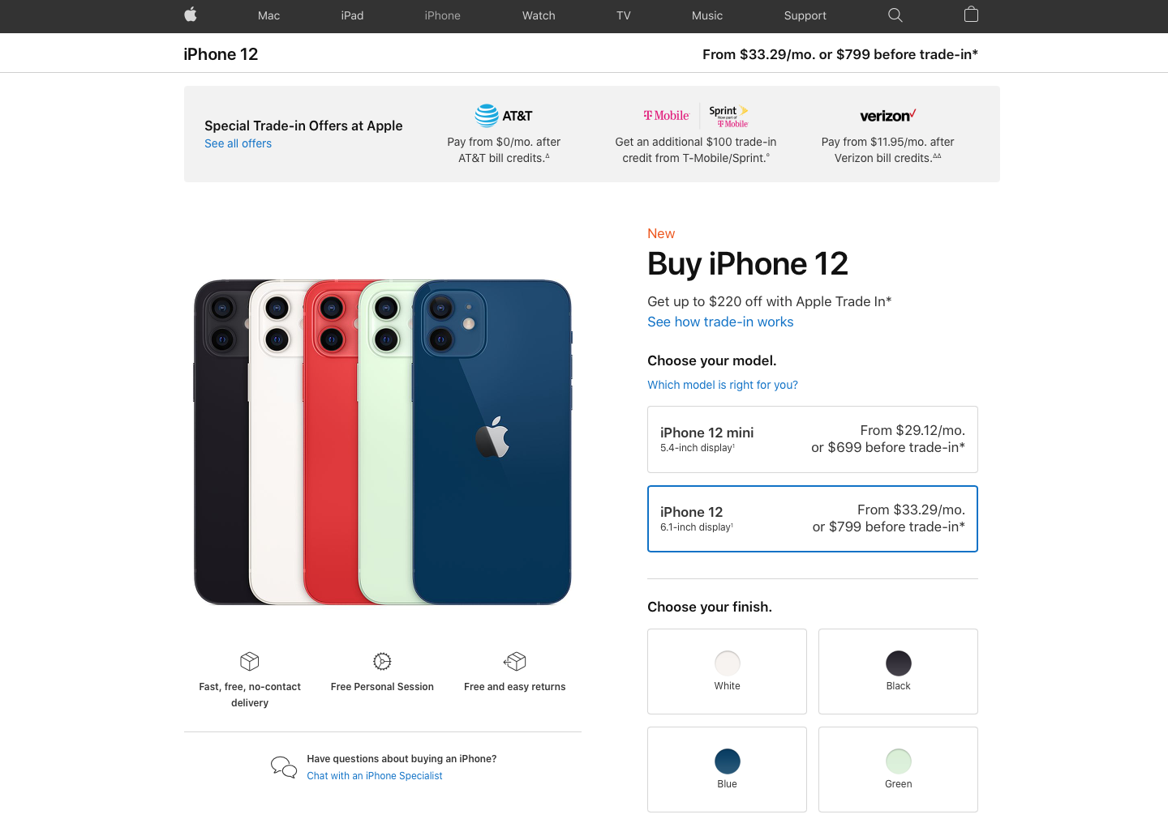
Retrieved: https://www.apple.com/shop/buy-iphone/iphone-12

Slide 7
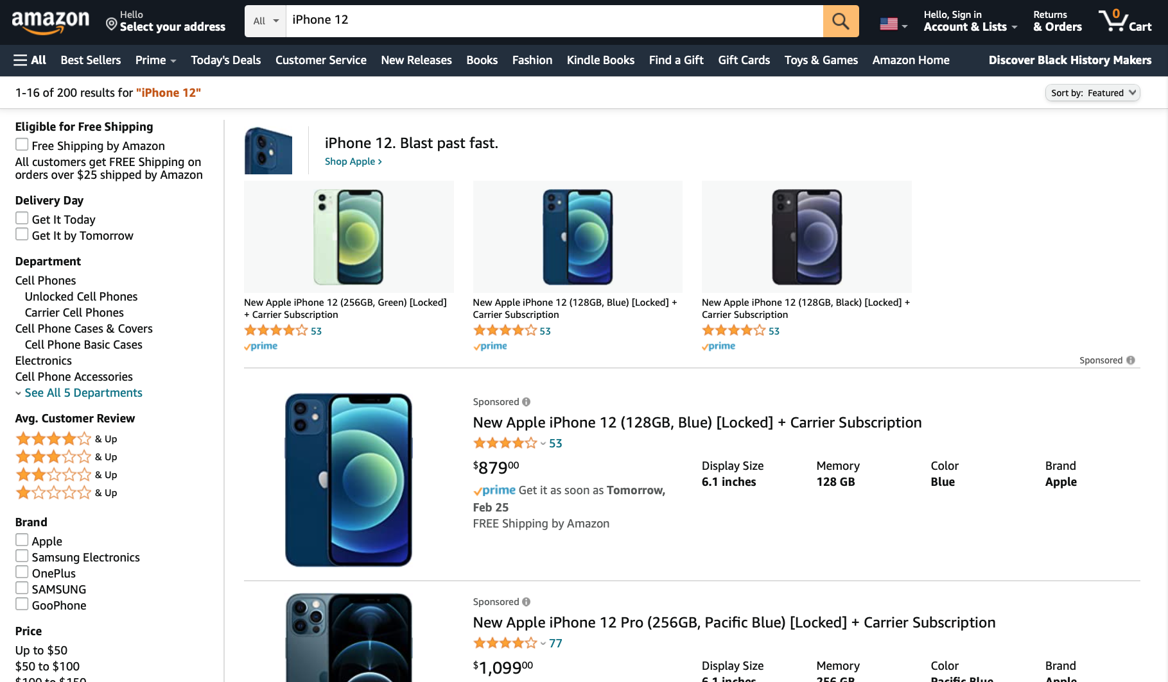
Retrieved: www.amazon.com

Slide 8
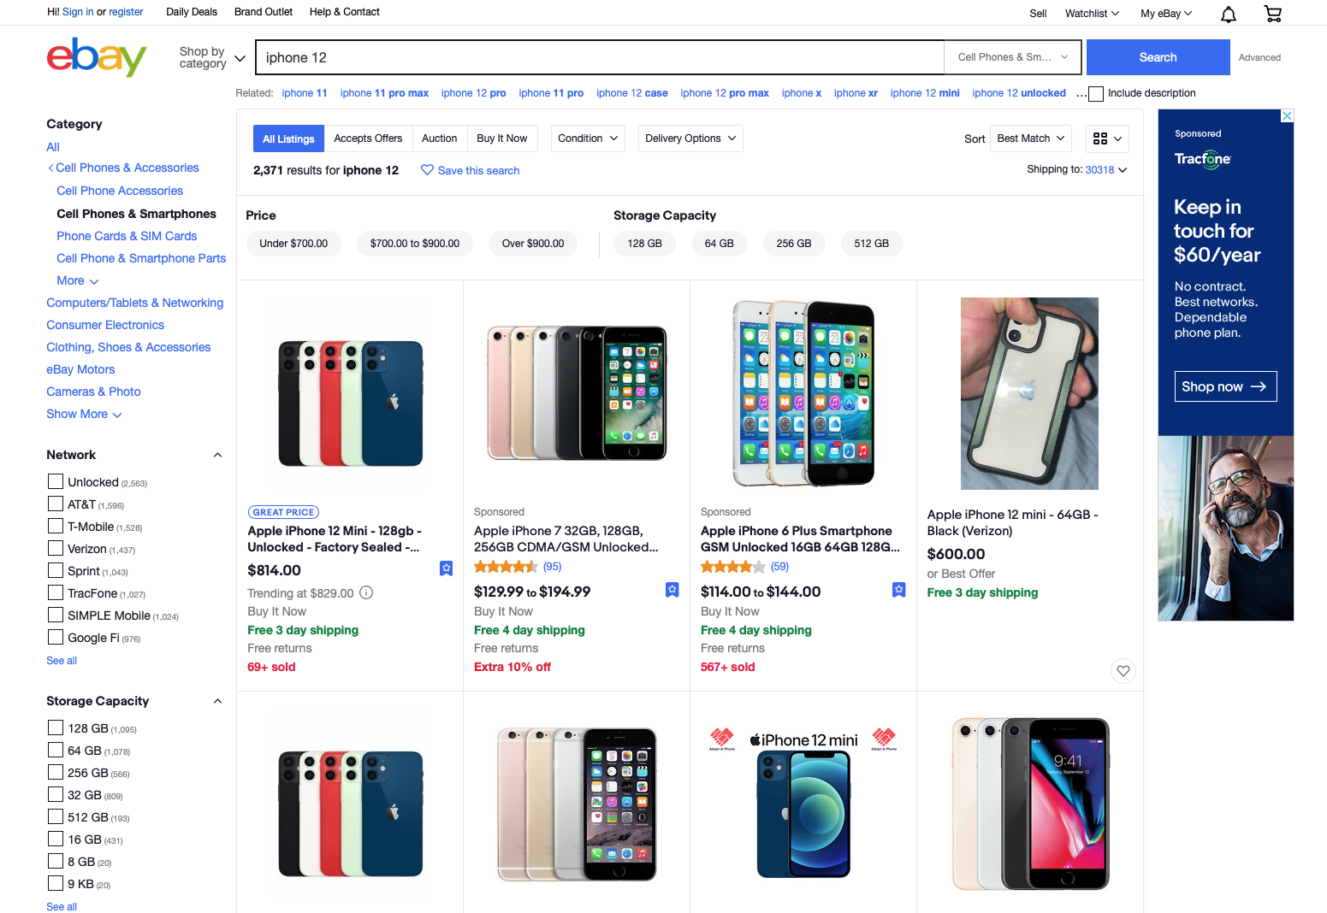
Retrieved: www.ebay.com

Slide 9
D-Dupe
Interactive Data Deduplication and Integration
TVCG 2008
University of Maryland
Bilgic, Licamele, Getoor, Kang, Shneiderman
Retrieved: https://linqspub.soe.ucsc.edu/basilic/web/Publications/2006/bilgic:vast06/

Slide 10
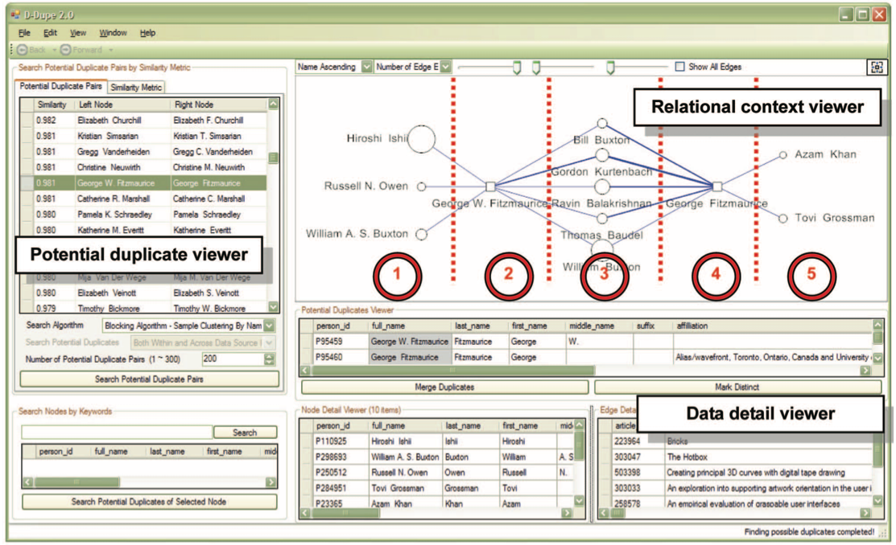

Slide 11
Alice
Polo
Bob
Carol
Paolo
Dave

Slide 12
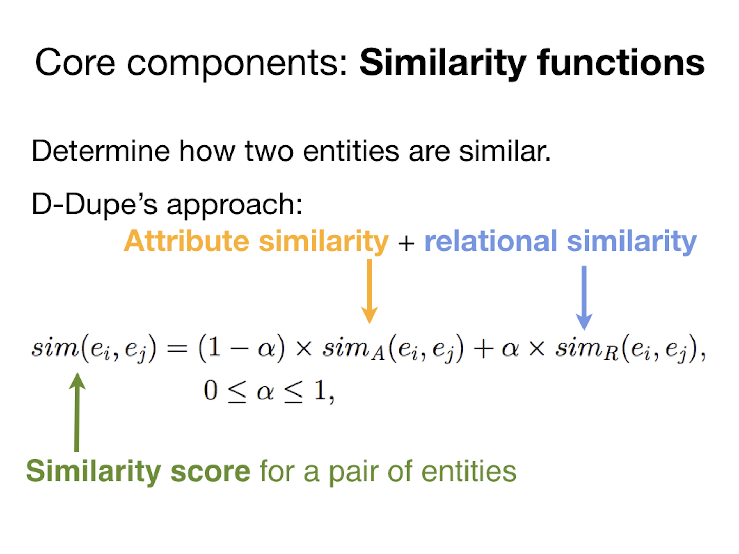

Slide 13
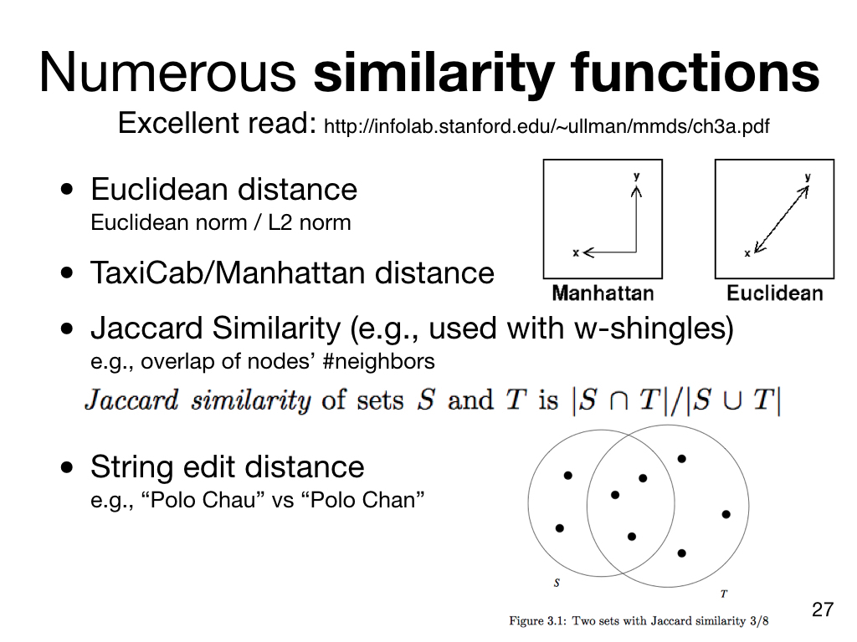
Retrieved: Mining of Massive Datasets by Jure Leskovec, Anand Rajaraman, Jeff Ullman
Retrieved: http://www.improvedoutcomes.com/docs/WebSiteDocs/Clustering/Clustering_Parameters/Manhattan_Distance_Metric.htm

Slide 14
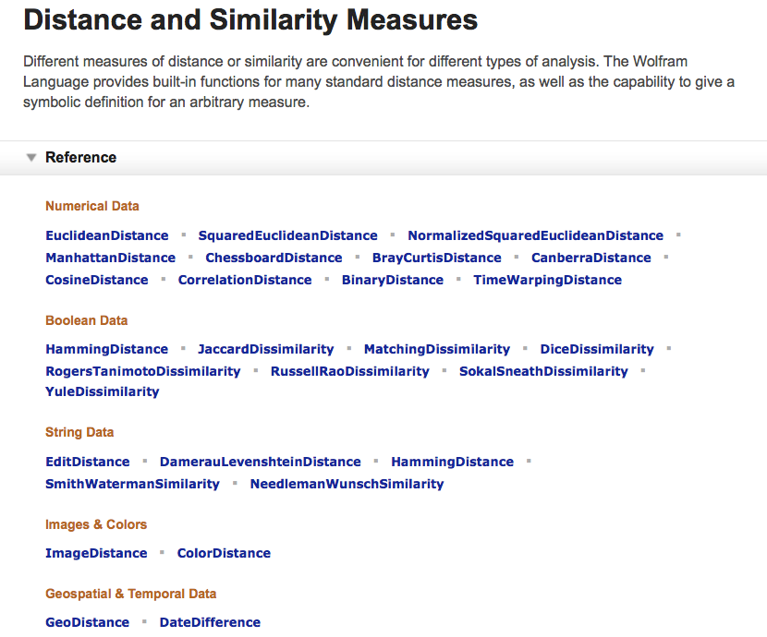
https://reference.wolfram.com/language/guide/DistanceAndSimilarityMeasures.html

Slide 15
Excellent Tutorial on Entity Resolution
http://www.umiacs.umd.edu/~getoor/Tutorials/ER_KDD2013.pdf
by Lise Getoor and Ashwin Machanavajjhala

Slide 16
DLI Accelerated Data Science Teaching Kit
Thank You

