Slide 1
Lecture 6.1 - Break Complex Problems into Simpler Ones: Part 1
DLI Accelerated Data Science Teaching Kit

Slide 2

The Accelerated Data Science Teaching Kit is licensed by NVIDIA, Georgia Institute of Technology, and Prairie View A&M University under the
Creative Commons Attribution-NonCommercial 4.0 International License.

Slide 3
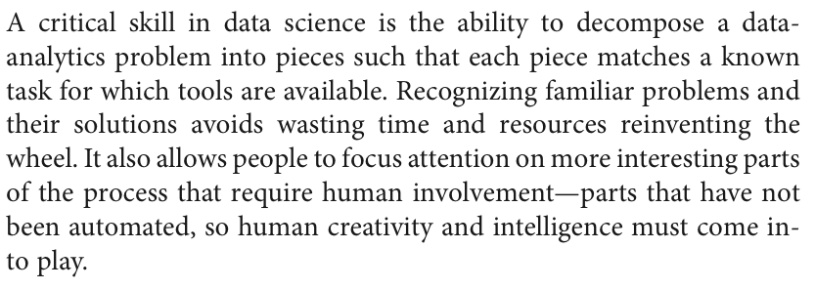
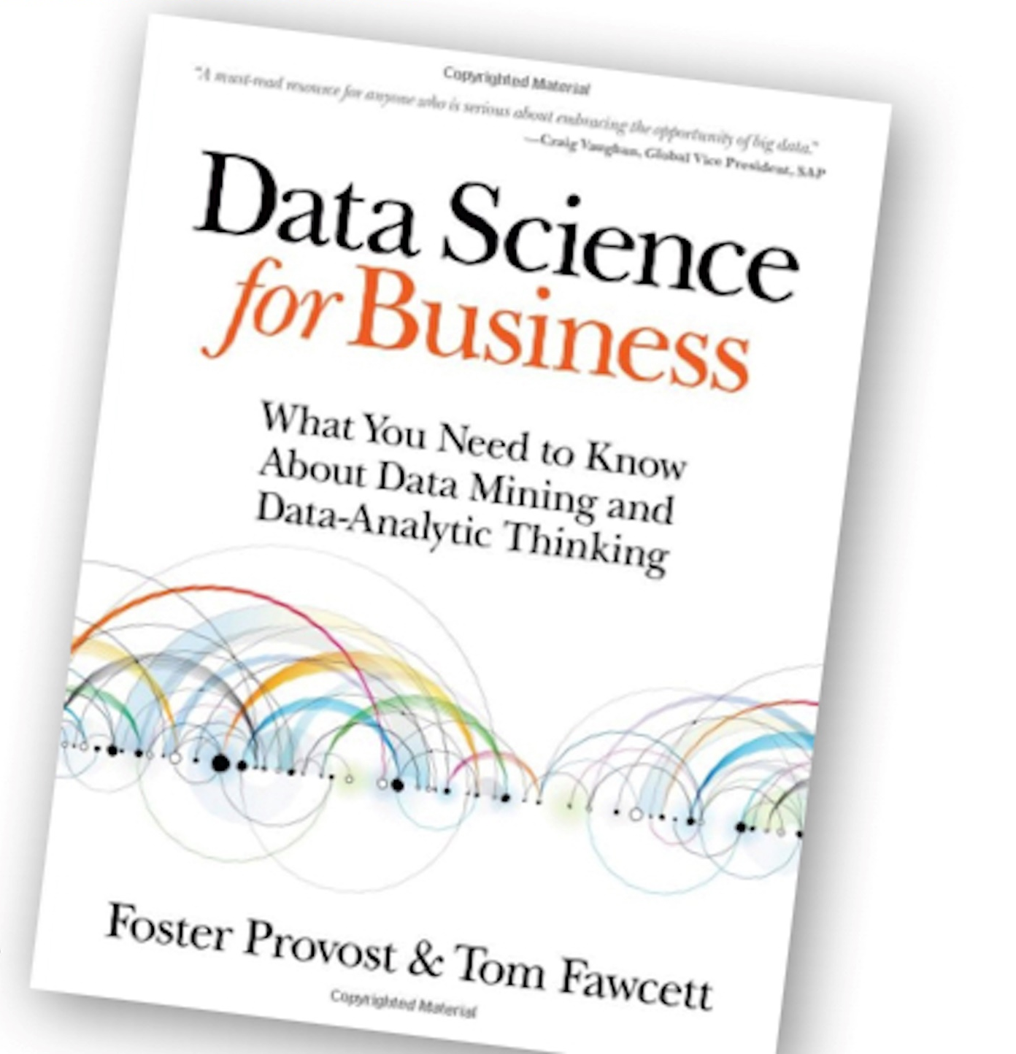
8 non-mutually exclusive concept classes
http://www.amazon.com/Data-Science-Business-data-analytic-thinking/dp/1449361323
Notes:
Not very good resolution.

Slide 4
1. Classification
Predict which of a (small) set of classes an entity belongs to:
email spam (y, n)
sentiment analysis (+, -, neutral)
news (politics, sports, …)
medical diagnosis (cancer or not)
shirt size (s, m, l)
cat detection
face detection (baby, middle-aged, etc)
buy/not buy - commerce
Notes:
Not very good resolution.

Slide 5
2. Regression (“value estimation”)
Predict the numerical value of some variable for an entity.
point value of wine (50-100)
credit scores
stock prices
relationship between price and sales
weather
sports and game scores
Notes:
Not very good resolution.

Slide 6

3. Similarity Matching
Find similar entities (from a large dataset) based on what we know about them.
find similar gene sequences (that may be repeating, or does similar things)
online dating
patent search
carpool matching (find people to carpool)
Notes:
Not very good resolution.

Slide 7
4. Clustering (unsupervised learning)
(For most algorithms, user provides # of clusters)
Group entities together by their similarity.
groupings of similar bugs in code
topical analysis (tweets?)
land cover: tree/road/…
for advertising: grouping users for marketing purposes
cluster people by accents (y’all, you all)
Notes:
Not very good resolution.

Slide 8
DLI Accelerated Data Science Teaching Kit
Thank You

