Slide 1
Lecture 7.1 - What is Info Vis and Why it is Important
DLI Accelerated Data Science Teaching Kit

Slide 2

The Accelerated Data Science Teaching Kit is licensed by NVIDIA, Georgia Institute of Technology, and Prairie View A&M University under the
Creative Commons Attribution-NonCommercial 4.0 International License.

Slide 3

Information Visualization Crash Course
(AKA Information Visualization 101)
Chad Stolper Software Engineer at Google
(graduated from Georgia Tech CS PhD)

Slide 4
What is Information Visualization?

Slide 5
Information Visualization
“The use of computer-supported, interactive, visual representations of abstract data to amplify cognition.”
Card, Mackinlay, and Shneiderman 1999

Slide 6
Communication
Exploratory Data Analysis (EDA)

Slide 7
Communication
(gone wrong)

Slide 8
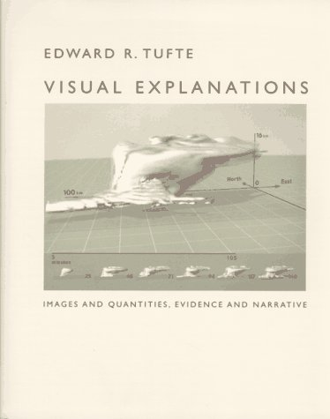
Tufte, E. R. (2012). Visual explanations: images and quantities, evidence and narrative. Cheshire, CT: Graphics Press.

Slide 9
Notes:
Excerpted from Edward Tufte’s Visual Explanations

Slide 10
Space Shuttle Challenger
January 28, 1986
Morning Temperature: 31°F
Notes:
Excerpted from Edward Tufte’s Visual Explanations

Slide 11
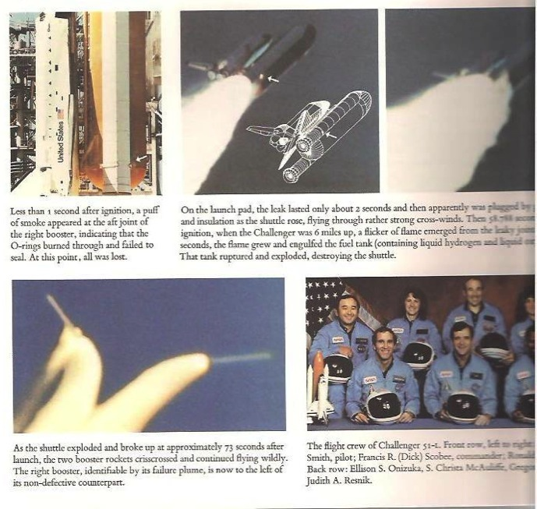
Tufte, E. R. (2012). Visual explanations: images and quantities, evidence and narrative. Cheshire, CT: Graphics Press.

Slide 12
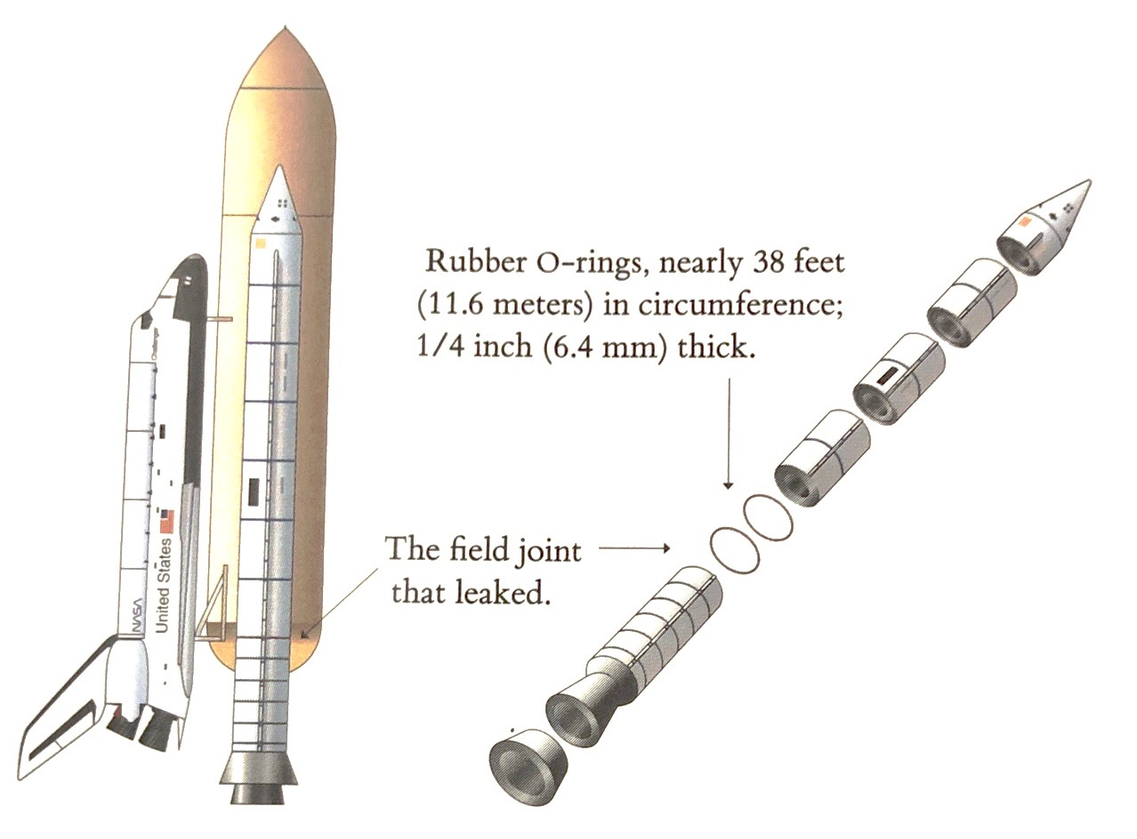
Tufte, E. R. (2012). Visual explanations: images and quantities, evidence and narrative. Cheshire, CT: Graphics Press.

Slide 13
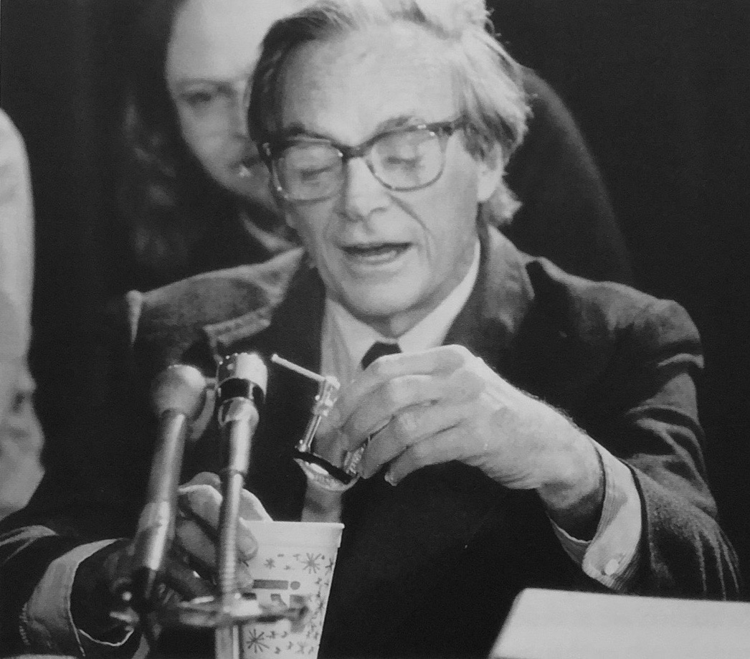
Most Watched Science Experiment
Richard Feynman, Physics Nobel laureate explained how rubber became rigid in cold temperate
YouTube video: https://youtu.be/6Rwcbsn19c0
Video originally from: http://www.FeynmanPhysicsLectures.com
Notes:
Richard Feynman in front of Congress
“most watched science experiment of all time” (”fine” man)
Please visit YouTube to view video: https://youtu.be/6Rwcbsn19c0

Slide 14
How did this happen?

Slide 15
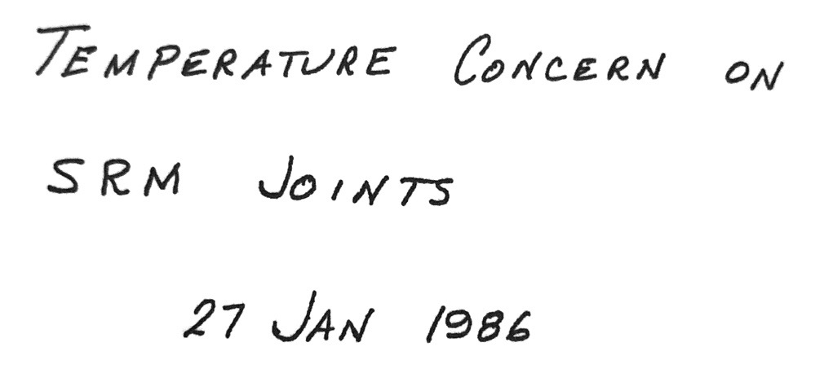
Engineers at Morton Thiokol, the rocket maker, presented on the day before and recommended not to launch.
Tufte, E. R. (2012). Visual explanations: images and quantities, evidence and narrative. Cheshire, CT: Graphics Press.

Slide 16
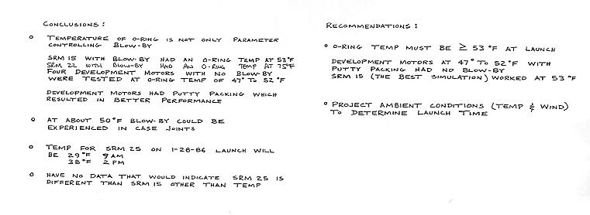
Tufte, E. R. (2012). Visual explanations: images and quantities, evidence and narrative. Cheshire, CT: Graphics Press.
Notes:
>= 53 degrees F at launch

Slide 17
Tufte, E. R. (2012). Visual explanations: images and quantities, evidence and narrative. Cheshire, CT: Graphics Press.

Slide 18
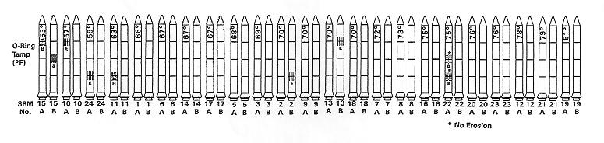
Tufte, E. R. (2012). Visual explanations: images and quantities, evidence and narrative. Cheshire, CT: Graphics Press.

Slide 19
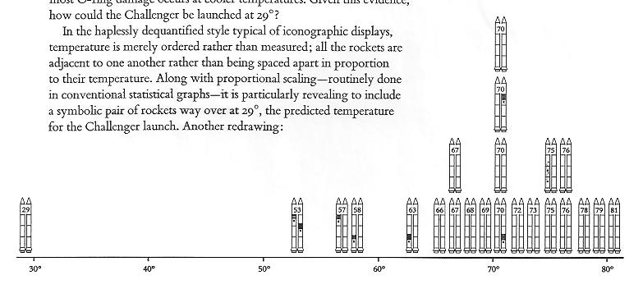
Tufte, E. R. (2012). Visual explanations: images and quantities, evidence and narrative. Cheshire, CT: Graphics Press.

Slide 20
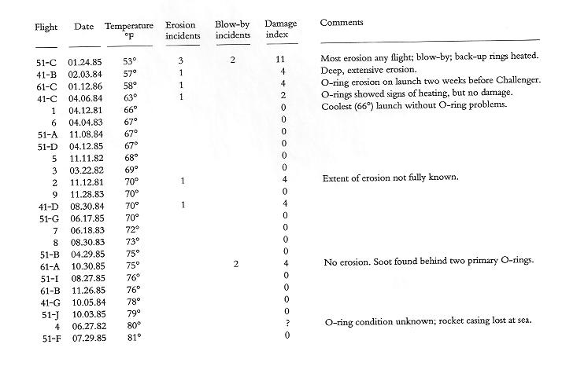
Tufte, E. R. (2012). Visual explanations: images and quantities, evidence and narrative. Cheshire, CT: Graphics Press.
Notes:
Tufte went through and generated this table

Slide 21
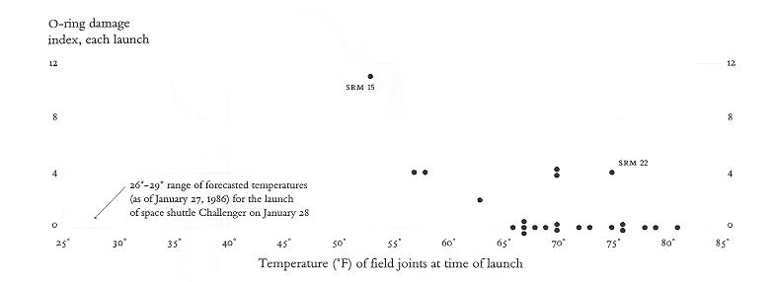
Tufte, E. R. (2012). Visual explanations: images and quantities, evidence and narrative. Cheshire, CT: Graphics Press.

Slide 22
So, communication is extremely important. Visualization can help with that – communicate ideas and insights.

Slide 23
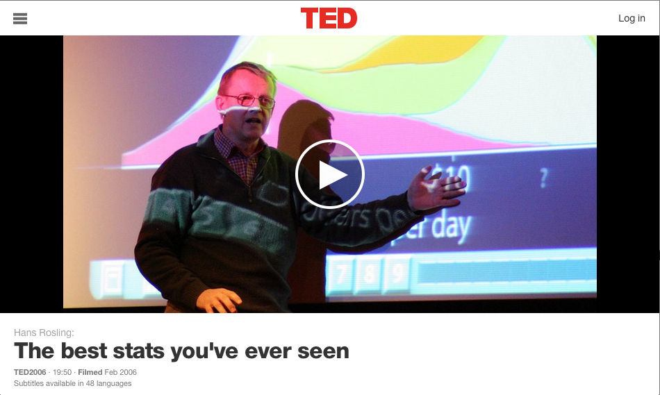
Notes:
Please visit to view video http://www.ted.com/talks/hans_rosling_shows_the_best_stats_you_ve_ever_seen.html

Slide 24
Visualization can also help with Exploratory Data Analysis (EDA)
But why do you need to explore data at all???

Slide 25
“There are three kinds of lies: lies, damned lies, and statistics.”
-Various Attributions

Slide 26
Mystery Data Set
Property | Value
mean( x ) | 9
variance ( x ) | 11
mean( y ) | 7.5
variance ( y ) | 4.122
correlation ( x,y ) | 0.816
Linear Regression Line | y = 3 + 0.5x

Slide 27
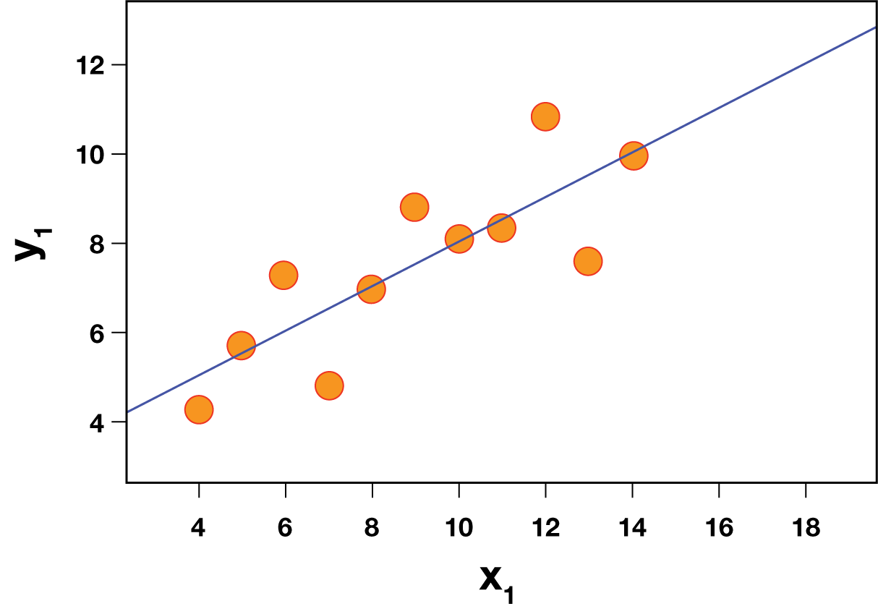

Slide 28
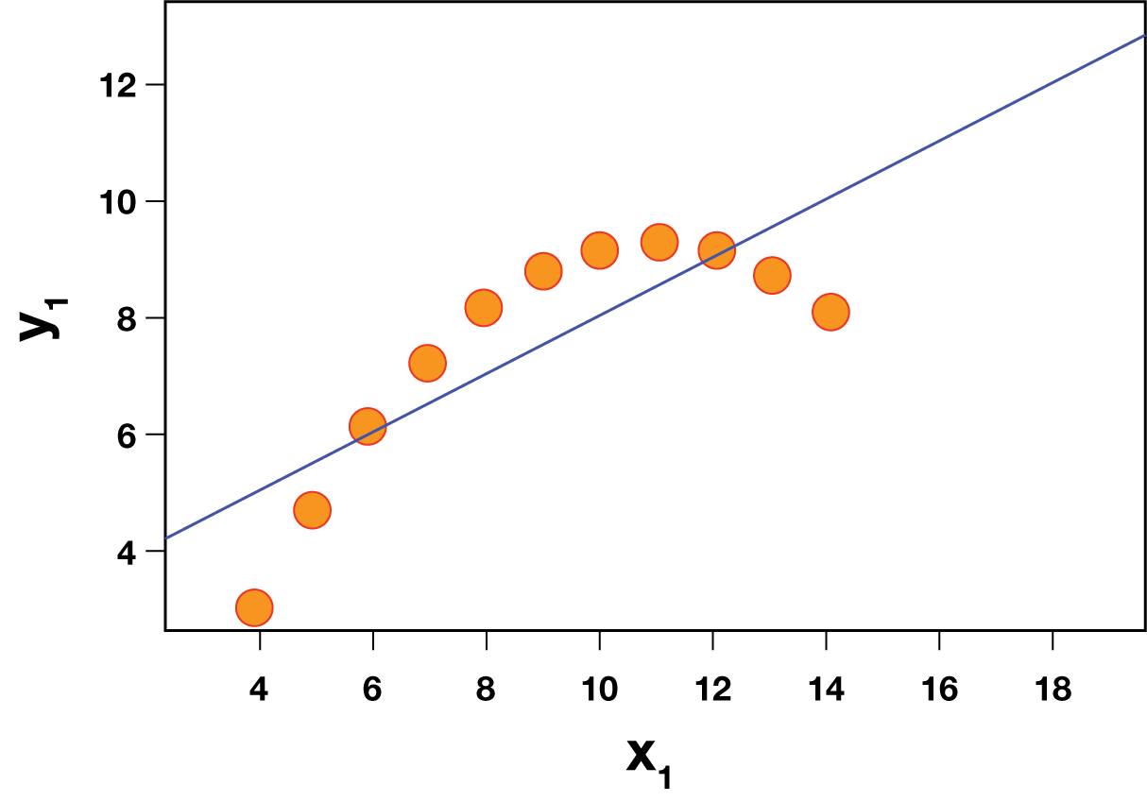

Slide 29
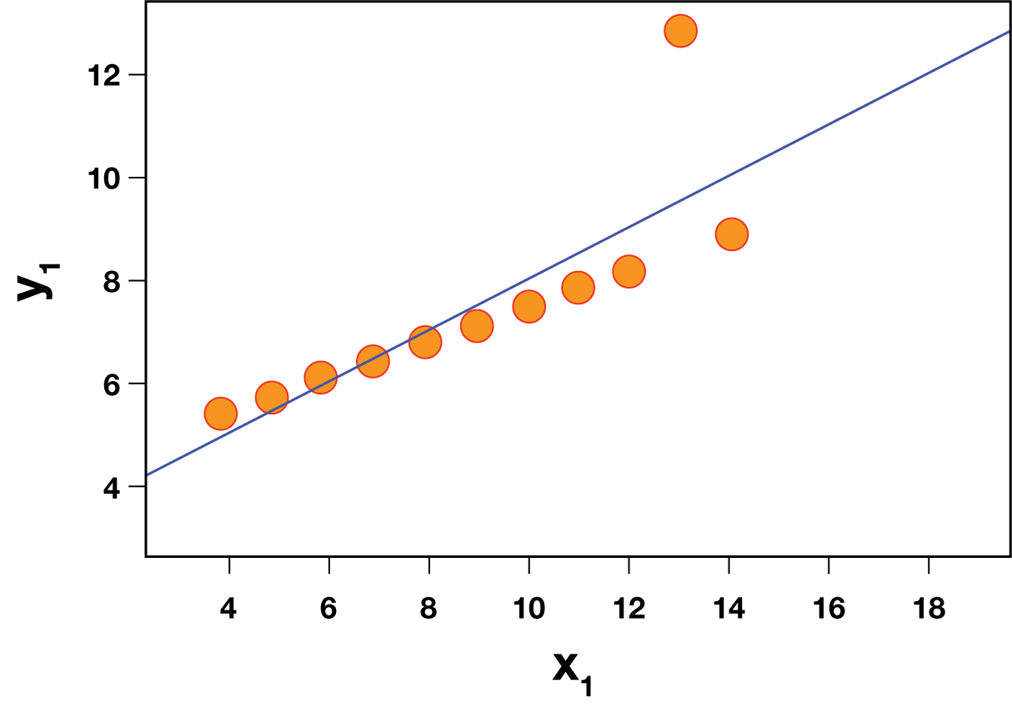

Slide 30
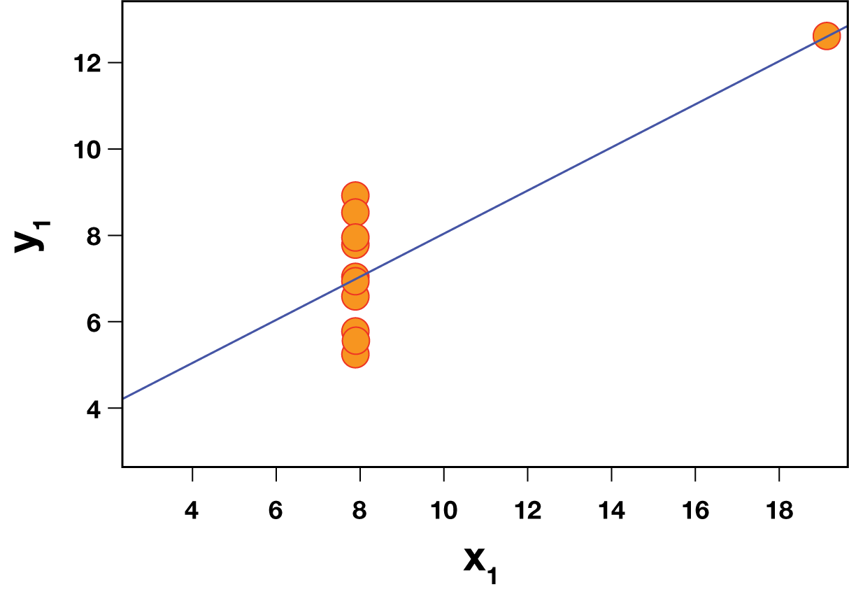

Slide 31
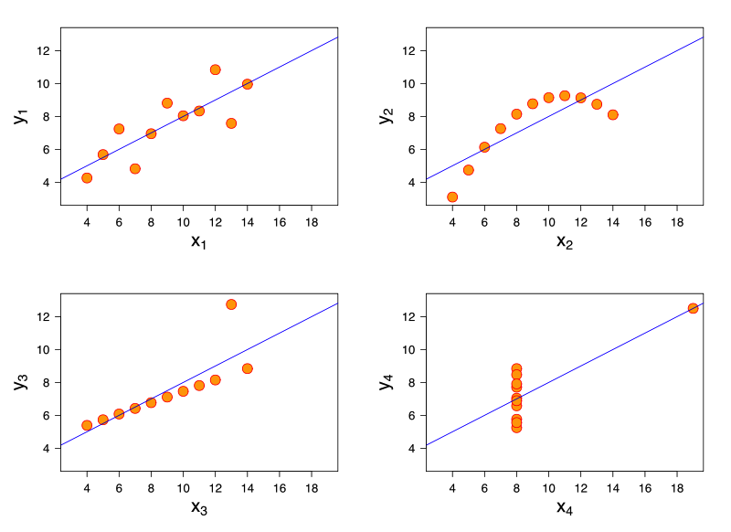
Anscombe’s Quartet
https://en.wikipedia.org/wiki/Anscombe%27s_quartet

Slide 32
Anscombe’s Quartet
Sanity Checking Models
Outlier Detection

Slide 33
DLI Accelerated Data Science Teaching Kit
Thank You

