Slide 1
Lecture 7.2 - Human Perception
DLI Accelerated Data Science Teaching Kit

Slide 2

The Accelerated Data Science Teaching Kit is licensed by NVIDIA, Georgia Institute of Technology, and Prairie View A&M University under the
Creative Commons Attribution-NonCommercial 4.0 International License.

Slide 3
Data visualization leverages
human perception
Notes:
The reason we should understand human perception is because…
So to design effective visualization, it is important to …

Slide 4
Name the five senses.
Notes:
The human visual perception is a powerful channel to leverage, because process lots of info…
A quick quiz… certainly, sight is one of them

Slide 5
Sense | Bandwidth (bits/sec)
Sight | 10,000,000
Touch | 1,000,000
Hearing | 100,000
Smell | 100,000
Taste | 1,000
http://www.britannica.com/EBchecked/topic/287907/information-theory/214958/Physiology

Slide 6
A (Simple) Model of
Human Visual Perception
Stage 1
Stage 2
Parallel detection of basic features into an iconic store
Serial processing of object identification and spatial layout

Slide 7
Stage 1: Pre-Attentive Processing
Rapid
Parallel
Automatic
(Fleeting = lasting for a short time)

Slide 8
Stage 2: Serial Processing
Relatively Slow
(Incorporates Memory)
Manual

Slide 9
Stage 1: Pre-Attentive Processing
The eye moves every 200ms.
(so this processing occurs every 200ms-250ms)

Slide 10
Example
1281768756138976546984506985604982826762
9809858458224509856458945098450980943585
9091030209905959595772564675050678904567
8845789809821677654876364908560912949686

Slide 11
Example
1281768756138976546984506985604982826762
9809858458224509856458945098450980943585
9091030209905959595772564675050678904567
8845789809821677654876364908560912949686

Slide 12
  A few more examples from
  Prof. Chris Healy at NC State

Slide 13
Left Side Right Side

Slide 14
Where is the RED DOT?
On the left or on the right?

Slide 15
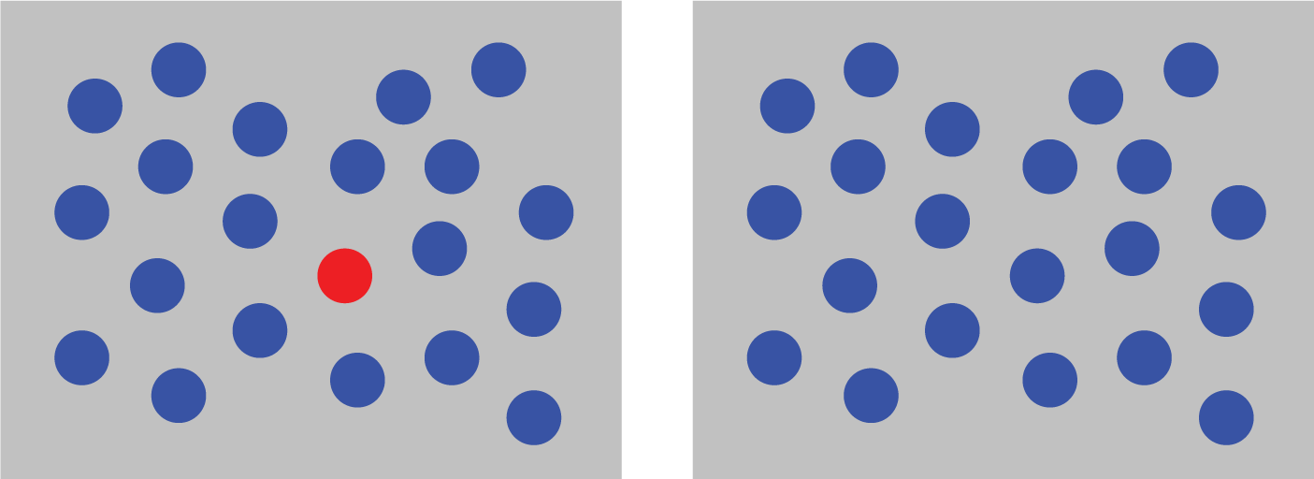

Slide 16
Where is the RED DOT?
On the left or on the right?

Slide 17
Color (hue) is pre-attentively processed.

Slide 18
Where is the RED DOT?
On the left or on the right?

Slide 19


Slide 20
Where is the RED DOT?
On the left or on the right?

Slide 21
Shape is pre-attentively processed.

Slide 22
Where is the RED DOT?
On the left or on the right?

Slide 23
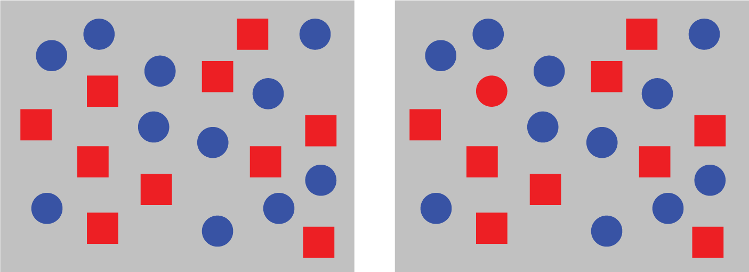

Slide 24
Where is the RED DOT?
On the left or on the right?

Slide 25
Hue and shape together are NOT pre-attentively processed.

Slide 26
Pre-Attentive Processing
length
width
size
curvature
number
terminators
intersection
closure
hue
lightness
flicker
direction of motion
binocular luster
stereoscopic depth
3-D depth cues
lighting direction

Slide 27
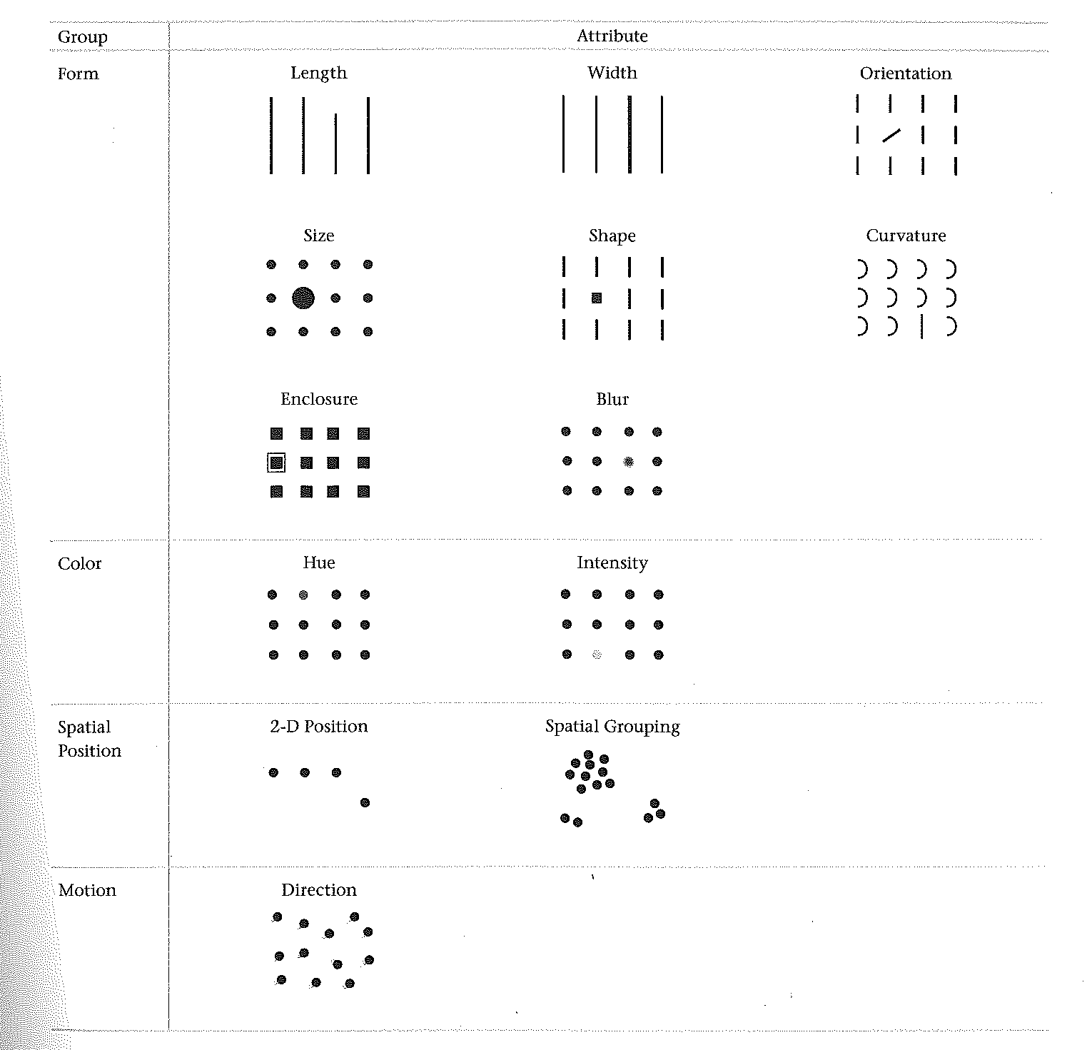
Few, S. (2012). Show me the numbers: designing tables and graphs to enlighten. Burlingame, Calif: Analytics Press.

Slide 28
DLI Accelerated Data Science Teaching Kit
Thank You

