Slide 1
Lecture 7.3 - Gestalt Psychology
DLI Accelerated Data Science Teaching Kit

Slide 2

The Accelerated Data Science Teaching Kit is licensed by NVIDIA, Georgia Institute of Technology, and Prairie View A&M University under the
Creative Commons Attribution-NonCommercial 4.0 International License.

Slide 3
Pre-Attentive → Cognitive

Slide 4
Gestalt Psychology
Berlin, Early 1900s
Notes:
https://www.youtube.com/watch?v=2etrdZwpm7Q

Slide 5
Gestalt Psychology
Goal was to understand
pattern perception Gestalt (German) = “seeing the whole picture all at once” instead of as collection of parts
Identified 8 “Laws of Grouping”
http://study.com/academy/lesson/gestalt-psychology-definition-principles-quiz.html

Slide 6
Gestalt Psychology
Proximity
Similarity
Closure
Symmetry
Common Fate
Continuity
Good Gestalt
Past Experience
Image Credit: https://en.wikipedia.org/wiki/Gestalt_psychology

Slide 7
How many groups are there?

Slide 8
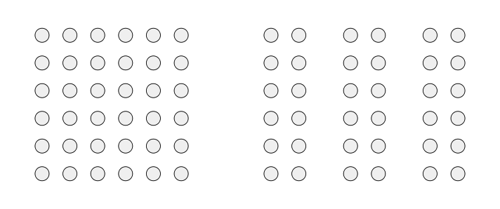
Retrieved: https://en.wikipedia.org/wiki/Gestalt_psychology

Slide 9
Proximity
Retrieved: https://en.wikipedia.org/wiki/Gestalt_psychology

Slide 10
How many groups are there?

Slide 11
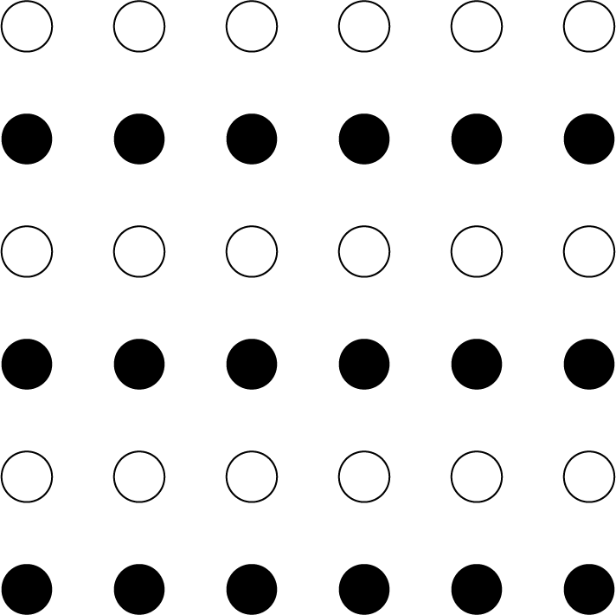
Retrieved: https://en.wikipedia.org/wiki/Gestalt_psychology

Slide 12
Similarity
Retrieved: https://en.wikipedia.org/wiki/Gestalt_psychology

Slide 13
How many shapes are there?

Slide 14
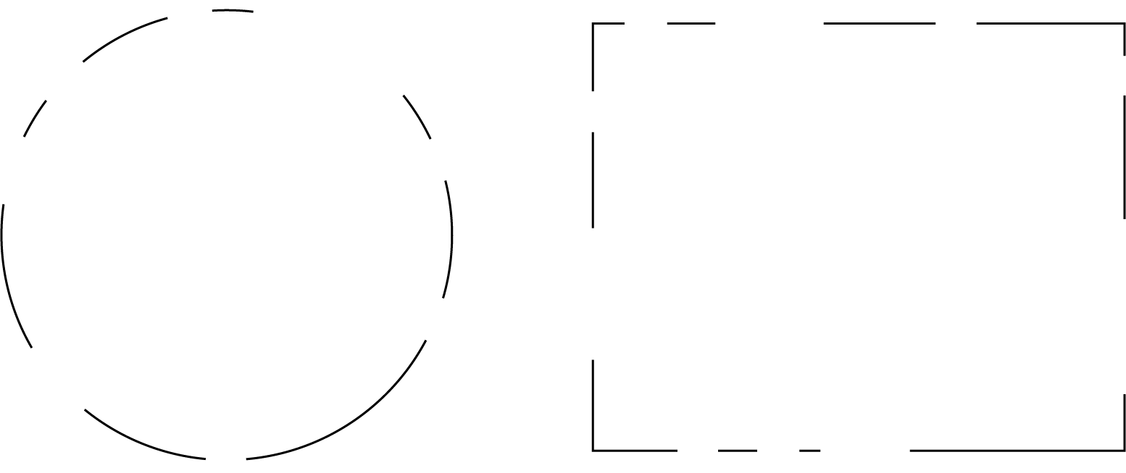
Retrieved: https://en.wikipedia.org/wiki/Gestalt_psychology

Slide 15
Closure
Retrieved: https://en.wikipedia.org/wiki/Gestalt_psychology

Slide 16
How many items are there?

Slide 17
( ) { } [ ]

Slide 18
Symmetry
( ) { } [ ]

Slide 19
How many sets are there?

Slide 21
Common Fate

Slide 22
How many objects are there?

Slide 23


Slide 24
Continuity

Slide 25
How many objects are there?

Slide 26
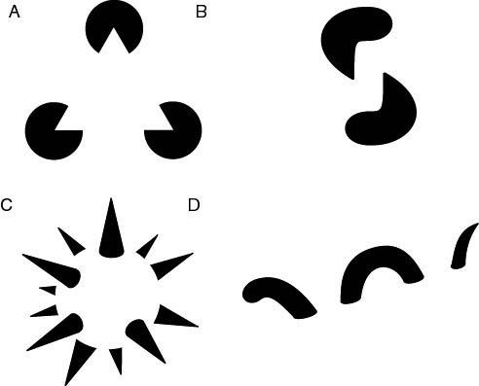
Retrieved: https://en.wikipedia.org/wiki/Gestalt_psychology

Slide 27
Good Gestalt
Retrieved: https://en.wikipedia.org/wiki/Gestalt_psychology

Slide 28
What is this word?

Slide 30
Past Experience

Slide 31
DLI Accelerated Data Science Teaching Kit
Thank You

