Slide 1
Lecture 7.4 - Chart Basics
DLI Accelerated Data Science Teaching Kit

Slide 2

The Accelerated Data Science Teaching Kit is licensed by NVIDIA, Georgia Institute of Technology, and Prairie View A&M University under the
Creative Commons Attribution-NonCommercial 4.0 International License.

Slide 3
Pre-Attentive Processing Gestalt Laws

Slide 4
Detect quickly does NOT mean detect accurately
Ideally you want both.

Slide 5
Crowdsourcing Graphical Perception: Using Mechanical Turk to Assess Visualization Design.Heer and Bostock. Proc ACM Conf. Human Factors in Computing Systems (CHI) 2010, p. 203–212.

Slide 6
Crowdsourcing Graphical Perception: Using Mechanical Turk to Assess Visualization Design.Heer and Bostock. Proc ACM Conf. Human Factors in Computing Systems (CHI) 2010, p. 203–212.

Slide 7
Mackinlay, L. (1986). Echo of applause. Leicester: Ulverscroft.

Slide 8
What does this tell us?

Slide 9
Barcharts, scatterplots, and line charts are really effective for quantitative data

Slide 10
(and for statistical distributions) Tukey Box Plots

Slide 11
Outliers
Largest < Q3 + 1.5 IQR
Largest < Q3
Median
Smallest > Q1
Smallest > Q1 - 1.5 IQR

Slide 12
Tufte’s Chart Principles
Edward Tufte
Tufte, Edward. (n.d.). In Wikipedia. Retrieved November 30, 2017. from https://en.wikipedia.org/wiki/Edward_Tufte

Slide 13
Tufte’s Chart Principles
DO NOT LIE!
Maximize Data-Ink Ratio
Minimize Chart Junk

Slide 14
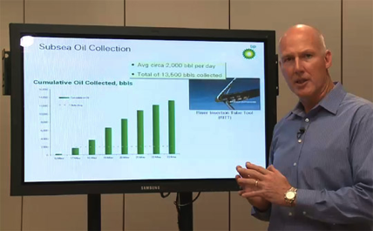
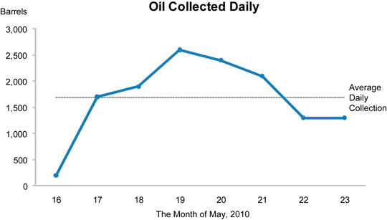
“Cumulative”
Retrieved: http://www.perceptualedge.com/blog/?p=790
Notes:
BP senior vice president
Show company’s efforts to collect the oil spewing to the sea
“Here you can see how we’ve continued to ramp up”

Slide 15
Tufte’s Chart Principles
DO NOT LIE!
Maximize Data-Ink Ratio
Minimize Chart Junk

Slide 16
Figure 5: “Diamonds Were a Girl’s Best Friend.” Chart by Nigel Holmes in “A Gem That Lost Its Luster,” Time 120, no. 9 (August 30, 1982): 66. Used with permission.
Retrieved: https://en.wikipedia.org/wiki/Chartjunk
http://skilfulminds.com/2011/04/05/exploring-the-usefulness-of-chartjunk-at-stl-ux-2011/
Notes:
Nigel Holmes
USA Today
Tufte hates this.

Slide 17
Please…

Slide 18
No pie charts. No 2.5D charts.

Slide 20
2
1
24
37
36

Slide 23
PLEASE DON’T
EVER DO THIS!

Slide 25
DLI Accelerated Data Science Teaching Kit
Thank You

