Slide 1
Lecture 7.5 - Colors
DLI Accelerated Data Science Teaching Kit

Slide 2

The Accelerated Data Science Teaching Kit is licensed by NVIDIA, Georgia Institute of Technology, and Prairie View A&M University under the
Creative Commons Attribution-NonCommercial 4.0 International License.

Slide 3
Anyone bored
by my color choices?

Slide 4
In fact, grayscale can be risky…

Slide 5
In fact, grayscale can be risky…

Slide 6
Color is Powerful

Slide 7
Color
Call attention to information
Increase appeal
Increase memorability
Another dimension to work with

Slide 8
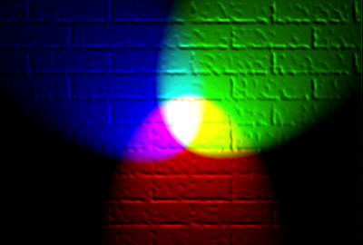
Have you heard of RGB?
Additive color model: colors create by mixing
red, green, blue light
Retrieved: https://en.wikipedia.org/wiki/RGB_color_model

Slide 9
We see in RGB,
but we don’t interpret in RGB…

Slide 10
HSV Color Model
Source: color picker in Affinity Designer

Slide 11
Hue and Colorblindness
10% of males and 1% of females
are Red-Green Colorblind

Slide 12
Retrieved: https://en.wikipedia.org/wiki/Color_blindness

Slide 13
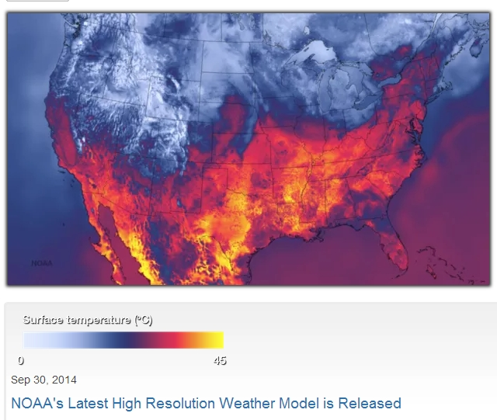
http://viz.wtf/post/98981561686/ht-matthewbgilmore-noaas-new-weather-modelling

Slide 14
Color and Quantitative Data
Can you order these (low→hi)?

Slide 15
http://www.personal.psu.edu/faculty/c/a/cab38/ColorSch/Schemes.html via Munzner

Slide 16
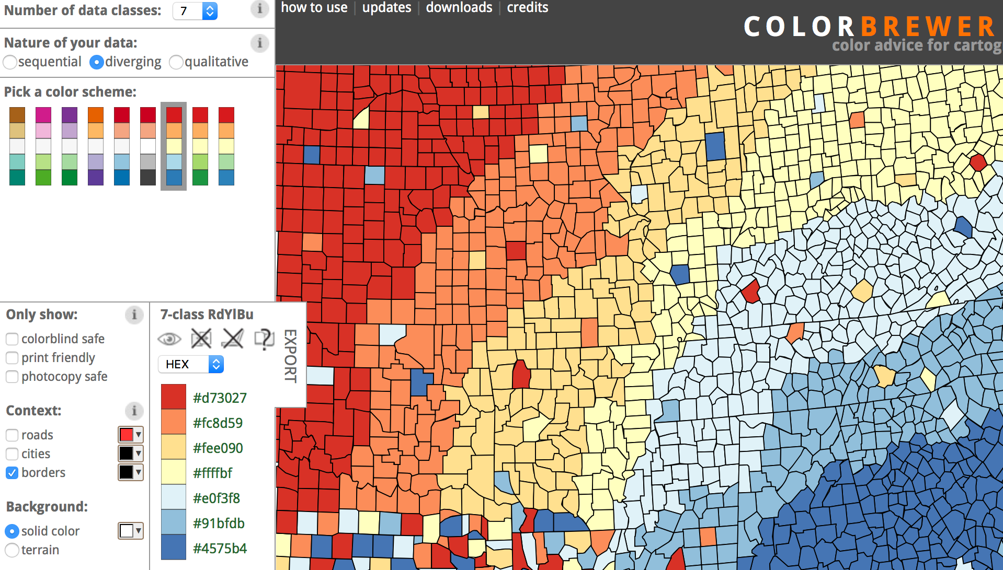
Color Brewer for Picking Color Scales
http://colorbrewer2.org/

Slide 17
DLI Accelerated Data Science Teaching Kit
Thank You

