Slide 1
Lecture 7.6 - cuXFilter
DLI Accelerated Data Science Teaching Kit

Slide 2

The Accelerated Data Science Teaching Kit is licensed by NVIDIA, Georgia Institute of Technology, and Prairie View A&M University under the
Creative Commons Attribution-NonCommercial 4.0 International License.

Slide 3

How to implement visualization?
cuXFilter
(ku-cross-filter)
Retrieved from https://github.com/rapidsai/cuxfilter

Slide 4
What is cuXFilter?
RAPIDS framework connecting web visualization to GPU accelerated cross-filtering (filtering data and having visualization tool reflect the changes)
Inspired from Crossfilter library
What is Crossfilter?
Javascript library
Explore multivariate datasets in browser with filtering mechanism
Limitations of Crossfilter?
Data stored in client-side browser memory
Inefficient on large datasets

Slide 5
How to overcome limitations associated with large datasets?
Maintain data in GPU via RAPIDS’ GPU Dataframe (cuDF)
No longer dependent on browser memory
RAPIDS GPU acceleration now available

Slide 6
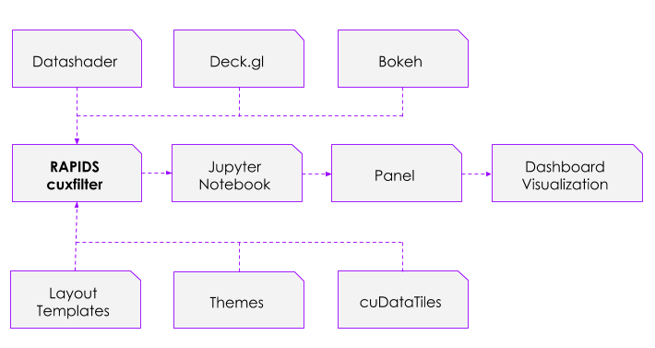
What Does cuXFilter Do?
Connects different visualization libraries to GPU backend
Provides user with UI components connecting libraries
Precomputes aggregations for quick visualization interactions via cuDataTiles
Retrieved from https://github.com/rapidsai/cuxfilter

Slide 7
What Does cuXFilter Do?
Connects different visualization libraries to GPU backend
Provides user with UI components connecting libraries
Precomputes aggregations for quick visualization interactions via cuDataTiles
Visualization libraries
cuXFilter dashboard
F
Retrieved from https://github.com/rapidsai/cuxfilter

Slide 8
How fast is cuXFilter?
cuDataTiles take around 250 milliseconds per chart given a 100 million row dataset.

Slide 9
How fast is cuXFilter?
cuDataTiles take around 250 milliseconds per chart given a 100 million row dataset.
Quite fast!

Slide 10
cuXFilter Demonstration

Slide 11
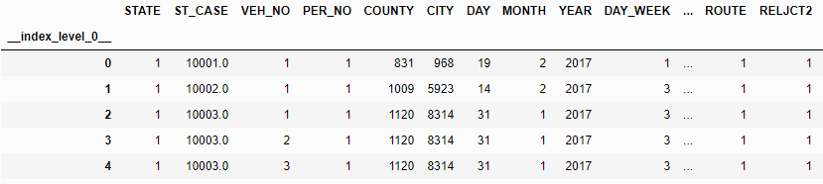
Importing Data and Setting Up cuDF
import cuxfilter
cux_df = cuxfilter.DataFrame.from_dataframe("./path_to_dataframe")
#would display something like image from below
cux_df.data.head()
Retrieved from https://docs.rapids.ai/api/cuxfilter/stable/10%20minutes%20to%20cuxfilter.html

Slide 12
Creating Charts Based Off Data
demo_palette = ["#3182bd", "#6baed6", "#7b8ed8", ... , "#323232" ]
chart1 = cuxfilter.charts.scatter(x='data_column_1', y='data_column_2', aggregate_col='data_column_3', aggregate_fn='mean', color_palette=demo_palette, tile_provider='CARTODBPOSITRON’, pixel_shade_type='linear’)
chart2 = cuxfilter.charts.bar('data_column_4')
...
charts_list = [chart1, chart2, ...]
Retrieved from https://docs.rapids.ai/api/cuxfilter/stable/10%20minutes%20to%20cuxfilter.html

Slide 13
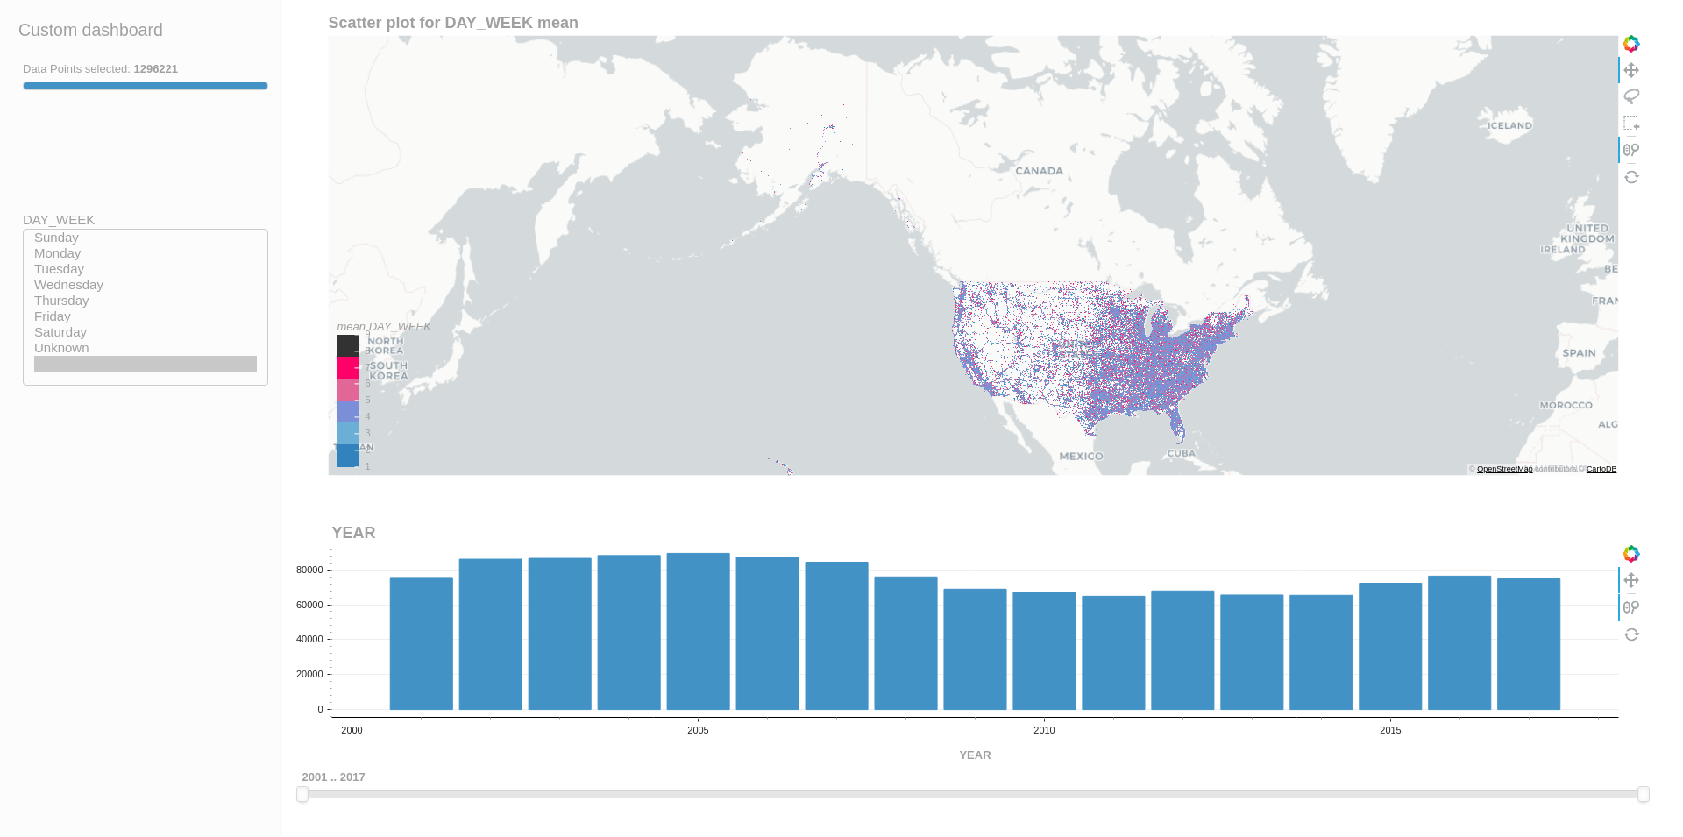
Viewing Dashboard with Charts
d = cux_df.dashboard(charts_list, title='Custom dashboard’, layout=layouts.feature_and_base, theme=themes.light, data_size_widget=True)
#display a dashboard like below
await d.preview()
Retrieved from https://docs.rapids.ai/api/cuxfilter/stable/10%20minutes%20to%20cuxfilter.html

Slide 14
Running Dashboard and Saving Snapshot
#opens in new tab
d.show('current_notebook_url:current_notebook_port')
#saves snapshot as dataframe
current_state_df = d.export()
#stops server
d.stop()
Retrieved from https://docs.rapids.ai/api/cuxfilter/stable/10%20minutes%20to%20cuxfilter.html

Slide 15
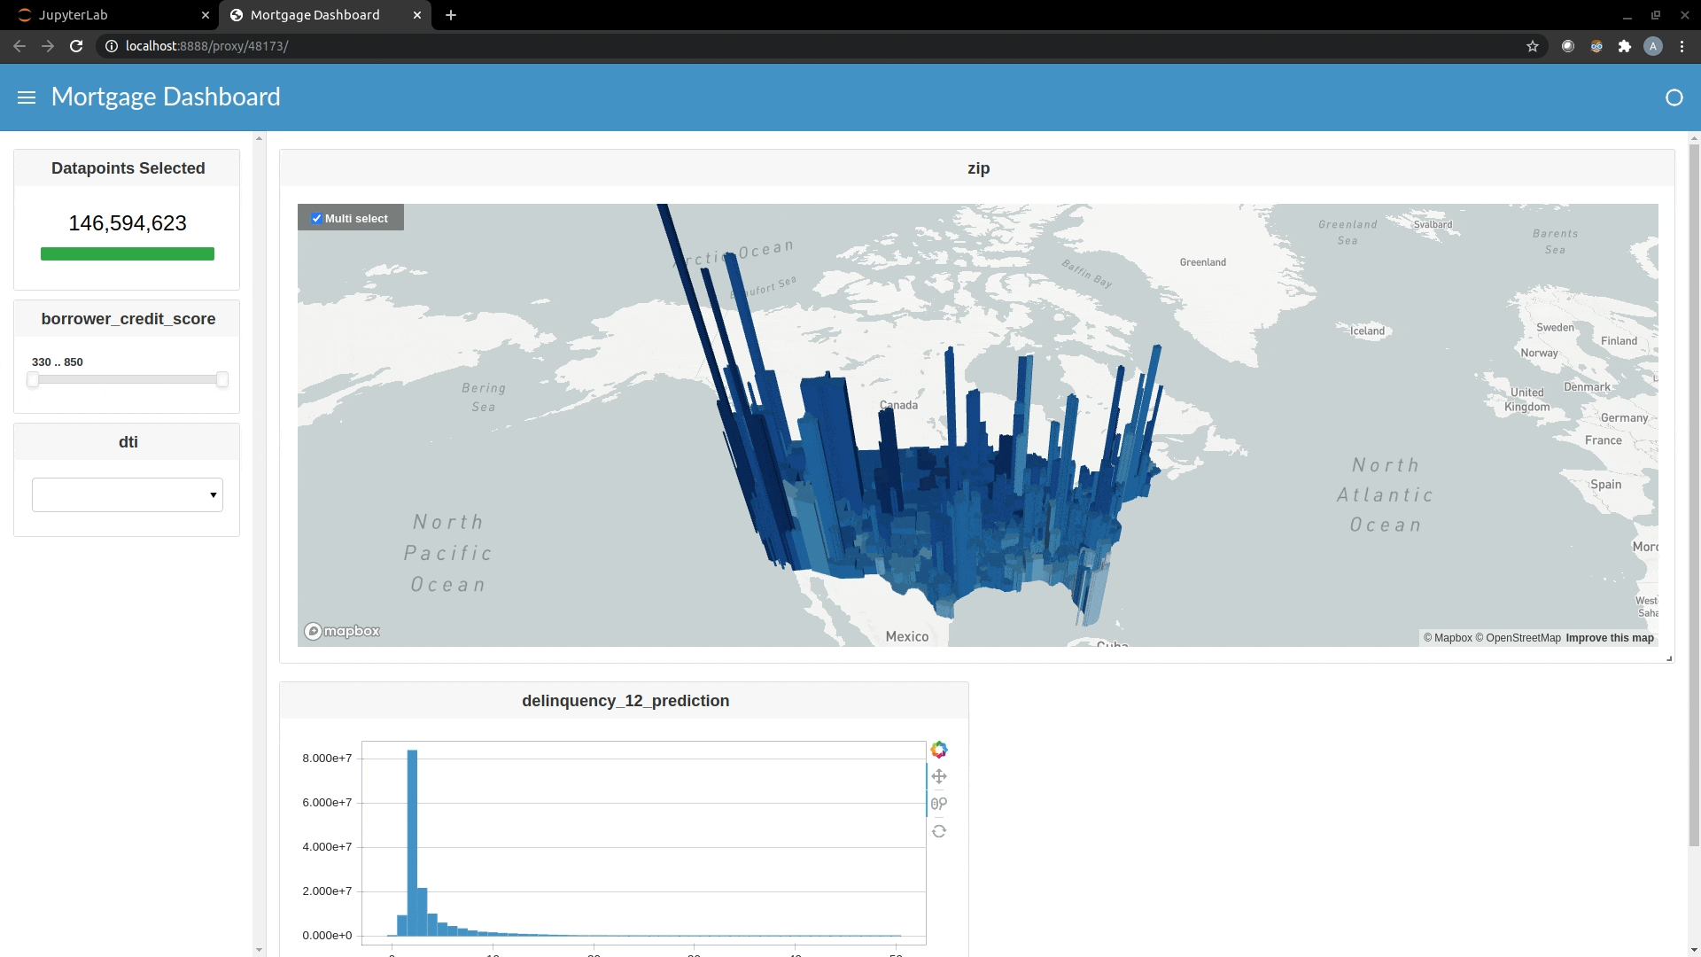
Live Demo of cuXFilter Dashboard
Demo retrieved from https://github.com/rapidsai/cuxfilter

Slide 16
DLI Accelerated Data Science Teaching Kit
Thank You

