Slide 1
Lecture 8.1 - Fixing Bar Charts, Line Charts, Tables and More
DLI Accelerated Data Science Teaching Kit

Slide 2

The Accelerated Data Science Teaching Kit is licensed by NVIDIA, Georgia Institute of Technology, and Prairie View A&M University under the
Creative Commons Attribution-NonCommercial 4.0 International License.

Slide 3
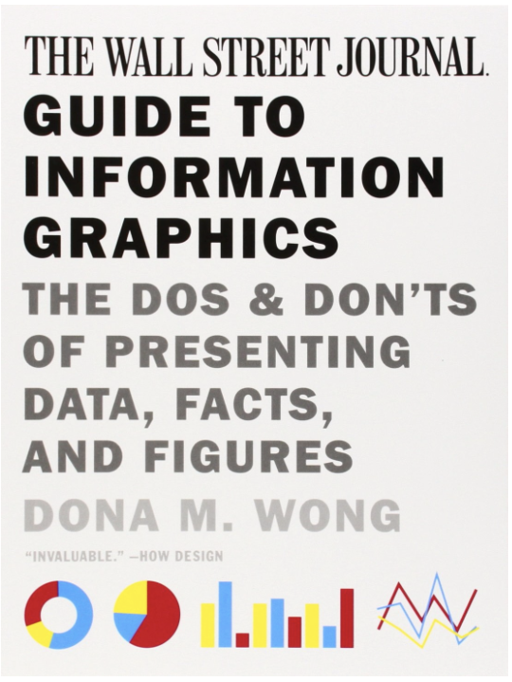
Student of
Edward Tufte
Wong, D. M. (2013). Guide to information graphics: the dos and donts of presenting data, facts, and figures. New York: W.W. Norton & Company.

Slide 4
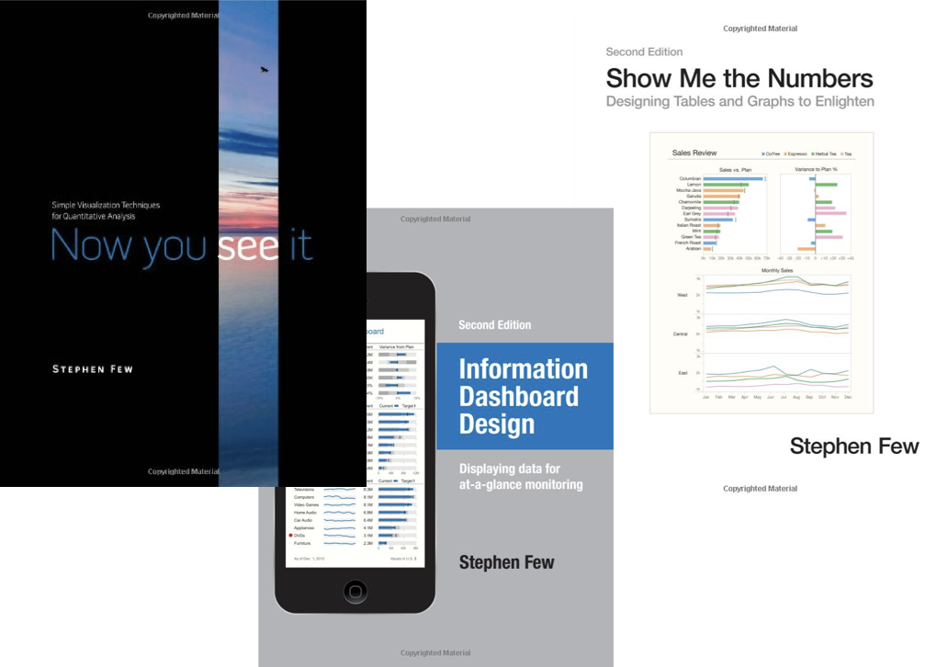
Also Highly Recommended:

Slide 5
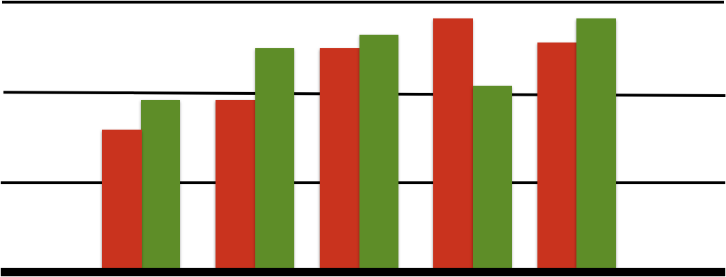
Bar Charts
The color scheme reminds you of what?

Slide 6
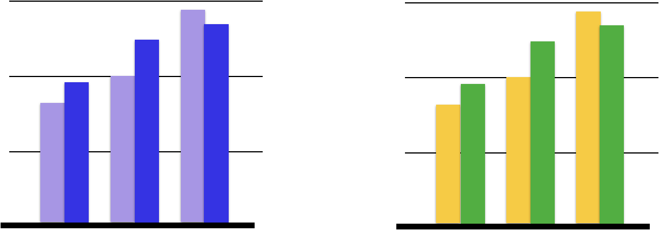
Better than Christmas (Use color brewer to find good color schemes)

Slide 7
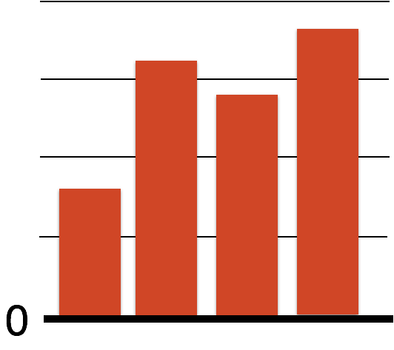
Company Profits
Don’t show profits in red!! Think carefully about your color choices.

Slide 9
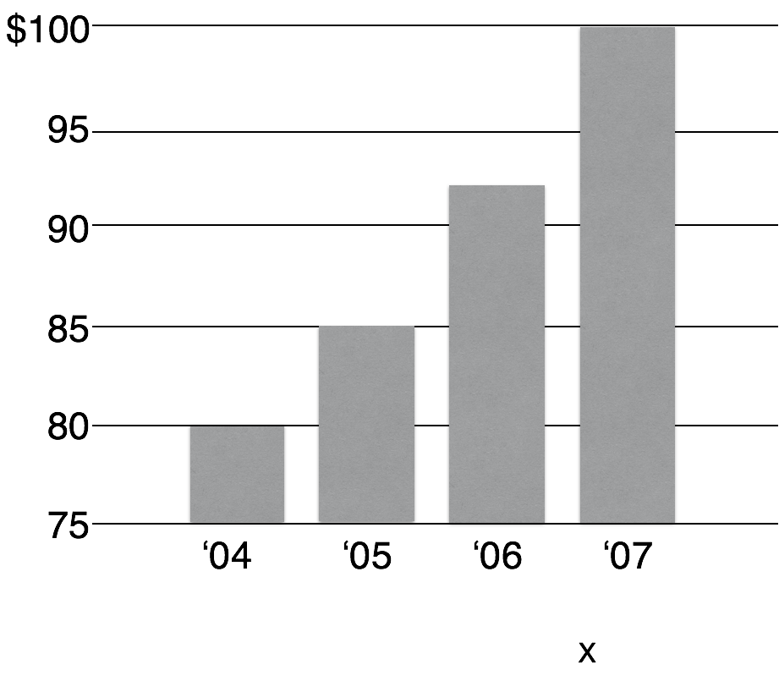
Misleading Bar Charts

Slide 10
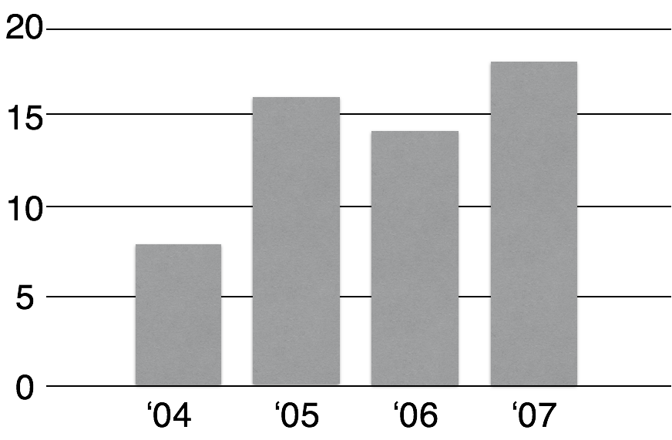
Vertical axis of bar charts should start at 0, almost always

Slide 11
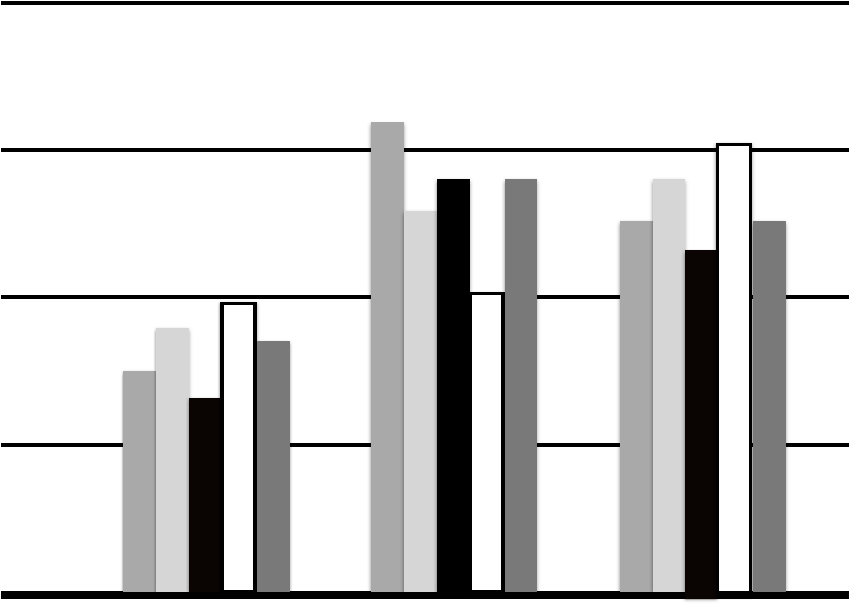
Disorienting Color Bars

Slide 12
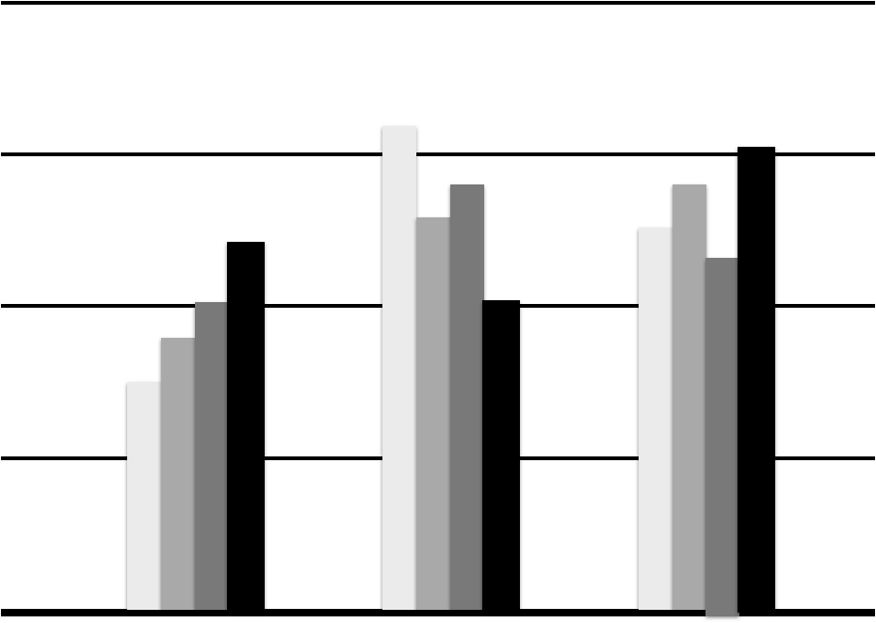
Use gradation

Slide 13
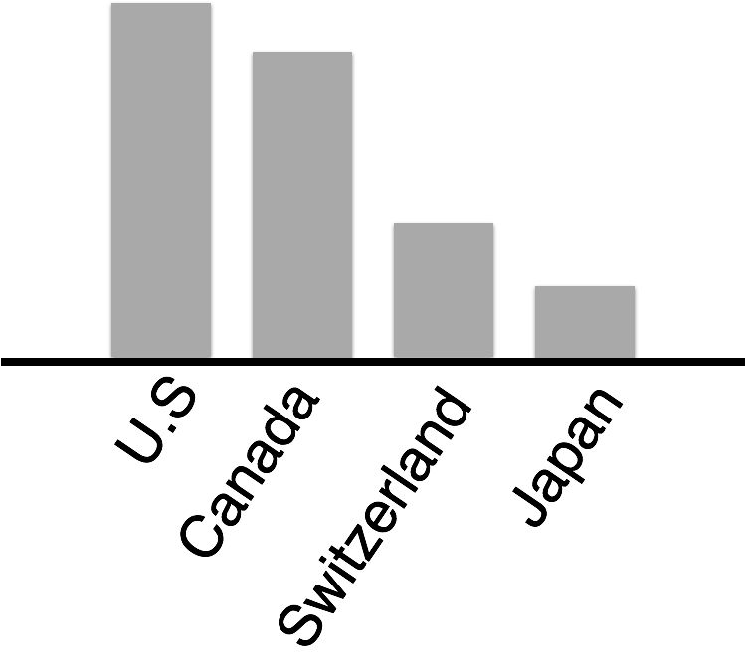
Avoid Tilted or Rotated labels

Slide 14
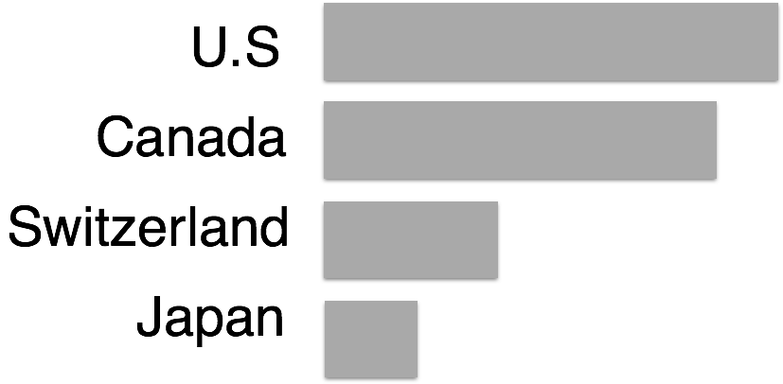
Bars can be Horizontal
When labels are hard to read, try horizontal layout. Don’t settle for the default.

Slide 15
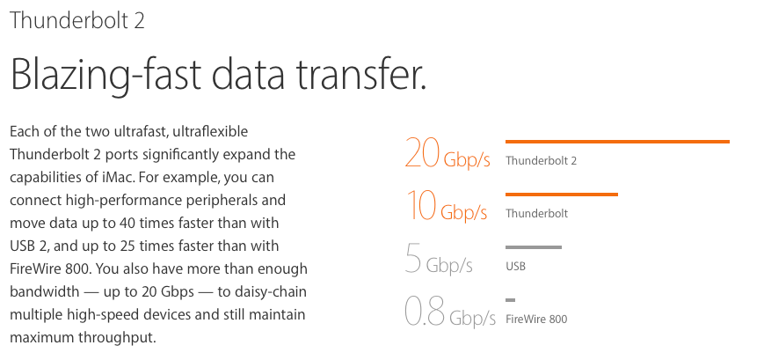
http://www.apple.com/imac/performance/

Slide 16
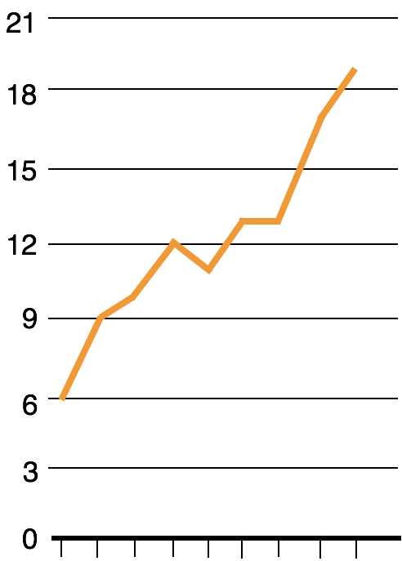
Line Charts
Can you improve the tick labels ?

Slide 17
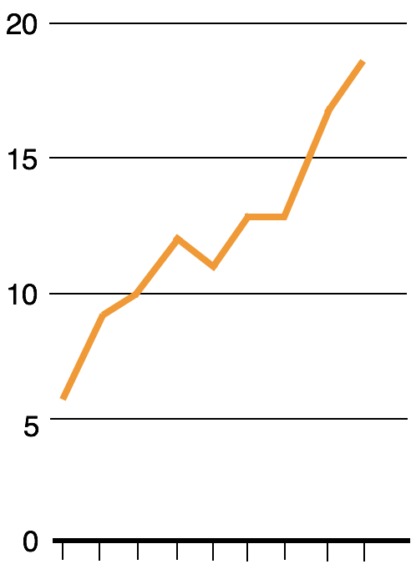

Use tick at common intervals (e.g. 2, 5, 10, etc.)

Slide 18
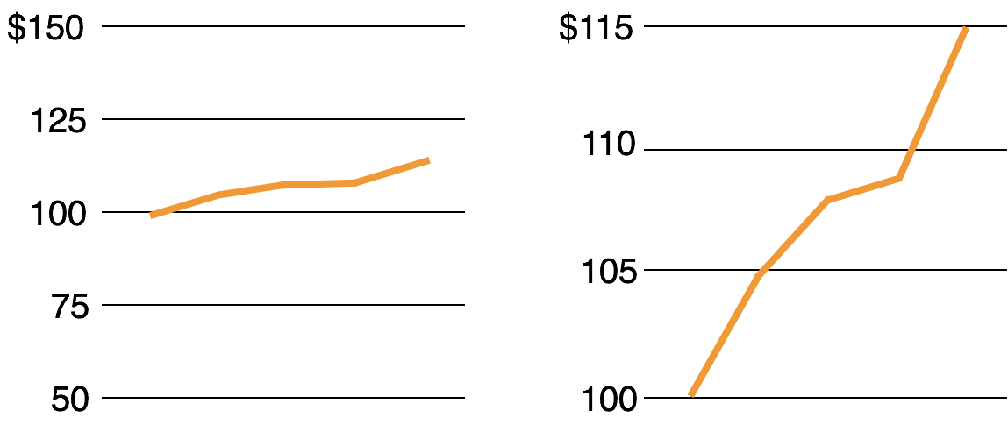
Too flat or too steep?
Too flat obscures
the message
Too exaggerated
overstates the trend
Note y-axis does not need to start at 0. Why not as bad as in the case of bar chart?

Slide 19
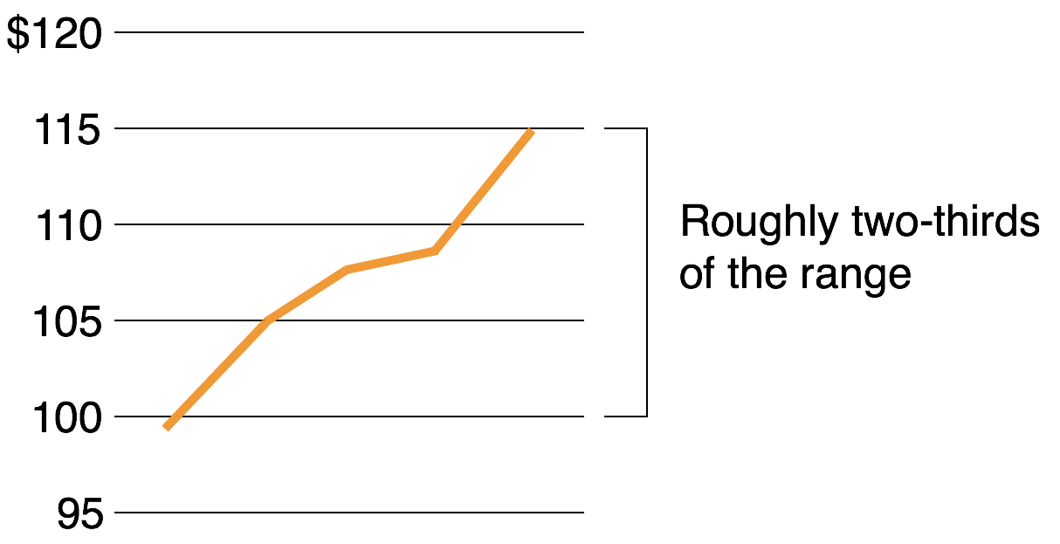
Rule of Thumb

Slide 20
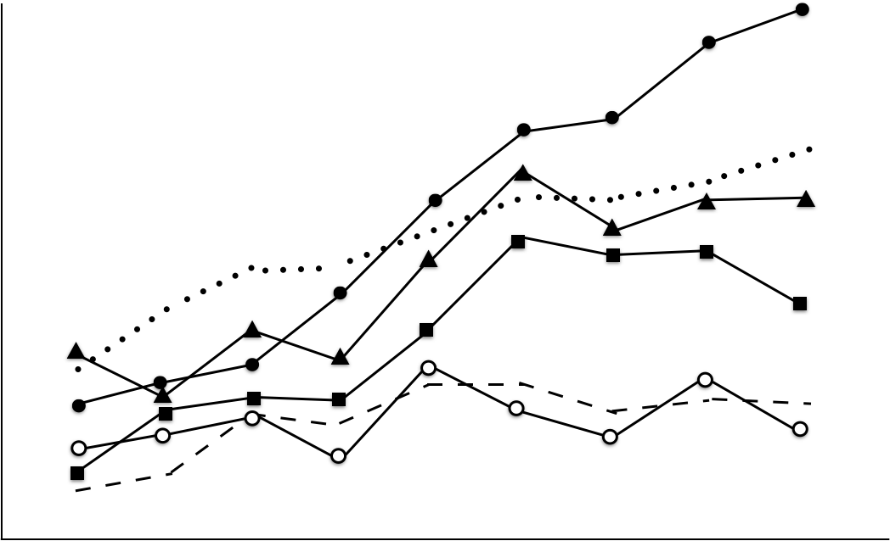
Multiple Patterned Lines
in one chart

Slide 21
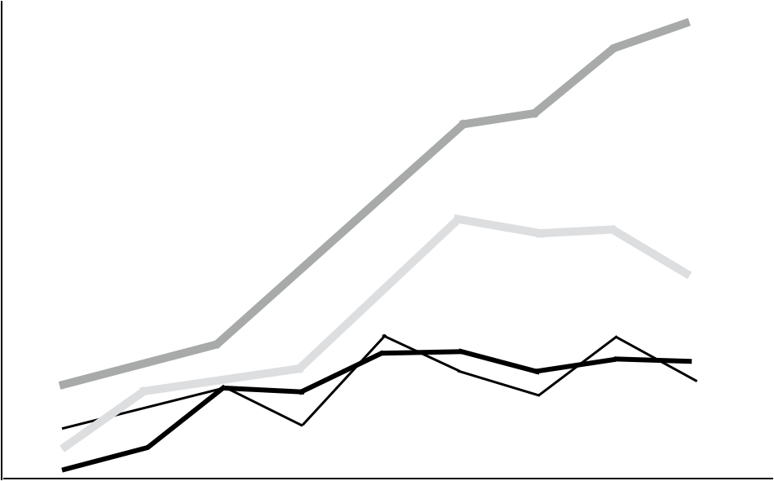
Better? Note the “double encoding” of line width and brightness. What if you have many lines you want to show?

Slide 22
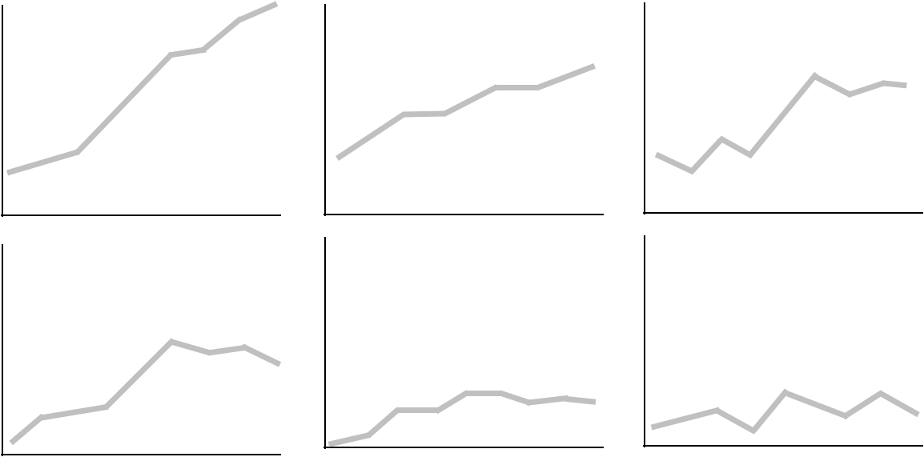
“Small Multiple” - Edward Tufte Better than overlapping (sometimes)
“a series or grid of small similar graphics or charts, allowing them to be easily compared”

Slide 23
Tables
What can you improve ?

Slide 24
What’s the problem with making everything bold or italic?

Slide 25
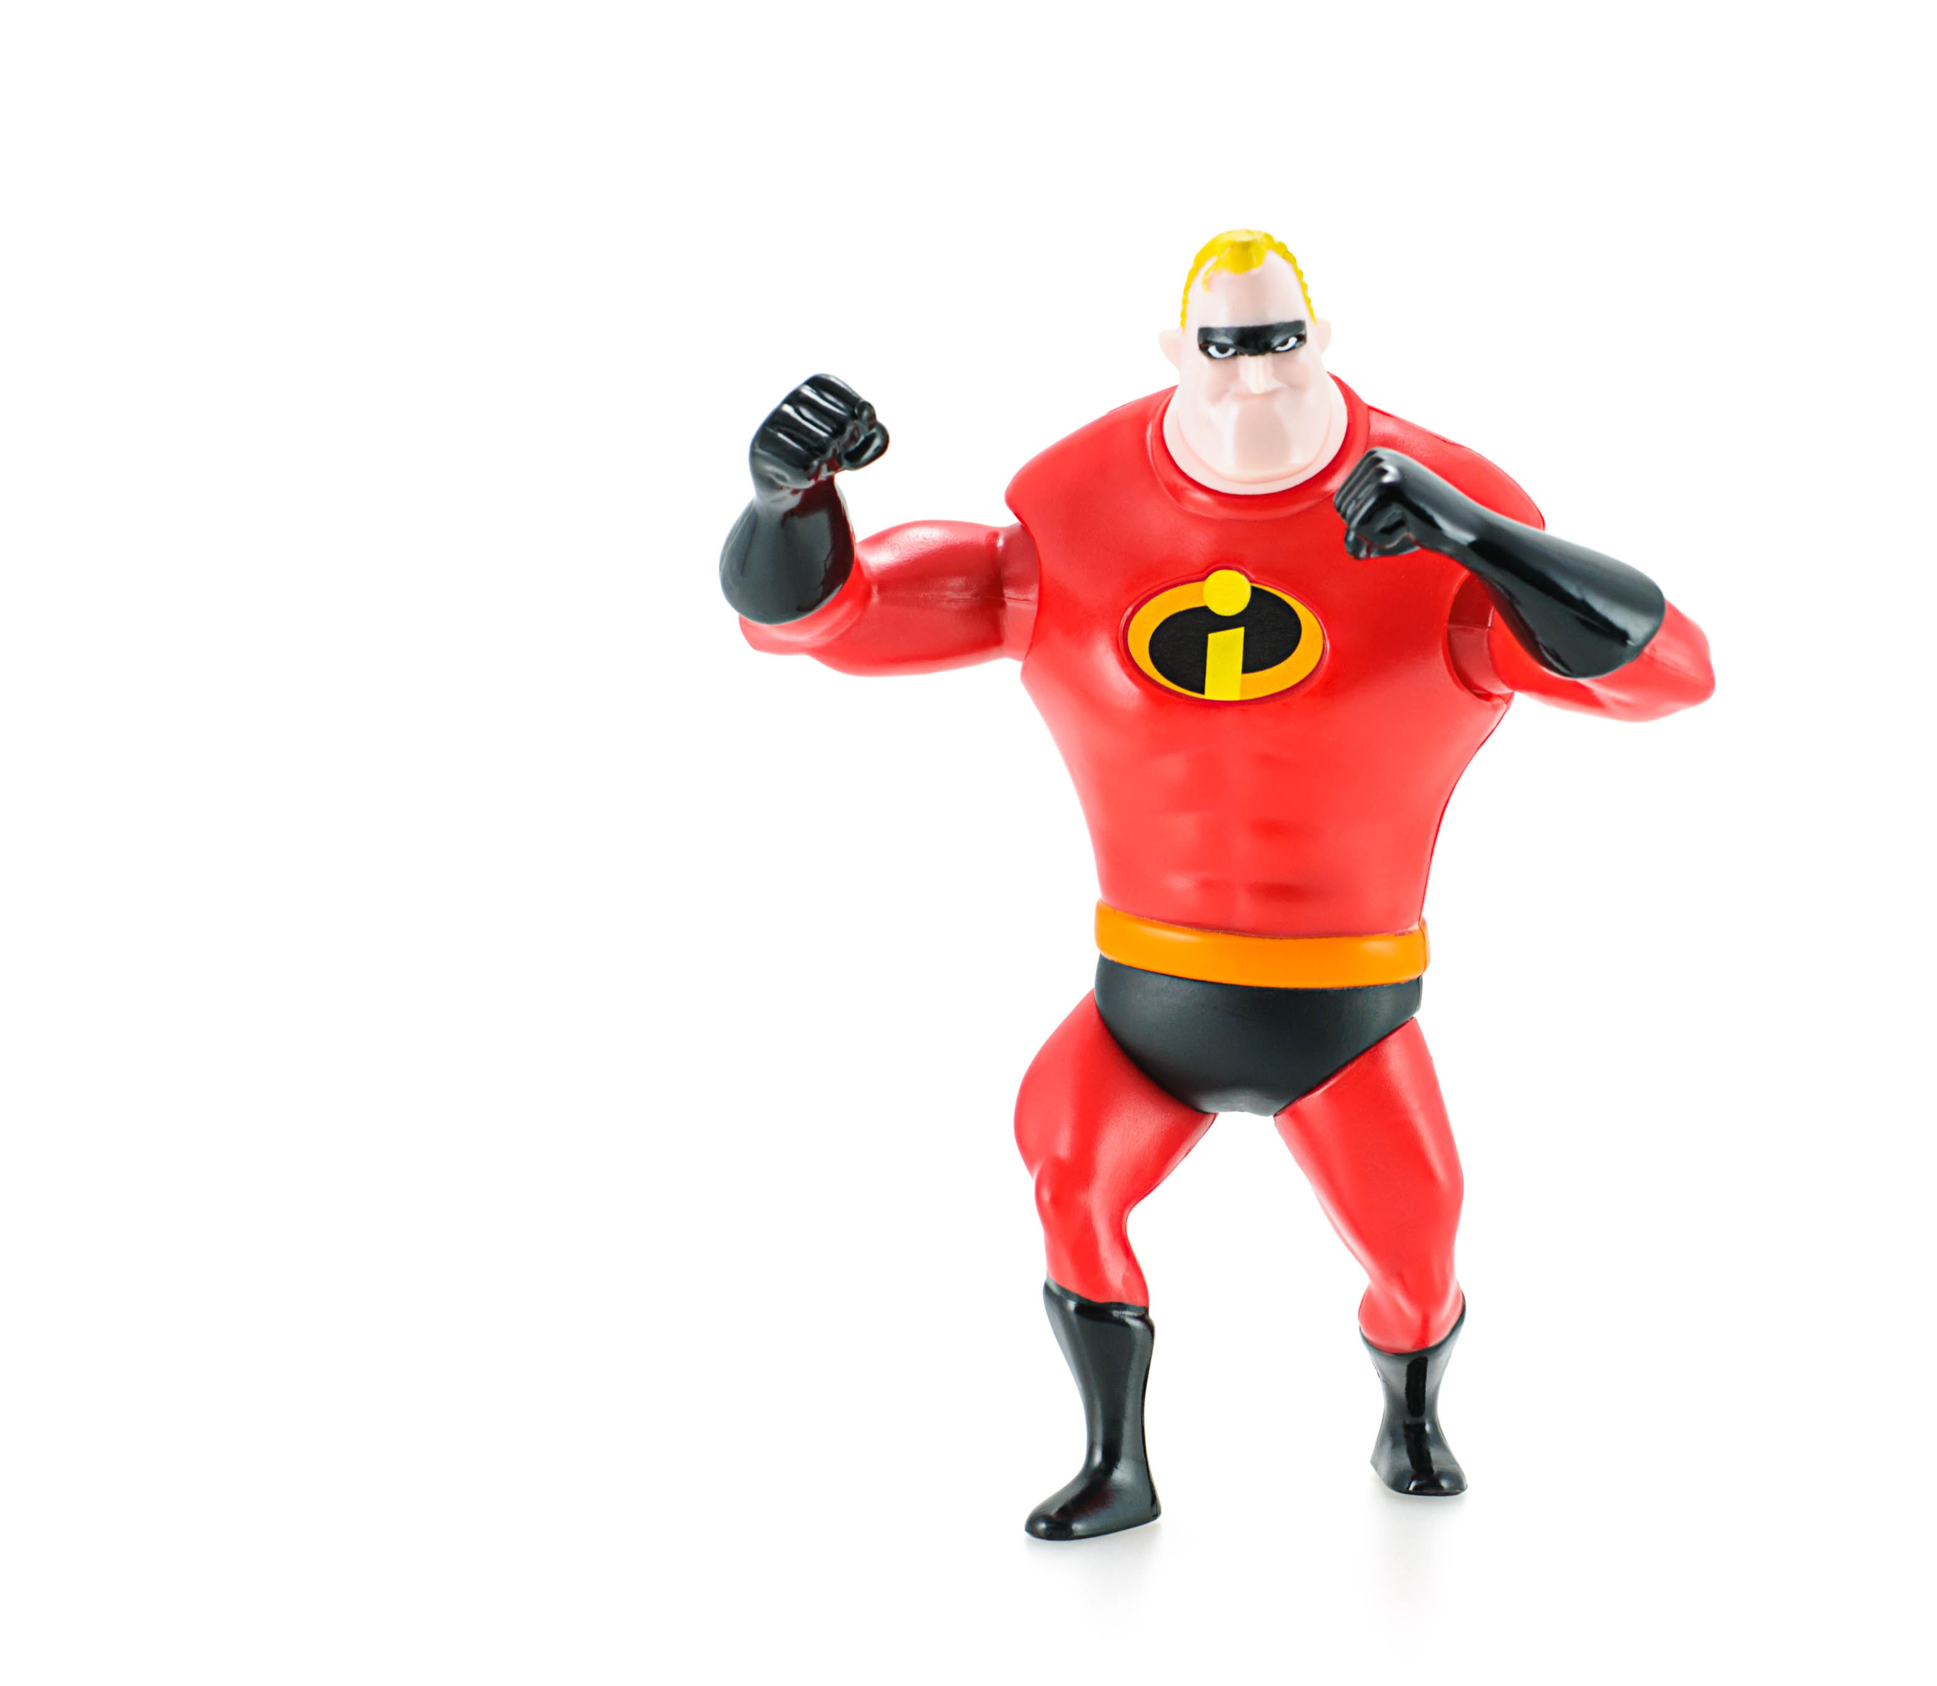
When everyone is special, no one is!

Slide 26
When everyone is special, no one is!

Slide 27
A lot of “chart junk”. Low “data to ink” ratio (Edward Tufte)

Slide 28
Higher “data to ink” ratio

Slide 29
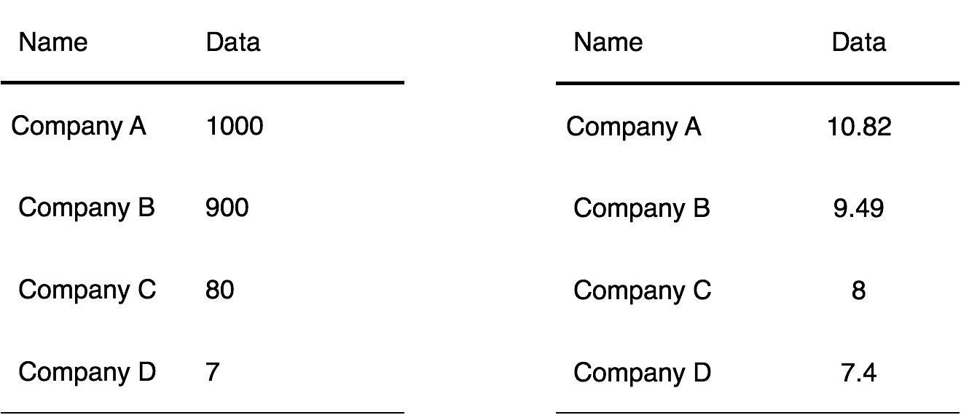
Problems?

Slide 30
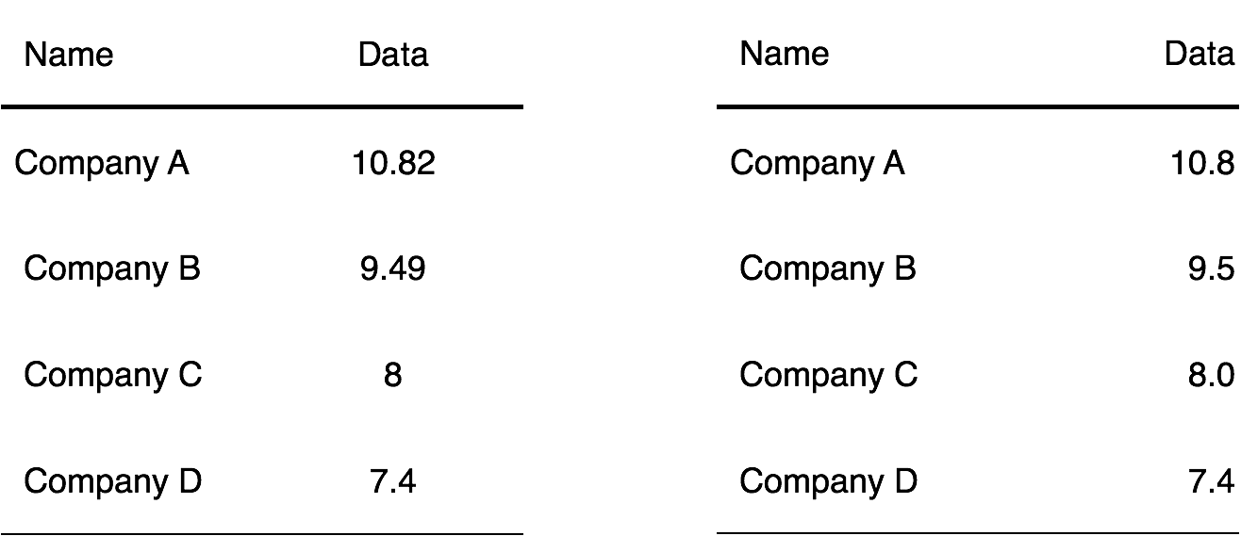

Slide 31
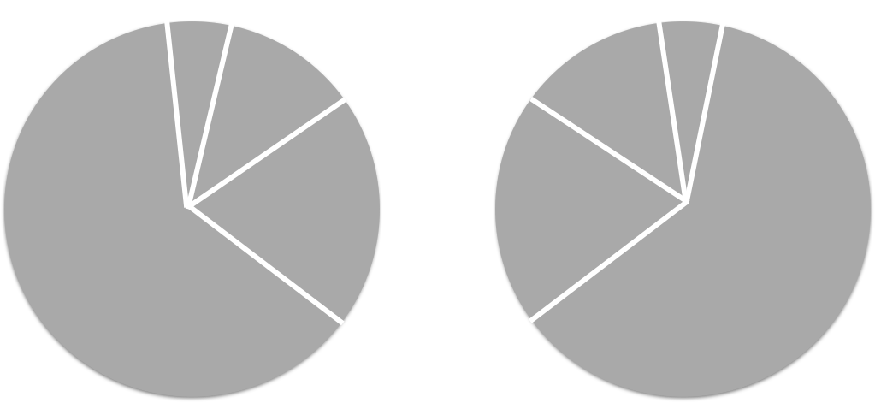
The Dreaded Pie Charts
Why people like to use pie charts ?

Slide 32
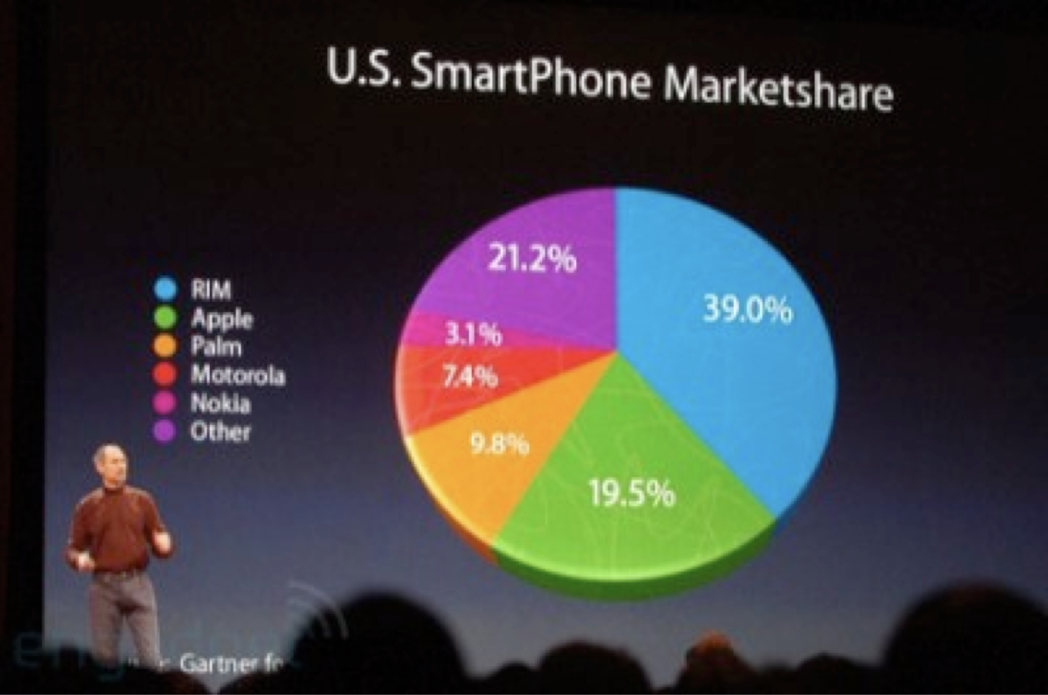
Beschizza, R. (2017, June 03). MacWorld's iPhone Pie Chart: Perspective Trick Makes 19.5% Look Bigger Than 21.2%.
Retrieved November 30, 2017, from http://www.wired.com/2008/02/macworlds-iphon

Slide 33
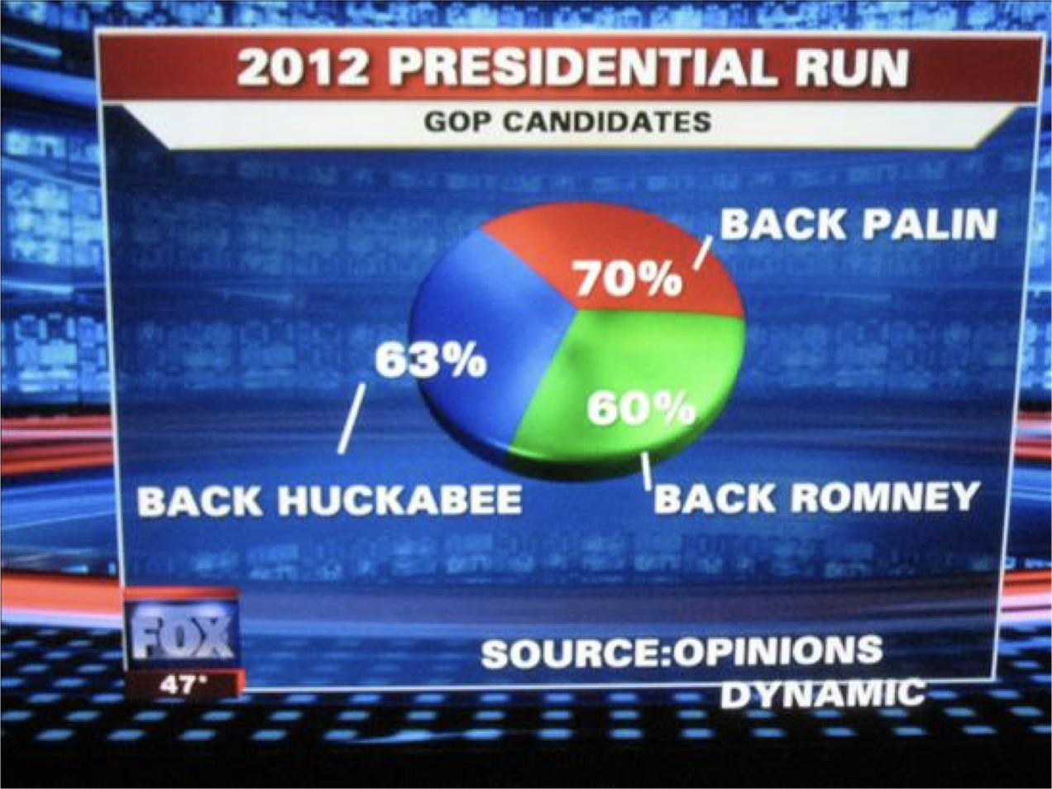
http://wonkette.com/412361/all-193-of-republicans-support-palin-romney-and-huckabee

Slide 34
http://infosthetics.com/archives/2008/09/funniest_pie_chart_ever.html

Slide 35
Log scale instead of linear scale
Include numbers from different orders of magnitude

Slide 36
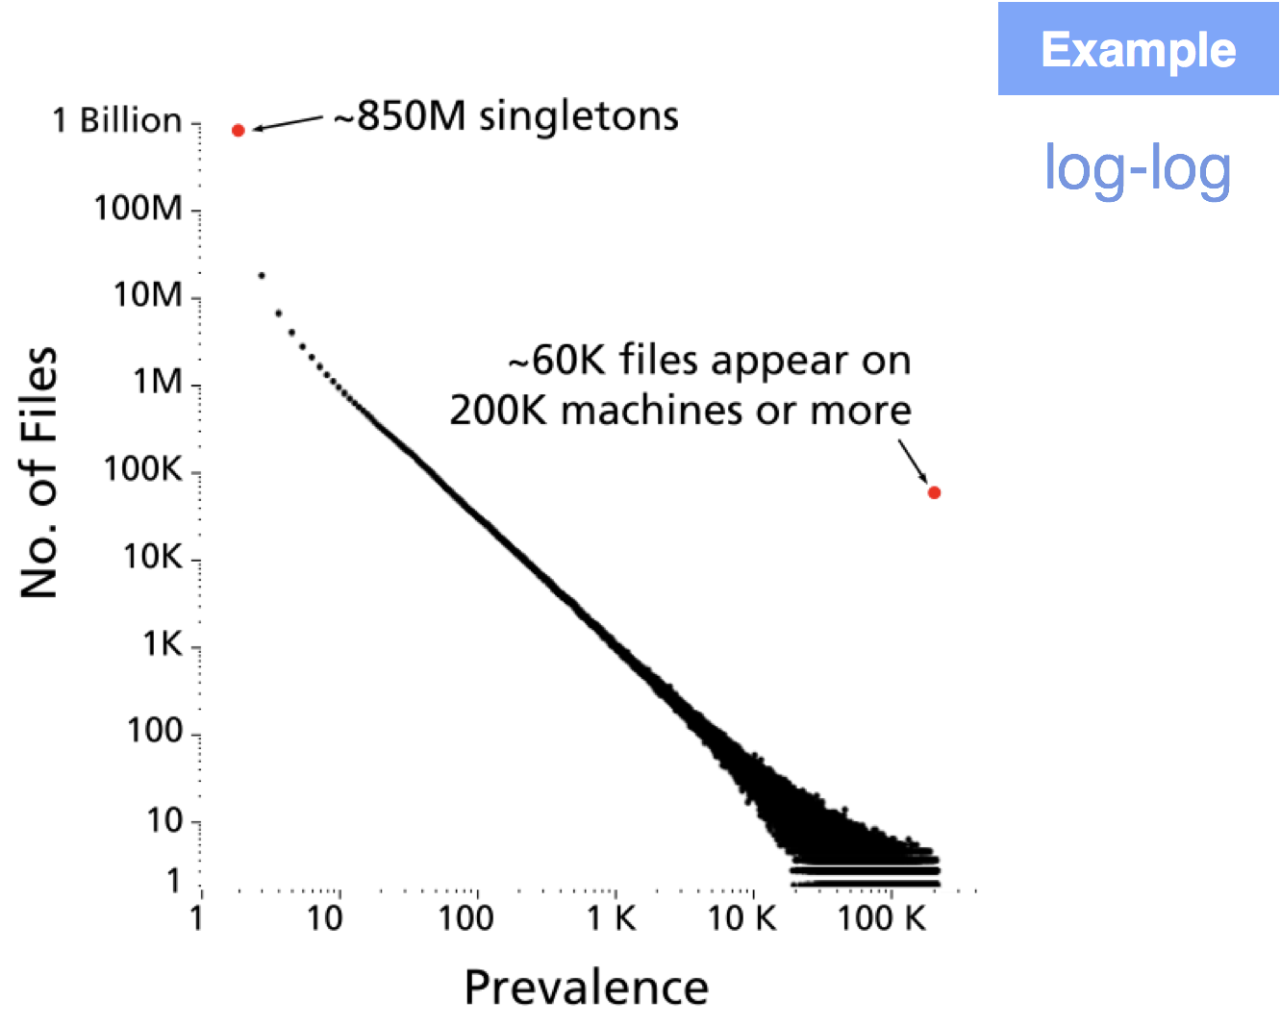

Slide 37
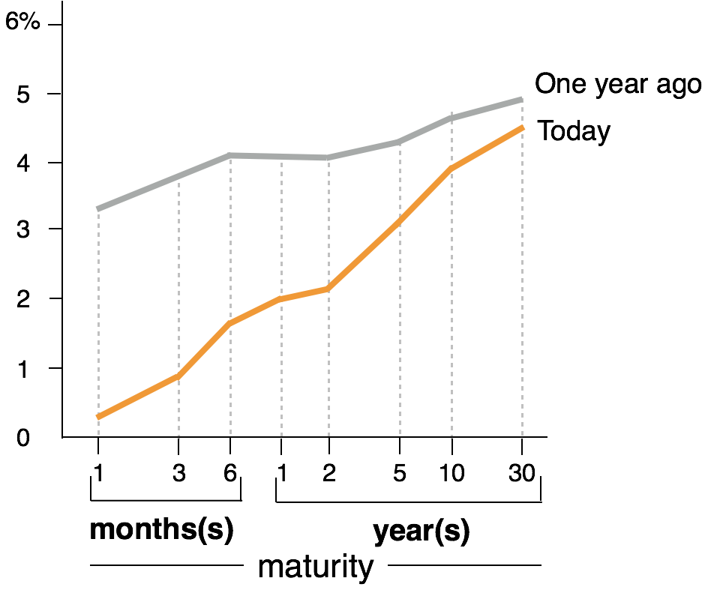
The yield curve of Treasury bills, notes and bonds

Slide 38
DLI Accelerated Data Science Teaching Kit
Thank You

