Slide 1
Lecture 8.2 - Applying What You've Learned
DLI Accelerated Data Science Teaching Kit

Slide 2

The Accelerated Data Science Teaching Kit is licensed by NVIDIA, Georgia Institute of Technology, and Prairie View A&M University under the
Creative Commons Attribution-NonCommercial 4.0 International License.

Slide 3
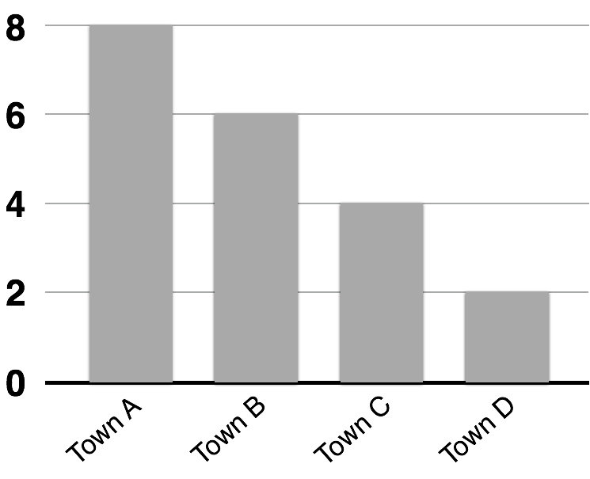
HEADLINE OF THE CHART
A brief description that outlines
what the data shows
Can you improve its visual design?

Slide 4
Headline of the chart
HEADLINE OF THE CHART
A brief description that outlines
what the data shows
A brief description that outlines
what the data shows
8
6
4
2
0
Town A
Town B
Town C
Town D
Which is better?

Slide 5
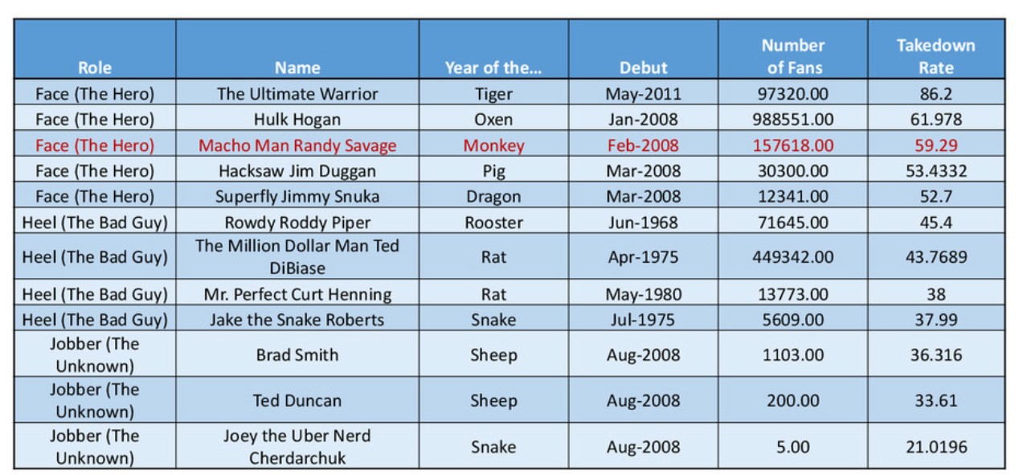
How to fix the defaults
http://www.darkhorseanalytics.com/blog/clear-off-the-table

Slide 6
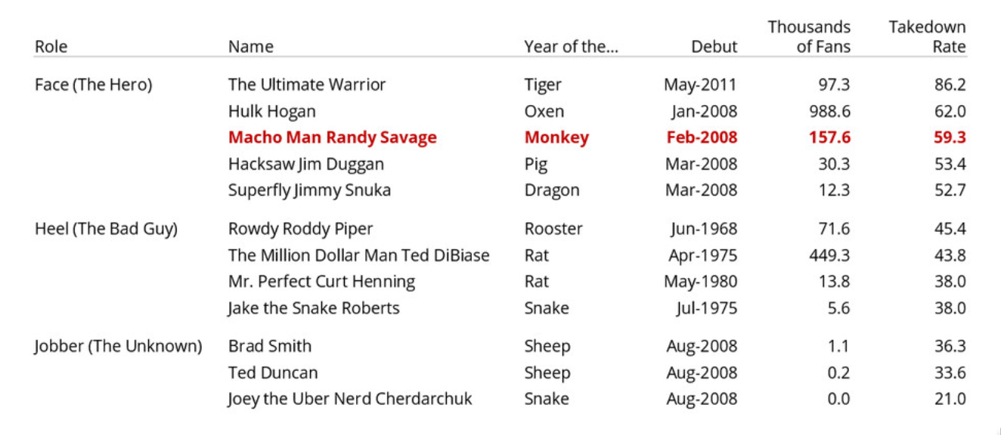
How to fix the defaults
http://www.darkhorseanalytics.com/blog/clear-off-the-table
Notes:
What's good? Spacing, alignment, grid lines, color
Watch slide show to see "before" transformed to "After"

Slide 7
DLI Accelerated Data Science Teaching Kit
Thank You

