Slide 1
Lecture ​9.1 - Why Learn D3?
DLI Accelerated Data Science Teaching Kit

Slide 2

The Accelerated Data Science Teaching Kit is licensed by NVIDIA, Georgia Institute of Technology, and Prairie View A&M University under the
Creative Commons Attribution-NonCommercial 4.0 International License.

Slide 3
D3: The Crash Course
aka D3: The Early Sticking Points
aka D3: Only the Beginning

Slide 4
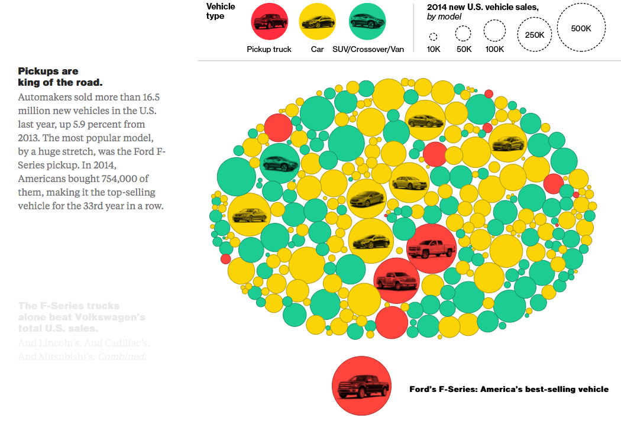
Retrieved: on December 1, 2017 from http://www.bloomberg.com/graphics/2015-auto-sales/
Notes:
Bloomberg

Slide 5
Why should you learn D3?

Slide 6
If you visualization/system/tool will benefit from interactivity.
Otherwise, use anything you want (e.g., tableau, excel, python:seaborn, R:ggplot2, etc.)
More online discussion: https://news.ycombinator.com/item?id=11995332

Slide 7
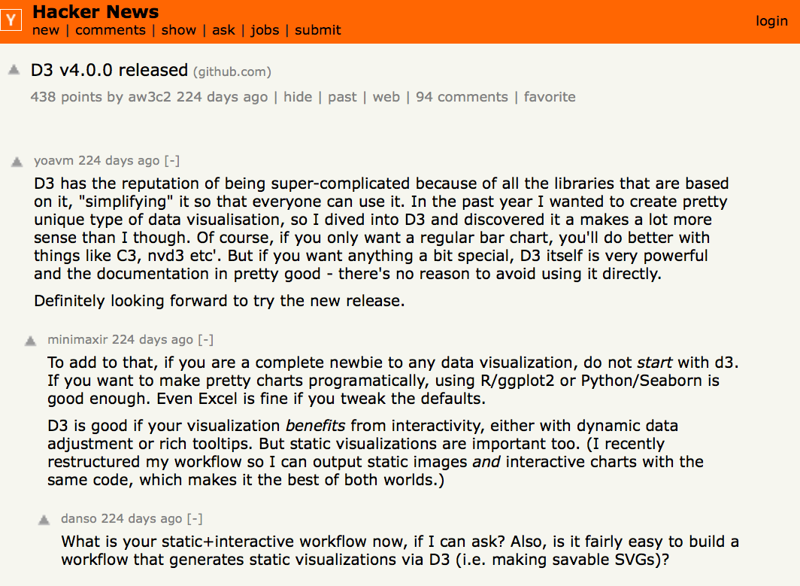

Slide 8
D3 versions
Most D3 examples/tutorials uses v3 and v4
This lecture is based on v3; concepts covered generalize to higher versions
V6 is the latest, but has “breaking” changes

Slide 9
DLI Accelerated Data Science Teaching Kit
Thank You
We thank Dr. Chad Stolper for sharing teaching materials for visualization and D3.

