Slide 1
Lecture 9.2 - Prerequisites: Javascript & SVG
DLI Accelerated Data Science Teaching Kit

Slide 2

The Accelerated Data Science Teaching Kit is licensed by NVIDIA, Georgia Institute of Technology, and Prairie View A&M University under the
Creative Commons Attribution-NonCommercial 4.0 International License.

Slide 3
Chrome Inspector and Console
Open the webpage
Right-click on anything
Click “inspect”
Open the console too, so you can see the error messages

Slide 4
Starting a Local Web Server
Necessary for Chrome, not for Safari or Firefox (This is a security measure: to prevent reading from your file systems)
Python 2.x
python -m SimpleHTTPServer 8000
Python 3.x
python –m http.server 8000
http://localhost:8000

Slide 5

If you’re new to JavaScript…
prepare for a lot of…
confusion (wat??)
and hair pulling
I’m serious.

Slide 6
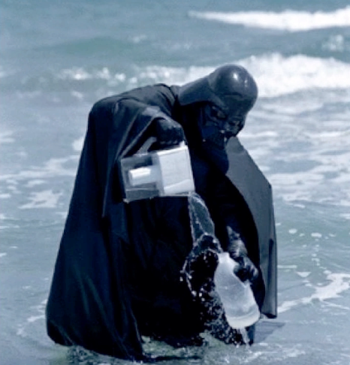
If you’re new to JavaScript…
https://www.destroyallsoftware.com/talks/wat
(start video at 1:20)
Screenshot from video
Notes:
Watch video. Funny, and help you foresee the quirks you need to work with

Slide 7
JavaScript 101
All variables are global, unless declared using var
x = 300 (global)
var x = 300 (local)
Semicolons are optional
“text” is the same as ‘text’
JS arrays and objects are almost exactly the same syntax as python’s lists [ ] and dicts { }
object.key is the same as object[‘key’]
Print to the console using console.log( )

Slide 8
JavaScript 102: Functional Programming
Javascript supports functional programming
Functions are themselves objects
Functions can be stored as variables
Functions can be passed as parameters
D3 uses these abilities extensively!
Some people say javascript is a “multi-paradigm” programming language.
http://stackoverflow.com/questions/3962604/is-javascript-a-functional-programming-language

Slide 9
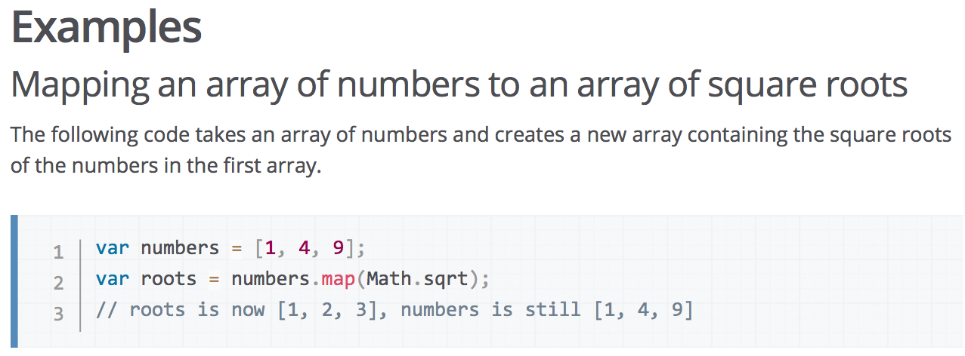
What does that mean?
Passing Math.sqrt (a function) as a parameter
https://developer.mozilla.org/en-US/docs/Web/JavaScript/Reference/Global_Objects/Array/map
Notes:
Numbers is an array

Slide 10
MDN – the BEST Javascript reference
Mozilla Developer Network
https://developer.mozilla.org/en-US/docs/Web/JavaScript/Reference
(Easier: google “<command> mdn”)

Slide 11
Method Chaining
“Syntactic Sugar” paradigm where each method returns the object that it was called on
group
.attr(“x”,5)
.attr(“y”,5); //returns group
is the same as
group.attr(“x”,5) //returns group
group.attr(“y”,5) //returns group

Slide 12
SVG Basics
SVG = Scalable Vector Graphics
Retrieved on December 1, 2017 https://en.wikipedia.org/wiki/Scalable_Vector_Graphics

Slide 13
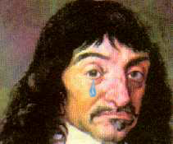
(0,0)
y
x
http://smg.photobucket.com/user/Pavan2099/media/RvB/Descart-weeping.png.html

Slide 14
SVG Basics
SVG -> XML Vector Graphics
(Scalable Vector Graphics)

Slide 15
SVG Basics
XML Vector Graphics
Tags with Attributes
<circle r=5 fill="green"></circle>
W3C Standard
http://www.w3.org/TR/SVG/
Supported by all the major browsers

Slide 16
SVG Basics
<svg>
<circle>
<rect>
<path>
<g>
<text>

Slide 17
<svg> element
Overarching canvas
(optional) Attributes:
width
height
Create with
d3.select("#vis").append("svg")
<body>
<div id=“vis”>
<svg></svg>
</div>
</body>

Slide 18
<circle> element
Attributes:
cx (relative to the LEFT of the container)
cy (relative to the TOP of the container)
r (radius)
(optional) Attributes:
fill (color)
stroke (the color of the stroke)
stroke-width (the width of the stroke)
Create with
.append("circle")

Slide 19
<rect> element
Attributes:
x (relative to the LEFT of the container)
y (relative to the TOP of the container)
width (cannot be negative)
height (cannot be negative)
(optional) Attributes:
fill (color)
stroke (the color of the stroke)
stroke-width (the width of the stroke)
Create with
.append("rect")

Slide 20
(0,0)
y
x
height
width
http://smg.photobucket.com/user/Pavan2099/media/RvB/Descart-weeping.png.html

Slide 21
Rather than positioning each element, what if we want to position (or style) a group of elements?

Slide 22
<g> element
Generic container (Group) element
Attributes
transform
(fill,stroke,etc.)
Create with:
var group = vis.append("g")
Add things to the group with:
group.append("circle")
group.append("rect")
group.append("text")

Slide 23
CSS Selectors Reference
By ID: #vis → <tag id="vis">
By tag name: circle → <circle>
By class name: .canary → <tag class="canary">
By attribute: [color="blue"] → <tag color="blue">
And many more ways
http://www.w3schools.com/cssref/css_selectors.asp
And any combinations…
AND circle.canary → <circle class=“canary”>
OR circle, .canary → <circle> <circle class=“canary”> <tag class=“canary”>
Notes:
Creating visualization, likely need to select things. For example, bar chart: set all bars to blue

Slide 24
DLI Accelerated Data Science Teaching Kit
Thank You
We thank Dr. Chad Stolper for sharing teaching materials for visualization and D3.

