Slide 1
Lecture 9.5 - Attributes, Styles, Classes & Text
DLI Accelerated Data Science Teaching Kit

Slide 2

The Accelerated Data Science Teaching Kit is licensed by NVIDIA, Georgia Institute of Technology, and Prairie View A&M University under the
Creative Commons Attribution-NonCommercial 4.0 International License.

Slide 3
.attr()
The Attribute Method
Sets attributes such as x, y, width, height, and fill
Technical details:
  group.attr(“x”, 5)
  <rect x=“5”></rect>

Slide 4
.attr() and Functional Programming
Input
[ {size: 10}, {size: 8}, {size: 12.2} ]
We want 3 rectangles:
  <rect height=“10” x=“5”></rect>
  <rect height=“8” x=“10”></rect>
  <rect height=“12.2” x=“15”></rect>
.attr(“height”, function(d,i){ return d.size })
  d: the data point
.attr(“x”, function(d,i){ return (i+1)*5; })
  i: the index of the data point

Slide 5
<text> elements
I’m going to apologize in advance here for the lousy job the W3C did with the <text> definition.
You’re going to have to just either memorize these things or keep referring back to http://www.w3c.org/TR/SVG/text.html (first Google hit for “svg text”) like I do.

Slide 6
<text> elements
Extra Method in D3
  .text(“Your Text Goes Here”)
  <tag>Your Text Goes Here</tag>
Attributes
  x
  y
Styles
  text-anchor: start, middle, end
  dominant-baseline: [nothing], hanging, middle

Slide 7
text-anchor style
Where is (0,0)?
This is my line of text.
start
middle
end

Slide 8
dominant-baseline style
Where is (0,0)?
This is my line of text.
hanging
middle
default

Slide 9
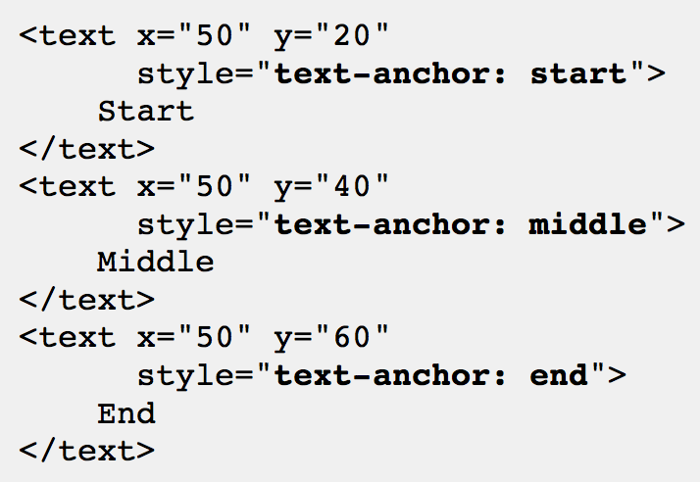
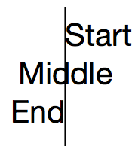
<text> example
http://tutorials.jenkov.com/svg/text-element.html

Slide 10
The .style() Function
Like attr, but for the style attribute
Inline CSS styling
.style(“prop1”,“val1”)
.style(“prop2”,“val2”)
.style(“prop3”, function(d,i){ })
<ele style=“prop1: val1; prop2: val2;”>

Slide 11
<text> example
group.append(“svg:text”)
.text(function(d){return d.name})
.attr(“x”, function(d,i){return i*5})
.attr(“y”, function(d,i){return height;})
.style(“dominant-baseline”,“hanging”)
.style(“text-anchor”, “middle”)
Need to remember what to use .style and when to use .attr

Slide 12
What if you have
two different types of circles?

Slide 13
Classing
CSS Classes
  Any number of classes per element
  Select using “.classname”
blue = vis.selectAll(“circle.bluecircle”)
  .data(bluedata, function(d){return d.id;})
blue.enter( ).append(“svg:circle”)
  .classed(“bluecircle”, “true”)
vis.selectAll(“.bluecircle”).attr(“fill”,“blue”)

Slide 14
DLI Accelerated Data Science Teaching Kit
Thank You
We thank Dr. Chad Stolper for sharing teaching materials for visualization and D3.

