Slide 1
Lecture 9.6 - Scales and Axes
DLI Accelerated Data Science Teaching Kit

Slide 2

The Accelerated Data Science Teaching Kit is licensed by NVIDIA, Georgia Institute of Technology, and Prairie View A&M University under the
Creative Commons Attribution-NonCommercial 4.0 International License.

Slide 3
Scales
(e.g., sizing a circle based on data value)
Notes:
Scale = transform range of input values,
to range of output values

Slide 4
.attr(“height”, function(d){ return d; })
can blow up really quickly…
Notes:
If don't use, as in linear scale...

Slide 5
Scales
D3 has many types of scales
I am only going to cover two:
  Linear Scales
  Ordinal Scales

Slide 6
Linear Scales
var xscale = d3.scale.linear( )
      .domain( [min, max] )
      .range( [minOut, maxOut] )
group.attr(“x”, function(d,i){
      return xscale(d.size);
})
Notes:
defines the mapping...
domain: range of input values
range: range out output values
Then, use it as below...

Slide 7
Min and Max
But how do you figure out the min and max for the domain?
Notes:
But...

Slide 8
D3
A really powerful for-loop with a ton of useful helper functions
Notes:
Remember that D3 is a really...

Slide 9
Min and Max
d3.min( [ ] ) → number
d3.max( [ ] ) → number
d3.extent( [ ] ) → [number,number]
Notes:
D3 has built in functions like…
e.g., min() takes array of numbers and return…

Slide 10
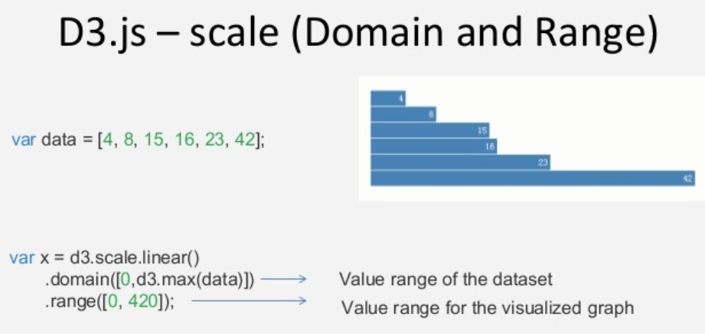
Domain & Range
http://image.slidesharecdn.com/d3-140708145630-phpapp02/95/d3-17-638.jpg?cb=1404831405
Notes:
Here's an example of how to use in practice
Here, input is an array of numbers.
But what if the numbers that you scale
is part of an object, ...

Slide 11
An optional accessor function may be specified, which is equivalent to calling array.map(accessor) before computing the maximum value.
d3.max(
  data.map( function(d){ return d.age; })
) // returns the maximum age
https://github.com/d3/d3-3.x-api-reference/blob/master/Arrays.md
Notes:
As in this example: age
D3 allows you to use an Accessor to extract
the number you want from an object
data.map() is the Accessor

Slide 12
var maxAge = d3.max(
  data.map( function(d){ return d.age; })
) // returns the maximum age
var yscale = d3.scale.linear( )
      .domain( [0, maxAge] )
      .range( [0, 100] )
Notes:
Here's an example of how to use in practice…
Top is Accessor
Bottom: use computed maxAge in domain

Slide 13
Ordinal Scales
D3 has built-in color scales!
  (And they’re easy!)
var colorscale = d3.scale.category10( )
Also available are:
  category20( )
  category20b( )
  category20c( )
  (and even a few more)
Notes:
D3 has built-in color scales.
E.g., category10 gives you 10 colors
Category20 gives you 20 colors
Variations…

Slide 14

Ordinal Categorical Scales
D3 has built-in color scales!
  (And they’re easy!)
var colorscale = d3.scale.category10( )
Also available are:
  category20( )
  category20b( )
  category20c( )
  (and even a few more)
Think carefully before using a rainbow palette for ordinal data!
http://www.mathworks.com/tagteam/81137_92238v00_RainbowColorMap_57312.pdf
Notes:
D3 in fact doesn’t care about what you pass in to an ordinal scale.
Only requirement is that the domain is discrete.
So you can pass in ordinal data – meaningful ordering, e.g., in Likert (like, neutral, dislike)
Or categorical, e.g., blood type
So be careful!

Slide 15
Ordinal Categorical Scales
[ {type:'Bird'},{type:'Rodent'},{type:'Bird'} ]
var colorscale = d3.scale.category10( )
.attr(“fill”,function(d,i){
  return colorscale(d.type)
  }
<rect fill="blue"></rect>
<rect fill="orange"></rect>
<rect fill="blue"></rect>
Bird
Rodent
Notes:
Here's an example of how to use in practice…
Input: array of 3 animal objects, each has a type
In colorscale, each color has an index.
Bird = first color (blue), Rodent = 2nd color (orange)

Slide 16
D3 also has visual helper-functions
Notes:
Besides scales, which transforms data values...

Slide 17
Axes
yaxisglyph = vis.append("g")
yaxis = d3.svg.axis( )
  .scale( yscale ) // must be a numerical scale
  .orient( 'left' ) // or 'right', 'top', or 'bottom'
  .ticks( 6 ) // number of ticks, default is 10
yaxisglyph.call(yaxis)
Notes:
Axes... also easy to use

Slide 18
DLI Accelerated Data Science Teaching Kit
Thank You
We thank Dr. Chad Stolper for sharing teaching materials for visualization and D3.

