Slide 1


Lecture 2.1 - Natural Language Processing and Language Modeling
Generative AI Teaching Kit

Slide 2

The NVIDIA Deep Learning Institute Generative AI Teaching Kit is licensed by NVIDIA and Dartmouth College under the
Creative Commons Attribution-NonCommercial 4.0 International License.

Slide 3
This lecture
Introduction to NLP: History and Applications
Classical NLP Methods
Language Models: From Basics to Modern Approaches
Transformers and the Rise of Modern LMs

Slide 4
Introduction to NLP: History and Applications

Slide 5
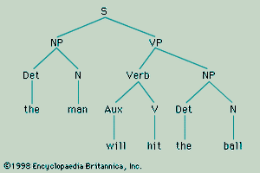
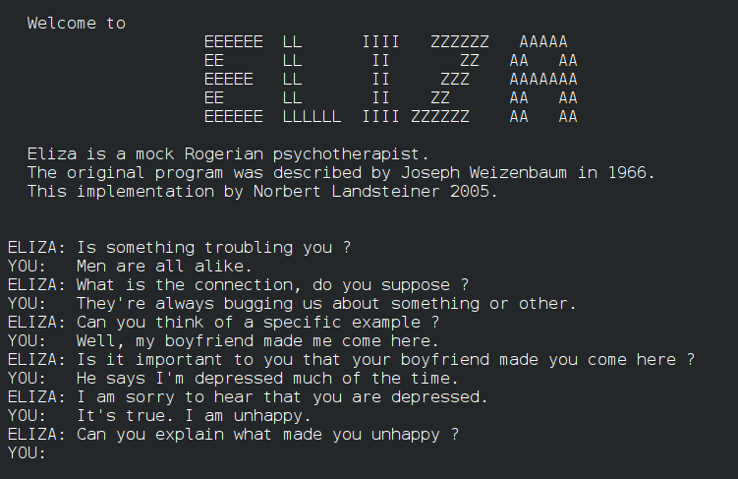
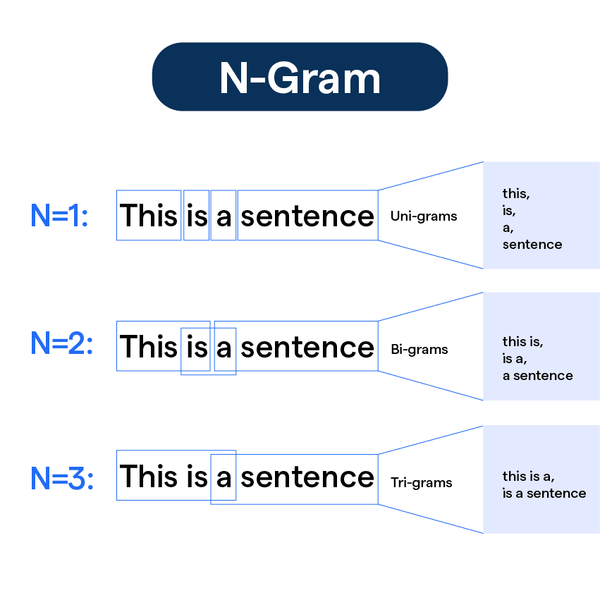
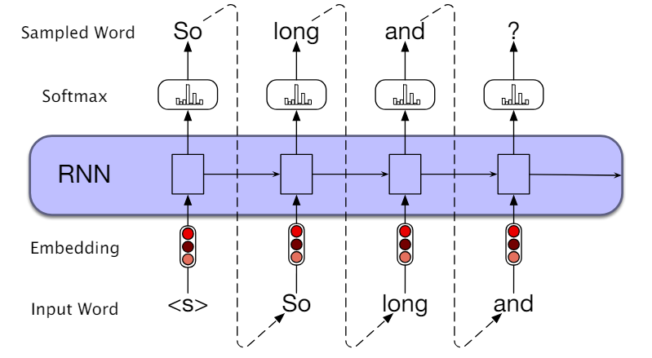
Introduction to NLP: History and Applications
1950s – 1960s: Rules-based
Challenges:
Scalability issues due to manual rule creation.
Limited ability to handle ambiguity in natural language.
1960s – 1980s: Statistical Methods
Challenges:
Dependence on large labeled datasets.
Difficulty handling long-range dependencies in language.
1990s – 2010s: Machine Learning Methods
Challenges:
Difficulty scaling RNNs to handle very long sequences.
Training inefficiencies for deep networks.
Notes:
https://en.wikipedia.org/wiki/ELIZA
https://www.britannica.com/topic/Syntactic-Structures
https://botpenguin.com/glossary/n-gram
https://pub.aimind.so/generating-text-with-lstm-networks-using-tensorflow-a-comprehensive-guide-79cc2eeda20a

Slide 6
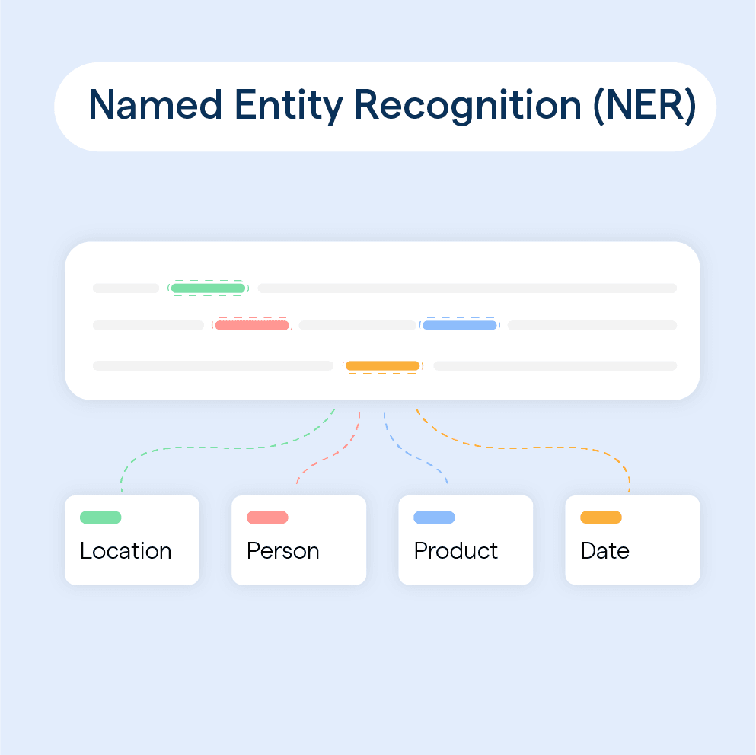
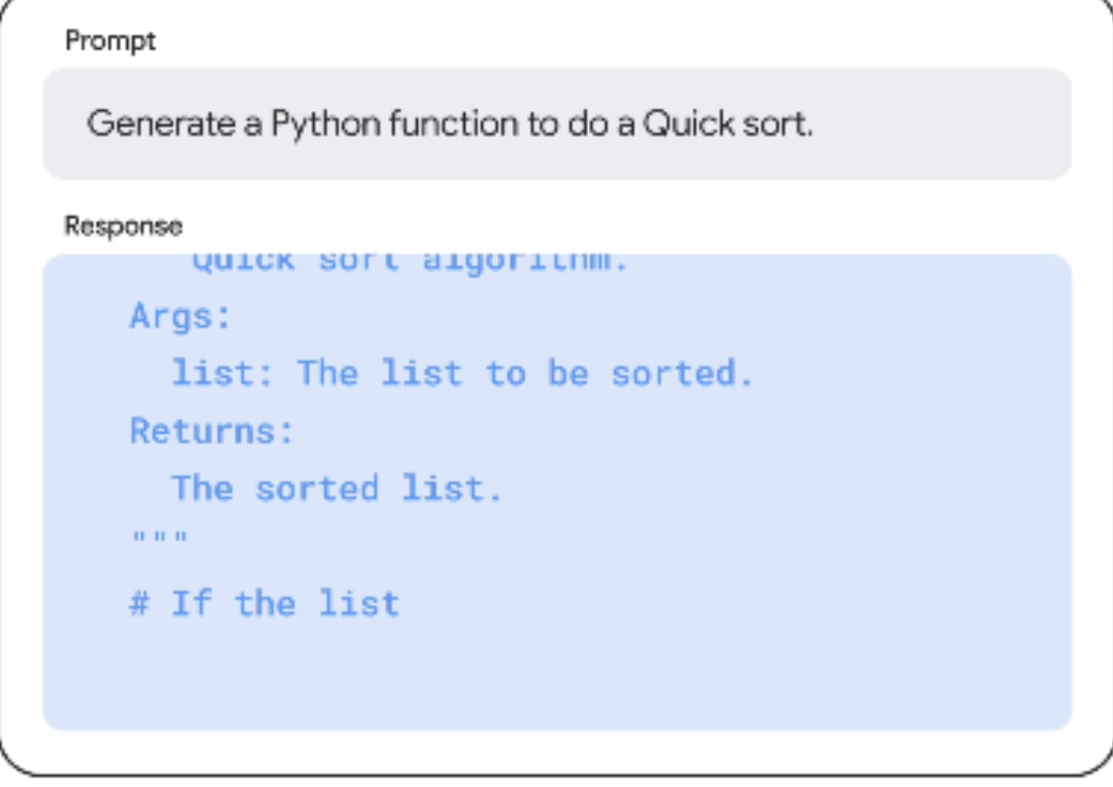
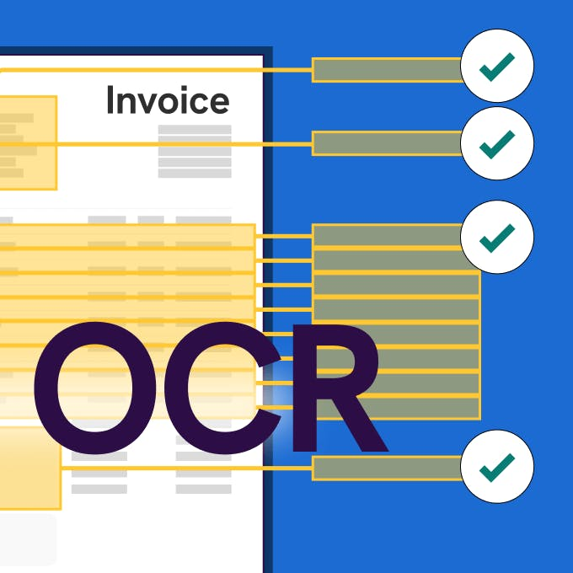
Introduction to NLP: History and Applications
NLP is used for a wide variety of applications:
Classification
Sentiment Analysis
Text Classification
Named Entity Recognition (NER)
Semantic Analysis
Grammar and Spell Checking
Generation
Language Translation
Chatbots
Text Summarization
Code Generation
Multimodal
Text-to-Image Descriptions
Text-to-Speech (TTS)
Optical Character Recognition (OCR)
Notes:
https://botpenguin.com/glossary/named-entity-recognition
https://cloud.google.com/use-cases/ai-code-generation

Slide 7
Classical NLP Methods

Slide 8
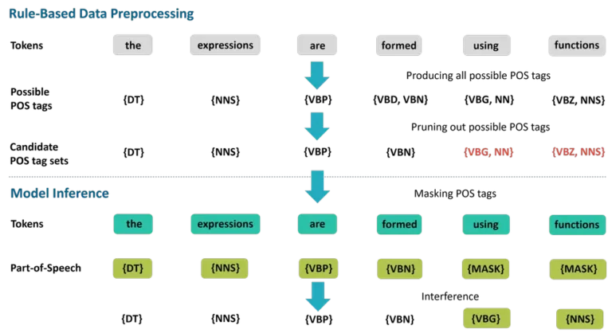
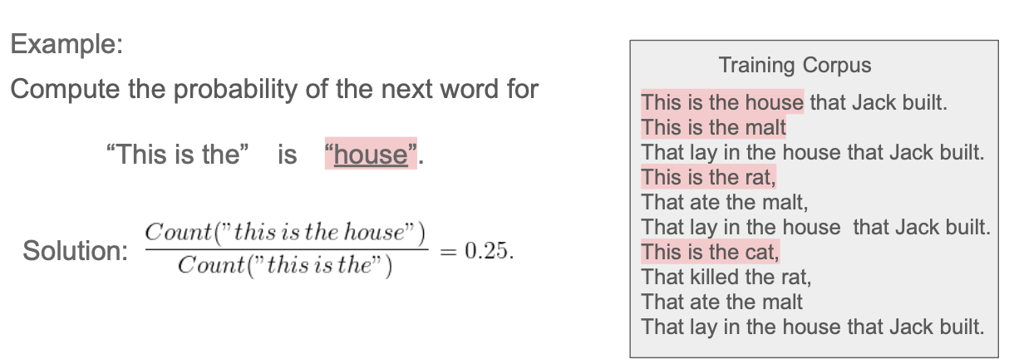
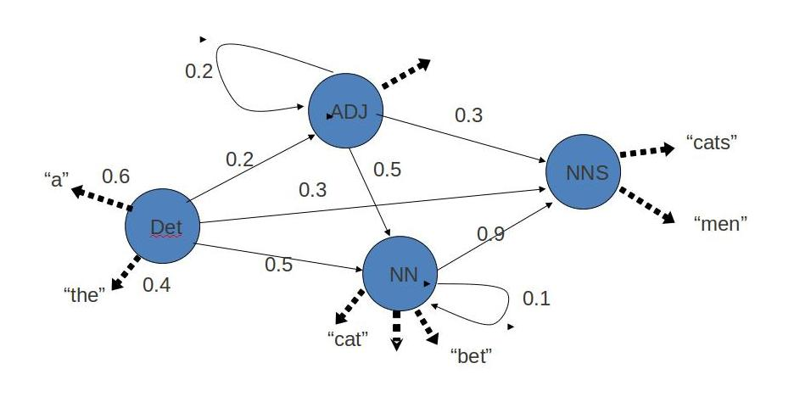
Classical NLP Methods
Prior to modern deep learning-based NLP approaches, other approaches like rules-based and statistics-based models were popular:
Rules-based
Rule-based models use a set of predefined rules to interpret and understand natural language. These models work by breaking down text into smaller parts, such as words or phrases, and then applying a set of rules to those parts to extract meaning. The rules can be simple or complex and are usually created the humans to understand the language and perform tasks.
Statistics-based
N-gram Model
N-gram word models are based on an assumption that the probability of the next word in a sequence depends only on a fixed size window of previous words. If only one previous word is considered, it is called a bigram model; if two words, a trigram model; if n − 1 words, an n-gram model.
Hidden Markov Model
A Hidden Markov Model (HMM) is a statistical Markov model in which the system being modeled is assumed to be a Markov process with unobserved (hidden) states. In a regular Markov model (Markov Model), the state is directly visible to the observer, and therefore the state transition probabilities are the only parameters. In a hidden Markov model, the state is not directly visible, but output, dependent on the state, is visible.
Notes:
https://medium.com/@ginoasuncion/an-overview-of-n-gram-language-modeling-e0f2d0f9f089
http://en.wikipedia.org/wiki/Markov_model
https://www.geeksforgeeks.org/rule-based-approach-in-nlp/
https://lumenci.com/blogs/language-processing-models/

Slide 9
Classical NLP Methods - Limitations
1. Lexical Ambiguity
Words with multiple meanings (e.g., “bank” as a financial institution vs. river bank).
Syntactic Ambiguity:
Different ways to parse a sentence (e.g., “I saw the man with a telescope”).
Contextual Limitations:
Classical methods often struggle with determining meaning based on context.
2. Fixed-Size Context Windows:
N-gram models and early statistical methods consider only short-term dependencies.

Slide 10
Classical NLP Methods - Limitations
3. Handling Out-of-Vocabulary (OOV) Words
Vocabulary Limitations:
Classical methods struggle with unseen words or variations (e.g., “tweeted” vs. “tweet”).
Morphological Variations:
Inflexible handling of word forms (e.g., “run,” “running,” “ran”).
4. Difficulty in Capturing Semantics
Surface-Level Understanding:
Classical methods focus on syntax and word frequency rather than meaning.
No Contextual Word Representation:
Words are treated independently, missing nuances and context (e.g., “bat” as an animal vs. sports equipment).

Slide 11
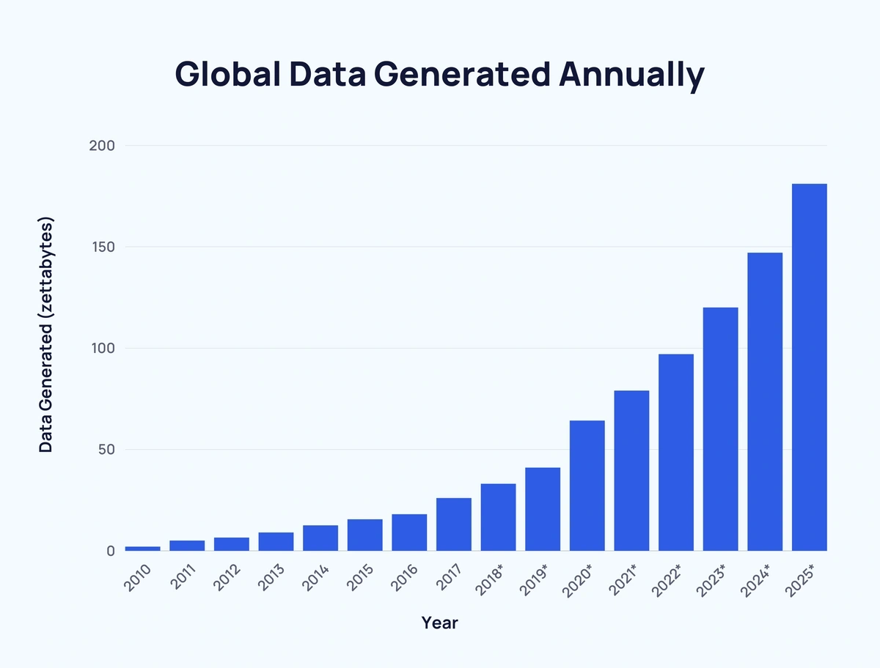
Classical NLP Methods - Limitations
5. Poor Scalability with Large Data
Rule Explosion:
As data size grows, maintaining and expanding rule sets becomes impractical.
Statistical Models:
Often require extensive feature engineering and large labeled datasets.
Notes:
https://explodingtopics.com/blog/data-generated-per-day

Slide 12
Language Models: From Basics to Modern Approaches

Slide 13
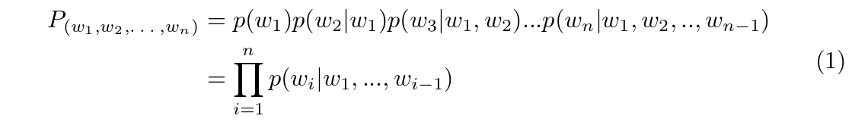
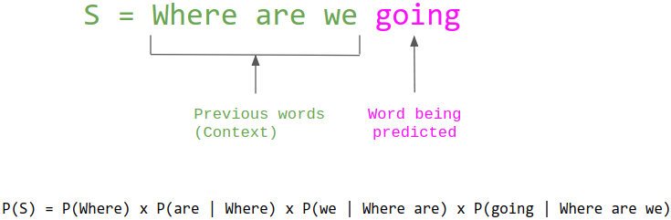
Language Models: From Basics to Modern Approaches
What are language models/language modeling?
Language modeling is the process of assigning probabilities to sequences of words, capturing how likely a sequence is to occur.
- is the probability of word w₂ given that word w₁ is the previous word. Typically, the word with the highest probability in the vocabulary is then selected as the next word.

Slide 14
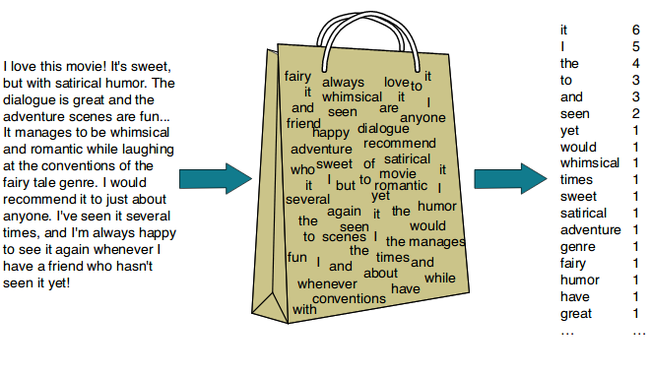
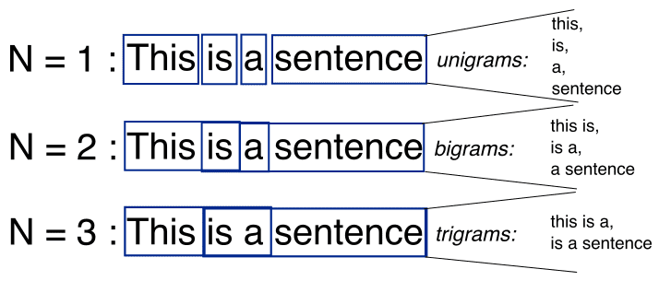
Language Models: From Basics to Modern Approaches
Bag of Words (BoW)
Description:
Represents text as an unordered collection of words, ignoring grammar and word order.
Pros:
Simple and Efficient: Easy to implement and computationally inexpensive.
Good for Short Texts: Works well when context and order aren’t crucial (e.g., spam detection).
Cons:
Ignores Word Order: Loses context and meaning (e.g., “not good” vs. “good”).
Sparse Representation: Large vocabulary leads to high-dimensional, sparse vectors.
Contextual Limitations: Struggles with understanding relationships between words.
N-Gram Models
Description:
Represents text as sequences of ￼-length contiguous words (e.g., bigrams = 2-word sequences).
Pros:
Captures Word Order: Preserves local context and basic syntax.
Better Context Representation: Improves performance over BoW for tasks like language modeling.
Cons:
Limited Context Window: Can’t capture long-range dependencies (e.g., beyond 3-4 words).
Data Sparsity: Rare n-grams can lead to poor generalization.
Scalability Issues: Large n-grams increase computational and memory demands.
P(“There was heavy rain”) ~ P(“There”) P(“was”|“'There”) P(“heavy”|“was”) P(“rain”|“heavy”)
Notes:
https://ogre51.medium.com/nlp-explain-bag-of-words-3b9fc4f211e8

Slide 15
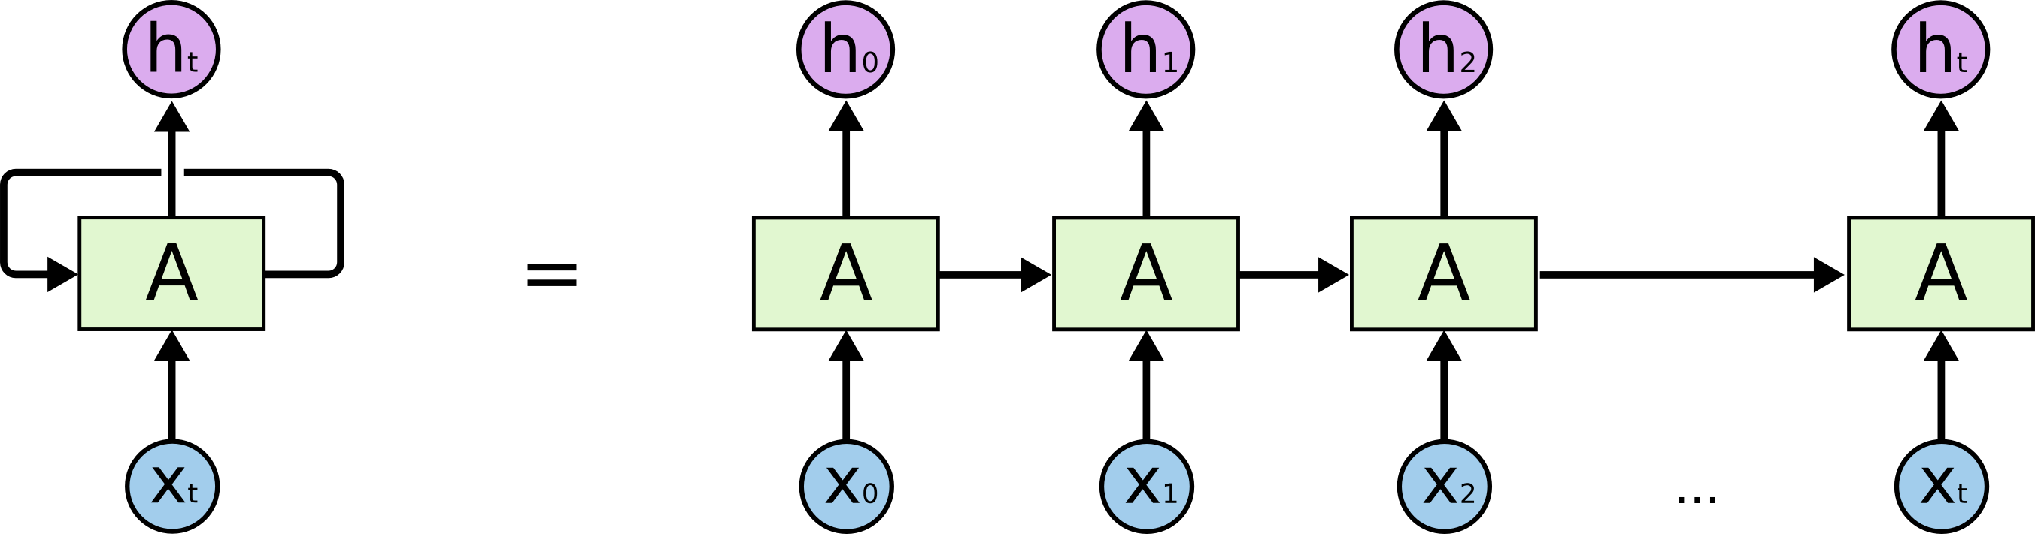
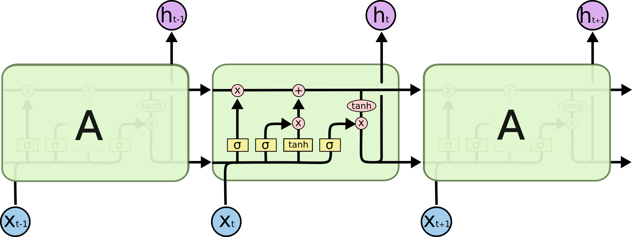
Language Models: From Basics to Modern Approaches
Recurrent Neural Networks
Advantages of RNNs:
Handle sequential data, including text, speech, and time series.
Process inputs of any length, unlike feedforward neural networks.
Share weights across time steps, enhancing training efficiency.
Disadvantages of RNNs:
Prone to vanishing and exploding gradient problems.
Training can be challenging, especially for long sequences.
Computationally slower than other neural network architectures.
Long-Short Term Memory Networks
Advantages of LSTMs
Address the Vanishing Gradient Problem
Capable of Learning Long-Range Dependencies
Effective Handling of Sequential Data
Improved Gradient Flow
Disadvantages of LSTMs
Computational Complexity
Memory Usage
Overfitting on Small Datasets
Slower Inference and Training
Notes:
https://colah.github.io/posts/2015-08-Understanding-LSTMs/

Slide 16
Transformers and the Rise of Modern LMs

Slide 17
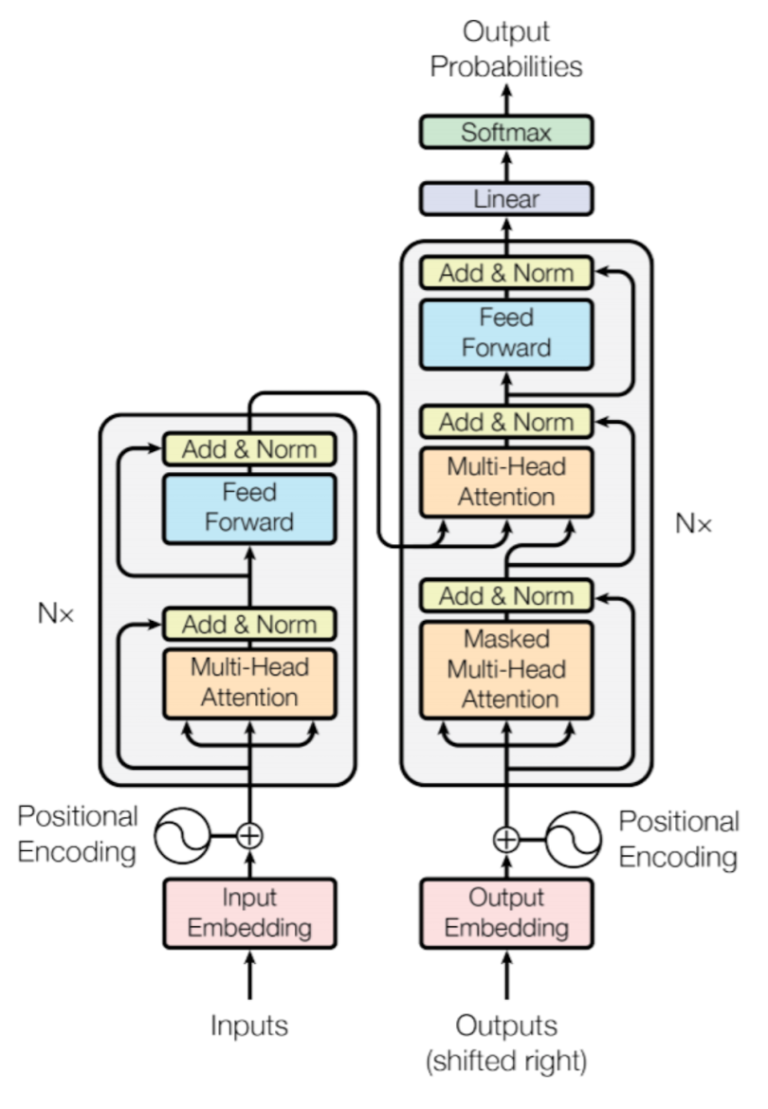
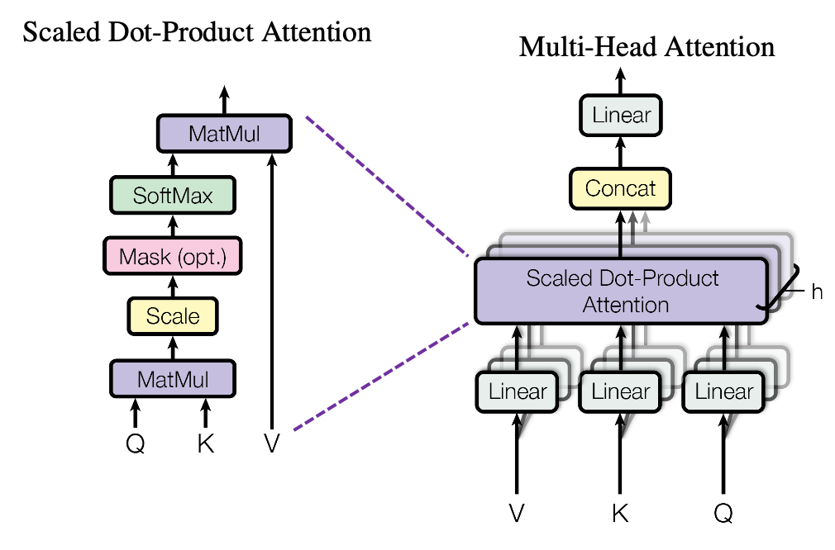
Transformers and the Rise of Modern LMs
A neural network architecture designed for handling sequential data using a self-attention mechanism. Introduced in the paper “Attention Is All You Need” (2017), Transformers are the foundation for modern models like BERT, GPT, and T5.
In the following modules we will delve into the structure and training of transformer-based models.
Notes:
https://builtin.com/artificial-intelligence/transformer-neural-network
https://arxiv.org/abs/1706.03762

Slide 18
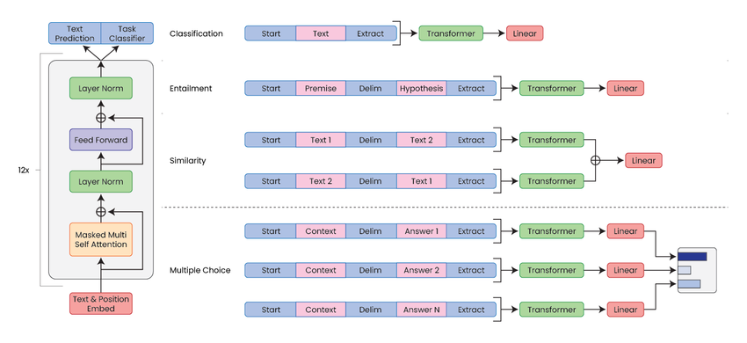
Transformers and the Rise of Modern LMs
Pros:
Handles Long-Range Dependencies
Parallelizable
Scalability
State-of-the-Art Performance
Cons:
High Computational Cost
Data Hungry
Lack of Recurrence
Interpretability Issues
Notes:
https://www.researchgate.net/figure/The-Transformers-Architecture-as-defined-in-GPT-14_fig3_374935854

Slide 19
Wrap Up
Natural Language Processing and Language Modeling
Today we introduced natural language processing and language models
We saw the evolution of NLP approaches from the 1950s rules-based methods to the current deep learning approaches
Language models were described as a family of probabilistic models used to predict/classify the next word which would solve or naturally follow a given sequence
-----------------------------------------------------------------------------
In the next class we will explore tokens and tokenization to see how these models connect language with computing

Slide 20
Thank you!

