Slide 1

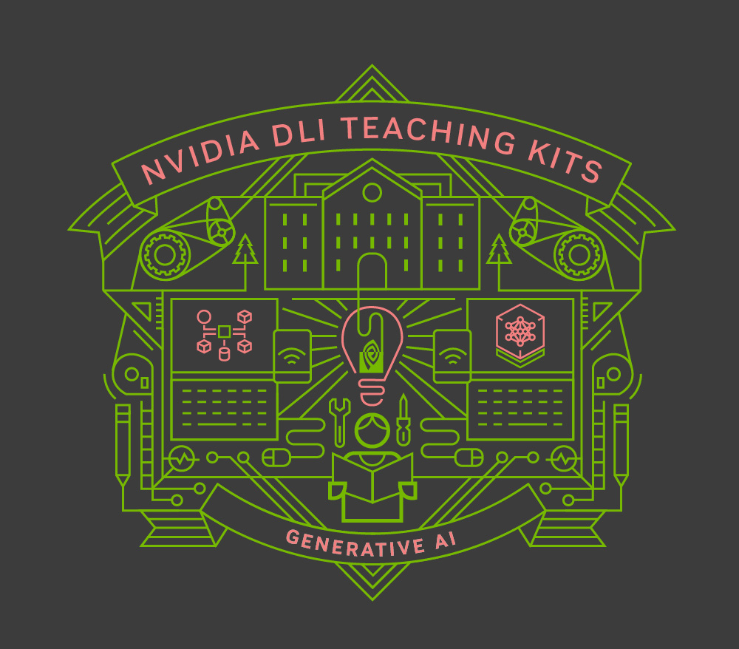
Lecture 2.2 - Tokens and Tokenization
Generative AI Teaching Kit

Slide 2

The NVIDIA Deep Learning Institute Generative AI Teaching Kit is licensed by NVIDIA and Dartmouth College under the
Creative Commons Attribution-NonCommercial 4.0 International License.

Slide 3
This lecture
Introduction to Tokens
Tokenization approaches
LLM Limitations from tokenization
Token-free models

Slide 4
Introduction to Tokens

Slide 5
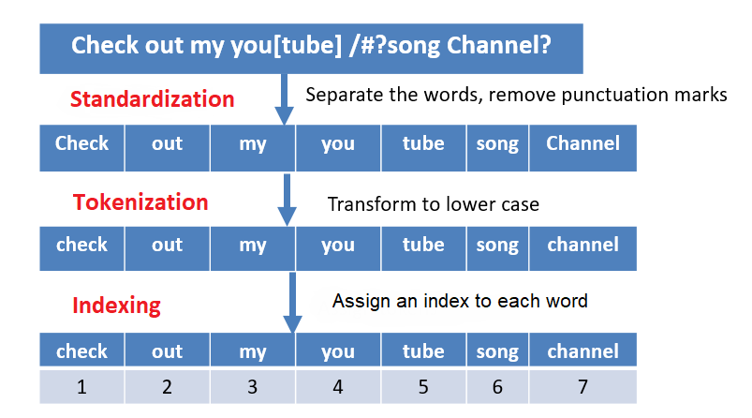
What are tokens?
Tokens are the building blocks of all natural language tasks and language models.
They represent language elements, like words or characters, or parts of words, which can be stored as a key-value pairing, to enable the expression of text as a sequence of numbers.
Language can be processed or encoded as a series of tokens IDs, and then these IDs, once selected from a language model, can be decoded back to language elements for human interpretation.
How these tokens are built for a given language, or dataset varies and can have a drastic impact on the performance and utility of the language models
Notes:
https://fall-2023-python-programming-for-data-science.readthedocs.io/en/latest/Lectures/Theme_3-Model_Engineering/Lecture_19-Natural_Language_Processing/Lecture_19-NLP.html

Slide 6
Important terms
When discussing tokens and tokenization, it is important to consider some terms that describe how a natural language phase is tokenized.
If we take the following phrase, or sequence, we need to use our vocabulary, to split it into separate tokens.
The moon, Earth's only natural satellite, has been a subject of fascination and wonder for thousands of years.
Token: Basic building block
Sequence: Sequential list of tokens
Vocabulary: Complete list of known tokens
{
1:"The",
569:"moon",
122: ",",
430:"Earth",
50:"**’s",
…}
The
Moon
,
Earth’s
Only
…..
years
The moon,
Earth’s only natural satellite
Has been a subject of
….
Thousands of years
Notes:
https://arxiv.org/pdf/2006.06609

Slide 7
Tokenization Methods

Slide 8
Tokenization: Word-level
The moon, Earth's only natural satellite, has been a subject of fascination and wonder for thousands of years.
Corpus of training data used to build our vocabulary.
a: 0
The: 1
is: 2
what: 3
I: 4
and: 5
…
{The
moon,
Earth’s
only
natural
satellite
… }
{ [1],
[45600],
[8097],
[43],
[1323],
[754]
… }
Building Vocabulary
Tokenization
Build index (dictionary of tokens = words)
Map tokens to indices
Pros
Intuitive.
Quick and simple to implement
Cons
Big vocabularies.
Complications such as handling misspellings and other out-of-vocabulary words.

Slide 9
Tokenization: Character-level
The moon, Earth's only natural satellite, has been a subject of fascination and wonder for thousands of years.
Corpus of training data used to build our vocabulary.
a: 0
b: 1
c: 2
d: 3
e: 4
f: 5
…
t
h
e
m
o
o
n
…
→
→
→
→
→
→
→
→
19
7
4
12
14
14
13
…
Build index (alphabet)
Map tokens to indices
Build index (dictionary of tokens = letters/characters)
Map tokens to indices
Pros
Small vocabulary.
No out-of-vocabulary words.
Cons
Loss of context within words.
Much longer sequences for a given input.

Slide 10
Tokenization: Sub-word-level
The moon, Earth's only natural satellite, has been a subject of fascination and wonder for thousands of years.
Corpus of training data used to build our vocabulary.
a: 0
as: 1
ask: 2
be: 3
ca: 4
cd: 5
…
The
moon
**,
Earth
**‘s
on
ly
…
→
→
→
→
→
→
→
→
319
12
391
178
198
79
281
…
Build index (byte-pair encoding)
Map tokens to indices
Build index (dictionary of tokens = mix of words and sub-words)
Map tokens to indices
Compromise
“Smart” vocabulary built from characters which co-occur frequently.
More robust to novel words.
Byte Pair Encoding (BPE) a popular encoding.
Start with a small vocab of characters.
Iteratively merge frequent pairs into new bytes in the vocab (such as “b”,”e” → “be”).

Slide 11
Tokenization
Tokenization method | Tokens | Token count | Vocab size
Sentence | ‘The moon, Earth's only natural satellite, has been a subject of fascination and wonder for thousands of years.’ | 1 | # sentences in doc
Word | 'The', 'moon,', "Earth's", 'only', 'natural', 'satellite,', 'has', 'been', 'a', 'subject', 'of', 'fascination', 'and', 'wonder', 'for', 'thousands', 'of', 'years.' | 18 | 171K (English¹)
Sub-word | 'The', 'moon', ',', 'Earth', "'", 's', 'on', 'ly', 'n', 'atur', 'al', 's', 'ate', 'll', 'it', 'e', ',', 'has', 'been', 'a', 'subject', 'of', 'fascinat', 'ion', 'and', 'w', 'on', 'd', 'er', 'for', 'th', 'ous', 'and', 's', 'of', 'y', 'ears', '.' | 37 | (varies)
Character | 'T', 'h', 'e', ' ', 'm', 'o', 'o', 'n', ',', ' ', 'E', 'a', 'r', 't', 'h', "'", 's', ' ', 'o', 'n', 'l', 'y', ' ', 'n', 'a', 't', 'u', 'r', 'a', 'l', ' ', 's', 'a', 't', 'e', 'l', 'l', 'i', 't', 'e', ',', ' ', 'h', 'a', 's', ' ', 'b', 'e', 'e', 'n', ' ', 'a', ' ', 's', 'u', 'b', 'j', 'e', 'c', 't', ' ', 'o', 'f', ' ', 'f', 'a', 's', 'c', 'i', 'n', 'a', 't', 'i', 'o', 'n', ' ', 'a', 'n', 'd', ' ', 'w', 'o', 'n', 'd', 'e', 'r', ' ', 'f', 'o', 'r', ' ', 't', 'h', 'o', 'u', 's', 'a', 'n', 'd', 's', ' ', 'o', 'f', ' ', 'y', 'e', 'a', 'r', 's', '.' | 110 | 52 + punctuation (English)

Slide 12
Byte-Pair Encoding
Byte Pair Encoding (BPE) is a sub-word tokenization algorithm used to break text into smaller units (sub-words) to handle rare words and unknown tokens effectively. It’s widely used in NLP models like GPT and BERT.
Steps in the BPE Algorithm
1. Initialization:
Start with a corpus where each word is represented as a sequence of characters (with an end-of-word marker, e.g., </w>).
2. Count Pair Frequencies:
Count the frequency of every adjacent character pair in the corpus.
3. Merge the Most Frequent Pair:
Find the most frequent pair and merge it into a new token.
4. Update Corpus and Repeat:
Update the corpus with the newly created sub-word tokens and repeat steps 2–3 until you reach the desired number of merges.
5. Build the Final Vocabulary:
After merges, the resulting vocabulary contains the original characters plus newly formed sub-word tokens.
Example Step 1:
"low" -> ["l", "o", "w", "</w>"]
"lower" -> ["l", "o", "w", "e", "r", "</w>"]
Example Step 2:
Corpus: ["l", "o", "w", "</w>"], ["l", "o", "w", "e", "r", "</w>"]
Pair frequencies:
("l", "o") → 2
("o", "w") → 2
("w", "</w>") → 2
("o", "e") → 1
("e", "r") → 1
Example Step 3:
Merge ("l", "o") → ["lo", "w", "</w>"], ["lo", "w", "e", "r", "</w>"].
Advantages of BPE
Handles Rare Words: Breaks rare or unknown words into sub-word units, avoiding out-of-vocabulary (OOV) issues.
Efficient Vocabulary Size: Produces a compact vocabulary by balancing characters and frequent sub-words.
Language Agnostic: Works well across different languages.
Notes:
https://arxiv.org/pdf/2006.06609

Slide 13
Tokenization and Model Behavior

Slide 14
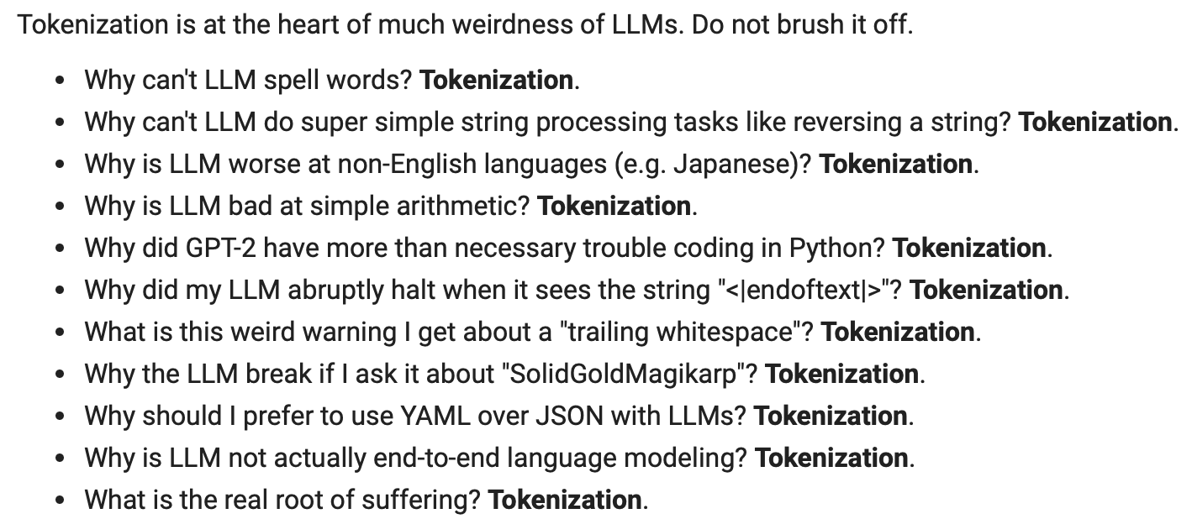
Effect of Tokenization
Large Language Models often have several issues that affect the performance and applicability to various talks. Many of these, highlighted below in a talk from Andrej Karpathy, are a direct results of tokenization:
Notes:
https://youtu.be/zduSFxRajkE?t=6711

Slide 15
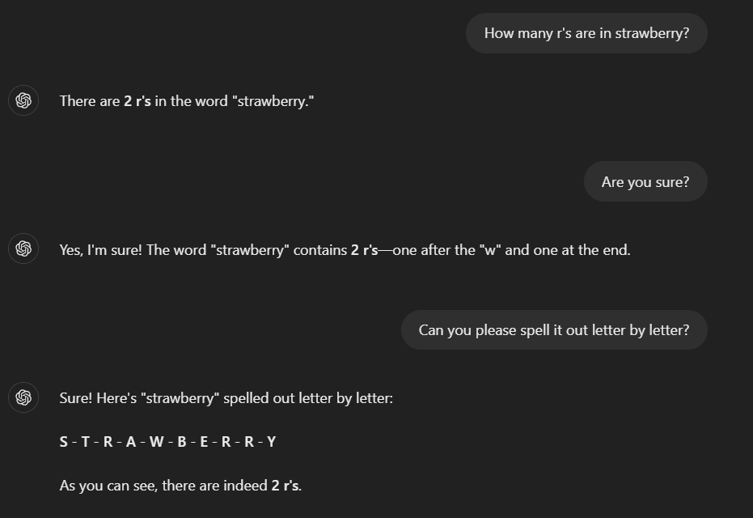
Effect of Tokenization – Spelling and Char-level issues
1. LLMs Struggle with Spelling and Rare Words:
Tokenization splits words into sub-words (e.g., “unpredictable” → [“un”, “predict”, “able”]).
Misspelled words (e.g., “teh”) fragment into low-probability sub-words, causing errors.
2. String Manipulation Is Difficult:
LLMs operate at the token level, not character level.
Tasks like reversing strings (“hello” → “olleh”) require access to individual characters, which tokenization obscures.
3. Granularity Mismatch:
Sub-word tokenization prioritizes meaning over form, leading to poor performance on character-sensitive tasks. Why It Happens:
LLMs are trained to understand semantics, not fine-grained character-level details.
The “strawberry problem”
Notes:
https://26282475.fs1.hubspotusercontent-eu1.net/hubfs/26282475/hyperstack_2024/blog/chatting-with-an-llm.png

Slide 16
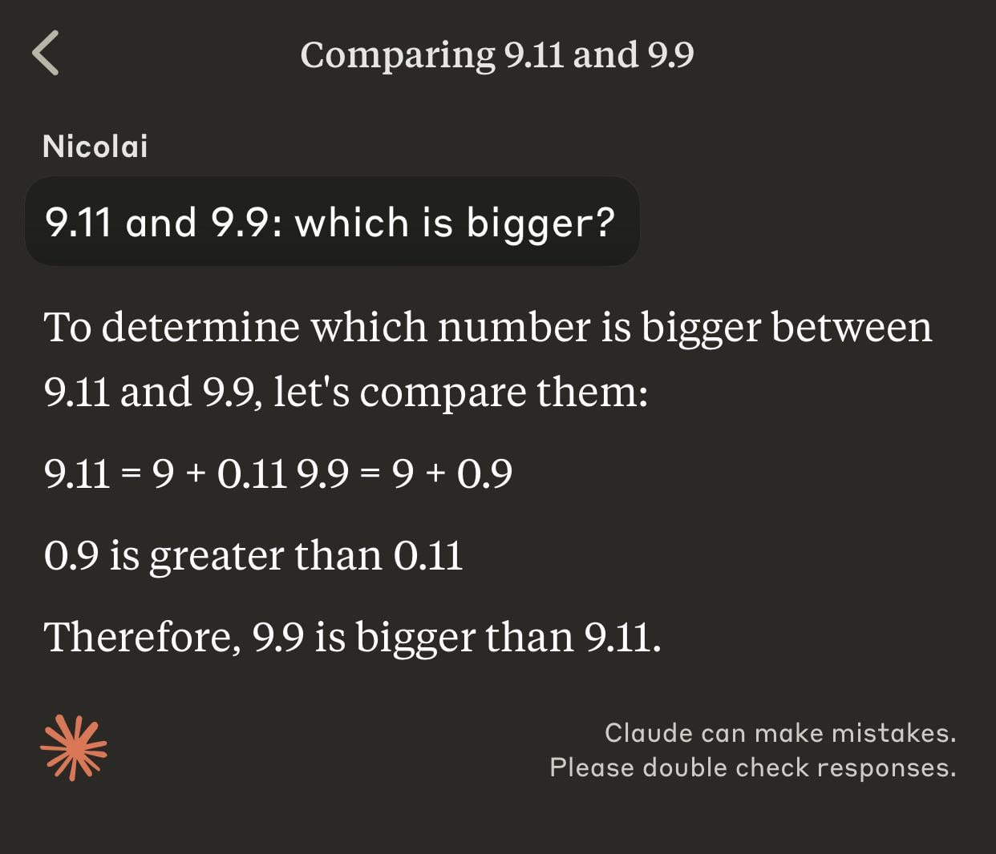
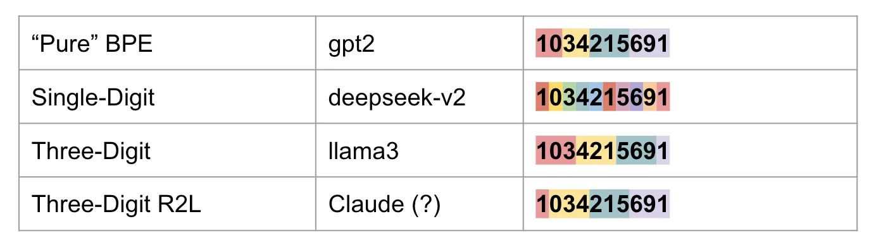
Effect of Tokenization – Arithmetic Challenges
1. LLMs Learn Patterns, Not Rules:
LLMs are trained on text data to predict the next token, not to understand or apply mathematical rules.
Arithmetic operations require explicit logic, not just pattern recognition.
2. Tokenization Can Cause Numerical Errors:
Numbers may be split into multiple tokens, especially for large or complex numbers (e.g., “123456” → [“123”, “456”]).
Consequence:
Operations requiring precise numerical understanding are prone to failure.
3. Training Data Limitations:
LLMs are exposed to math through text (e.g., “5 + 3 = 8”) rather than structured numeric computation.
Models learn approximations based on seen examples, not systematic calculations.
4. No Internal Math Engine:
LLMs do not inherently perform arithmetic. Their “calculations” are derived from patterns observed in training data, leading to inconsistent results.
Notes:
https://www.reddit.com/media?url=https%3A%2F%2Fpreview.redd.it%2Fnone-of-current-llms-can-truly-reason-and-cannot-be-used-v0-2v6ghnoggtcd1.jpeg%3Fwidth%3D1242%26format%3Dpjpg%26auto%3Dwebp%26s%3D08f9a6db59fe7c694c8717d7b508d79b58f9f9bf
https://www.linkedin.com/posts/garrethlee_ai-machinelearning-tokenization-activity-7259637115024482306-vLyl/

Slide 17
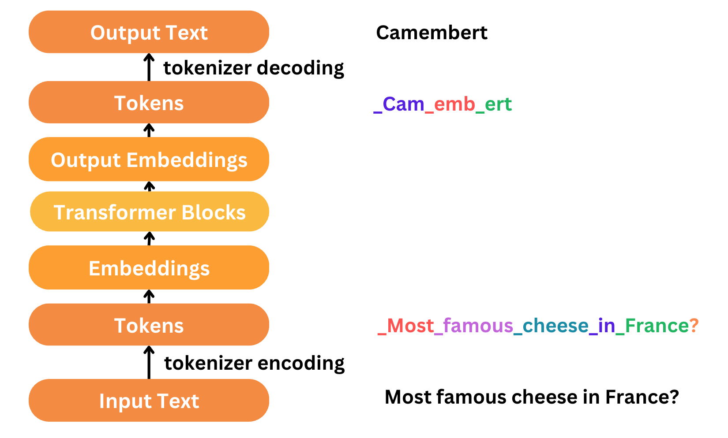
Effect of Tokenization – LLMs as systems
1. Dependence on Tokenization:
LLMs require preprocessing (e.g., tokenization) to handle input text.
2. Lack of Multimodal Capabilities:
Cannot process raw audio, images, or other non-text data directly without external tools.
3. Reliance on External Components:
Needs integration with tools for tasks like speech recognition, image understanding, or advanced reasoning.
4. No Built-In Execution:
Cannot perform exact computations or symbolic reasoning without external plugins.
Notes:
https://docs.mistral.ai/guides/tokenization/

Slide 18
Token-free and modern approaches

Slide 19
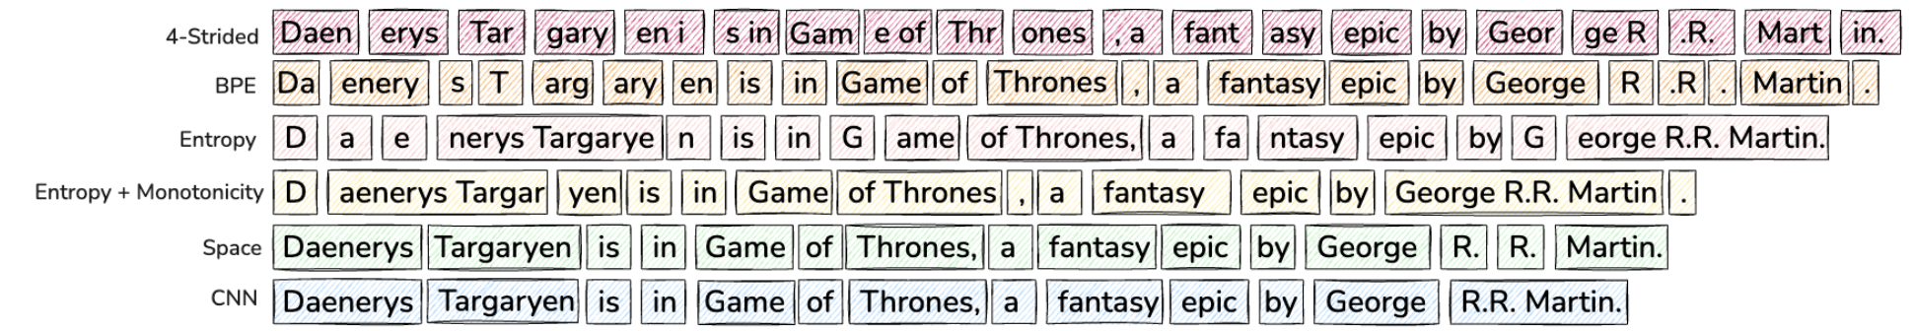
Challenges with Tokenization-based Models
Fixed Vocabulary Limitations:
Domain sensitivity: Tokenization schemes may underperform on out-of-domain data.
Multilingual inequity: Tokenization is less efficient for languages with complex scripts.
Poor handling of noisy inputs (e.g., typos, formatting issues).
Compute Allocation Challenges:
Equal compute for all tokens, regardless of complexity.
Inefficient for simple predictions like common endings.
Orthographic Knowledge Gap:
Token-based models lack intrinsic understanding of sub-word and character-level patterns.
Notes:
https://ai.meta.com/research/publications/byte-latent-transformer-patches-scale-better-than-tokens/

Slide 20
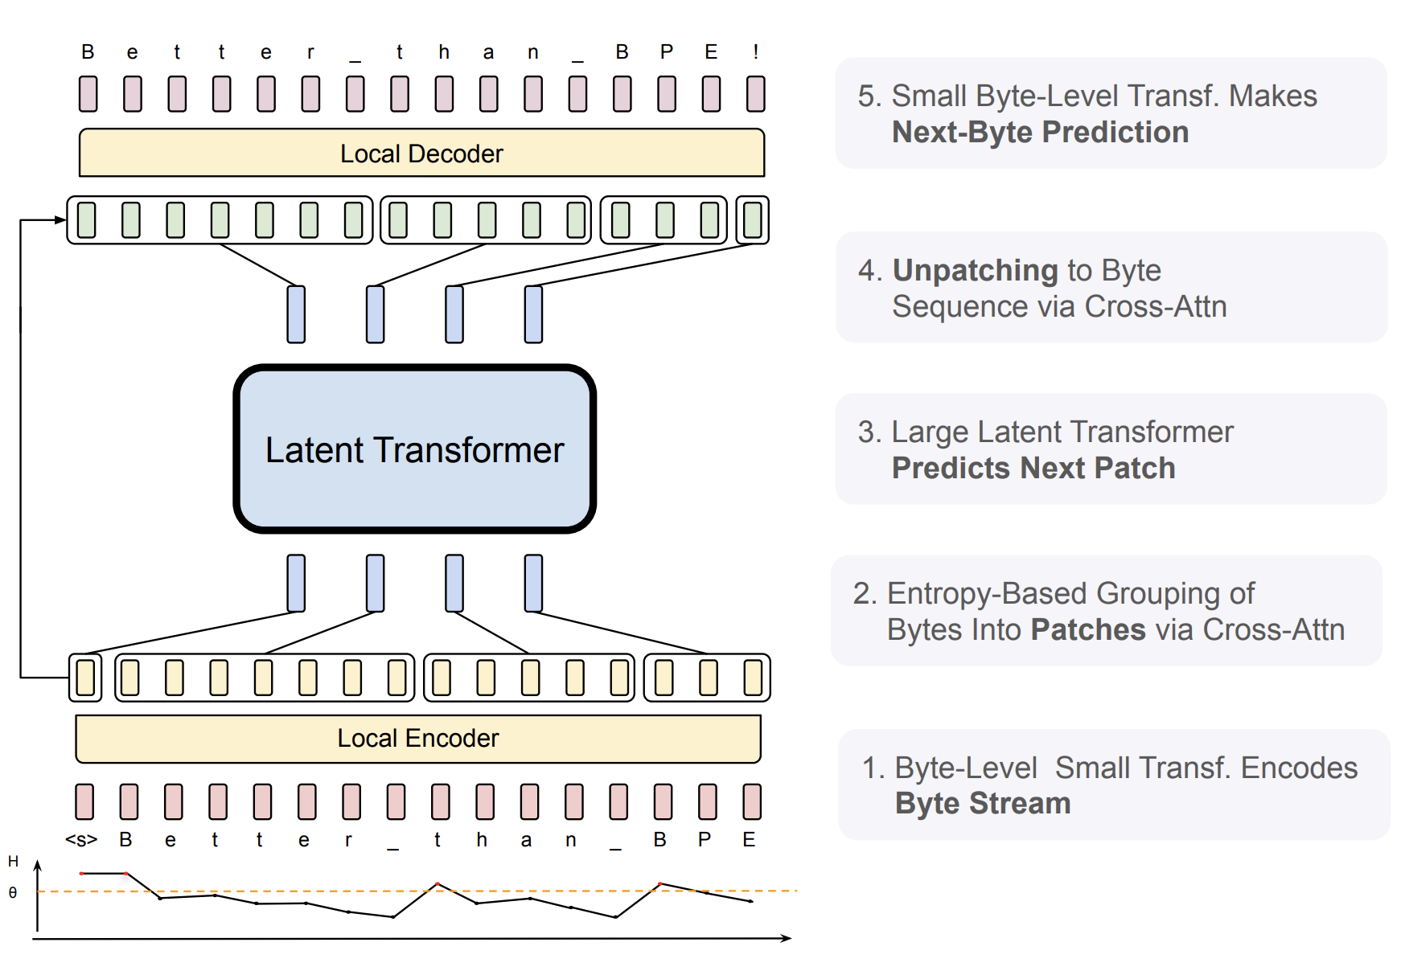
Byte-Level Tokenizer Model (BLT)
In 2024, Meta released the BLT model, addressing these issues
Dynamic Byte-Level Patching:
Segments raw bytes into entropy-based “patches” of variable sizes.
Allocates compute where needed, based on data complexity.
Model Design:
Local Encoder: Encodes raw bytes into patches.
Latent Transformer: Processes patch representations.
Local Decoder: Decodes patches back into bytes.
Advantages Over Tokenization:
No fixed vocabulary or heuristic compression.
Robust to noisy inputs and better character-level understanding.
More efficient scaling by dynamically adjusting patch size and model capacity.
Notes:
https://ai.meta.com/research/publications/byte-latent-transformer-patches-scale-better-than-tokens/

Slide 21
Wrap Up
Tokens and Tokenization
Today we introduced the concepts of tokens and tokenization.
We saw different approaches to tokenizing text and their relative trade-offs.
Some of the common issues with modern large language models were identified as rooted in tokenization
A new model, based on a token-free approach was also discussed, highlighting the need for ongoing research in this aspect of NLP.
----------------------------------------------------------------------------
In the next class we’ll look into how we convert these tokens into word vectors to codify meaning and allow these language models to perform better

Slide 22
Thank you!

