Slide 1


Lecture 3.1 - Language Models and Attention
Generative AI Teaching Kit
Notes:
https://pbs.twimg.com/media/Gd5WAejaQAAVHYh?format=jpg&name=4096x4096

Slide 2

The NVIDIA Deep Learning Institute Generative AI Teaching Kit is licensed by NVIDIA and Dartmouth College under the
Creative Commons Attribution-NonCommercial 4.0 International License.

Slide 3
This lecture
Language Models in Deep Learning
Evolution of attention mechanisms pre-transformers
Attention Mechanism

Slide 4
Language Models in Deep Learning

Slide 5
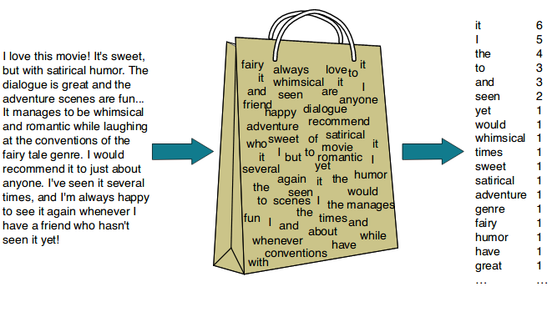
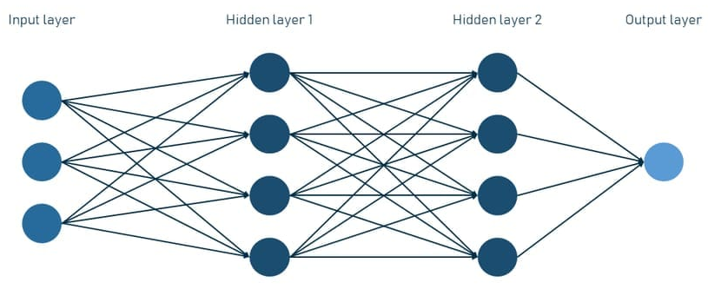
Deep Language Modeling
Recall that a goal of a language model is to predict the correct word based on the given input and the available corpus.
We have already seen statistical methods like Bag of Words which use the statistics of the prevalence of words in the dataset to predict the most likely next word.
But deep learning typically allows for more complex features to be encoded into a model.
Using deep learning for language, we can explore more complex relationships and more efficiently make use of the wealth of language data that is present digitally.
Notes:
https://www.altexsoft.com/blog/language-models-gpt/
https://www.comet.com/site/blog/spam-filtering-using-bag-of-words/

Slide 6
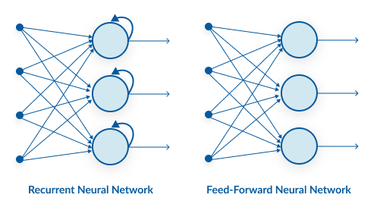
Challenges of Deep Learning Sequences
One main issue that standard neural networks run into when attempting to model language is time-dependency.
Language is causal, previous words influence future words, the same is true for sentences and paragraphs.
Neural networks don’t have an inherent way to “remember” previous inputs, or to properly represent sequences.
A newer innovation, the recurrent neural network is designed to process sequential data by maintaining a form of memory through its recurrent connections.
Notes:
https://www.analyticsvidhya.com/blog/2020/02/cnn-vs-rnn-vs-mlp-analyzing-3-types-of-neural-networks-in-deep-learning/

Slide 7
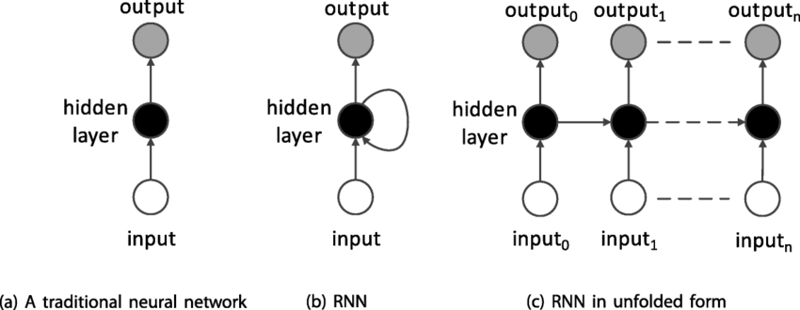
Recurrent Neural Networks
Unlike traditional feedforward networks, RNNs are designed to recognize patterns in sequences of data, such as time-series, text, speech, or videos, by maintaining a hidden state that captures information about previous inputs in the sequence.
Key Characteristics of RNNs:
Sequential Processing:
RNNs process input one step at a time, making them well-suited for tasks where data has a temporal or sequential structure.
Recurrent Connections:
At each time step, the hidden state of the network is updated based on the current input and the hidden state from the previous time step. This allows the network to "remember" information from earlier in the sequence.
Shared Weights:
The weights used for processing are shared across time steps, which reduces the number of parameters and helps capture temporal dependencies.
Memory:
The hidden state serves as a form of memory, enabling the network to use information from earlier inputs to influence later outputs.
Training via Backpropagation Through Time (BPTT):
The gradient is computed for all time steps of the sequence to train the network. However, this can lead to issues like vanishing or exploding gradients.
Notes:
https://www.researchgate.net/publication/330323646/figure/fig2/AS:962174709166124@1606411735542/Traditional-vs-recurrent-neural-networks-RNNs.png

Slide 8
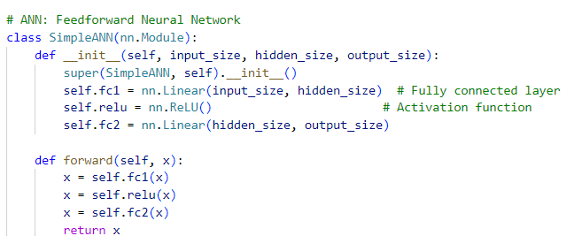
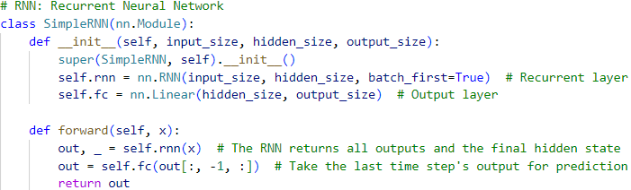
Recurrent Neural Networks – Code Differences
Key Differences
ANN: Processes inputs without considering temporal relationships; uses a simple Linear layer.
RNN: Processes sequences with recurrent connections; uses an RNN layer and captures sequential dependencies.
Notes:
https://www.researchgate.net/publication/330323646/figure/fig2/AS:962174709166124@1606411735542/Traditional-vs-recurrent-neural-networks-RNNs.png

Slide 9
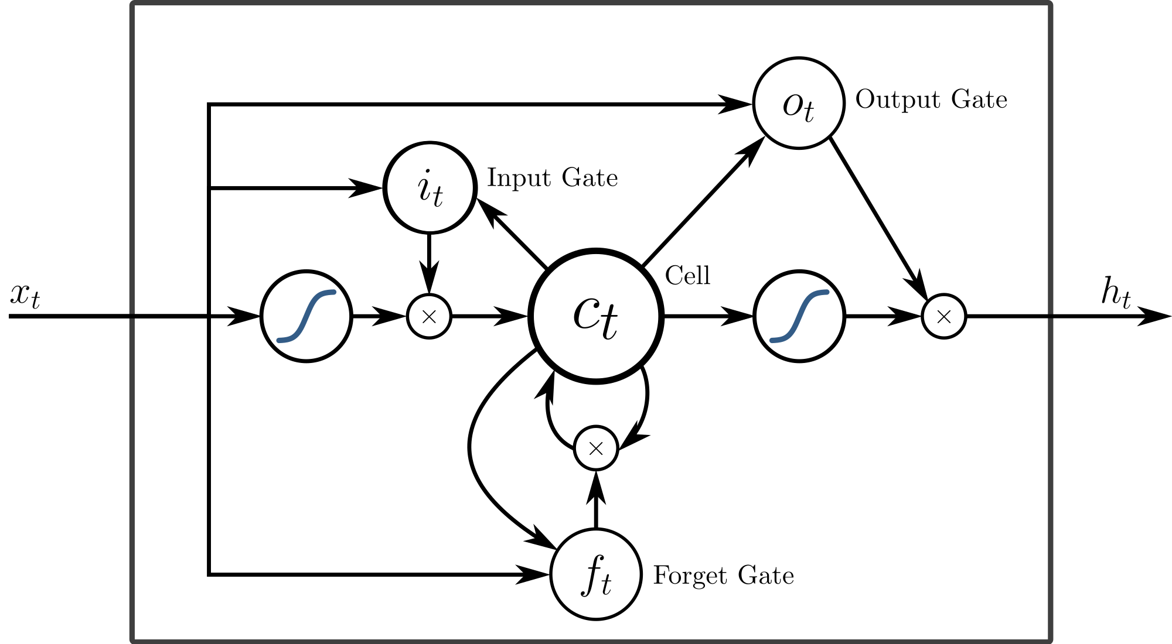
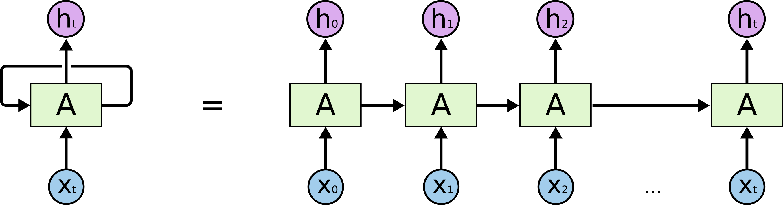
Long-Short Term Memory Models (LSTM)
Challenges with RNNs
Struggle with long input sequences: Information from earlier words gets diluted as it propagates through the sequence.
Vanishing Gradient Problem: Gradients shrink over time, reducing the ability to learn long-term dependencies.
Solution: LSTMs
Introduce a "cell state" to selectively retain or discard information.
Effectively capture long-range dependencies in sequences.
Notes:
https://ai.stackexchange.com/questions/18198/what-is-the-difference-between-lstm-and-rnn

Slide 10
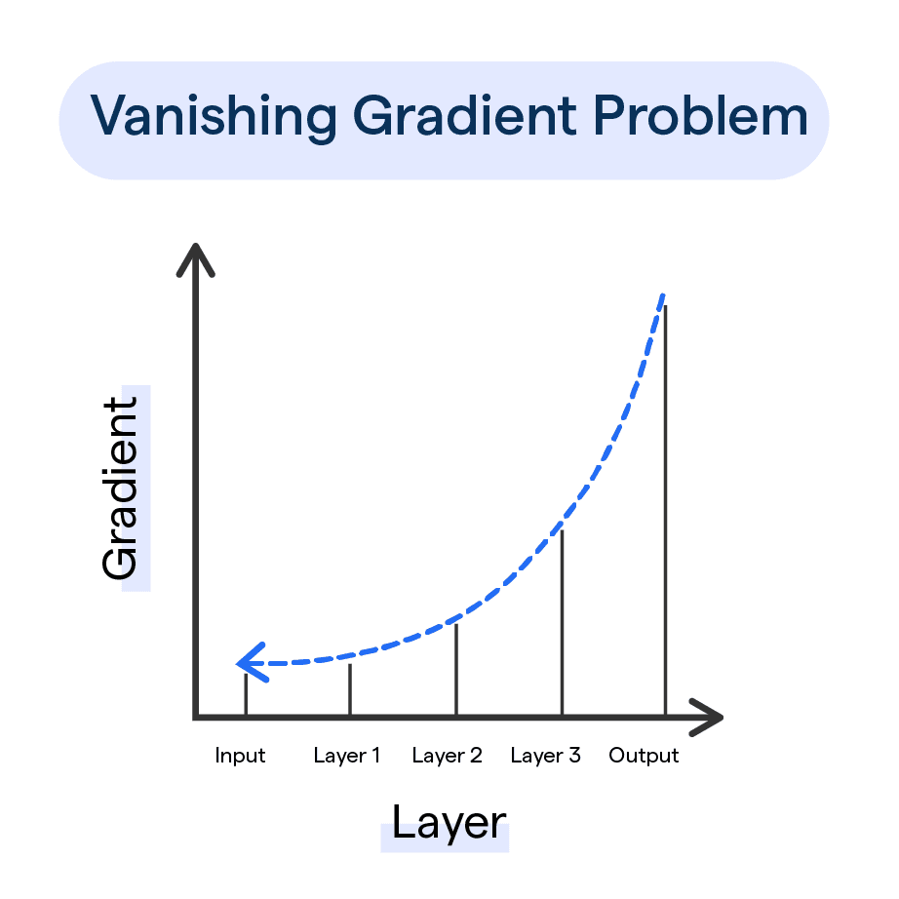
Limitations of RNNs and LSTMs in Language Modeling
Sequential Processing Bottleneck
RNNs and LSTMs process inputs step-by-step, making training and inference slow for long sequences.
Vanishing Gradients
Gradients diminish as they backpropagate through many time steps, limiting the network’s ability to learn relationships across long sequences.
Challenges with Long-Range Dependencies
Even with LSTMs, retaining information from distant parts of a sequence is difficult, leading to a loss of context over time.
Focus on Local Context
RNNs and LSTMs prioritize immediate neighboring words but struggle to model relationships across the entire input effectively.
The solution?
A new mechanism that would enable parallel process, dynamically focusing on relevant sequence parts, and capturing long-range dependencies without the limitations of step-by-step computing or vanishing gradients…
Notes:
https://botpenguin.com/glossary/vanishing-gradient-problem

Slide 11
Evolution of attention mechanisms pre-transformers

Slide 12
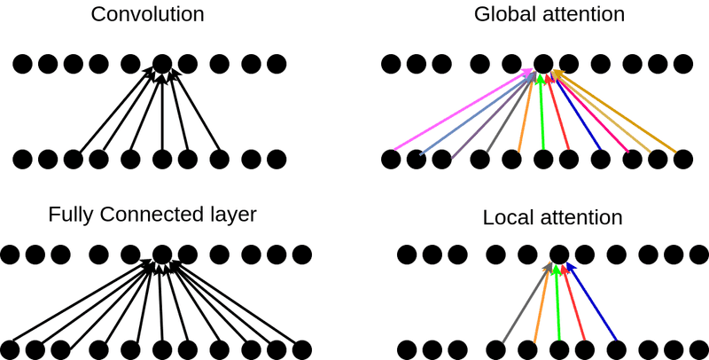
Adding Attention
What is Attention?
Attention is a mechanism that enables a model to focus on the most relevant parts of the input while making predictions.
Instead of treating all input information equally, it assigns varying levels of "importance" (weights) to different parts based on the task.
Key Idea:
When processing sequences, attention computes a weighted sum of the input elements, where the weights represent how much "attention" each element deserves.
Different to other Layer types?
Fully Connected: Listens to everyone equally, regardless of relevance.
Convolution: Pays attention only to nearby neighbors.
Attention: Actively decides who to listen to, whether they are nearby or far away.
Notes:
https://theaisummer.com/attention/

Slide 13
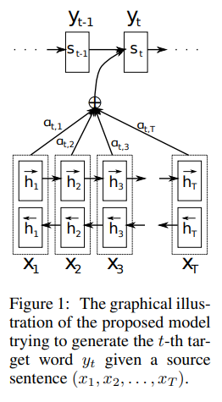
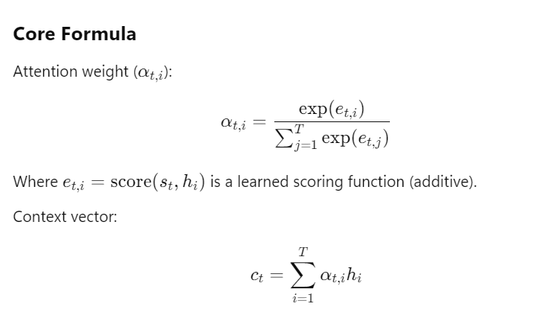
Early Attention Attempts – Bahdanau et.al 2014
Bahdanau et.al introduced a mechanism to dynamically focus on specific parts of the input sequence while generating each element of the output sequence.
The encoder produces a set of context vectors (hidden states) for each input token.
For each output token, the decoder calculates an attention score for each input token based on its relevance to the current decoding step.
The scores are normalized (using SoftMax) to produce attention weights, which are used to compute a weighted sum of encoder hidden states (context vector).
This context vector is then used by the decoder to produce the next output token.
Notes:
https://arxiv.org/pdf/1409.0473

Slide 14
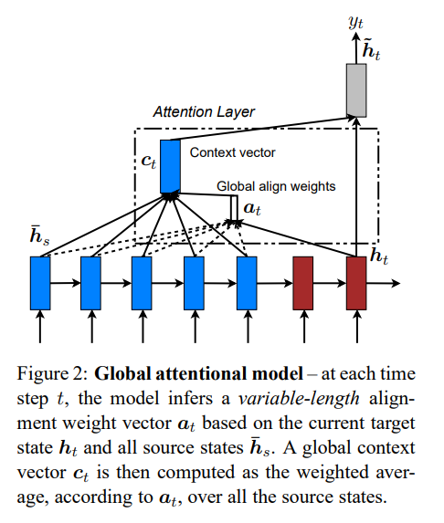
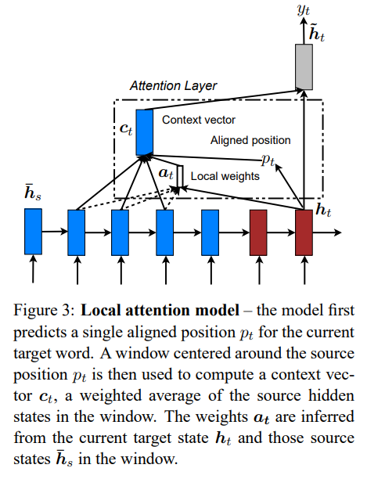
Improved Attention – Luong et.al 2015
Luong et.al introduced in the paper “Effective Approaches to Attention-based Neural Machine Translation” by Minh-Thang Luong et al., this innovation focused on improving the computational efficiency and flexibility of attention mechanisms.
Multiplicative Attention (Dot-Product Scoring):
Replaced Bahdanau's additive scoring function with a simpler dot-product or scaled dot-product function to calculate attention scores.
Resulted in faster computations while maintaining strong performance.
Global vs. Local Attention:
Proposed two types of attention mechanisms:
  Global Attention: Attends to all input tokens for each output token (like Bahdanau et.al).
  Local Attention: Focuses on a subset of the input sequence for efficiency, using a predicted alignment window.
Improved Training Efficiency:
By simplifying the attention computation, Luong et.al allowed larger models and longer sequences to be trained more effectively.
Notes:
https://arxiv.org/pdf/1508.04025

Slide 15
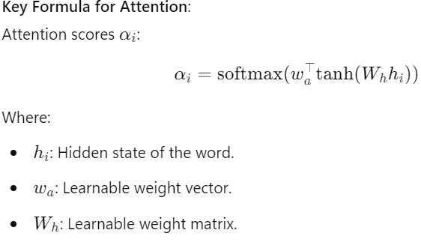
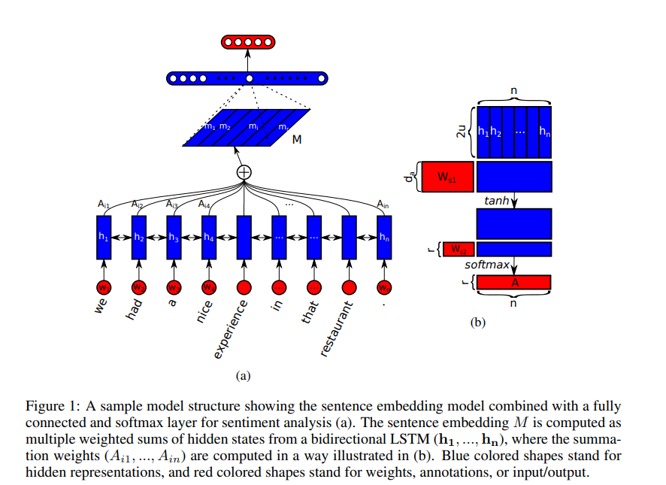
Early Self-Attention – Lin et.al 2017
Lin et al. introduced a self-attention mechanism to create structured, multi-aspect sentence embeddings, enabling models to focus on different parts of a sentence simultaneously.
Self-Attention for Sentence Embeddings:
Dynamically assigns attention weights to input tokens, emphasizing their importance to the sentence representation.
Multi-Aspect Representations:
Captures diverse aspects of a sentence by generating multiple attention vectors (hops), enabling richer embeddings.
Regularization for Diversity:
Introduced a penalty term to ensure attention focuses on distinct sentence parts, reducing redundancy.
Notes:
https://arxiv.org/pdf/1703.03130

Slide 16
Remaining Limitations with Attention Methods
Despite the novel innovations of attention methods, these approaches still suffered from some general limitations, preventing their widespread use.
Dependence on Recurrence
  Attention mechanisms (e.g., Bahdanau, Luong, Lin et al.) were tightly integrated with RNNs/LSTMs, which process sequences sequentially.
  Gradient Issues: The reliance on recurrence also made them susceptible to vanishing or exploding gradients, limiting their ability to model very long dependencies.
Lack of Scalability
  RNN/LSTM-based models with attention were computationally expensive and struggled with large datasets or sequences.
  Memory Usage: Maintaining hidden states for long sequences was resource-intensive.
Inefficient Training
  Training LSTM-based models with attention was slow because of sequential dependencies and the need to process data step-by-step.

Slide 17
The Self-Attention Mechanism

Slide 18
Attention is all you need – Vaswani et.al 2017
One of the most seminal papers of machine learning to date. “Attention is all you need” introduced a new concept of how to make use of attention and completely removed the reliance on recurrence to process sequences. In the next lesson we will dive deeper into the Transformer model, but now we will focus on how self-attention is presented in that paper.
Self-Attention: What Does It Actually Mean?
Self-attention is a mechanism that allows a model to dynamically focus on the most relevant parts of a sequence when computing representations for each token.
Key Concept:
Every token in the sequence can attend to every other token, including itself, to understand its relationship and importance in the context of the entire sequence.
E.g.
In the sentence: "The cat chased the mouse,"
Self-attention helps the model understand that "the mouse" is what "the cat" chased, by focusing on the semantic relationship between "chased" and "the mouse."

Slide 19
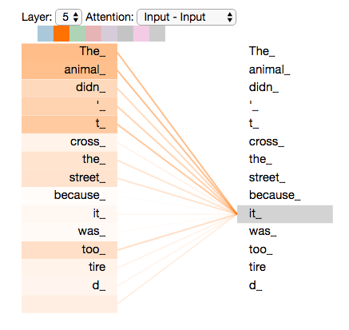
How Self-Attention Mechanisms Work
The implementation of self-attention can vary, but the essence is to:
Compare: Each token is compared to every other token in the sequence to compute relevance scores.
Weight: Assign weights to other tokens based on their relevance to the current token.
Aggregate: Combine information from all tokens, weighted by their relevance, to compute a new representation for the current token.
Global Context
Captures relationships between tokens across the entire sequence, not just local neighbors.
Dynamic Focus
The model decides what to focus on for each token, rather than relying on fixed patterns (e.g., sliding windows in convolution).
Flexibility
Works for variable-length sequences and tasks requiring both short- and long-range dependencies.
Notes:
https://jalammar.github.io/illustrated-transformer/

Slide 20
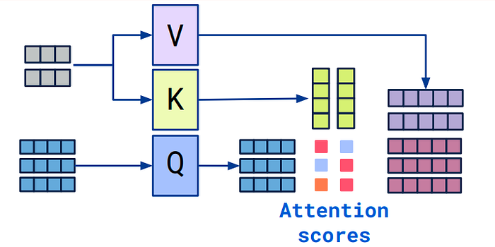

Queries, Key, and Values
In the Attention is all you need paper, a novel algorithm, based on Queries, Keys, and Values is presented to handle the attention calculations:
QKV allows each token to decide:
What it wants to know (Query).
What information it can provide (Key).
The actual data it contributes to the result (Value).
Step 1: Create Q, K, V
Each input token (e.g., word embedding) is linearly transformed into three vectors: Query (Q), Key (K), and Value (V).
Step 2: Compute Attention Scores:
Compare the Query of a token with the Keys of all tokens in the sequence to measure relevance. Use the dot product to capture similarity.
Step 3: Normalize Scores (SoftMax):
Apply SoftMax to the attention scores to ensure they sum to 1, producing attention weights.
Step 4: Aggregate Values:
Multiply the attention weights by the corresponding Values and sum them to produce the output representation for each token.
Notes:
https://media.licdn.com/dms/image/v2/D5612AQHGqpYzGg5Rgw/article-cover_image-shrink_600_2000/article-cover_image-shrink_600_2000/0/1710049461853?e=2147483647&v=beta&t=FMvxGDZZFSykfsb1fi3ebdRhq3eW_1XouRJyg3p_REc

Slide 21
Wrap Up
Language Models and Attention
Today we introduced the concepts of deep learning in the context of language models.
We saw some of the older model architectures like recurrent neural networks that were used to model sequence data as an improvement over traditional feedforward neural networks.
The concept of attention mechanisms was also discussed as a means to add extra information between parts of sequences
As a precursor to the introduction of the full transformer model, we looked back at the evolution of attention models in deep learning.
Finally, we presented the self-attention mechanism that provided the breakthrough needed for modern LLMs and Transformer-based models
-----------------------------------------------------------------------------
In the next class we will explore the transformer model.

Slide 22
Thank you!

