Slide 1


Lecture 3.2 - The Transformer Architecture
Generative AI Teaching Kit

Slide 2

The NVIDIA Deep Learning Institute Generative AI Teaching Kit is licensed by NVIDIA and Dartmouth College under the
Creative Commons Attribution-NonCommercial 4.0 International License.

Slide 3
This lecture
Recap on challenges with LSTMs
Attention is all you need – breakthrough
The Transformer Block
Multi-headed Attention
Positional Encoding
Original Transformer Architecture

Slide 4
Recap on challenges with LSTMs

Slide 5
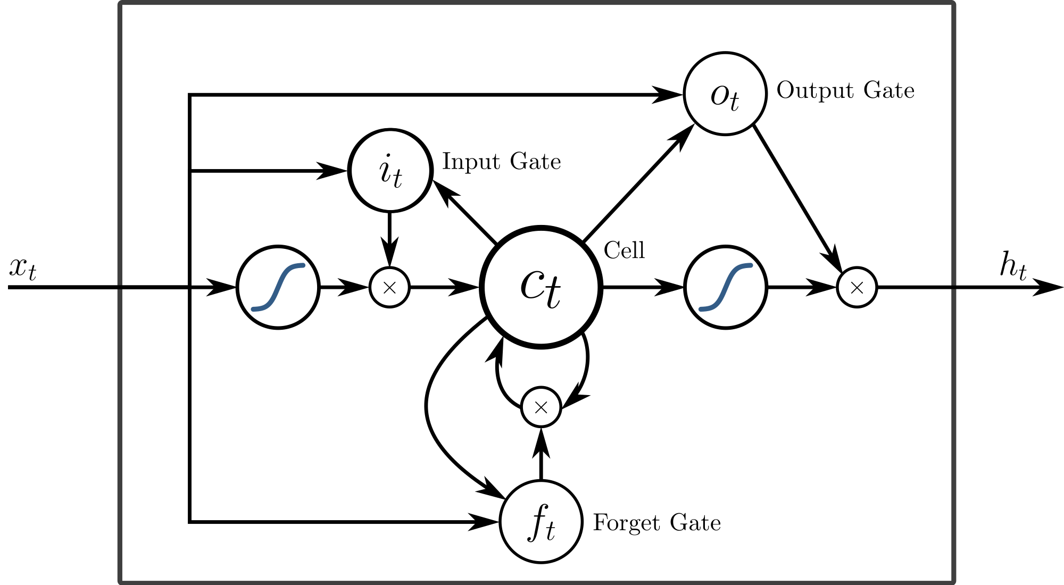
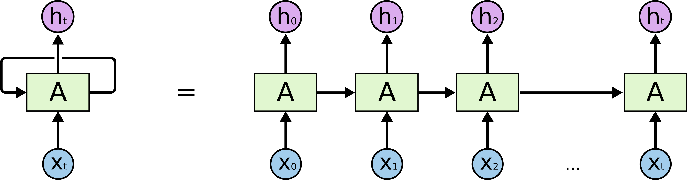
The limitations with sequence deep learning models
Last time we saw that deep learning language models required a special treatment of the causal-sequence nature of language.
This meant that special architectures like Recurrent Neural Networks and LSTMs became the standard for language modeling in deep learning.
These models used memory components to keep track of parts of sequences but still lacked some important components and encountered limitations.
Notes:
https://ai.stackexchange.com/questions/18198/what-is-the-difference-between-lstm-and-rnn

Slide 6
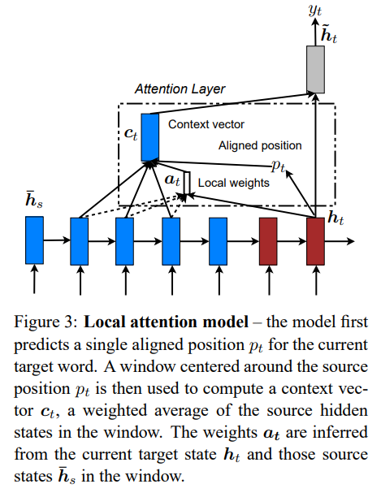
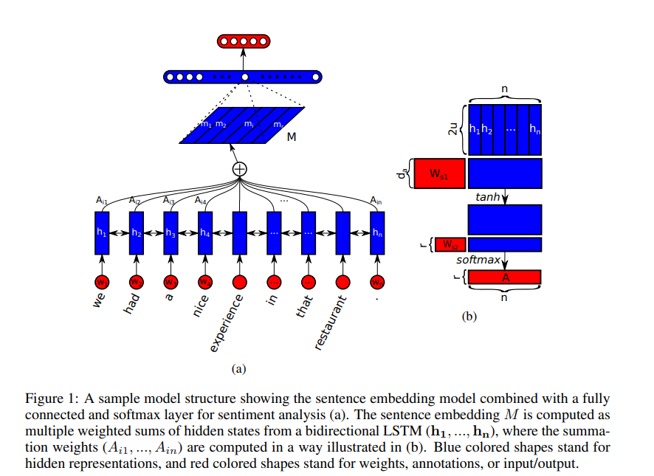
The limitations with sequence deep learning models
One key missing feature to vanilla RNNs and LSTMs was the concept of attention.
Attention is defined as a mechanism that enables a model to focus on the most relevant parts of the input while making predictions.
Instead of treating all input information equally, it assigns varying levels of "importance" (weights) to different parts based on the task.
Innovations began to emerge in the late 20-`teens` but still all focused-on applications of the LSTMs/RNN models and were hampered by those models’ limitations.
Notes:
https://arxiv.org/pdf/1508.04025
https://arxiv.org/pdf/1703.03130

Slide 7
Attention is all you need – breakthrough

Slide 8
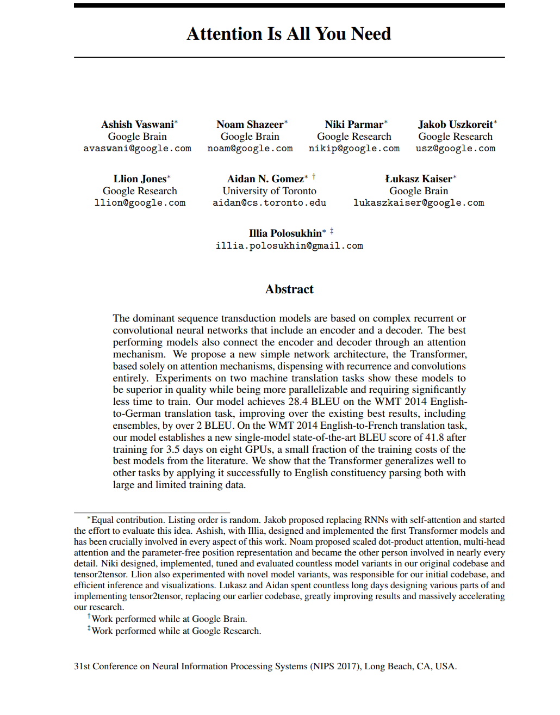
Attention is all you need – the game changing paper
In 2017, a paper was presented at the 31st Neural Information Processing Systems Conference.
This paper introduced a new model architecture, the transformer, which uses as a central point, self attention, and removed any need for recurrence or convolution layers.
The focus of this new architecture on only attention, and some feedforward networks, meant that this model could process sequences in parallel, with drastically improved efficiency in training.
Notes:
https://arxiv.org/pdf/1706.03762

Slide 9
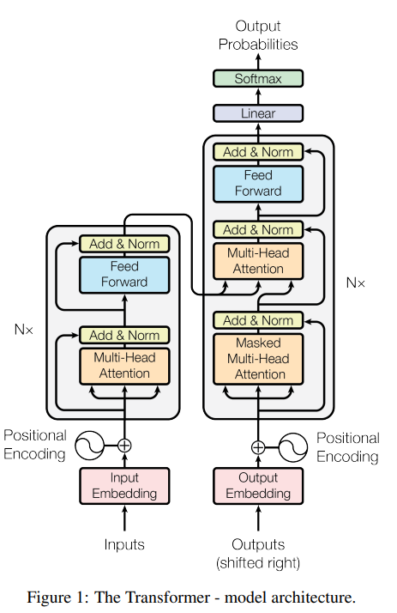
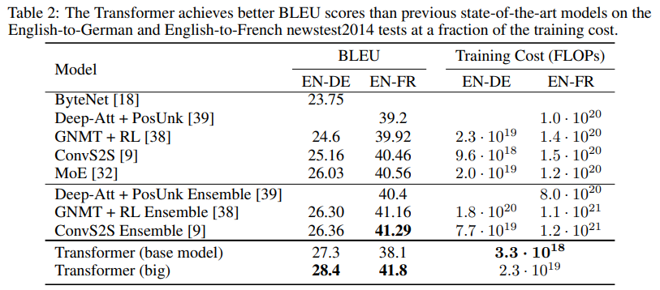
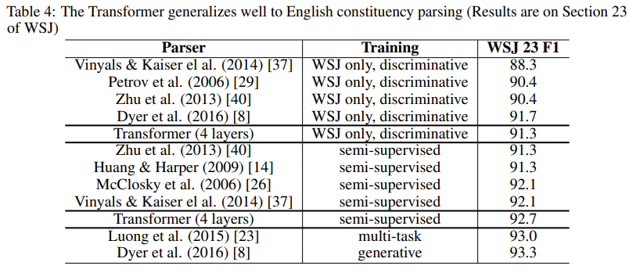
Attention is all you need – the game changing paper
This new model, the Transformer, was shown to outperform state-of-the-art machine translation models using a fraction of the training cost.
The benefits of this architecture was also in the generalizable nature of its design. This model was not designed for machine translation specifically and could be re-trained for other tasks such as English constituency parsing.
Notes:
https://arxiv.org/pdf/1706.03762

Slide 10
The Transformer Block

Slide 11
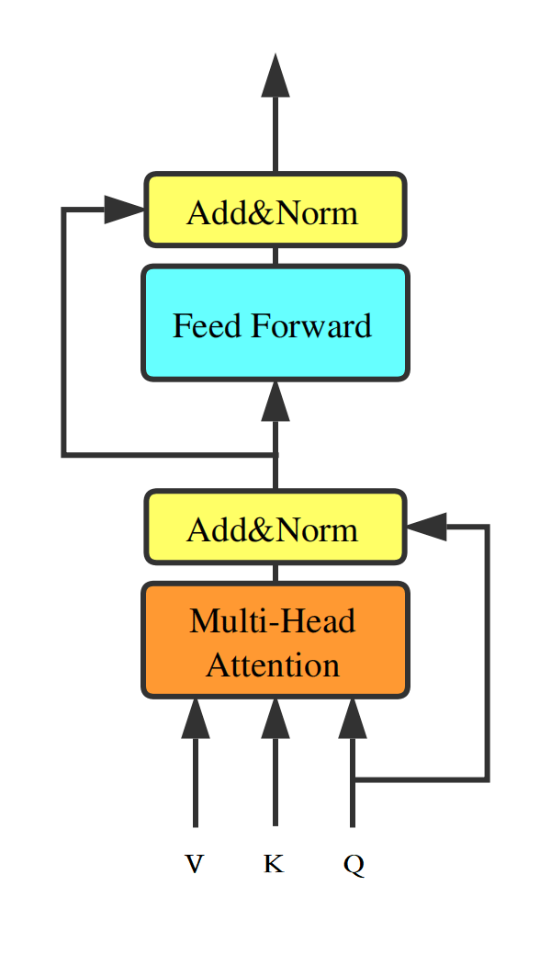
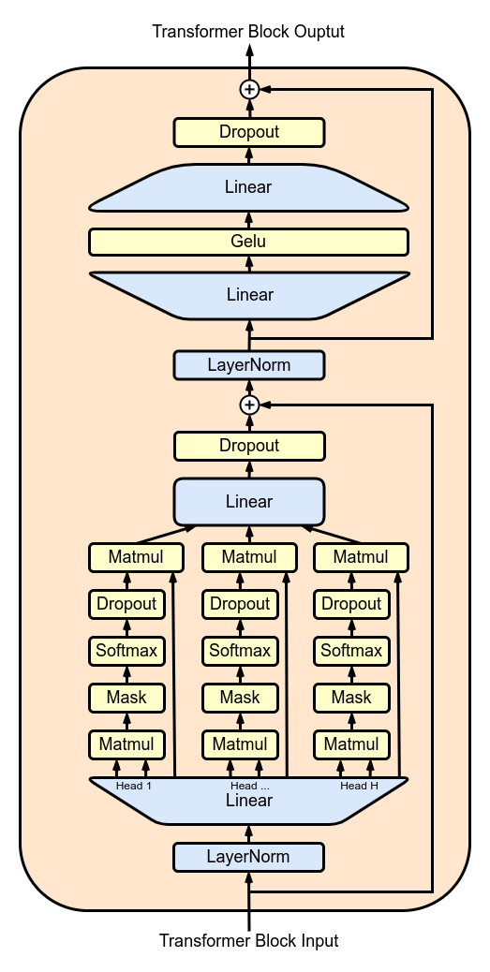
The Transformer Block
Multi-Head Attention (Orange Block):
  Input: Queries (Q), Keys (K), and Values (V).
  Process: Attention weights are calculated to decide how much focus each token should give to others in the sequence. Multiple heads capture different types of relationships.
  Output: A weighted representation of the sequence.
Add & Norm (Yellow Block):
  The output of the Multi-Head Attention is added back to the input (residual connection) to preserve the original information.
  Then, it is normalized to stabilize training and ensure smooth gradient flow.
Feed Forward (Blue Block):
  A fully connected network processes each token independently, adding non-linearity and helping the model capture complex patterns.
Add & Norm (Yellow Block):
  The output of the Feed Forward layer is added back to its input (another residual connection).
  Normalization is applied again for stability.
This flow repeats across multiple layers, enabling the Transformer to model relationships across all tokens efficiently while keeping computations stable and balanced.
Notes:
https://upload.wikimedia.org/wikipedia/commons/6/6a/Gpt-transformer-block.png
https://www.researchgate.net/figure/The-structure-of-a-Transformer-Block_fig1_336224014

Slide 12
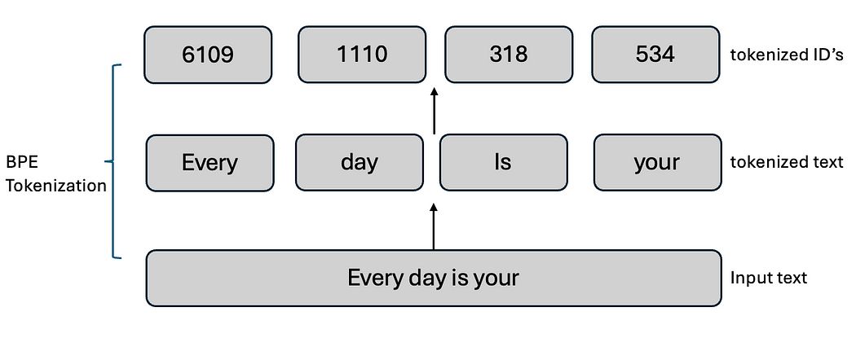
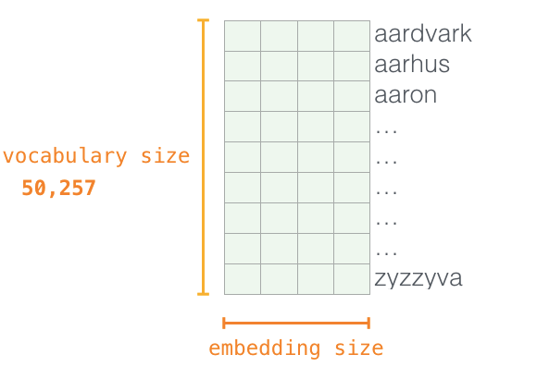
The Transformer Block – Tokenization and Word Embeddings
Preparing inputs for the Transformer involves three main steps:
Tokenization
  The text input is split into smaller units called tokens. These tokens could represent words, subwords, or even individual characters, depending on the tokenization strategy.
  Each token is assigned a unique identifier based on the model's vocabulary, converting the text into a numerical sequence.
Word Embedding
  Each token ID is mapped to a high-dimensional vector using a pre-trained or learned embedding matrix.
  These embeddings capture semantic meaning, allowing the model to understand relationships between words or tokens (e.g., synonyms or contextual similarities).
Positional Encoding*
  Since Transformers process all tokens simultaneously, they lack an inherent sense of order.
  Positional encoding is added to embeddings to inject information about token positions in the sequence, enabling the model to capture word order.
  *We’ll see more of this soon.
Notes:
https://medium.com/@vipul.koti333/from-theory-to-code-step-by-step-implementation-and-code-breakdown-of-gpt-2-model-7bde8d5cecda

Slide 13
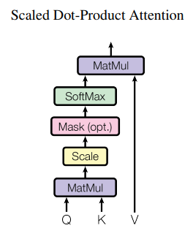
Scaled Dot-Product Attention
Definition:
Attention maps a query and a set of key-value pairs to an output, where:
Query (Q): What you're looking for.
Key (K): What the data is indexed by.
Value (V): The information being retrieved.
How It Works:
Compute the dot product of the query with all keys to measure compatibility.
Scale the result by dk\sqrt{d_k}dk​​ to prevent large values.
Apply a SoftMax function to convert scores into probabilities (weights).
Use the weights to compute a weighted sum of the values.
Key Points:
Faster and more space-efficient than additive attention due to matrix operations.
Scaling improves stability by preventing the softmax from collapsing for large dimensions.
Notes:
https://arxiv.org/pdf/1706.03762

Slide 14
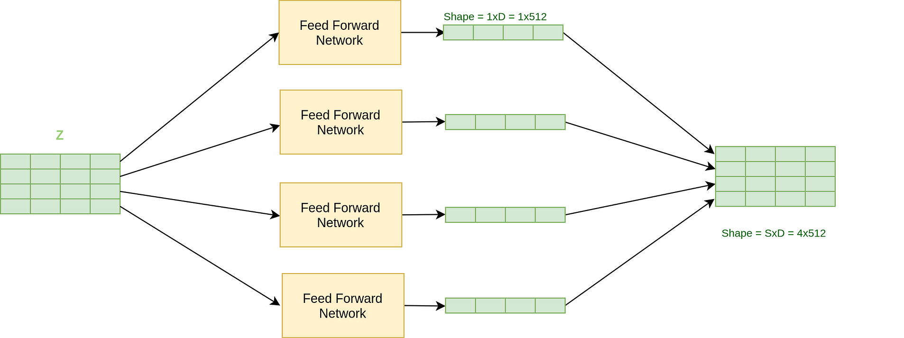
The Transformer Block – Position-wise Feedforward Network
If we look at the progress of a token as it passes through the Transformer, we can see that it is processed in the following ways:
Tokenization – Linear Operation
Word Embedding – Linear Operation
Self-Attention – Linear Operation
So, how does non-linearity get added into the Transformer? Ans: Position-wise Feedforward Neural Network
What is it and how does it work?
A feedforward neural network is applied independently to each token’s embedding at each position in the sequence. This adds non-linearity and expressive power to the Transformer. Each feedforward layer consists of two fully connected layers with a non-linear activation in between
Why It Works:
Non-linearity (e.g., ReLU) enables the model to capture complex relationships that linear operations cannot. The position-wise nature means each token is processed independently, preserving parallelizability.
Notes:
https://www.kdnuggets.com/2020/10/understanding-transformers-data-science-way.html

Slide 15
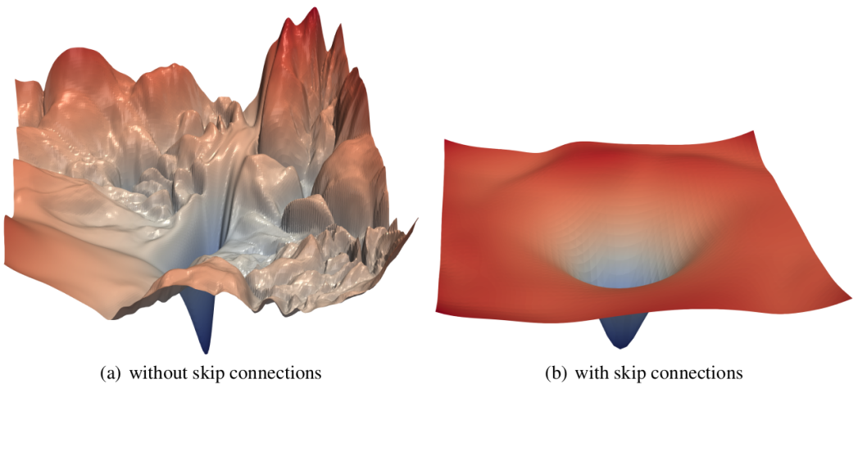
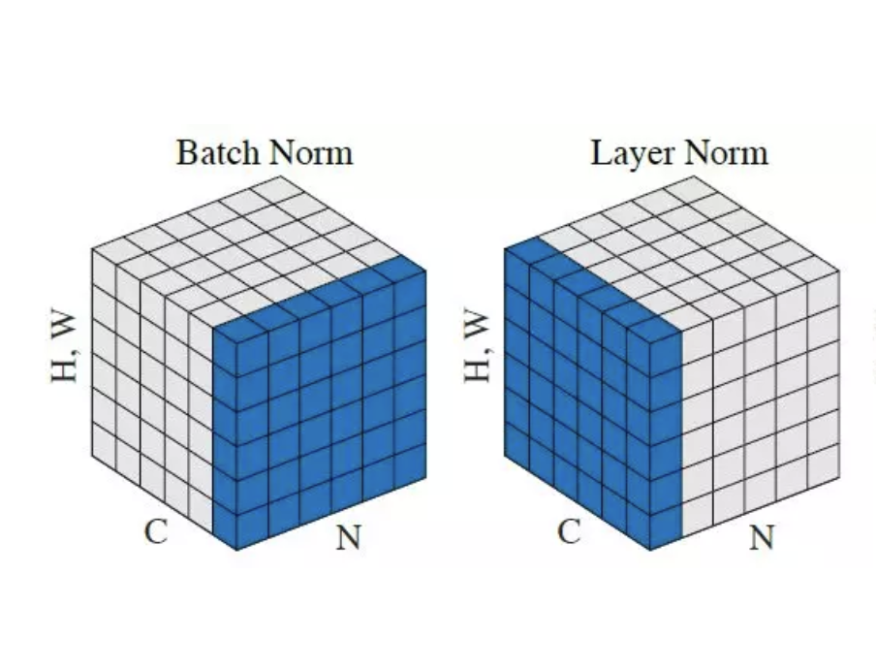
The Transformer Block – Residual Connection and Normalization
Residual Connections
Residual connections, also called skip connections, allow the input of a layer to bypass the layer and be added directly to its output.
Facilitate Gradient Flow: Prevent vanishing or exploding gradients in deep networks by ensuring gradients can propagate back through the network effectively.
Improve Convergence: Enable faster training by providing a "shortcut" for information.
Preserve Information: Retain information from earlier layers, which might otherwise be overwritten during training.
Layer Normalization
Layer normalization standardizes the activations across the features of a token at each position, ensuring that the input to each layer has zero mean and unit variance.
Stabilize Training: Normalization ensures consistent scaling of activations, making training more stable.
Prevent Exploding Activations: Keeps activations within a manageable range, preventing instability.
Enable Robust Generalization: Helps the model generalize better by reducing sensitivity to the scale of the input data.
Why Both?
Residual connections ensure information flow across the network.
Layer normalization stabilizes the output at each step, improving gradient flow and model convergence.
Notes:
https://www.analyticsvidhya.com/blog/2021/08/all-you-need-to-know-about-skip-connections/
https://paperswithcode.com/method/layer-normalization

Slide 16
Multi-headed Attention

Slide 17
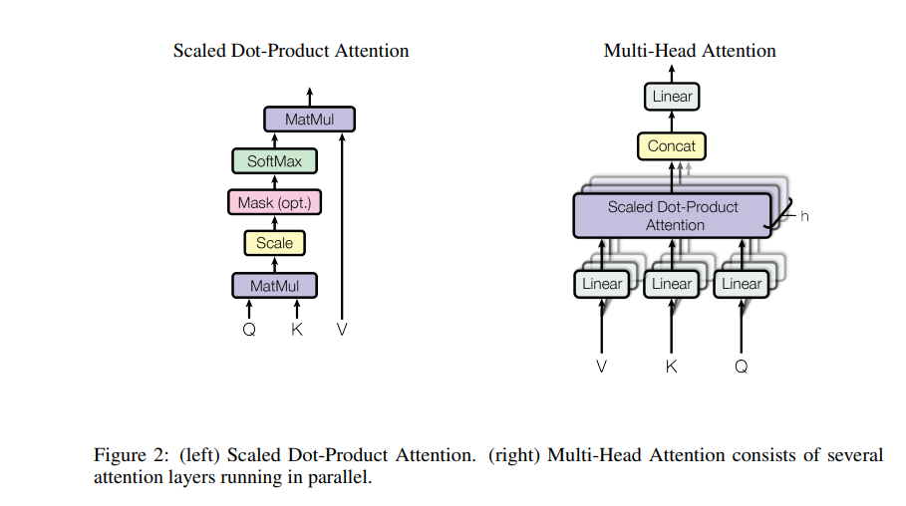
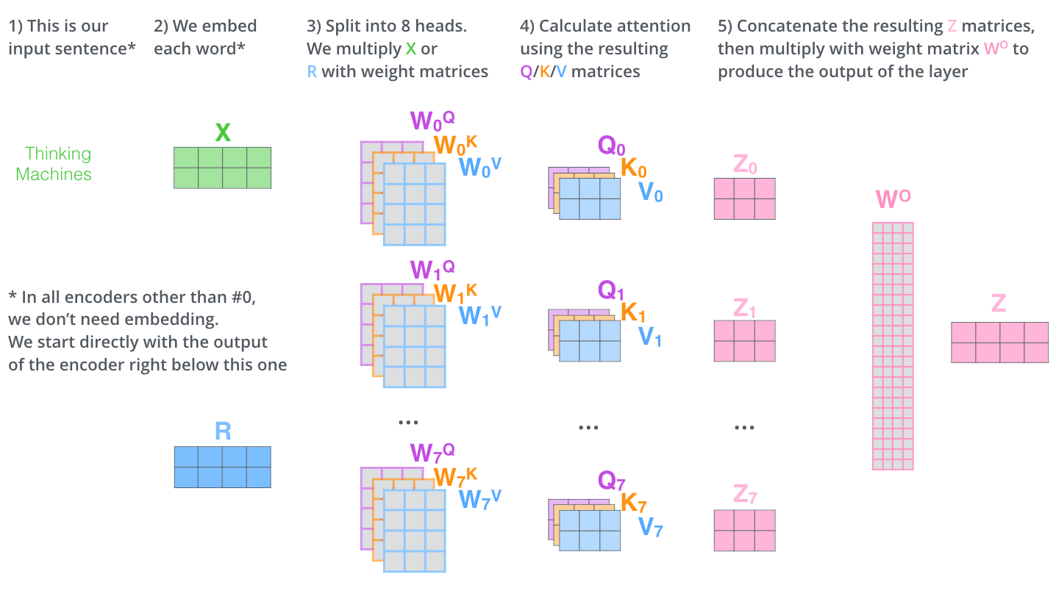
Self-Attention – Multiheaded Attention
The authors also implemented “multi-headed attention” to address the limitations of single-headed attention, which could only focus on one type of relationship or dependency at a time.
Parallel Attention Mechanisms:
Multi-headed attention allows the model to focus on different parts of the input sequence simultaneously, capturing diverse relationships (e.g., word-to-word, phrase-to-phrase).
Improved Representations:
Each "head" learns unique attention patterns, enabling the model to extract more nuanced information, such as syntactic and semantic dependencies.
Scalability and Flexibility:
By splitting the computation into smaller attention heads, the model efficiently handles large inputs and produces richer, context-aware embeddings.
Notes:
https://arxiv.org/pdf/1706.03762
https://jalammar.github.io/illustrated-transformer/

Slide 18
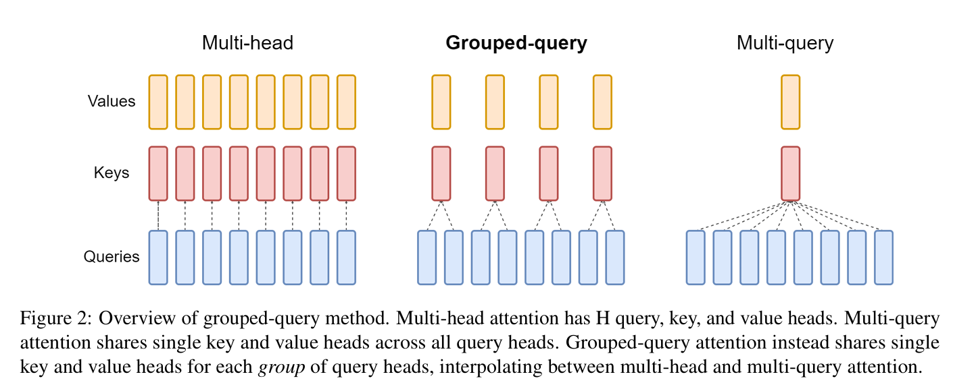
Variations of Multiheaded Attention
GQA (Grouped-Query Attention)
Reduces the computational cost by grouping multiple queries together and computing attention collectively rather than individually.
Key Advantage: Drastically lowers memory and compute requirements, especially for large-scale models like GPT-3.
Multi-Query Attention
Instead of having separate key-value pairs for each query, all queries share the same set of key-value pairs.
Key Advantage: Reduces the memory overhead of storing multiple key-value pairs without significantly impacting model performance.
Notes:
https://arxiv.org/abs/2305.13245v3

Slide 19
Positional Encoding

Slide 20
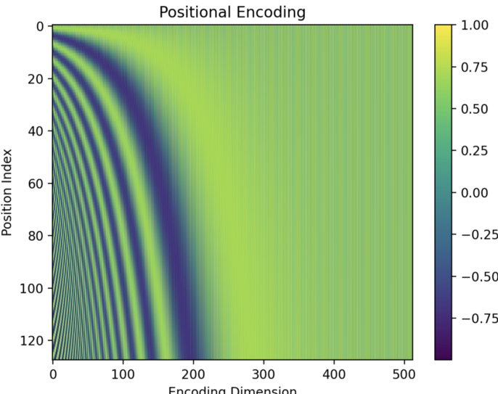

Positional Encoding
The original Transformer relies on positional encoding to inject information about the order of tokens into the model. The self-attention mechanism itself lacks positional awareness, and in language we need to preserve this sequential understanding.
How Positional Encoding Works
Positional encodings are added to the input embeddings to encode the order of tokens in the sequence.
The sinusoidal functions used in the original paper allow the model to generalize to sequences longer than those seen during training because the values are periodic and predictable.
Relative positions between tokens are naturally encoded through phase differences in sine and cosine values.
Notes:
https://kikaben.com/transformers-positional-encoding/

Slide 21
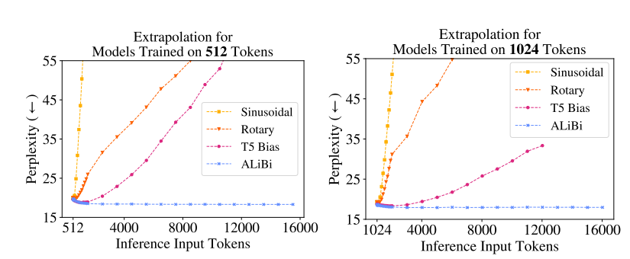
Limitations of Sinusoidal Positional Encoding
While sinusoidal positional encodings from the original Transformer paper have been highly effective, they come with notable limitations.
Fixed and Non-Adaptive:
  Sinusoidal encodings are fixed and do not adapt to specific datasets or tasks. This inflexibility can limit their ability to capture task-specific positional information.
Absolute Position Encoding:
  They encode absolute positions rather than explicitly modeling relative distances between tokens. While the differences in sine/cosine phases indirectly encode relative positions, this is not optimized for tasks requiring strong relative positioning (e.g., question answering or summarization).
Lack of Scalability:
  When handling very long sequences, the sin⁡\sinsin and cos⁡\coscos functions may lose precision due to numerical instability in their periodicity.
Inefficiency for Long Contexts:
  Sinusoidal encodings struggle to efficiently represent relationships for extremely long sequences, which are increasingly common in models like GPT-style LLMs designed for multi-turn dialogues or document understanding.
Notes:
https://miro.medium.com/v2/resize:fit:1400/1*jkTqoUUhkP-w7_u7DZe4eQ.gif

Slide 22
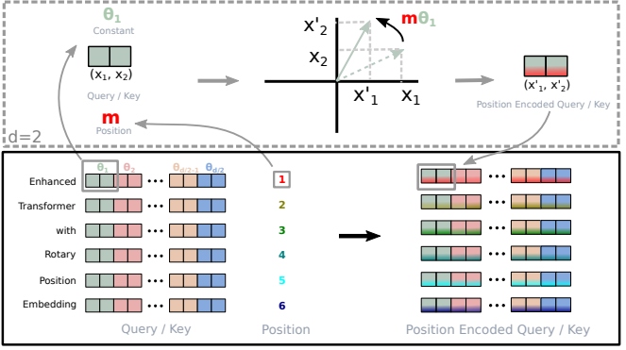
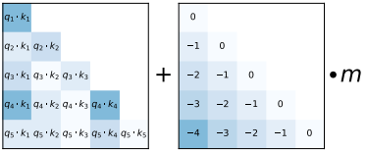
Improvements to Sinusoidal Positional Encoding
Rotary Positional Embedding (RoPE)
Rotary Positional Embedding introduces relative position encoding directly into the attention mechanism, making the model more effective at capturing positional relationships. This transformation embeds relative positional information naturally into the attention scores without modifying the self-attention computation pipeline.
Key Advantages:
Relative Position Awareness: Unlike sinusoidal embeddings, RoPE explicitly models relative positions, which is crucial for tasks involving long-term dependencies.
Efficient for Long Contexts: Handles long sequences better than sinusoidal encodings due to its explicit relative positioning.
ALiBi (Attention with Linear Biases)
Attention with Linear Biases, modifies the attention mechanism by adding a learnable linear bias to the attention scores based on the relative distance between tokens.
Key Advantages:
Efficient Scaling: ALiBi introduces no additional parameters or overhead, as the bias is directly applied to attention scores.
Strong Relative Position Encoding: By modifying attention weights directly, ALiBi enhances the model’s ability to capture relative positional information efficiently.
Supports Extrapolation: ALiBi enables models to generalize better to longer sequences during inference, even when trained on shorter sequences.
Notes:
https://arxiv.org/pdf/2108.12409
https://arxiv.org/pdf/2104.09864

Slide 23
Original Transformer Architecture

Slide 24
Cross-Attention
Cross-attention is a mechanism where one sequence (e.g., the decoder input) attends to another sequence (e.g., the encoder output).
This allows the model to integrate information from a source sequence (like an input sentence in machine translation) into the target sequence generation process.
In the Transformer architecture, cross-attention is implemented in the decoder block, where the decoder uses the encoder's output to guide the generation of the target sequence.
Cross-Attention Inputs
Key-Value Pairs (K, V):
These come from the encoder outputs.They represent the context learned from the source sequence (e.g., input sentence in a translation task).
Query (Q):
This comes from the decoder's previous layer (or the embeddings of the previously generated tokens in the decoder).
Cross Attention
Self-Attention
Notes:
https://miro.medium.com/v2/resize:fit:1400/1*jkTqoUUhkP-w7_u7DZe4eQ.gif

Slide 25
The Transformer
Now that we can see what is inside the transformer blocks, let’s talk about the original transformer and what it was used for.
Architecture Details:
Transformer Blocks/Layers: 6 encoder and 6 decoder layers.
Hidden Dimension for the word embeddings: 1024
Feedforward Hidden Dimension: 4096 (ie a 4x expansion internally)
Attention Heads for multi-headed attention: 16
Sequence Length: Up to 512 tokens.
Total Parameters: 213 million (213M)
Training Details
Task: English to German Translation
Batch Size: 131,072 tokens per batch
Training Steps: 100 k
Dataset: WMT 2014 English-to-German (4.5M sentence pairs).
Training Time: ~3.5 days on 8xP100 GPUs for English-to-German

Slide 26
Wrap Up
The Transformer Architecture
Today we introduced one of the most exciting innovations of the last decade, the Transformer.
We looked inside the model to see how each part of this architecture is constructed and why it offered the breakthrough in sequence analysis over existing models.
We looked at the original attention mechanism in the attention is all you need paper and how it was scaled to produce the Transformer.
Now that we have an understanding of the fundamental piece of Generative AI, we can look further and into even more exciting and exotic models.
-----------------------------------------------------------------------------
In the next class we will explore what it takes to train a model like the transformer. The data preparation and the considers required for autoregressive modeling.

Slide 27
Thank you!

