Slide 1


Lecture 4.1 - LLM Architecture Variants
Generative AI Teaching Kit

Slide 2

The NVIDIA Deep Learning Institute Generative AI Teaching Kit is licensed by NVIDIA and Dartmouth College under the
Creative Commons Attribution-NonCommercial 4.0 International License.

Slide 3
This lecture
Review of the original Transformer
Encoder only Models
Decoder only Models
Encoder-decoder models
New Variants

Slide 4
Review of the original Transformer

Slide 5
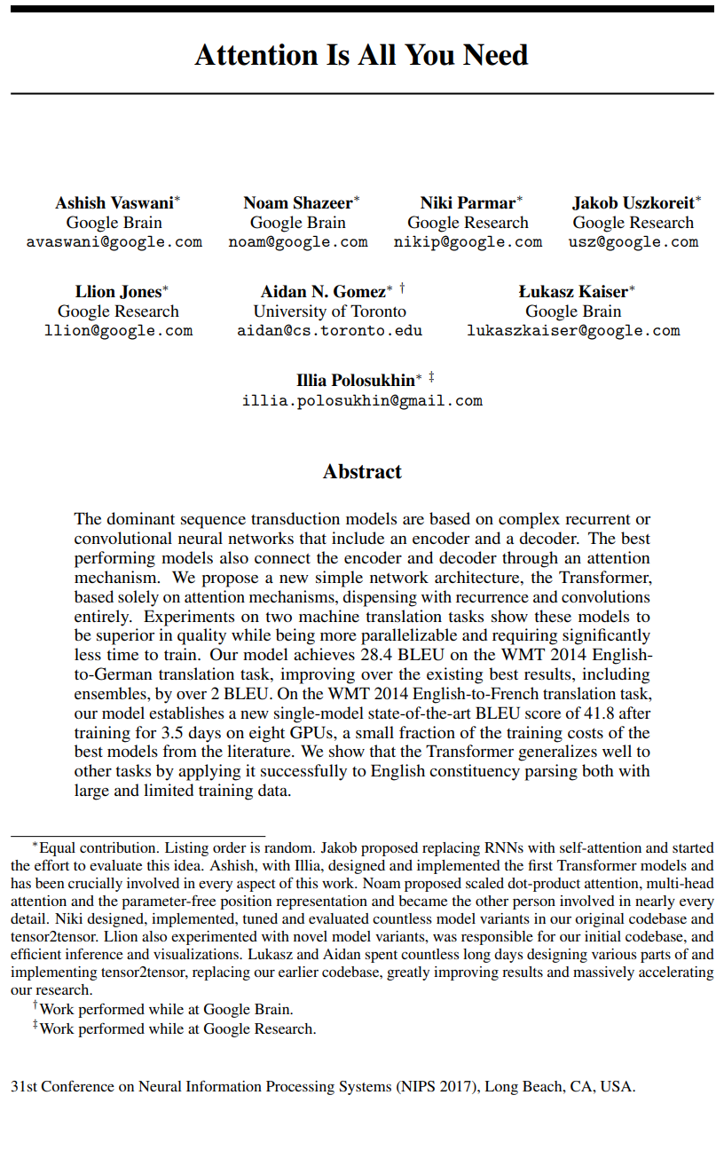
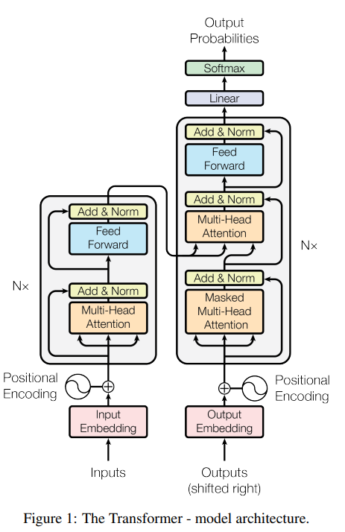
Recap: The Original Transformer
Last time we saw the biggest innovation in machine learning in the last decade, the Transformer.
The paper, “Attention Is All You Need”, introduced a new paradigm for processing sequences in parallel with self-attention.
This model was used as a translation tool and was shown to outperform the state-of-the-art, even with a fraction of the compute requirements.
Notes:
https://arxiv.org/abs/1706.03762

Slide 6
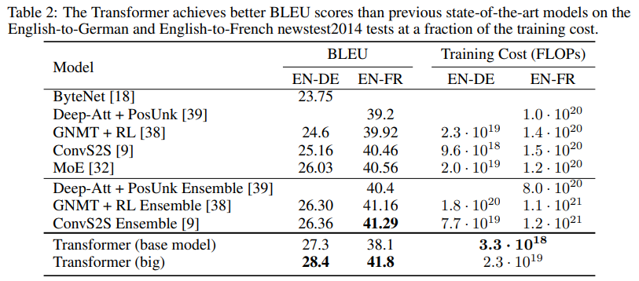
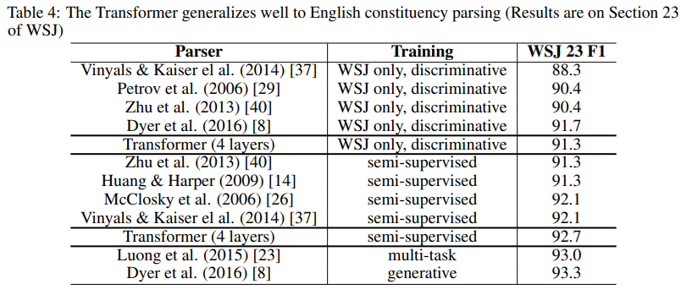
Breakthrough innovation
Architecture Details:
Transformer Blocks/Layers: 6 encoder and 6 decoder layers.
Hidden Dimension for the word embeddings: 1024
Feedforward Hidden Dimension: 4096 (ie a 4x expansion internally)
Attention Heads for multi-headed attention: 16
Sequence Length: Up to 512 tokens.
Total Parameters: 213 million (213M)
Training Details
Task: English to German Translation
Batch Size: 131,072 tokens per batch
Training Steps: 100 k
Dataset: WMT 2014 English-to-German (4.5M sentence pairs).
Training Time: ~3.5 days on 8xP100 GPUs for English-to-German
Notes:
https://arxiv.org/abs/1706.03762

Slide 7
Composition and Task focus
Decoder
This model architecture was composed of two components:
An Encoder:
Processes the input sequence all at once.
Maps the input tokens into continuous vector representations using self-attention and feedforward layers.
Captures contextual relationships across the entire sequence.
Used in tasks like text classification and feature extraction.
A Decoder:
Generates output tokens one by one in an autoregressive manner.
Attends to both the encoder’s output and previously generated tokens using masked self-attention.
Produces meaningful sequences based on learned patterns (e.g., translation, text generation).
But do we always need both components?
Encoder
Notes:
https://arxiv.org/abs/1706.03762

Slide 8
Encoder only Models

Slide 9
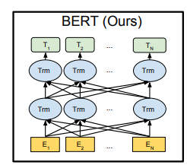
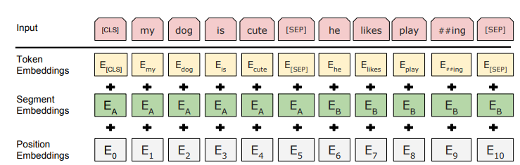
Splitting the Transformer – BERT/Embeddings
If we focus on just the encoder side of the original transformer, we end up with the Bidirectional Encoder Representations from Transformers. Unlike the original Transformer (which was designed for seq-to-seq tasks like translation), BERT focuses on deep bidirectional context learning.
What Happens When We Keep Only the Encoder?
The model processes all tokens simultaneously, rather than autoregressively generating output token-by-token.
Instead of predicting the next token, BERT learns contextual embeddings using masked language modeling (MLM).
No autoregressive decoding, making it ideal for feature extraction rather than generation.
How Encoder Embeddings Work
Token Embeddings: Each token is mapped to a high-dimensional contextualized vector.
[CLS] Token: Represents a fixed-length sentence embedding, useful for tasks like classification or retrieval.
Layer-wise Representations: Embeddings can be extracted from different encoder layers depending on the task.
Notes:
https://arxiv.org/pdf/1810.04805

Slide 10
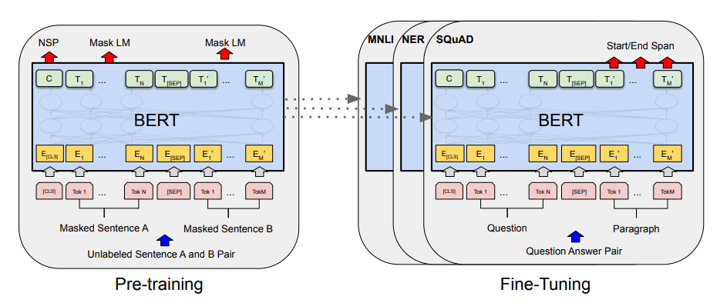
Training Encoder Models - BERT
Pretraining: Learning Universal Representations
BERT undergoes self-supervised learning on massive unlabeled text corpora using two key objectives:
Masked Language Modeling (MLM)
Randomly masks 15% of tokens and trains the model to predict them.
Encourages deep bidirectional context learning by making the model rely on both left and right words.
Next Sentence Prediction (NSP)
Given two sentences, the model predicts if the second follows the first.
Helps capture sentence-level relationships (though later models like RoBERTa remove this step).
Pretraining Output: A general-purpose transformer capable of understanding contextual meaning across various domains.
Fine-Tuning: Adapting BERT for Specific Tasks
After pretraining, BERT is fine-tuned on labeled datasets for specific NLP applications. Fine-tuning involves:
Adding a Task-Specific Output Layer
Training on a Labeled Dataset
Fine-Tuning Output: A specialized BERT model optimized for task-specific performance (e.g., sentiment analysis, QA, information retrieval).
Notes:
https://arxiv.org/pdf/1810.04805

Slide 11
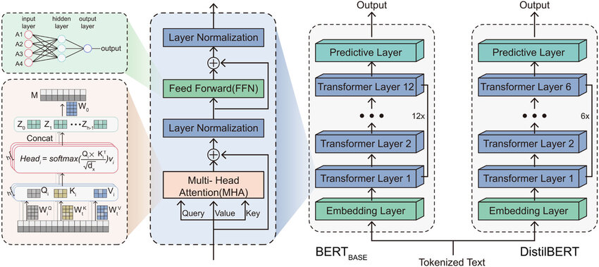
Evolution of BERT models
The Problem with Original BERT
Introduced bidirectional attention, making it strong at understanding context.
But: Computationally expensive, requires large-scale training, and Next Sentence Prediction (NSP) is ineffective.
RoBERTa – More Data, No NSP
Removed NSP, trained on 10x more data with dynamic masking.
Better accuracy but requires even more compute than BERT.
DistilBERT – Making BERT Faster
Used knowledge distillation to create a lighter version of BERT.
60% fewer parameters, 60% faster inference, retaining 95% of original BERT’s accuracy.
Why This Evolution Matters
BERT started as powerful but inefficient → newer models optimized for speed, size, and compute efficiency.
Trade-offs: More efficient models reduce size but may lose flexibility or require different training techniques.
Modern NLP uses these advancements to deploy transformer models at scale, even on limited hardware.
Notes:
https://arxiv.org/abs/1907.11692
https://zilliz.com/learn/distilbert-distilled-version-of-bert

Slide 12
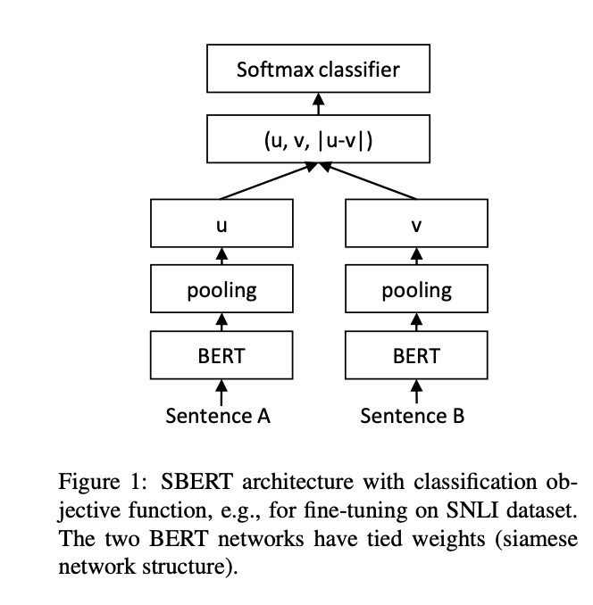
SBERT and Cross-Encoder Models
SBERT Extending BERT for Sentence Similarity
Why Standard BERT is Inefficient for Sentence Comparison:
BERT processes each sentence independently, meaning similarity needs to be computed after embedding extraction.
This results in slow, inefficient comparisons, especially for large-scale retrieval tasks.
SBERT (Sentence-BERT)
How It Works
1. Encodes sentences separately using a shared BERT model.
2. Outputs fixed-length embeddings, which can be compared using cosine similarity.
3. Fine-tuned with tasks like semantic textual similarity (STS).
Advantages
Fast similarity search – Ideal for retrieval and clustering.
Fixed embeddings – Precomputed vectors allow efficient comparison.
Limitations
Less precise for nuanced comparisons – Doesn’t leverage full pairwise attention like cross-encoders.
Notes:
https://arxiv.org/abs/1908.10084

Slide 13
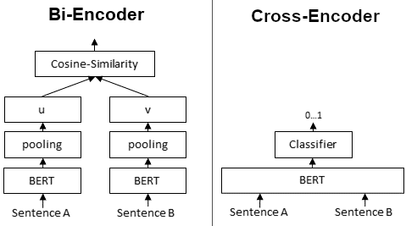
SBERT and Cross-Encoder Models
Cross-Encoders: Instead of processing sentences separately, a cross-encoder jointly encodes both inputs, allowing full self-attention across sentences.
How It Works
1. The model takes both sentences concatenated together as input.
2. Outputs a single scalar score (e.g., similarity score for STS).
3. Typically fine-tuned with classification loss for ranking.
Advantages
Higher accuracy – Fully utilizes attention across both sentences.
Better for ranking – Used in re-ranking pipelines for search engines and QA.
Limitations
Much slower – Requires recomputing embeddings every time, making it impractical for large-scale retrieval.
Choosing SBERT vs. Cross-Encoders
Need efficiency: Use SBERT for retrieval tasks.
Need accuracy: Use Cross-Encoders for ranking and fine-grained comparisons.
Many NLP systems use both together – SBERT for initial retrieval, followed by a Cross-Encoder for refinement.
Notes:
https://www.sbert.net/examples/applications/cross-encoder/README.html

Slide 14
Decoder only Models

Slide 15
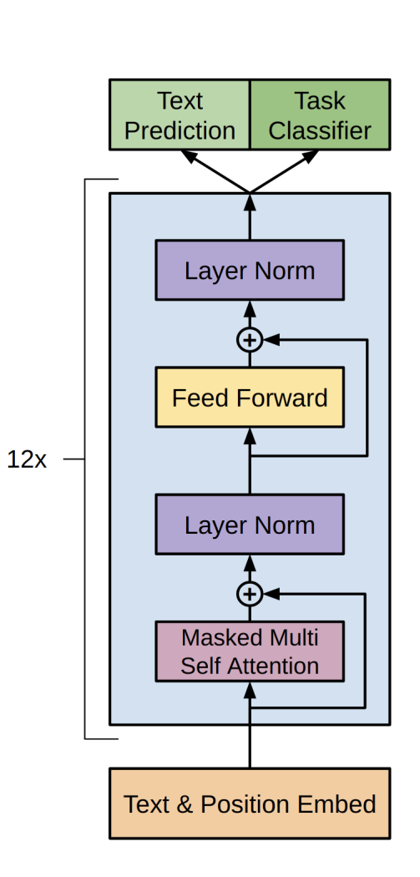
Splitting the Transformer – Autoregressive
Focusing on Just the Decoder: The Autoregressive Transformer
If we focus only on the decoder side of the original Transformer, we get an autoregressive model, such as GPT (Generative Pretrained Transformer). Unlike the original Transformer (which was designed for seq-to-seq tasks like translation), decoder-only models specialize in generating text token-by-token, making them ideal for open-ended text generation.
What Happens When We Keep Only the Decoder?
The model generates tokens sequentially, predicting the next token based on previous tokens.
Uses causal (unidirectional) self-attention, meaning tokens cannot attend to future words.
Unlike encoder-based models (e.g., BERT), decoder-only models do not generate embeddings for entire sequences at once—they generate text step-by-step.
How Decoder-Based Models Generate Text
Token-by-Token Generation: Each new token is conditioned on all previously generated tokens.
Autoregressive Sampling: Uses methods like greedy decoding, beam search, or nucleus sampling to determine the next token.
No Fixed-Length Representations: Unlike encoder models that output a static embedding, decoder models produce dynamic text sequences, making them useful for chatbots, story generation, and machine translation.
Key Differences from Encoder-Only Models
Optimized for generation, rather than feature extraction.
Uses causal self-attention, preventing tokens from seeing the future.
Can generate arbitrarily long text, making them flexible for applications like chatbots, dialogue models, and creative writing.
Notes:
https://cdn.openai.com/research-covers/language-unsupervised/language_understanding_paper.pdf

Slide 16
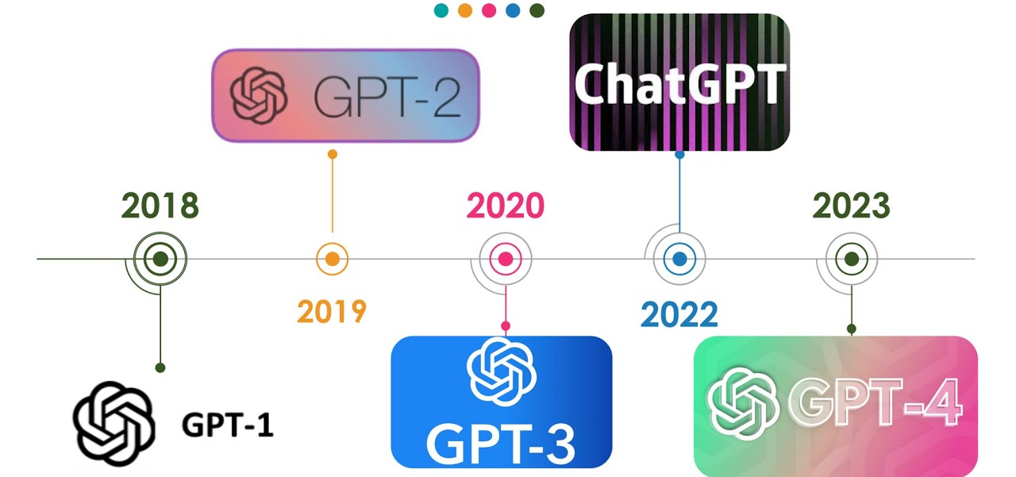
GPT and the Decoder Models
GPT-1 (2018) – Introducing Autoregressive Pretraining
The first Generative Pretrained Transformer (GPT-1) introduced the idea of pretraining on large text corpora using causal (unidirectional) self-attention. It was trained on BookCorpus (7000 books) using a left-to-right language model objective, meaning it predicted the next word based on previous context. While effective for text generation, it lacked fine-tuning capabilities for downstream tasks.
GPT-2 (2019) – Scaling Up and Zero-Shot Learning
GPT-2 significantly increased model size (up to 1.5B parameters) and was trained on a much larger dataset (WebText, 40GB of internet text). Unlike GPT-1, it demonstrated strong zero-shot learning, meaning it could perform tasks like translation and summarization without explicit fine-tuning. OpenAI initially withheld its release due to concerns over potential misuse in text generation.
GPT-3 (2020) – Massive Scale and Few-Shot Learning
GPT-3 pushed scale even further, with 175B parameters, making it one of the largest models of its time. It introduced few-shot learning, where the model could generalize to new tasks using only a few examples provided in-context. This made it far more flexible, reducing the need for task-specific fine-tuning. However, it was computationally expensive and sometimes generated incoherent or biased responses due to training data limitations.
GPT-4 (2023) – Improved Reasoning and Multimodality
GPT-4 refined previous architectures with better alignment, stronger reasoning capabilities, and improved factual accuracy. It introduced multimodal capabilities, allowing it to process both text and images. Compared to GPT-3, it was more reliable, creative, and better at nuanced instructions, reducing biases and hallucinations through improved training techniques and human feedback alignment.

Slide 17
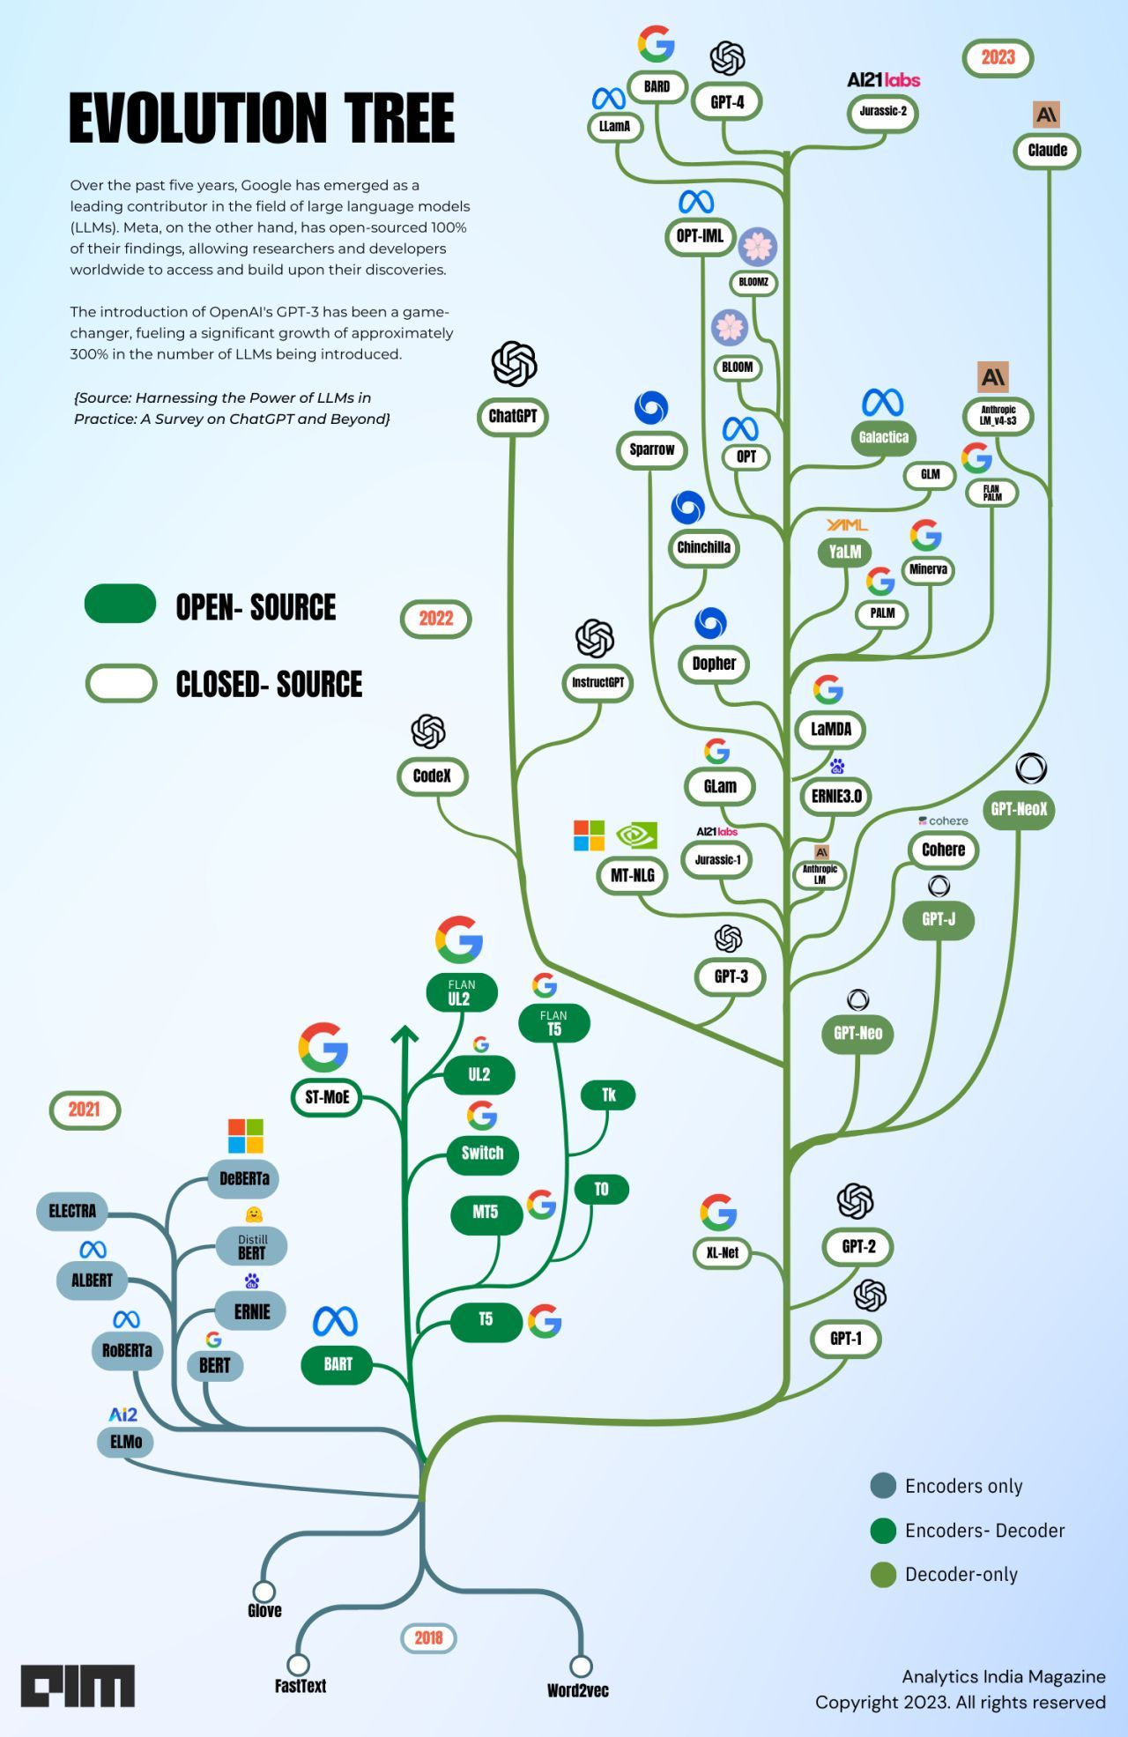
Evolution of Decoder Models
2019–2020: Scaling Transformer Decoders
Following GPT-2’s success, researchers realized that scaling decoder-only transformers significantly improved language generation. Models like GPT-3 (175B parameters, 2020) demonstrated that sheer size enabled few-shot learning, allowing models to perform new tasks with minimal examples. However, these models were computationally expensive, prone to hallucinations, and had limited reasoning abilities.
2021–2022: Efficiency and Alignment
As models grew, focus shifted toward optimizing inference and improving factual accuracy. Approaches like Mixture of Experts (MoE) (e.g., GLaM, 2021) enabled selective activation of model parameters, reducing compute costs while maintaining performance. Alignment techniques such as Reinforcement Learning from Human Feedback (RLHF), popularized by InstructGPT (2022), made models safer and more useful for practical applications.
2023–2024: Multimodality and Reasoning
With GPT-4 (2023), models became multimodal, processing text and images together. Advances in long-context understanding (e.g., Anthropic’s Claude 2) and retrieval-augmented generation (RAG) enabled more reliable knowledge-based responses. Research also explored smaller, specialized models (e.g., Meta’s LLaMA series) to make deployment more accessible.
2025 and Beyond: Specialization and Efficiency
By 2025, decoder models are expected to become more efficient, customizable, and domain-specific. Innovations in speculative decoding, dynamic token generation, and hardware-optimized architectures will likely improve speed and affordability. The rise of agent-like models, capable of long-term memory and planning, will push the boundaries of autonomous decision-making beyond simple text generation.
Notes:
https://www.linkedin.com/posts/bhaskergupta_over-the-years-decoder-only-models-have-activity-7079428841621905408-bH3H/

Slide 18
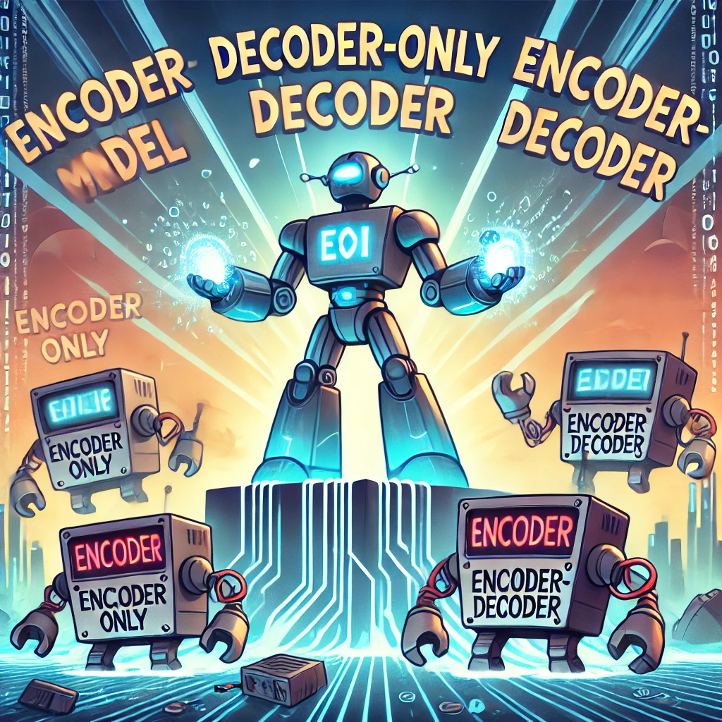
Dominance of Decoder Models
While many models are still being released that are Encoder based, the vast majority of effort is centered around decoder-only models.
Early Use Cases: Encoders and Encoder-Decoder Models
Encoders (BERT, RoBERTa, SBERT, etc.) excel at understanding language but are limited to classification and retrieval tasks.
Encoder-Decoder (T5, BART, etc.) were designed for sequence-to-sequence tasks like translation and summarization but required more complex architectures.
Limitation: Neither approach was optimized for open-ended text generation, leading to decoder-only models emerging as the dominant paradigm.
Why Decoder-Only Models Took Over
Optimized for Autoregressive Generation: Predicting one token at a time allows for flexible, dynamic text generation.
Scaling Laws Favor Decoders: Research (Kaplan et al., 2020) showed that bigger models trained autoregressively outperform alternative architectures given enough compute.
General-Purpose Capability: Models like GPT-3 and GPT-4 adapt to a wide range of tasks without task-specific architectures, making them ideal for chatbots, coding assistants, and creative writing.
Dominance in Industry & Research
NLP Applications: ChatGPT, Claude, Gemini, and LLaMA all use decoder-only models because they are superior at long-form generation and instruction following.
Multimodality Expansion: GPT-4 and Gemini introduced text + image processing, further solidifying decoder models as the backbone of AI.
Fine-Tuning and Customization: Open-source decoders like LLaMA-2, Mistral, and Falcon have enabled research and deployment at various scales.

Slide 19
Encoder-decoder models

Slide 20
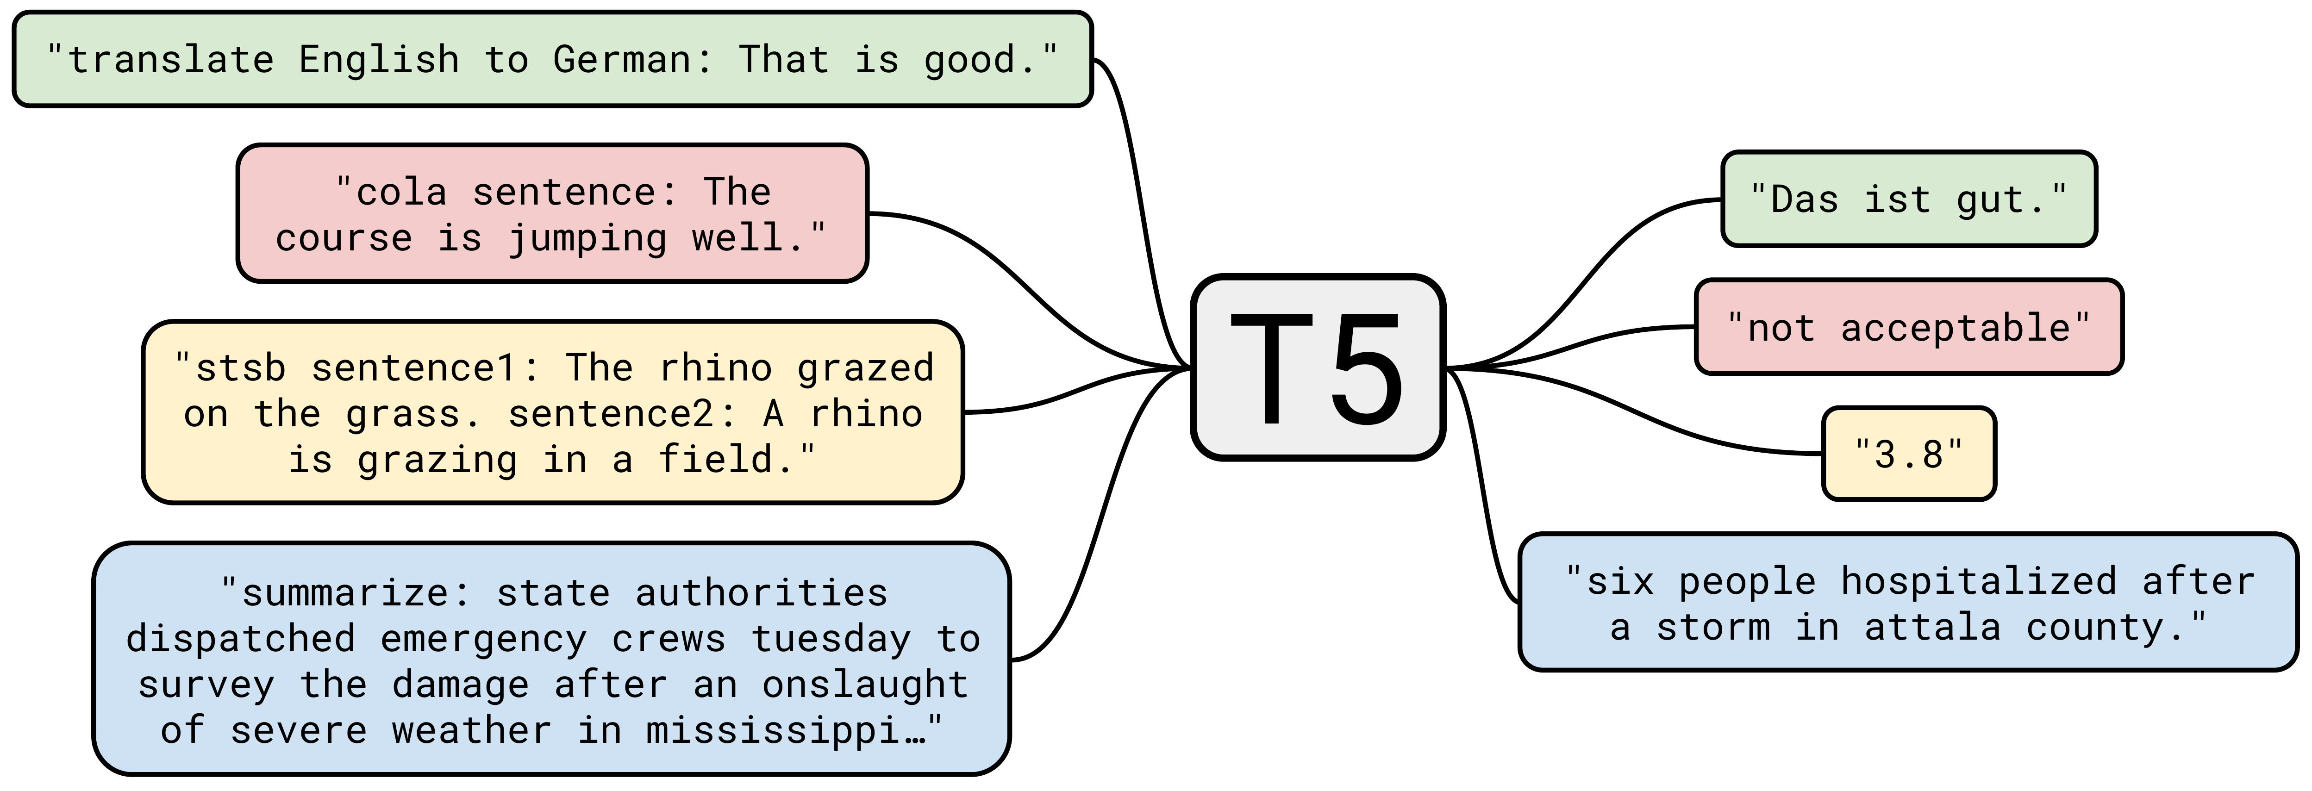
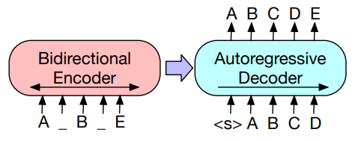
Evolving the Original Transformer Model
While the original transformer was introduced as an encode-decoder format. Those individual families have shown significantly more development than the dual format.
The Original Encoder-Decoder Transformer (2017)
Introduced in “Attention Is All You Need”, designed for sequence-to-sequence tasks like machine translation.
The encoder processes input into contextual representations, while the decoder generates output token by token.
Used self-attention in both encoder and decoder, with cross-attention in the decoder to connect input and output.
Early Innovations (2018–2020)
BERT’s Influence on Pretraining
T5 (2019): Treated all NLP tasks as text-to-text problems, unifying classification, translation, and summarization.
BART (2020): Used denoising pretraining to improve robustness in text generation.
2. Hybrid Approaches for Better Representations
MASS (2019): Combined masked token prediction with sequence-to-sequence training.
mBART (2020): Extended BART to multilingual settings, improving cross-lingual translation.
Challenges & Decline in Adoption (2021–2023)
Computational inefficiency: Training both an encoder and a decoder made models slower and more memory-intensive.
Decoder-only models (GPT, LLaMA) became dominant for generation, outperforming encoder-decoder models in open-ended tasks.
Encoder-only models (BERT, RoBERTa) remained superior for retrieval and classification, leaving encoder-decoder models in a niche space.
Notes:
https://paperswithcode.com/method/t5
https://botpenguin.com/blogs/introducing-flan-t5

Slide 21
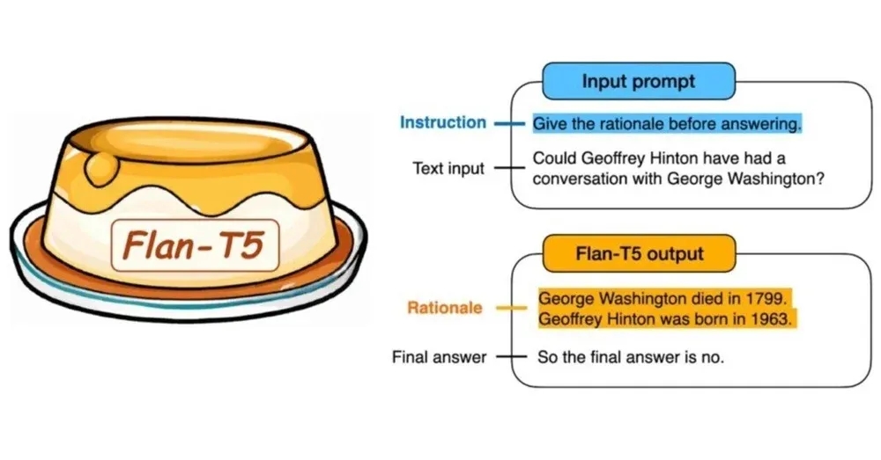
T5 (Text-to-Text Transfer Transformer) and Seq2Seq Models
1. T5 (Text-to-Text Transfer Transformer) – 2019
Reformulated all NLP tasks as text-to-text problems, where both input and output are in natural language.
Architecture: Encoder-Decoder transformer, similar to the original transformer but designed for general-purpose NLP.
Trained on C4 dataset (Colossal Clean Crawled Corpus), a massive web-scraped dataset.
Advantages:
Unified approach: Works for classification, translation, summarization, and QA with the same architecture.
Strong fine-tuning performance across diverse NLP benchmarks.
Limitations:
Expensive to train due to its encoder-decoder structure.
Not instruction-tuned, meaning it required fine-tuning per task.
2. Flan-T5 – Instruction-Tuning for Better Generalization (2022–2023)
Built on T5, but trained with instruction tuning, meaning it learned from a wide variety of task prompts instead of requiring separate fine-tuning.
Training Enhancements:
Multi-task learning: Exposed to thousands of NLP tasks to improve generalization.
Better zero-shot and few-shot learning than original T5.
Advantages:
Stronger out-of-the-box performance on unseen tasks.
More efficient than GPT-3 while achieving comparable results.
Smaller, accessible open-source versions make it practical for real-world applications.
Limitations:
Still limited to text-based tasks, unlike multimodal models like GPT-4 or Gemini.
Larger versions (Flan-T5-XL/XXL) require significant compute for fine-tuning.
Notes:
https://paperswithcode.com/method/t5
https://botpenguin.com/blogs/introducing-flan-t5

Slide 22
New Variants

Slide 23
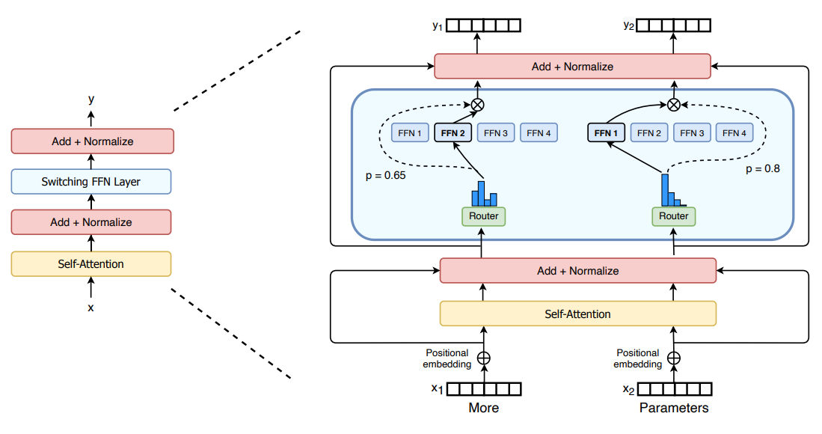
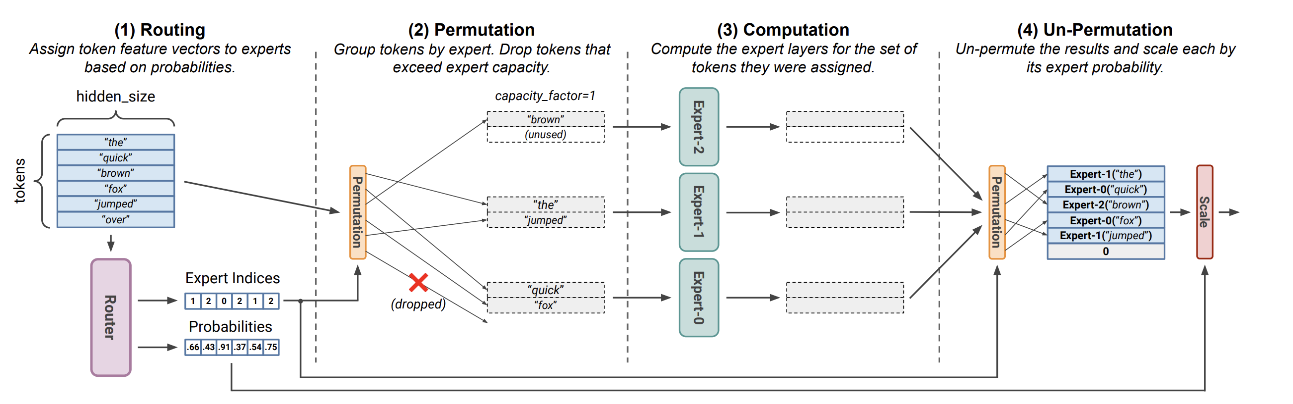
Beyond the Transformer – Mixture-of-Experts
What is Mixture of Experts (MoE)?
A neural network design where only a subset of model parameters are activated per input, reducing compute costs while maintaining high capacity.
Uses a router mechanism to select which “expert” subnetworks process each token.
Why MoE?
Increases model size without proportional compute cost (e.g., GLaM, Switch Transformer).
Improves efficiency by activating only relevant experts per input, rather than the entire model.
Scales effectively, making large models more computationally feasible.
Challenges of MoE
Complex training dynamics (balancing expert utilization and load balancing).
Increased memory requirements for storing multiple expert networks.
Harder to deploy compared to dense models like GPT-3.
Key Applications
Google’s Switch Transformer (2021): 1.6T parameters, but only 1/64 active per token.
GLaM (Google, 2021): Achieved GPT-3 level performance with less compute.
Recent MoE Models (2023–2025): Used in open-source LLMs and hybrid architectures for efficiency.
Notes:
https://huggingface.co/blog/moe
https://arxiv.org/pdf/2211.15841

Slide 24
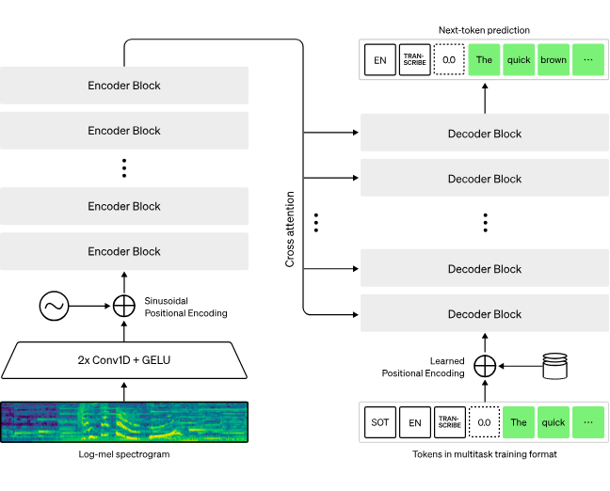
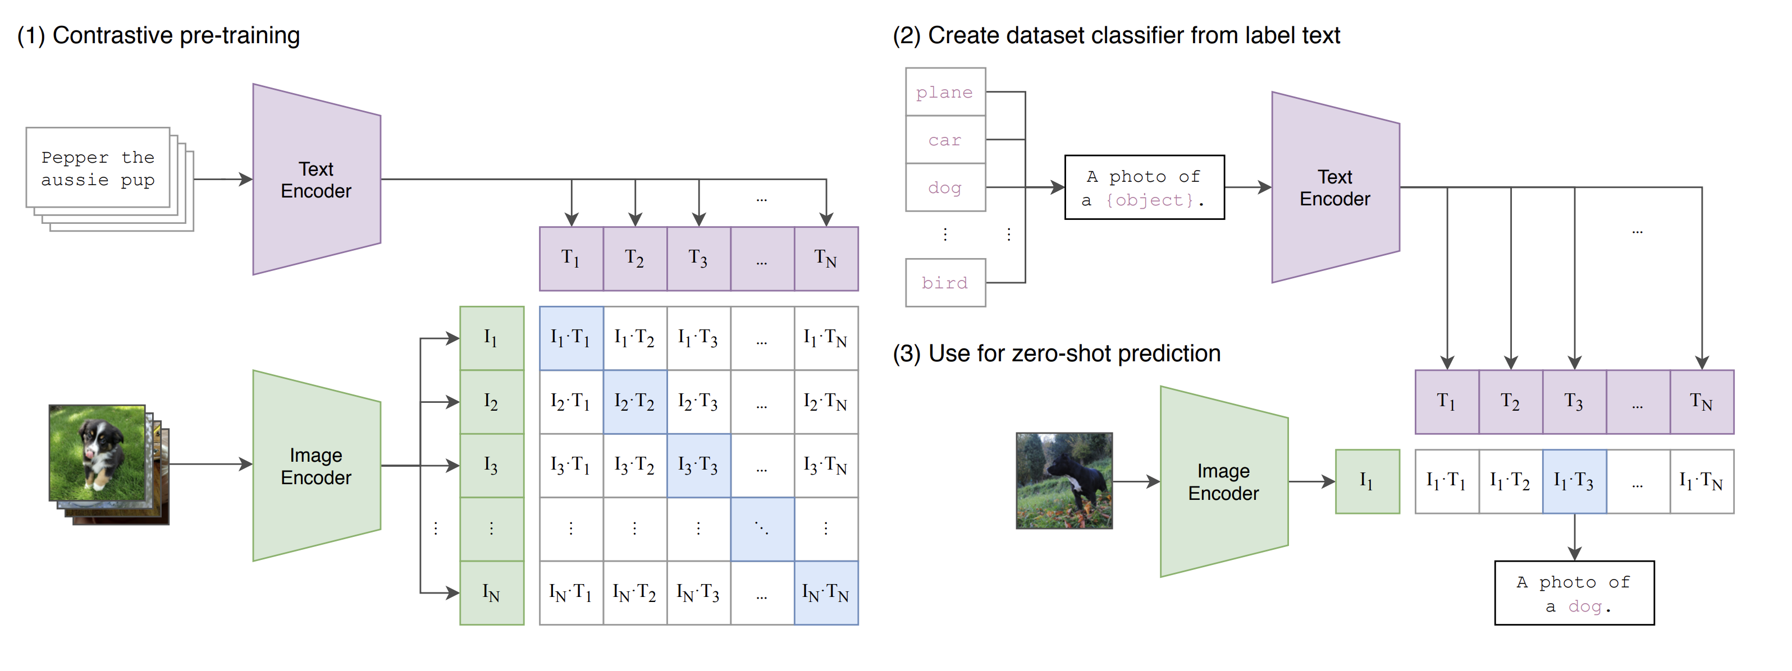
Beyond the Transformer – Multimodal
Multimodal Models are AI models that process and generate multiple types of data (e.g., text, images, audio, video).
Unlike text-only transformers (GPT, BERT), multimodal models integrate different input formats within a unified architecture.
1. Vision-Language Models (VLMs)
CLIP (2021): Learned joint text-image embeddings, enabling zero-shot classification.
Flamingo (2022): Fine-tuned for image captioning and reasoning using few-shot learning.
2. Multimodal Transformers
PaLI (2022) & Gemini (2024): Use encoder-decoder architectures to jointly process text and images.
GPT-4V (2023): Extended GPT-4 with visual processing, enabling image-based reasoning.
3. Speech & Audio Integration
Whisper (2022): High-quality speech recognition trained on diverse multilingual datasets.
MM1 (2024, Meta): Explored text, image, and speech in a single transformer.
We’ll learn more about these later in the course!
Notes:
https://arxiv.org/pdf/2103.00020
https://openai.com/index/whisper/

Slide 25
Wrap Up
LLM Architecture Variants
Today we introduced a number of variants of the original transformer architecture.
We saw the encoder-only models which can be used to generate highly enriched embedding vectors that can be used for several applications.
The decoder-only LLMs were introduced, the basis of models like GPT and Llama which have dominated the GenAI landscape.
We also saw the continuation of the encode—decoder architecture and,
Some of the new variants of LLMs including the Mixture of Experts and Multimodal models
-----------------------------------------------------------------------------

Slide 26
Thank you!

