Slide 1


Lecture 5.1 - Introduction to Multimodal Models
Generative AI Teaching Kit

Slide 2

The NVIDIA Deep Learning Institute Generative AI Teaching Kit is licensed by NVIDIA and Dartmouth College under the
Creative Commons Attribution-NonCommercial 4.0 International License.

Slide 3
This lecture
Introduction to Modalities
Historical Approaches
Multimodalities in GenAI
Whisper: Combining Audio and Text with Transformers

Slide 4
Introduction to Modalities
Listen, Read, Speak, Watch

Slide 5








Data Modalities
Modalities are different forms of information or sensory inputs that can be processed
Common modalities include:
  Visual (images, video, diagrams)
  Audio (speech, music, environmental sounds)
  Text/Language
  Numerical/Structured data
  Time series
  Tactile/haptic feedback
  Spatial/geometric information

Slide 6
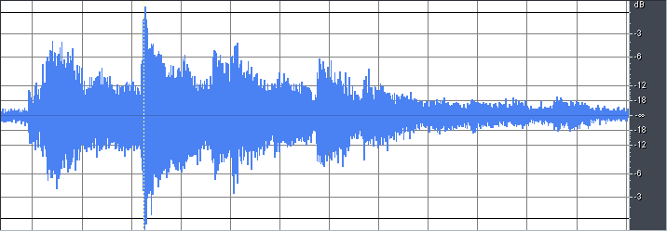
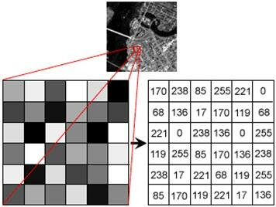
Modalities – Statistical Properties
Each modality has distinct characteristics:
  Different dimensionality (e.g., 2D for images, 1D for audio)
  Varying scales and distributions
  Unique noise patterns and types
  Different sparsity levels
  Temporal dependencies (strong in audio/video, less so in static images)
  Varying degrees of structure (highly structured text vs. raw sensor data)
Notes:
https://stackoverflow.com/questions/18404962/how-to-get-the-audio-graph-for-sou
https://www.researchgate.net/publication/325569674_Analysis_of_Emotions_From_Body_Postures_Based_on_Digital_Imaging/figures?lo=1nd-file-in-wave-form

Slide 7
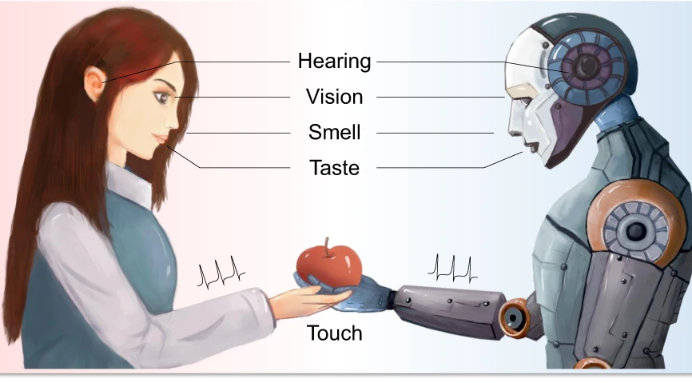
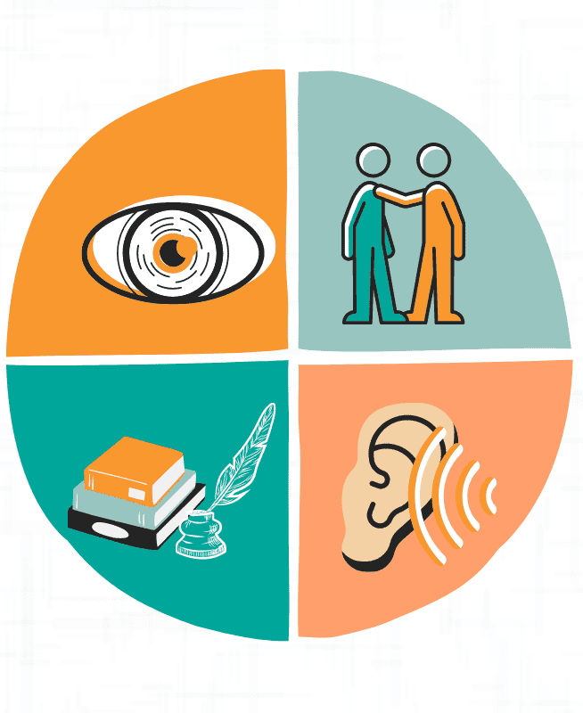
Modalities – Human Processing
Humans naturally integrate multiple modalities:
  Cross-modal integration (e.g., lip reading combines visual and audio)
  Complementary information (text captions helping understand ambiguous images)
  Redundancy for robustness (understanding speech better when seeing the speaker)
  Hierarchical processing (from raw sensory input to abstract concepts)
  Attention mechanisms to focus on relevant modal information
Notes:
https://www.nature.com/articles/s41467-021-21404-z/figures/1
https://www.kdnuggets.com/2023/03/multimodal-models-explained.html

Slide 8
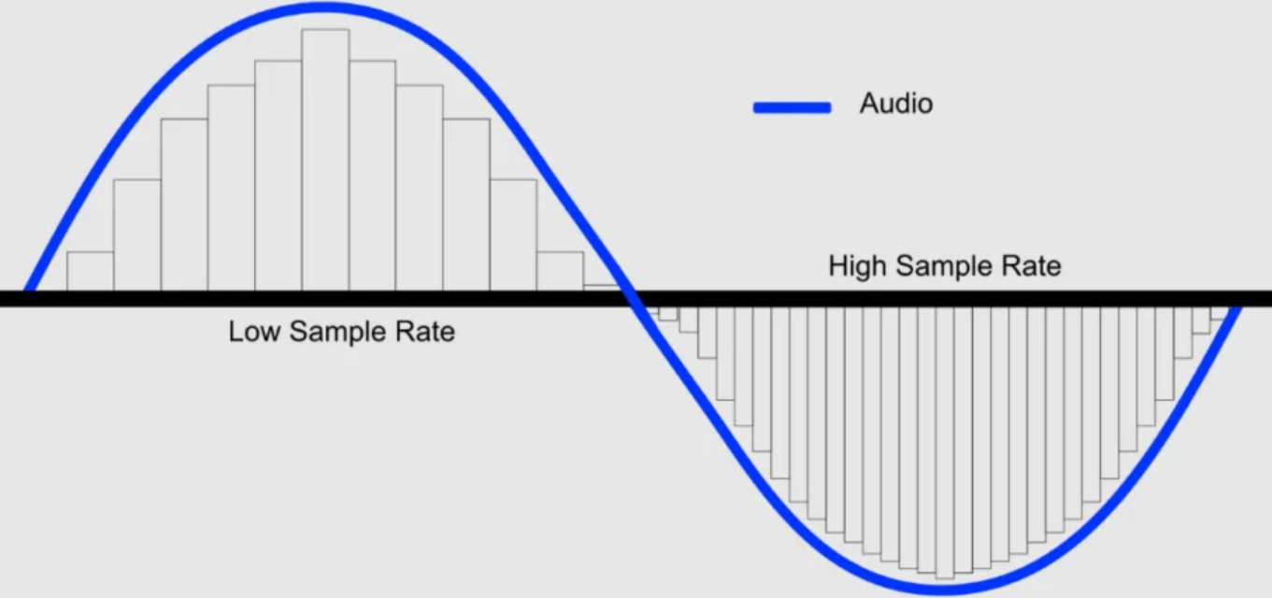
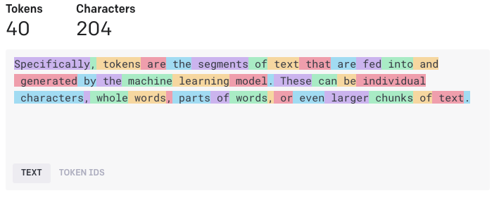
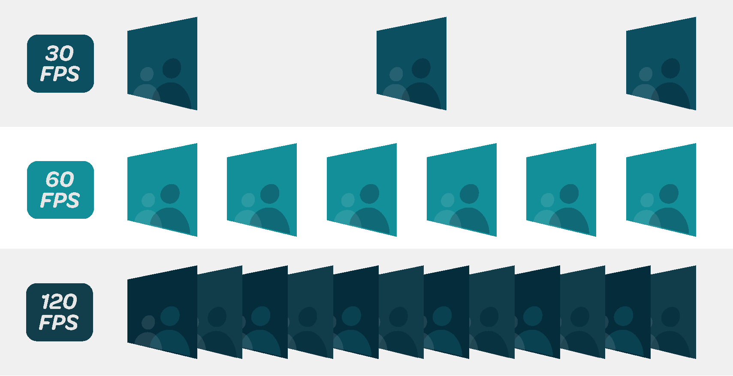
Modality Incompatibilities – Sampling Rates
Technical obstacles:
  Images might be 224x224 pixels while audio is 16kHz
  Text comes in discrete tokens vs continuous sensor values
  Video frames at 30fps vs audio at 44.1kHz
Design considerations:
  Need for modality-specific encoders
  Synchronization/resampling strategies
  Managing computational complexity across scales
Notes:
https://www.switcherstudio.com/blog/what-is-frame-rate
https://medium.com/aimonks/demystifying-tokens-a-beginners-guide-to-understanding-ai-building-blocks-8e00110be553
https://www.hollyland.com/blog/tips/what-is-sample-rate-in-audio

Slide 9

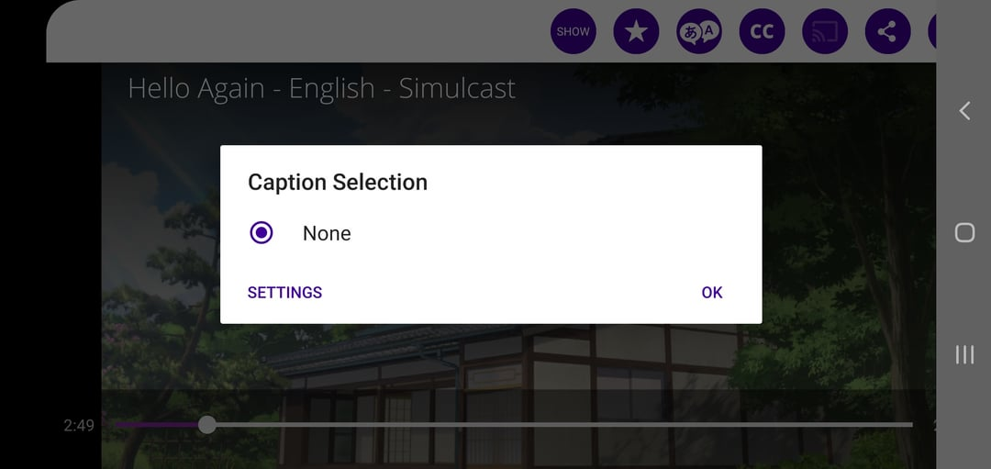
Modality Incompatibilities – Missing or Noisy Data
Common scenarios:
  Images without captions
  Videos with corrupted audio
  Partial sensor readings
Key challenges:
  Handling incomplete pairs during training
  Robust inference with missing modalities
  Cross-modal imputation strategies
  Quality assessment across modalities
Notes:
https://www.gillware.com/data-recovery-services/fix-corrupted-video/
https://www.reddit.com/r/funimation/comments/fwlau4/no_closed_captions_for_your_deafhoh_audience/

Slide 10
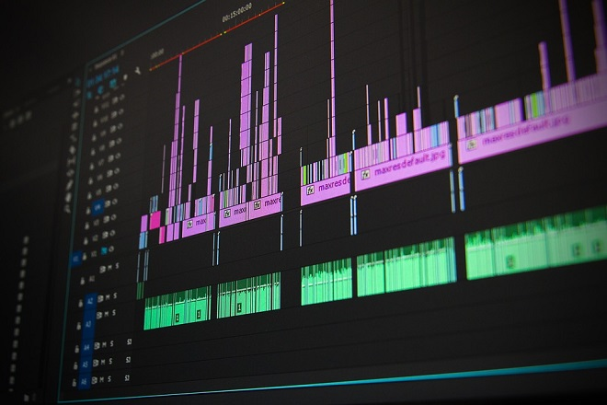
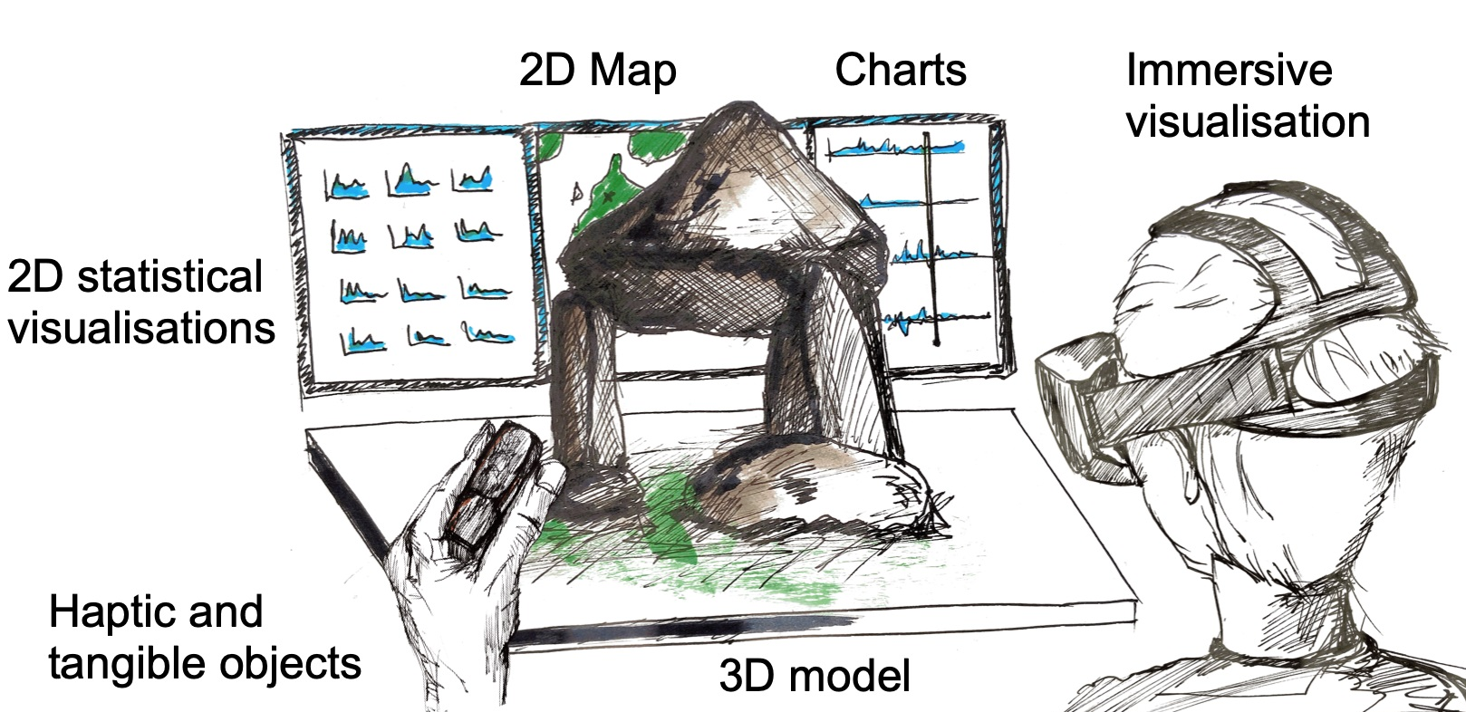
Modality Incompatibilities – Alignment between modalities
Temporal alignment:
  Synchronizing speech with lip movements
  Matching text descriptions to video segments
  Handling varying speeds/durations
Semantic alignment:
  Connecting abstract concepts across modalities
  Dealing with ambiguous relationships
  Managing cultural/contextual differences
Spatial alignment:
  Object references across image and text
  Mapping 3D scenes to 2D descriptions
  Coordinating multiple viewpoints
Notes:
https://www.mdpi.com/2073-431X/11/2/20#
https://myelearningworld.com/sync-audio-and-video/

Slide 11
Historical Approaches
Previous attempts to build multimodal models

Slide 12
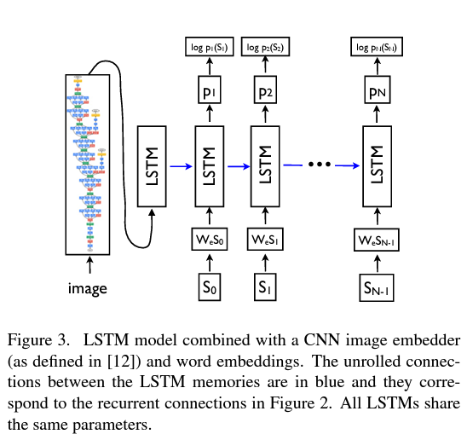
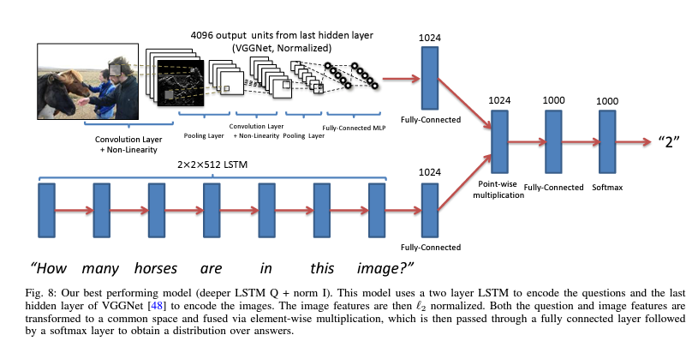
Early deep learning approaches to multimodal models
CNN + LSTM Approaches
Common architectures:
  CNN for visual features
  LSTM for sequential data (text/audio)
  Early visual-linguistic models (2014-2016)
Notable examples:
  Show and Tell (2015): CNN+LSTM for image captioning
  VQA (2015): CNN features + LSTM for question answering
Limitations:
  Sequential bottleneck in LSTMs
  Limited bidirectional interaction
  Fixed visual features from pretrained CNNs
Notes:
https://arxiv.org/abs/1411.4555
https://arxiv.org/abs/1505.00468

Slide 13
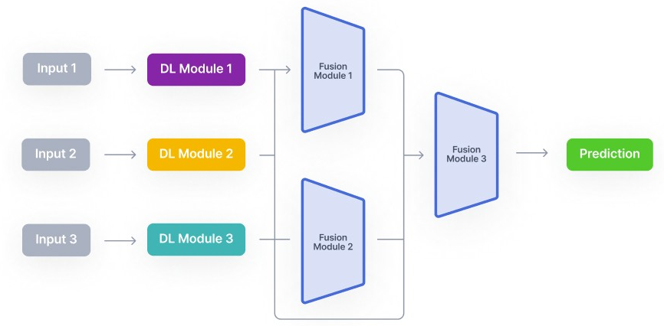
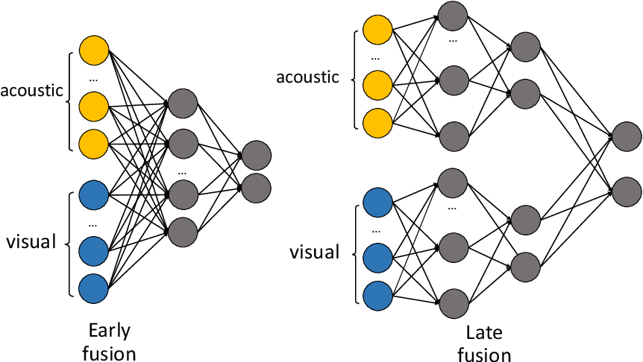
Early deep learning approaches to multimodal models
Feature-level fusion:
  Simple concatenation of CNN + LSTM features
  Element-wise operations (add, multiply)
  Basic attention mechanisms
Common architectures:
  Two-stream networks
  Encoder-decoder with feature injection
  Hierarchical fusion networks
Notes:
https://www.v7labs.com/blog/multimodal-deep-learning-guide
https://www.semanticscholar.org/paper/Hierarchical-Tensor-Fusion-Network-for-Deception-Tung-Yoshino/c0dfcd1a3e5d2c3c86a8576ecce52626edbf324a

Slide 14
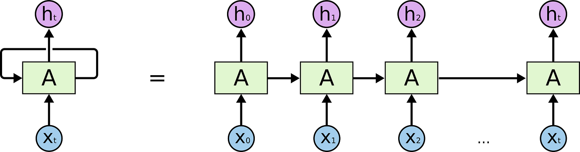
Early deep learning approaches to multimodal models
Design patterns:
  Mostly pipeline approaches
  Limited end-to-end training
  Heavy reliance on pretraining
  Modality-specific architectures first
Technical constraints:
  GPU memory limitations
  Computational bottlenecks
  Training instability
  Limited cross-modal interaction
Notes:
https://medium.com/ai-ml-at-symantec/should-we-abandon-lstm-for-cnn-83accaeb93d6

Slide 15
Modern Foundations
Utilizing attention and modern AI tools to enable Multimodal Models

Slide 16
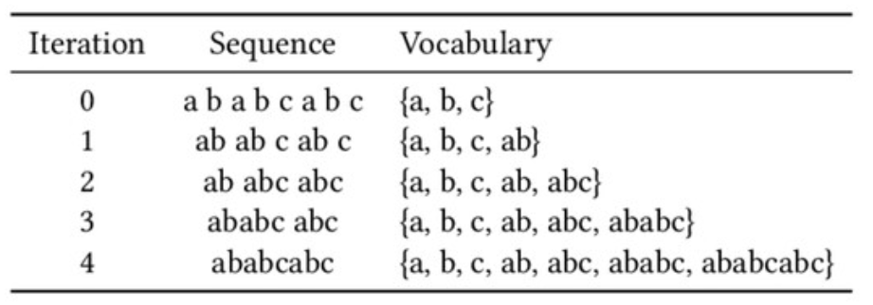
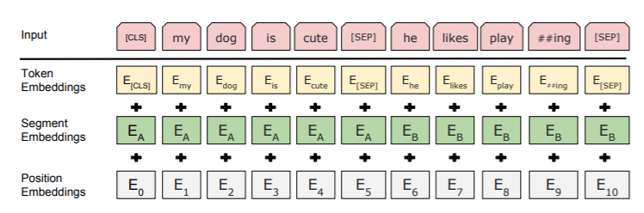
Modern Text Modeling
Text Tokenization
  Subword tokenization (BPE, WordPiece, SentencePiece)
  Character-level vs subword vs word-level tradeoffs
  Specialized tokenizers for code/formulas
Implementation considerations:
  Vocabulary size optimization
  Special token handling ([CLS], [SEP], [MASK])
  Length standardization/truncation
  Language-specific considerations
  Handling of emojis/special characters
Notes:
https://speakerdeck.com/scatterlab/neural-machine-translation-with-byte-level-subwords?slide=4
https://medium.com/@noa_lubin/using-bert-with-pytorch-b9624edcda4e

Slide 17
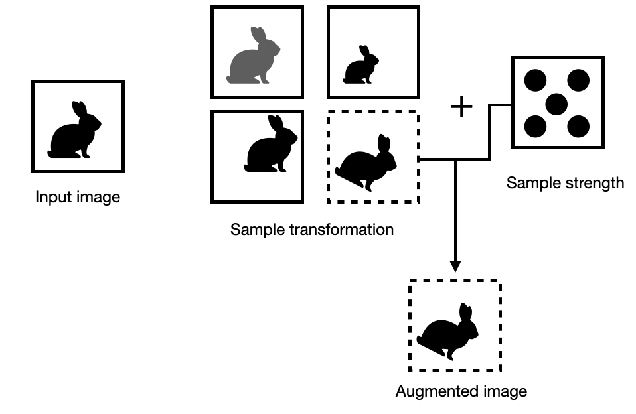
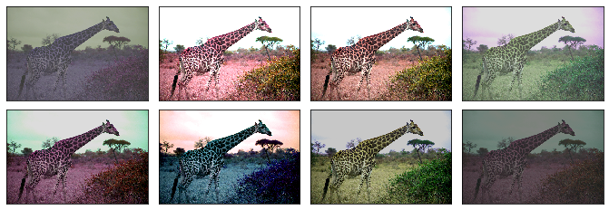
Modern Image Modeling
Standard pipeline:
  Resizing/cropping strategies (224x224, 384x384, 512x512)
  Normalization (ImageNet stats commonly used)
  Patch extraction (16x16 or 32x32 patches)
  Positional embeddings
Advanced techniques:
  Random augmentations during training
  Color jittering/normalization
  Aspect ratio handling
  Resolution adaptation
  Region feature extraction
Notes:
https://sebastianraschka.com/blog/2023/data-augmentation-pytorch.html
https://paperswithcode.com/method/colorjitter

Slide 18
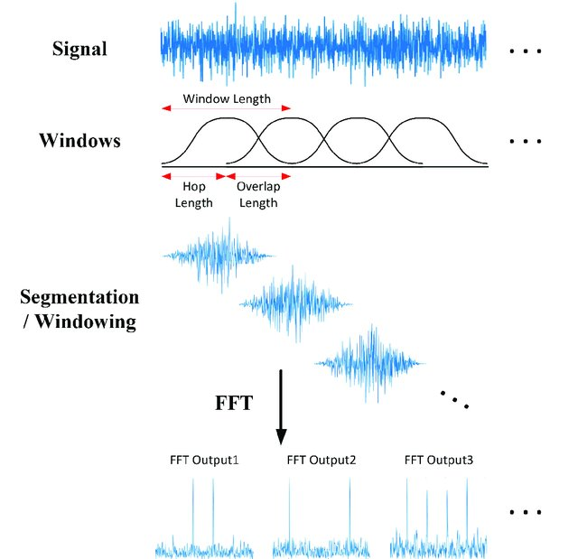
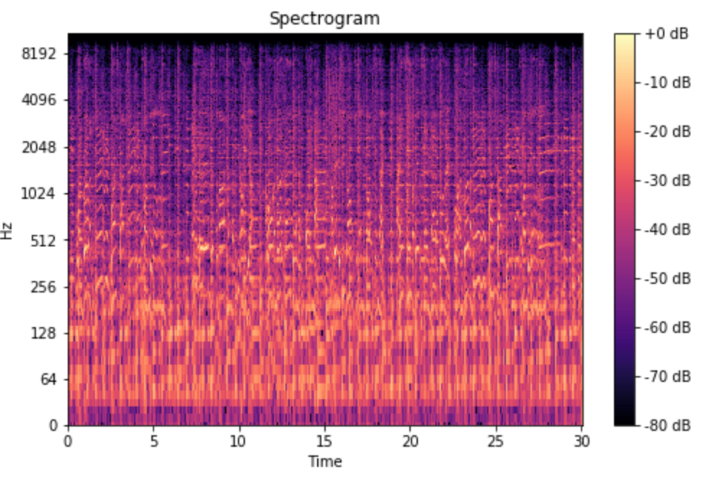
Modern Audio Processing
Spectrogram generation:
  Short-time Fourier transform (STFT)
  Mel-scale conversion
  Log-scale transformation
Key parameters:
  Window size/overlap
  Number of mel bands
  Frequency range
  Sample rate considerations
Additional processing:
  Normalization strategies
  Time-frequency masking
  Phase information handling
  Feature stacking/splicing
Notes:
https://www.researchgate.net/publication/346243843_Area-Efficient_Short-Time_Fourier_Transform_Processor_for_Time-Frequency_Analysis_of_Non-Stationary_Signals/figures?lo=1
https://medium.com/analytics-vidhya/understanding-the-mel-spectrogram-fca2afa2ce53

Slide 19
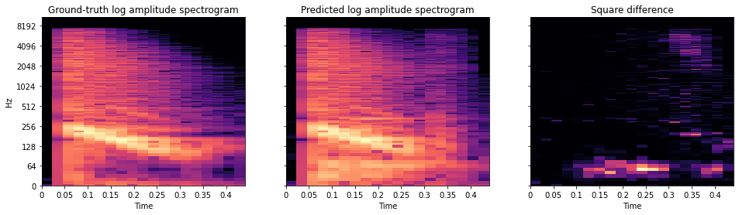
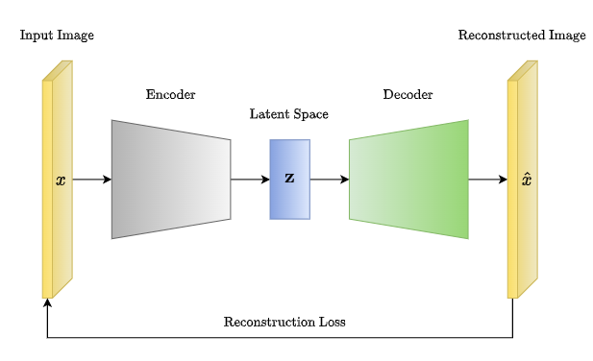
Modern Training Strategies
Training multimodal models involves careful consideration for the losses relative to each mode’s input/output relationship
Per modality:
  MSE for continuous features
  L1 for sparse signals
  Perceptual losses for images
  Spectral losses for audio
Cross-modal:
  Cycle consistency losses
  Feature matching losses
  Style-content separation
  Domain adaptation losses
Notes:
https://www.soundsandwords.io/audio-loss-functions/
https://medium.com/@rushikesh.shende/autoencoders-variational-autoencoders-vae-and-%CE%B2-vae-ceba9998773d

Slide 20
Audio and Text Modality - Whisper
Applying Transformers Automatic Speech Recognition

Slide 21
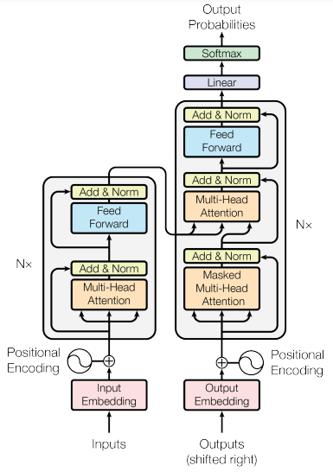
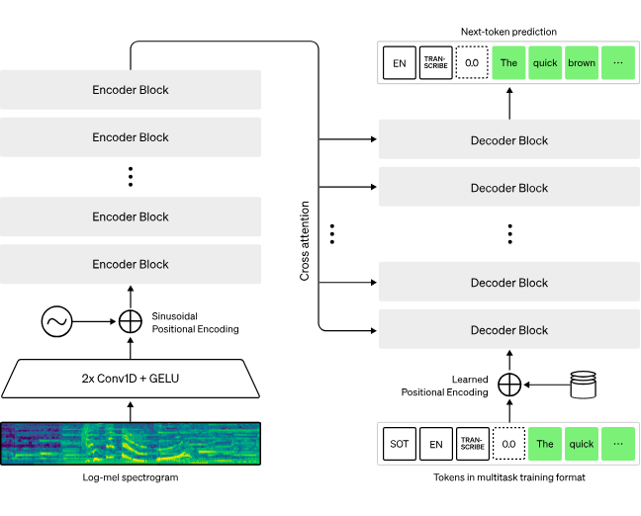
The Whisper Model – Transforming Transcription
In 2022, OpenAI released the Whisper family of models
Whisper was one of the first multimodal applications of the transformer architecture with the purpose of audio transcription and translation.
Audio Input processing:
  Mel spectrograms (80 bands)
  30-second context windows
  25ms frame length, 10ms stride
Model components:
Input:
  Convolutional frontend to process the input audio spectrograms
Transformer backbone:
  Encoder: 12-24 transformer layers to encode the audio signal
  Decoder: Causal masking for autoregressive generation
Audio signal processing as input to encode-decoder transformer
Notes:
https://openai.com/index/whisper/
https://cdn.openai.com/papers/whisper.pdf
https://arxiv.org/abs/1706.03762

Slide 22
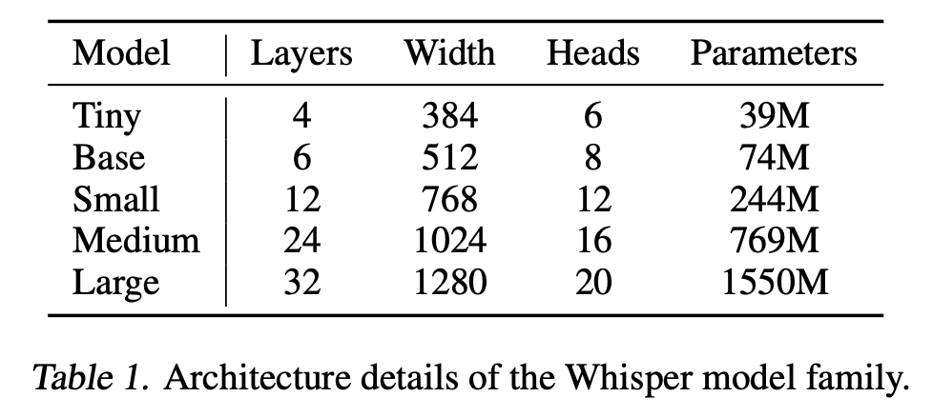
The Whisper Model – Transforming Transcription
Whisper Model Design
Convolutional frontend
    Down-sampling and feature extraction
    Local pattern recognition
Encoder:
    12-24 transformer blocks (size dependent)
    Multi-head cross-attention
    Layer normalization strategy
Decoder:
    Causal masking for autoregressive generation
    Cross-attention to audio features
    Vocabulary of 50k tokens (similar to GPT-3)
    Special tokens for tasks/languages
Notes:
https://openai.com/index/whisper/
https://cdn.openai.com/papers/whisper.pdf
https://arxiv.org/abs/1706.03762

Slide 23
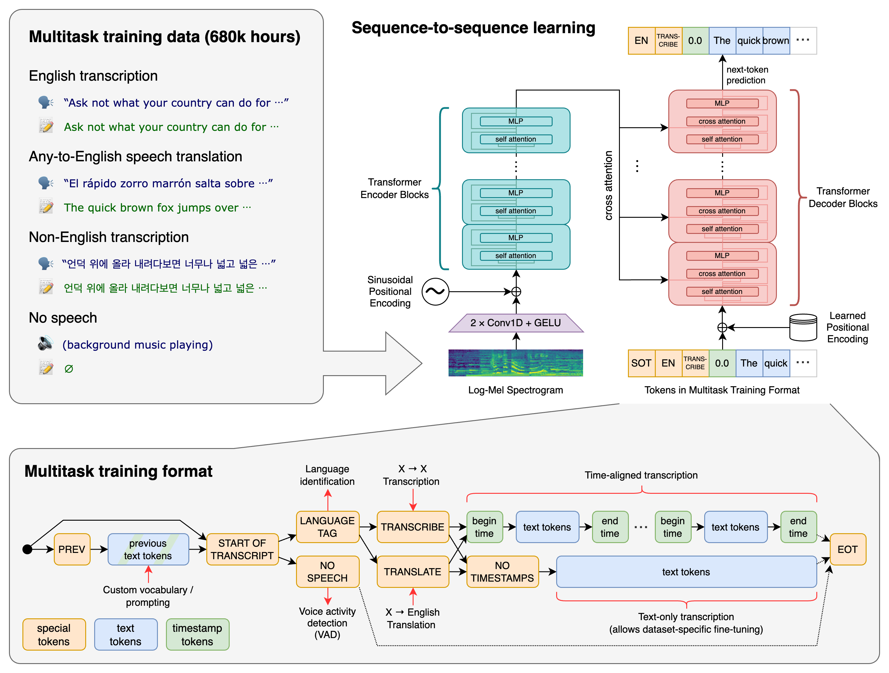
Training Whisper on large data and tasks
At 680,000 hours of labeled audio, the Whisper dataset is one of the largest ever created in supervised speech recognition.
Dataset composition:
  WebText-like filtering
  YouTube, podcasts, audiobooks
  98 languages represented
  Quality tiering system
Training methodology:
  Multi-task setup:
    Speech recognition
    Translation
    Language identification
    Transcription formats (verbatim/clean)
  Data augmentation:
    Speed perturbation
    Background noise addition
    Channel dropping
    Time masking
Notes:
https://cdn.openai.com/papers/whisper.pdf
https://github.com/openai/whisper?tab=readme-ov-file

Slide 24
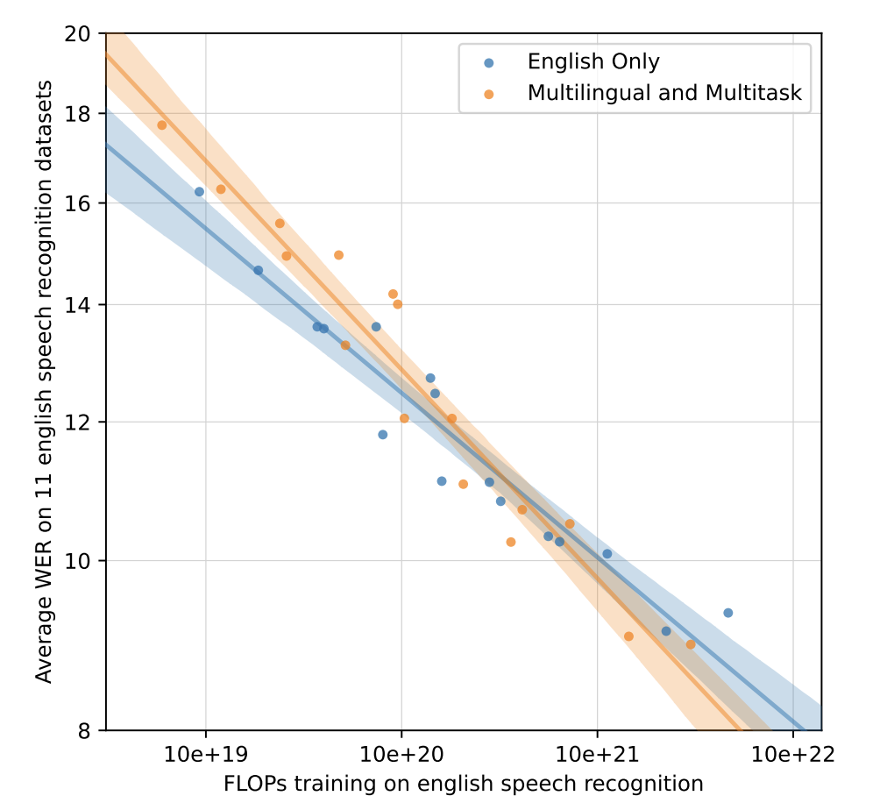
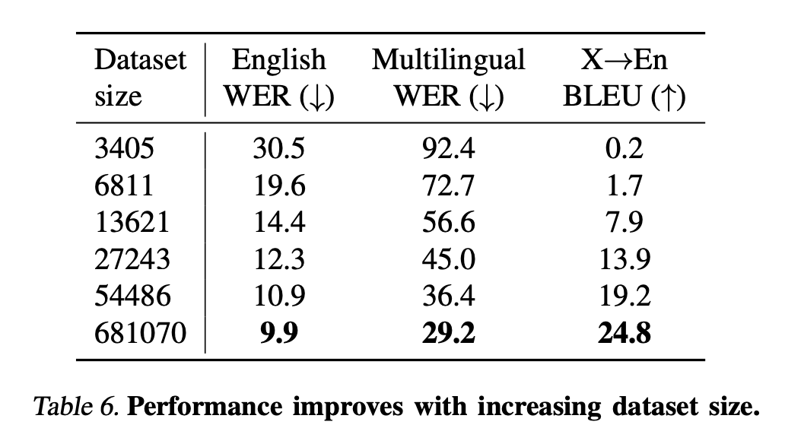
Whisper Performance on Benchmarks
Speech recognition research typically evaluates and compares systems based on the word error rate (WER) metric.
Benchmark datasets:
  LibriSpeech
  Common Voice
  MUST-C
  Fleurs
Metric categories:
  Transcription accuracy:
    Word Error Rate (WER)
    Character Error Rate (CER)
    Proper noun accuracy
  Translation quality:
    BLEU score
Notes:
https://cdn.openai.com/papers/whisper.pdf

Slide 25
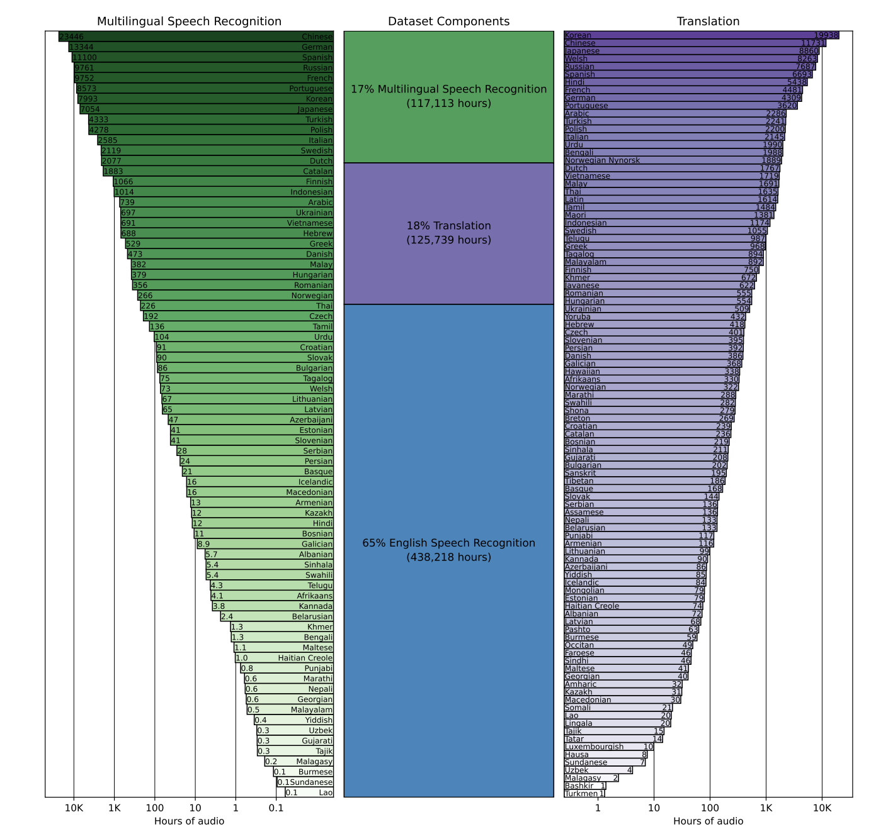
Transformers as Ideal Multimodal Backbones
Architectural Simplicity
Demonstrated that a standard transformer architecture could handle non-text data
Minimal audio-specific modifications needed
Success through scale rather than complex design
Data-Centric Innovation
Showed the power of large-scale, diverse, noisy training data
680,000 hours of multilingual audio
Proved robustness emerges from data diversity, not architectural complexity
Notes:
https://cdn.openai.com/papers/whisper.pdf

Slide 26
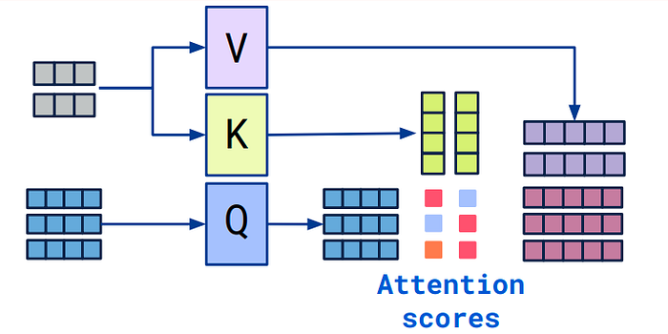
Transformers as Ideal Multimodal Backbones
Cross-Modal Translation
Direct speech-to-text translation across 99 languages
Bridged the gap between audio and text modalities
Demonstrated transformers could learn cross-modal relationships
Foundation for Multimodality
Proved transformers could effectively process alternative input formats
Suggested a general pattern: adapt input encoding, keep core architecture
Hinted at transformer's potential as a universal sequence processor
Notes:
https://www.linkedin.com/pulse/what-self-attention-impact-large-language-models-llm-nikhil-goel-srpbc/

Slide 27
Wrap Up
Introduction to Multimodal Models
Today we introduced the concept of modalities of data and how they can be processed with machine learning
The value of multimodal models arises when comparing the ability of monomodal with how humans process various data streams
We discussed some of the older approaches to combine modes of data in deep learning with feature fusion
The Whisper model family of speech-to-text analysis was introduced as one of the first applications of the transformer architecture
Attention and the transformer approach was discussed as a general framework to combine modal features
-----------------------------------------------------------------------------
In the next class we will explore this transformer approach with other modalities

Slide 28
Thank you!

