Slide 1


Lecture 5.3 - Perceiver IO and more generalized Multimodal Models
Generative AI Teaching Kit

Slide 2

The NVIDIA Deep Learning Institute Generative AI Teaching Kit is licensed by NVIDIA and Dartmouth College under the
Creative Commons Attribution-NonCommercial 4.0 International License.

Slide 3
This lecture
Multimodal Models Recap
GPT-4V and LLaVa Multimodal Assistants
Perceiver Architectures

Slide 4
Multimodal Models
Recap on what modalities we’ve seen

Slide 5
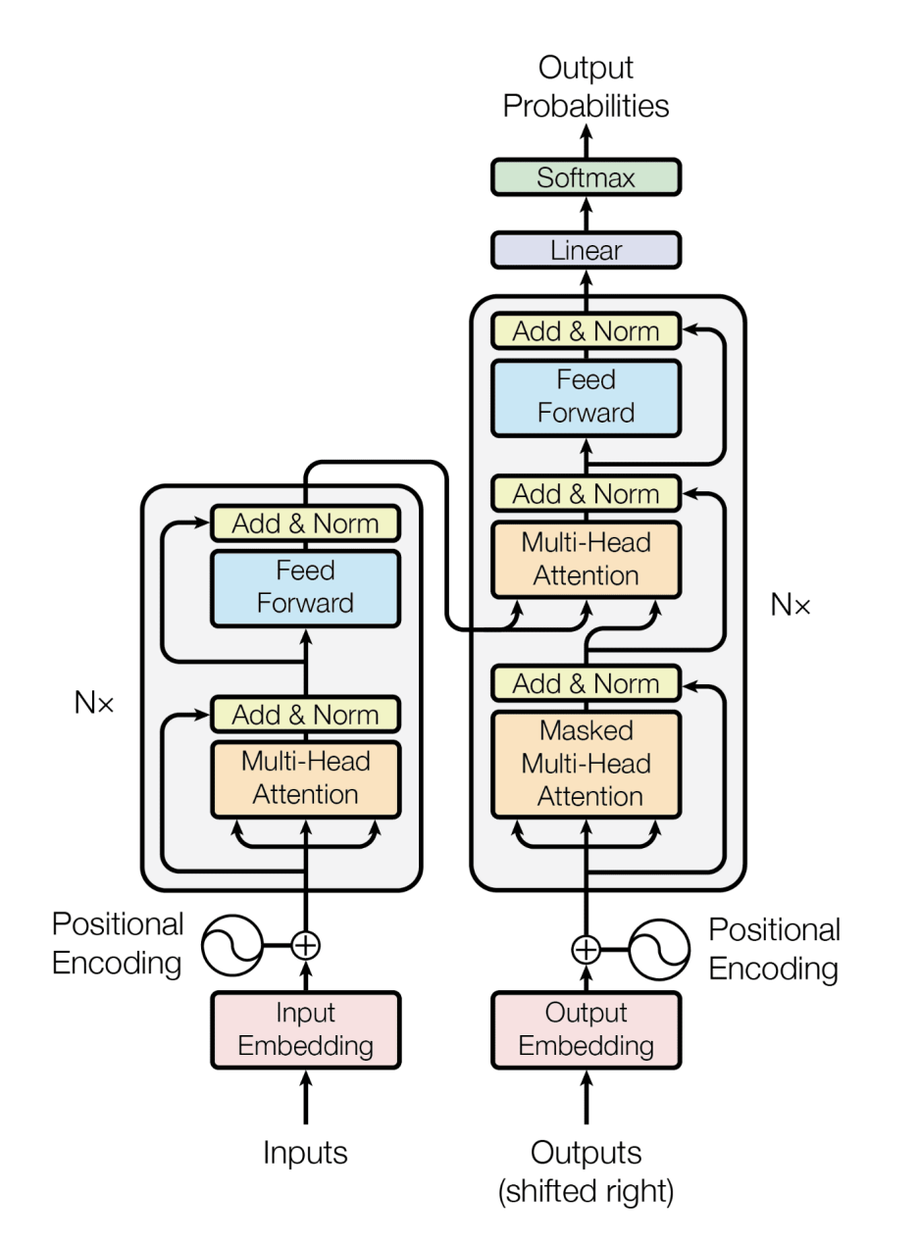
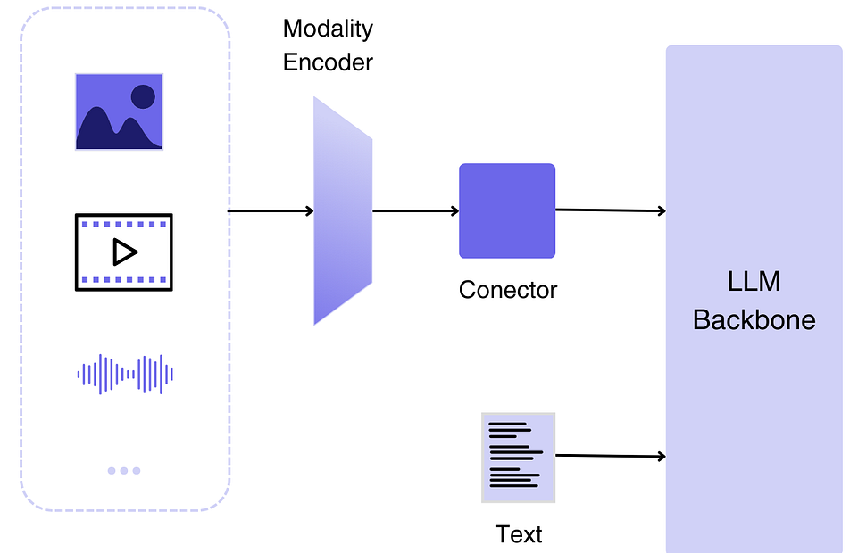
Multimodal Model Types
So far we have looked at the following modalities:
Text
Audio
Images
These three (along with video) make up the bulk of problems that are associated with multimodalities.
We have seen these as inputs to many models with transformers as the backbone.
GPT/BERT
Input: text | Output: text
Whisper
Input: Audio | Output: text
ViT/CLIP
Input: Images | Output: text
Notes:
https://medium.com/@tenyks_blogger/multimodal-large-language-models-mllms-transforming-computer-vision-76d3c5dd267f
https://arxiv.org/pdf/2006.06609

Slide 6
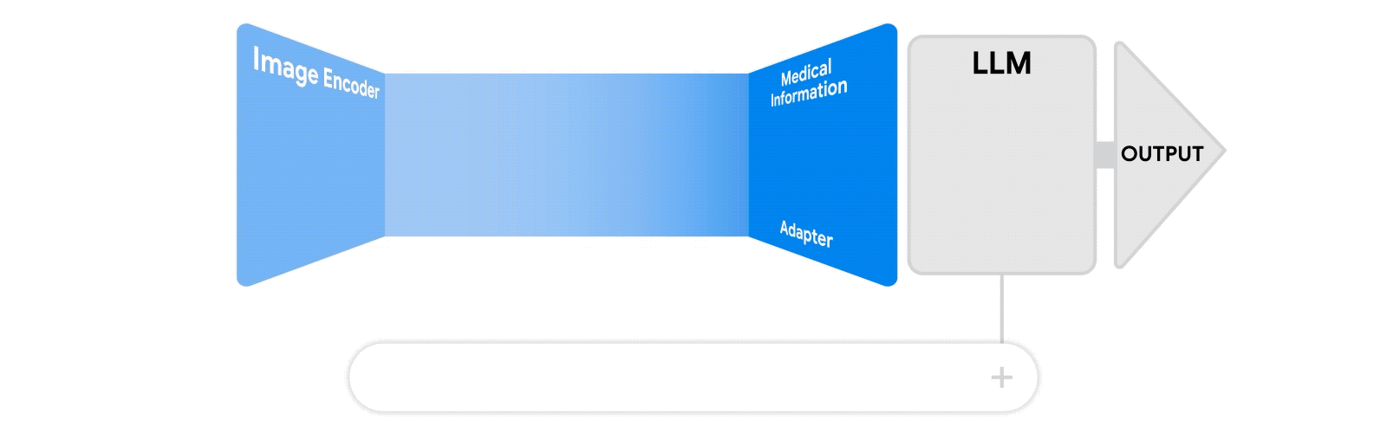
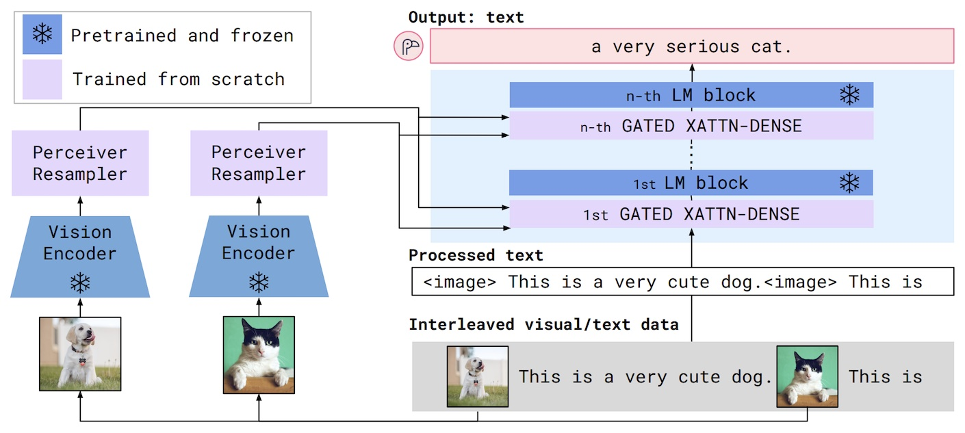
Multimodal Model Types – Image to Text
We have seen these models that can produce text that classifies, captions, and answers questions to what is in an image.
Some examples of these include:
Vision Transformer
Contrastive Language-Image Pretraining
Flamingo
This model extends on some of the previous work in CLIP by allowing the model to generate text rather than align text to an image. This allows Flamingo to be used like BLIP as a VQA model answering questions of input images and text.
Flamingo Model
Notes:
https://medium.com/@tenyks_blogger/multimodal-large-language-models-mllms-transforming-computer-vision-76d3c5dd267f

Slide 7
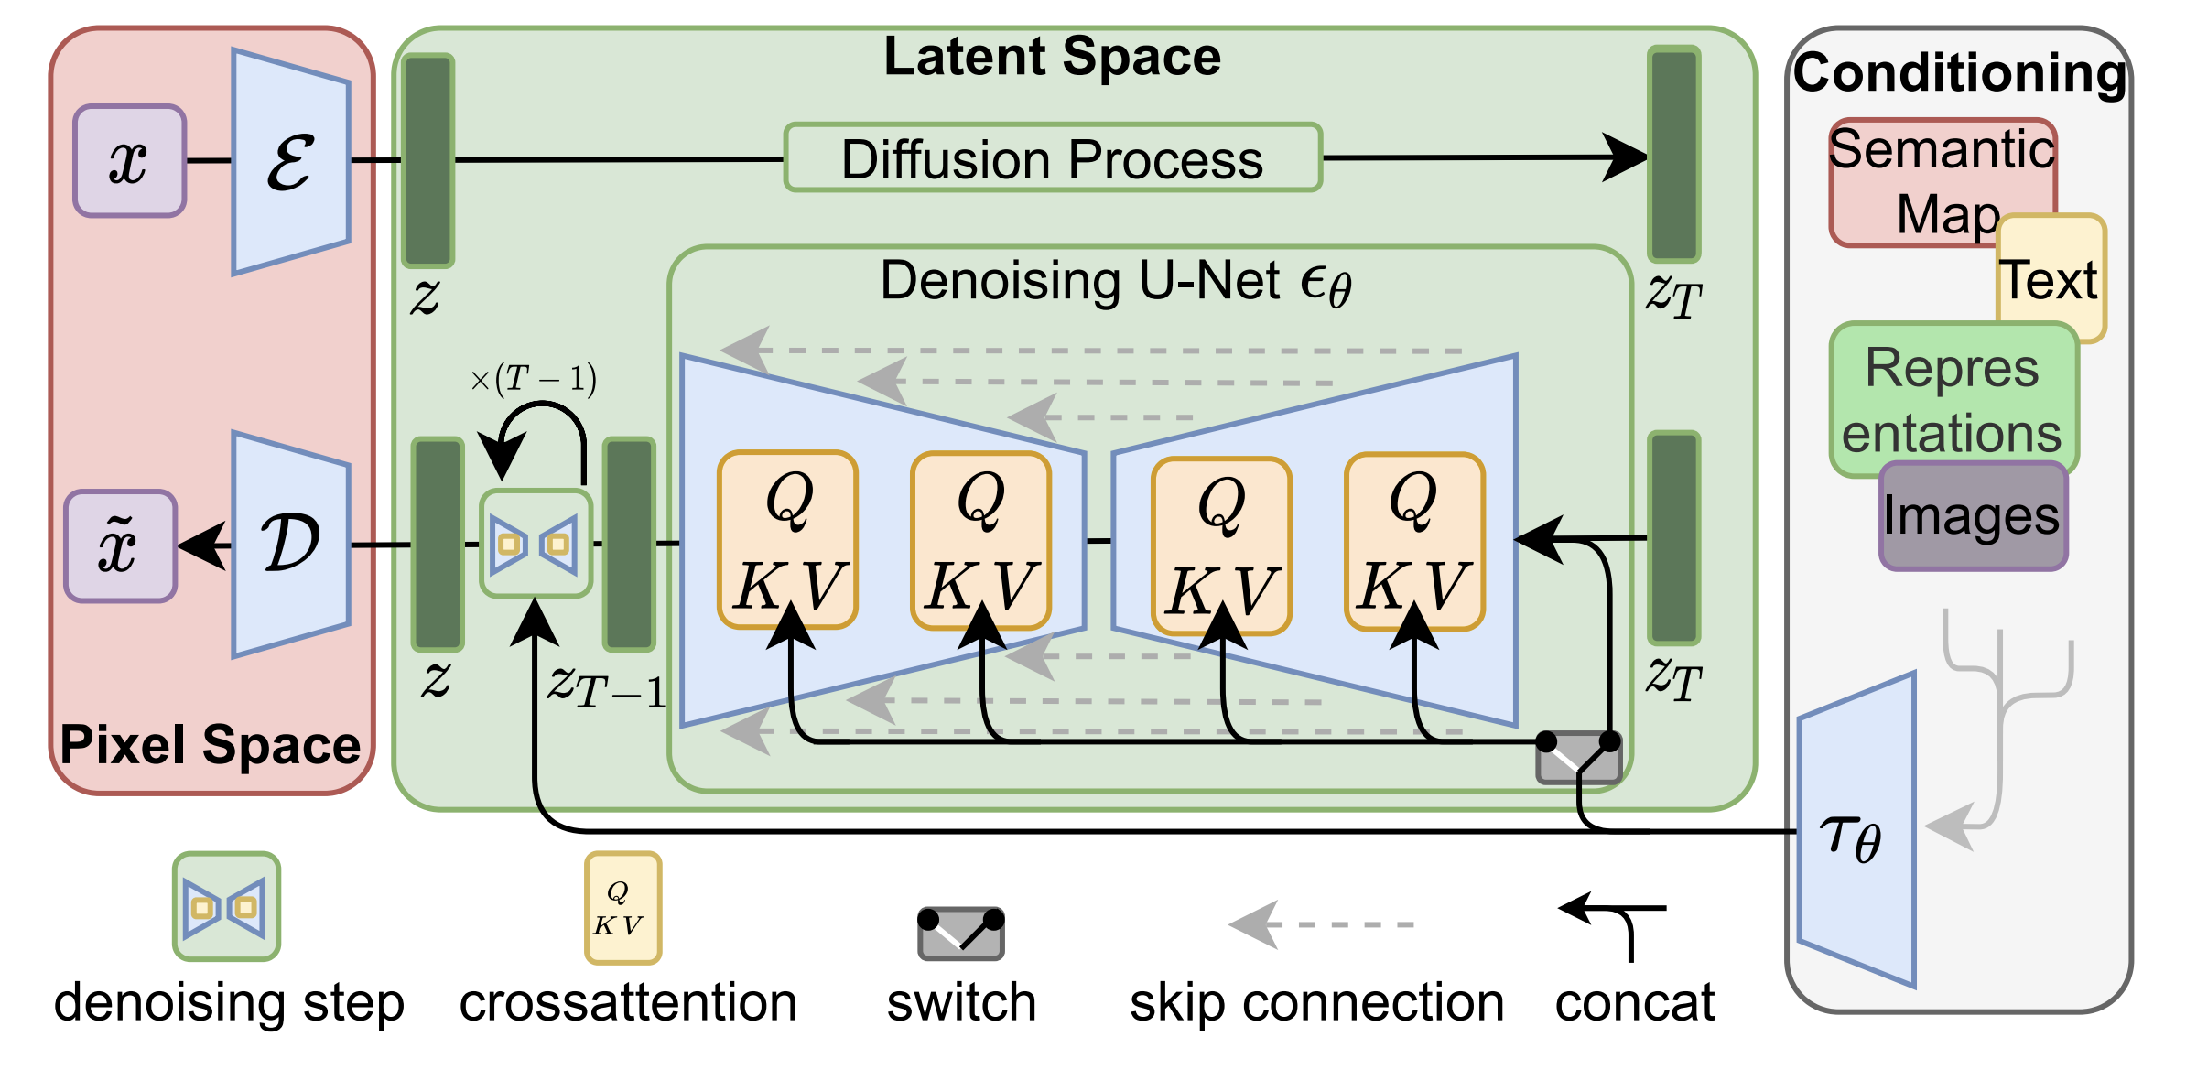
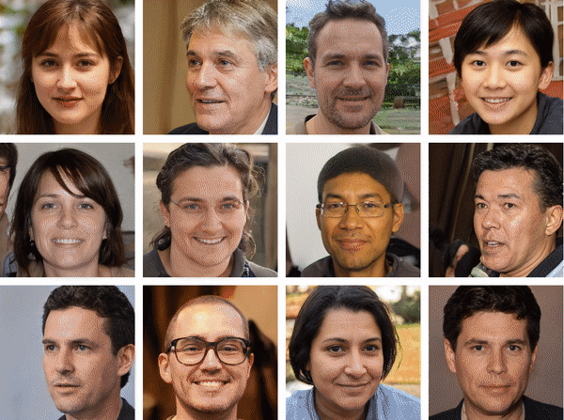
Multimodal Model Types – Text/Image to Image
To generate images, typically diffusion models are used in modern application. These models, which take text as input and output images, older models like cycle/styleGAN can also generate images based on image, and potentially text, as input.
In Module 6 we will cover image generation and diffusion models in much more detail, but they are worth mentioning here as a form of multimodal models.
Notes:
https://medium.com/@tenyks_blogger/multimodal-large-language-models-mllms-transforming-computer-vision-76d3c5dd267f
https://arxiv.org/pdf/2112.10752
https://paperswithcode.com/paper/stylealign-analysis-and-applications-of-1

Slide 8
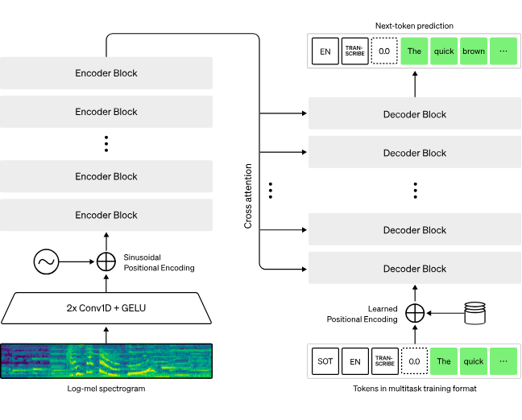
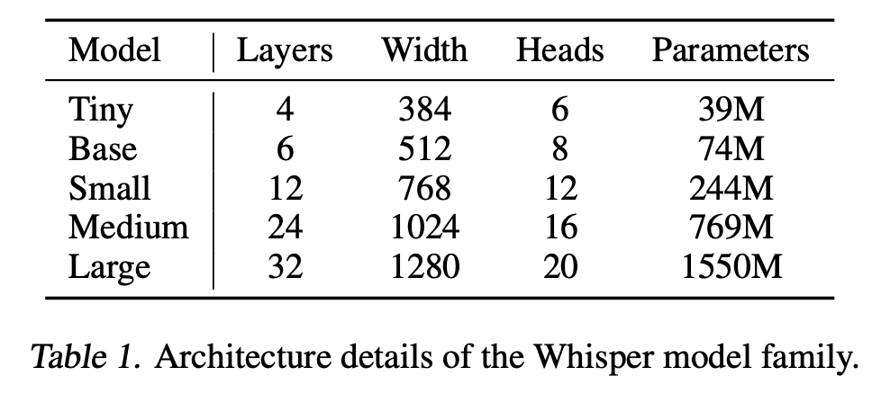
Multimodal Model Types - Audio
The Whisper model uses a transformer with some additional encoders to make use of audio signals and text generation for audio transcription.
Encoder:
12-24 transformer blocks (size dependent)
Multi-head cross-attention
Layer normalization strategy
Decoder:
Causal masking for autoregressive generation
Cross-attention to audio features
Vocabulary of 50k tokens (similar to GPT-3)
Special tokens for tasks/languages
As with all approaches to transformer-based multimodal modelling, the key challenge is encoding the inputs into a latent space before being processed.
Notes:
https://openai.com/index/whisper/
https://cdn.openai.com/papers/whisper.pdf
https://arxiv.org/abs/1706.03762

Slide 9
GPT-4V and LLaVa
Chatting with modalities

Slide 10
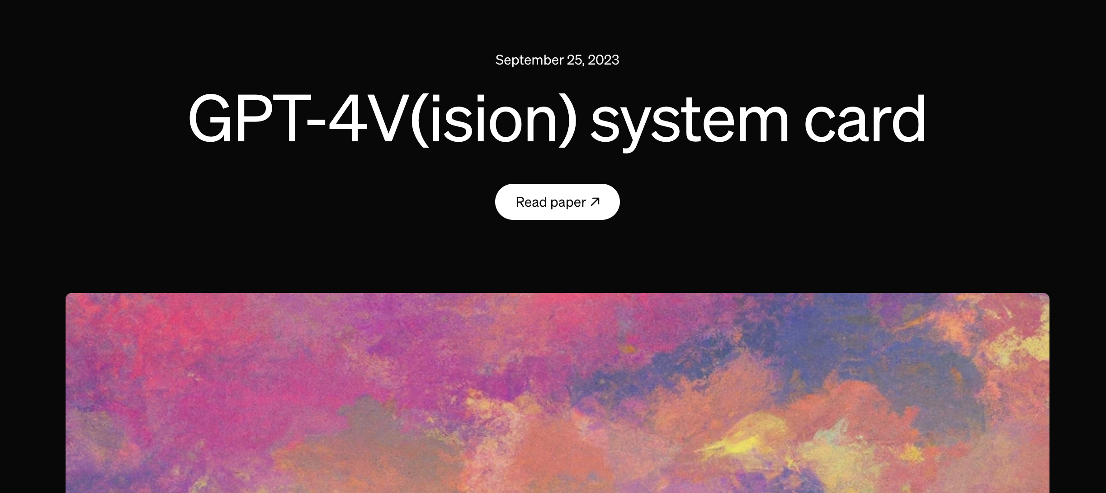
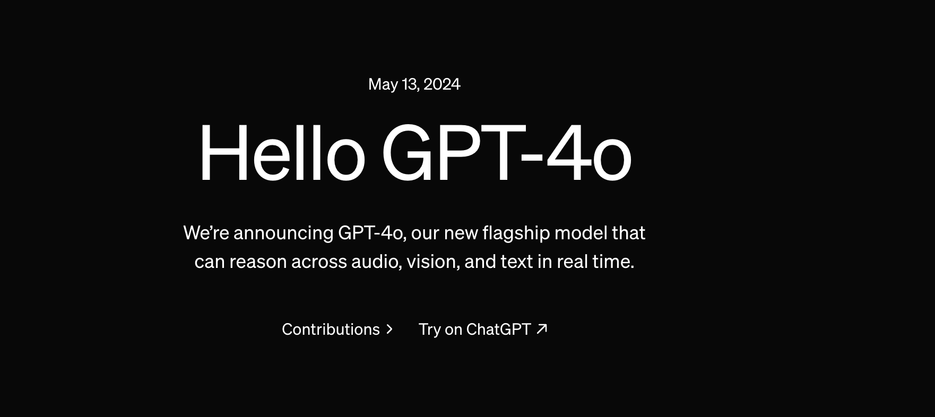
Adding Vision to ChatGPT
With the release of GPT-4o, ChatGPT was able to interpret images and other modalities in a single model.
GPT-4V – OpenAI’s Vision Transformer
Prior to this, GPT-4V was an image description model that would take as input images and generate text output based on conditioned inputs.
While the exact technical details of GPT-4V were not released, speculation as to the architecture included a variation of the CLIP-based models (CLIP also being an OpenAI model) with a vision encoder, likely a Vision Transformer, conditioned on image-text pairs.
ChatGPT with GPT-4o
GPT-4o, however, is further trained with Reinforcement learning with Human Feedback to allow the model to chat along side processing image information.
Note: while ChatGPT technically can produce images, this is done by parsing the inputs from the user and sending relevant prompts to a Dall-E model which uses diffusion modeling to produce the image.
Notes:
https://huggingface.co/blog/peft
https://pub.towardsai.net/how-do-8-smaller-models-in-gpt4-work-7335ccdfcf05

Slide 11
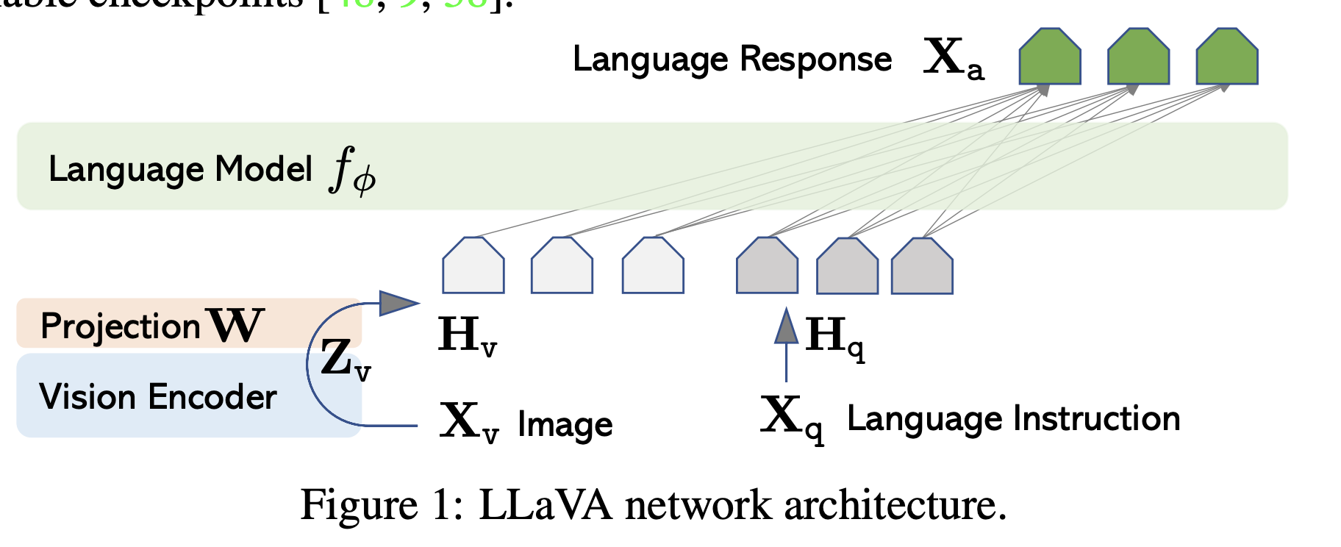
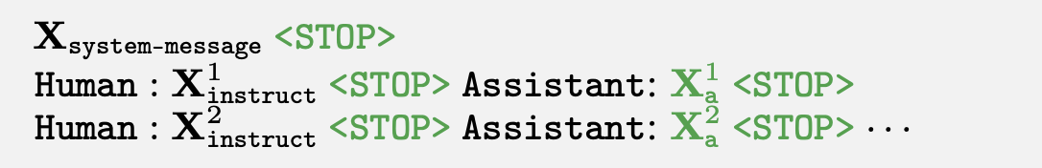
Community response to GPT-4V - LLaVA
LLaVA: Large Language and Vision Assistant
LLaVA is an open-source alternative to GPT4-V and -4o. This model utilizes both images and text as input and outputs text.
Input: Vision and Language Encoding
Images are processed using a vision encoder, typically a ViT, and are projected into the same space as the text encoder, thereby enabling a combined multimodal encoding.
Output: Text-Language
Text outputs are trained in an autoregressive manner, in conjunction with Instruction/Chat modeling to enable an assistant-type interaction.
Notes:
https://huggingface.co/blog/peft
https://pub.towardsai.net/how-do-8-smaller-models-in-gpt4-work-7335ccdfcf05

Slide 12
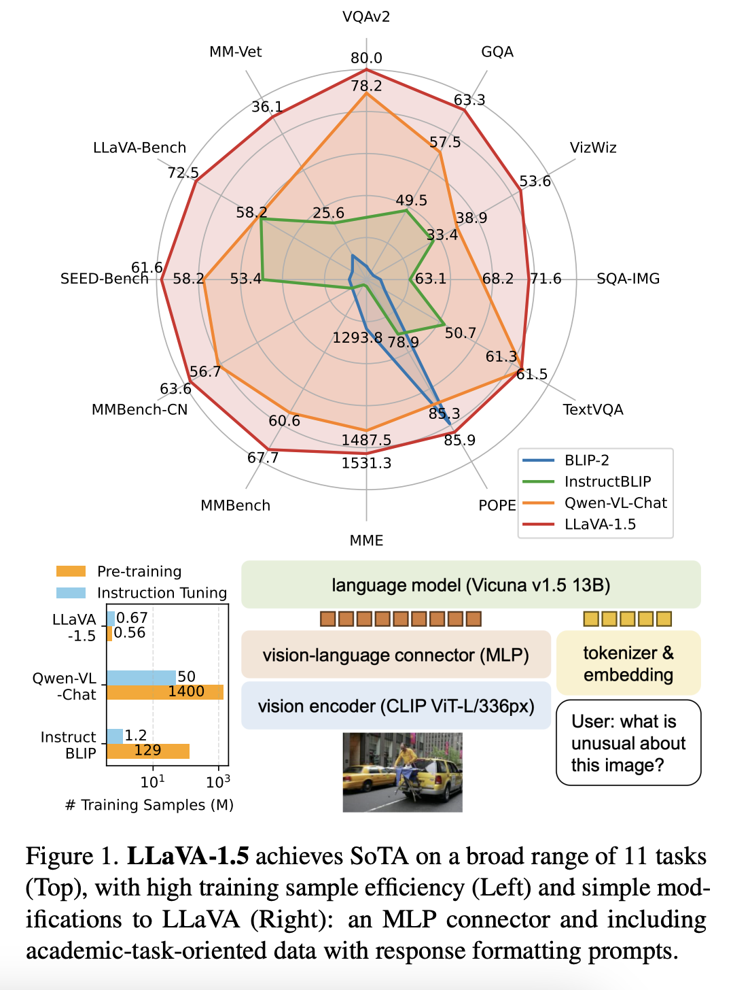
Further Improvements to LLaVA
LLaVA 1.5 – Simple Changes and Large Improvements
6 Months after the release of the LLaVA 1.0 model, the authors improved upon the design by releasing LLaVA 1.5 (May 2024). This update included:
Adding a MLP layer instead of a linear projection layer after the vision encoder to form richer interactions with the language encoder.
Using a more advanced CLIP-ViT image encoder
Training with VQA academic tasks
With these changes, LLaVA 1.5 achieved SOTA in various benchmarks and strongly surpassed the performance of LLaVA 1.0.
Notes:
https://arxiv.org/pdf/2310.03744

Slide 13
Perceiver Models
Enabling more than just text outputs with generalized attention

Slide 14
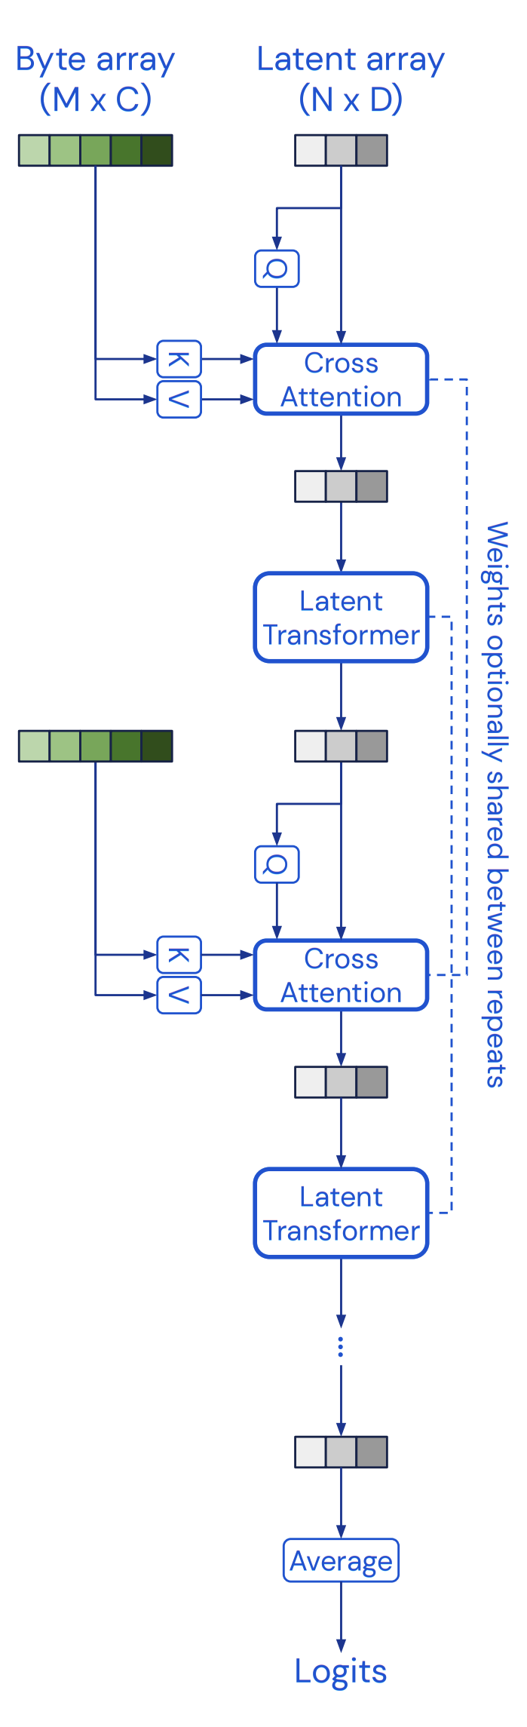
Perceiver – Utilizing agnostic attention architecture
Flexible Multimodal Architectures
The Perceiver (Jun 2021) is designed to very flexibly handle a wide range of inputs out of the box even if they come from very different modalities, including high-bandwidth ones such as images and audio
Concept of Latent Bottleneck
The core idea is to introduce a small set of latent units that forms an attention bottleneck through which the inputs must pass.
This eliminates the quadratic scaling problem of all-to-all attention of a classical Transformer and decouples the network depth from the input’s size, allowing the construction of very deep models.
By attending to the inputs iteratively, the Perceiver can channel its limited capacity to the most relevant inputs, informed by previous steps.
Notes:
https://arxiv.org/pdf/2103.03206
https://arxiv.org/pdf/2107.14795

Slide 15
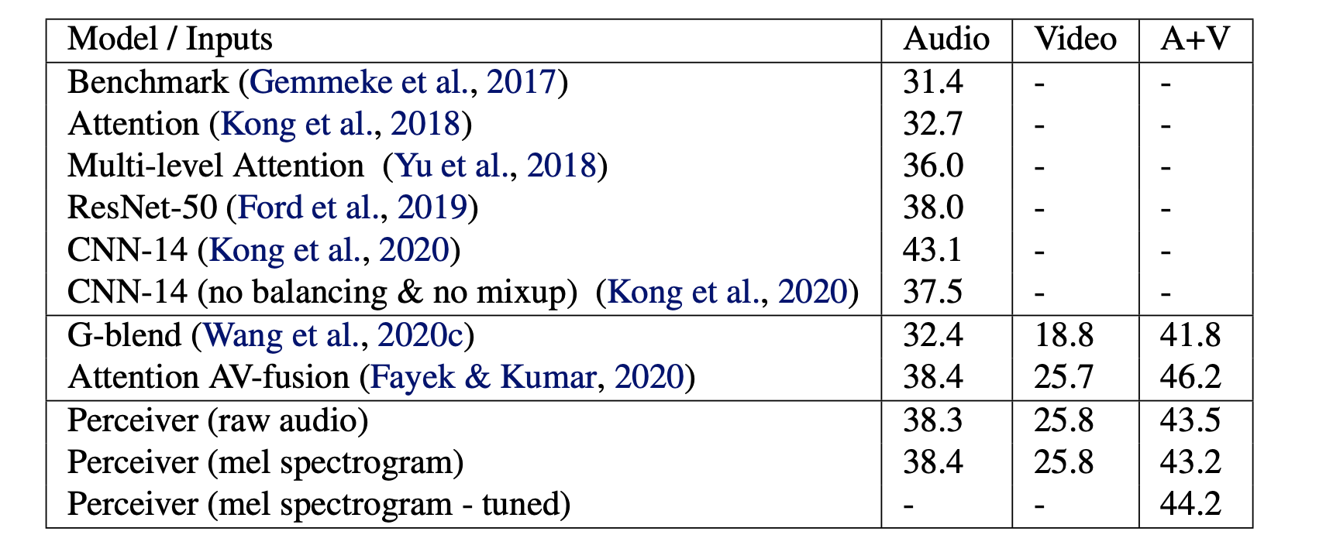
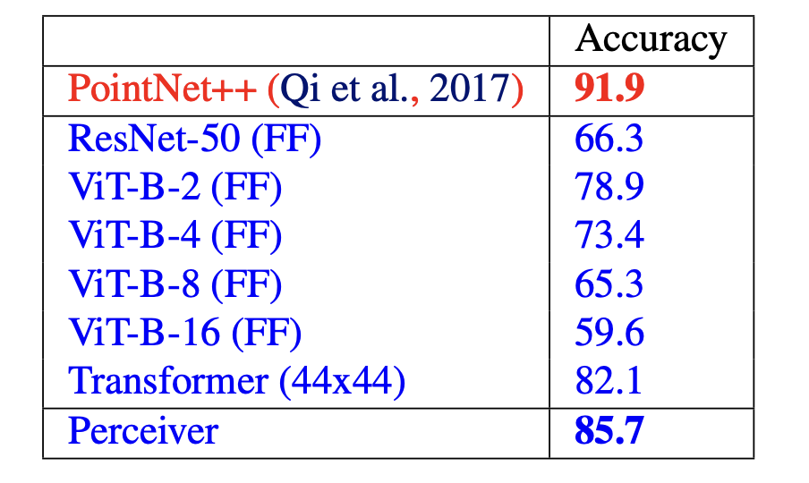
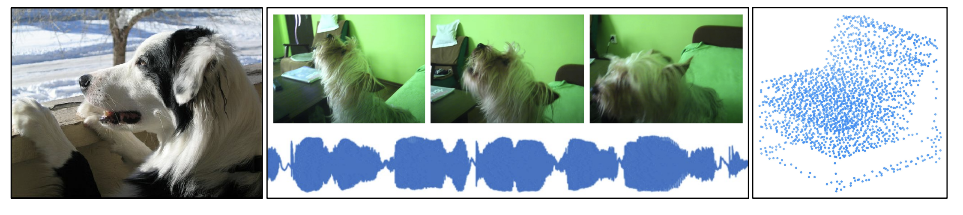
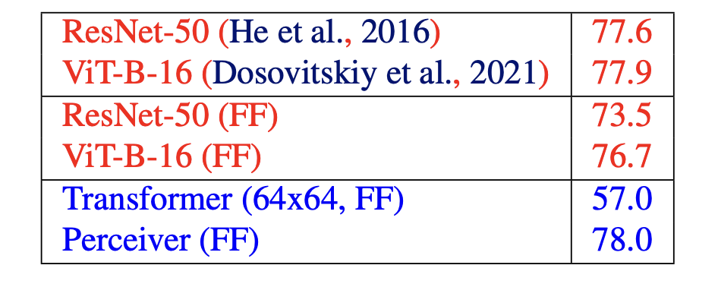
Perceiver – Utilizing agnostic attention architecture
The Perceiver architecture can be trained on several different modalities.
In their work, the authors show that across images, audio-video, and point-cloud data, the Perceiver performs at or above state-of-the-art purpose built models.
However, while this model can take arbitrary inputs, the outputs are still designed for text-only output.
Notes:
https://arxiv.org/pdf/2103.03206
https://arxiv.org/pdf/2107.14795

Slide 16
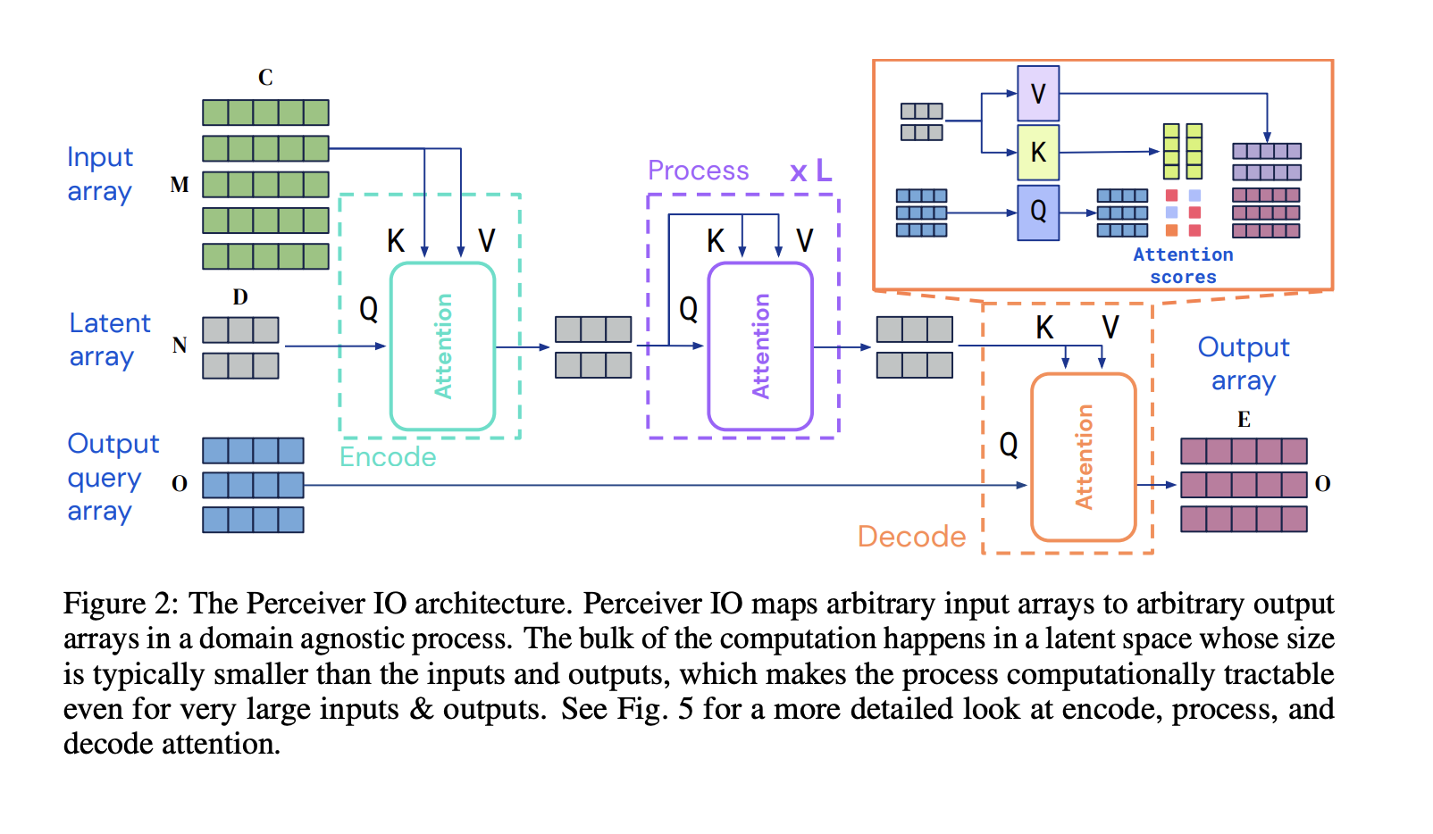
Perceiver IO – Enabling multimodal output
To achieve multimodal output as well as input, the authors released an update to Perceiver in Mar 2022, Perceiver IO.
Output Arbitrary Query Array
Perceiver IO maps an arbitrary input array to an arbitrary output array in a domain agnostic process.
The bulk of the computation takes place in a reduced latent space where data is compressed, which enables more efficient processing of even high resolution input data.
Notes:
https://arxiv.org/pdf/2107.14795

Slide 17
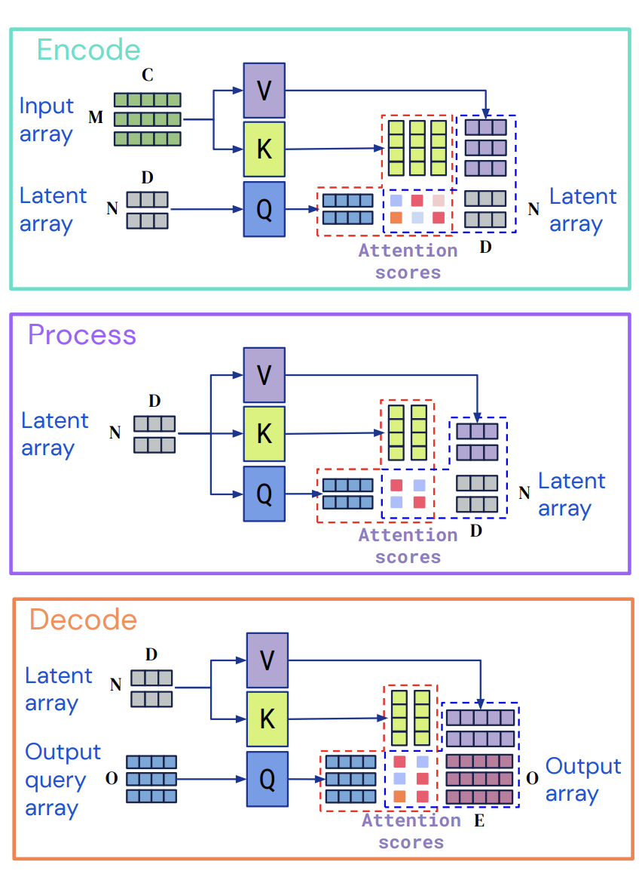
Perceiver IO – Enabling multimodal output
The Perceiver IO architecture can be split into three main components. These are all roughly similar in design, but make use of different vectors to attend to.
Encode
Here inputs are mapped to a latent space, typically with a smaller dimension relative to the input.
Process
Self-attention blocks in the style of regular transformers are used to produce highly enriched vectors.
Decode
The latent space is mapped to the output space, which also has a larger dimensionality than the latent space
Notes:
https://arxiv.org/pdf/2107.14795

Slide 18
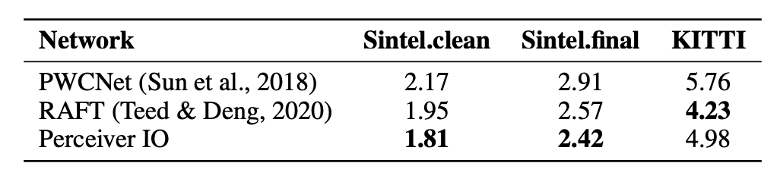
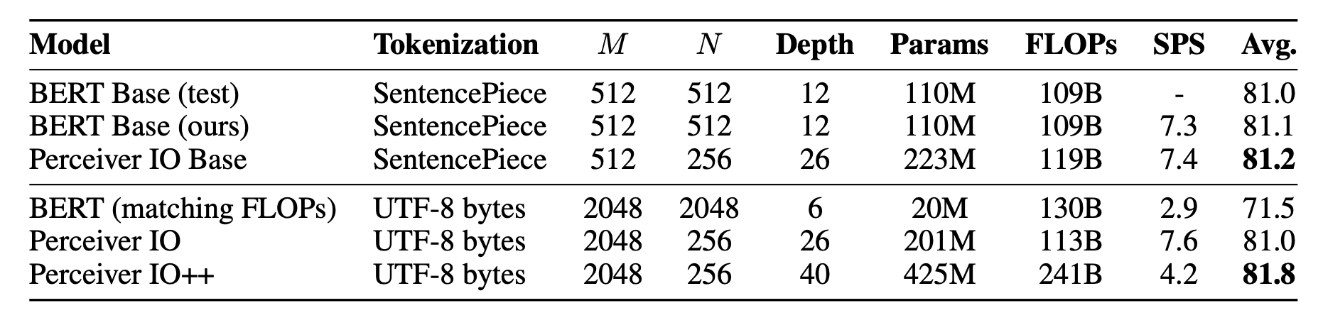
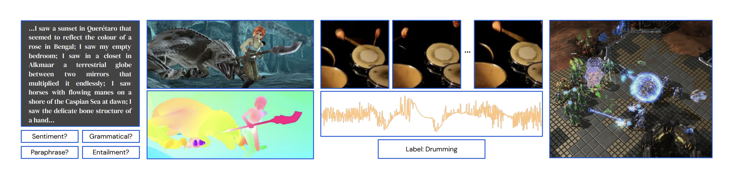
Perceiver IO – Enabling multimodal output
With the development of the output query vector, Perceiver IO can then be used to process and produce multimodal output. In the paper, the authors show SOTA or near SOTA in tasks like:
Optical Flow
Playing Starcraft
Language Tasks
Audio transcription
Image captioning/labeling
Notes:
https://arxiv.org/pdf/2107.14795

Slide 19
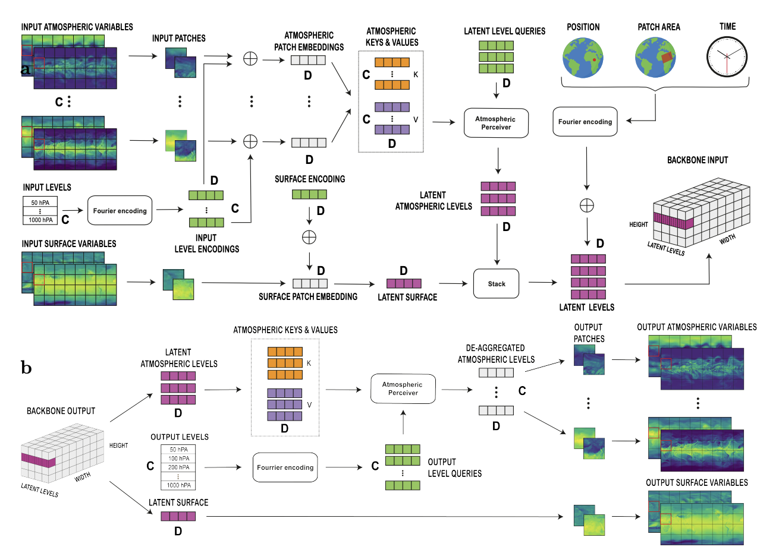
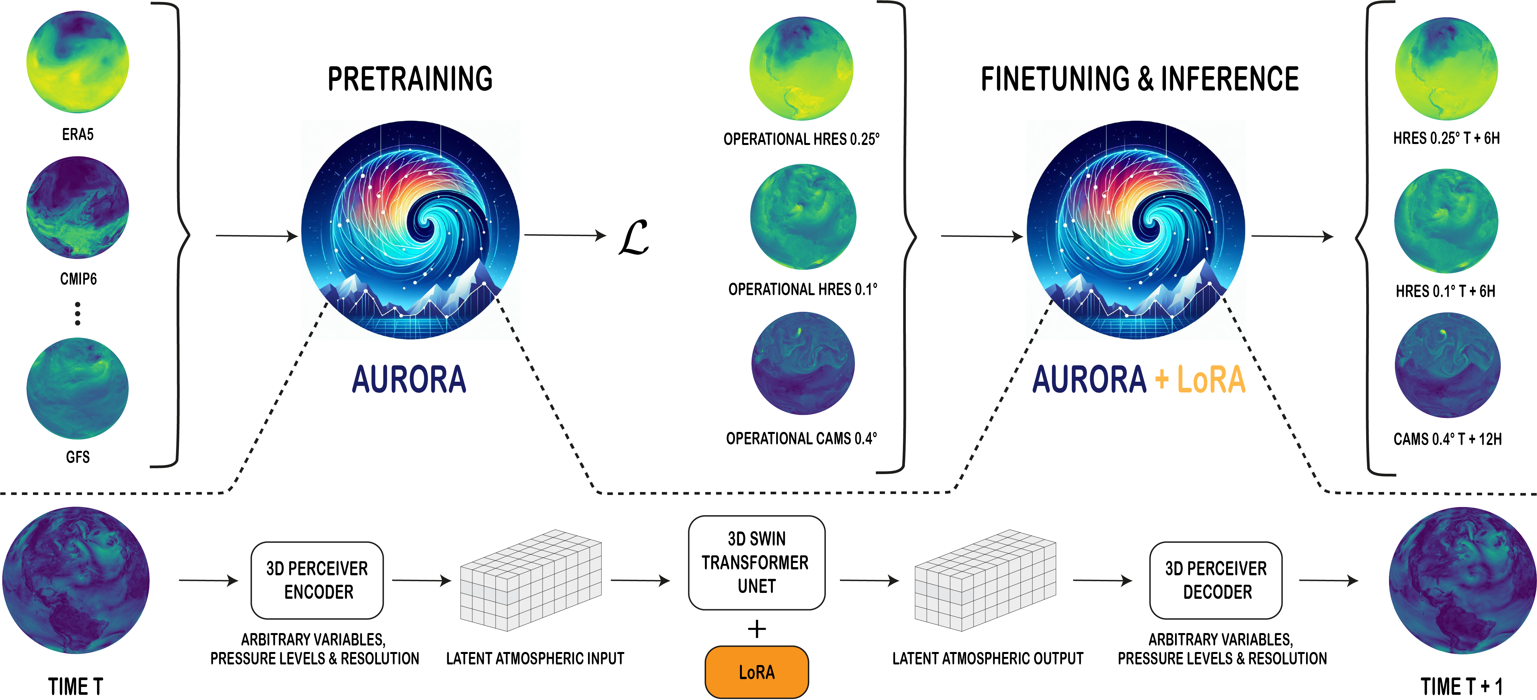
Application of Perceiver IO - Aurora
Aurora is a climate forecasting model that utilizes Perceiver IO as a backbone, in conjunction with a UNet for time stepping, and enables production of multiple geospatial fields over time. This model is a massive foundation model that can be fine tuned to predict different climate variables across the globe.
Code here: https://github.com/microsoft/aurora
Notes:
https://arxiv.org/pdf/2405.13063
https://github.com/microsoft/aurora

Slide 20
Wrap Up
Perceiver IO and more generalized Multimodal Models
Today we wrapped up or multimodal module
We saw the development of vison and language assistants with LLaVA 1.0/1.5 which makes use of vision and language encoders
The Perceiver architecture which abstracts out the input modality to generalized attention processes, was introduced
Perceiver IO, a further development of the Perceiver model to allow for multimodal outputs with the introduction of an output query vector.
We explored an application of the Perceiver IO model to model climate simulations with the Aurora model.
-----------------------------------------------------------------------------

Slide 21
Thank you!

