Slide 1

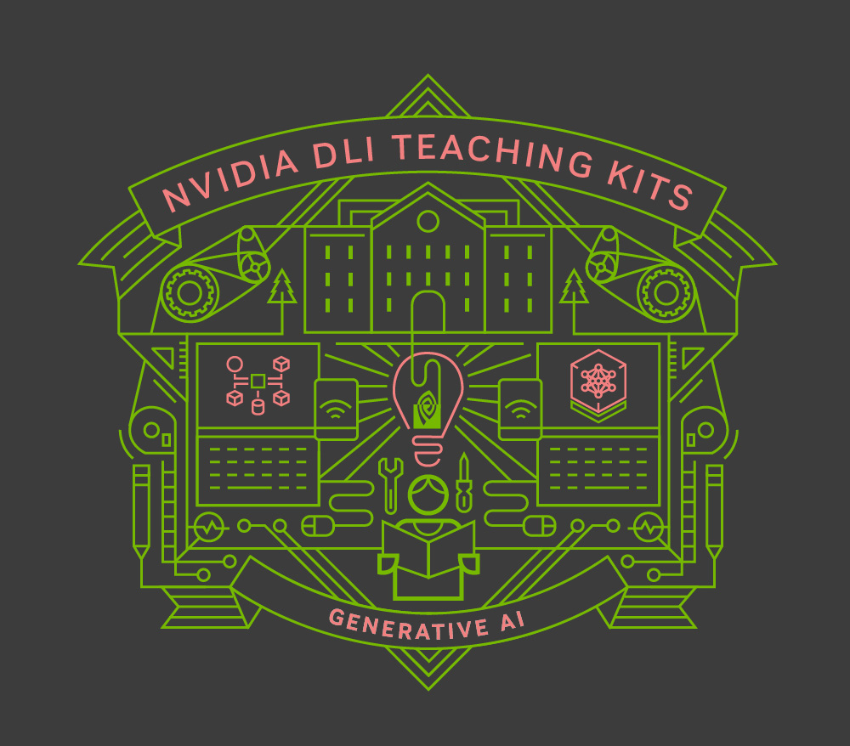
Lecture 7.1 - Pre-training, continued pre-training, and task training
Generative AI Teaching Kit

Slide 2

The NVIDIA Deep Learning Institute Generative AI Teaching Kit is licensed by NVIDIA and Dartmouth College under the
Creative Commons Attribution-NonCommercial 4.0 International License.

Slide 3
This lecture
Autoregressive Training
Pre-training LLMs
Instruction Fine-tuning LLMs
Continued Pre-training LLMs

Slide 4
Autoregressive Training
Making use of unlabeled data and learning to speak

Slide 5
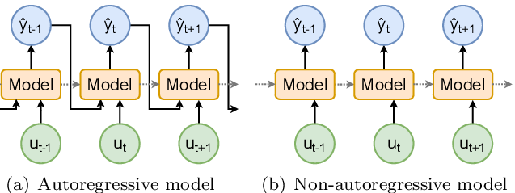
What are Autoregressive models?
In an autoregressive model, each value in a sequence is predicted based on the prior values.
Each value is predicted conditionally based on the previous values.
Autoregressive models are particularly powerful for sequential data and are fundamental to large language models (LLMs) like GPT (Generative Pre-trained Transformer), which predict tokens in a sequence of text.
The Autoregressive nature of LLMs explains a number of key advantages and challenges
Notes:
https://www.getpeech.com/blog/non-autoregressive-models-hideout

Slide 6
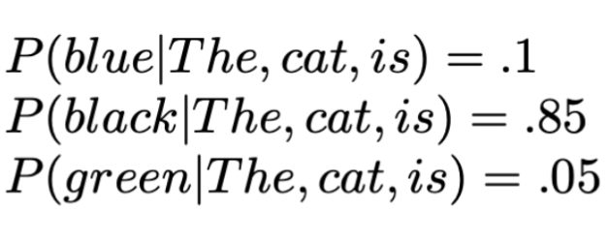
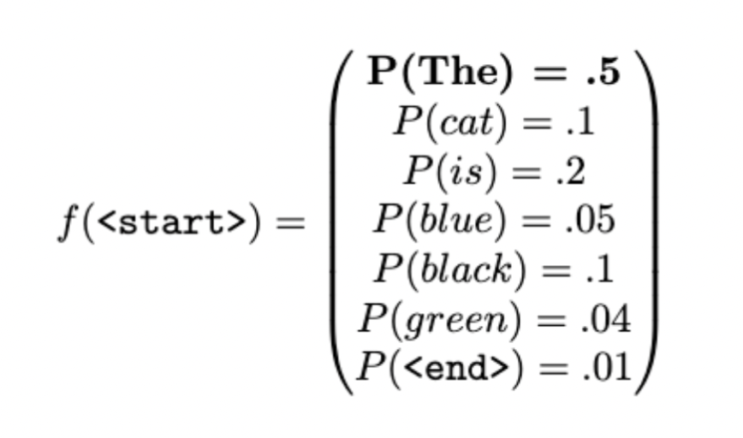
Predicting the next token
LLMs, such as GPT generate text token by token, where each token prediction depends on all previously generated tokens.
For example, given the sequence:
“The cat is …”
The model computes a probability distribution over the possible next tokens (e.g., "sleeping," "jumping," etc.). Each token prediction is made by conditioning on the previous tokens in the sequence.
This prediction is probabilistic. The model does not simply predict the next token deterministically. Instead, it computes a probability distribution over all possible next tokens The next token is then sampled from this probability distribution, making the process both sequential and probabilistic.
Notes:
https://www.lakera.ai/blog/large-language-models-guide

Slide 7
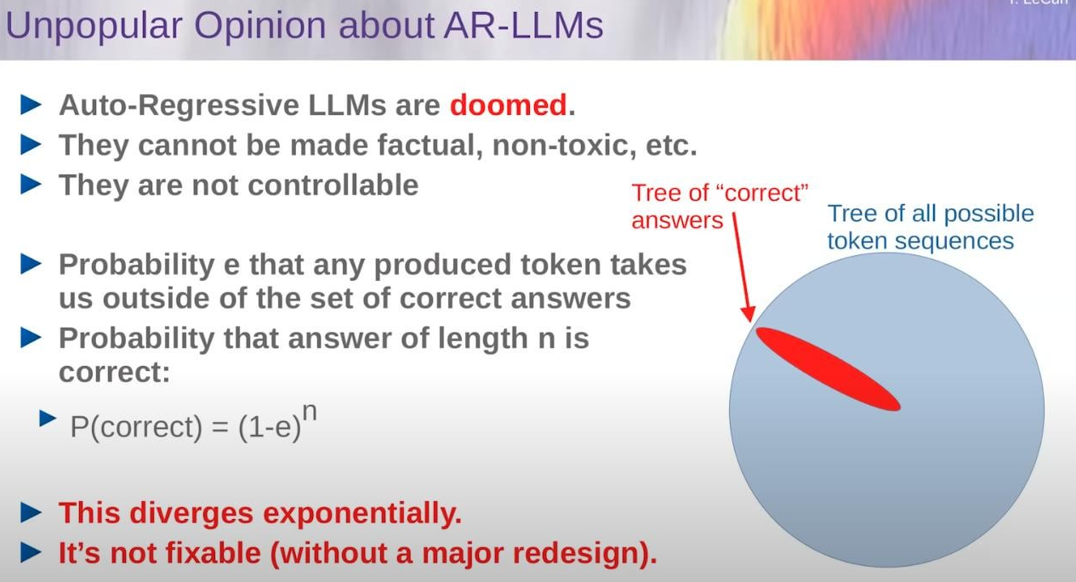
Autoregression and Hallucination
Hallucination:
“LLMs generating text that sounds plausible but is factually incorrect or nonsensical.”
Relation to Autoregression:
Token-by-token generation: Each token depends on previous ones. A small error can propagate, leading to hallucinations.
Probabilistic predictions: Models sample from a probability distribution, which can lead to selecting less likely tokens, increasing hallucination risk.
Notes:
https://www.reddit.com/media?url=https%3A%2F%2Fpreview.redd.it%2Fwhat-do-you-think-about-yann-lecuns-controversial-opinions-v0-xxmxgrdk02cc1.jpg%3Fwidth%3D1581%26format%3Dpjpg%26auto%3Dwebp%26s%3Dc12b6130f67a16ebfa19164bd289a963d6a7da0c

Slide 8
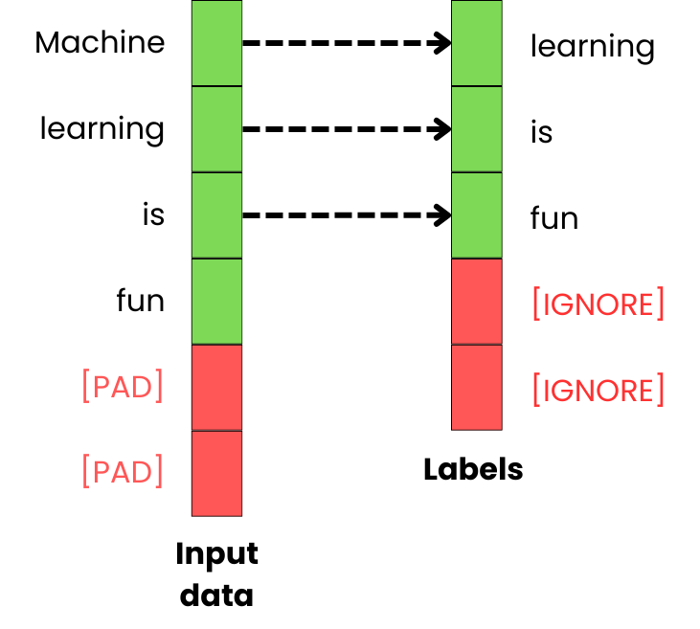
Training Autoregressive Models for Language Modeling
Data Preparation for Autoregressive Training:
The data preparation step is crucial because the model needs to learn to predict the next token based on previous tokens in a sequence. Here’s how it works:
Sequence Construction:
The tokenized text is split into sequences of fixed lengths, often referred to as the context window. For instance, if the context window is 512 tokens, the text is chunked into sequences of 512 tokens.
Creating Input-Output Pairs:
The key to autoregressive training is predicting the next token. For each sequence, we create input-output pairs where:
Input: The first N tokens.
Output: The N+1st token. This is a shifted copy of the sequence:
Input: [125, 894, 45, 204, 10] → Output: [894, 45, 204, 10, 356] The input is what the model sees, and the output is what the model is trained to predict.
Batching:
These input-output pairs are then grouped into batches for efficient training. The model processes multiple sequences in parallel, where each batch contains a set of input-output pairs.
Notes:
https://newsletter.theaiedge.io/p/fine-tuning-llms-from-a-to-z

Slide 9
Pre-training
Creating our Language Model from scratch

Slide 10
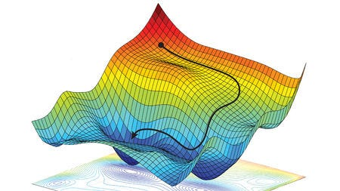
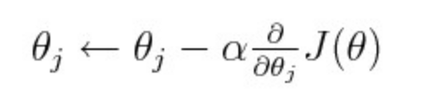
Training a deep learning model
Creating a well performing deep learning model is all about the loss.
This “loss” is the difference between the predicted value output of the model, and some true/known value that comprises the target of our training data.
The model is trained by varying all the weights such that this loss is minimized as we traverse the loss landscape.
Various gradient decent methods, most of them based on Stochastic Gradient Descent are available, but they largely depend on 1) the current weight value, and 2) the gradient of the weights with respect to the loss.
We continue to vary the weights in training until this loss reaches a state where we decide to stop further training.
Loss landscape
A simple gradient descent update
Notes:
https://towardsdatascience.com/its-only-natural-an-excessively-deep-dive-into-natural-gradient-optimization-75d464b89dbb

Slide 11
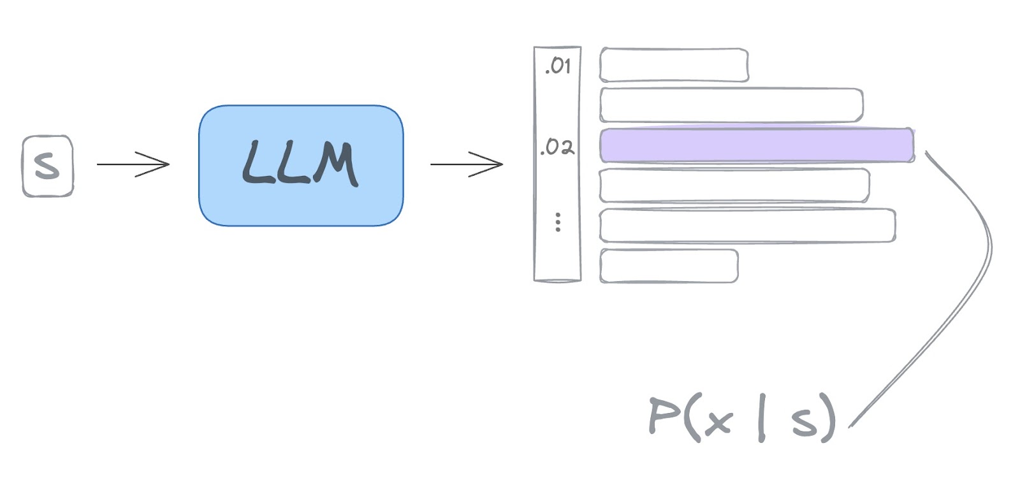
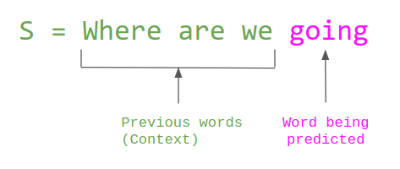
Language Model Training
Language Models are those which attempt to predict the missing token of a given input.
For Decoder-type models, this is the next token.
For Encoder-type models, this can be some intermediate token that has been masked.
Either way, Language Models use the vocabulary they have, to select the right token.
Notes:
https://www.assemblyai.com/blog/decoding-strategies-how-llms-choose-the-next-word/

Slide 12
Preparing an LLM for Pre-training
To get a model ready for pre-training, we need to set up the following:
The training data must be collected and curated
The data must be in the right format and ready to be loaded in batches
The model architecture must be constructed and loaded into memory
All algorithm configurations set to appropriate values
The compute infrastructure established
Training strategy configured to ensure the hardware and data are being most effectively utilized
Let’s look at these one-by-one

Slide 13
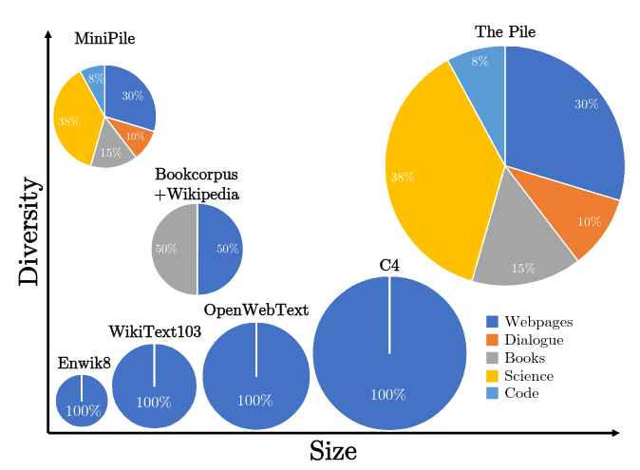
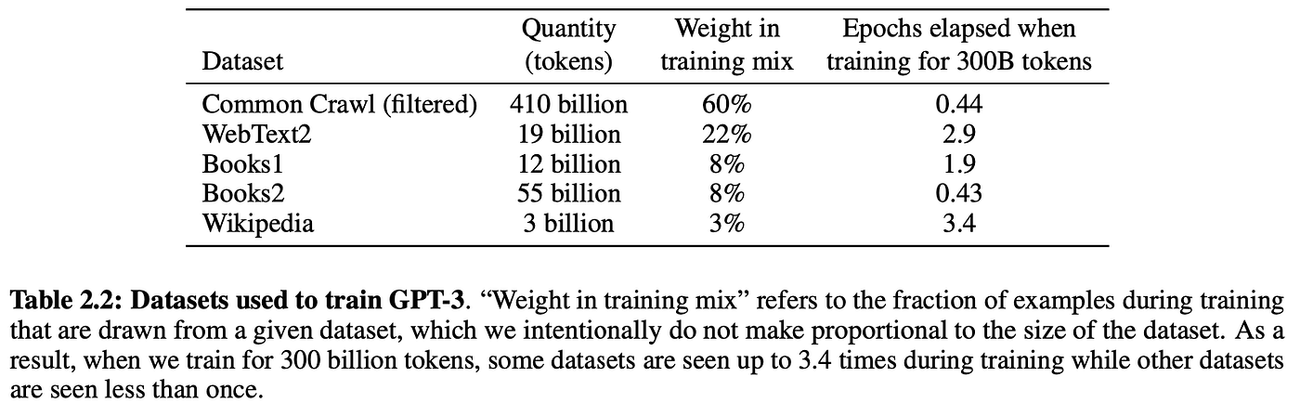
1 - The training data must be collected and curated
By crawling the open web, we can create massive datasets of all of the digital knowledge stored online.
The issues arise when finding what site to use and what not to use.
The CommonCrawl project was started over a decade ago to find all addressable links.
Wikipedia also contains a huge repository of human language information
Getting the best data, though, is still an art rather than a science as the terabytes of raw text are impossible to manually clean and curate.
Notes:
https://snats.xyz/pages/articles/breaking_some_laws.html
https://blog.gopenai.com/how-much-data-from-the-public-internet-is-used-for-training-llms-dff5bc5ebb02
https://medium.com/@dlaytonj2/chatgpt-show-me-the-data-sources-11e9433d57e8

Slide 14
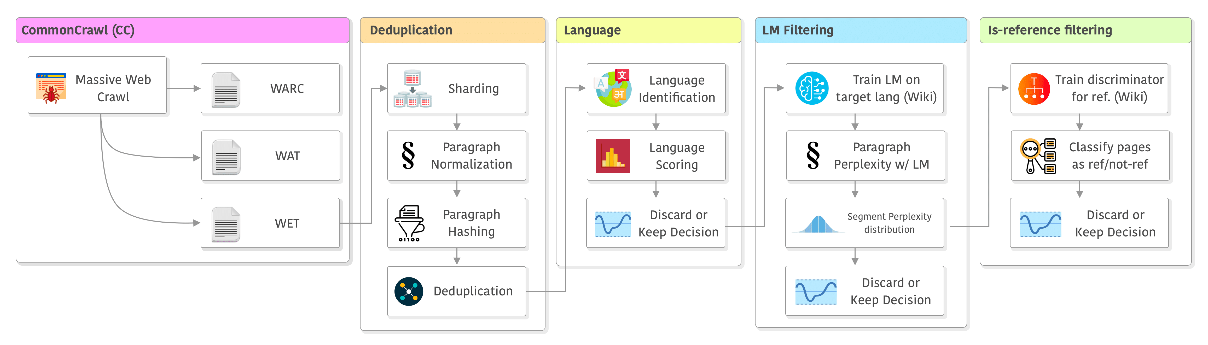
2 – Data Formatting for Training
Once collected, the data must be processed before being useful for training.
A typical workflow consists of:
Gather the raw data
Removing duplicated data (deduplication)
Filtering for language (e.g. only English)
Filtering for harmful or specific content
Remove unknown tokens
Format data into training and testing datasets
Notes:
https://blog.christianperone.com/2023/06/appreciating-llms-data-pipelines/

Slide 15
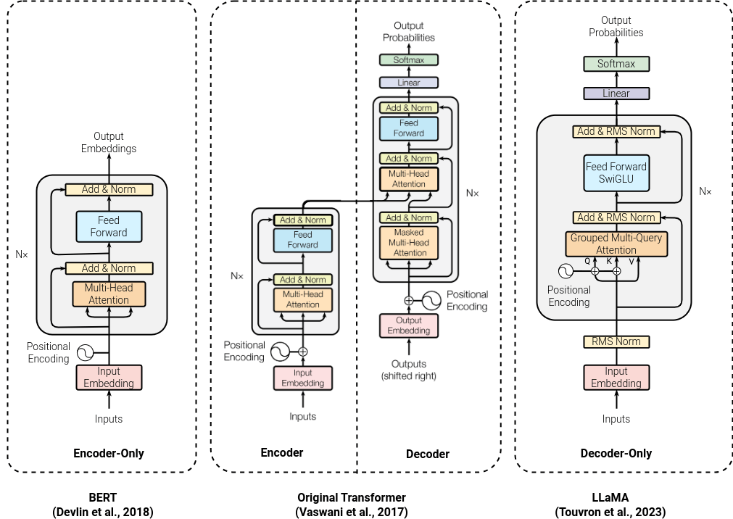
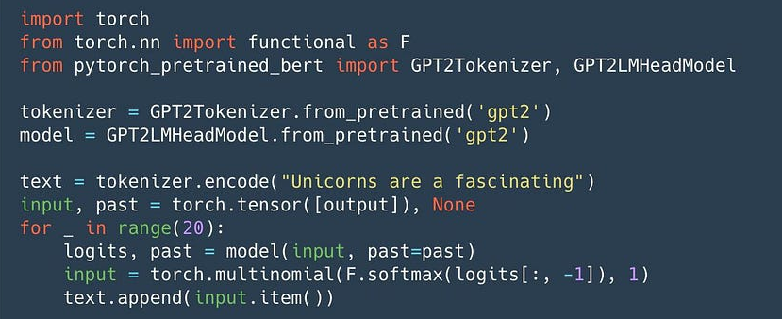
3 – Selecting Model Architecture
Depending on the desired task for which the LLM will be used, a specific architecture will need to be programmed using libraries such as PyTorch, TensorFlow, or Jax.
There are now several libraries that help with predefined architectures which can leverage the developments of the community
Notes:
https://www.luminis.eu/blog/llm-series-part-1-a-comprehensive-introduction-to-large-language-models/
https://medium.com/syncedreview/hugging-face-releases-pytorch-bert-pretrained-models-and-more-b8a7839e7730
https://medium.com/@abhinavkimothi/3-llm-architectures-f527ed781ba9

Slide 16
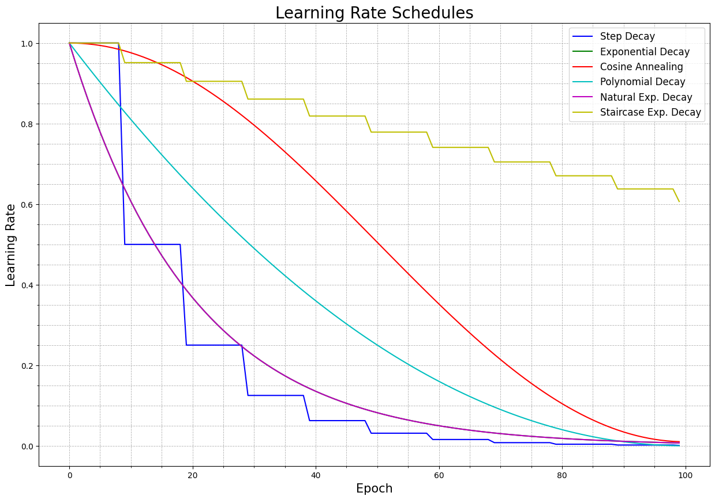
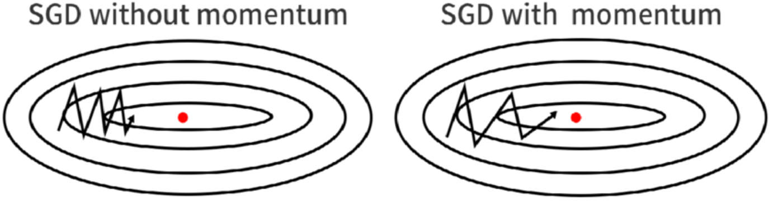
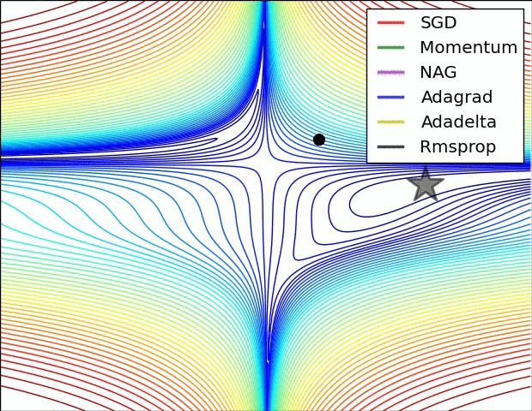
4 – Training Algorithms
Once we have the data and the model architecture, we are ready to setup the training loop.
In this loop we will have some practical choices to make:
Data Loader
Batch Size
Shuffle
Micro batch size
Loss Function
Cross Entropy / Negative Log Likelihood
MSE/MAE
Optimizer
Stochastic Gradient Descent
ADAM
RMSProp
Learning Rate Schedule
Constant
Cosine
Training Length
- Epochs, Batches, Tokens
Notes:
https://musstafa0804.medium.com/optimizers-in-deep-learning-7bf81fed78a0
https://medium.com/@theom/a-very-short-visual-introduction-to-learning-rate-schedulers-with-code-189eddffdb00

Slide 17
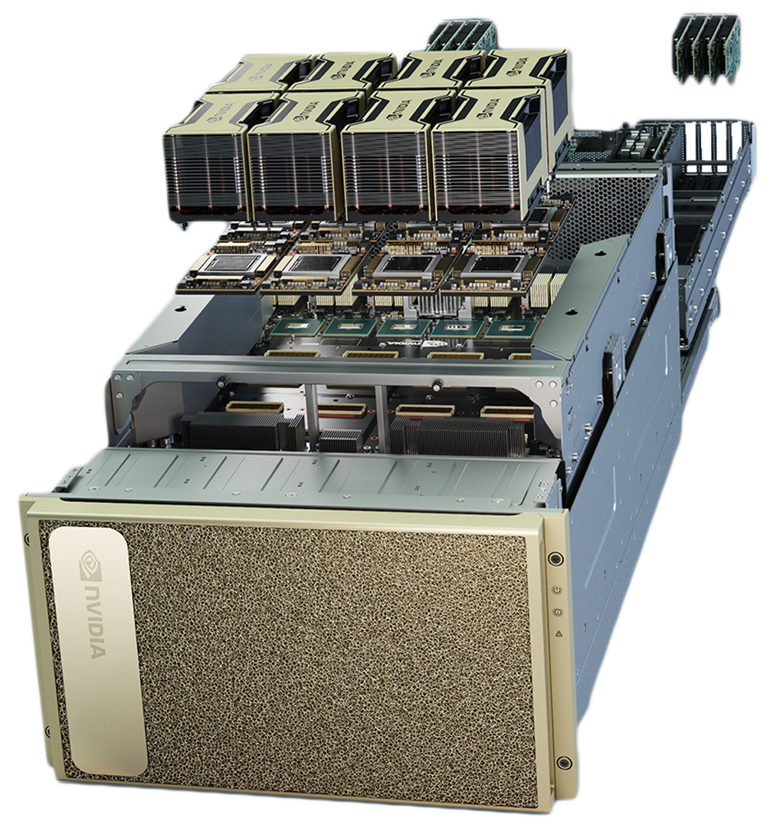
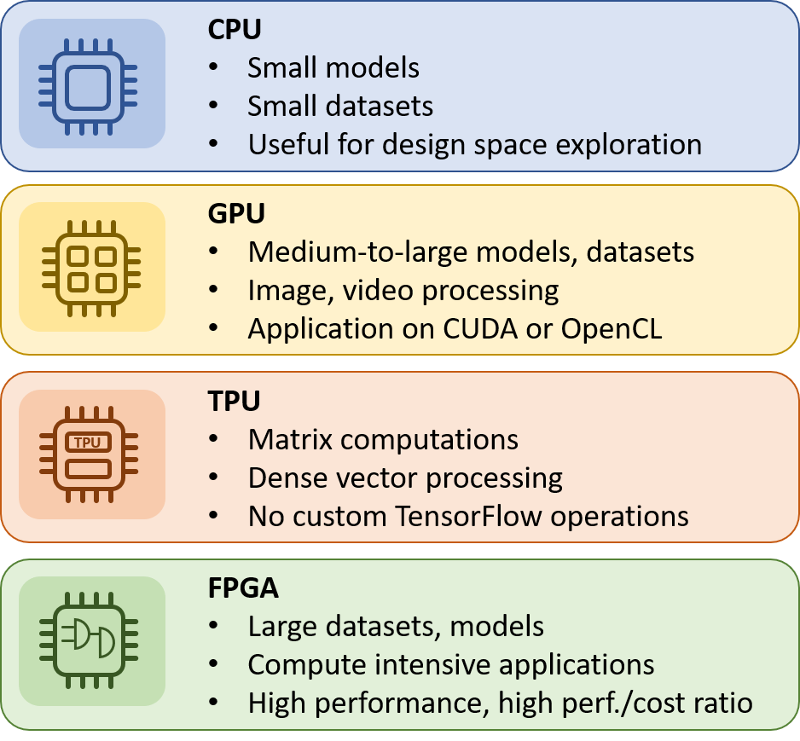
5 – Compute Infrastructure for Training
Single Node: Training happens on a single machine, using one or multiple CPUs/GPUs. This setup is simpler and typically used for smaller datasets and models.
Multi Node: Involves distributing training across multiple machines (nodes). This is useful for training large models or datasets that can’t fit into a single machine’s memory. It requires communication between nodes, often managed by distributed computing frameworks like Horovod or PyTorch Distributed.
CPU, GPU, TPU Providers and Configurations:
CPU: Central Processing Units (CPUs) are versatile but slower for deep learning tasks. Suitable for small models or when GPU/TPU resources are limited.
GPU: Graphics Processing Units (GPUs) are highly efficient for parallel processing tasks like matrix operations, making them the go-to for deep learning. Configurations can vary from single to multiple GPUs.
TPU: Tensor Processing Units (TPUs) are specialized hardware designed by Google for accelerating deep learning, especially for TensorFlow. TPUs are extremely fast but require specific configuration.
Cloud vs. Local:
Cloud: Cloud providers (e.g., AWS, Google Cloud, Azure) offer scalable resources for training, allowing easy access to multiple GPUs/TPUs. This is ideal for large-scale training but comes with cost considerations.
Local: Training on your own hardware (CPUs/GPUs) may be cost-effective but is limited by available resources. Local setups are good for experimentation and small-scale models but may struggle with large datasets or models.
Notes:
https://medium.com/polo-club-of-data-science/how-to-measure-inter-gpu-connection-speed-single-node-3d122acb93f8
https://inaccel.com/cpu-gpu-fpga-or-tpu-which-one-to-choose-for-my-machine-learning-training/

Slide 18
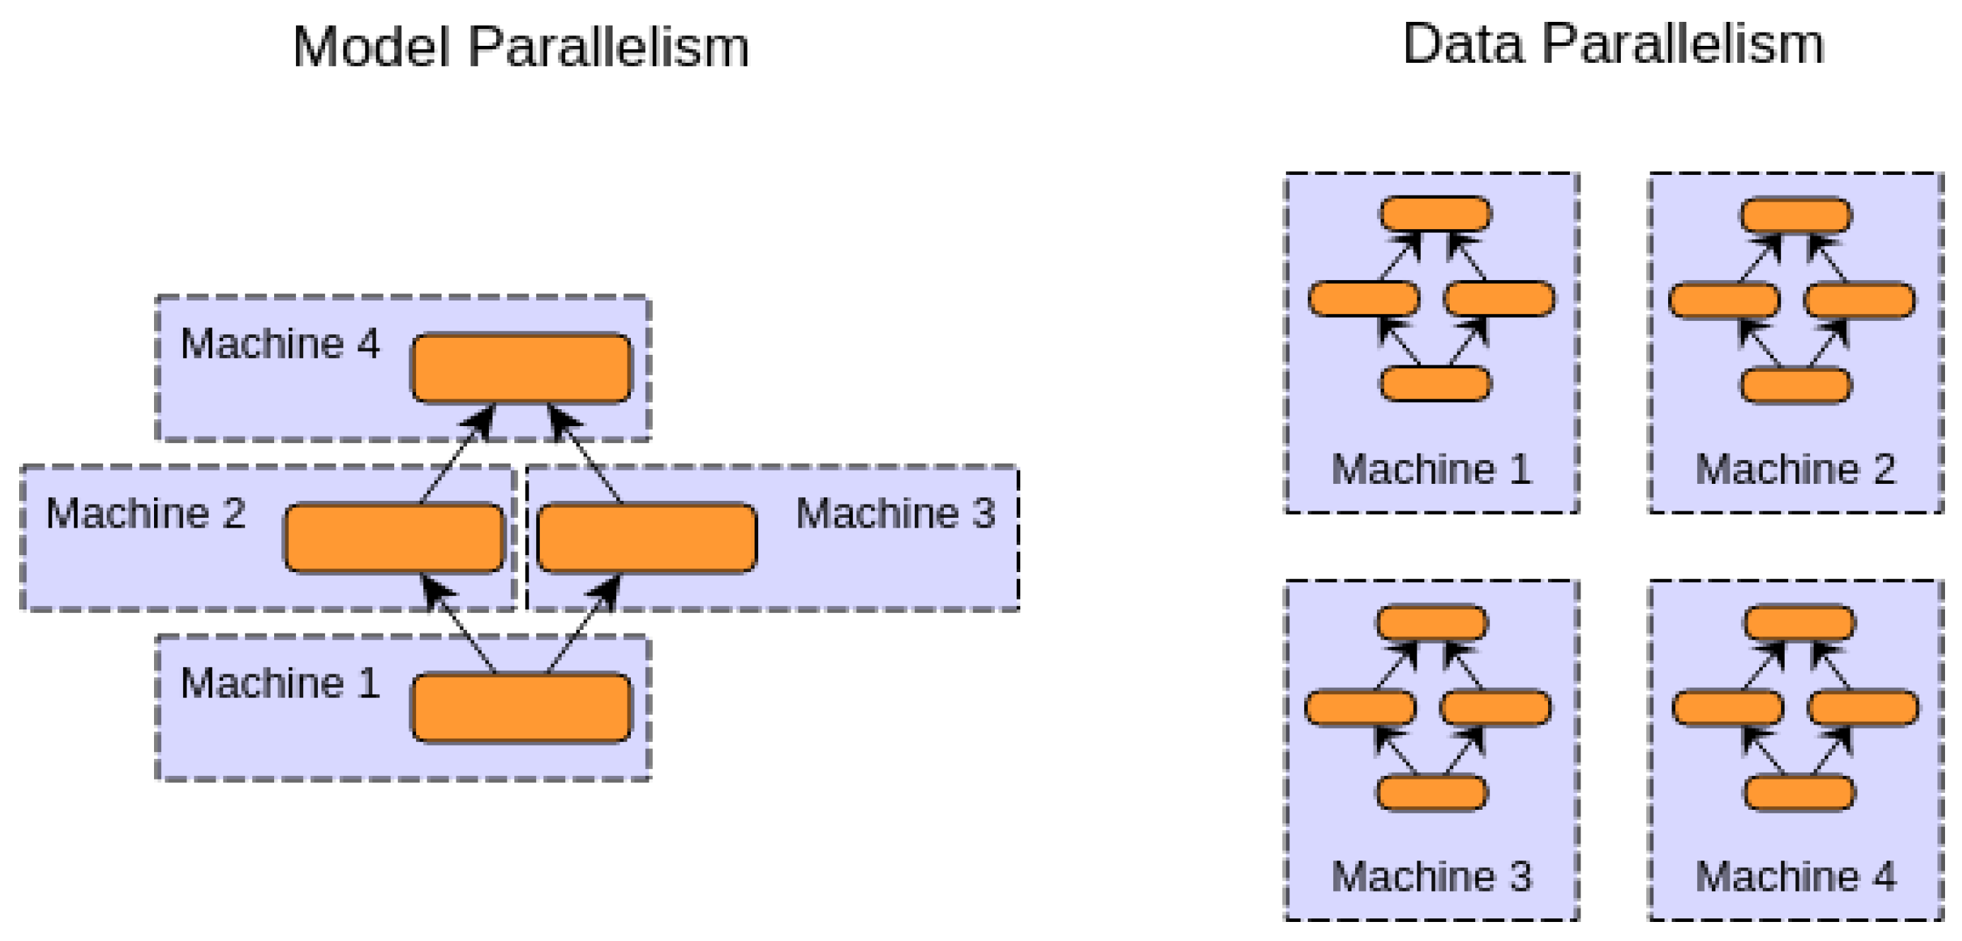
6 - Training Strategy
Data Parallelism:
DDP (Distributed Data Parallel): A standard method for splitting data across multiple GPUs/nodes, where each device processes a portion of the dataset, and gradients are averaged across all devices during backpropagation.
DeepSpeed: A framework designed for large-scale model training that optimizes memory and computation efficiency. It includes optimizations like zero redundancy, gradient accumulation, and mixed precision training.
FSDP (Fully Sharded Data Parallel): Shards (splits) both model weights and optimizer states across GPUs to minimize memory usage, enabling training of extremely large models on fewer GPUs.
Model Parallelism:
Pipeline Parallelism: Instead of replicating the entire model on each GPU, the model is split into layers and distributed across different devices. Each device processes a part of the forward and backward pass, working like an assembly line.
Tensor Parallelism: Model tensors (such as weight matrices) are split across multiple GPUs, allowing each GPU to handle a subset of the computations. This technique is commonly used for large-scale matrix operations in models like transformers
Notes:
https://www.mdpi.com/sensors/sensors-23-03500/article_deploy/html/images/sensors-23-03500-g017.png

Slide 19
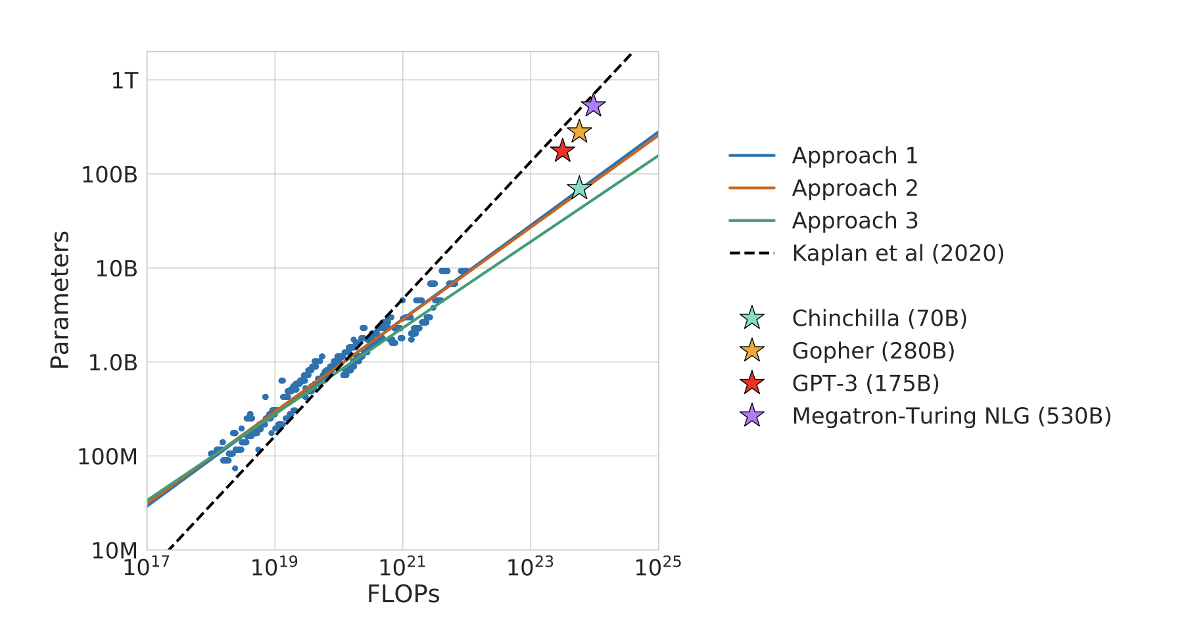
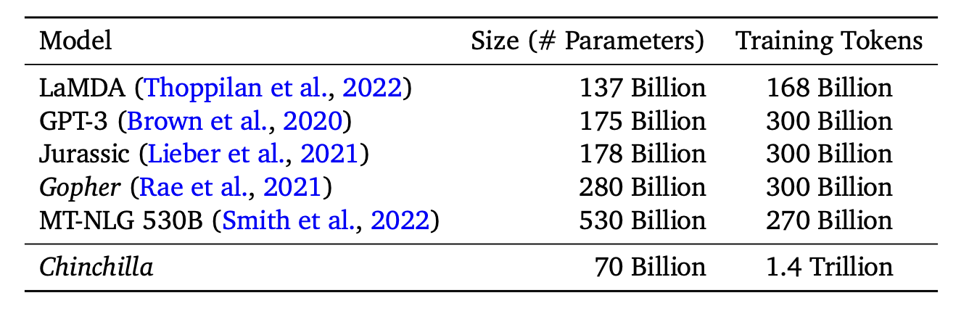
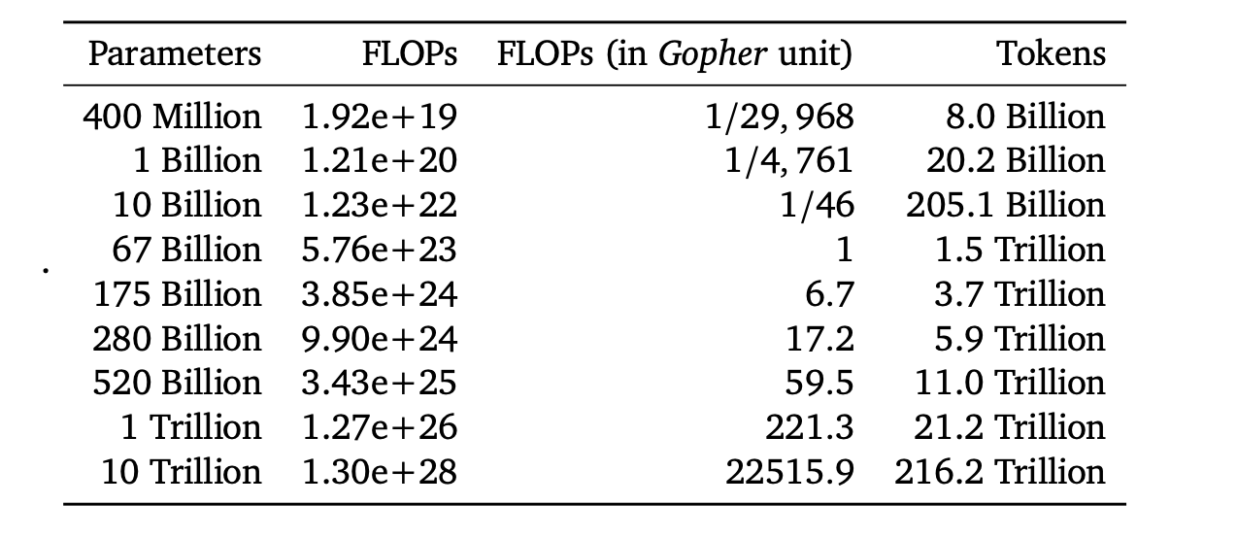
How much to train?
Chinchilla is a state-of-the-art language model proposed by DeepMind, known for optimizing model size and training duration based on the scaling laws of deep learning. Here’s a breakdown of the key concepts and graphs: Chinchilla Scaling Laws
Key Insight: For optimal performance, the number of parameters in the model should scale proportionally with the amount of data used for training. Previous large models (like GPT-3) were over-parameterized relative to the data available.
Chinchilla’s Adjustment: Reduces the number of parameters but trains on significantly more data to strike a better balance between model size and data size.
Notes:
https://arxiv.org/pdf/2203.15556v1

Slide 20
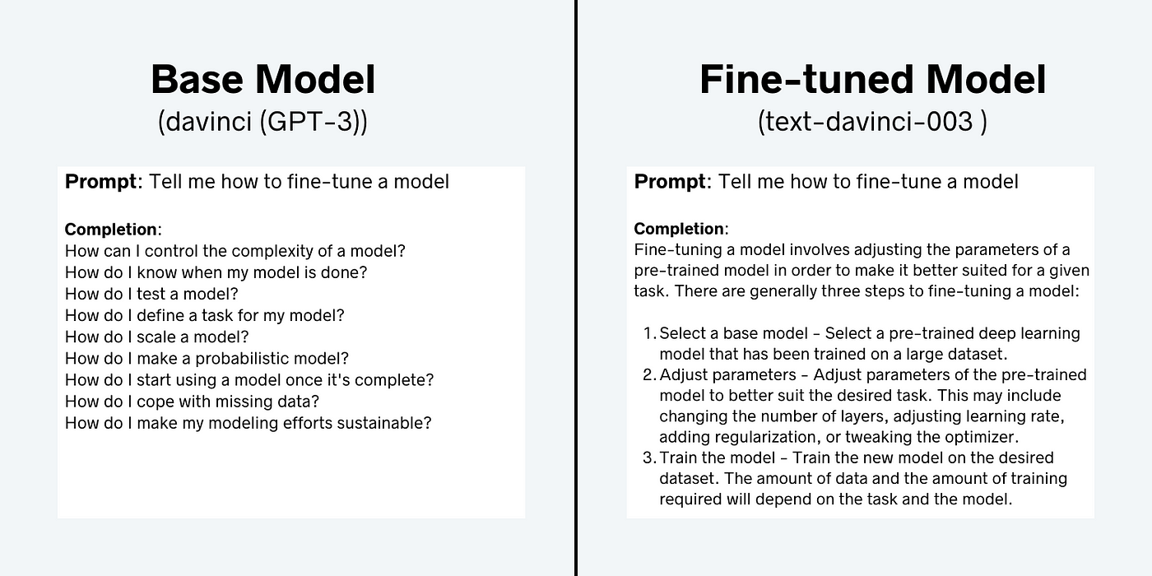
Are we done? Limitations of base models.
Shallow Understanding:
Base models, like GPT, predict the next word based on patterns, not true comprehension. They generate plausible text without deep understanding.
No Task-Specific Knowledge:
They struggle with complex tasks like reasoning, question-answering, or structured outputs because they aren’t fine-tuned for specific tasks.
No Long-Term Planning:
Next-token models can’t plan or keep track of long sequences. They may lose coherence in long tasks (like storytelling) because they don’t retain a memory of earlier steps.
Limited in Complex Dependencies:
They handle local coherence but struggle with tasks requiring structure or logic over longer spans (e.g., math, formal reasoning).
Notes:
https://towardsdatascience.com/fine-tuning-large-language-models-llms-23473d763b91

Slide 21
Instruction Fine-tuning
Beyond the next token

Slide 22
How useful are pre-trained models?
While base models can be used with techniques such as few shot learning and other in-context learning methods, these quickly become limitations
In every case where a task would be needed, a collection of few shot examples would also be needed.
Notes:
https://towardsdatascience.com/fine-tuning-large-language-models-llms-23473d763b91

Slide 23
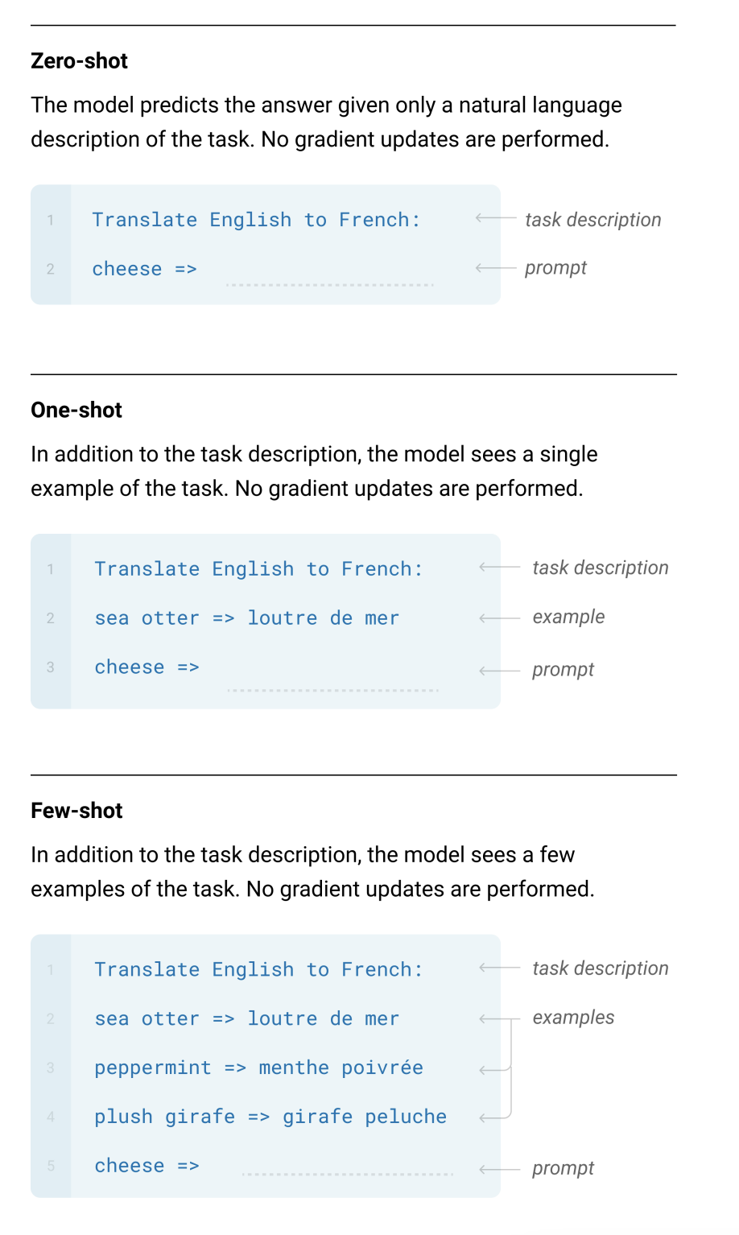
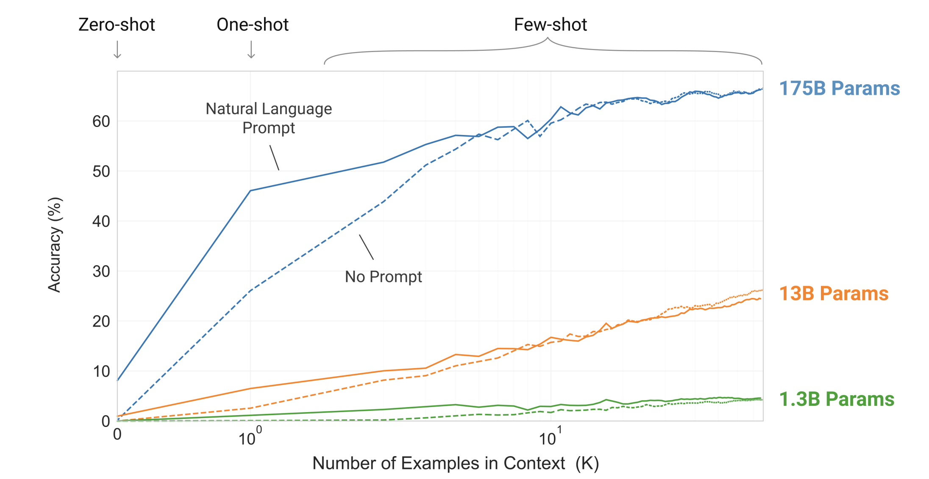
Few shot learning
GPT 3 showed the world that LLMs could perform tasks beyond what it was trained on.
This ability to learn from the input context, know as in-context learning, can be used to leverage the inherent abilities and knowledge the model gained through pre-training.
Notes:
https://arxiv.org/pdf/2005.14165

Slide 24
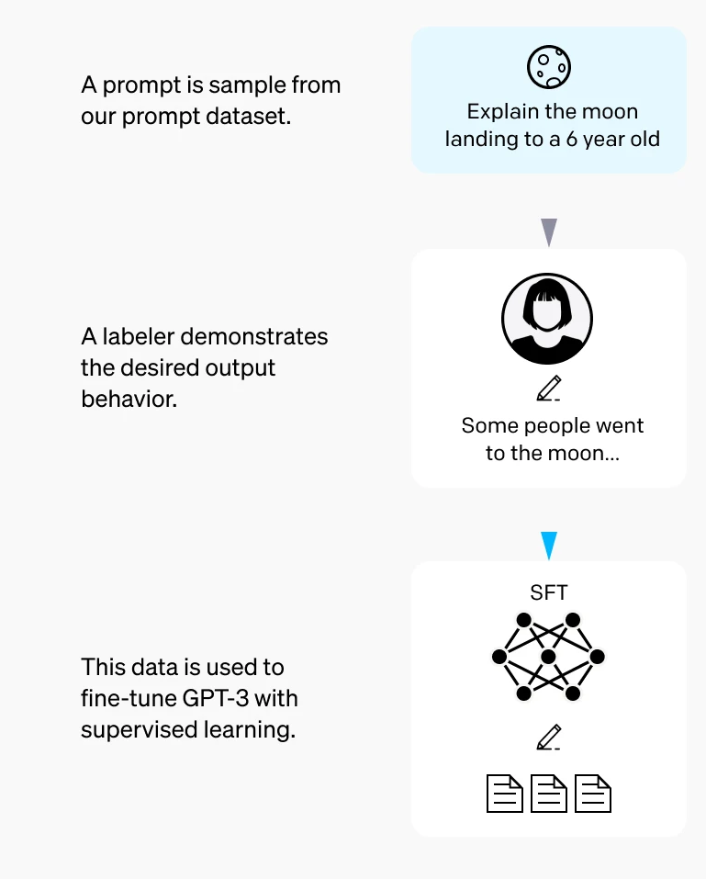
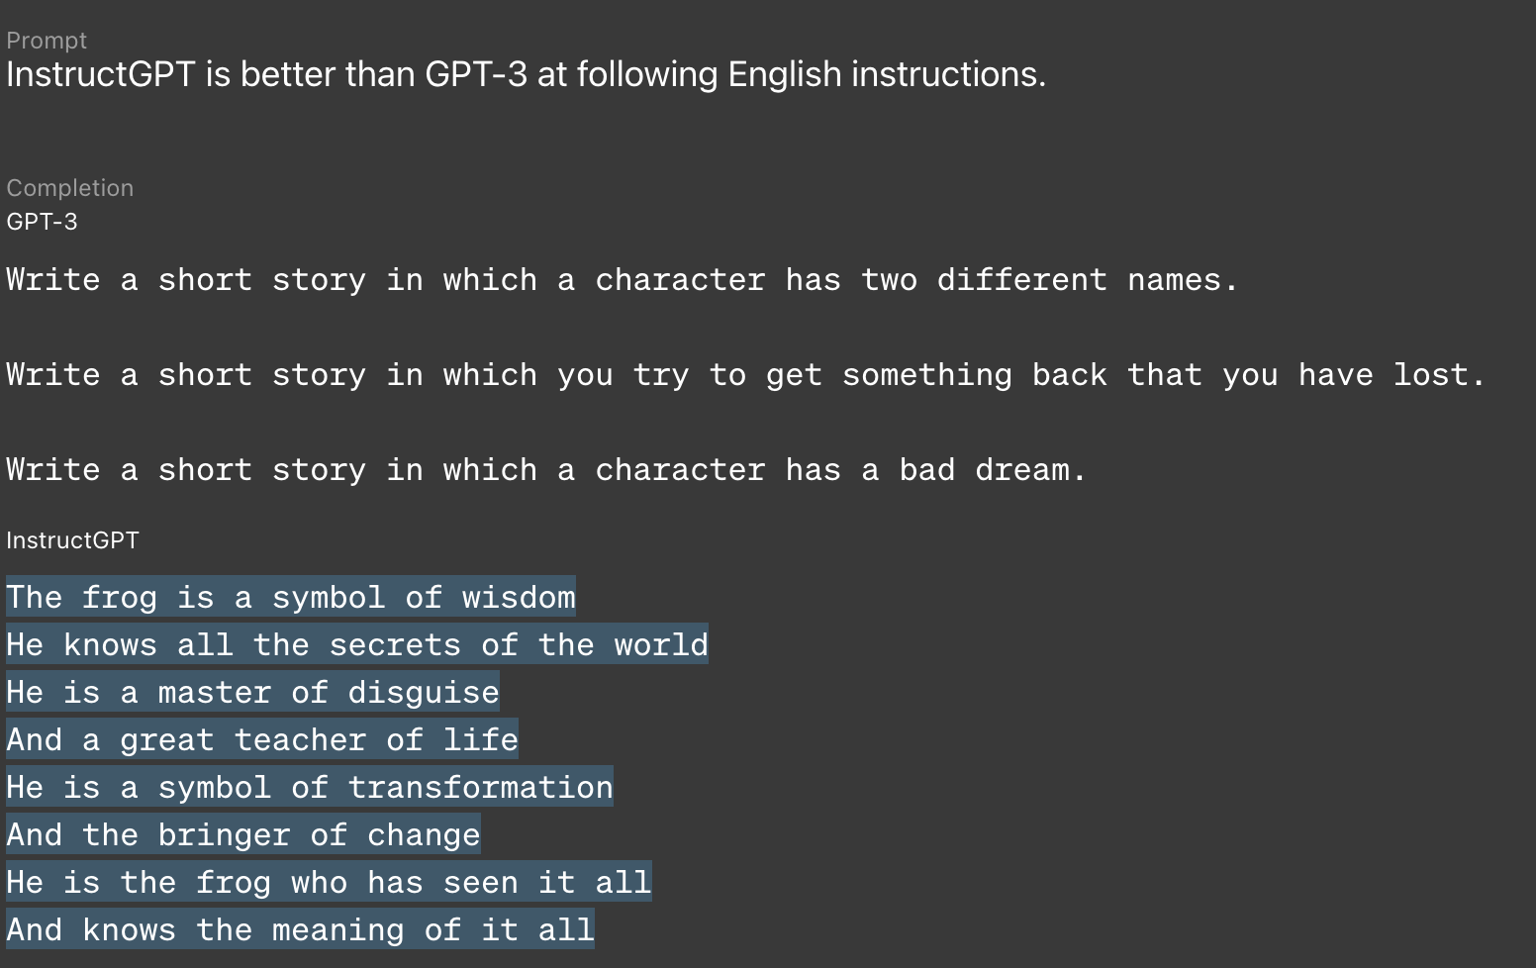
Instruction following
We can use this ability of the model to utilize in-context learning to change how the model behaves.
By training the model to learn how to respond to input instructions with response pairs, the model can learn how to respond to general queries.
Notes:
https://openai.com/index/instruction-following/

Slide 25
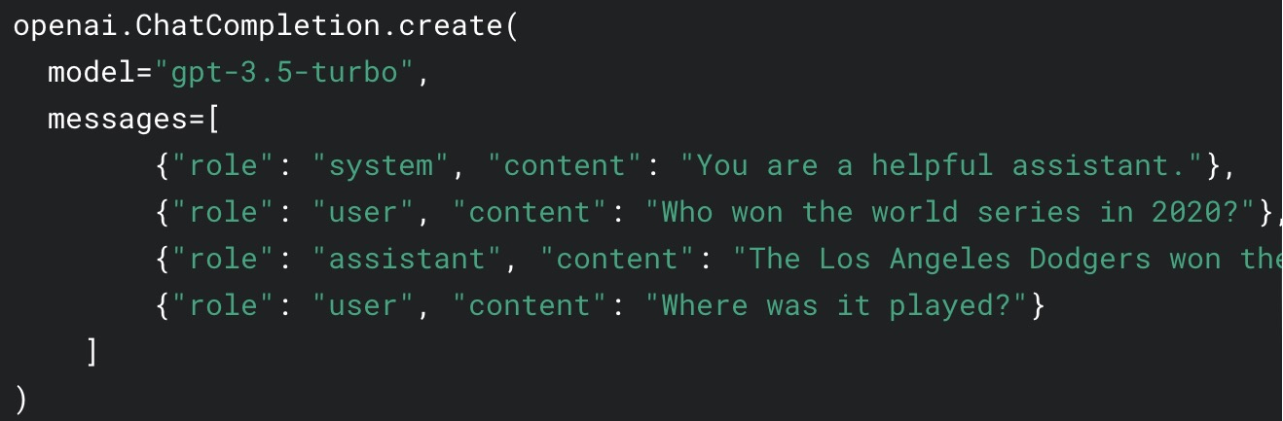
The chat structure
What is the best format to train models with?
Currently, the structure used to build training data and to interact with the LLM APIs is based on the “chat structure”. Here a series of roles and their respective content is stored in a messages array.
This allows for the system, assistant, and user roles to be stored in the same place, and the content of the interaction can be progressively added.
This provides a consistent format to both train and use the models as they react to user input.
Notes:
https://imgur.com/RRZhQ09

Slide 26
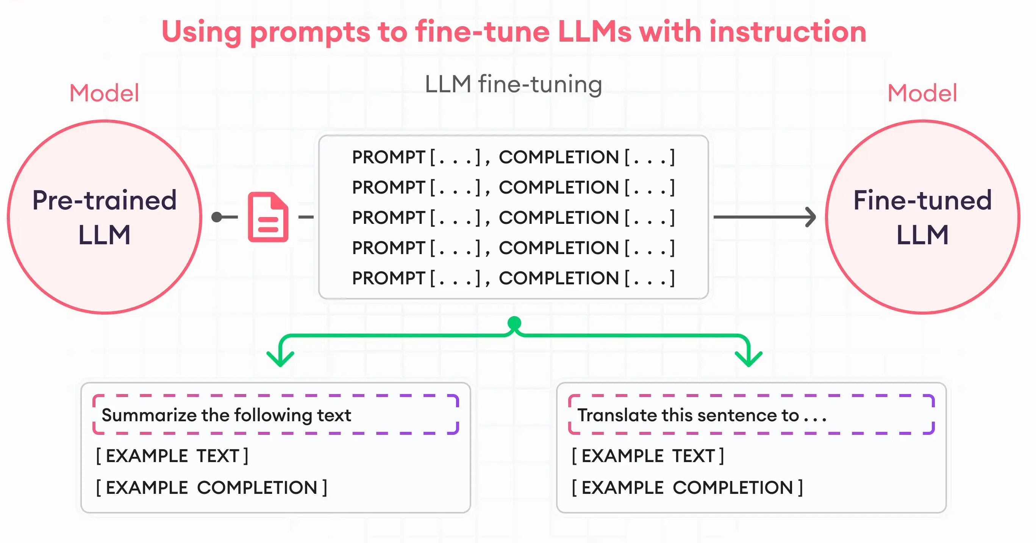
IFT Data Preparation
Generating prompt-response pairs requires more intentional curation than for pre-training.
The data can be generated synthetically with another LLM that has already been trained to create queries from raw data.
Or, more commonly or when starting from scratch, a human-generated dataset will need to be created with a variety of query-response pairs.
These pairs can be simple input-output or they can also include additional context to the query, e.g. Summarize this email into 5 bullet points.
The model will be trained to produce the specific output, not predict the next token.
This changes how the model behaves.
Notes:
https://www.superannotate.com/blog/llm-fine-tuning

Slide 27
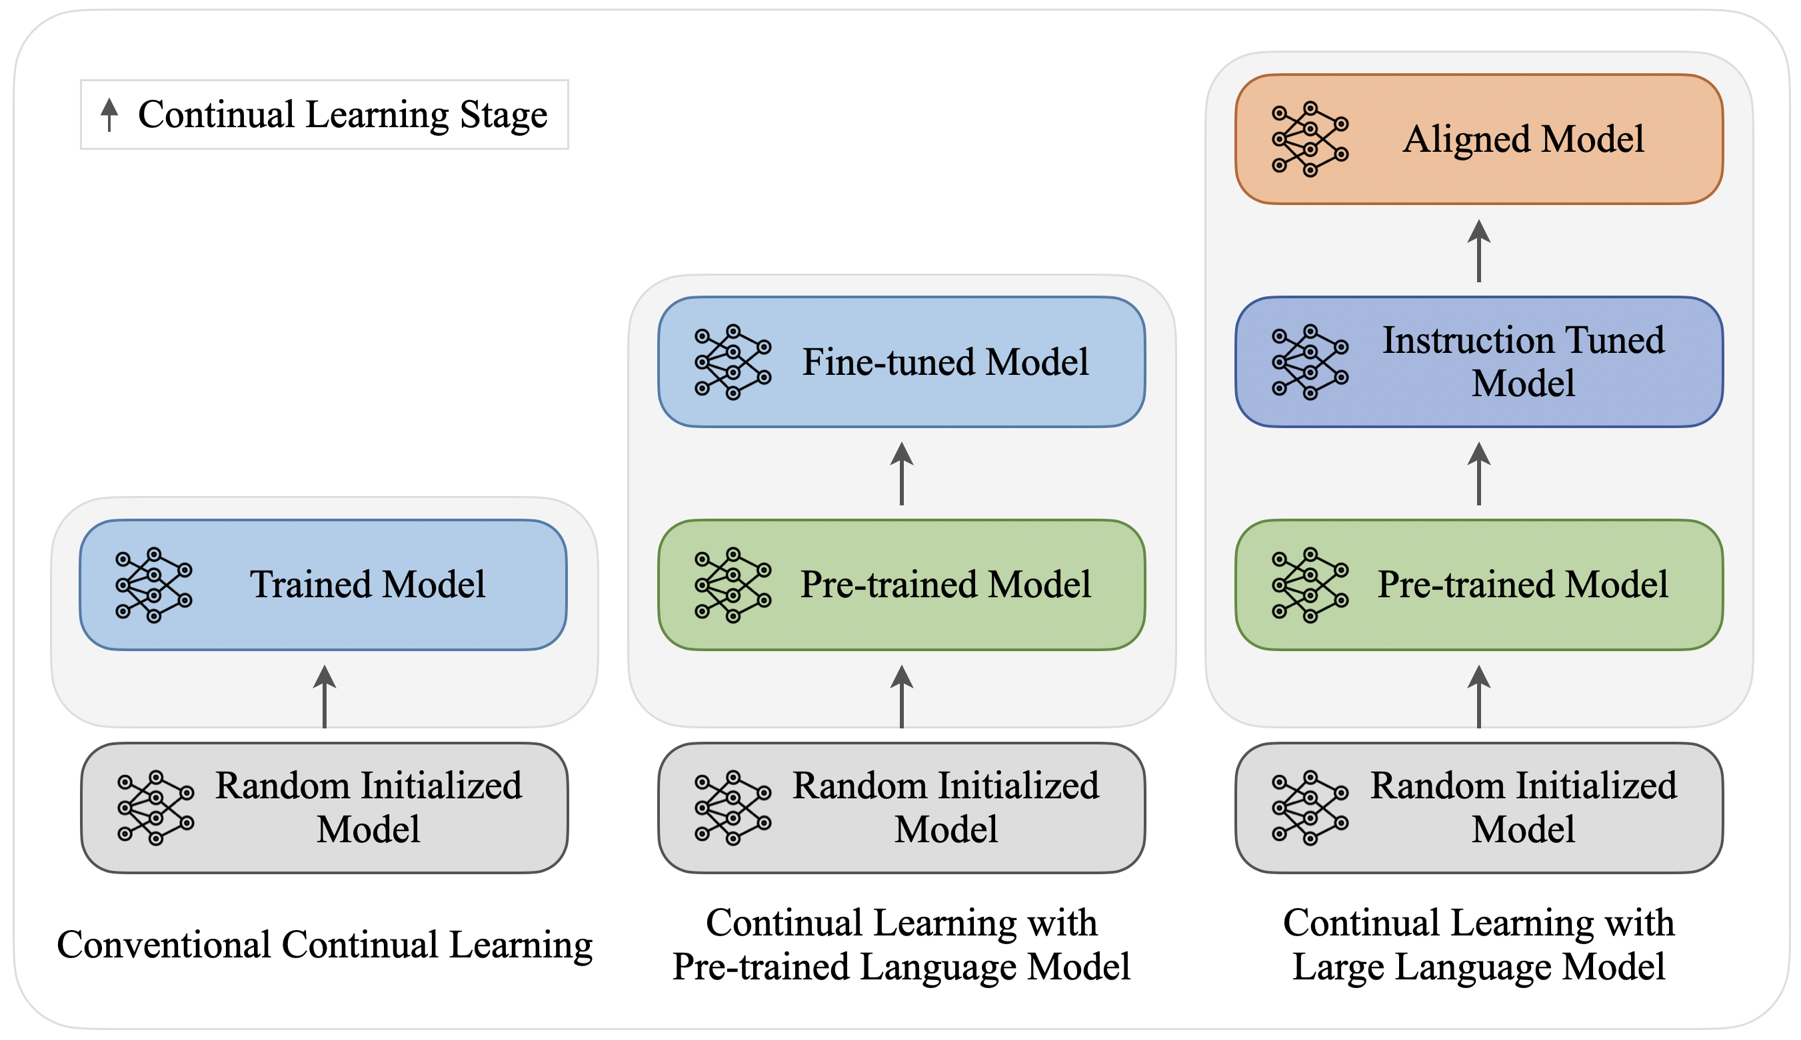
Limits of IFT for domain adaptation – Going deeper?
When a model has been trained for IFT, it will have new abilities to respond to a users’ query.
However, one issue that can arise is a lack of domain adaptation.
If the model was trained on a broadly trained base model, the instruction fine-tuning data often just changes the behavior of the model, rather than teaching is any domain-specific behavior.
If we need to instill domain-specific information, or align the model, how can we do this without starting from scratch?
Ans: Continued Pre-training
Notes:
https://arxiv.org/html/2402.01364v2
https://twitter.com/JayAlammar/status/1490712428686024705/photo/1

Slide 28
Continued Pre-training
Focusing domain understanding

Slide 29
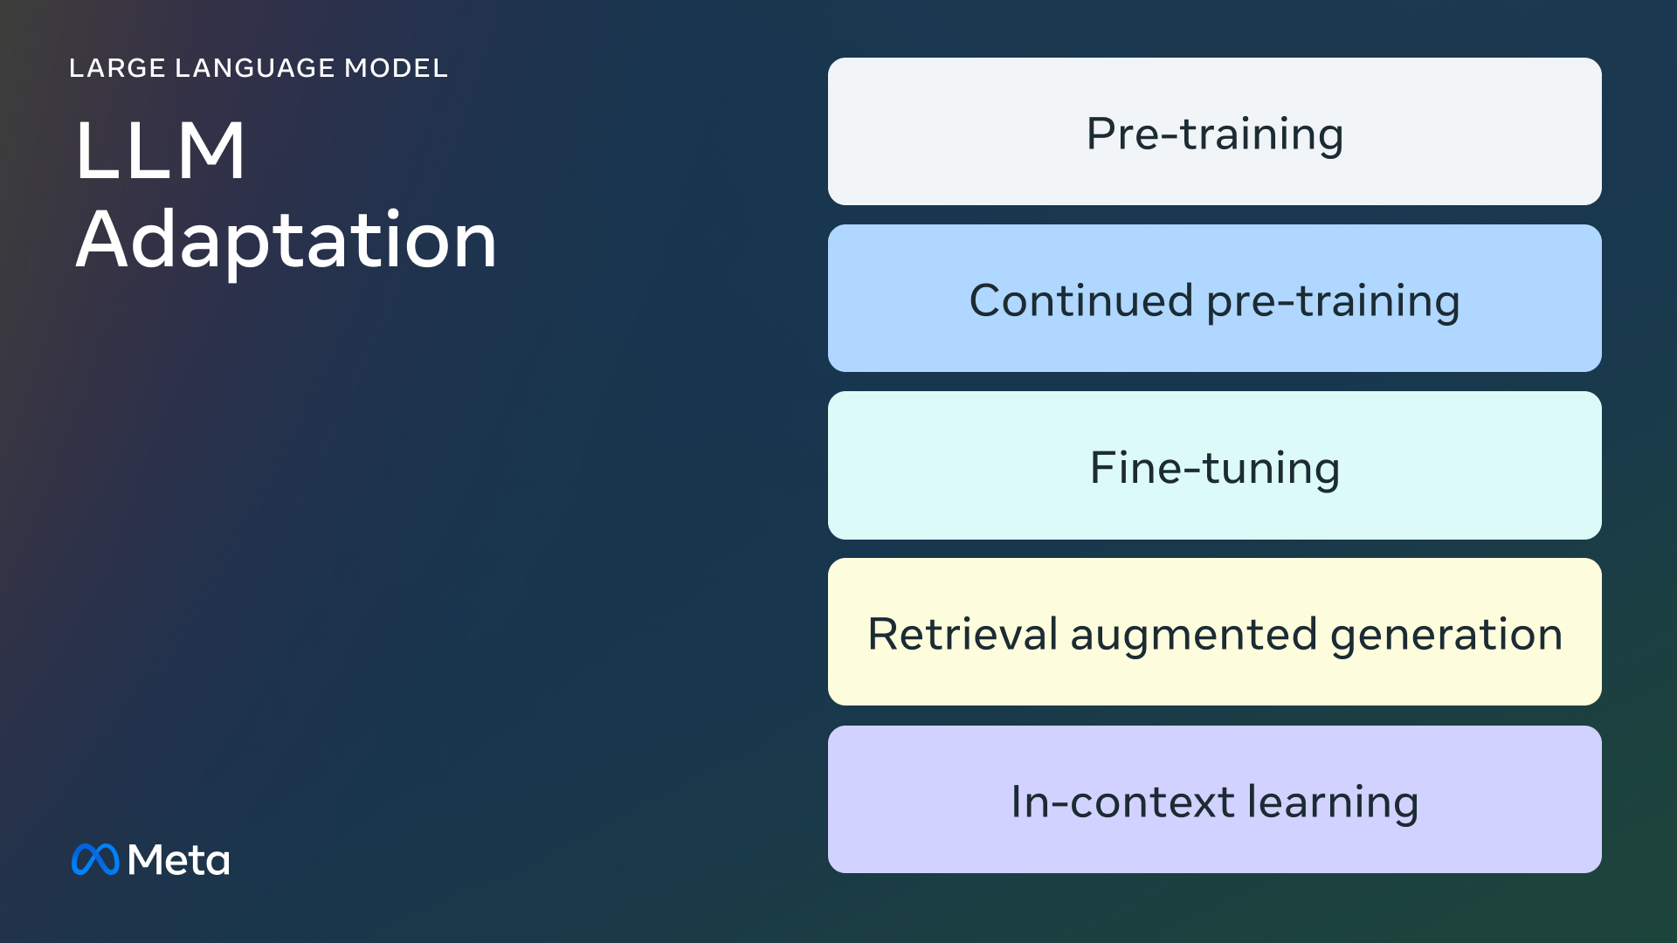
Why do Continued Pre-Training?
Building an LLM to understand language and respond to queries can be a challenging task.
Using the breadth of of data from the web can teach the model to have vast knowledge and linguistic skills, but focusing on the nuances of specific fields can be limited, particularly for smaller models.
Continued Pre-Training (CPT) can help address this issue by training a base model on domain-specific data to tune the model weights to align with a specific area of interest.
Notes:
https://ai.meta.com/blog/adapting-large-language-models-llms/

Slide 30
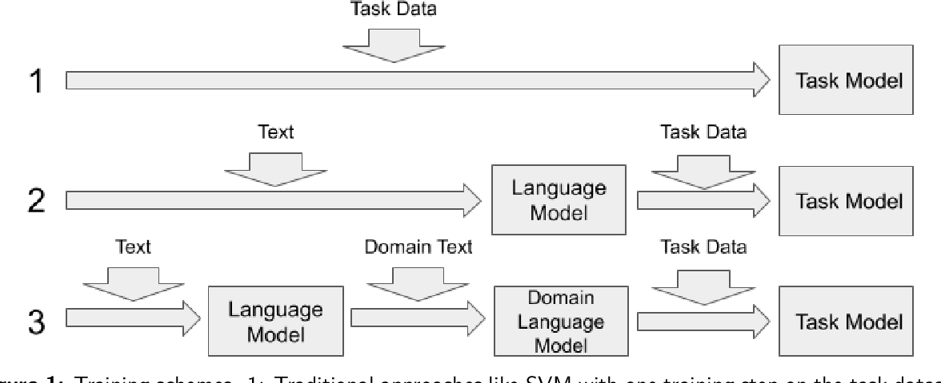
What does it mean to continue Pre-training?
Unlike Instruction Fine-Tuning (IFT) where the goal is to change how the model responds by training it on pairs of inputs and outputs, in CPT, a base model is trained in the exact same manner as pre-training but for a much shorter amount of time and with a custom and smaller dataset.
The hope is that this new CPT-base model that results will be more attuned to specific domain tasks, e.g. legal document analysis.
1. Pre-train a model on task data: typically poor performance.
2. IFT a base mode: moderate performance on domain-specific tasks
3. CPT and IFT a model for domain-specific task: best results

Slide 31
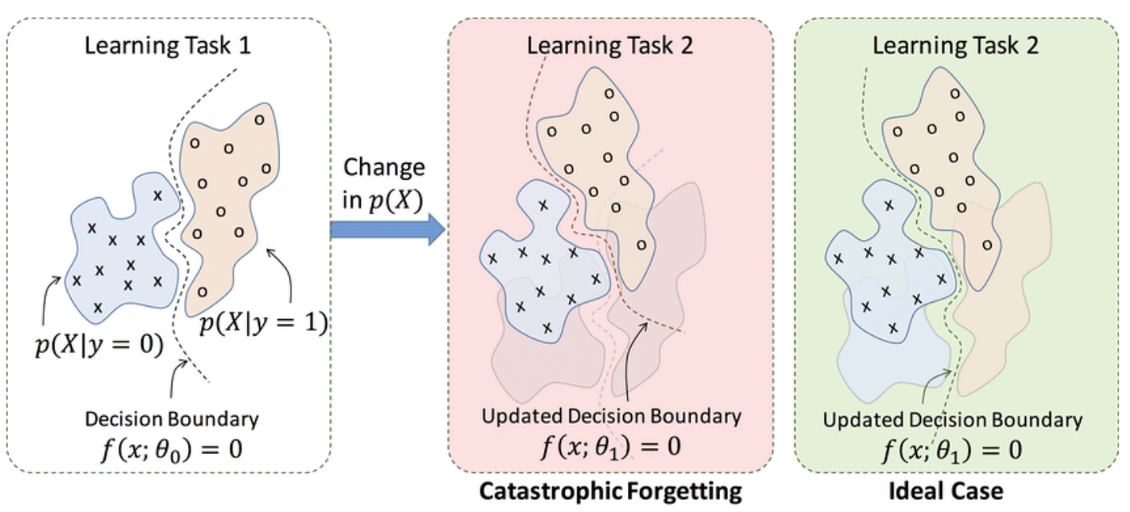
CPT Data and Catastrophic Forgetting
While focusing a model to learn a specific domain, there is a risk that the model will forget about other, potentially important, pieces of information. This is known as catastrophic forgetting, and can only be mediated with a very carefully selected data mixture to preserve whatever desired knowledge from the base model.
Notes:
https://towardsdatascience.com/forgetting-in-deep-learning-4672e8843a7f

Slide 32
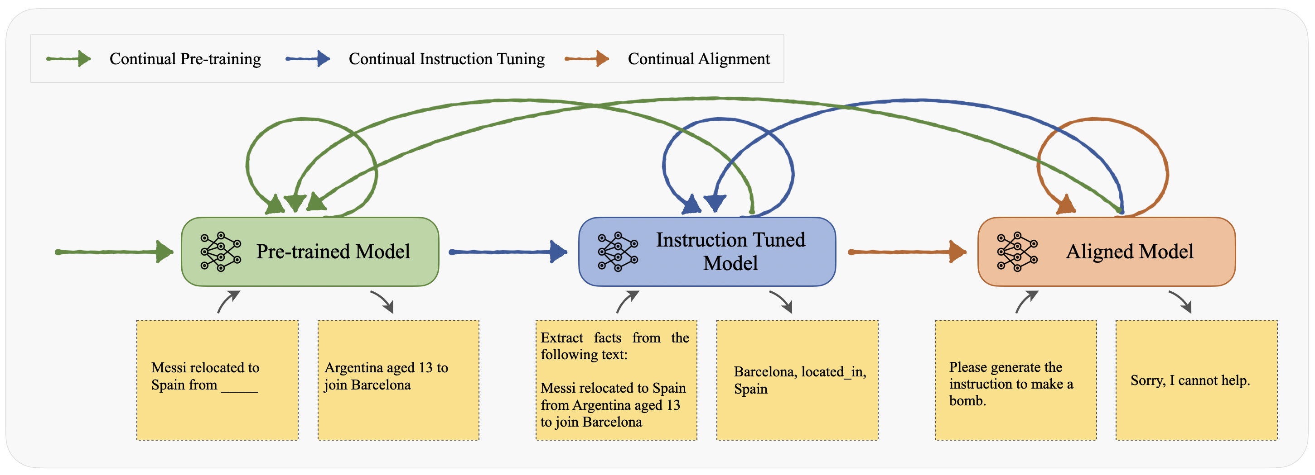
CPT and IFT
In most use cases, a CPT model on its own is not very useful, in the same way that a base model is not.
A CPT model will still only predict the next token.
The typical workflow is to:
Test a model on a particular set of domain-specific tasks
If the model achieves sufficient performance, stop.
If not, take the underlying base model and perform CPT on domain-specific data
Then perform IFT on the new CPT version of the base model
Collect more data for each stage as needed and repeat the process until sufficient performance is achieved.

Slide 33
Wrap Up
Training LLMs
Today we discussed the different ways to train LLMs
We introduced the idea of LLMs as Auto Regressive models
Pre-training was presented as the method to train these models on massive datasets of text
Instruction Fine-tuning was discussed as a solution to these models not inherently being able to response to a query
Continued pre-training was also covered as a means to domain tune an existing base model.
-----------------------------------------------------------------------------

Slide 34
Thank you!

