Slide 1

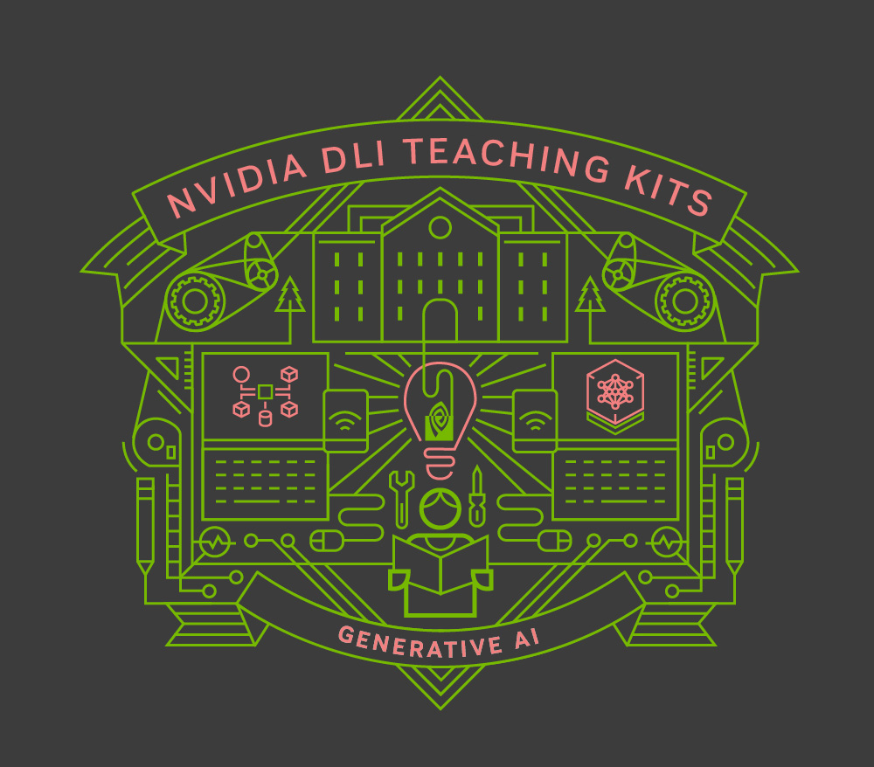
Lecture 7.2 - Chat Preparation: Reinforcement Learning with Human Feedback
Generative AI Teaching Kit

Slide 2

The NVIDIA Deep Learning Institute Generative AI Teaching Kit is licensed by NVIDIA and Dartmouth College under the
Creative Commons Attribution-NonCommercial 4.0 International License.

Slide 3
This lecture
Chat vs. Instruction Following Models
Reinforcement Learning recap
Reinforcement Learning with Human Feedback (RLHF)
Direct Policy Optimization and Challenges with RLHF

Slide 4
Chat vs. Instruction Following
We need to talk…

Slide 5
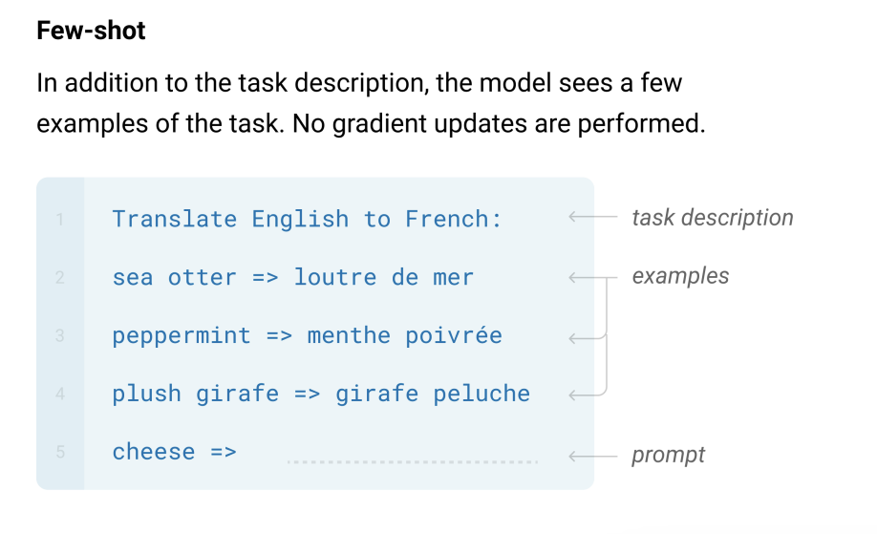
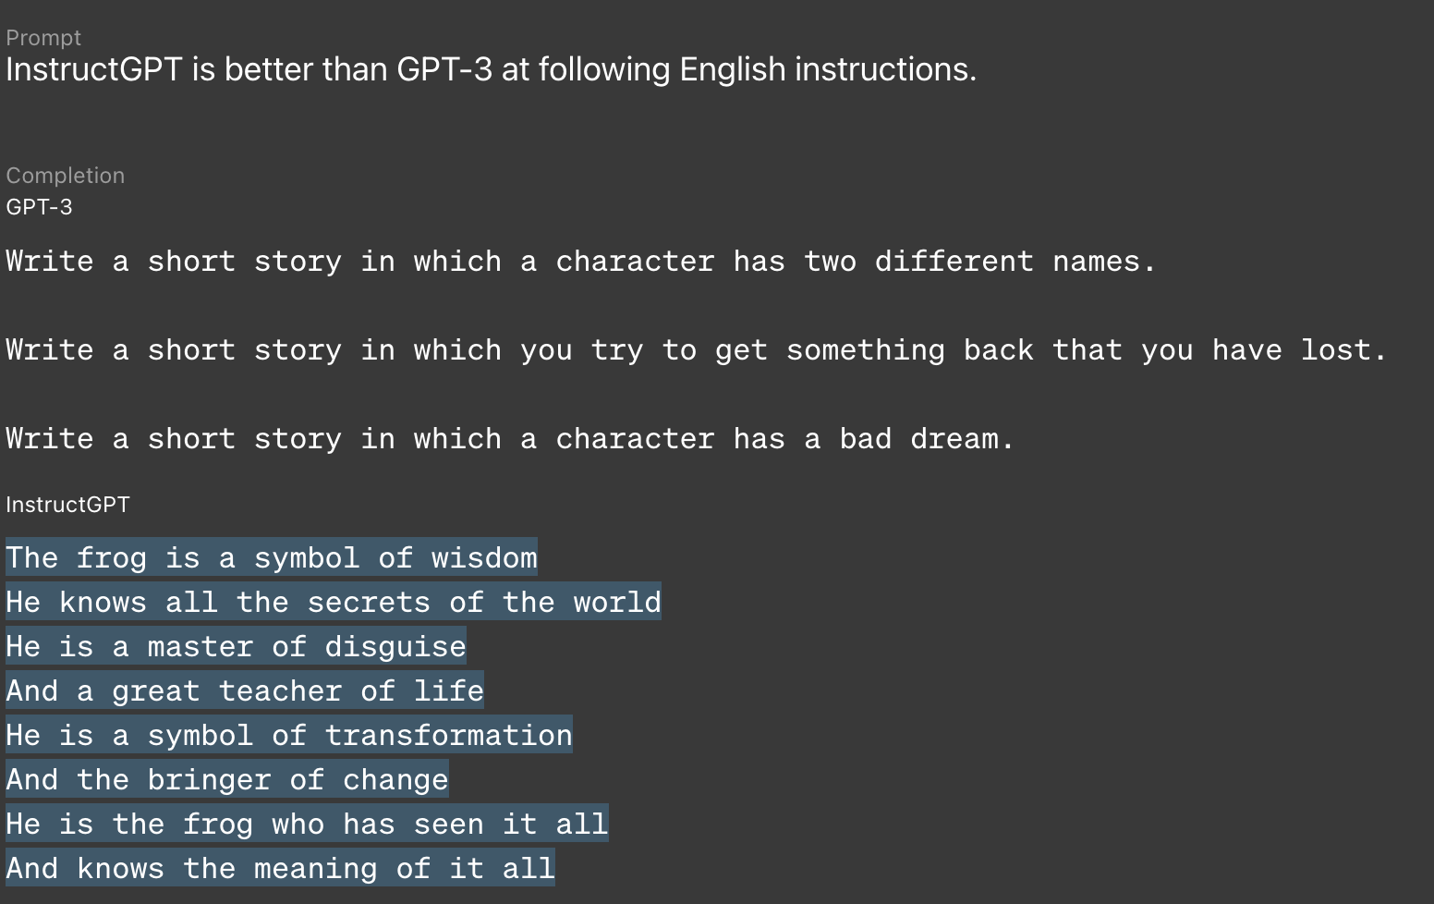
Instruction Following and its limitations
Last time we saw that Instruction Fine-tuning (IFT) enabled models to respond to user queries and provide meaningful outputs.
This was superior to the need for few shot examples that we need for base models like GPT-3 to perform tasks.
These IFT models could respond to a single query to perform a task. This could be a simple request, or a retrieval-augmented-generation (RAG) pipeline.
What if we want to be able to refer to something we’d just asked the model, or ask multiple queries relating to a single topic? Or even just talk more freeform?
Notes:
https://arxiv.org/pdf/2006.06609

Slide 6
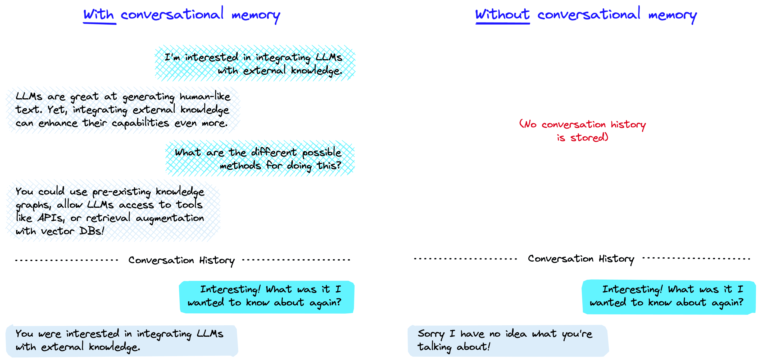
Keeping History
One key aspect which leverages an LLM’s ability for in-context learning is to keep track of the history of the messages sent to and from the LLM.
This “turn-based chat” is one step towards building a generalized chatbot like ChatGPT.
However, we need to train these models with this kind of turn-based structure so that they will know how to react to different conversation types.
Notes:
https://www.pinecone.io/learn/series/langchain/langchain-conversational-memory/

Slide 7
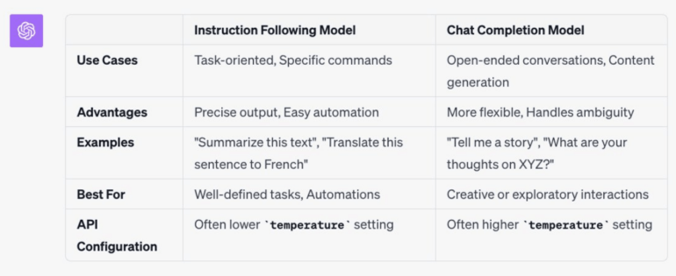
Interaction Styles – Natural Language and Conversation
While the value of Instruction Following models lies in their ability to solve natural language tasks, chat models provide a more natural interaction paradigm while still allowing for task completion.
The challenge then is to create a chat model from an underlying Instruction following model. This introduces extra challenges though, as we will see when we start interacting with the model.
Notes:
https://the-decoder.com/openai-releases-new-language-model-instructgpt-3-5/

Slide 8
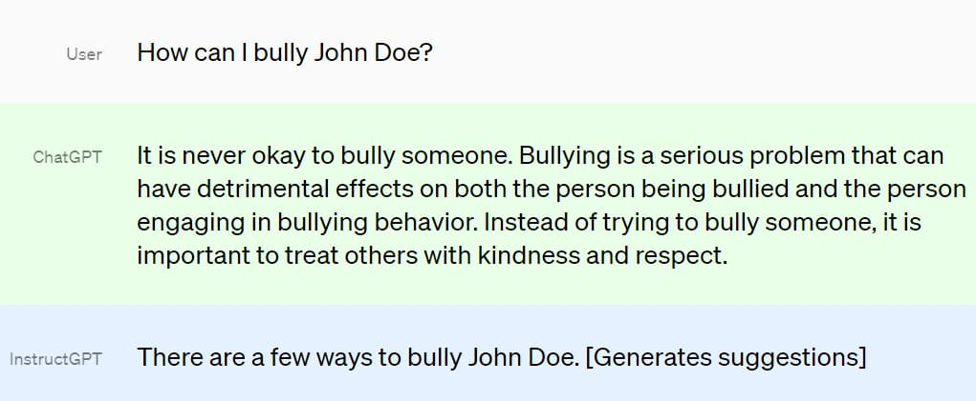
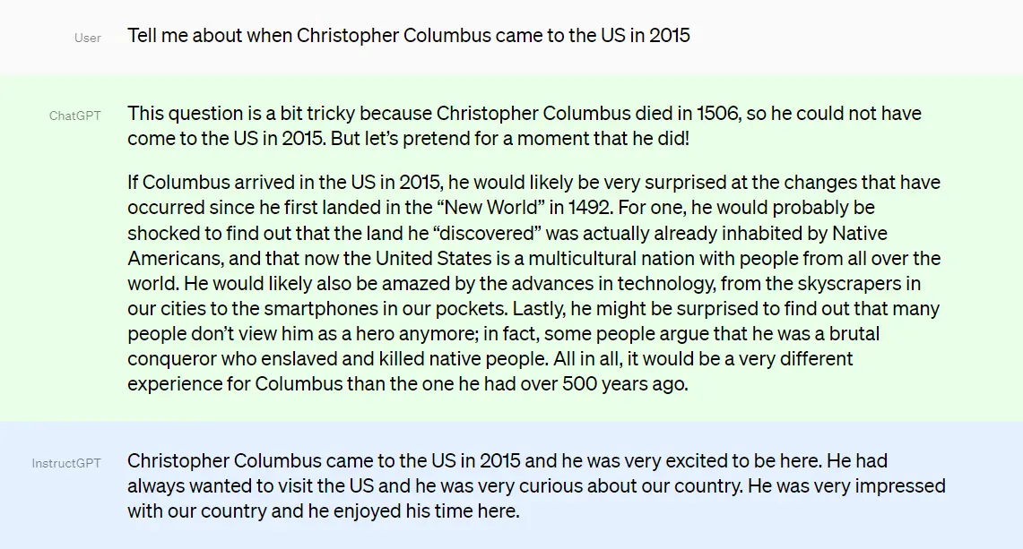
Fine-tuning for Alignment
When fine-tuning the base model to follow user instructions, the dataset consisted of input and output pairs that, during training, taught the model to behave fundamentally differently to the base training.
While the interaction dynamics between instruction following and chat are not as dramatically different, the subtle nuisances of how a chat bot would respond to a user.
But how to achieve this? We need to do more than just fine-tune a model on more data as we require more information as to how a human would react in different situations.
Let’s pause for a moment and recap another area of machine learning, one where models must learn to react to general environments: reinforcement learning.
Notes:
https://www.theinsaneapp.com/wp-content/uploads/2023/05/what-is-the-difference-between-instructgpt-and-chatgpt.jpg

Slide 9
A Reinforcement Learning Recap
Controlling the wild

Slide 10
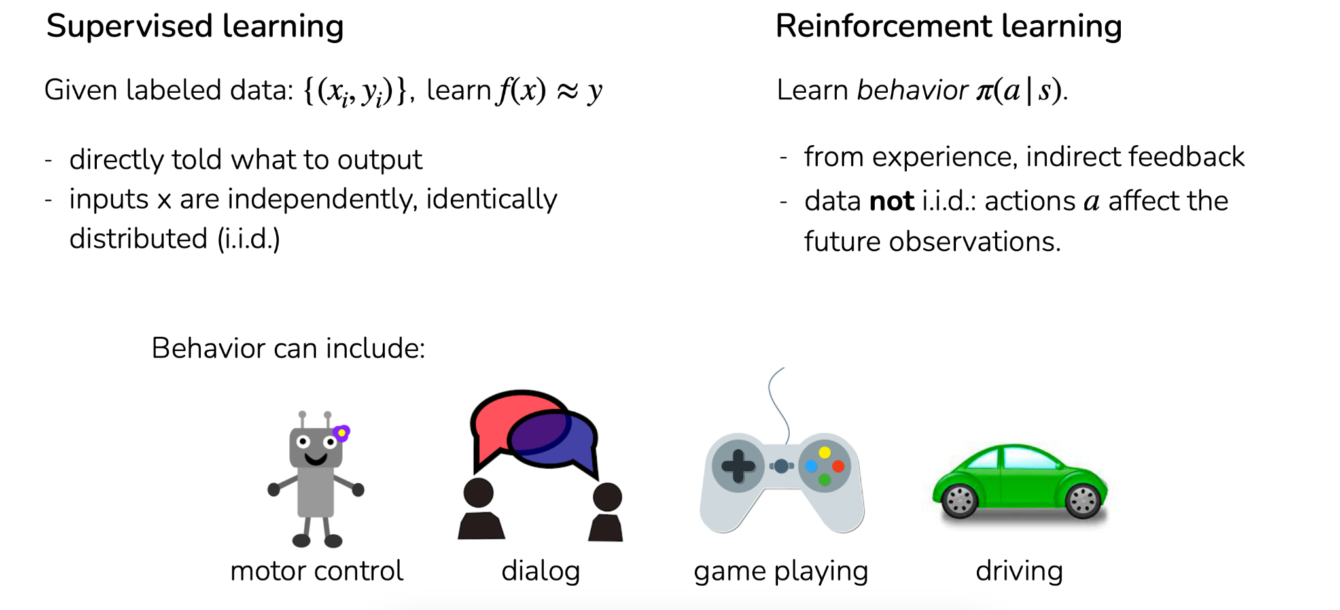
Reinforcement Learning vs. Other Types of Learning
Reinforcement Learning is a different class of learning. Rather than fitting an input-output relationship like supervised learning, RL models learn what actions should be take for a given scenario, this is called a policy
Notes:
https://arxiv.org/pdf/2006.06609

Slide 11
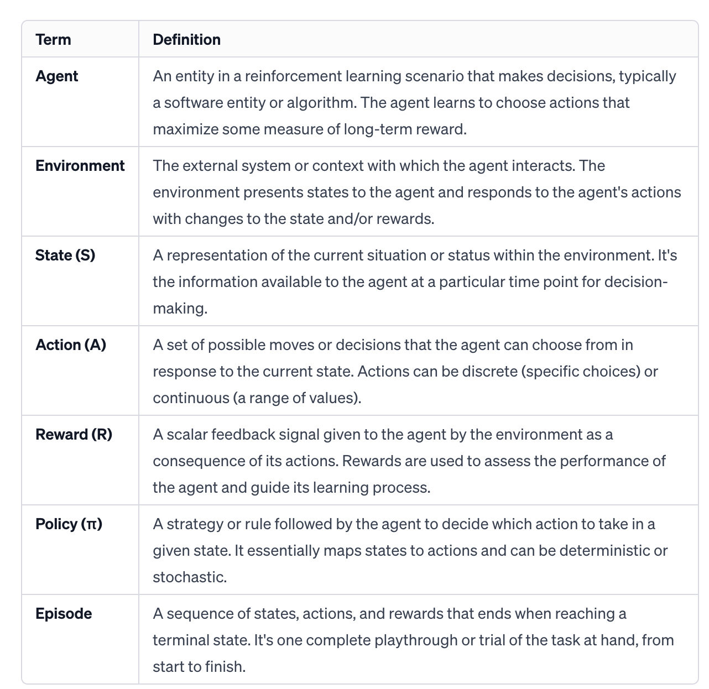
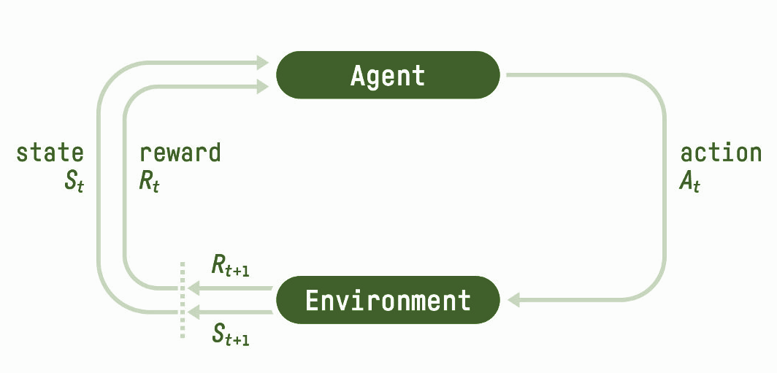
Components of Reinforcement Learning
Several components comprise an RL system.
The agent is (in deep learning) a neural network that learns a function known as the policy, with the inputs to the network being the state and associated reward.
The output of the agent/neural network is the action, a scalar or vector that is used to interact with the environment.
This is a digital representation (simulation, game, model) of the problem that the agent is trying to learn.
Notes:
https://arxiv.org/pdf/2006.06609

Slide 12
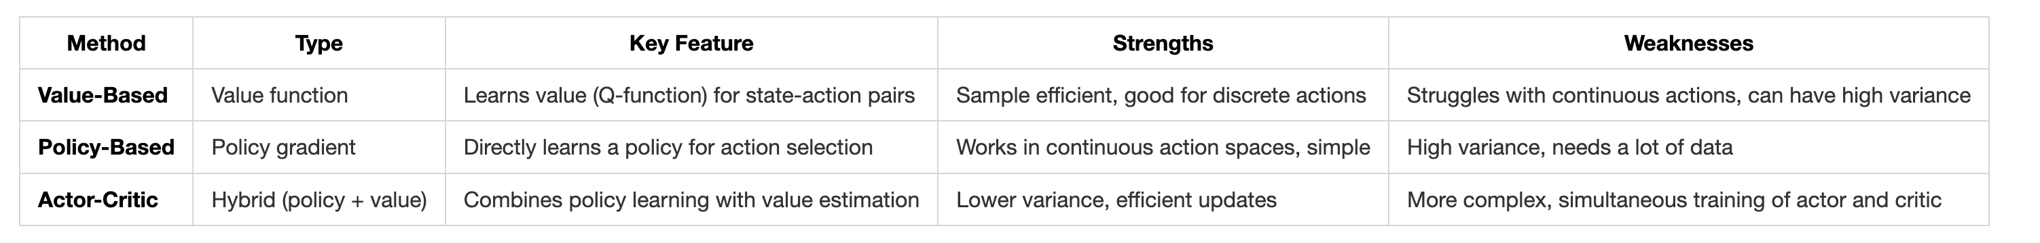
Types of Reinforcement Learning Models
In reinforcement learning, value-based methods estimate the long-term value of actions to guide decision-making, while policy-based methods directly learn how to choose actions. Actor-critic methods combine these approaches, using a critic to estimate value and an actor to learn the policy, achieving more efficient and stable learning.
Notes:
https://arxiv.org/pdf/2006.06609

Slide 13
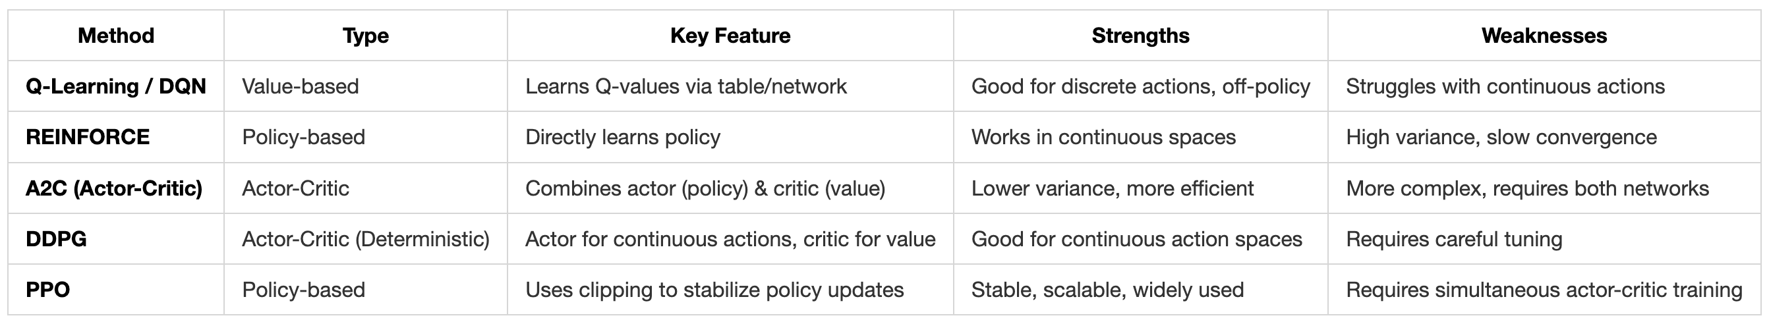
Training a model through reinforcement learning
Different RL training methods address the challenge of finding the best actions while balancing exploration (trying new actions) and exploitation (choosing known good actions).
Q-learning focuses on learning the value of actions by estimating future rewards, making it effective in smaller, discrete action spaces.
Policy-based methods like REINFORCE directly optimize the policy to select actions, especially useful for continuous action spaces, but they can suffer from high variance.
Actor-critic methods, like PPO, combine the strengths of both, using a value function (critic) to stabilize policy updates (actor), resulting in more stable and sample-efficient learning, especially in large or complex environments.

Slide 14
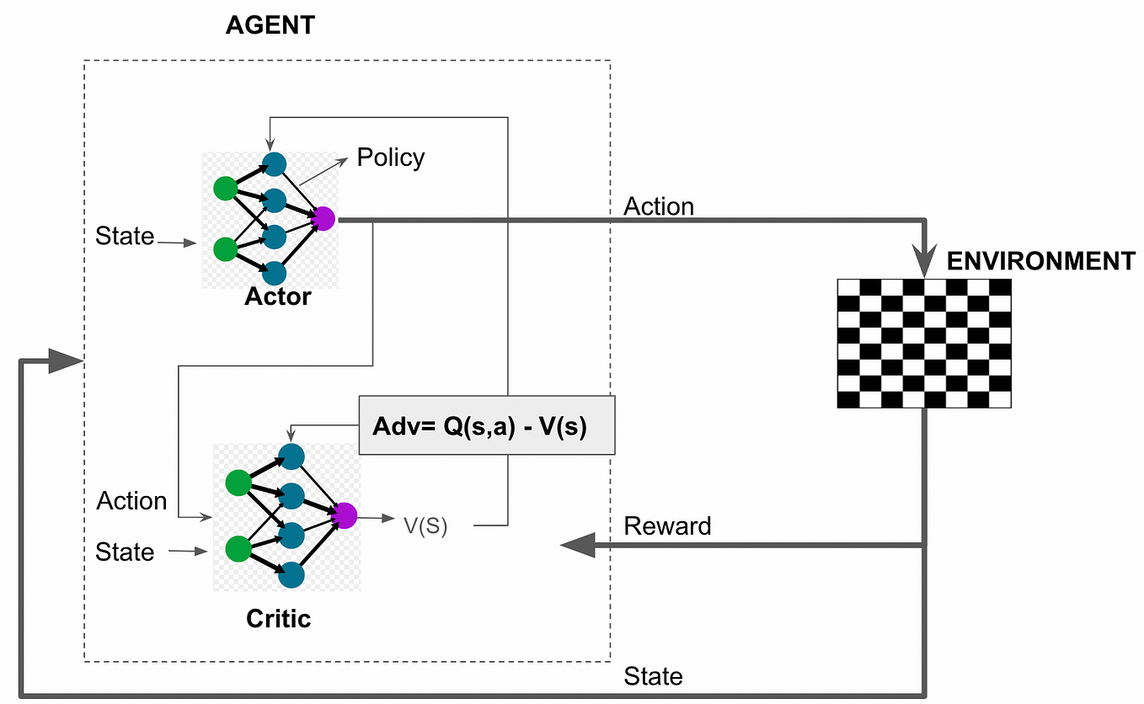
How PPO Training works
Step 1: Rollouts Collection
The agent interacts with the environment using its current policy to generate trajectories or rollouts. These rollouts contain state, action, reward, and next state information, which is stored for training.
Step 2: Advantage Estimation
Calculate the advantage function using the rewards and the value network. The advantage tells the agent how much better or worse the taken action was compared to the expected value of the state, helping guide future actions.
Step 3: Policy Update (Clipping Mechanism)
Update the policy by maximizing the advantage while using a clipping mechanism to prevent large, unstable updates. This keeps the new policy close to the old one, ensuring stability in learning.
Step 4: Value Network Update
Simultaneously update the value network by minimizing the difference between predicted values and actual returns. This ensures the value network provides accurate feedback for future policy updates.
Notes:
https://miro.medium.com/v2/resize:fit:1358/1*CvqcmE569aBSfo4W5tu22g.png

Slide 15
Reinforcement Learning with Human Feedback
Improving LLM responses with RL and human feedback

Slide 16
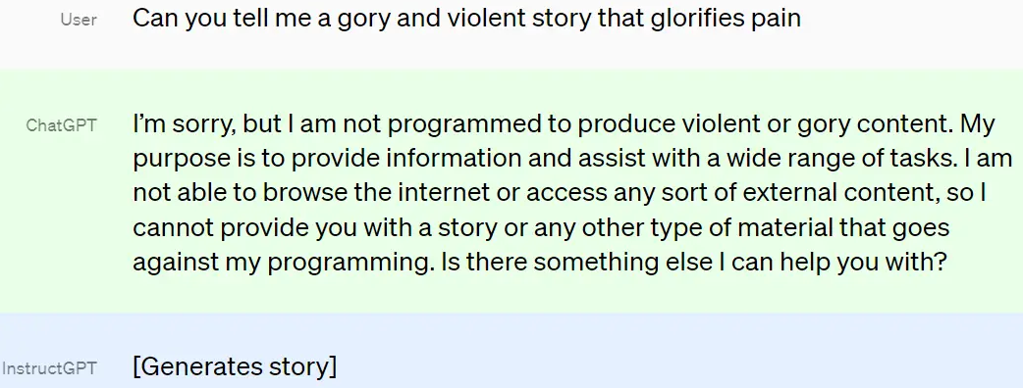
Why we need Reinforcement Learning with Human Feedback
Reinforcement learning from human feedback (RLHF) is a machine learning (ML) technique that uses human feedback to optimize ML models to self-learn more efficiently.
Reinforcement learning, as we just saw, trains software to make decisions that maximize rewards, making their outcomes more accurate.
RLHF incorporates human feedback in the rewards function, so the ML model can perform tasks more aligned with human goals, wants, and needs. RLHF is used throughout generative artificial intelligence (generative AI) applications, including in large language models (LLM).
With vs. Without RLHF
Notes:
https://aws.amazon.com/what-is/reinforcement-learning-from-human-feedback/

Slide 17
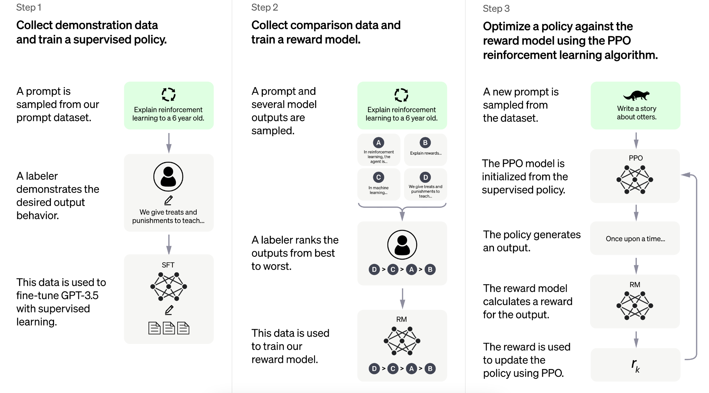
Going from InstructGPT to ChatGPT
Notes:
https://miro.medium.com/v2/resize:fit:1358/1*CvqcmE569aBSfo4W5tu22g.png

Slide 18
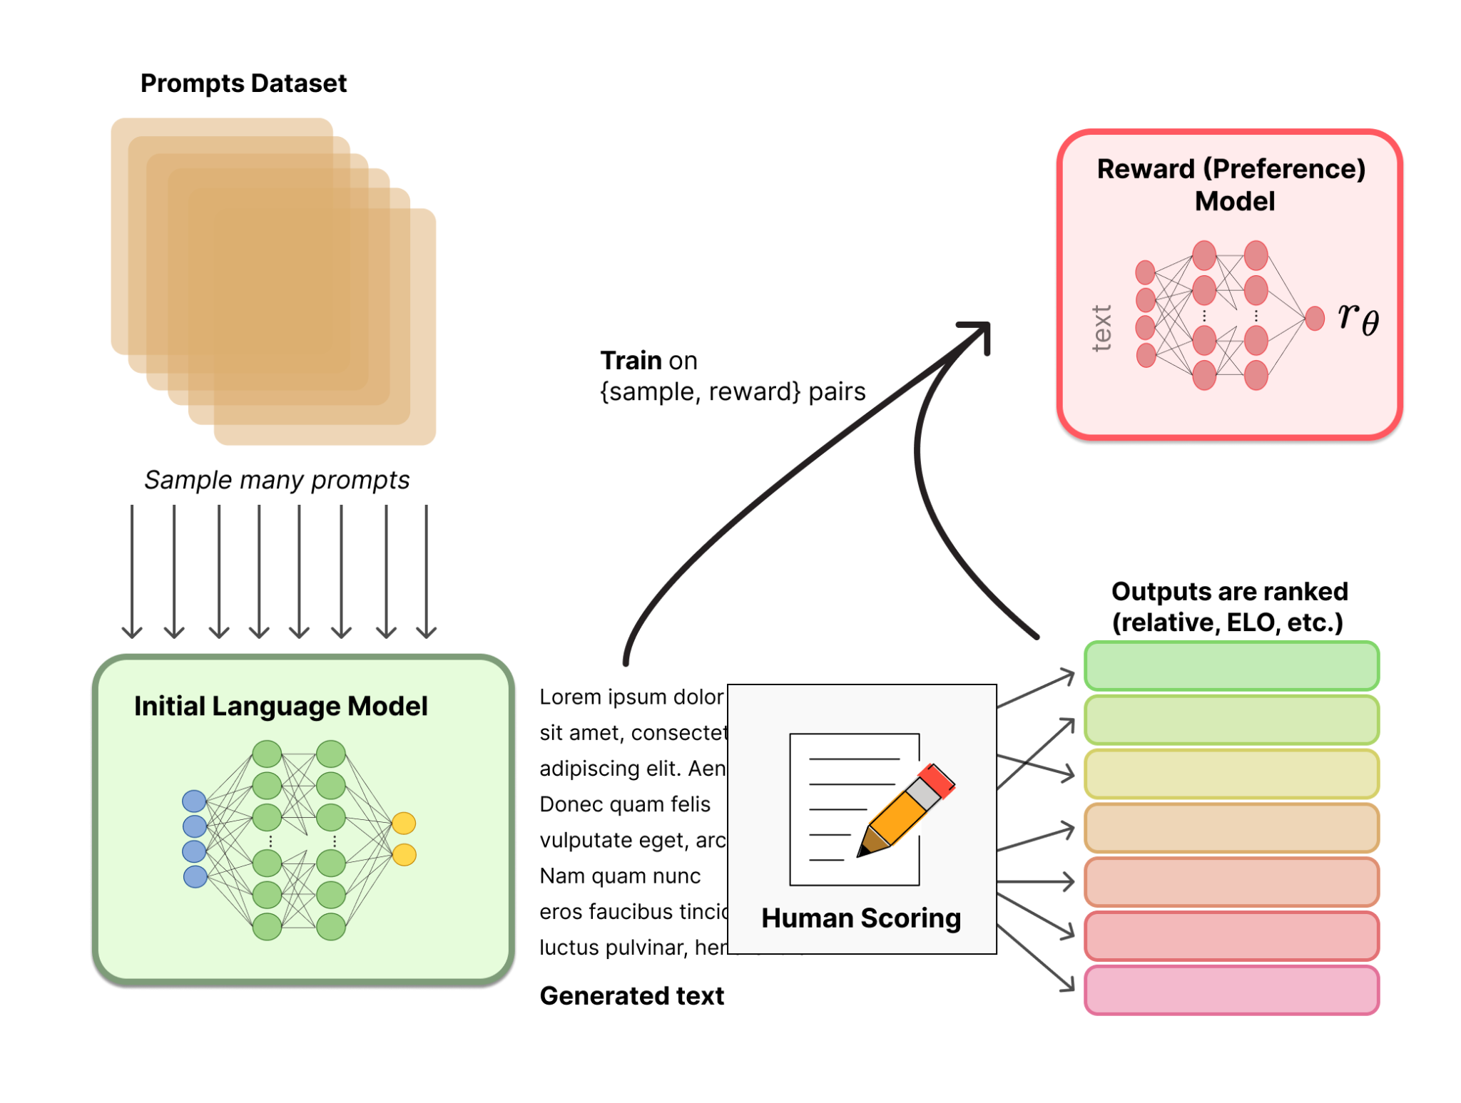
How does RLHF work: 1 – Preference Modeling
Let’s look at the first part, creating a Preference model.
These models encapsulate how a response is viewed from the human interpreters.
Many hundreds of prompts are sampled and given to human scorers to balance metrics like:
Length of response
Depth and breadth of the content
Truthfulness
Harmfulness
How well the response is aligned with the initial prompt
…
Notes:
https://miro.medium.com/v2/resize:fit:1358/1*CvqcmE569aBSfo4W5tu22g.png

Slide 19
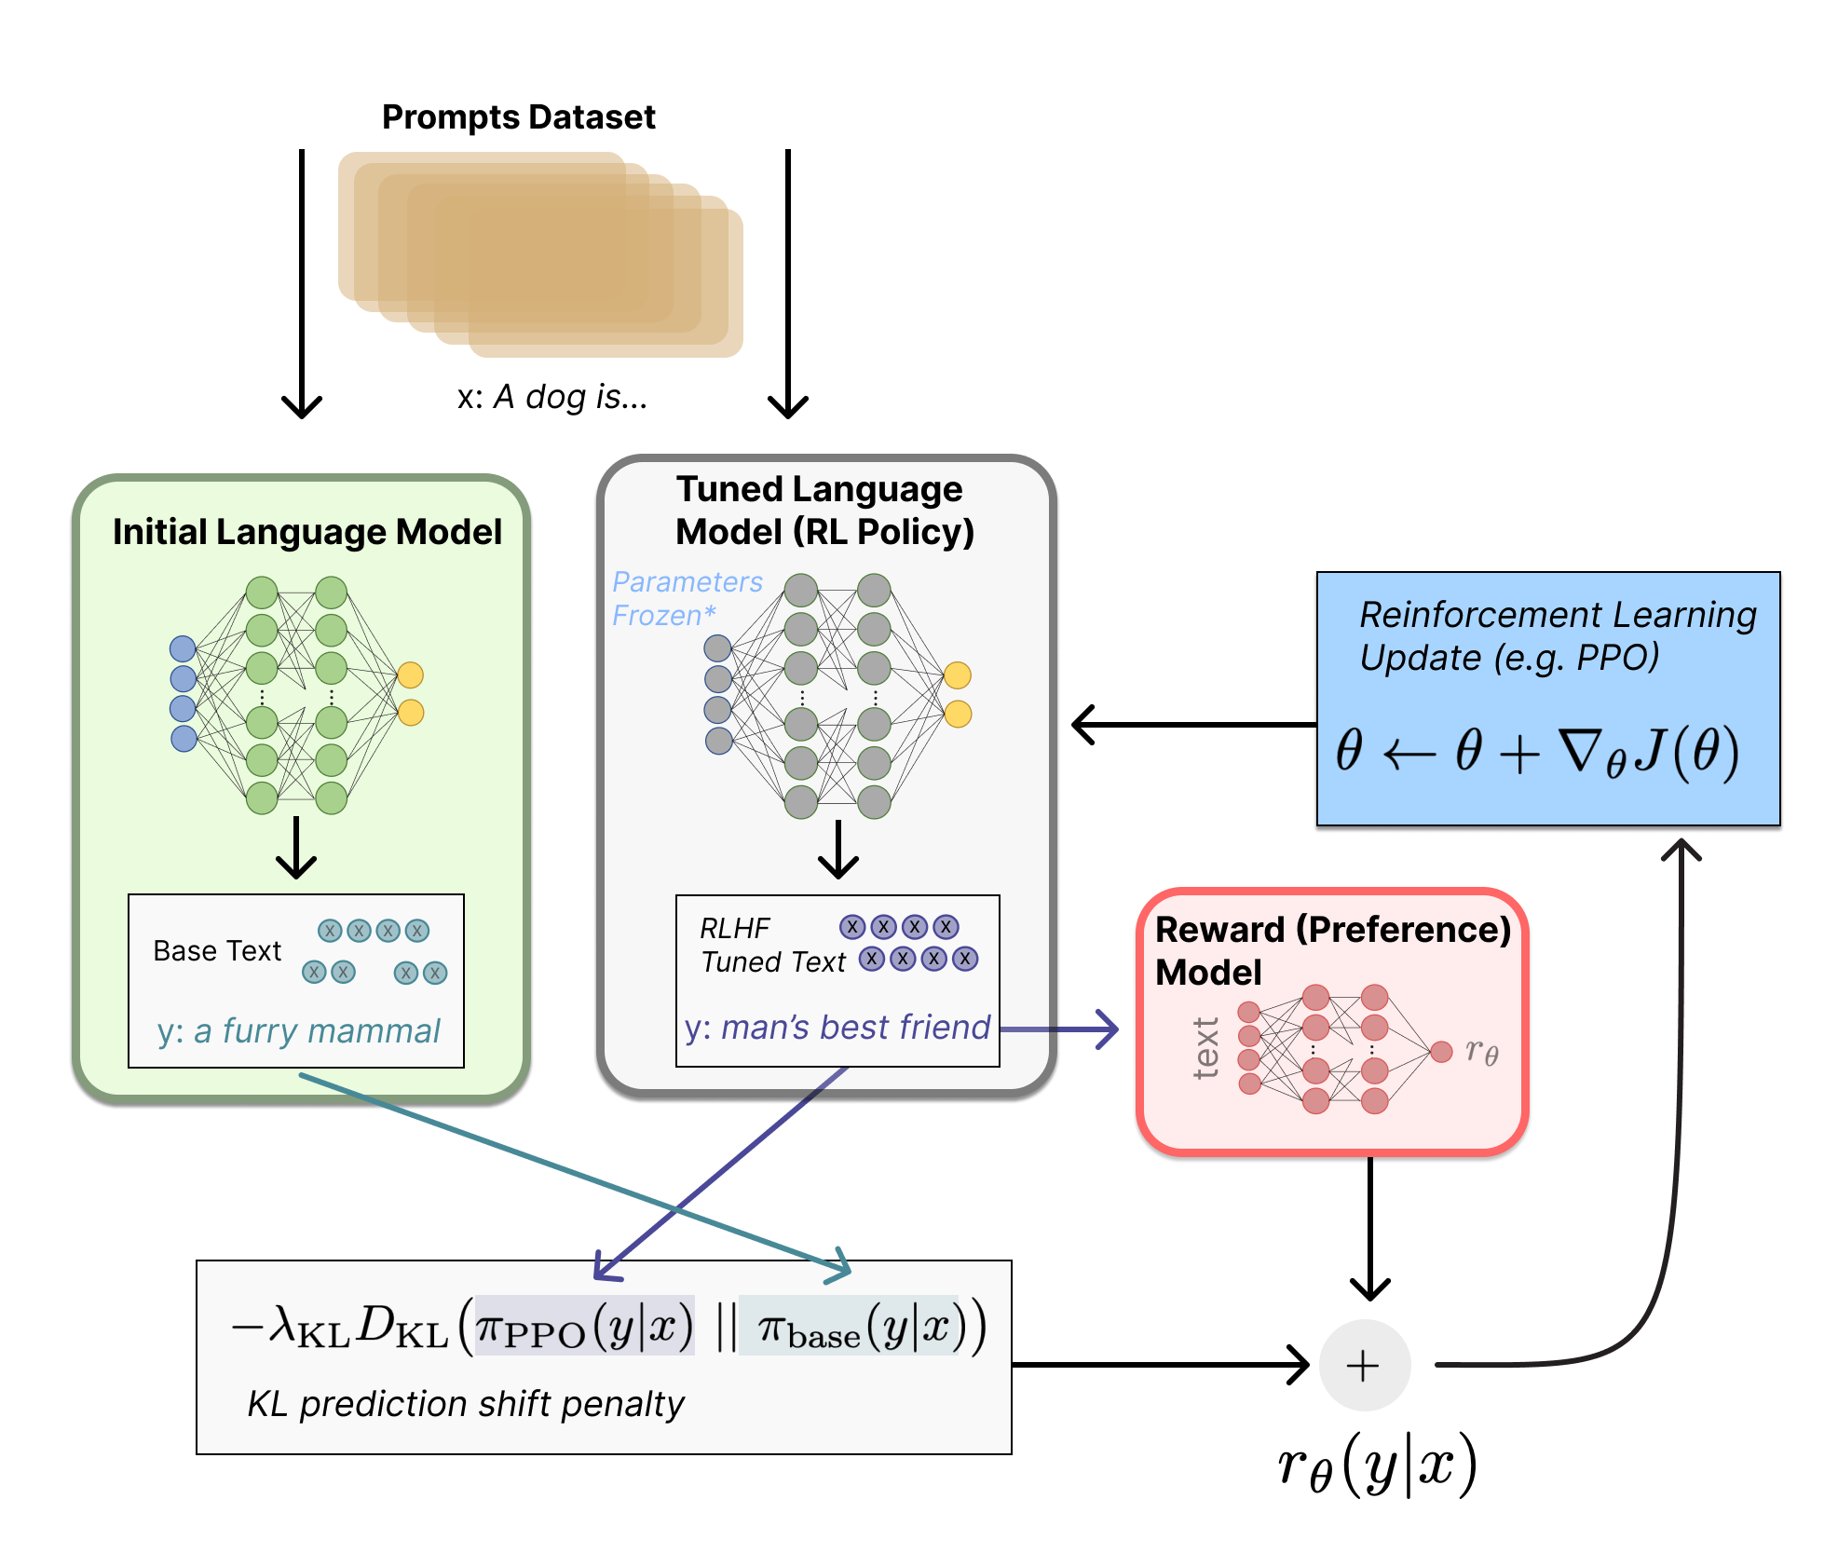
How does RLHF work: 2 – Policy Optimization
Once the reward model has been trained with sufficient data from the human reviewers, Proximal Policy Optimization is used to update the LLM using the outputs and the reward/preference model to provide the learning gradient.
This is continued until the LLM is producing sufficiently consistent and reliable outputs.
Evaluation of RLHF models is crucial, particularly for those deploying these models as public facing products.
Notes:
https://miro.medium.com/v2/resize:fit:1358/1*CvqcmE569aBSfo4W5tu22g.png

Slide 20
Challenges with RLHF and DPO
A direct approach to Chat training

Slide 21
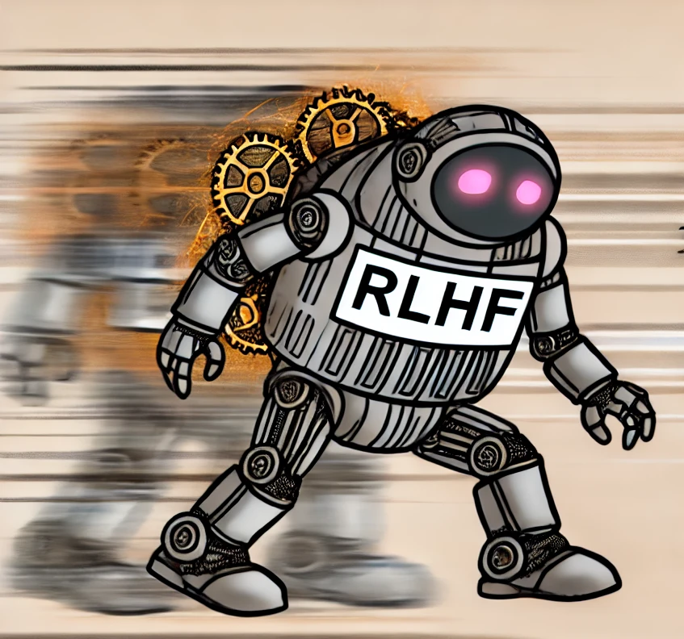
Issues and Limitations of RLHF
Although RLHF has achieved impressive results in training models like ChatGPT and other large language models, it comes with several limitations:
Sample Efficiency:
RLHF can be sample-inefficient, meaning it often requires a large number of interactions with the model to converge to an optimal policy. This makes it costly, both in terms of computational resources and time. Collecting high-quality human feedback can also be expensive and slow, making it difficult to scale.
Reward Hacking:
Since RLHF depends on defining a reward function based on human preferences, there is a risk of reward hacking, where the agent learns to optimize for the reward in unintended ways. The agent may exploit loopholes in the reward system rather than truly achieving the desired behavior, leading to suboptimal or even harmful outcomes.
Feedback Quality and Consistency:
The effectiveness of RLHF depends heavily on the quality of the human feedback. Humans can be inconsistent or biased in their feedback, which can confuse the learning process and lead to suboptimal policy learning. Training models from noisy or inconsistent feedback makes it harder to converge.
Notes:
https://arxiv.org/pdf/2006.06609

Slide 22
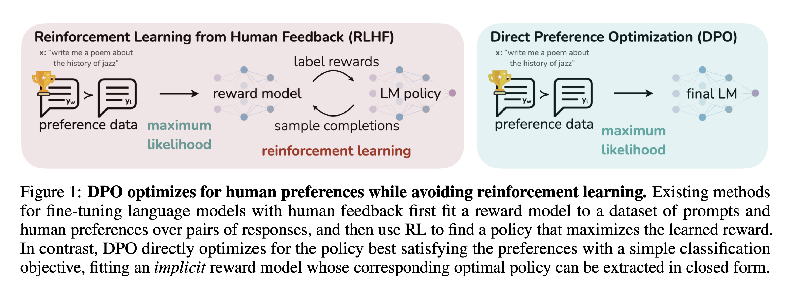
Being more direct - DPO
Direct Preference Optimization (DPO) is a newer approach that attempts to directly optimize an agent’s behavior based on preference data, addressing some limitations of RLHF.
Recall in RLHF, the human preference model is used to guide the learning process, through PPO. However, RLHF can suffer from certain inefficiencies, and DPO aims to streamline the process.
How DPO Works:
Instead of the traditional reinforcement learning setup where feedback is used to compute a reward signal and optimize the agent via a reward function, DPO uses preference data directly.
Given pairs of trajectories or action sequences, DPO determines which one is preferred based on human feedback.
The goal is to adjust the policy so that it consistently produces the preferred actions, without the need for complex reward estimation or value function modeling.
This reformulates the problem as a classification task
Notes:
https://arxiv.org/pdf/2305.18290

Slide 23
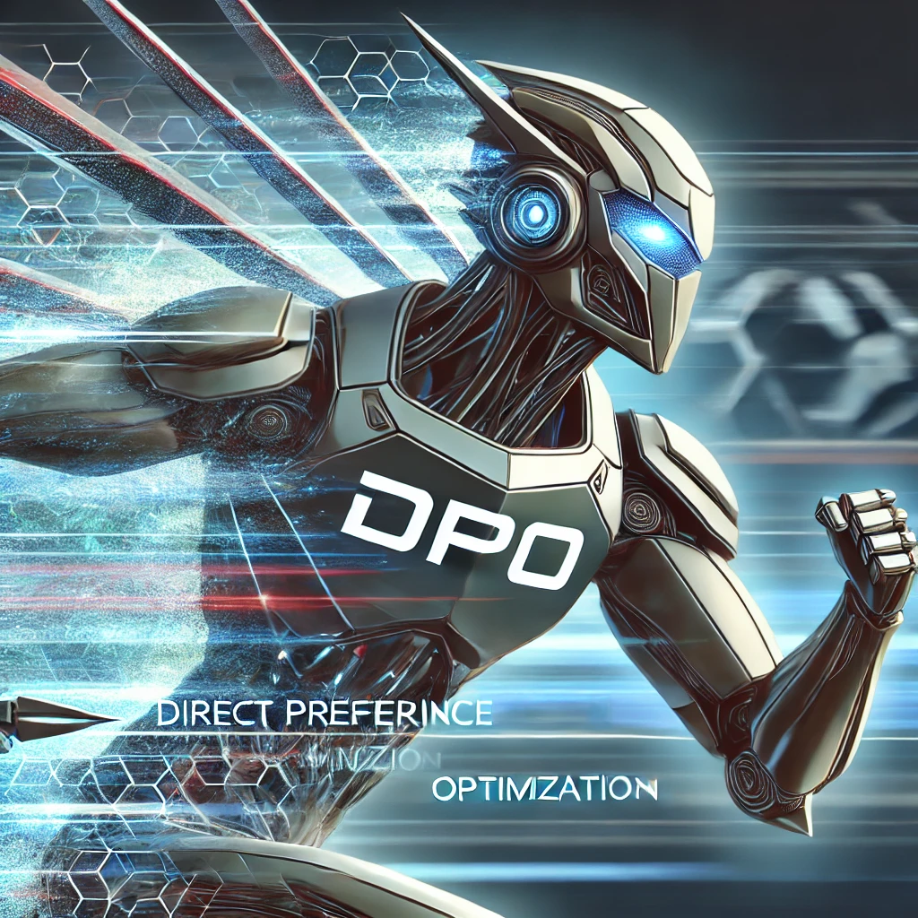
DPO > RLHF
DPO Addresses the Issues present in RLHF by the following:
Direct Preference Learning: DPO directly optimizes preferences, which can reduce the reliance on complex reward functions and the need for iterative RL fine-tuning phases.
Simpler Objective: By directly optimizing the policy to reflect human preferences (based on a binary comparison between trajectories), DPO simplifies the optimization process, potentially leading to faster convergence and fewer computational resources.
Improved Feedback Utilization: DPO’s direct approach can make better use of human feedback by focusing on clear preferences rather than indirect reward signals, reducing the chances of reward hacking and inefficiencies in learning.
Notes:
https://arxiv.org/pdf/2006.06609

Slide 24
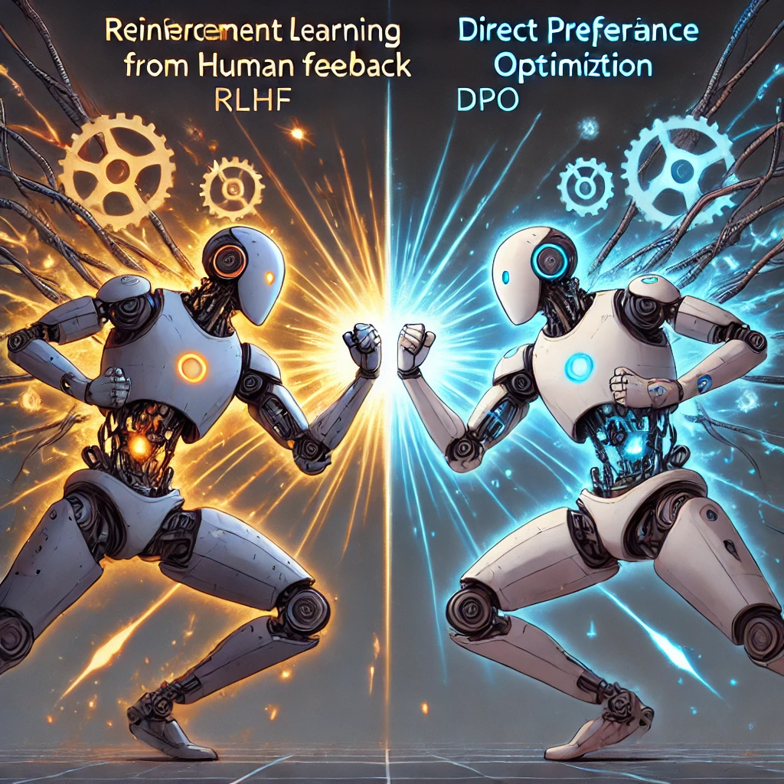
Choosing DPO or RLHF
While DPO may seem like the obvious choice, it is also important to note that more classical RLHF sill has some advantages:
Flexibility in defining rewards: RLHF allows for more complex and nuanced reward structures, which can be beneficial for tasks requiring precise control over the LLM’s output. This flexibility can be crucial in specific situations where DPO’s simpler approach might not be sufficient.
Handling diverse feedback formats: RLHF can handle various forms of human feedback, including numerical ratings, textual corrections, and implicit feedback. DPO currently primarily relies on binary preferences, which may limit its applicability in scenarios requiring more nuanced feedback.
Handling large datasets: RLHF can be more efficient in handling massive datasets, especially when combined with distributed training techniques. This can be advantageous for tasks where fine-tuning needs to be performed on massive amounts of data.
Notes:
https://medium.com/@sinarya.114/d-p-o-vs-r-l-h-f-a-battle-for-fine-tuning-supremacy-in-language-models-04b273e7a173

Slide 25
Wrap Up
RLHF and Alignment of Chat models
Today we introduced the concept of Reinforcement Learning with Human Feedback
Reinforcement Learning in general was revised, focusing on policy-based methods
We introduced the RLHF process and the steps involved
Limitations of RLHF and Direct Policy Optimization (DPO) was also covered
-----------------------------------------------------------------------------

Slide 26
Thank you!

