Slide 1


Lecture 9.3 - Scaling Inference and Deployment
Generative AI Teaching Kit

Slide 2

The NVIDIA Deep Learning Institute Generative AI Teaching Kit is licensed by NVIDIA and Dartmouth College under the
Creative Commons Attribution-NonCommercial 4.0 International License.

Slide 3
This lecture
Inference of LLMs vs. Trainings LLMs
Inference Optimization
Production-Scale Inference
End-to-End Deployment Optimizations

Slide 4
Inference vs. Training LLMs
Showing what you’ve learned

Slide 5
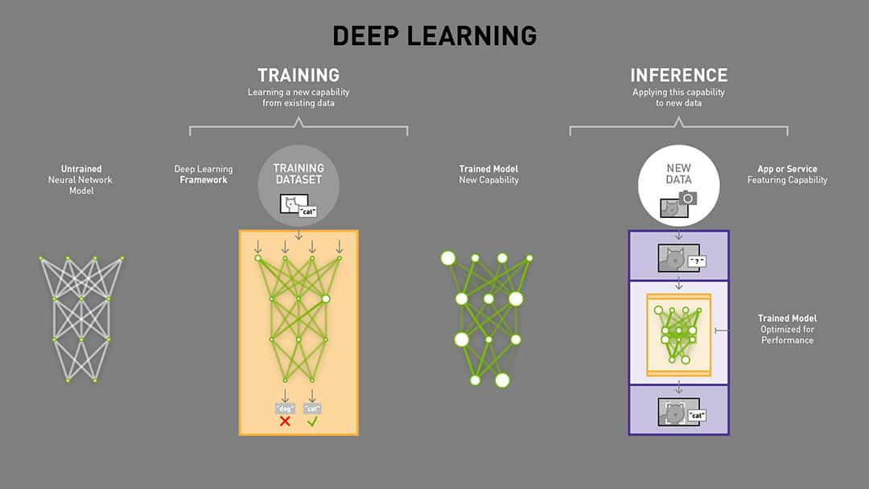
Training vs. Inference
Unlike training, inference is the process of using a trained model to make predictions or generate outputs for unseen data.
This is the “deployment” stage where models provide value, powering applications like chatbots, recommendation systems, and image generation.
Characteristics of Inference
Latency Sensitivity:
Critical for applications like chatbots or live translation.
Performance is measured in milliseconds per query.
Resource Efficiency:
Must run on diverse hardware, from high-end GPUs to edge devices.
Optimization often trades accuracy for speed.
Predictability:
Unlike training, inference workloads are more predictable and involve fixed computations
Notes:
https://blogs.nvidia.com/blog/difference-deep-learning-training-inference-ai/

Slide 6
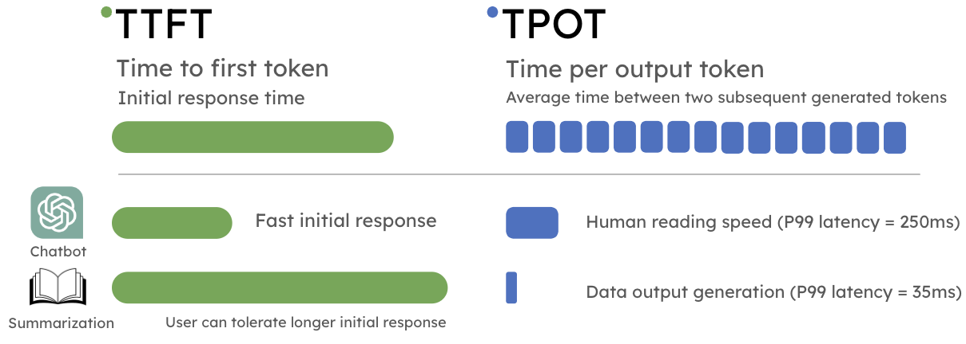
Challenges in GenAI
Inference in GenAI is typically constrained by specific features related to how these models work and are used.
Token-by-Token Generation:
Generative models (e.g., GPT) output text sequentially, requiring multiple forward passes.
Latency scales with sequence length, making optimizations essential.
Memory Bottlenecks:
Large models may exceed memory limits of inference hardware.
Techniques like model sharding and offloading are used.
Concurrency:
Handling simultaneous user requests efficiently.
Scaling through distributed systems is crucial for high-demand applications.
Notes:
https://hao-ai-lab.github.io/blogs/distserve/

Slide 7
Inference Optimization
Getting the most of our model

Slide 8
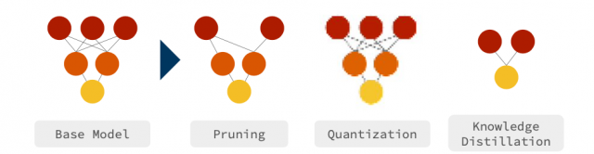
Why do we need to “optimize”?
Once training has finished and the model is performing its best at predicting an output, we can often benefit by optimizing the model for deployment.
Pushing the model to be as large as possible to achieve the training objectives allows us more room to compress the model without losing too much accuracy whilst improving:
Latency
The more neurons and layers in a model has increases the time it takes to calculate an output
Size
The smaller a model can be, the more batches can be run and the cheaper a deployment can be on hardware
Throughput
The combination of latency and size informs the total throughput of the model when deployed as smaller, faster models can process more data faster
Notes:
https://centralcoastdatascience.org/projects/all/2022/compression-nlp-domain-deep-learning-models

Slide 9

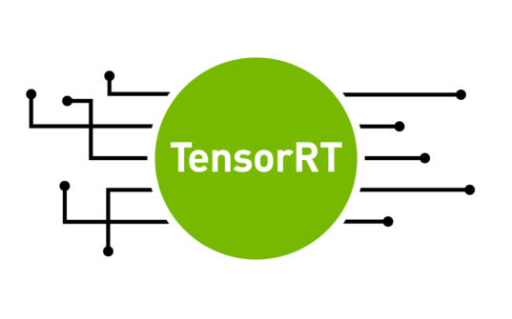


Libraries for NN Optimization
To automate and standardize different techniques to optimize models for deployment, a number of popular libraries have been developed and adopted by the industry. These libraries focus on improving performance, scalability, and efficiency for inference, especially in distributed and real-time settings.
ONNX (Open Neural Network Exchange)
A standard format for representing machine learning models across different frameworks (e.g., PyTorch, TensorFlow).
TensorRT / LLM
NVIDIA’s library for high-performance inference on NVIDIA GPUs, tailored for both general and large language models (LLMs).
vLLM
A specialized library designed for efficient and scalable inference of large language models.
Triton Inference Server
A scalable and production-ready inference server designed for hosting multiple models and managing inference pipelines.
Notes:
https://onnx.ai/
https://github.com/vllm-project/vllm
https://developer.nvidia.com/blog/speed-up-inference-tensorrt/
https://catalog.ngc.nvidia.com/orgs/nvidia/containers/tritonserver

Slide 10
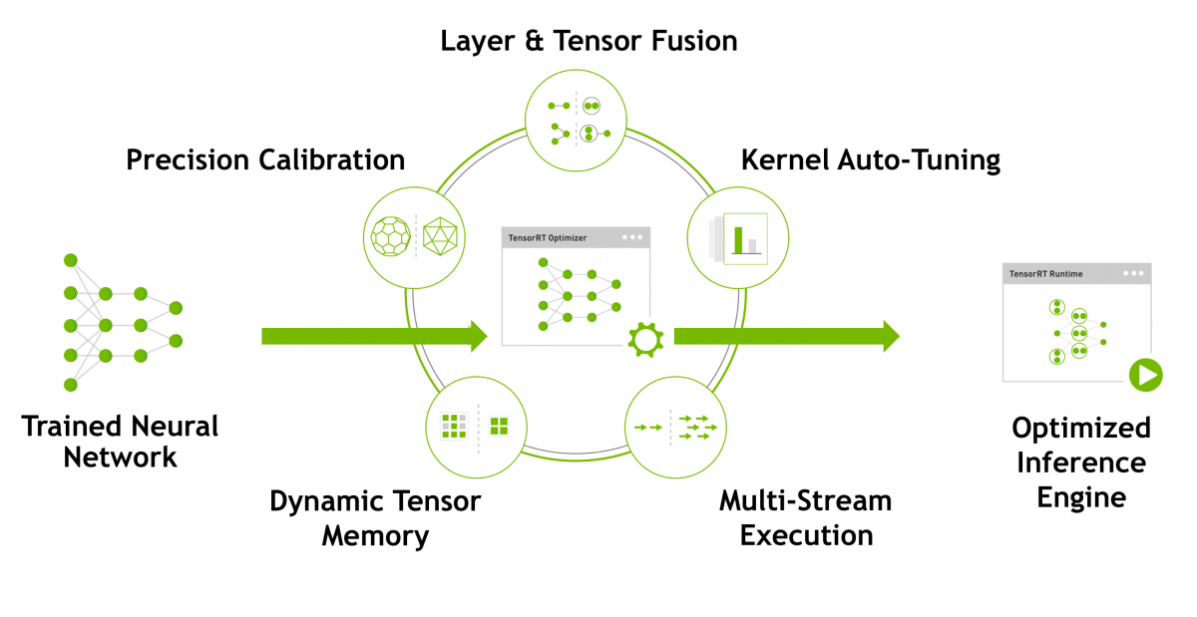
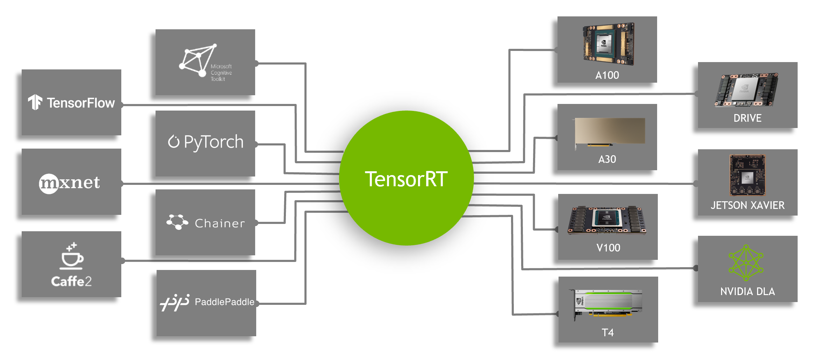
NVIDIA TensorRT
TensorRT is NVIDIA's high-performance library designed for optimizing and deploying
deep learning models for inference on NVIDIA GPUs. The core idea of TensorRT is to take a trained model (e.g., from PyTorch or TensorFlow)
and convert it into a highly optimized version for inference. This optimization
process involves several steps:
Parsing: TensorRT reads and parses the model definition, often in a format like ONNX or directly exported from a framework like PyTorch. This step ensures the model structure is understood.
Optimization: TensorRT applies a series of performance enhancements. These include:
Layer fusion: Combining multiple operations into a single GPU kernel to reduce memory overhead.
Precision calibration: Reducing precision from FP32 to FP16 or INT8 to save memory and boost computation speed, with minimal impact on model accuracy.
Kernel auto-tuning: Selecting the most efficient GPU kernels for each operation.
Serialization: Once optimized, the model is serialized into an engine file, which is essentially a binary that can be directly executed by TensorRT. This serialized engine is specific to the GPU hardware it was optimized for.
Inference Execution: TensorRT provides APIs to load and run the optimized engine. In Python, the TensorRT Python API allows for easy integration into applications.
A typical workflow with TensorRT in Python might look like this:
- Convert your model (e.g., export to ONNX if using PyTorch).
- Use TensorRT's Python API to parse and optimize the model.
- Save the optimized engine.
- Load the engine for inference and integrate it into your application.
Notes:
https://developer.nvidia.com/blog/speeding-up-deep-learning-inference-using-tensorflow-onnx-and-tensorrt/
https://medium.com/@abhaychaturvedi_72055/understanding-nvidias-tensorrt-for-deep-learning-model-optimization-dad3eb6b26d9

Slide 11
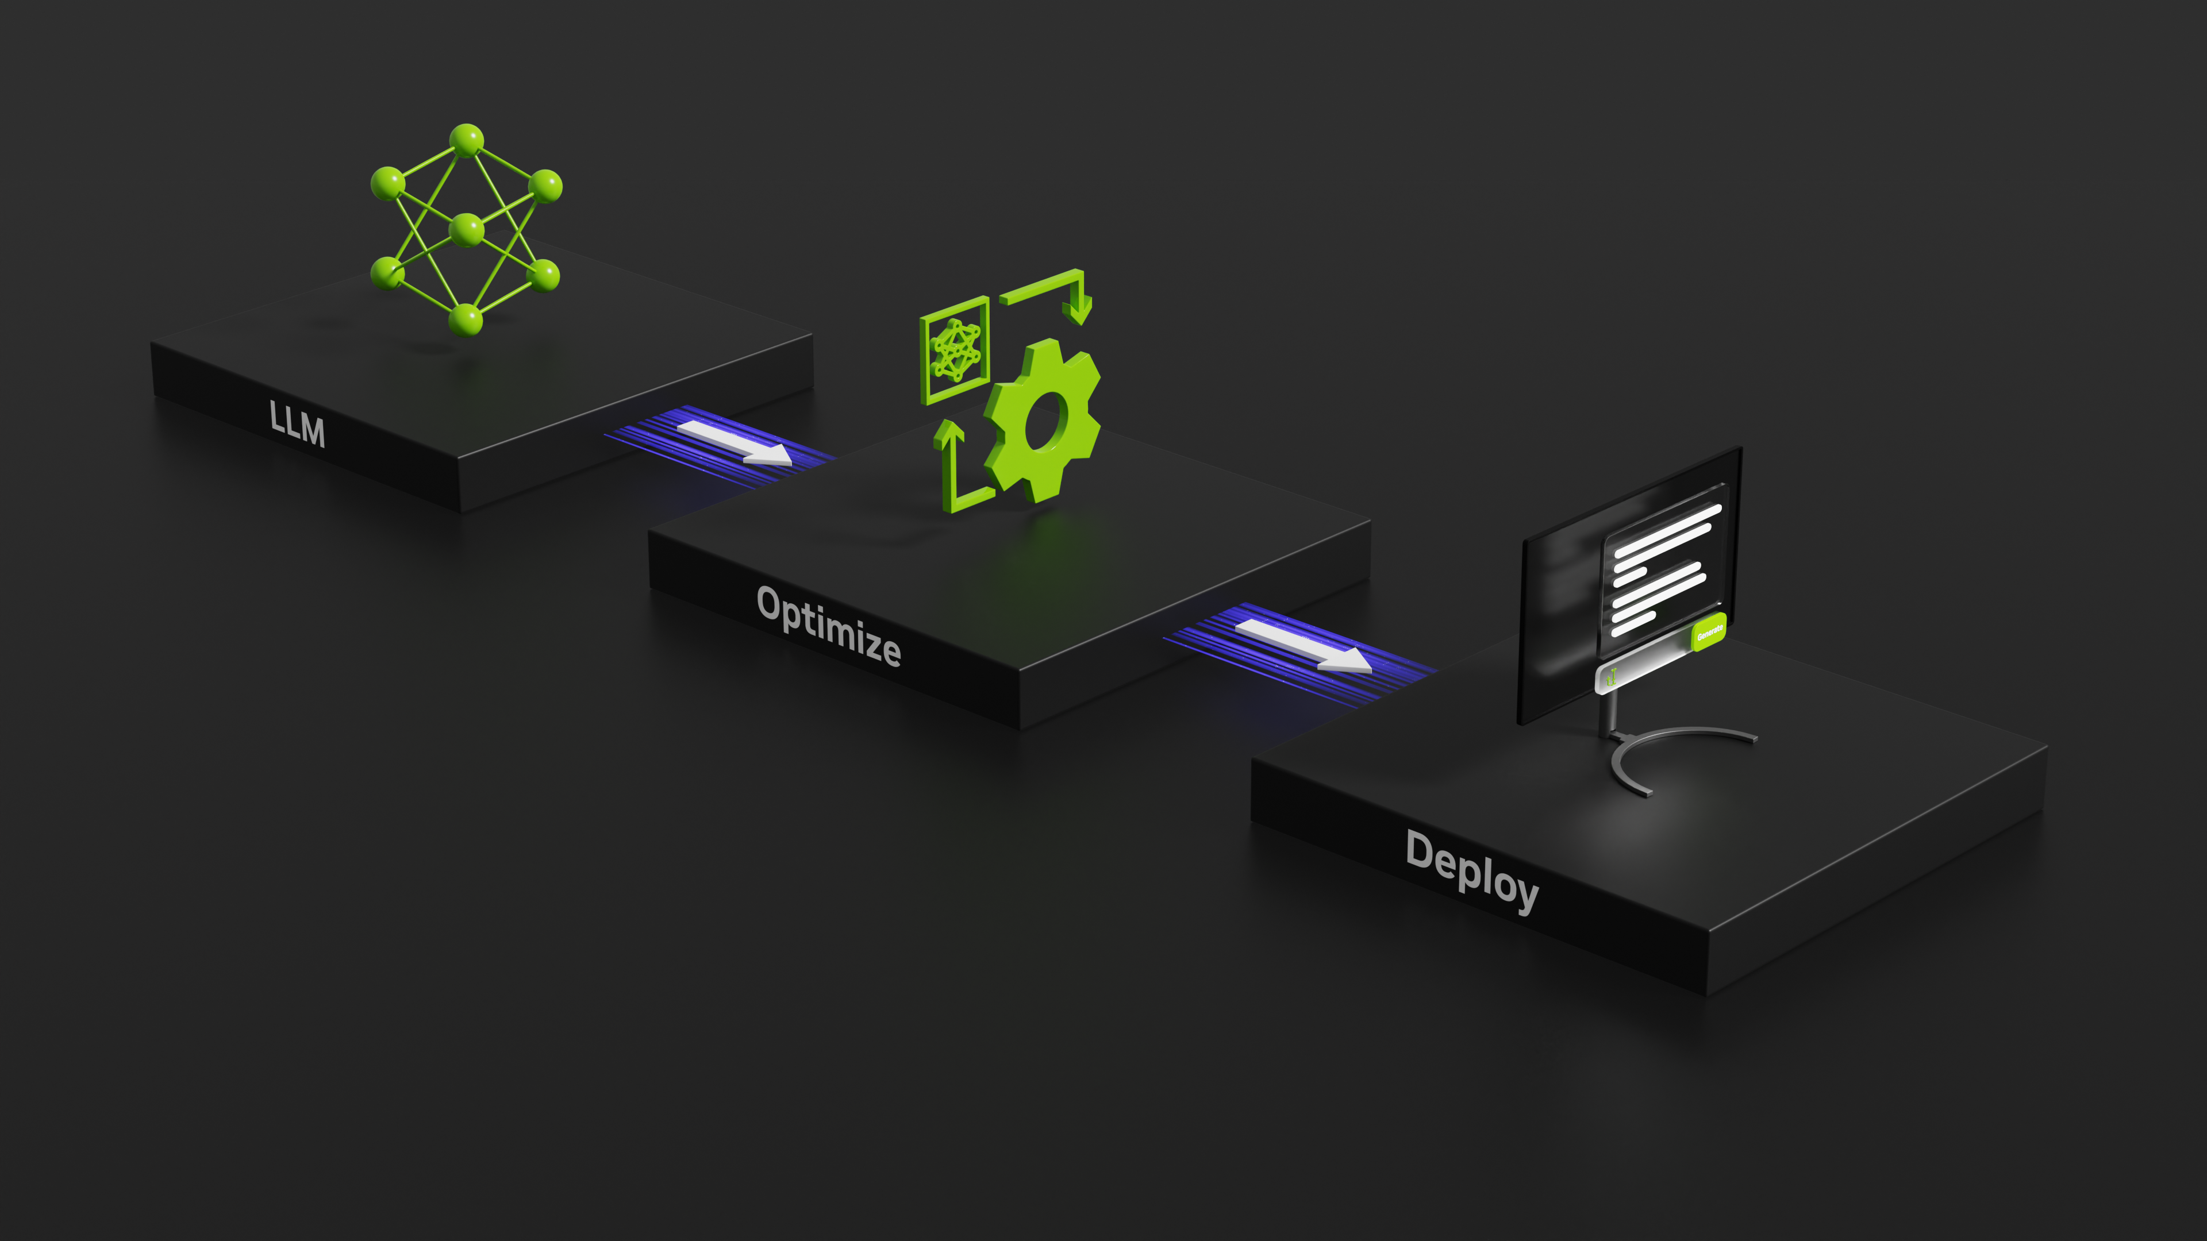
TensorRT-LLM
TensorRT-LLM is a specialized extension of TensorRT, optimized specifically for deploying large language models. It builds on TensorRT's general capabilities while introducing features and optimizations tailored to the unique demands of LLM inference.
The primary focus of TensorRT-LLM is on maximizing the efficiency of token generation.
1. TensorParallel and Multi-GPU Support:
TensorRT-LLM enables seamless distribution of the model across multiple GPUs. It uses techniques like tensor parallelism.
2. Optimized Kernels for LLMs:
TensorRT-LLM provides custom kernels optimized for transformer-based architectures. These include improvements in self-attention computation, faster layer normalization, and fused operations that reduce memory access overhead.
3. Dynamic Sequence Length Management:
In LLM inference, sequences can vary in length, and managing these dynamically is important to minimize wasted computation. TensorRT-LLM supports efficient handling of dynamic batch sizes and sequence lengths, which is crucial for real-time generation tasks.
4. High Throughput and Low Latency:
With support for mixed precision (FP16 and INT8), TensorRT-LLM achieves significant reductions in inference latency while maintaining model accuracy. This makes it ideal for applications like chatbots or content generation, where response time is critical.
Notes:
https://developer.nvidia.com/blog/nvidia-tensorrt-llm-supercharges-large-language-model-inference-on-nvidia-h100-gpus/

Slide 12
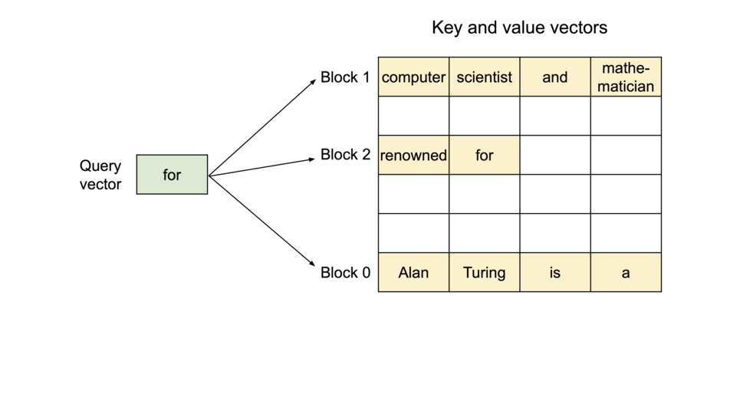
vLLM
vLLM is a library designed specifically for efficient and scalable inference of large language models (LLMs). It focuses on optimizing token generation and maximizing GPU utilization to handle real-world, high-demand use cases.
One of vLLM's standout features is its state management system. Unlike traditional LLM inference, where past key-value pairs (used for attention mechanisms) are recomputed or inefficiently managed, vLLM introduces a high-performance caching mechanism.
vLLM is particularly effective in handling concurrent requests. It uses dynamic batching to combine multiple inference requests into a single GPU operation, maximizing throughput while maintaining low latency.
PagedAttention
Notes:
https://www.cs.princeton.edu/courses/archive/fall19/cos484/lectures/lec5.pdf
https://www.cs.utexas.edu/~gdurrett/courses/sp2021/lectures/lec7-4pp.pdf

Slide 13
Production-Scale Inference
Connecting text to data

Slide 14
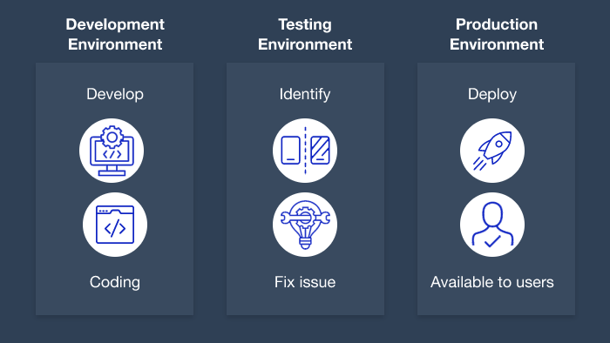
Development vs. Production-scale Inference Challenges
Development and Production environments present different challenges
Development Scale:
Single-user or small-team testing.
Focused on correctness, model debugging, and small data batches.
Less emphasis on latency and resource utilization.
Production Scale:
Multi-user, high-demand scenarios with concurrent requests.
Prioritizes low latency, high throughput, and cost efficiency.
Involves dynamic scaling and robust fault tolerance.
Notes:
https://d3lkc3n5th01x7.cloudfront.net/wp-content/uploads/2023/01/02055540/testing-environment.png

Slide 15
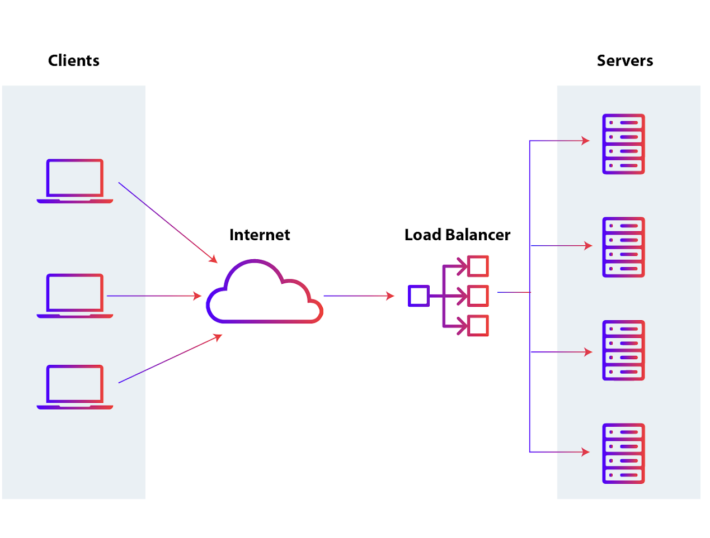
Load Balancing
What is Load Balancing?
Even distribution of inference requests across servers or GPUs.
Prevents bottlenecks and ensures high availability.
Strategies:
1. Round Robin: Requests are assigned sequentially across nodes.
2. Weighted Distribution: Prioritizes more powerful nodes for heavier loads.
3. Dynamic Balancing: Adapts to workload changes in real time.
Tools:
Kubernetes for horizontal scaling.
Triton Inference Server with dynamic batching support.
Notes:
https://www.appviewx.com/education-center/load-balancer-and-types/

Slide 16
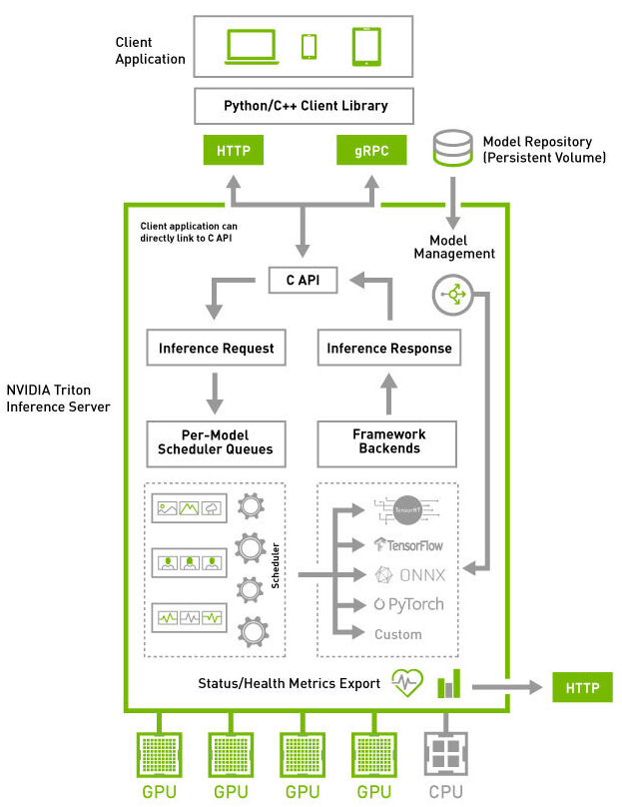
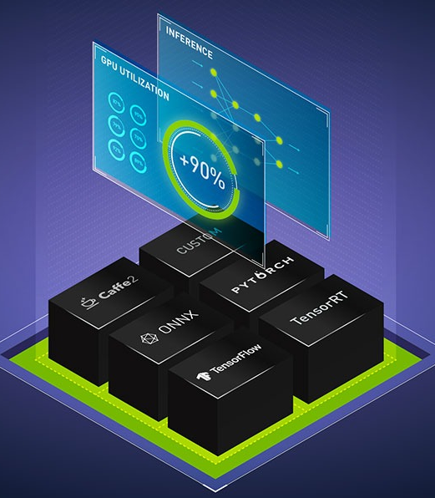
Triton Inference Server
Triton Inference Server is a production-ready platform for deploying and serving
deep learning models at scale. It is designed to handle the complexities of inference in distributed environments, offering flexibility, scalability, and high performance.
A key feature of Triton is dynamic batching. Unlike static batching, where requests must arrive together to be processed in a batch, dynamic batching aggregates requests in real time. This ensures high GPU utilization without compromising latency for smaller requests.
In distributed setups, Triton works well with container orchestration tools like Kubernetes. It enables horizontal scaling by deploying multiple instances, with load balancing to manage traffic efficiently.
Triton Inference Server is particularly well-suited for GenAI applications, where token-by-token generation and high concurrency are common. Its dynamic batching, multi-model support, and optimized GPU usage make it a go-to solution for serving deep learning models in production.
Notes:
https://www.nvidia.com/content/dam/en-zz/Solutions/ai-data-science/products/triton-inference-server/nvidia-triton-inference-server-og-1200x630.jpg

Slide 17
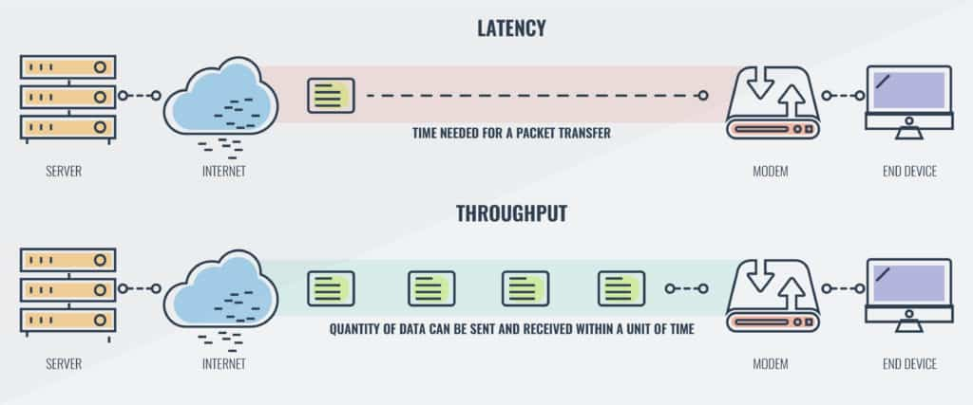
Latency vs. Throughput
Latency:
Definition: Time taken for a single request to be processed.
Key metric for real-time applications (e.g., chatbots, live translation).
Prioritized in low-concurrency, interactive scenarios.
Throughput:
Definition: Total number of requests processed per second.
Key metric for batch processing (e.g., recommendation systems).
Prioritized in high-concurrency or backend pipelines.
Trade-offs:
Increasing throughput often increases latency (e.g., batching delays).
Balancing depends on the application (e.g., GenAI text generation often prioritizes latency).
Notes:
https://cdn.comparitech.com/wp-content/uploads/2019/01/DiagramLatency-vs-throughput-2-1024x427.jpg

Slide 18
End-to-End Deployment with TensorRT-LLM
Putting everything together

Slide 19

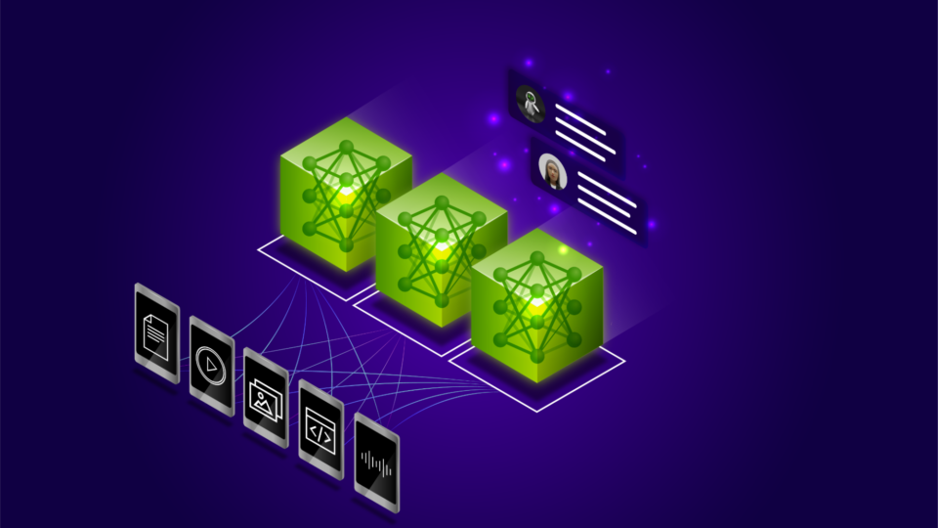
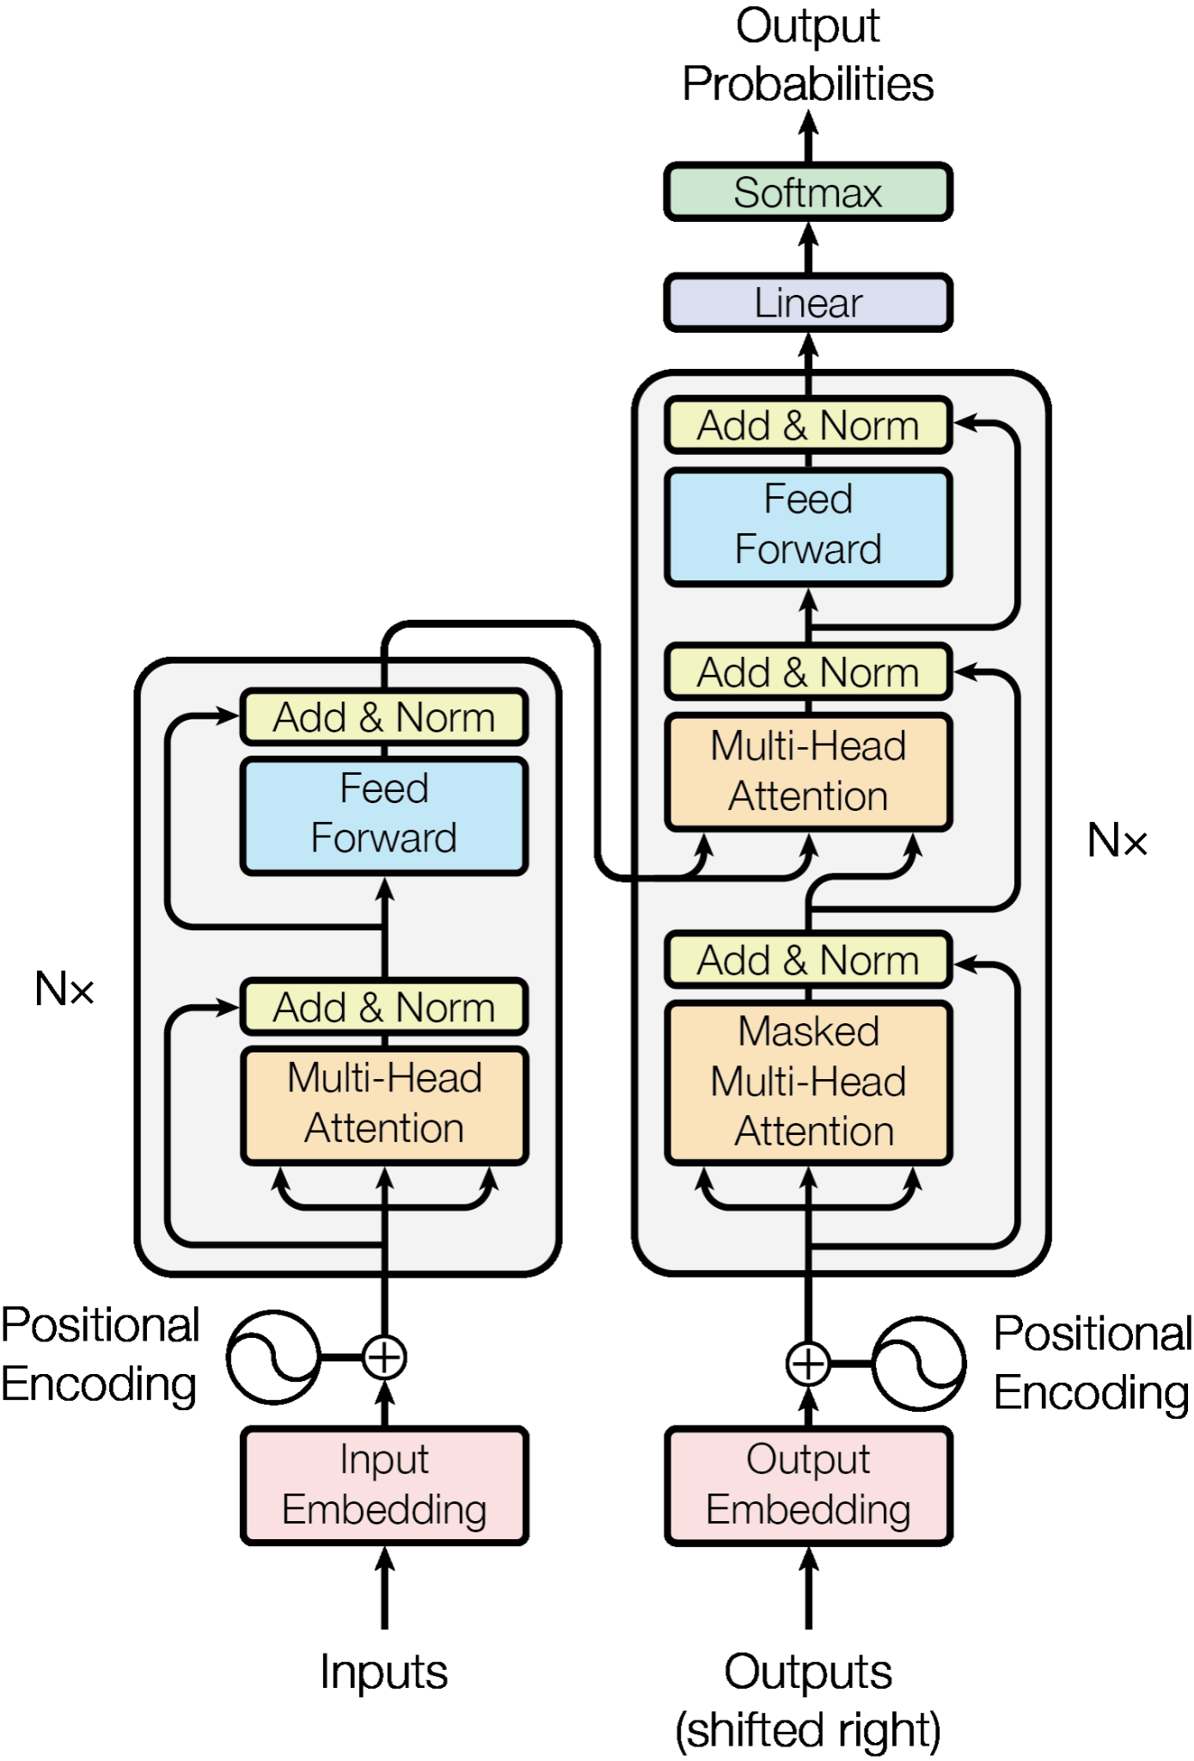
Life Cycle of an LLM
At this point in the course we have seen all of the necessary components to take a model from ideation to deployment. Let’s go through the steps below and build a chatbot and deploy it:
Finding the right task to solve
Gathering data
Building the right model architecture
Developing a smaller model
Training a large model with distributed computing
Preparing the trained model for inference
Notes:
https://journals.plos.org/plosbiology/article?id=10.1371/journal.pbio.1001934
https://www.medicalnewstoday.com/articles/324529#3-Language-in-the-brain
https://www.sltinfo.com/specialization-within-language-areas-brain-scanning/

Slide 20
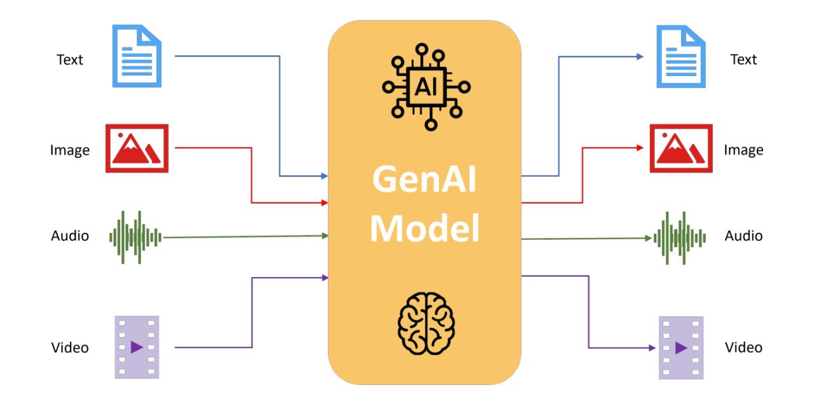
Life Cycle of an LLM
Step 1: Finding the right task to solve
Before begging, we need to decide what our task is to solve:
Notes:
https://media.licdn.com/dms/image/v2/D5612AQF-tooFXqp8OA/article-cover_image-shrink_720_1280/article-cover_image-shrink_720_1280/0/1721981401137?e=2147483647&v=beta&t=UDw6UxJdVJBL_OQQD5sNoDjQPjI41TIIXphYWnm1geQ

Slide 21
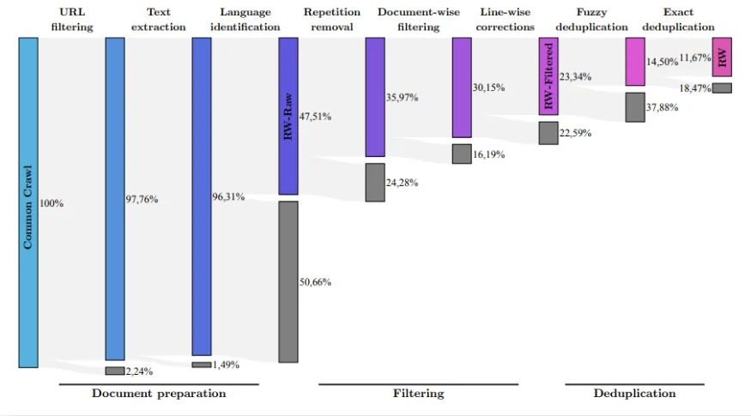
Life Cycle of an LLM
Step 2: Gathering data
With the task chosen, we then need to collect and collate the right data to build our model. For example, if we want to build a chatbot, we need a large amount of high-quality data from the web. This involves several stages of preparation.

Slide 22
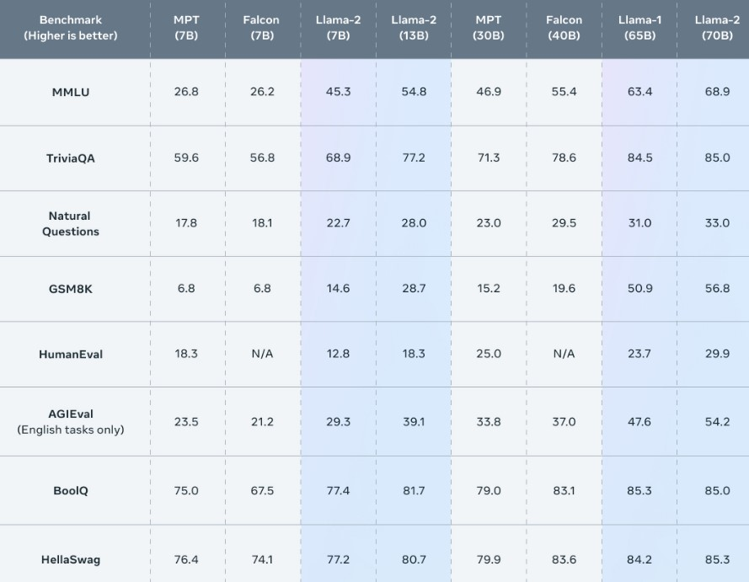
Life Cycle of an LLM
Step 3: Building the right model architecture
Based on the task and data we have chosen we now need to settle on the architecture given our performance expectations and compute budget.
This could be the decoder style, or different layer types, or the number of parameters.
Notes:
https://www.mercity.ai/blog-post/comprehensive-comparison-of-llms-8-2023

Slide 23
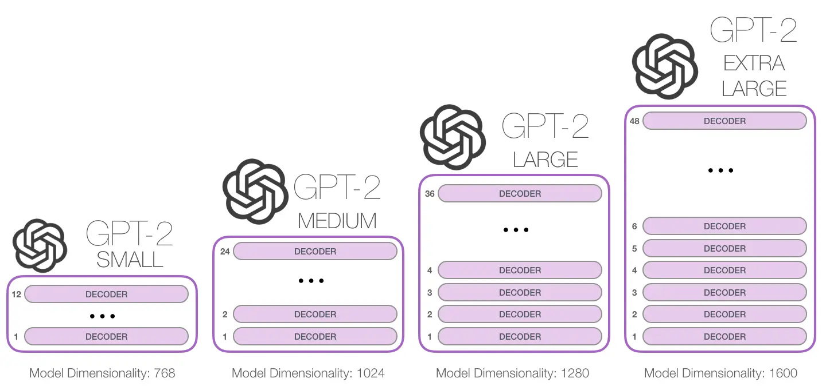
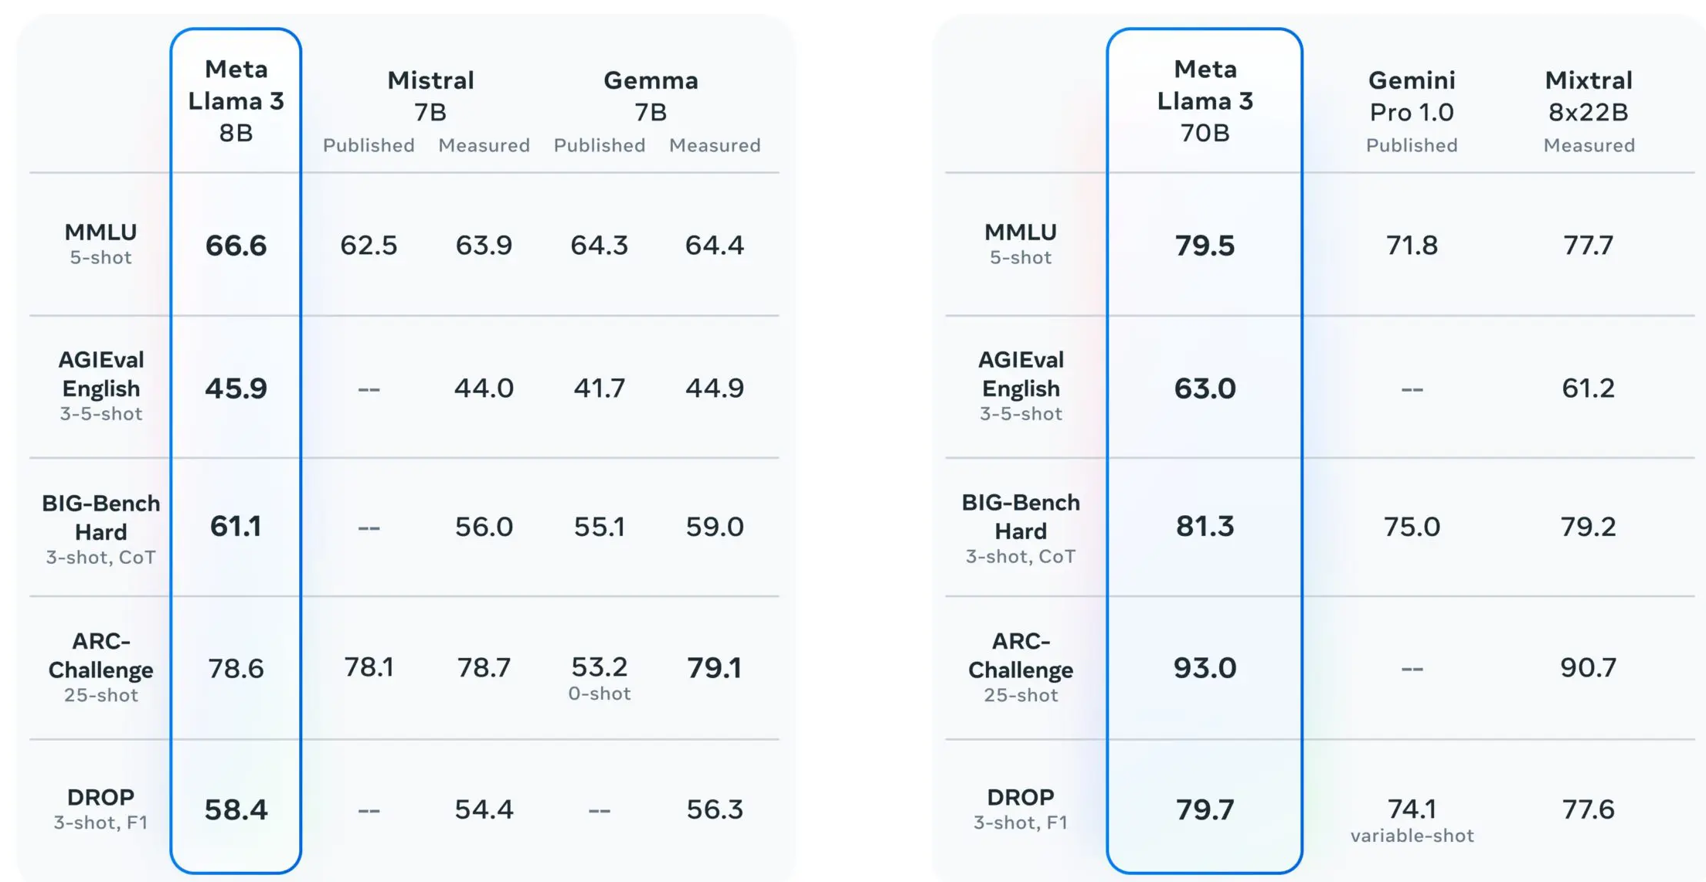
Life Cycle of an LLM
Step 4: Developing a smaller model
Our first step in building the model is starting with a smaller model that will let us:
1. Pipeline Validation:
Allows us to ensure the end-to-end workflow (data preprocessing, model training, evaluation, and inference) is functioning correctly without investing significant computational resources.
Helps identify potential bottlenecks or compatibility issues early in the development process.
2. Faster Iterations:
Smaller models train and infer more quickly, enabling rapid experimentation with different configurations or features.
This is especially useful when testing new techniques or architectures.
3. Baseline Establishment:
A smaller model serves as a baseline for performance metrics like accuracy, latency, and memory usage.
Provides a reference point to measure improvements when scaling up the model.
Notes:
https://www.labellerr.com/blog/unveiling-the-contrasts-developing-small-scale-and-large-scale-language-models/

Slide 24
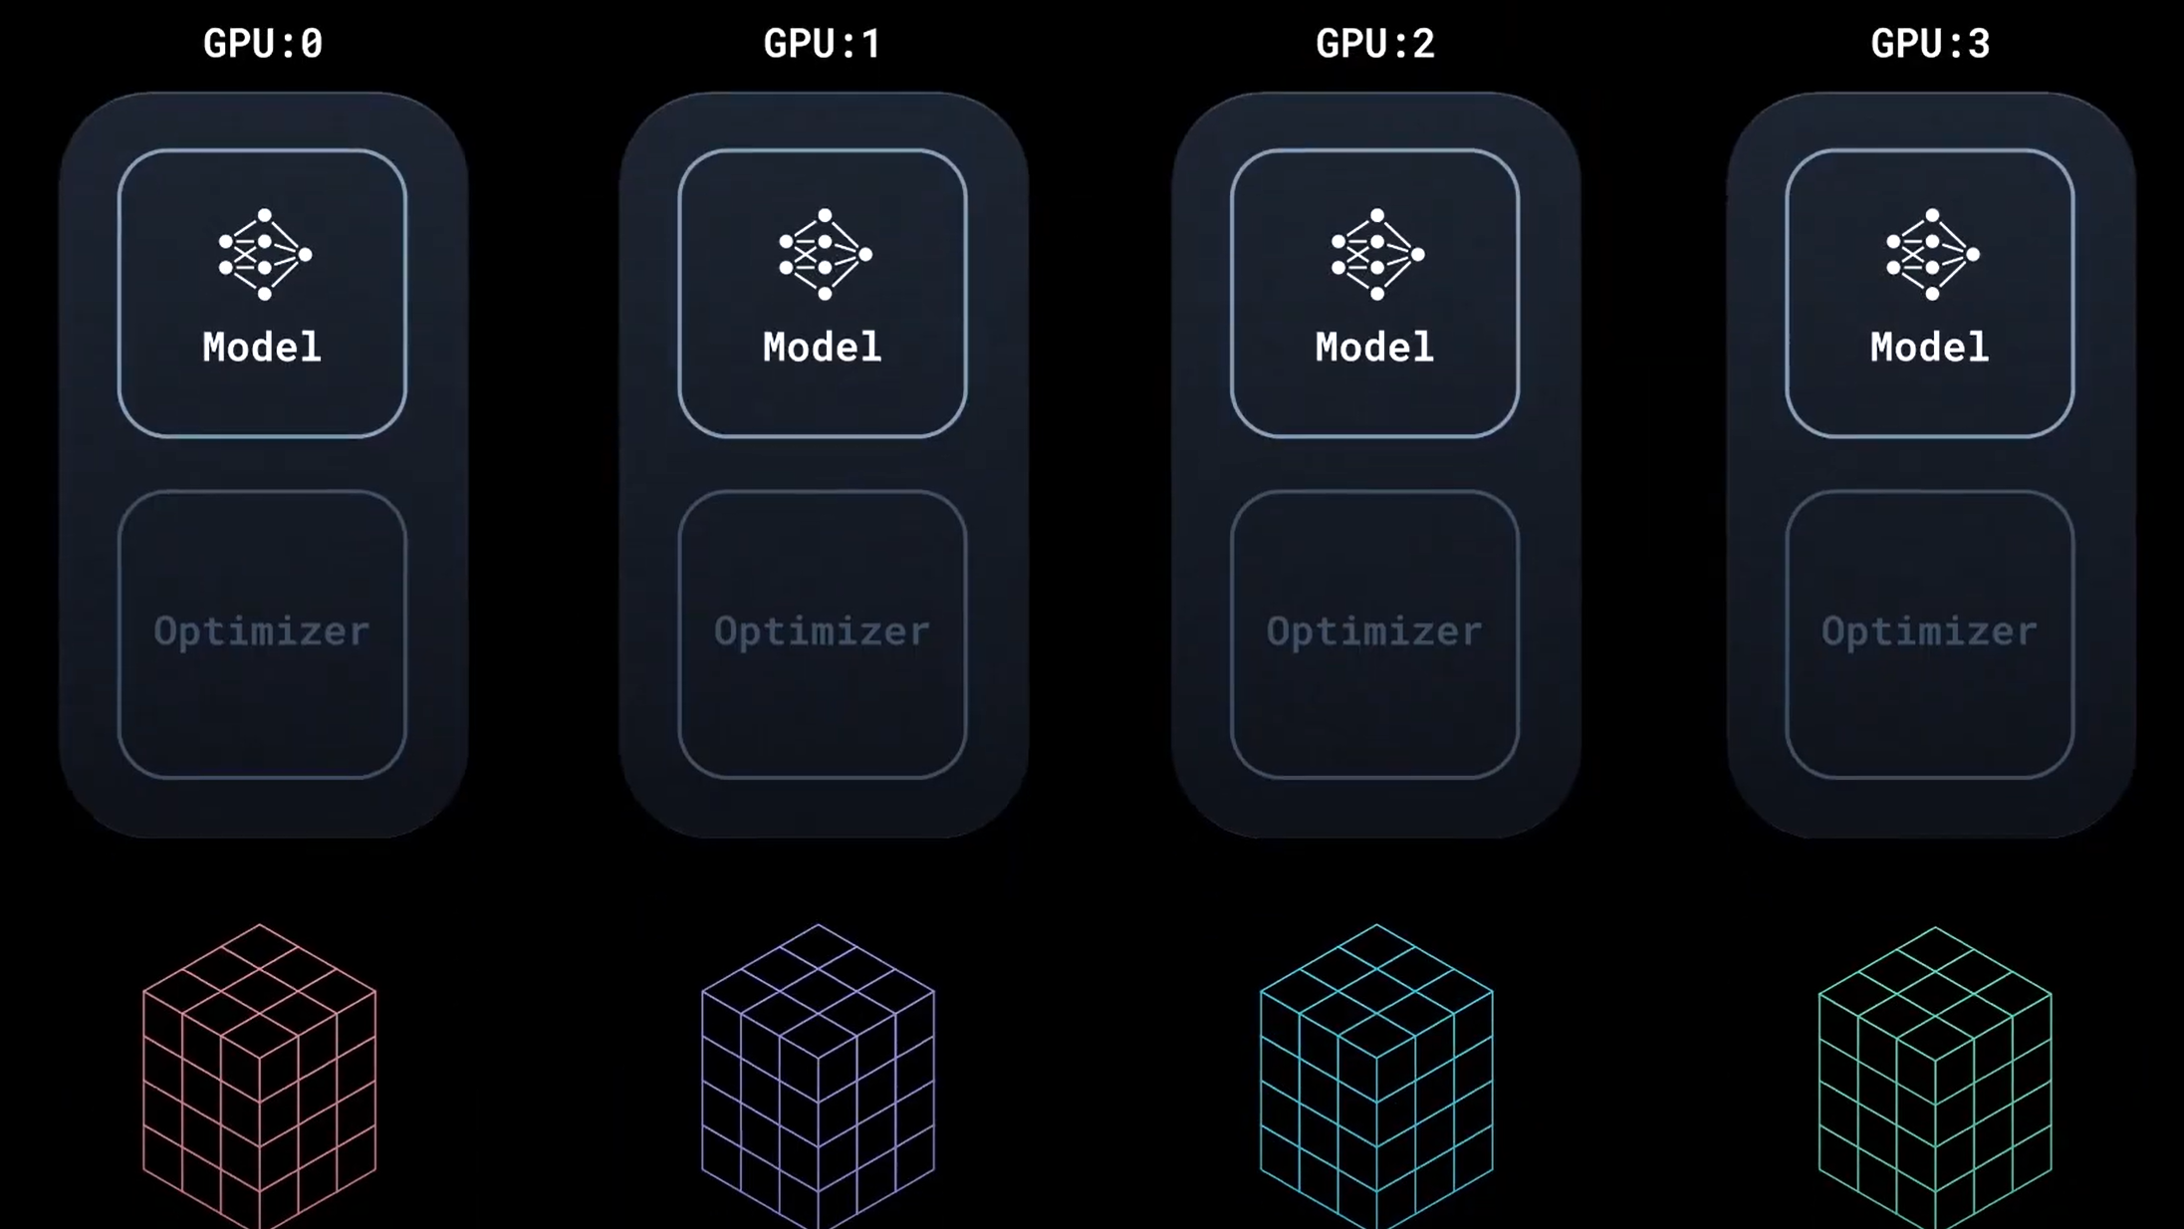
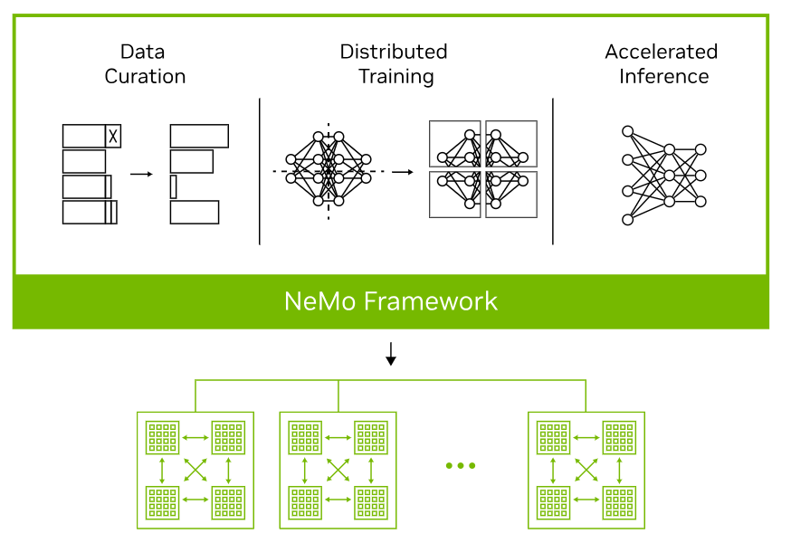
Life Cycle of an LLM
Step 5: Training a large model with distributed computing
With a smaller model and pipeline now validated and showing the right performance characteristics for scale, we now implement the distributed training procedures.
Data and Model Parallelism
Depending on the model scaling, data scaling and resource availability data parallelism, such as FSDP could be utilized but if the model becomes too large, model parallelism may also be required to split the model across the compute resources.
This stage will be the most expensive and time consuming so good monitoring and robustness in the approach is critical.
`
Notes:
https://journals.plos.org/plosbiology/article?id=10.1371/journal.pbio.1001934
https://www.medicalnewstoday.com/articles/324529#3-Language-in-the-brain
https://www.sltinfo.com/specialization-within-language-areas-brain-scanning/

Slide 25
Life Cycle of an LLM
Step 6: Preparing the trained model for inference
With the model trained, it is now ready for deployment so it can be used for inference.
Optimizing the model involves pruning and quantizing the model to sufficiently balance performance.
This will involve libraries like TensorRT/LLM to utilize specially designed CUDA kernels and optimizations to convert the trained model into a package ready for inference deployment.
Notes:
https://journals.plos.org/plosbiology/article?id=10.1371/journal.pbio.1001934
https://www.medicalnewstoday.com/articles/324529#3-Language-in-the-brain
https://www.sltinfo.com/specialization-within-language-areas-brain-scanning/

Slide 26
Life Cycle of an LLM
Step 7: Deploying the trained model on an inference server
The final stage is deploying the LLM for production inference. In this stage the model has been optimized but may be processed further, including processes like model parallelism to ensure that throughput and latency can be maximized for performance.
Before deployment, careful consideration should be given to :
Load balancing
Dynamic batching
Resource allocation
Monitoring tools are also set up to track inference metrics, such as latency, GPU utilization, and error rates, ensuring the system remains robust under production workloads.

Slide 27
Wrap Up
Scaling Inference and Deployment
Today we concluded this module on distributed computing and deployment
We saw the different priorities that inference/deployment of models.
Libraries like TensorRT, Triton, and vLLM were introduced as tools to convert our trained model to be deployment ready.
-----------------------------------------------------------------------------
Notes:
https://arxiv.org/pdf/1301.3781

Slide 28
Thank you!

